Slide 1
Group component
Group 1

Slide 2
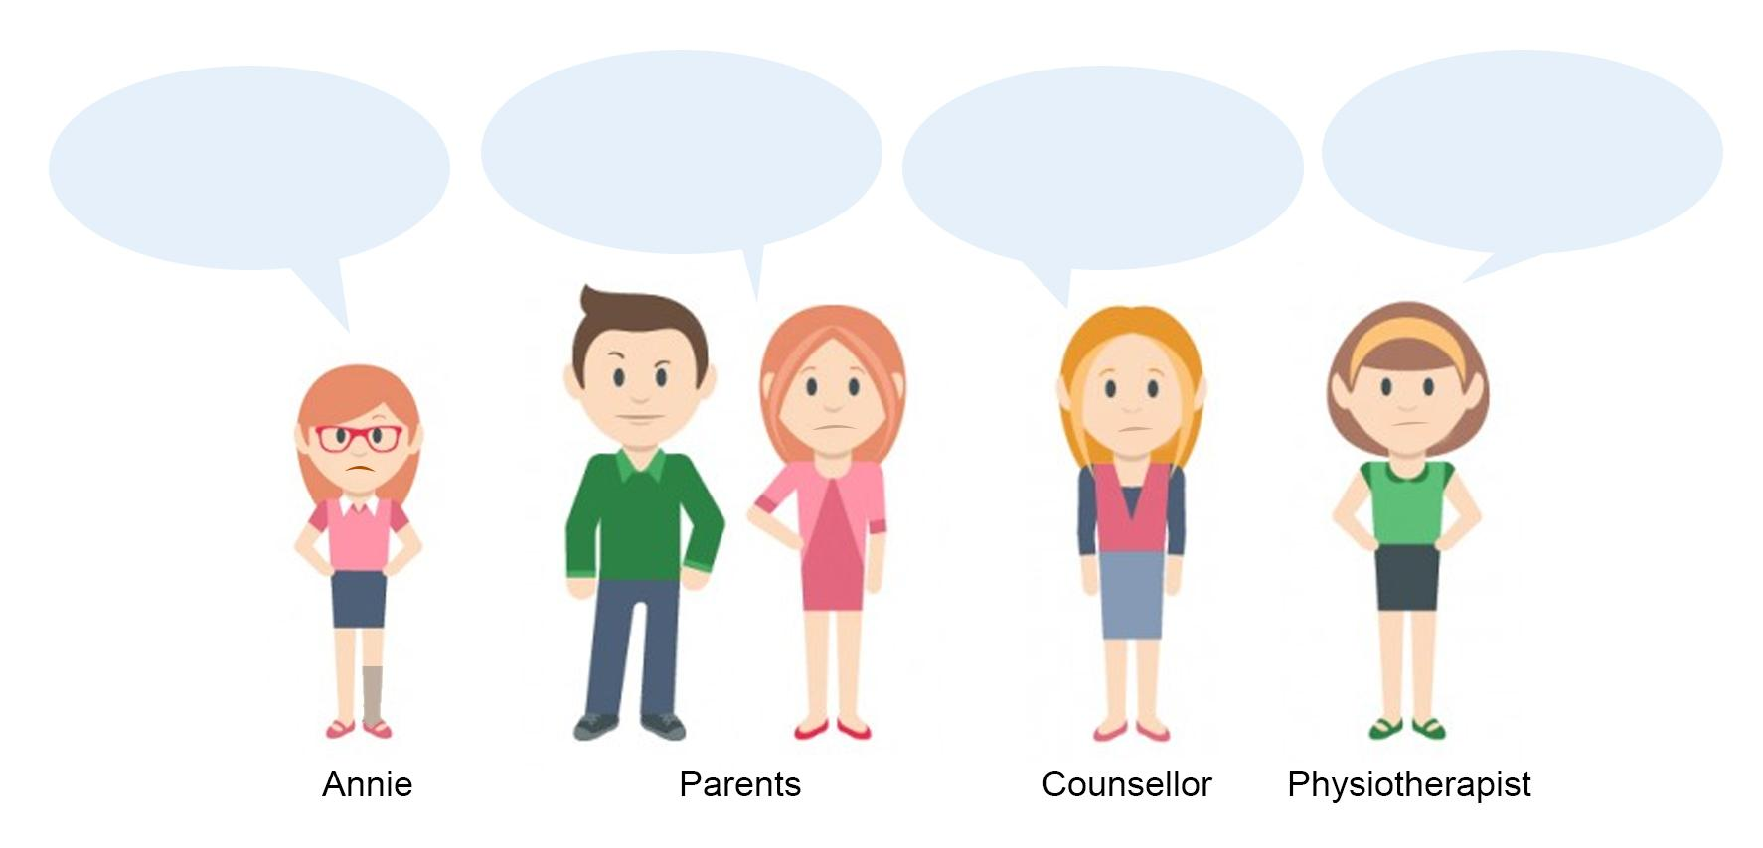
A day in the life of Annie...
We work full time and can’t be watching Annie at all times.
Annie’s experience was traumatic, she needs to talk it out.
Walking with my leg is awkward
Annie is not using her leg enough.

Slide 3
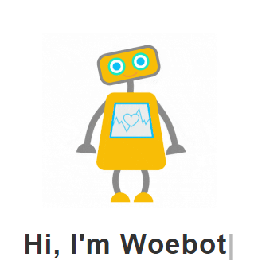
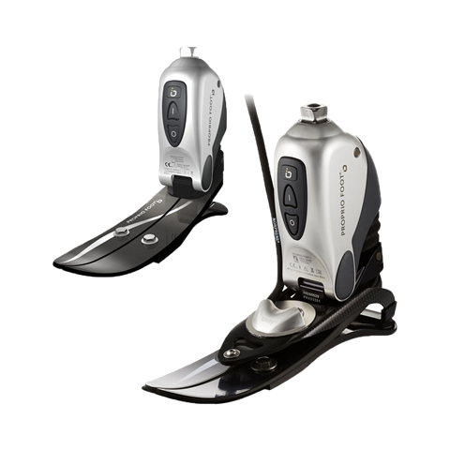
Existing solutions
Chatbots
Prosthetics
AI-based prosthetics: Rheo Knee, Power Knee, and Proprio Foot
Chatbots for people who are feeling down: Woebot
Our solution, EMMA
Notes:
Source: https://www.ossur.com/prosthetic-solutions/products/dynamic-solutions/rheo-knee; woebot.io

Slide 4

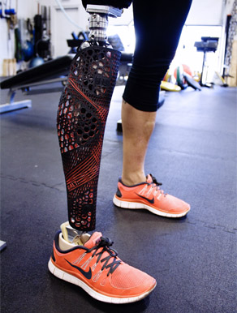


Emma
A new friend!
Emma is a live voice assistant that befriends the user, responding to questions and prompting action (e.g. using the leg)
Make walking easier
With our groundbreaking stabilising technology, we can create the safest and most comfortable walking experience possible for Anne
Understand how Anne is feeling
Through Anne’s walking and talking with Emma, we collect data not only on usage, but also on sentiments and feelings, to allow parents to understand her better.

Slide 5
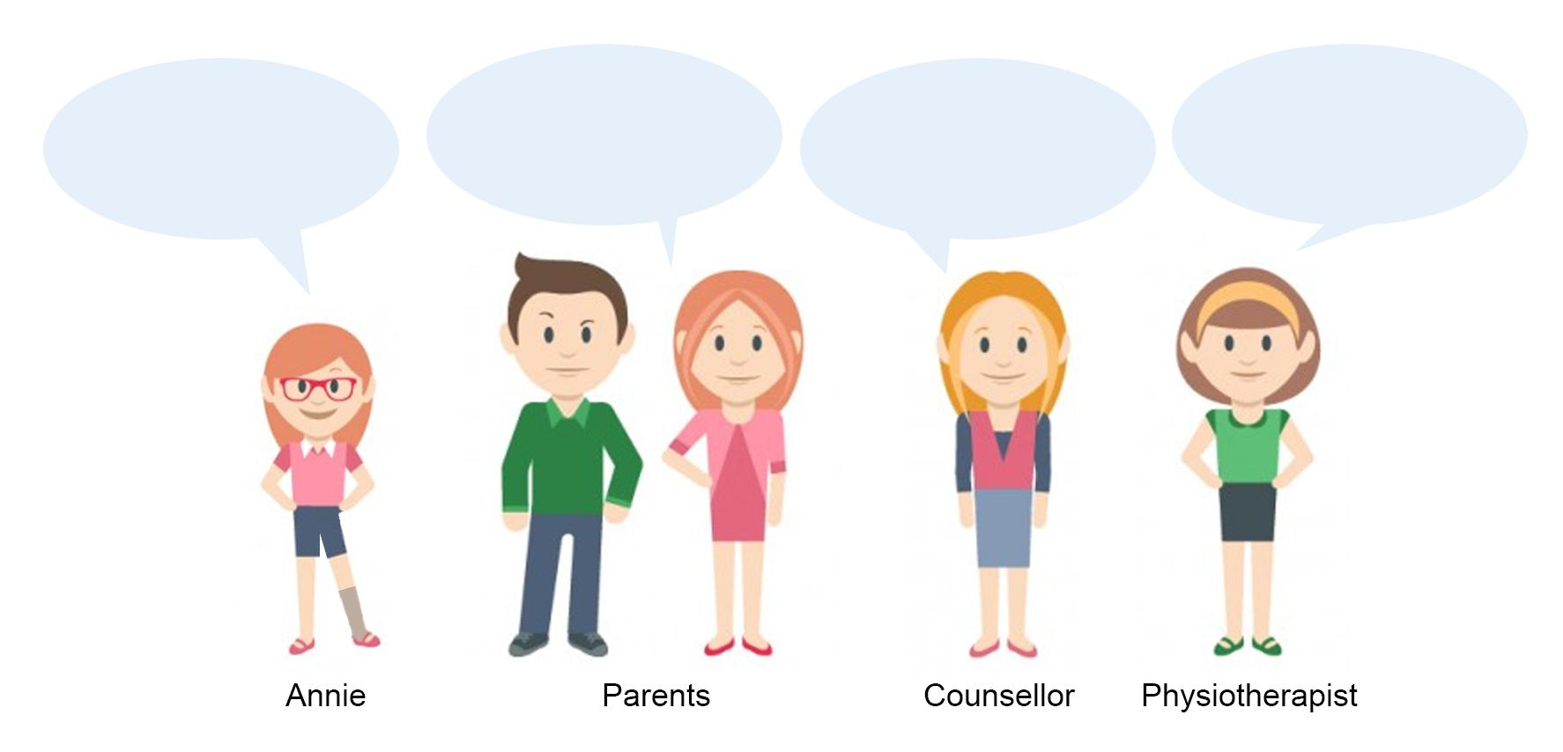
Everyone’s happy
Annie is recovering well and we know how she feels!
Annie’s mood seems lighter as she is better able to walk.
Annie is getting used to using her prosthetic leg!
Walking with my leg is so fun and a breeze!

Slide 6
Technical part
Category | Data | Algorithm | Engineering Trade-off | Success Metric
Walking Assistant | Pressure Sensors data Gyroscope / Orientation Pedometers | Reinforced Learning can learn without expert supervision and problem does not have obvious solution as everyone walk differently. E.g. if too much pressure at a certain point, it will try to alleviate by counterbalancing the pressure applied using hydraulic | Requires power source such as battery for sensors, microchips, communication modules, hydraulics. Requires server for computation and storage It will have a significantly higher initial cost and maintenance cost. | Based on the increment in weekly prosthetics usage up till standard usage.

Slide 7
Technical part
Category | Data | Algorithm | Engineering Trade-off | Success Metric
Emotional Support | Text Speech | Sentiment Analysis to extract the sentiment of Anne while she is communicating with the leg | In addition to above requirements, microphone, speaker and light for feedback. | Based on increment in positive input percentage from Anne

Slide 8






Data Flow chart
Anne’s Data
Cloud
Parents
Speech / Text
Walking Patterns
Sentiment Data
Sensors
Anne
Physiotherapist
Counsellor

Slide 9
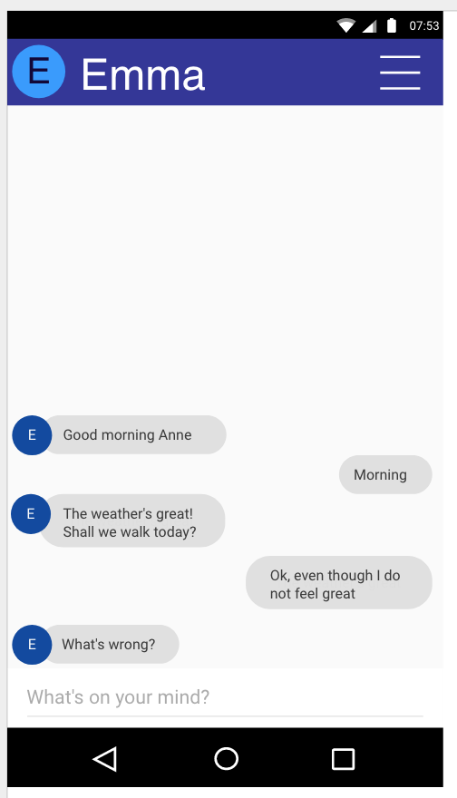

Slide 10
Biz case
Emma retails for SGD $35K (in line with competitors) with 10 year warranty and replacements - lower than average insurance / court payout for leg amputations (SGD $40-80K).
We need roughly 30 sales to make up our development cost of SGD 1 M - with total addressable market of ~600K leg amputees across developed world (2008)!
Source: https://projects.propublica.org/graphics/workers-compensation-benefits-by-limb
http://www.singaporebikes.com/forums/archive/index.php/t-352981.html
https://web.stanford.edu/class/engr110/2011/LeBlanc-03a.pdf

Slide 11
Questions?

