Slide 1
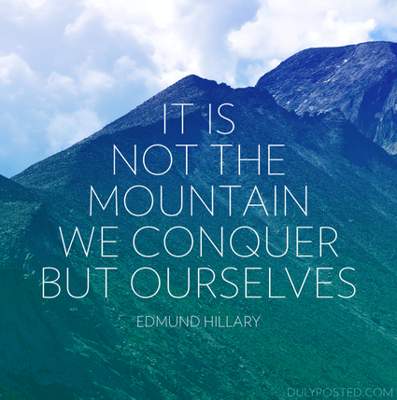
e-Motivate
Ryzal Kamis
Lee Chengkai
Gavin Low
Tan Yan Chong

Slide 2


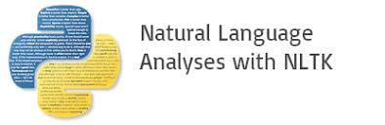
Idea Generation
Started with 3 ideas
Snapchat like overlay on top of the prosthetic leg, with a realistic lookalike leg
Thought about using OpenCV for detection
Muscle sensor for increased mobility
By collecting data of muscles, we know how Anne would want to move her legs
Emotions logging/ monitor for motivating patients (E-motivate)
Possible method to use could be classification
Data scraping of Social media, (Twitter, Facebook )
Utilizing NLP for more accurate diagnosis, based on Anne’s post

Slide 3
Why we choose E-motivate
Emotions and mental state as the greatest stumbling block
Fear, depression, despair
Most of the reason is due to:
Viability of idea in a short period of time
If we use OpenCV it might take hours to train the data.
Availability of Data
Are we able to source the amount of data in time

Slide 4
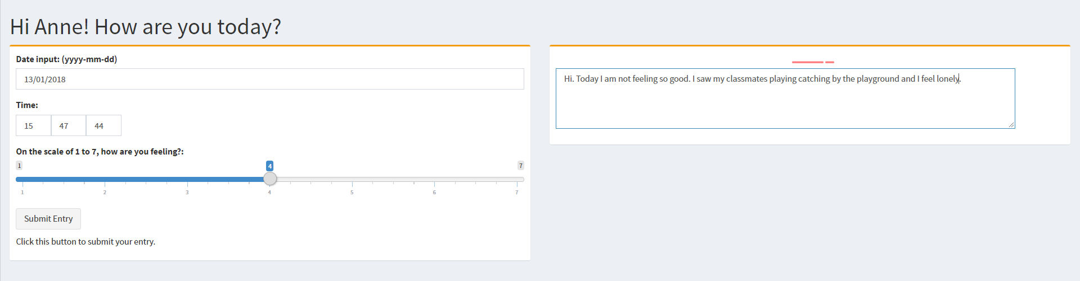
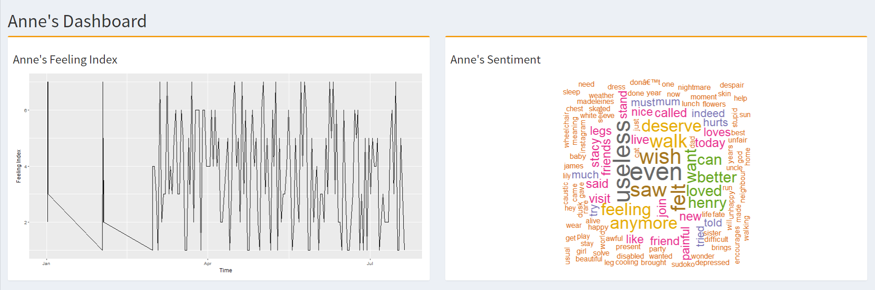
Examples of Dashboard

Slide 5
Further developments and improvements
A chatbot can help to follow up with Anne, and motivate her especially during days which Anne is more likely to be down.
Without meeting the counsellor , the counsellor can monitor, and turns reduces downtime of meetups, allowing the time of counsellor to be better utilized on patients that have a more serious condition.
Anne will also not feel awkward if she is an introvert, and with data scraping of social media, it will also provide a more accurate understanding Anne current state.

Slide 6
The End Thank you

Slide 7
Development process
Each of our group member helped out with the developments
Doing logging
Gathering data
Looking for tools
Developing dashboards
Business Ideas

