Slide 1
Face Recognition Using Principal Component Analysis
Aniketh Sukhtankar UFID : 7819 9584
EEL 6825 Pattern Recognition

Slide 2
Overview
Introduction
Literature Review
Principal Component Analysis
Proposed System
Results
Conclusion

Slide 3
Introduction

Slide 4
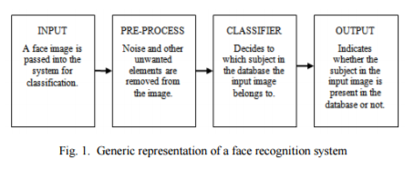
Idea
Facial recognition active area of research
Although trivial to humans, very tough to imitate artificially
Newest face recognition algorithms use machine learning and perform well, however the training amount and processing time is massive
Illustration of a Face Recognition System

Slide 5
Focus
Basic understand of the Algorithms provided by the OpenCV Library.
Methods and Theory behind the Eigenface, Fisher face and LPBH methods for facial recognition
Implementation using Python in a Windows-based environment
Runs on a console using laptop webcam for real-time facial recognition.

Slide 6
Goal
Research and Literature Review
General facial recognition methods
Eigenfaces
Fisher Faces
Local Binary Patterns Histograms
OpenCV’s facial recognition
Development
Build a facial recognizer
Expand to real-time using webcam to capture frames
Able to run on a regular python console

Slide 7
Background

Slide 8
Different Facial Recognition Methods
Principal Component Analysis
Eigenfaces
Fisherfaces
Local Binary Patterns
Active Appearance
3D Shape Models

Slide 9
Principal Component Analysis
Favored strategies for feature selection and dimension reduction
First done by Turk and Pentland
Defines a feature space that reduces dimensionality of the initial data space.
This reduced space is used for recognition
Good initial method, but had flaws
Poor discriminating power among the category
Enormous computation
Limitation overcome by Linear Discriminant Analysis
Uses PCA to cut back dimensions before applying LDA
This is done because LDA faces the small sample size problem

Slide 10
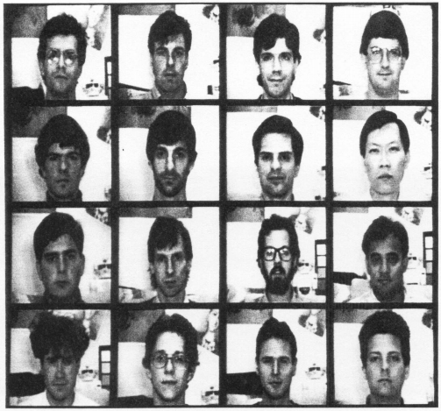
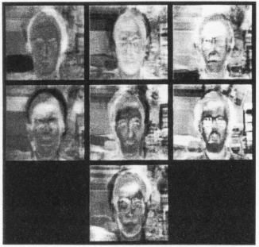
Eigenfaces
The Eigen faces method performs face recognition in three steps.
First all training samples generated are projected into the PCA subspace.
Second the image to be analyzed is projected into the same.
Third, the closest neighbor from projected training images similar to the provided projected query image is identified.

Slide 11
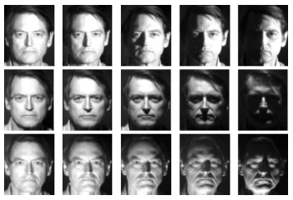
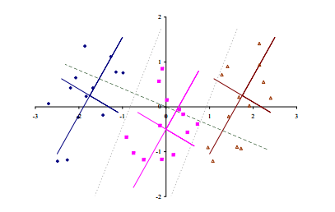
Fisherfaces
Linear Discriminant Analysis that forms the bases of the Fisher face technique performs dimensionality reduction only for specific classes.
Rather than maximizing the general the Linear Discriminant Analysis technique maximizes the quantitative relation of between-classes to within-classes scatter which effectively detects the mixture of features that separates best among distinct categories.
This was identified and applied to recognize faces.

Slide 12
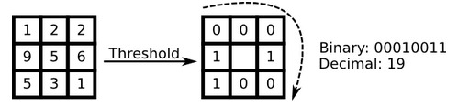
Local Binary Patterns
The Local Binary Patterns technique works by summarizing the local structure in an image by examining every pixel with its neighboring pixels.
The central pixel is compared against its neighbors. If the intensity of this pixel is less than its neighbor, it is denoted with a 0 and 1 if not. Every pixels can be represented as a binary range called local Binary Patterns and also known as LBP codes. the primary LBP operator actually used a strict 3 x 3 neighborhood that can be represented like this:

Slide 13
Theory

Slide 14
Basic Idea
The problem we face is that images in computers are represented using very high dimensions. A 2D x by y grayscale image constitutes a m = xy-dimensional vector area, thus a picture with say 40 x 40 pixels uses around 1600-dimensional image area already.
However, all the dimensions stored are not equally helpful from a face recognition standpoint.
What is most important to us are the components that are used for many of the data points.

Slide 15
Basic Idea
The Principal Component Analysis (PCA) technique takes a group of probably correlated variables and then convert it into a smaller set of unrelated variables.
The basic idea behind this approach is that a dataset of high dimensions is usually represented by correlated variables and only a few important dimensions’ matter.
The PCA technique identifies these so called principal components and uses them for matching faces.

Slide 16



Basic Idea
The vectors generated are referred to as eigenfaces
These represent the eigenvectors of the covariance matrix
They are represented as shown below

Slide 17
Method
The Eigen faces method performs face recognition in three steps.
First all training samples generated are projected into the PCA subspace.
Second the image to be analyzed is projected into the same.
Third, the closest neighbor from projected training images similar to the provided projected query image is identified.

Slide 18
Implementation

Slide 19
Set-up
OpenCV with extra modules running on Python
Windows-based environment
Camera to capture live frames

Slide 20








Training
Database of negatives
AT&T Laboratories Database of faces developed in the 90s

Slide 21





Training
Captured Positives
Used the camera to capture images
Images were then cropped and resized

Slide 22
Recognition
Steps to recognizing face
The Image is captured using a camera and fed into the algorithm
The algorithm first detects the faces in the image
The image is then cropped and resized around the face.
The image is then projected across the space with all eigenvectors
A Face class is identified such that the Euclidean distance is minimized
Return label from face class, and Euclidean distance
Euclidian distance is also referred to as Confidence level

Slide 23
Results

Slide 24
Results
Results from Data sets 1-3
Confidence represents distance from known face class
Data Set | Mean Confidence | Max Confidence | Min Confidence
1 | 41.70 | 48.89 | 32.12
2 | 21.27 | 25.68 | 18.35
3 | 17.09 | 21.96 | 12.17

Slide 25
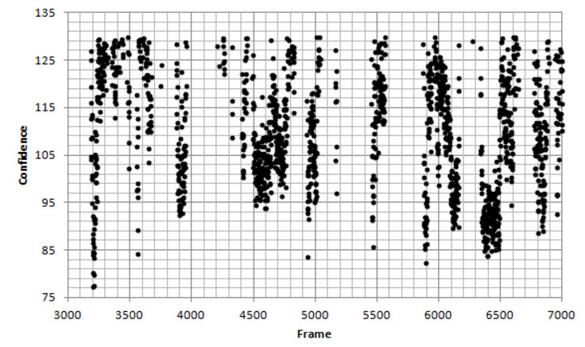
Results
Resultant graph when confidence is plotted for frames captured in real-time
Confidence represents distance from known face class

Slide 26
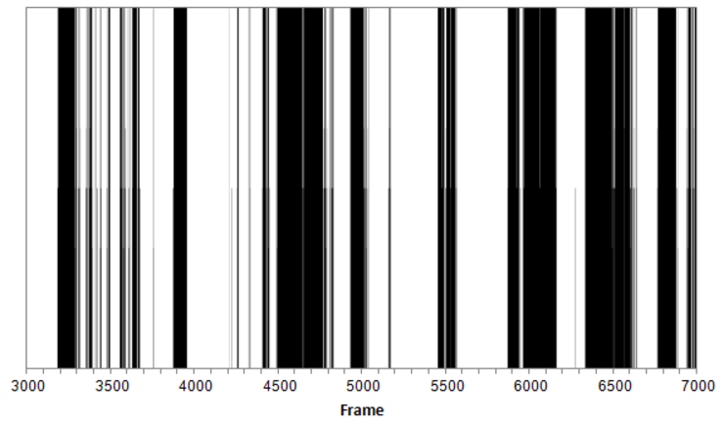
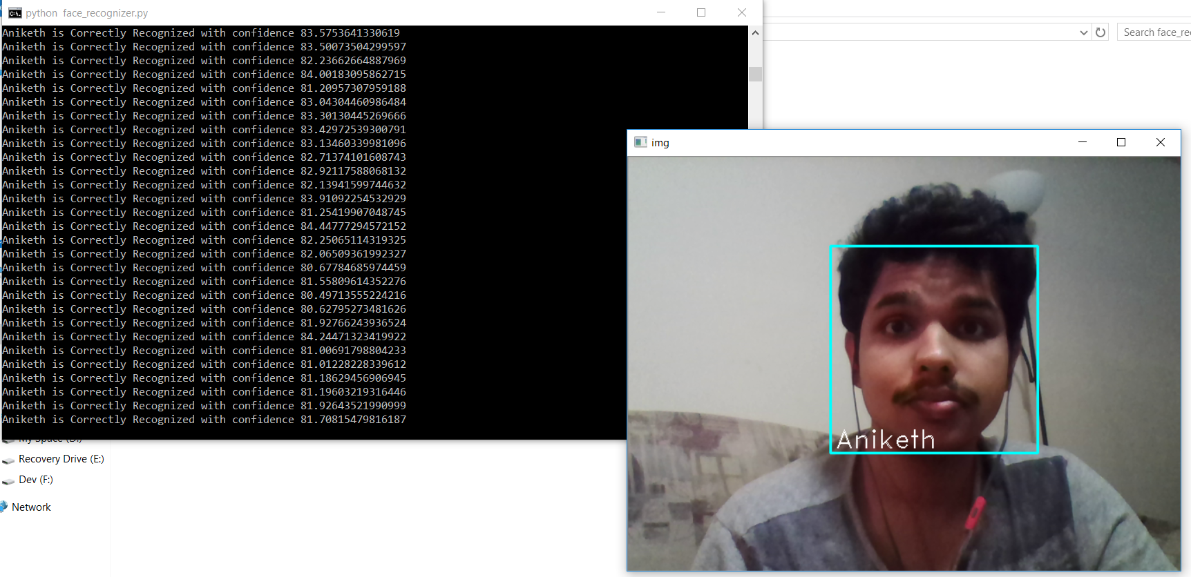
Results
By setting some threshold value, we can obtain a binary determination (yes/no) of which frames contain the frontal view of my face. We can also tag an individual by matching the frame captured to the database.

Slide 27
Conclusion

Slide 28
Conclusion
Conducted Literature Review of the existing face recognition techniques.
Implementation of the local binary patterns recognizer for normal and real time scenario.
Did a comparative analysis of the eigenface, fisher face and local binary patterns histograms techniques.

Slide 29
Conclusion
Several conclusions can be put forward as a result off the experiments conducted on the implemented system
1. If an image that is like a preexisting image in the training set is provided, all methods perform well.
2. Removing initial 3 principal components improves the performance displayed by the Eigenface technique in different lighting conditions.

Slide 30
Conclusion
3. In the limit as a higher number of principal components are used in Eigen face technique, performance becomes similar to correlation. When the first 3 principal components are taken out the performance becomes better as dimensionality of the feature space increases. Note that the performance levels off at 45 components as found by Sirovitch and Kirby when making use of Eigenface technique.
4. Fisher face technique seems to be the best at handling varying expressions and lighting conditions. Linear Subspace suffers with changing facial expressions.

Slide 31
Conclusion
Future work
Further testing of different training models
Implement a facial recognition that updates its database in real-time.

Slide 32
Related Work
A recently proposed facial recognition method makes use of PCA, LDA and neural network.
The algorithm consists of four steps: a) Preprocessing b) Using PCA for Dimension reduction b) Using LDA for feature extraction and d) neural network for classification. Combination of LDA and PCA are used in the technique for improving the capability of LDA when dealing with small sample size.
The algorithm makes use of a neural classifier to reduce number misclassification resulting due to non-linearly separable classes. The proposed technique has been tested on Yale face database. The results show that the algorithm displays less misclassification when compared to previous techniques.

Slide 33
Questions?

