Slide 1
A I V E R I F I C A T I O N & V A L I D A T I O N L A B — I N T E R N S H I P S U M M A R Y
From Backend Engineer
to Closed-Loop V&V Research
Learning, building, and evaluating decision-making policies under uncertainty
Ahmad Alfan Alfian Irfan
AI VnV Research Intern
Notes:
One sentence: this is the story of the whole internship — from backend engineering to a submitted V&V paper.

Slide 2
T H E S T A R T I N G P O I N T
A backend engineer, curious about uncertainty
• Background: backend engineering — not computer-science research
• The curiosity: how do agents decide under uncertainty? (POMDPs)
• Month one, honestly: unfamiliar ground — the theory, the tooling, the papers
• The result was bad performance — and a decision to fix it properly
The gap was fundamentals, not effort.
Notes:
Be honest about the first month — it sets up the whole arc. ~1 min.

Slide 3
T H E R E S E T
Back to fundamentals, deliberately
• Diagnosed the gap: decision-making theory and its ecosystem
• Coursera — decision-making course, from MDP basics up
• JuliaAcademy — Decision Making Under Uncertainty with POMDPs.jl
• Rule adopted: every concept gets rebuilt in code before moving on
Learn → build → verify became the working loop for everything after.
Notes:
~45 s.

Slide 4
L E A R N I N G B Y B U I L D I N G
Pluto notebooks as the learning medium
• Hands-on Pluto notebooks: MDP and POMDP from first principles
• Interactive solver playground — explore the JuliaPOMDP solver ecosystem side by side
• Worked through the Gallery of POMDPs.jl examples
• The notebooks double as a learning medium for the next intern
github.com/PannnTastic/Decision-Making-Under-Uncertainty
Notes:
~1 min. Mention the notebooks are interactive — sliders, live solvers.

Slide 5
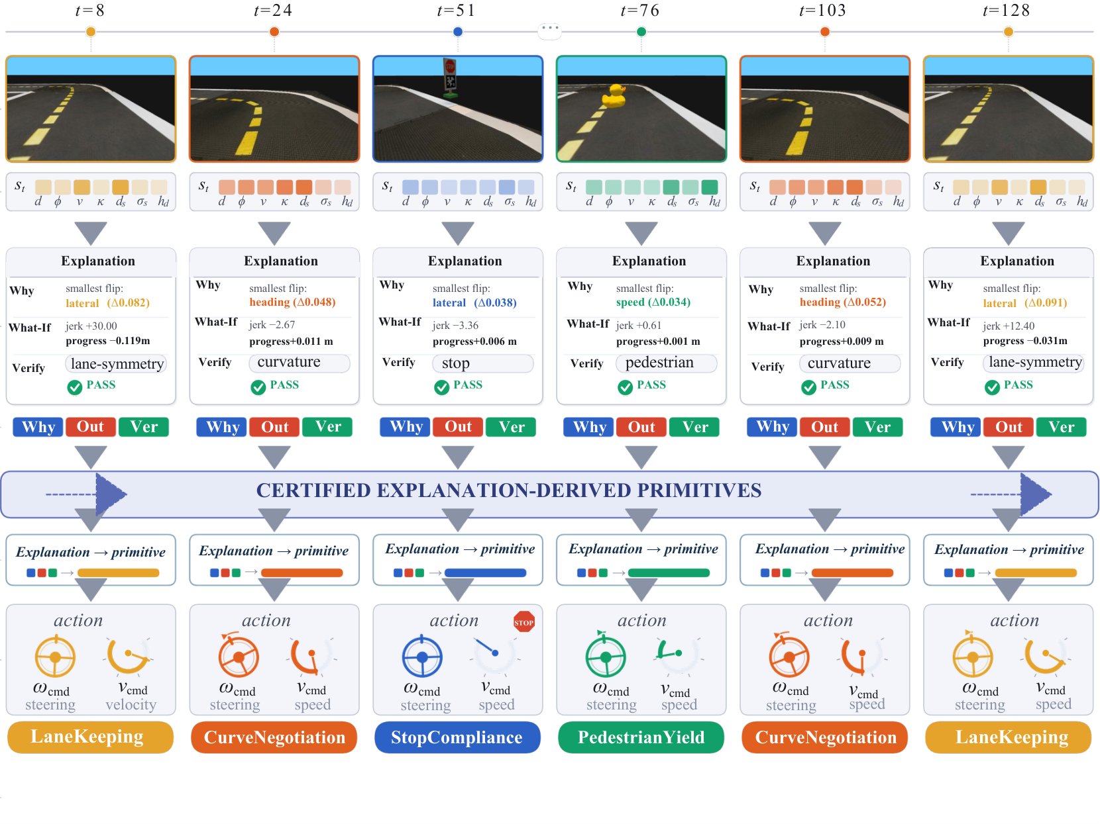
F I R S T P R O J E C T — D U C K I E M D P
Certified explanations for MDP driving policies
• MDP formulation of Duckietown driving; explanations in three pillars: why this action · what if another · is it consistent
• Counterfactual rollouts share exogenous noise — outcome claims settled exactly, across Q-learning, SARSA, SAC, TD3
github.com/PannnTastic/DuckieMDP · arXiv preprint
Notes:
First real project: fully observed MDP, certified explanation framework. ~1.25 min.

Slide 6
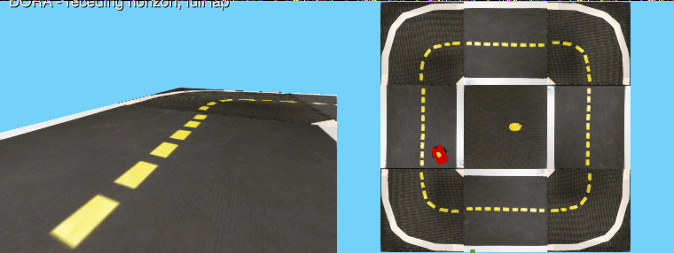
S I D E P R O J E C T — D U C K I E T O W N . J L
The simulator, reborn in Julia
• Native POMDPs.jl reimplementation of the DuckieMDP environment
• Validated decision by decision against Python — exact NumPy RNG streams, seeded episodes reproduce bit for bit
• Native renderer; DORASolvers.jl case study drives a full lap
DORA solver completing a lap, drawn by the package's native renderer
github.com/ai-vnv/Duckietown.jl
Notes:
The RNG-parity point is the punchline — the Julia port reproduces the Python episodes bit for bit. ~1 min.

Slide 7
M A I N P R O J E C T — S U B M I T T E D T O I E E E O J - I T S
A Closed-Loop Evaluation of
Capability Loss and Recovery
in Compressed Driving Policies
From learning POMDPs to using one as a research instrument.
Notes:
Transition into the main project. ~30 s.

Slide 8
T H E P R O B L E M
A policy can pass the benchmark and fail to stop
• Learned driving policies run on embedded computers
• Standard practice: prune, distill, quantize before deployment
• Progress measured by size, latency, aggregate accuracy
• Aggregate scores hide which behaviors compression removes
The question is not only how small the network can get — but which learned capabilities survive each stage.
Notes:
~45 s.

Slide 9
K E Y I D E A
Closed loop, stage by stage — reversed
• A policy acts on its own observations: small action drift compounds through the feedback loop
• Static test-set scores cannot see this
• Scenario-based assessment, reversed: fix the scenarios and seeds, vary the system under test
• Every compression stage is a new configuration to re-certify; acceptance criteria fixed before any result
Four questions: where does driving break · is it recoverable · does the data decide · does recovery survive lower precision.
Notes:
The V&V framing. ~1 min.

Slide 10
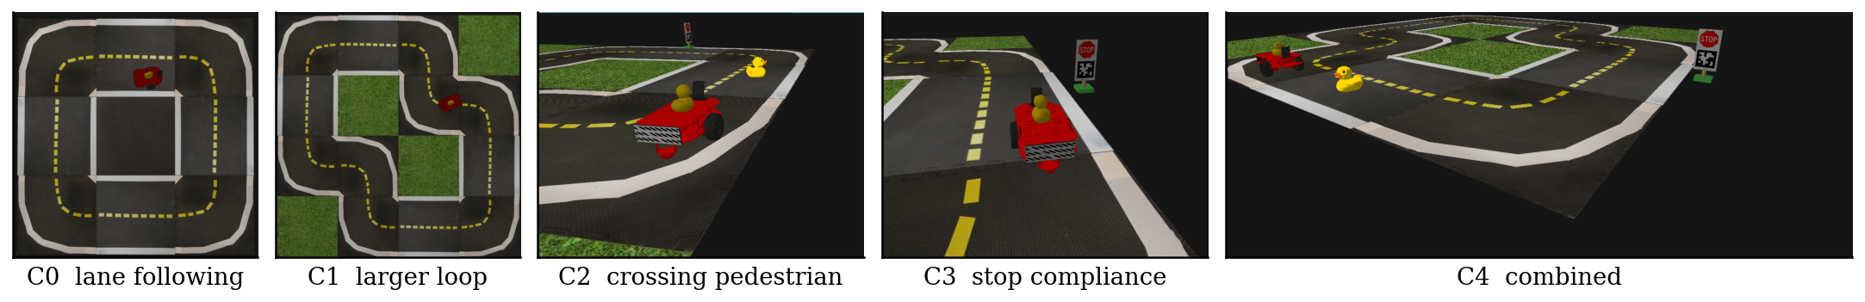
T H E D R I V I N G T A S K
Five curricula, shared seeds, rising difficulty
• C0–C1 lane following · C2 crossing pedestrian · C3 stop sign · C4 both
• The stop curricula demand interrupting the drive, then re-establishing it
Notes:
~45 s.

Slide 11
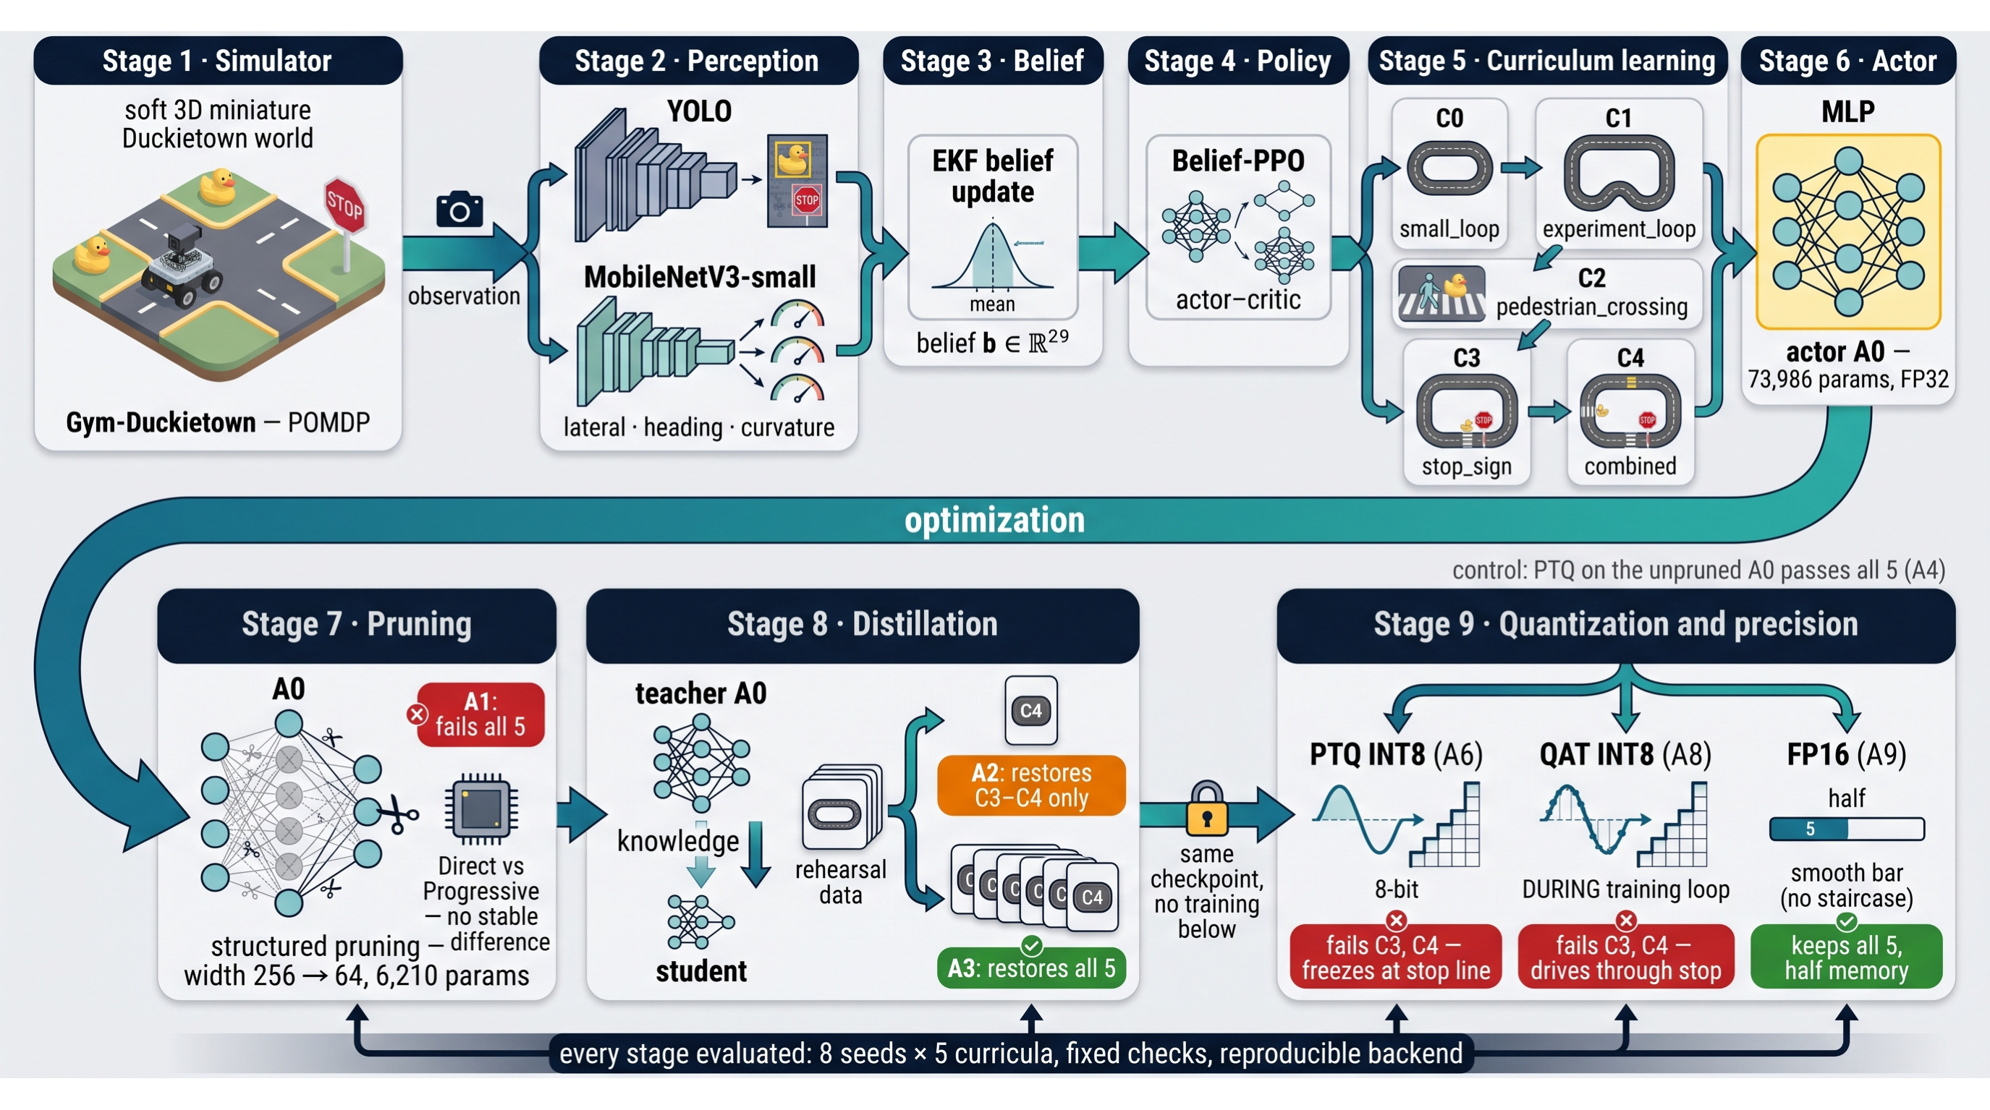
S Y S T E M U N D E R T E S T
A belief-state visuomotor policy (POMDP + PPO)
• Camera → YOLO11n (objects) + MobileNetV3 (lane pose)
• EKFs fuse detections into a 29-d belief vector
• Belief-PPO actor: 73,986 parameters (FP32)
• Only the actor is compressed; perception stays fixed
Notes:
~1 min.

Slide 12
H O W T H E P I P E L I N E W O R K S
Ten configurations, one shared ancestry
• A0 original actor (reference)
• A1 structured pruning, hidden width 256 → 64
• A2 + distillation on the hardest curriculum only
• A3 + distillation on balanced C0–C4 data (62,176 states)
• A6 A3 → post-training INT8 A8 A3 parent → QAT INT8
• A9 A3 → FP16 cast (precision control)
• A4, A5, A7 controls: unpruned INT8, no-distill INT8, historical QAT
Every arrow is evaluated the same way — no configuration is trusted on the previous stage's evidence.
Notes:
Story line: A1 → A2/A3 → A6/A8 → A9. ~1 min.

Slide 13
E V A L U A T I O N P R O T O C O L
400 matched episodes, two independent axes
• 10 models × 5 curricula × 8 seeds — identical seeds for all
• Acceptance checks preregistered: completion, progress, collisions, stop compliance and restart, lane keeping, clearance
• Evaluation backend verified bit-for-bit reproducible
• Axis 1: task verdicts (does it drive?)
• Axis 2: action fidelity vs. the original on identical inputs (does it imitate?)
Notes:
~45 s.

Slide 14
F I N D I N G S 1 & 2
Pruning breaks driving; rehearsal decides recovery
• Structured pruning: 73,986 → 6,210 parameters (−91.6%) — fails all five curricula
• Same teacher, loss, optimizer, budget — only the rehearsal data differs
• Distill on the hardest curriculum only → recovers C3–C4 only
• Balanced rehearsal across all five → recovers all five
What the student rehearses is what the student keeps.
Notes:
~1 min.

Slide 15
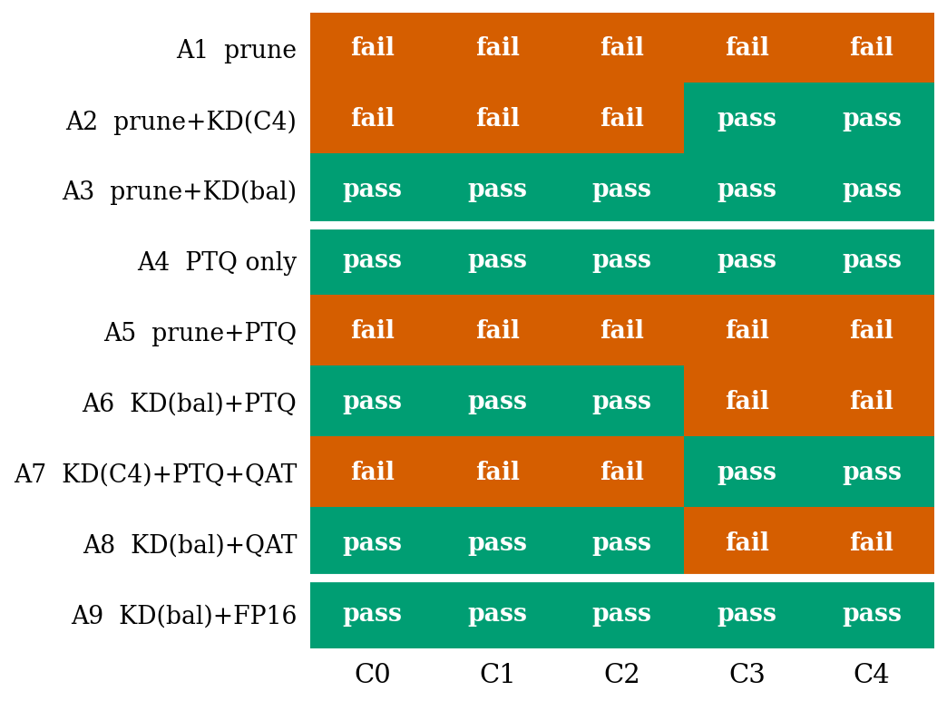
F I N D I N G 3
INT8 undoes a completed recovery
• Both INT8 routes fail C3–C4 from one byte-identical checkpoint
• Stop-task completion falls from 8/8 to 3/8 under PTQ
Notes:
Walk the matrix top to bottom. ~1 min.

Slide 16
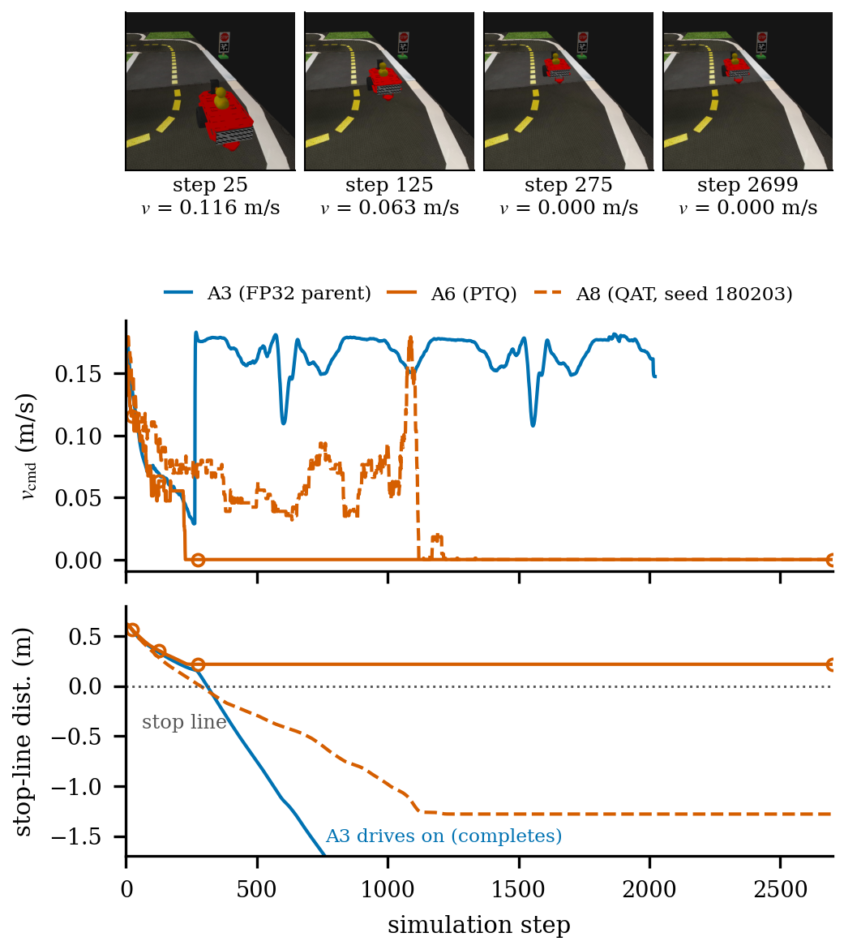
O P P O S I T E F A I L U R E P H E N O T Y P E S
One checkpoint, two ways to fail a stop
• A6 (PTQ) brakes correctly, parks 0.22 m before the line — and never moves again (to the 2700-step horizon)
• A8 (QAT) drives through the stop at low speed while the stop is still required
• Same parent, same task, opposite failures
Notes:
Frames reconstructed from telemetry; circles on the curves are the same steps. ~1 min.

Slide 17
F I N D I N G S 4 & 5
Controls and fidelity: the cause is the interaction
• Same PTQ on the unpruned actor → passes all five
• FP16 cast of the recovered actor → keeps all five
• So the failure is narrow width × INT8, not precision alone
• QAT imitates the original more closely than PTQ — and drives worse
• The unpruned INT8 control drives everything — and fails the similarity thresholds
Action-level similarity is not an acceptance test — in either direction.
Notes:
~1 min.

Slide 18
W H A T C O M P R E S S I O N B U Y S
Actor cost across precisions
Param. memory Median latency All curricula
A3 FP32 24.8 KB 19.4 µs pass
A9 FP16 12.4 KB 24.5 µs (+26%) pass
A6 INT8 7.6 KB 12.9 µs (1.50×) fail C3–C4
• FP16 halves memory but is slower here (no native half path on this CPU)
• The actor is under 0.1% of end-to-end step cost — perception dominates
Notes:
~45 s.

Slide 19
T A K E A W A Y S
Judge compressed policies by how they drive
• Compression is a sequence of behavioral transitions: lose, recover, lose again
• Evaluate every stage in closed loop — no stage is safe by inheritance
• Choose rehearsal data to cover everything the policy must keep
• A completed recovery is not robust to a later precision cut
• Action-level similarity is not an acceptance test
Notes:
~45 s.

Slide 20
F U T U R E W O R K S
Where this goes next
• Wider settings: more quantization configurations, more training realizations, more seeds
• Compress perception: the other 99.9% of step cost, under the same acceptance protocol
• Transfer the protocol: other policy stacks, other simulators, eventually hardware
• Julia-native line: Duckietown.jl as the ground for solver-level V&V experiments
Notes:
~1 min.

Slide 21
W H A T T H E I N T E R N S H I P B U I L T
Fundamentals first, then honest evaluation
• From backend engineering to an RL / POMDP research workflow
• 4 public repos · 2 papers · 1 Julia package
• From a bad first month to an OJ-ITS submission
• The lesson that stuck: measure what matters, in closed loop
Notes:
Personal close before Q&A. ~45 s.

Slide 22
T H A N K Y O U
Questions?
Everything in this talk is public:
github.com/ai-vnv/CompressedAutoDriving · github.com/PannnTastic/DuckieMDP
github.com/PannnTastic/Decision-Making-Under-Uncertainty · github.com/ai-vnv/Duckietown.jl
Internship summary — AI Verification & Validation Lab
Notes:
Close and take questions.

