Slide 1
Gather
Closed Birmingham community calendar
https://commseventsv1-production.up.railway.app
Gather · Birmingham
1 / 6

Slide 2
Problem — live role-play
Member
Cell leader
Which event tonight? Who’s going? Chat says maybe — but was it vetted? Afterward: who was actually there?
Listings appear from the web. Some need review. Members book late or offline. We need one controlled place.
Gather · Birmingham
2 / 6

Slide 3
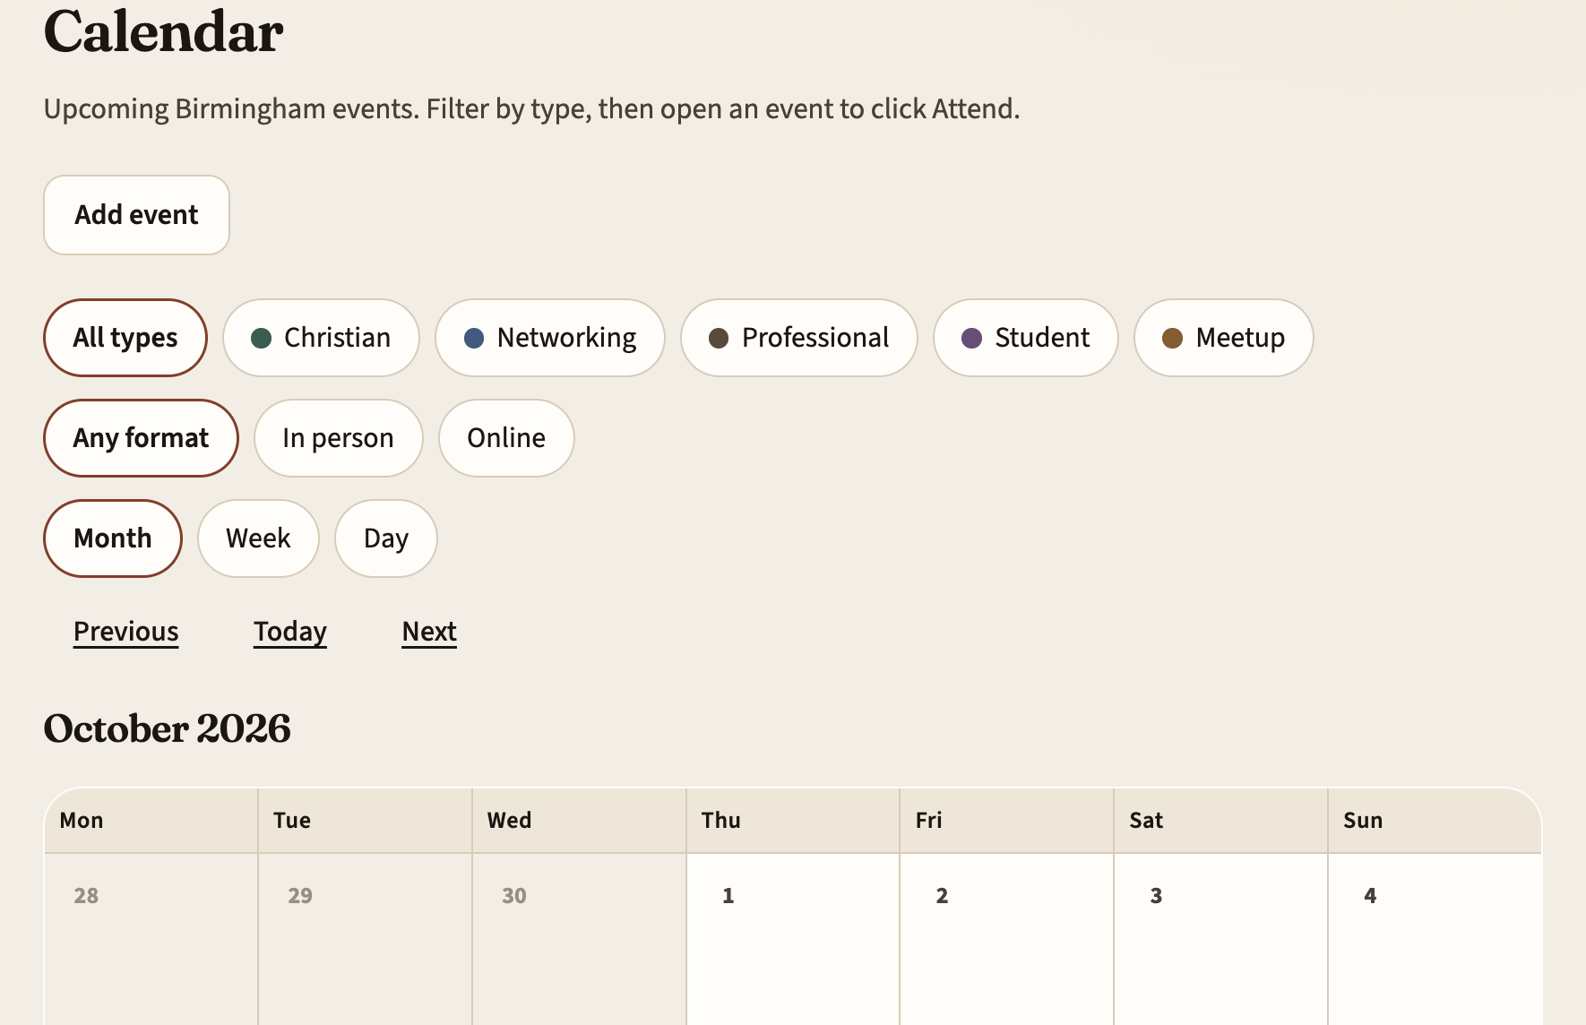
Requirements loop
Scope &
stories
→
AI
capture
→
Req
doc
→
AI app
generator
→
Validate
Validate loops back into capture.
https://github.com/ai-xps/comms_events_v1
Gather · Birmingham
3 / 6

Slide 4
Scenarios — demo on video or live
Member
Cell leader
Admin
Find event · see who’s going · Attend
Scrape · add · book · attendance
Whitelist · visibility · accounts
Gather · Birmingham
4 / 6

Slide 5
Next steps
1. Improve UX from team feedback
2. Finish testing (bugs + smoke)
3. Team hosting — more than one person can deploy and change requirements
4. Later: shared fonts, charts, templates, and Git standards across apps
Gather · Birmingham
5 / 6

Slide 6
Owners · ask for 10 minutes
Rebecca
Problem role-play script · next-steps narrative
Guillaume
10-min ask · cell import · scenario videos · Canva
An
Product · GitHub · tech brief · loop visual
Gather · Birmingham
6 / 6

