Slide 1
Gather
A quick look around
A closed calendar for one community in Birmingham. Have a click. Nothing here is a test you can fail.
Open this
https://commseventsv1-production.up.railway.app

Slide 2
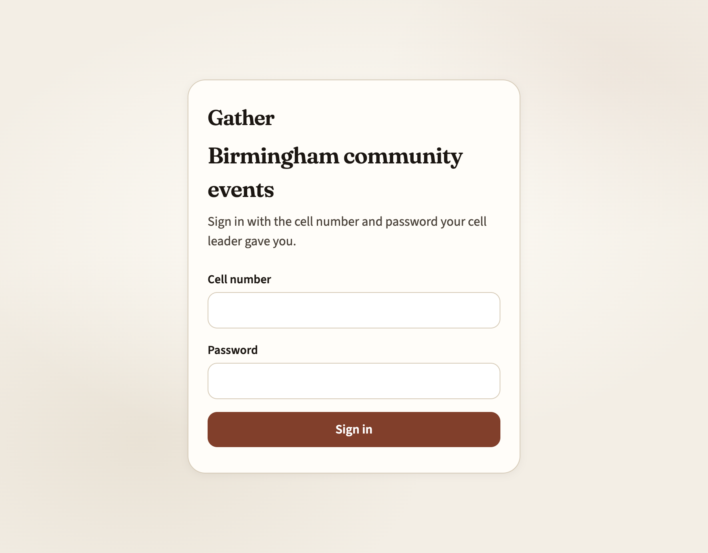
Sign in
Your cell leader gives you a cell number and a password. That is the whole door. There is no public sign-up.
Members
Browse the calendar, click Attend, confirm later if you went.
Cell leaders
Look after their own cell, review pending events, see Insights for that cell.
Admin
Sets people up, runs the scraper, sees the whole region.
Gather · Birmingham
2 / 6

Slide 3
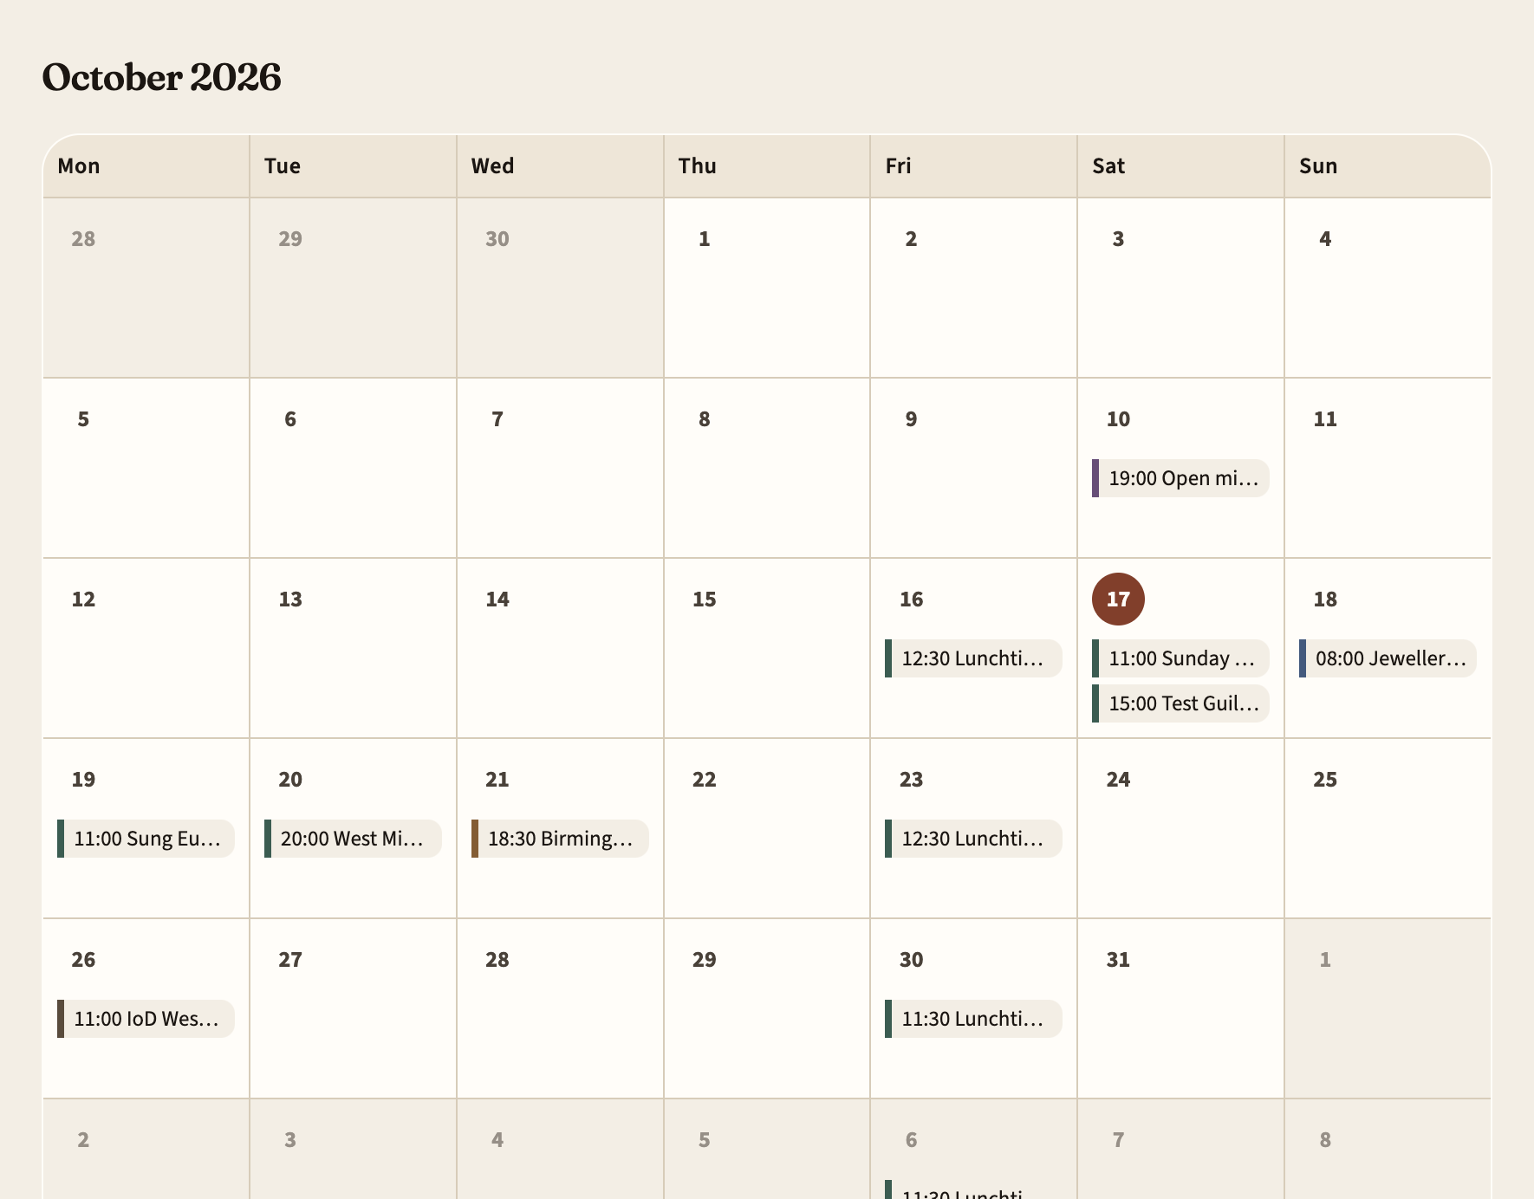
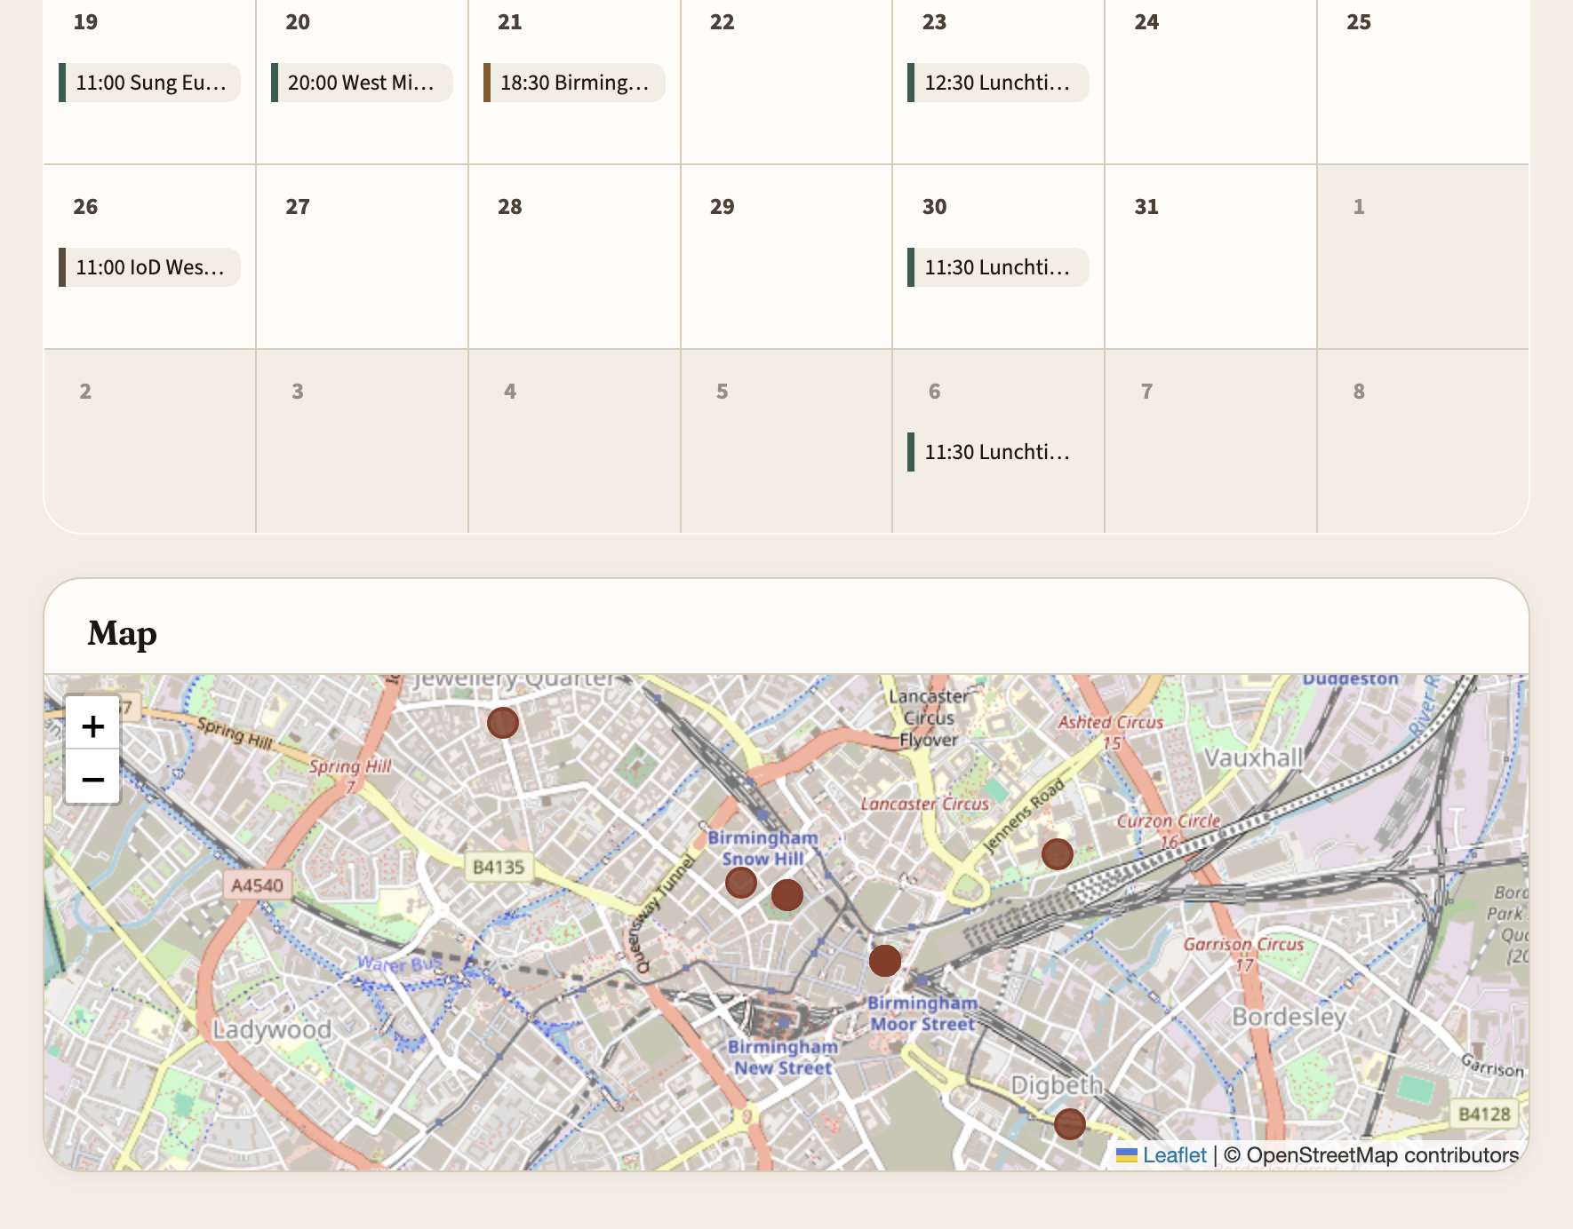
Find something
Month, week or day. Filter by type if you like. The map stays at the bottom even when a day is quiet.
Try week and day for today. Tap a type, then All types — everything should come back.
Gather · Birmingham
3 / 6

Slide 4
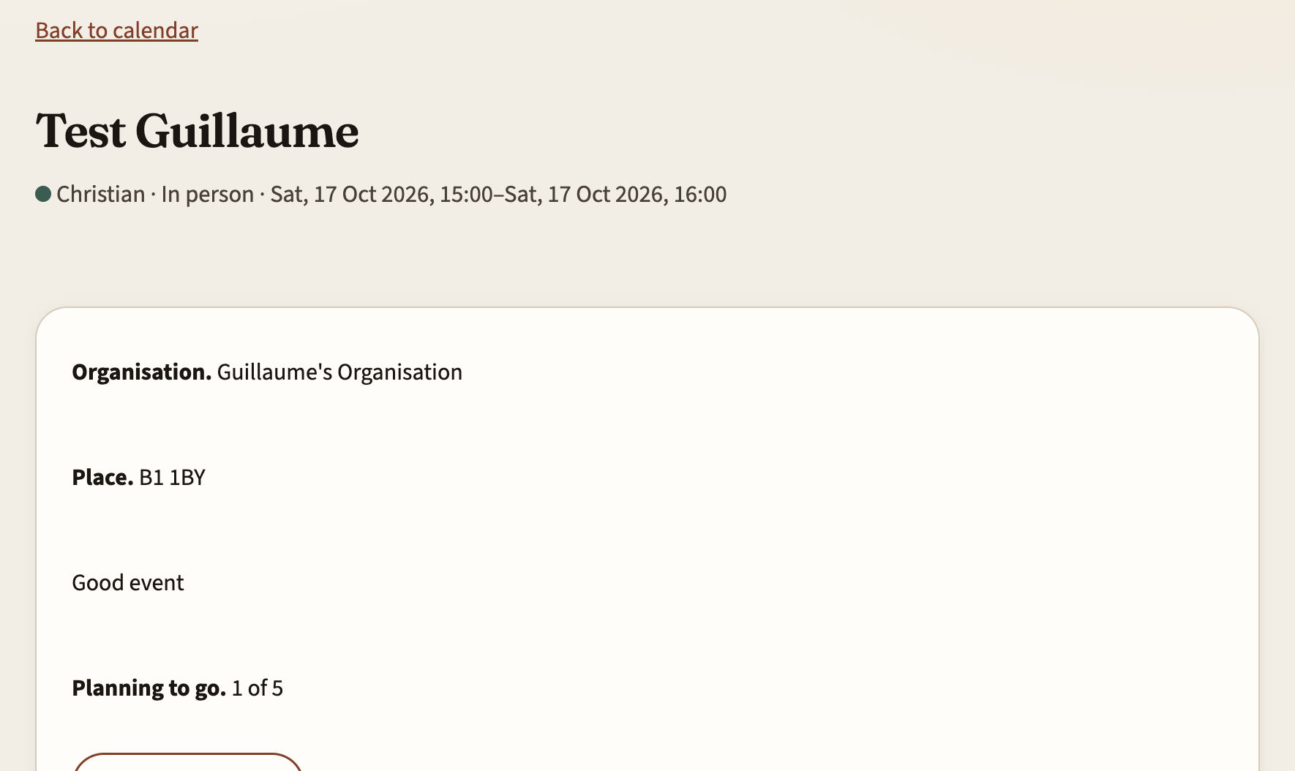
Attend, then say if you went
Attend
Means you plan to go. That is it.
Did you go?
After the event, a quiet prompt. Yes, no, or later.
Star
A bookmark. It drops once the event is over.
Names
Members usually see a count. An admin can choose initials, or name and cell.
Gather · Birmingham
4 / 6

Slide 5
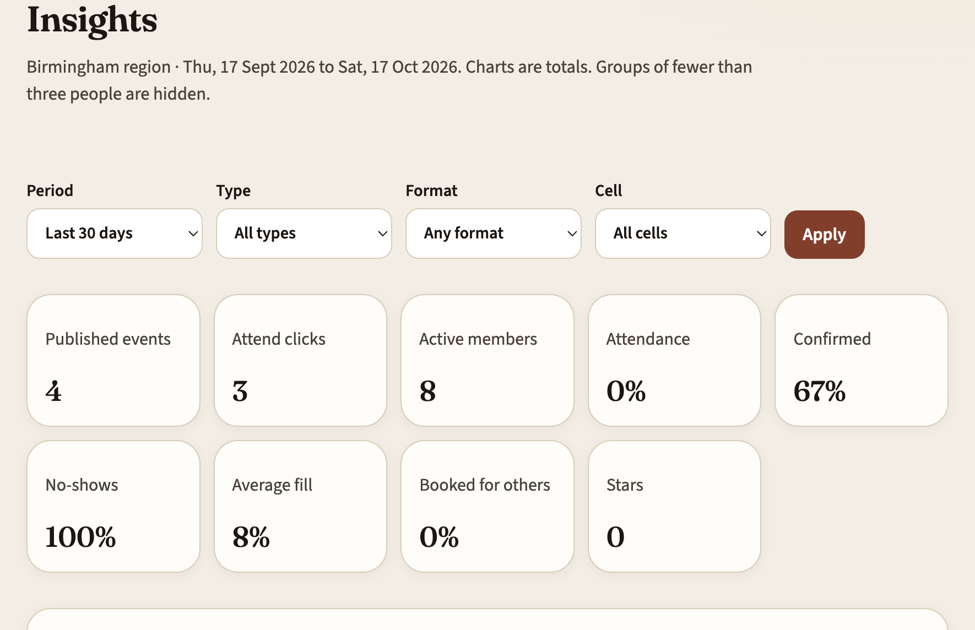
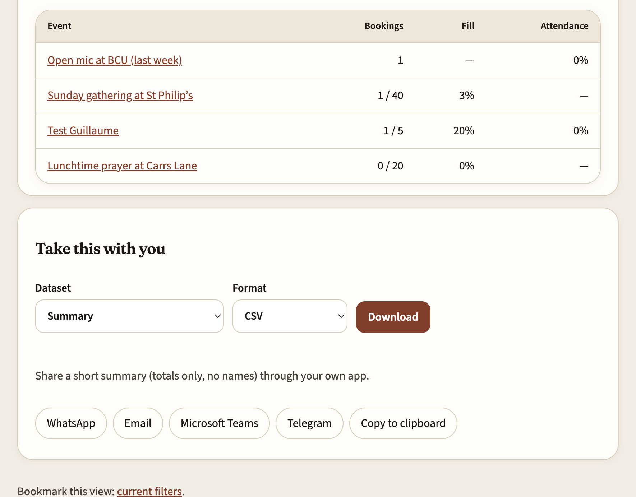
Insights, if you lead
Admin sees the region. Cell leaders see their own cell. Members do not see this page. A file or a short share uses the same numbers as the screen.
Gather · Birmingham
5 / 6

Slide 6
Have a play
Nice ones to tap
Not this round
Week and day for today.
A type chip, then All types.
Scroll to the map.
Open an event and click Attend.
If you can add events: drop a pin, add a link, publish — you should land back on pending.
No public sign-up, email or texts from Gather.
Share opens your own app. Gather does not send the message.
The phone-first look is still to come. This demo is the cream paper one.
If something feels off, say so. That is the point of looking.
Gather · Birmingham
6 / 6

