Slide 1

Multimodal Large Language Models
Applied Data Science - Clemson University

Slide 2

Course Context
Part of Applied Data Science course
Master's program in Computer Science
Prerequisites: Understanding of Transformer architecture
  Attention mechanisms
  Self-attention and cross-attention
Building on previous lessons on LLMs

Slide 3

Learning Objectives
Understand multimodal learning fundamentals
Master single-modality representations
Learn multimodal fusion strategies
Study state-of-the-art architectures
Understand training vs. fine-tuning
Apply on Palmetto cluster

Slide 4
What is Multimodal Learning?
Learning from multiple data modalities simultaneously
Modalities: Different types of data sources
  Vision (images, videos)
  Text (documents, captions)
  Audio (speech, sound)
Goal: Build unified representations
Enable cross-modal understanding

Slide 5

Why Multimodal Models?
Human perception is inherently multimodal
Richer understanding through multiple perspectives
Key applications:
  Visual Question Answering
  Image/Video captioning
  Text-to-image generation
  Embodied AI and robotics
Better generalization and robustness

Slide 6

Historical Context
2010s: Separate models per modality
2017: Attention mechanisms enable fusion
2019-2020: BERT + Vision (ViLBERT, LXMERT)
2021: CLIP revolutionizes vision-language
2022-2023: Large-scale models (Flamingo, GPT-4V)
2023-2024: Open-source alternatives (LLaVA, BLIP-2)
2024+: Any-to-any multimodal models

Slide 7

Challenges in Multimodal Learning
Modality gap: Different data distributions
Representation learning: Finding common space
Alignment: Matching corresponding elements
Fusion strategies: How to combine?
Data requirements: Need paired data
Computational cost: Processing multiple modalities
Evaluation: Measuring performance

Slide 8
Part I: Single Modality Foundations

Slide 9

Single Modality: Vision
Image representation: Pixels in grids
Convolutional Neural Networks (CNNs):
  Learn spatial hierarchies
  Translation invariance
Vision Transformers (ViT):
  Split image into patches
  Apply transformer to patches
  Better scalability with data
Output: High-dimensional feature vectors

Slide 10
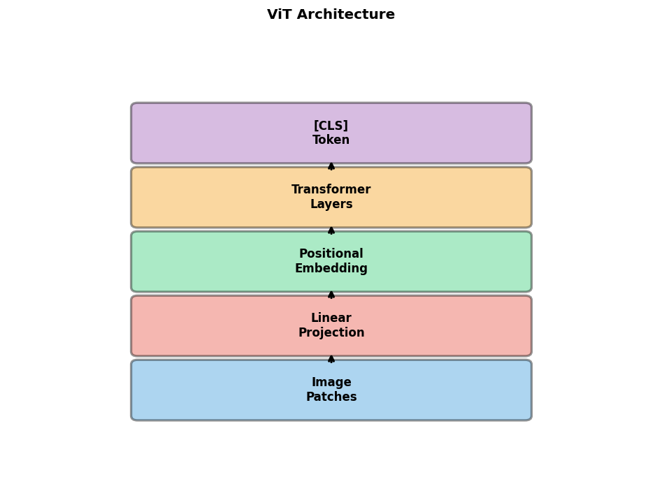
Vision Transformers (ViT)
Pure transformer applied to images
Process:
  1. Split image into 16×16 patches
  2. Flatten and linearly embed
  3. Add positional embeddings
  4. Feed through transformer
  5. Extract [CLS] token
Advantages: Scalable, less bias
Used in CLIP, BLIP, modern models

Slide 11
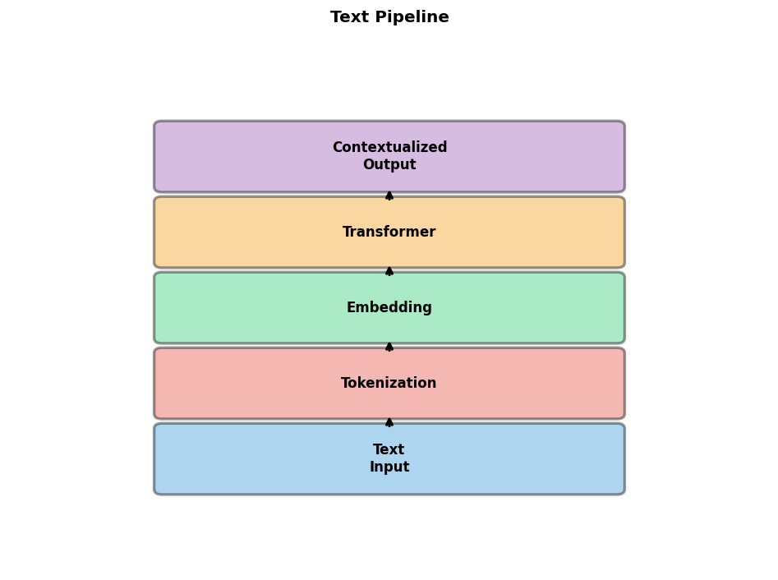
Single Modality: Text
Tokenization: Convert text to tokens
Embedding: Map tokens to vectors
Transformers for text:
  BERT: Bidirectional encoder
  GPT: Autoregressive decoder
  T5: Encoder-decoder
Contextual representations
Pre-training on large text corpora
Output: Sequence of embeddings

Slide 12

Single Modality: Audio
Raw audio: Waveform representation
Feature extraction:
  Mel-spectrograms: Time-frequency
  MFCCs: Cepstral coefficients
Models:
  Wav2Vec 2.0: Self-supervised speech
  Whisper: Robust speech recognition
  AudioMAE: Masked autoencoding
Output: Audio embeddings

Slide 13
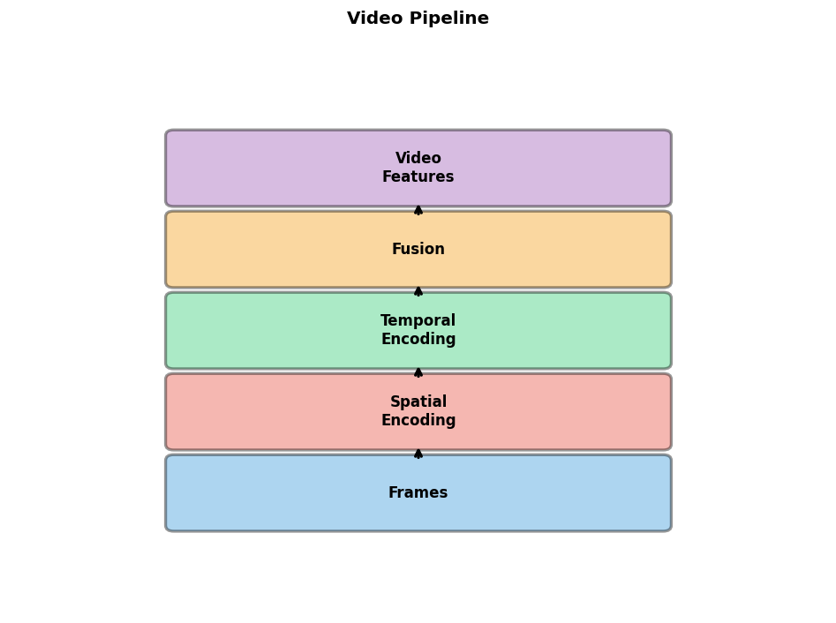
Single Modality: Video
Video = Images + temporal information
Spatial encoding: Per-frame CNN/ViT
Temporal encoding:
  3D convolutions
  Recurrent networks (LSTM)
  Temporal transformers
Challenges: Computational cost
Models: TimeSformer, VideoMAE
Output: Spatio-temporal features

Slide 14
Modality Representations
Each modality has unique characteristics
Vision: Spatial structure, continuous
Text: Sequential, discrete tokens
Audio: Temporal, continuous waveforms
Goal: Map to common semantic space
Representation learning objectives:
  Reconstruction
  Contrastive learning
  Masked modeling

Slide 15
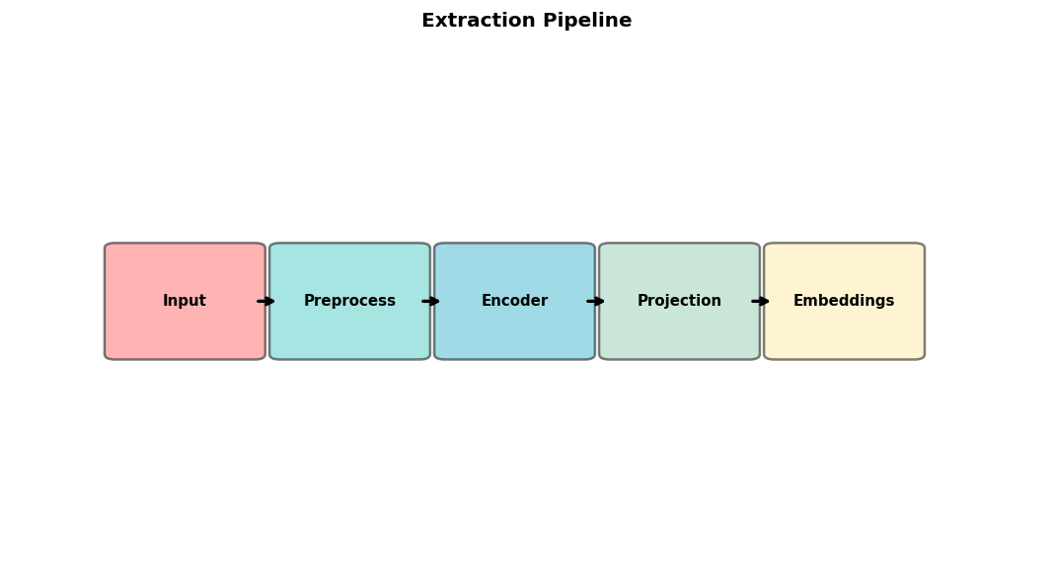
Feature Extraction Pipeline
Input: Raw data in original modality
Preprocessing:
  Images: Resize, normalize
  Text: Tokenize, add special tokens
  Audio: Resample, spectrogram
Encoder: Modality-specific network
Projection: Map to common dimension
Normalization: L2 normalize for similarity

Slide 16
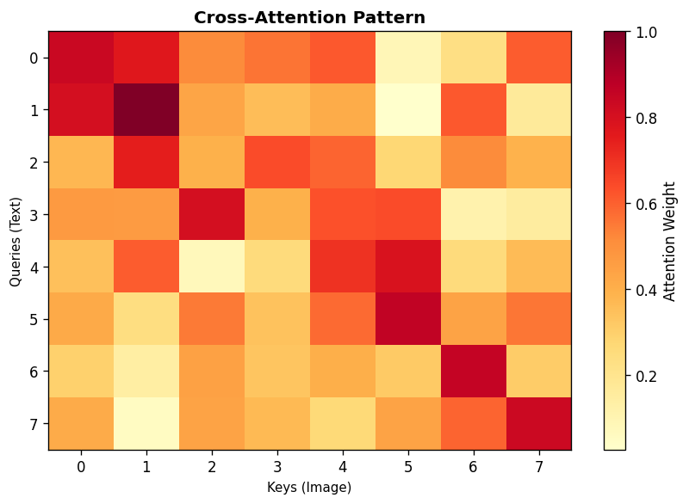
Embedding Spaces
Embedding space: High-dimensional vectors
Desirable properties:
  Semantic similarity → Vector proximity
  Modality invariance
  Structured relationships
Joint embedding space:
  Multiple modalities → same space
  Enable cross-modal retrieval
Learned through contrastive objectives

Slide 17
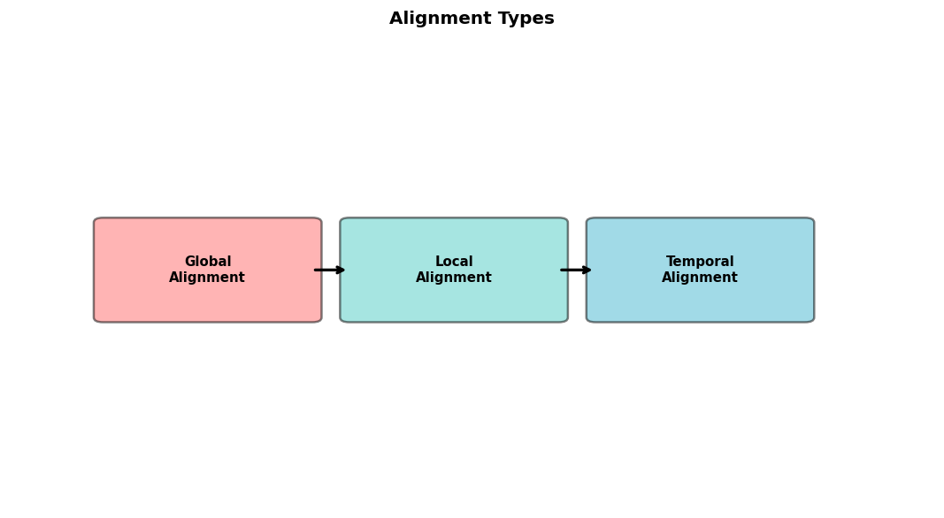
The Alignment Problem
Core challenge: Align different modalities
Types of alignment:
  Global: Image-caption pairs
  Local: Objects-words
  Temporal: Video-transcript
Solutions:
  Contrastive learning (CLIP)
  Cross-attention (Flamingo)
  Q-Former (BLIP-2)
Goal: Bridge the modality gap

Slide 18
Part II: Multimodal Architectures

Slide 19
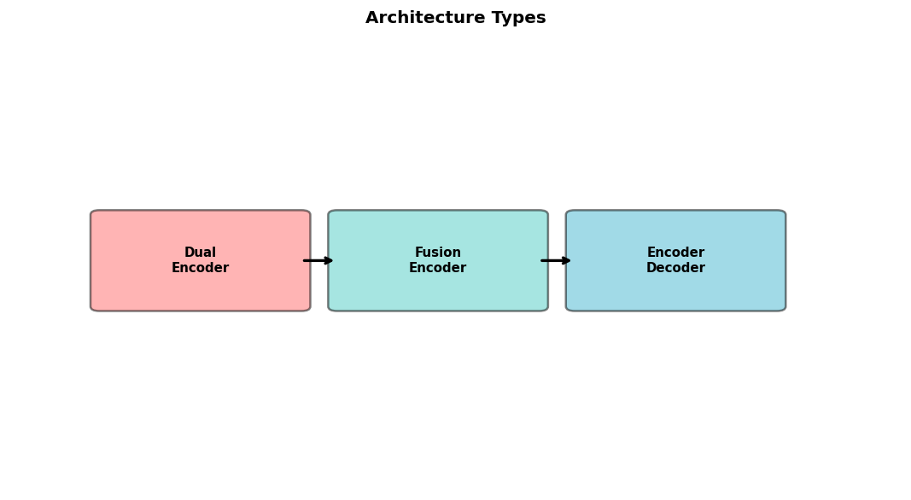
Overview of Multimodal Architectures
Three main paradigms:
1. Dual-encoder (CLIP, ALIGN)
  Separate encoders per modality
  Joint embedding space
2. Fusion encoder (LXMERT, ViLBERT)
  Cross-modal attention layers
3. Encoder-decoder (BLIP, Flamingo, LLaVA)
  Visual encoder + Language model
  Generation capabilities

Slide 20

Early Fusion
Combine raw features at input level
Concatenate or sum modality features
Process jointly through unified network
Advantages:
  Maximum interaction
  Simple architecture
Disadvantages:
  Hard to leverage pre-trained models
  Less flexible

Slide 21
Late Fusion
Process each modality independently
Combine at decision/output level
Examples: Ensemble approaches
Advantages:
  Easy to use pre-trained models
  Modular design
  Train modalities separately
Disadvantages:
  Limited cross-modal interaction
  May miss complex relationships

Slide 22
Hybrid Fusion
Combine early and late fusion benefits
Multi-stage interaction
Example: Cross-attention at multiple layers
Advantages:
  Flexible architecture design
  Leverage pre-trained components
  Rich cross-modal interaction
Most modern architectures use hybrid
Examples: BLIP-2, Flamingo, LLaVA

Slide 23
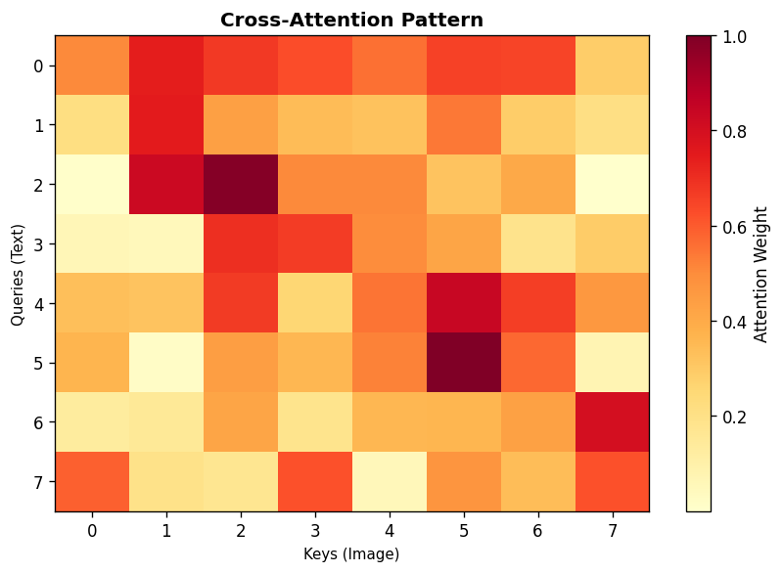
Cross-Attention Mechanisms
Key technique for multimodal fusion
Standard attention: Q, K, V from same sequence
Cross-attention: Q from one modality, K,V from another
Example: Text queries vision features
  Q = text embeddings
  K, V = image patch features
Bidirectional cross-attention for deep fusion
Used in: Flamingo, BLIP, Q-Former

Slide 24

CLIP: Contrastive Language-Image Pre-training
Dual-encoder architecture (OpenAI, 2021)
Components:
  Image encoder: ViT or ResNet
  Text encoder: Transformer
  Project to same dimension
Training: Contrastive learning on 400M pairs
Zero-shot capabilities
Applications: Classification, retrieval

Slide 25
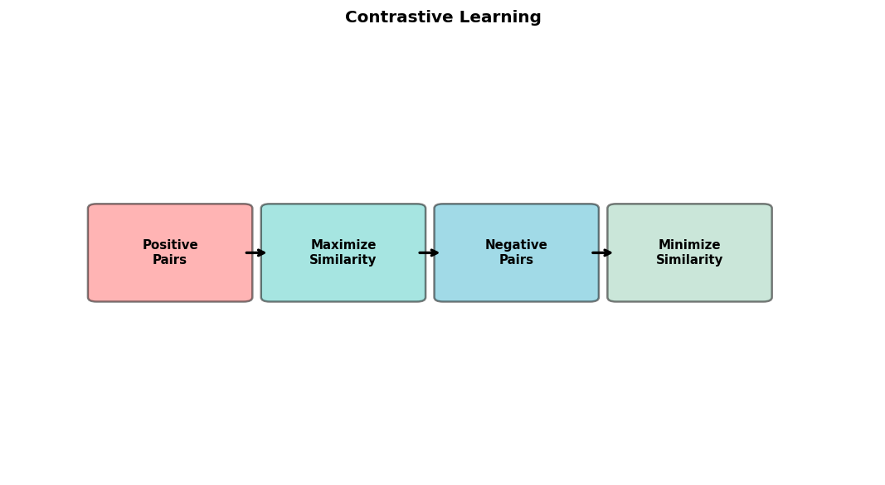
CLIP Training Objective
Contrastive loss on batch of N pairs
Maximize similarity of correct (image, text) pairs
Minimize similarity of incorrect pairs
Loss: InfoNCE
Temperature scaling: τ learned parameter
Symmetric: Both image→text and text→image
Result: Aligned vision-language space

Slide 26
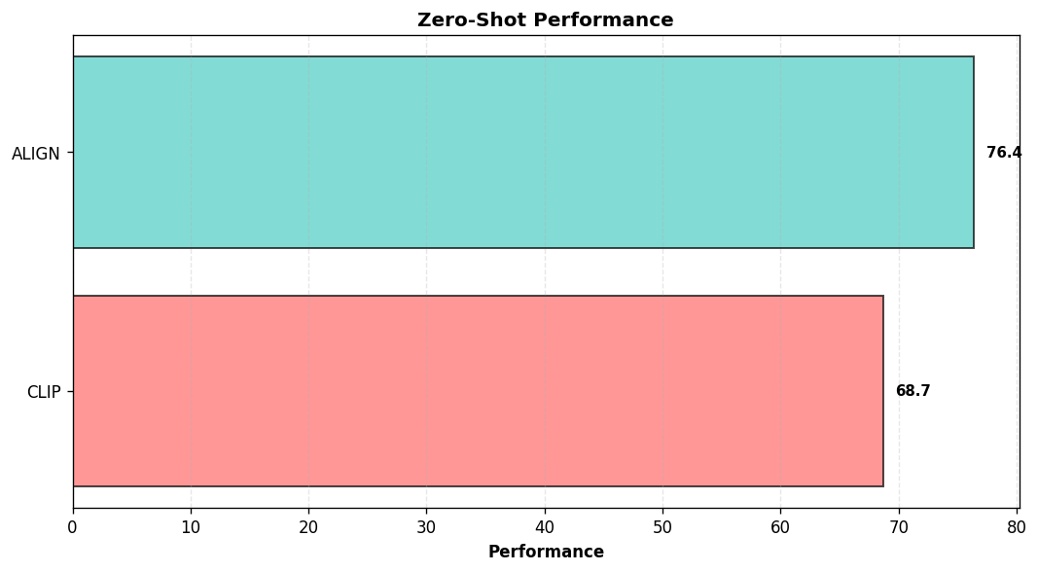
ALIGN: A Large-scale ImaGe and Noisy text
Similar to CLIP (Google, 2021)
Key difference: Noisy web data (1.8B pairs)
No careful curation
Components:
  EfficientNet for images
  BERT for text
Same contrastive objective
Insight: Scale > data quality
Comparable or better results

Slide 27
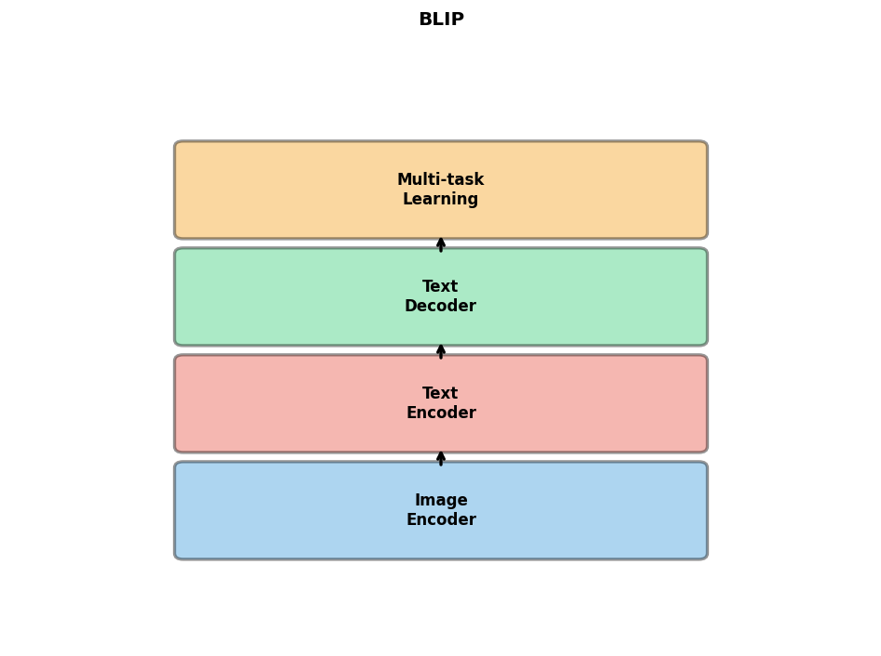
BLIP: Bootstrapping Language-Image Pre-training
Encoder-decoder architecture (Salesforce, 2022)
Three components:
  1. Image encoder: ViT
  2. Text encoder: BERT-like
  3. Text decoder: GPT-like
Multi-task learning:
  Contrastive learning
  Image-text matching
  Image-conditioned LM
CapFilt: Synthetic captions

Slide 28
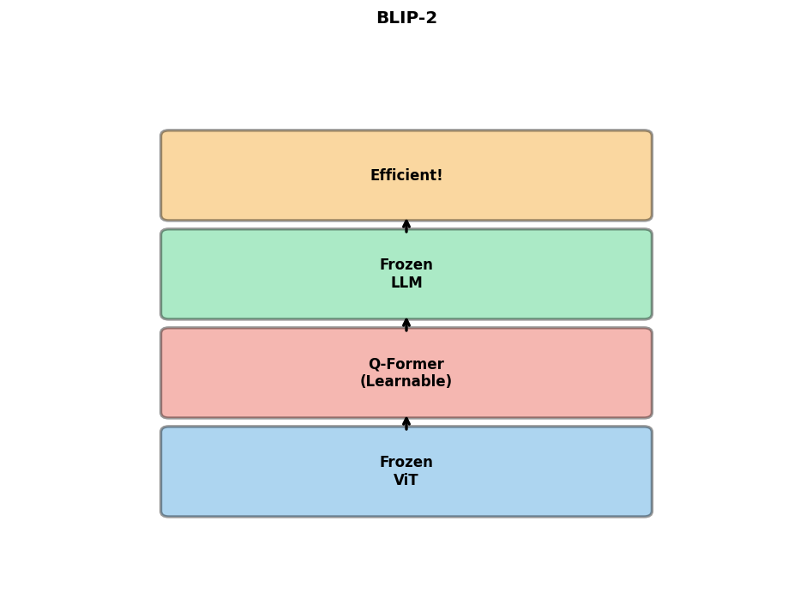
BLIP-2: Querying Transformer
Efficient architecture (Salesforce, 2023)
Key innovation: Q-Former
  Lightweight module between frozen encoders
  Learnable query tokens
  Cross-attention to vision
Two-stage training:
  Stage 1: Vision-language learning
  Stage 2: Vision-to-language generation
Much more parameter-efficient

Slide 29
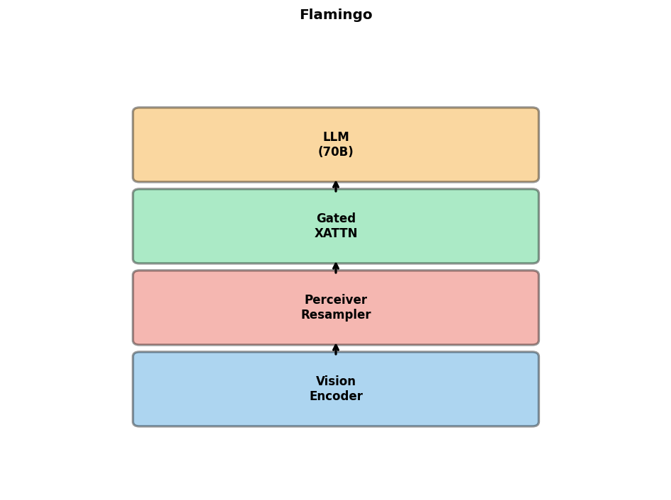
Flamingo: Visual Language Model
Few-shot learning VLM (DeepMind, 2022)
Architecture:
  Vision encoder: Frozen pre-trained
  Perceiver resampler: Compress features
  LLM: Frozen Chinchilla 70B
  Cross-attention: Gated XATTN-DENSE
Interleaved image-text input
In-context learning: Few-shot prompting
Powerful few-shot visual understanding

Slide 30
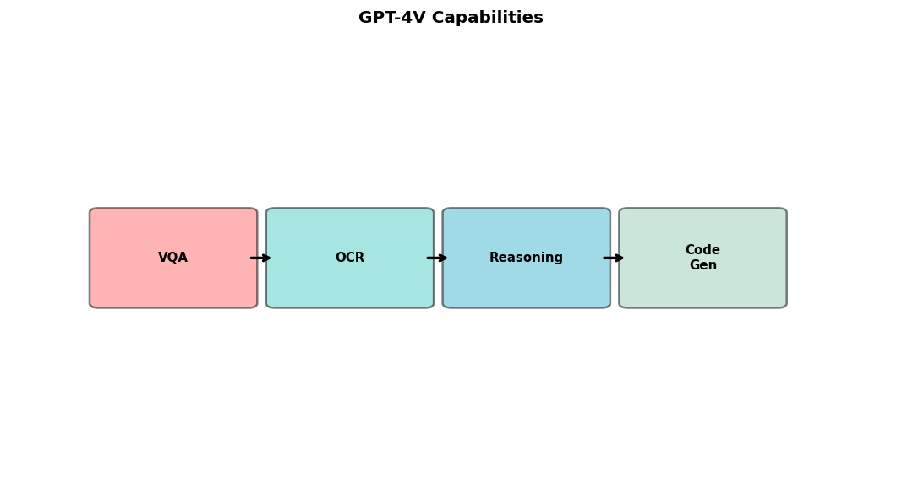
GPT-4V: Multimodal GPT-4
Proprietary multimodal model (OpenAI, 2023)
Accepts images and text as input
Architecture details not disclosed
Likely components:
  Enhanced CLIP-like vision encoder
  Large language model: GPT-4
  Sophisticated fusion
Capabilities: VQA, OCR, reasoning, code
State-of-the-art performance

Slide 31
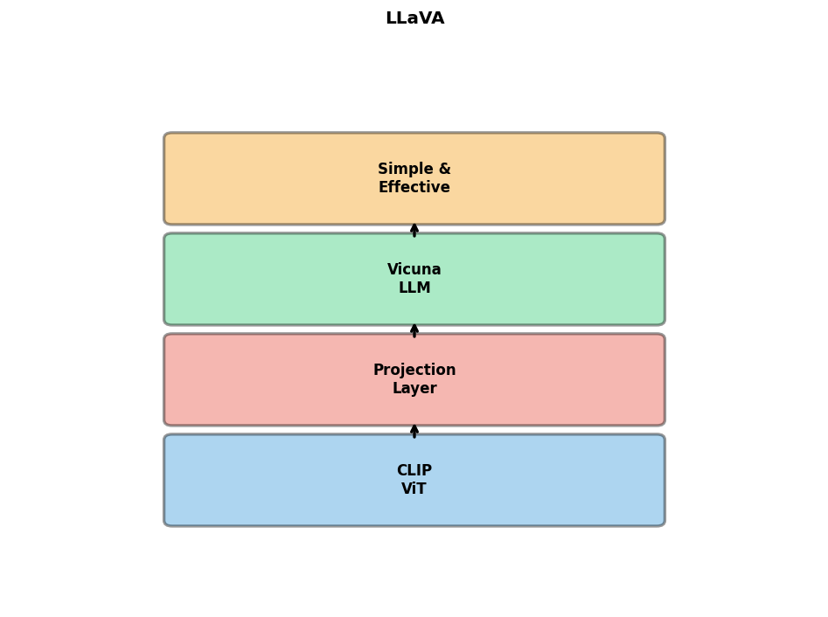
LLaVA: Large Language and Vision Assistant
Open-source VLM (Liu et al., 2023)
Simple architecture:
  Vision encoder: CLIP ViT-L/14
  Projection: Linear or MLP
  LLM: Vicuna (LLaMA-based)
Training data: GPT-4 generated instructions
Two-stage training:
  Pre-training: Projection only
  Fine-tuning: Full model or LoRA
Excellent performance, modest compute

Slide 32
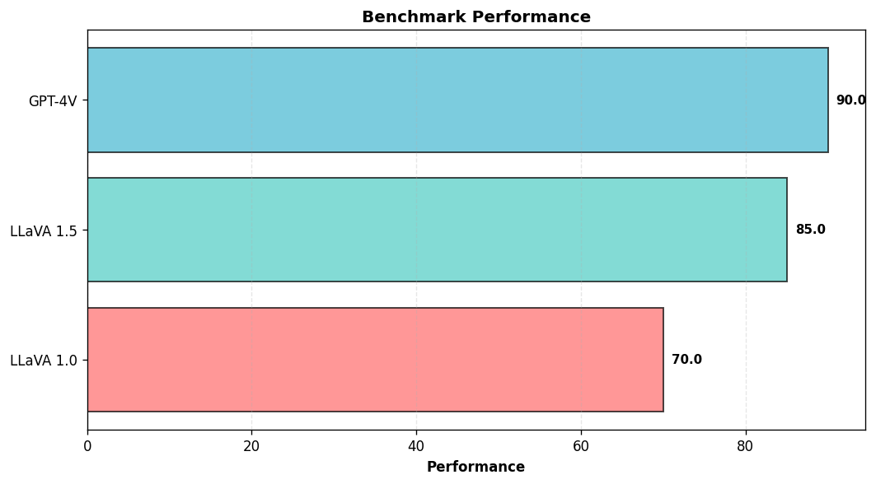
LLaVA 1.5 Improvements
Enhanced version (2023)
Improvements:
  MLP projection: 2-layer vs 1-layer
  Higher resolution: 336×336 vs 224
  Better instruction data
  Academic task data: VQA, OCR
Unified training recipe
Near GPT-4V on some tasks
Efficient: Fine-tune on single GPU

Slide 33
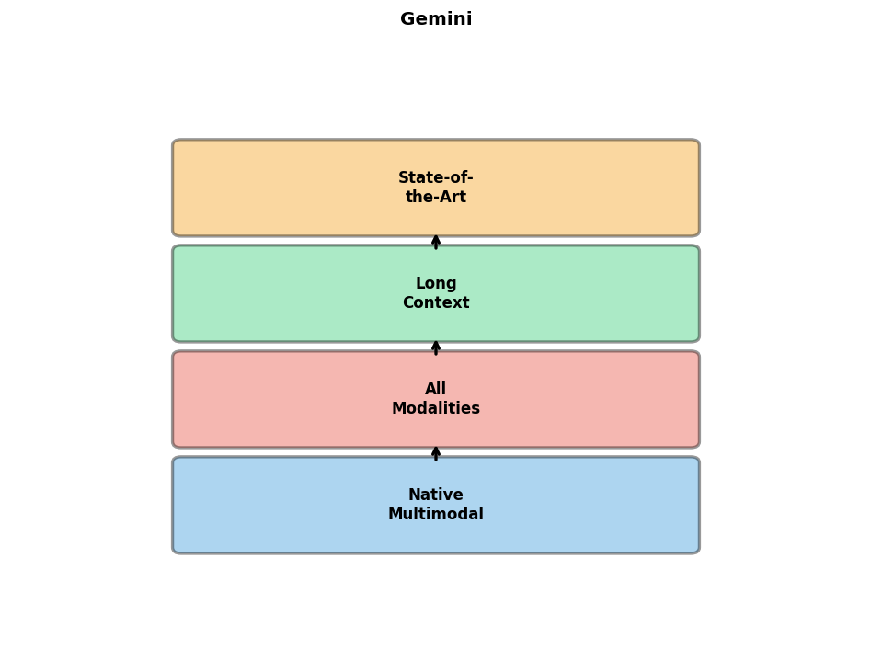
Gemini: Google's Multimodal Model
Native multimodal model (Google, 2023)
Three sizes: Nano, Pro, Ultra
Key: Natively multimodal from scratch
  Not adapting separate models
  Joint training on all modalities
Capabilities:
  Image, video, audio, text
  Long context: Up to 1M tokens
  Complex reasoning
State-of-the-art benchmarks

Slide 34
Any-to-Any Multimodal Models
Next generation: Unified for all modalities
Examples:
  NExT-GPT: Any-to-any generation
  CoDi: Composable diffusion
  Unified-IO 2: Single model, any task
Capabilities:
  Text → Image, Audio, Video
  Image → Text, Audio
  Any modality → Any modality
Challenges: Training complexity, data

Slide 35
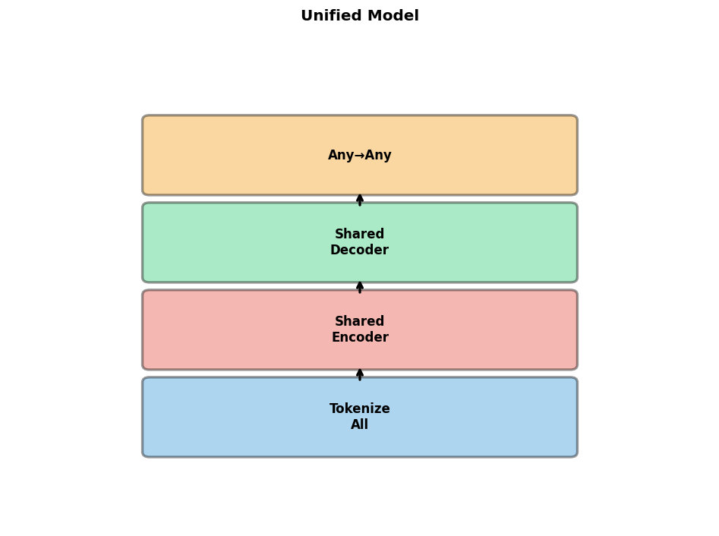
Unified Multimodal Models
Goal: Single model for all modalities
Approaches:
  Tokenize all modalities (Unified-IO)
  Shared encoder-decoder
  Modality-specific adapters
Benefits:
  Simplified deployment
  Cross-modal transfer
  Efficient inference
Research direction: Foundation models

Slide 36
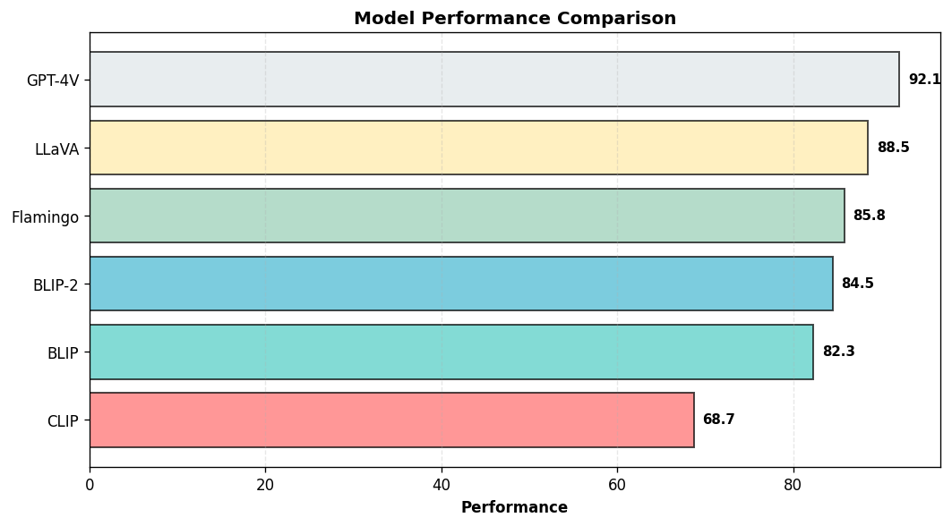
Architecture Comparison
CLIP: Fast, dual-encoder, zero-shot
BLIP: Versatile, generation + understanding
BLIP-2: Efficient, frozen components
Flamingo: Few-shot, interleaved input
LLaVA: Open-source, instruction-tuned
GPT-4V: State-of-the-art, proprietary
Selection: Task, compute, data, performance

Slide 37
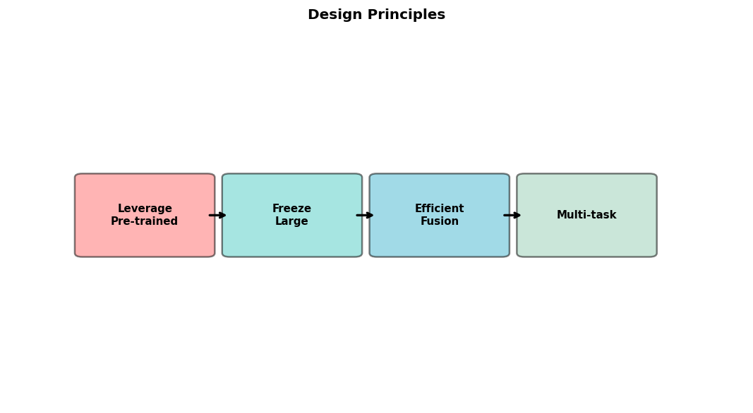
Design Principles
1. Leverage pre-trained models when possible
2. Freeze large components to reduce compute
3. Use efficient fusion (Q-Former, projectors)
4. Multi-task learning for generalization
5. High-quality instruction data crucial
6. Balance model size vs. performance
7. Consider inference efficiency
8. Open-source enables research

Slide 38
Part III: Training Strategies

Slide 39
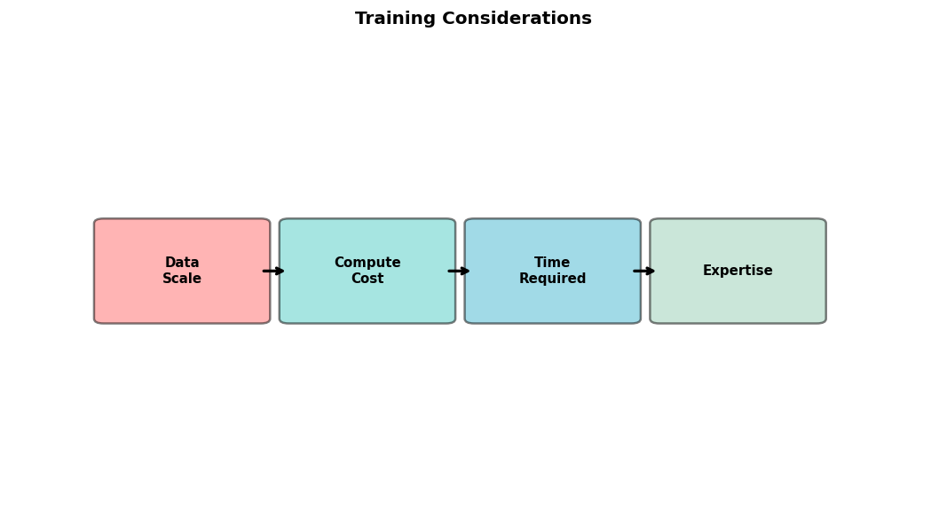
Training from Scratch
When to train from scratch?
  Novel architectures
  Unique data distribution
  Proprietary requirements
Challenges:
  Massive data (millions of pairs)
  Extensive compute (1000s GPU hours)
  Careful hyperparameter tuning
Alternative: Fine-tune pre-trained models

Slide 40
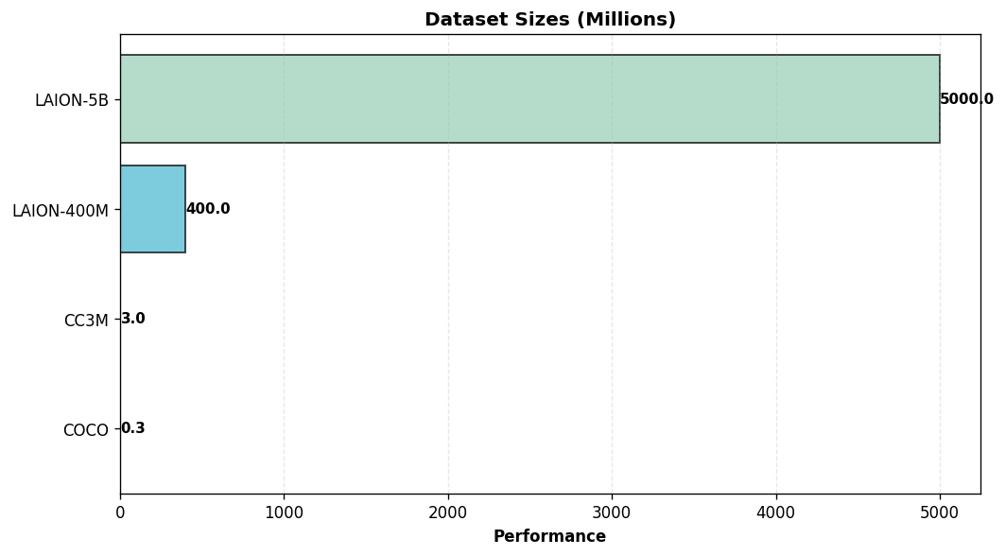
Data Requirements
Scale: Millions/billions of pairs
Types of data:
  Image-caption pairs
  Interleaved image-text
  Video-subtitle pairs
  Question-answer pairs
Data quality vs. quantity:
  CLIP: Curated 400M
  ALIGN: Noisy 1.8B
Diversity crucial for generalization

Slide 41
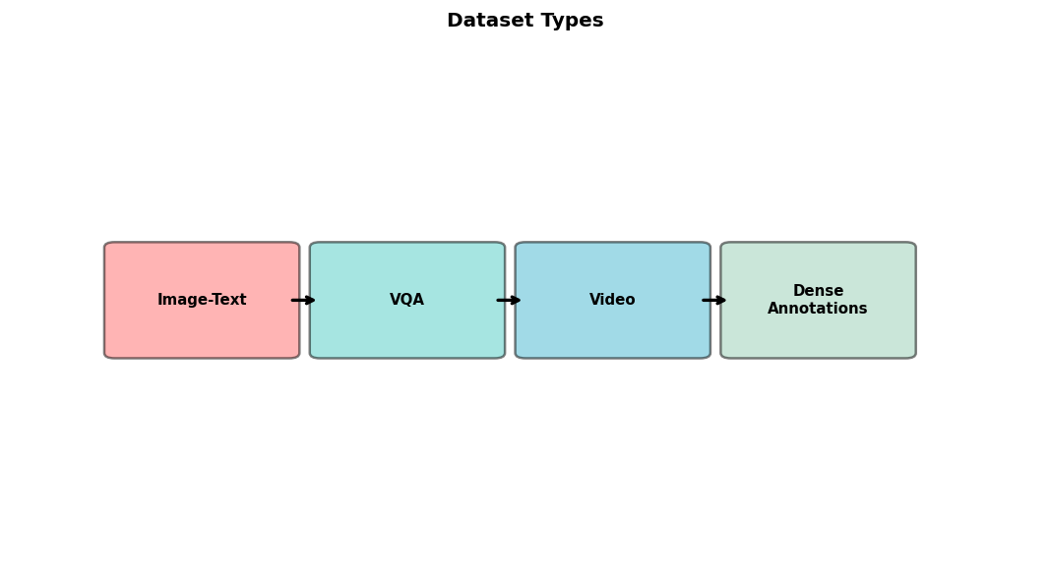
Key Datasets
Image-Text:
  COCO: 330K images with captions
  Visual Genome: 108K dense annotations
  Conceptual Captions: 3.3M pairs
  LAION-400M/5B: Large-scale web
VQA:
  VQAv2: 1.1M questions
  GQA: 22M questions with graphs
Video: WebVid, HowTo100M, YT-Temporal

Slide 42
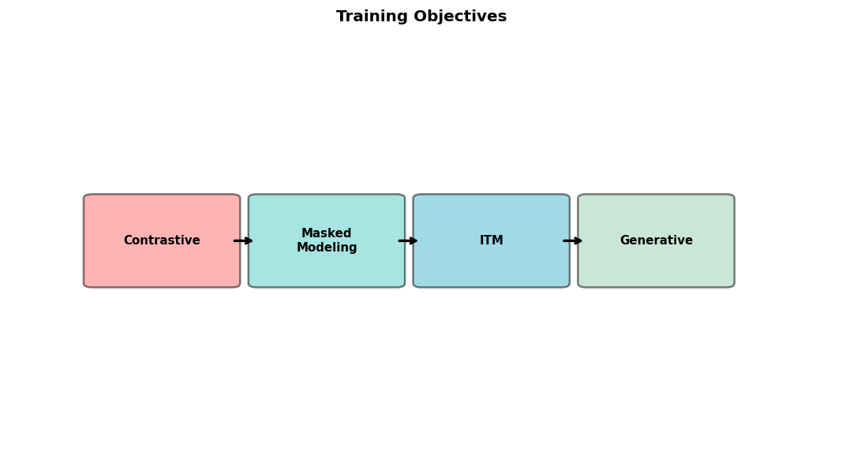
Pre-training Objectives
1. Contrastive Learning:
  Align positive pairs, separate negatives
  InfoNCE loss
2. Masked Language/Image Modeling:
  Mask tokens/patches, predict them
  Learn contextualized representations
3. Image-Text Matching:
  Binary: match or not
4. Generative objectives:
  Caption/image generation

Slide 43

Contrastive Learning
Core idea: Similar items close, dissimilar far
For multimodal: Match corresponding modalities
Positive pairs: (image, caption) from same example
Negative pairs: All other combinations
Loss function: InfoNCE
  Numerator: Similarity of positive
  Denominator: Sum of all similarities
Temperature scaling: Control sharpness
Effective for aligned embeddings

Slide 44
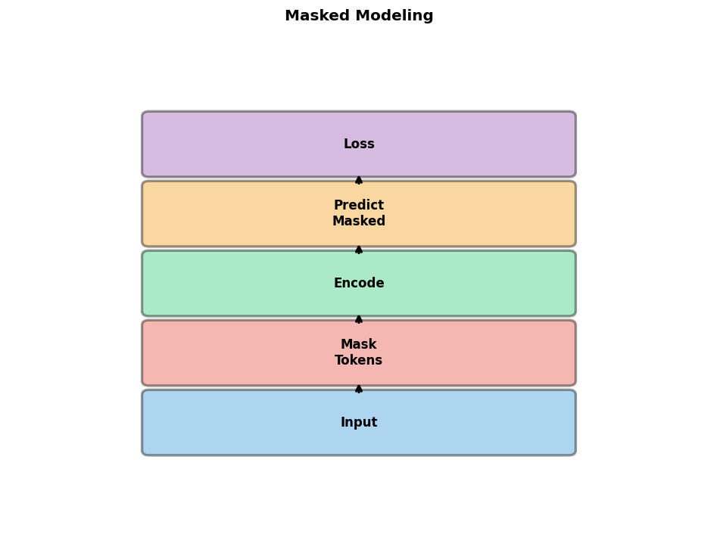
Masked Language/Image Modeling
Masked Language Modeling (MLM):
  Mask random tokens in text
  Predict from context
  Used in BERT, VilBERT
Masked Image Modeling (MIM):
  Mask random patches
  Reconstruct patches
  Used in MAE, SimMIM
Multimodal: Mask in both
Learn robust cross-modal representations

Slide 45

Image-Text Matching (ITM)
Binary classification task
Input: Image and text pair
Output: Match (1) or not (0)
Requires cross-modal interaction
  Usually through cross-attention
Negative sampling strategies:
  Random negatives from batch
  Hard negatives: Similar but wrong
Used alongside contrastive learning
Improves fine-grained alignment

Slide 46

Training Stability
Challenges:
  Large batch sizes needed
  Gradient explosion/vanishing
  Modality imbalance
Solutions:
  Gradient clipping
  Layer normalization
  Warmup learning rate schedule
  Mixed precision (FP16/BF16)
  Careful initialization
Monitor: Loss curves, gradient norms

Slide 47
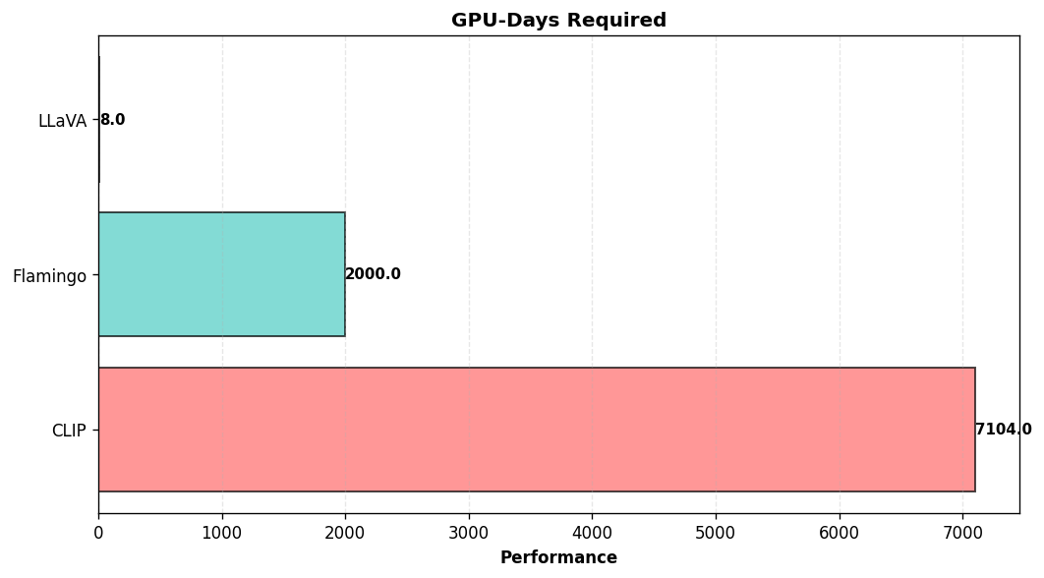
Computational Requirements
Training large models is expensive
Examples:
  CLIP: 592 V100 GPUs, 12 days
  Flamingo: TPUv4 pods, weeks
  LLaVA: 8 A100 GPUs, ~1 day
Factors: Model size, batch, data, resolution
Cost reduction:
  Freeze components
  Lower resolution in pre-training
  Use smaller models for research

Slide 48

Distributed Training
Essential for large-scale training
Strategies:
  Data parallelism: Split data across GPUs
  Model parallelism: Split model across GPUs
  Pipeline parallelism: Split layers
  Tensor parallelism: Split tensors
Frameworks:
  PyTorch DDP, FSDP
  DeepSpeed, Megatron-LM
Communication overhead: Critical bottleneck

Slide 49
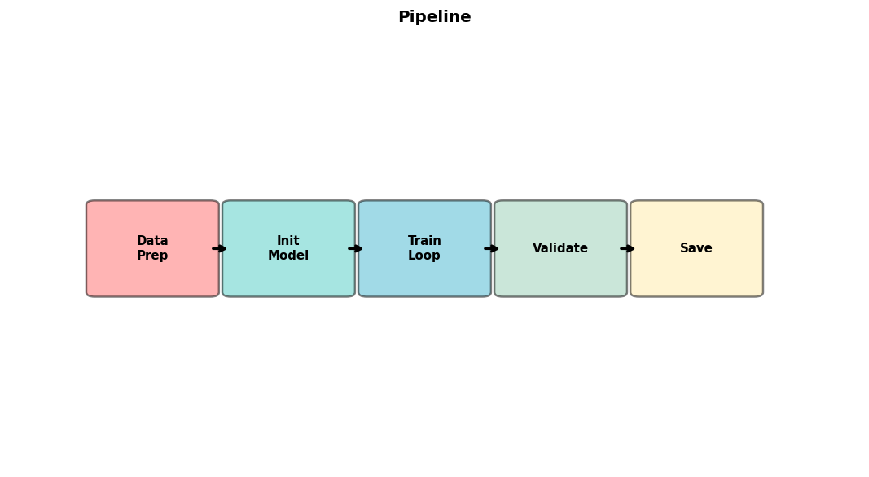
Training Pipeline
1. Data preparation:
  Collect and clean data
  Create train/val/test splits
2. Preprocessing:
  Tokenization, resizing
  Augmentation strategies
3. Model initialization:
  Load pre-trained weights
4. Training loop:
  Forward, loss, backward, update
5. Evaluation and checkpointing

Slide 50

Evaluation Metrics
Image-Text Retrieval:
  Recall@K, Mean Rank
VQA:
  Accuracy, VQA score
Image Captioning:
  BLEU, METEOR, CIDEr, SPICE
Zero-shot Classification:
  Top-1/Top-5 accuracy
General:
  Cross-modal similarity
  Human evaluation

Slide 51

Key Benchmarks
Classification: ImageNet, CIFAR
VQA: VQAv2, GQA, OK-VQA, VizWiz
Captioning: COCO Captions, NoCaps
Retrieval: COCO, Flickr30K
Reasoning: NLVR2, CLEVR
OCR: TextVQA, DocVQA, Infographics
Video: MSRVTT, ActivityNet
Comprehensive: MMBench, SEED-Bench, MM-Vet

Slide 52
Part IV: Fine-tuning Strategies

Slide 53
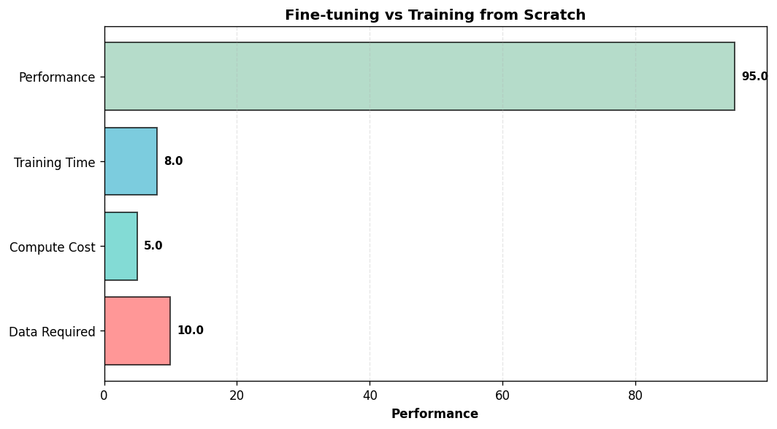
Fine-tuning Overview
Most practical approach
Start with pre-trained multimodal model
Adapt to specific task or domain
Advantages:
  Less data required
  Less compute required
  Faster convergence
  Better performance
Types: Full vs. parameter-efficient

Slide 54
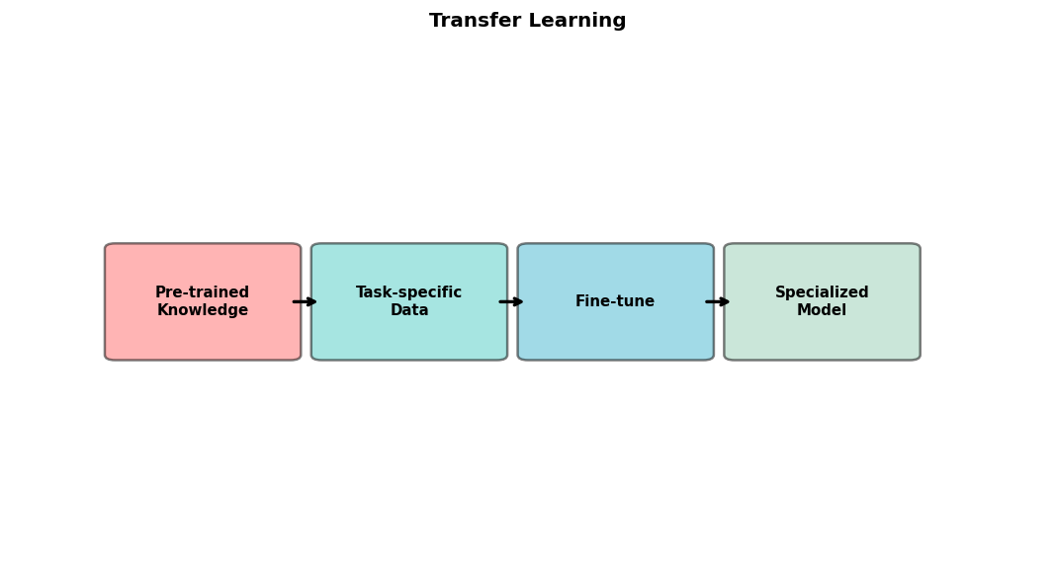
Transfer Learning
Leverage knowledge from pre-training
Pre-trained model already understands:
  Visual concepts
  Language semantics
  Cross-modal alignment
Fine-tuning teaches:
  Task-specific patterns
  Domain-specific knowledge
  Output format requirements
Critical: Choose appropriate base model

Slide 55
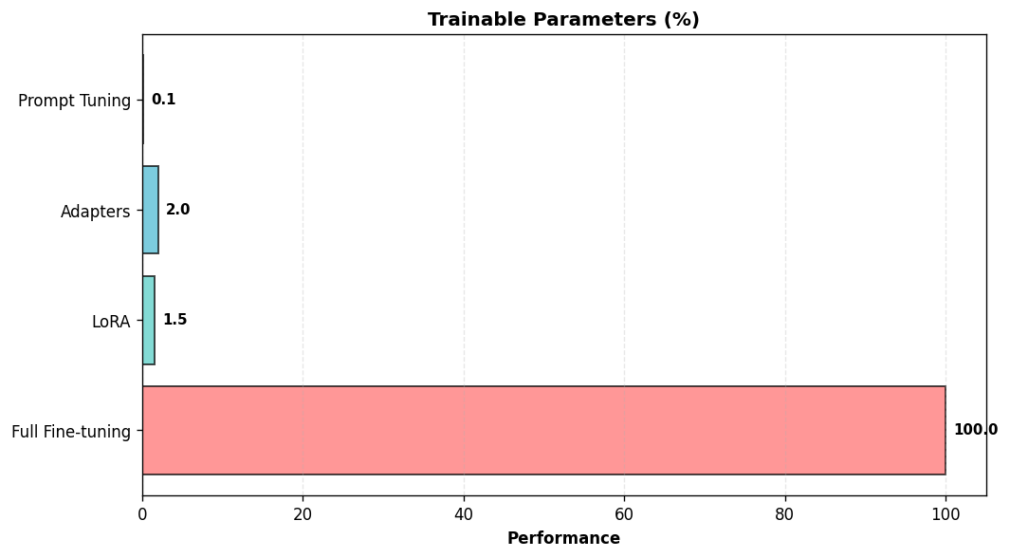
Parameter-Efficient Fine-tuning (PEFT)
Goal: Fine-tune with minimal parameters
Why PEFT?
  Large models too expensive
  Reduced memory
  Faster training
  Easy deployment (store adapters)
Methods:
  LoRA, Adapters, Prompt tuning
Often achieves comparable performance

Slide 56

LoRA: Low-Rank Adaptation
Learn low-rank updates to weights
W_new = W_frozen + B × A
  W_frozen: Original weights
  B, A: Low-rank matrices (rank r)
Only train B and A (1-2% of parameters)
Apply to:
  Attention projections (Q, K, V)
  Feed-forward layers
Works well for LLM in VLMs
Implementation: PEFT library

Slide 57
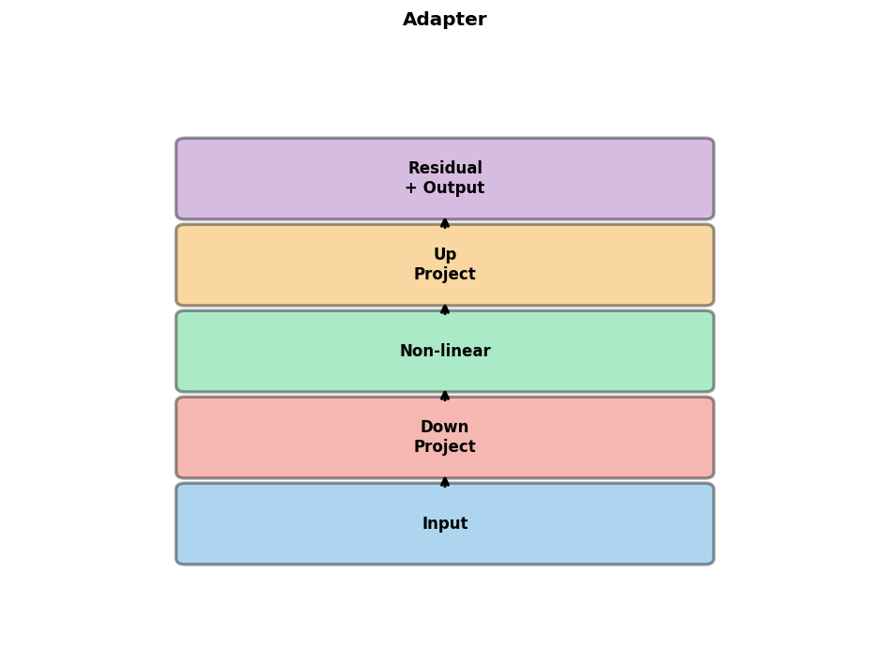
Adapter Modules
Small bottleneck layers inserted in network
Structure:
  Down-projection: d → r
  Non-linearity
  Up-projection: r → d
  Residual connection
Inserted after attention and FFN
Only adapters trained
Slightly more parameters than LoRA
Good for vision encoders

Slide 58
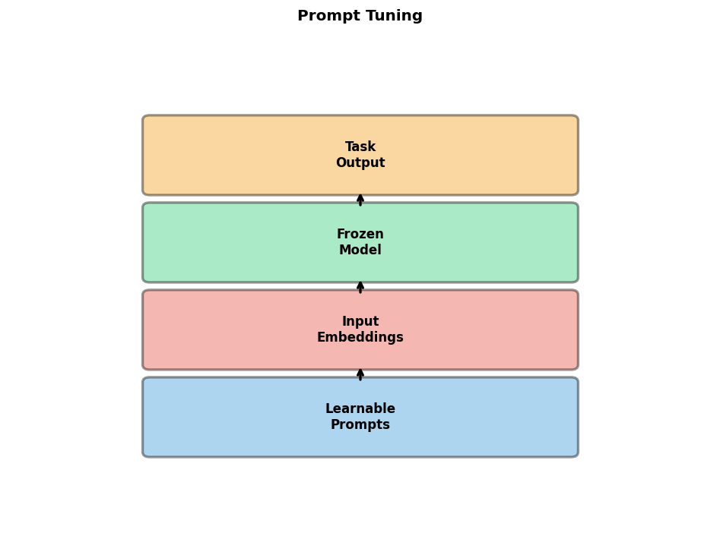
Prompt Tuning
Learn soft prompts: Continuous embeddings
Prepend learnable tokens to input
Visual prompt tuning:
  Learn perturbations to input image
  Or learn visual prefix tokens
Text prompt tuning:
  Learn continuous prompt embeddings
Extremely parameter-efficient
Challenges: More careful tuning needed
Good for: Few-shot learning

Slide 59
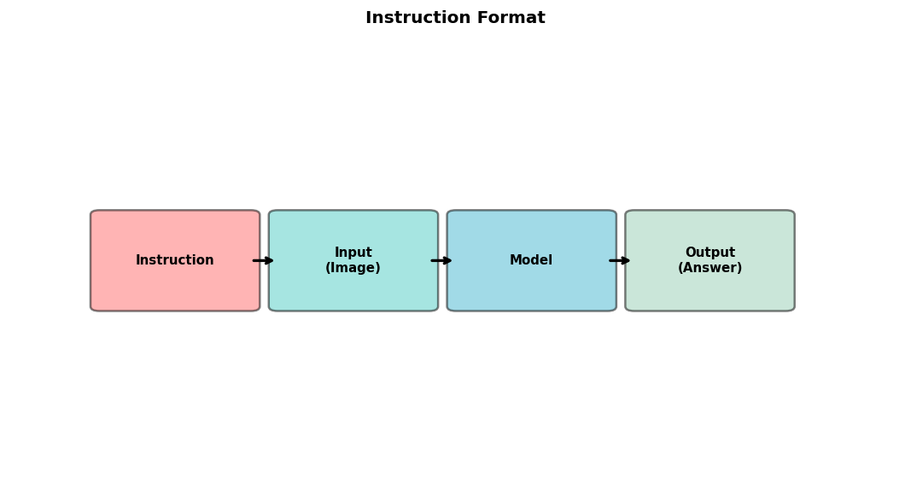
Instruction Tuning
Fine-tune on instruction-following data
Format: (Instruction, Input, Output)
Example:
  Instruction: 'Describe the image'
  Input: [Image]
  Output: 'A photo of...'
Benefits:
  Better instruction following
  More natural interactions
  Improved zero-shot generalization
Used in: LLaVA, InstructBLIP, Otter

Slide 60
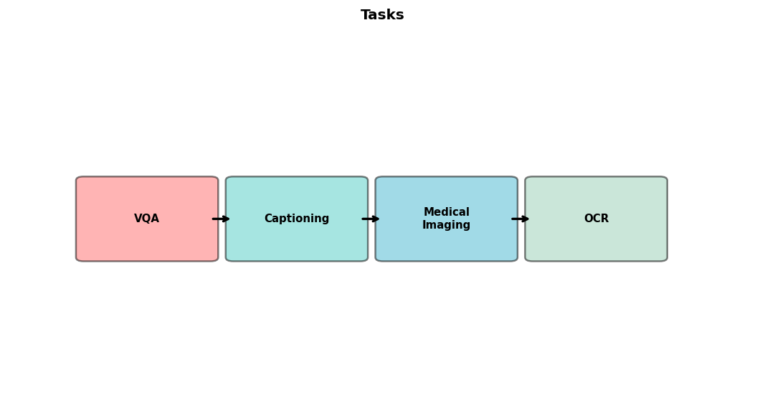
Task-Specific Fine-tuning
Adapt to specific downstream tasks
Examples:
  VQA: Fine-tune on VQAv2
  Captioning: Fine-tune on COCO
  Medical: Fine-tune on medical data
Task-specific head may be added
Data: 1K-100K task examples
Often use full fine-tuning or LoRA
Evaluation on task benchmark

Slide 61
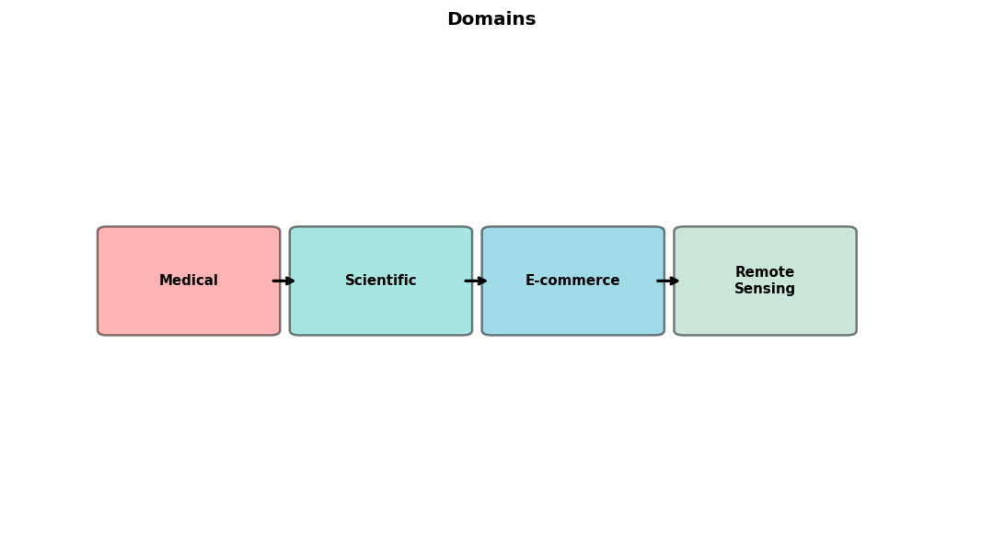
Domain Adaptation
Adapt to specific domain:
  Medical images and reports
  Scientific figures and papers
  E-commerce products
  Remote sensing imagery
Challenges:
  Domain shift from pre-training
  Specialized terminology
Solutions:
  Continue pre-training on domain data
  Task-specific fine-tuning

Slide 62
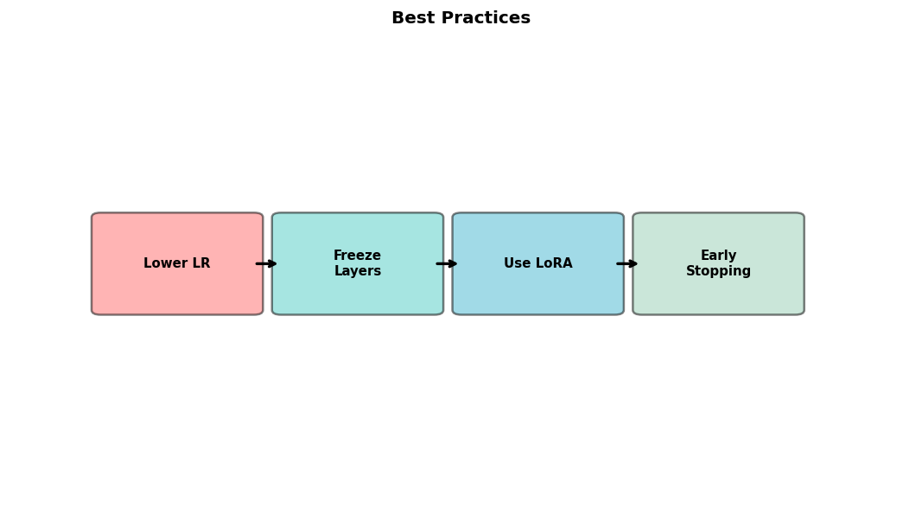
Fine-tuning Best Practices
1. Start with appropriate pre-trained model
2. Use lower learning rate than pre-training
3. Freeze vision encoder initially if needed
4. Use LoRA for large models
5. Monitor validation performance
6. Prevent overfitting:
  Early stopping, regularization
7. Data augmentation for small datasets
8. Gradient accumulation for larger batches

Slide 63
Part V: Implementation & Applications

Slide 64

Implementation Frameworks
HuggingFace Transformers:
  Pre-trained models: CLIP, BLIP, LLaVA
  Easy fine-tuning with Trainer API
  PEFT library for LoRA
PyTorch: Low-level flexibility
JAX/Flax: XLA compilation, TPU support
LangChain: Integration with applications
OpenCLIP: Open-source CLIP training
LLaVA codebase: Instruction tuning

Slide 65
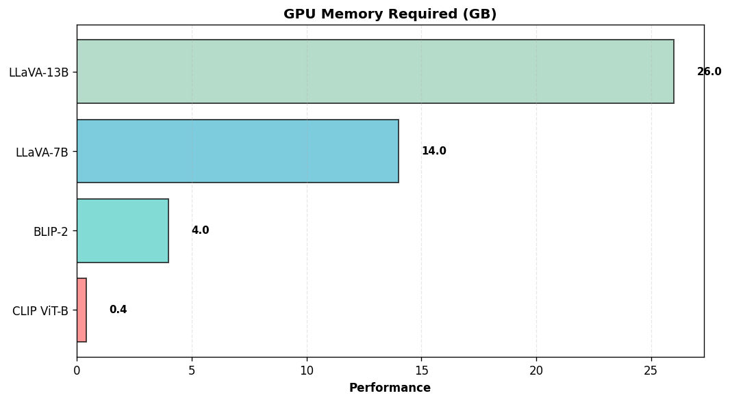
Hardware Requirements
GPU memory critical bottleneck
Model size considerations:
  CLIP ViT-B: ~400MB, any GPU
  BLIP-2: ~4GB, 16GB+ GPU
  LLaVA-7B: ~14GB, 24GB+ GPU
  LLaVA-13B: ~26GB, 40GB+ GPU
Memory reduction:
  8-bit quantization
  LoRA reduces by 2-3x
Palmetto: A100 (40/80GB), H100

Slide 66

Palmetto Cluster Setup
Clemson's HPC cluster
GPU nodes: V100, A100, H100
Setup steps:
  1. Request GPU: qsub -I ...
  2. Load modules: CUDA, conda
  3. Create env: conda create -n multimodal
  4. Install: transformers, torch, peft
Storage: /scratch for datasets
Jupyter via OnDemand
See lab notebook for details

Slide 67

Loading Pre-trained Models
HuggingFace example:
from transformers import CLIPModel, CLIPProcessor
model = CLIPModel.from_pretrained(
'openai/clip-vit-base-patch32')
processor = CLIPProcessor.from_pretrained(
'openai/clip-vit-base-patch32')
model.to('cuda')
See lab notebook for more examples!

Slide 68
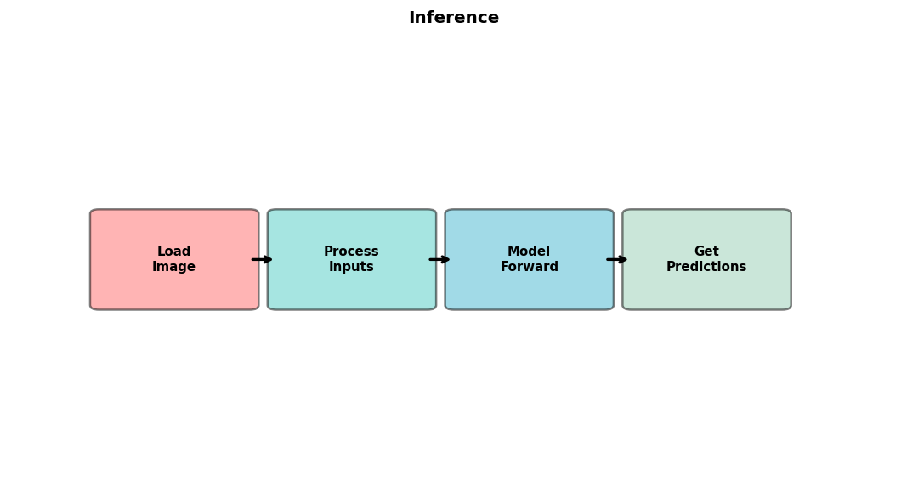
Inference Example
CLIP zero-shot classification:
image = Image.open('photo.jpg')
text = ['a photo of a cat', 'a photo of a dog']
inputs = processor(text=text, images=image,
return_tensors='pt')
outputs = model(**inputs)
probs = outputs.logits_per_image.softmax(dim=1)
See lab for BLIP, LLaVA examples

Slide 69
Fine-tuning Example
Using LoRA:
from peft import LoraConfig, get_peft_model
lora_config = LoraConfig(
r=8, lora_alpha=16,
target_modules=['q_proj', 'v_proj'])
model = get_peft_model(model, lora_config)
trainer = Trainer(model, args, dataset)
trainer.train()

Slide 70

Application: Visual Question Answering
Task: Answer questions about images
Input: Image + Question
Output: Answer (text)
Models: BLIP-2, LLaVA, InstructBLIP
Use cases:
  Accessibility for visually impaired
  Content moderation
  Educational tools
  Image search and retrieval
Datasets: VQAv2, GQA, OK-VQA

Slide 71
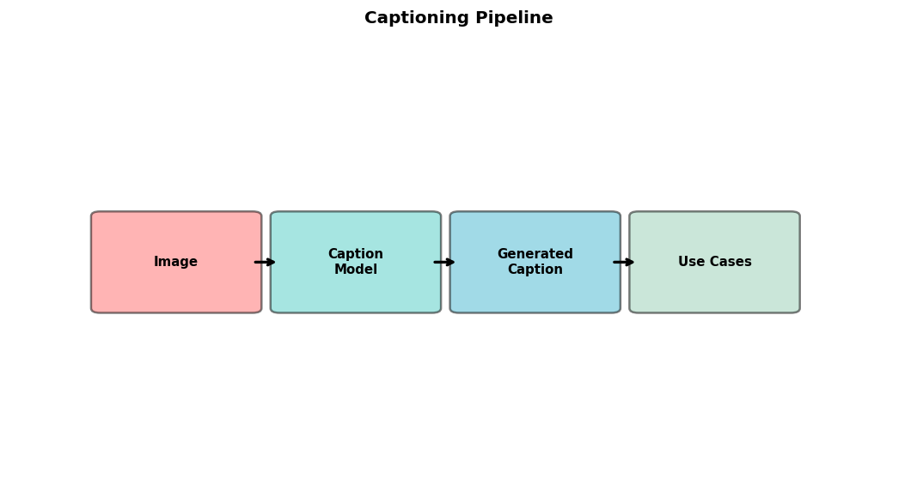
Application: Image Captioning
Task: Generate textual descriptions
Input: Image
Output: Caption (text)
Models: BLIP, BLIP-2, GIT
Use cases:
  Alt-text for web accessibility
  Photo organization and search
  Social media content
  Medical report generation
Evaluation: BLEU, CIDEr, SPICE

Slide 72
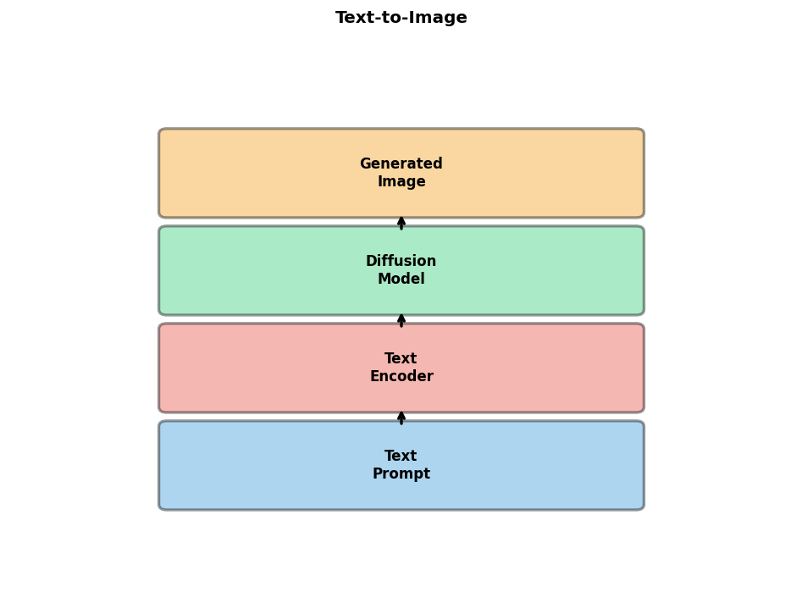
Application: Text-to-Image Generation
Task: Generate images from text
Input: Text prompt
Output: Image
Models: DALL-E, Stable Diffusion, Imagen
Architecture: Diffusion + text conditioning
  Text encoder: CLIP or T5
  Diffusion: U-Net with cross-attention
Use cases:
  Creative content generation
  Design and prototyping
  Data augmentation

Slide 73
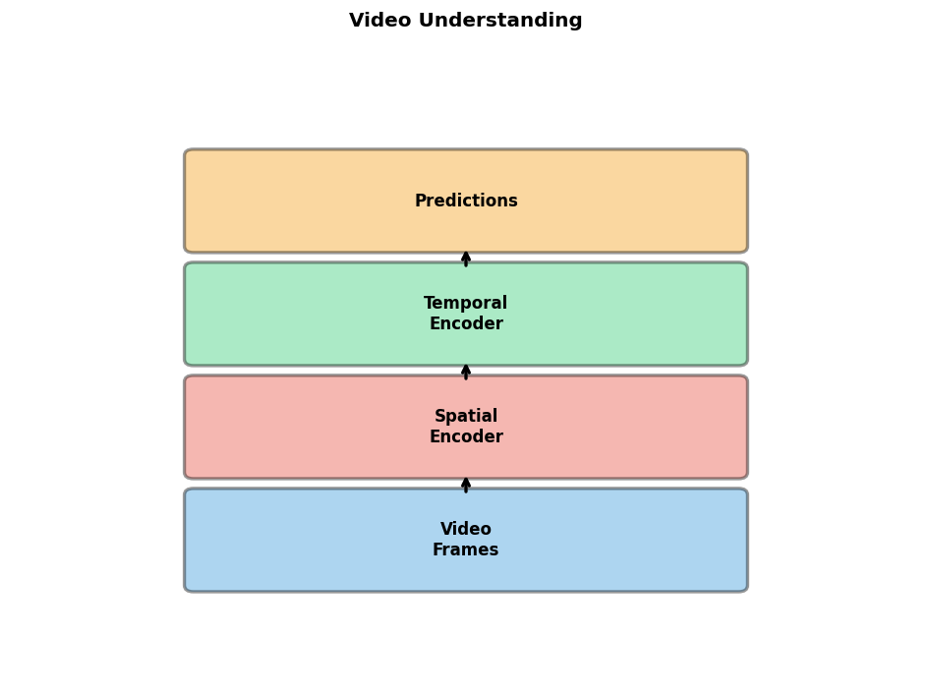
Application: Video Understanding
Task: Understand and reason about video
Input: Video (frames + audio)
Output: Caption, answer, action
Models: VideoMAE, TimeSformer, Video-LLaMA
Challenges:
  Temporal modeling
  Long sequences (memory)
  Multi-modal fusion (visual+audio+text)
Applications: Surveillance, sports, education

Slide 74

Challenges and Limitations
Hallucination: Generating false information
Robustness: Sensitive to input variations
Bias: Reflecting dataset biases
Computational cost: Training and inference
Data requirements: Large paired datasets
Interpretability: Understanding decisions
Safety: Potential for misuse
Evaluation: Measuring true understanding

Slide 75

Future Directions
Scaling: Larger models, more modalities
Efficiency: Smaller models with better performance
Grounding: Connecting to physical world
Reasoning: Better logical and causal reasoning
Embodied AI: Integration with robotics
Multilinguality: Support more languages
Scientific applications: Discovery and analysis
Democratization: Making models accessible

Slide 76
Key Takeaways
Multimodal learning enables richer AI
Modern architectures leverage pre-trained components
Contrastive learning is key for alignment
Fine-tuning is practical for most applications
Parameter-efficient methods make it accessible
Many open-source models available
Applications span VQA to text-to-image
Exciting field with rapid progress

Slide 77

Resources
Papers:
  CLIP, BLIP-2, LLaVA, Flamingo
Code:
  HuggingFace Transformers, PEFT
  OpenCLIP, LLaVA GitHub
Datasets:
  COCO, Visual Genome, LAION
Tutorials:
  HuggingFace docs
  Papers with Code
Next: Lab session!

Slide 78
Questions & Discussion

