Slide 1

This lecture introduces Multimodal Large Language Models as taught in the Applied Data Science course at Clemson University. Building on your existing knowledge of Transformer architectures and single-modality language models, we extend these concepts to systems that process multiple data types simultaneously. The diagram illustrates how different modalities (vision, text, audio, video) are mapped into a unified embedding space, enabling cross-modal understanding and generation.
Applied Data Science - Clemson University

Slide 2

Course Context
This course builds upon your understanding of Transformer architectures from previous lessons. You've already studied attention mechanisms, self-attention, cross-attention, and encoder-decoder frameworks. Now we extend these concepts to multimodal settings where models must process and align multiple heterogeneous data types. The transition from single-modality LLMs to multimodal models represents a paradigm shift in AI, enabling systems that can see, read, hear, and understand the relationships between different forms of information. This lecture provides the theoretical foundations and practical skills needed to work with state-of-the-art multimodal models.

Slide 3

Learning Objectives
Understand multimodal learning fundamentals
Master single-modality representations
Learn multimodal fusion strategies
Study state-of-the-art architectures
Understand training vs. fine-tuning
Apply on Palmetto cluster

Slide 4
What is Multimodal Learning?
Learning from multiple data modalities simultaneously
Modalities: Different types of data sources
  Vision (images, videos)
  Text (documents, captions)
  Audio (speech, sound)
Goal: Build unified representations
Enable cross-modal understanding

Slide 5

Why Multimodal Models?
Human perception is inherently multimodal
Richer understanding through multiple perspectives
Key applications:
  Visual Question Answering
  Image/Video captioning
  Text-to-image generation
  Embodied AI and robotics
Better generalization and robustness

Slide 6

Historical Context
2010s: Separate models per modality
2017: Attention mechanisms enable fusion
2019-2020: BERT + Vision (ViLBERT, LXMERT)
2021: CLIP revolutionizes vision-language
2022-2023: Large-scale models (Flamingo, GPT-4V)
2023-2024: Open-source alternatives (LLaVA, BLIP-2)
2024+: Any-to-any multimodal models

Slide 7

Challenges in Multimodal Learning
Modality gap: Different data distributions
Representation learning: Finding common space
Alignment: Matching corresponding elements
Fusion strategies: How to combine?
Data requirements: Need paired data
Computational cost: Processing multiple modalities
Evaluation: Measuring performance

Slide 8
Part I: Single Modality Foundations

Slide 9

Single Modality: Vision
Image representation: Pixels in grids
Convolutional Neural Networks (CNNs):
  Learn spatial hierarchies
  Translation invariance
Vision Transformers (ViT):
  Split image into patches
  Apply transformer to patches
  Better scalability with data
Output: High-dimensional feature vectors

Slide 10
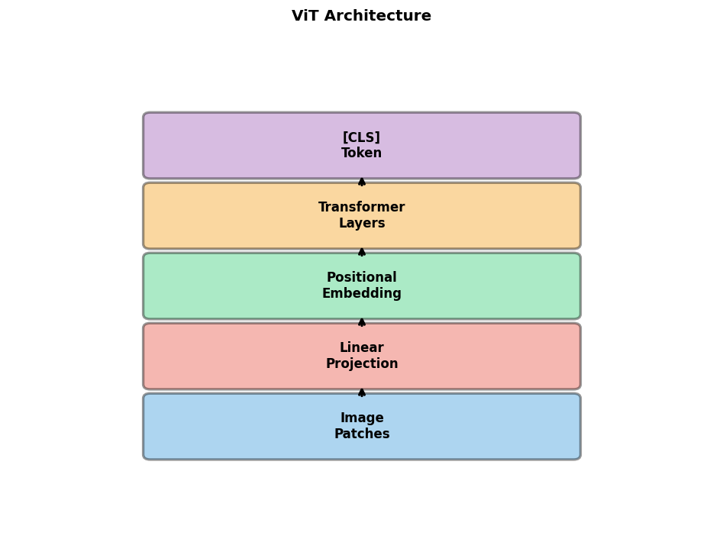
Vision Transformers (ViT)
Pure transformer applied to images
Process:
  1. Split image into 16×16 patches
  2. Flatten and linearly embed
  3. Add positional embeddings
  4. Feed through transformer
  5. Extract [CLS] token
Advantages: Scalable, less bias
Used in CLIP, BLIP, modern models

Slide 11
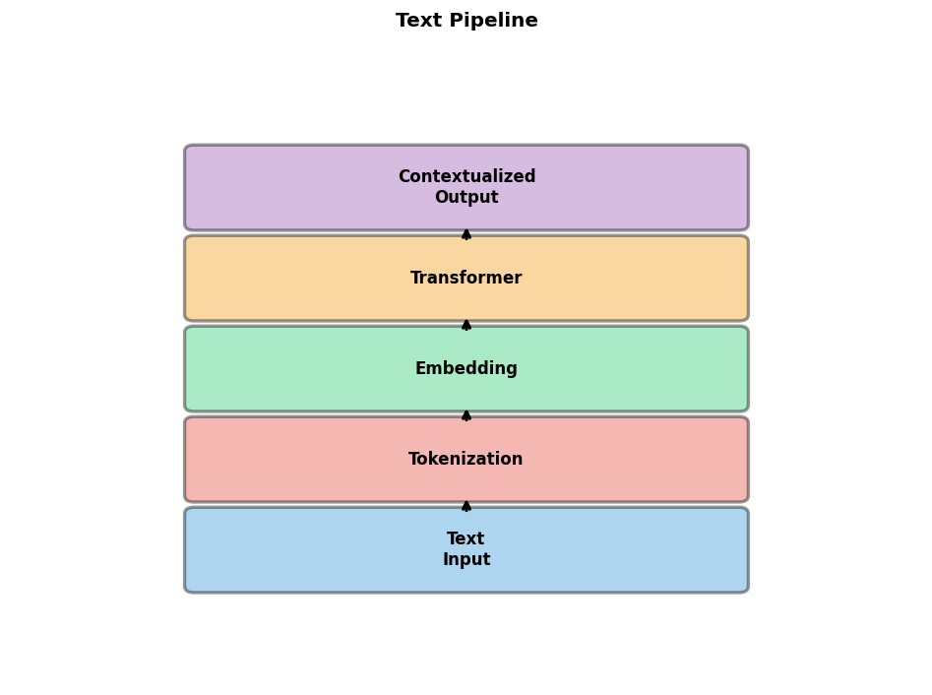
Single Modality: Text
Tokenization: Convert text to tokens
Embedding: Map tokens to vectors
Transformers for text:
  BERT: Bidirectional encoder
  GPT: Autoregressive decoder
  T5: Encoder-decoder
Contextual representations
Pre-training on large text corpora
Output: Sequence of embeddings

Slide 12

Single Modality: Audio
Raw audio: Waveform representation
Feature extraction:
  Mel-spectrograms: Time-frequency
  MFCCs: Cepstral coefficients
Models:
  Wav2Vec 2.0: Self-supervised speech
  Whisper: Robust speech recognition
  AudioMAE: Masked autoencoding
Output: Audio embeddings

Slide 13
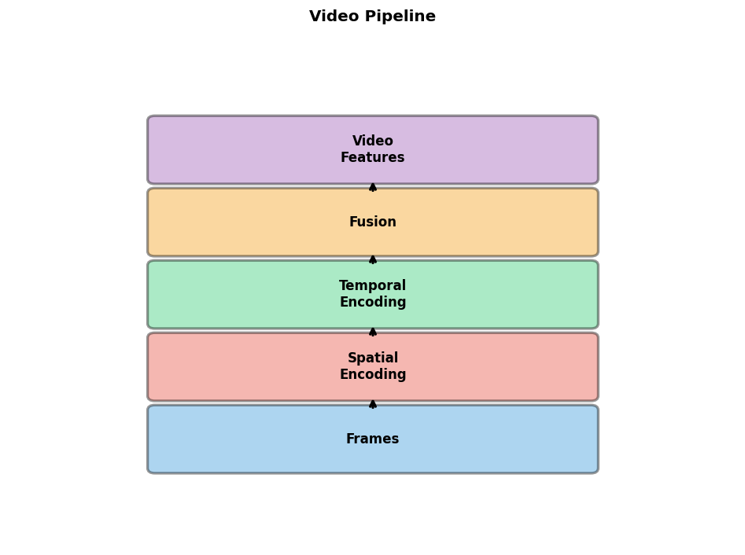
Single Modality: Video
Video = Images + temporal information
Spatial encoding: Per-frame CNN/ViT
Temporal encoding:
  3D convolutions
  Recurrent networks (LSTM)
  Temporal transformers
Challenges: Computational cost
Models: TimeSformer, VideoMAE
Output: Spatio-temporal features

Slide 14
Modality Representations
Each modality has unique characteristics
Vision: Spatial structure, continuous
Text: Sequential, discrete tokens
Audio: Temporal, continuous waveforms
Goal: Map to common semantic space
Representation learning objectives:
  Reconstruction
  Contrastive learning
  Masked modeling

Slide 15
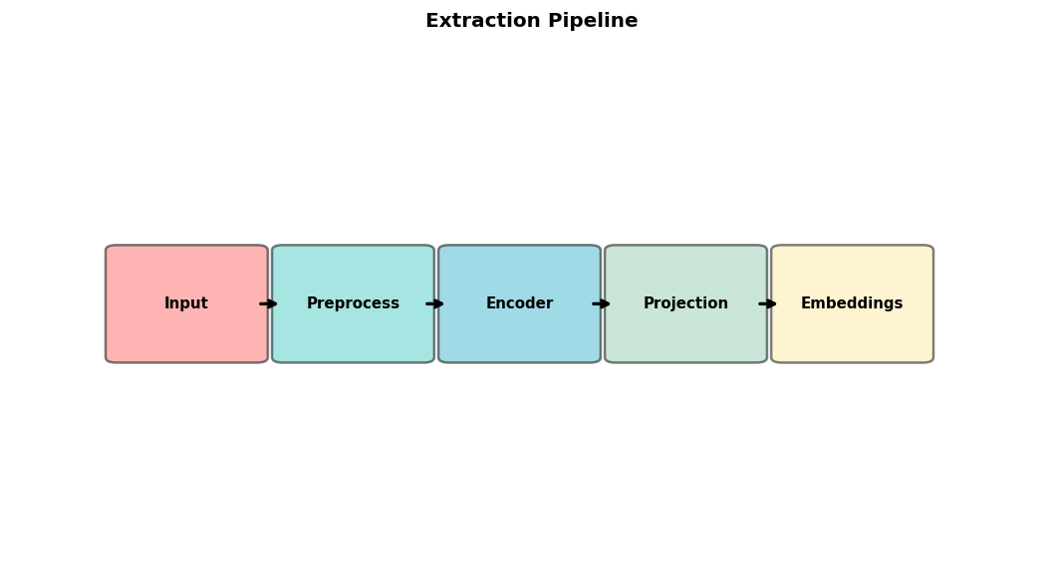
Feature Extraction Pipeline
Input: Raw data in original modality
Preprocessing:
  Images: Resize, normalize
  Text: Tokenize, add special tokens
  Audio: Resample, spectrogram
Encoder: Modality-specific network
Projection: Map to common dimension
Normalization: L2 normalize for similarity

Slide 16
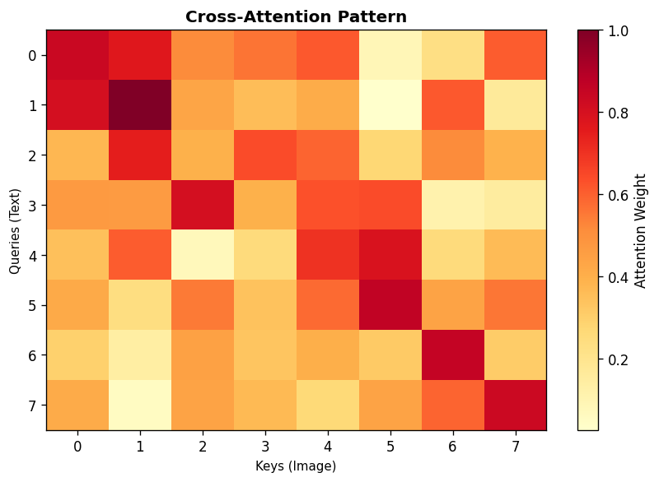
Embedding Spaces
Embedding space: High-dimensional vectors
Desirable properties:
  Semantic similarity → Vector proximity
  Modality invariance
  Structured relationships
Joint embedding space:
  Multiple modalities → same space
  Enable cross-modal retrieval
Learned through contrastive objectives

Slide 17
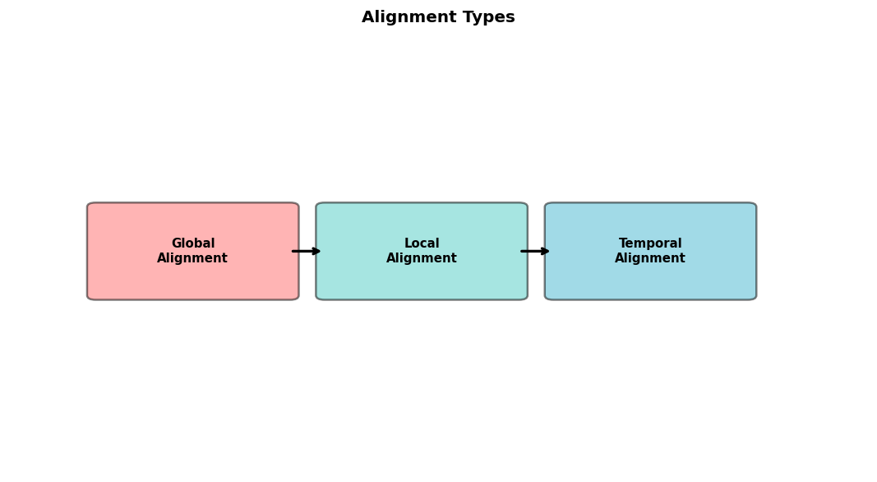
The Alignment Problem
Core challenge: Align different modalities
Types of alignment:
  Global: Image-caption pairs
  Local: Objects-words
  Temporal: Video-transcript
Solutions:
  Contrastive learning (CLIP)
  Cross-attention (Flamingo)
  Q-Former (BLIP-2)
Goal: Bridge the modality gap

Slide 18
Part II: Multimodal Architectures

Slide 19
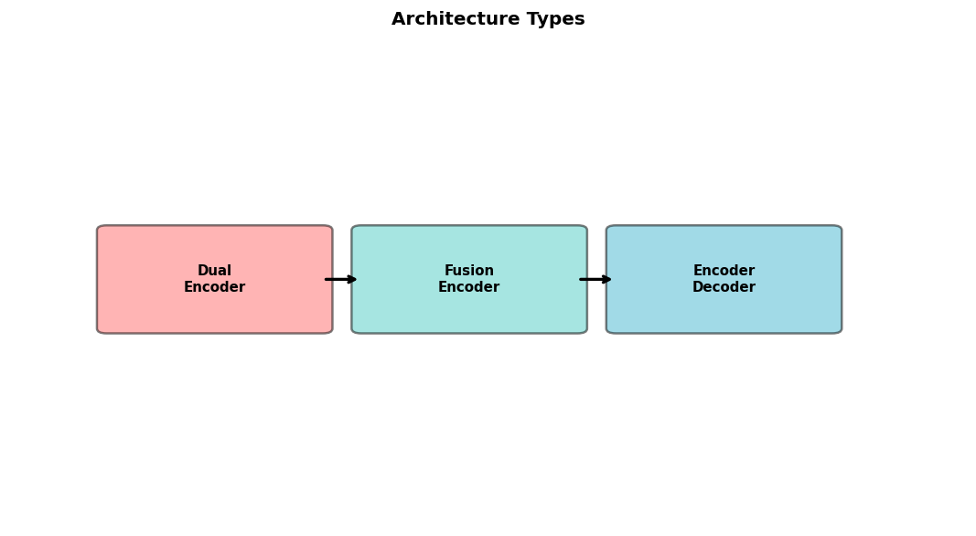
Overview of Multimodal Architectures
Three main paradigms:
1. Dual-encoder (CLIP, ALIGN)
  Separate encoders per modality
  Joint embedding space
2. Fusion encoder (LXMERT, ViLBERT)
  Cross-modal attention layers
3. Encoder-decoder (BLIP, Flamingo, LLaVA)
  Visual encoder + Language model
  Generation capabilities

Slide 20

Early Fusion
Combine raw features at input level
Concatenate or sum modality features
Process jointly through unified network
Advantages:
  Maximum interaction
  Simple architecture
Disadvantages:
  Hard to leverage pre-trained models
  Less flexible

Slide 21
Late Fusion
Process each modality independently
Combine at decision/output level
Examples: Ensemble approaches
Advantages:
  Easy to use pre-trained models
  Modular design
  Train modalities separately
Disadvantages:
  Limited cross-modal interaction
  May miss complex relationships

Slide 22
Hybrid Fusion
Combine early and late fusion benefits
Multi-stage interaction
Example: Cross-attention at multiple layers
Advantages:
  Flexible architecture design
  Leverage pre-trained components
  Rich cross-modal interaction
Most modern architectures use hybrid
Examples: BLIP-2, Flamingo, LLaVA

Slide 23
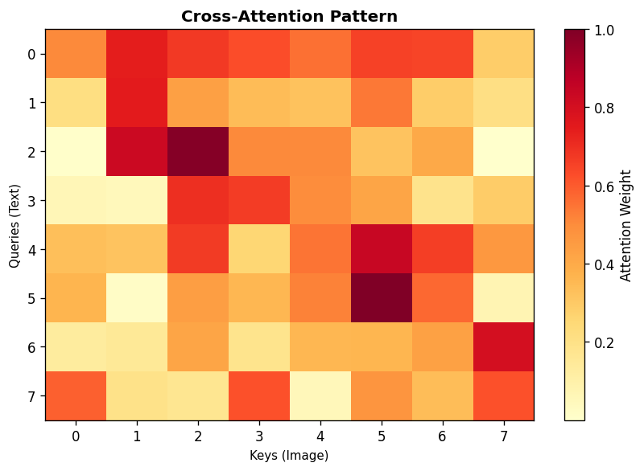
Cross-Attention Mechanisms
Key technique for multimodal fusion
Standard attention: Q, K, V from same sequence
Cross-attention: Q from one modality, K,V from another
Example: Text queries vision features
  Q = text embeddings
  K, V = image patch features
Bidirectional cross-attention for deep fusion
Used in: Flamingo, BLIP, Q-Former

Slide 24

CLIP: Contrastive Language-Image Pre-training
Dual-encoder architecture (OpenAI, 2021)
Components:
  Image encoder: ViT or ResNet
  Text encoder: Transformer
  Project to same dimension
Training: Contrastive learning on 400M pairs
Zero-shot capabilities
Applications: Classification, retrieval

Slide 25
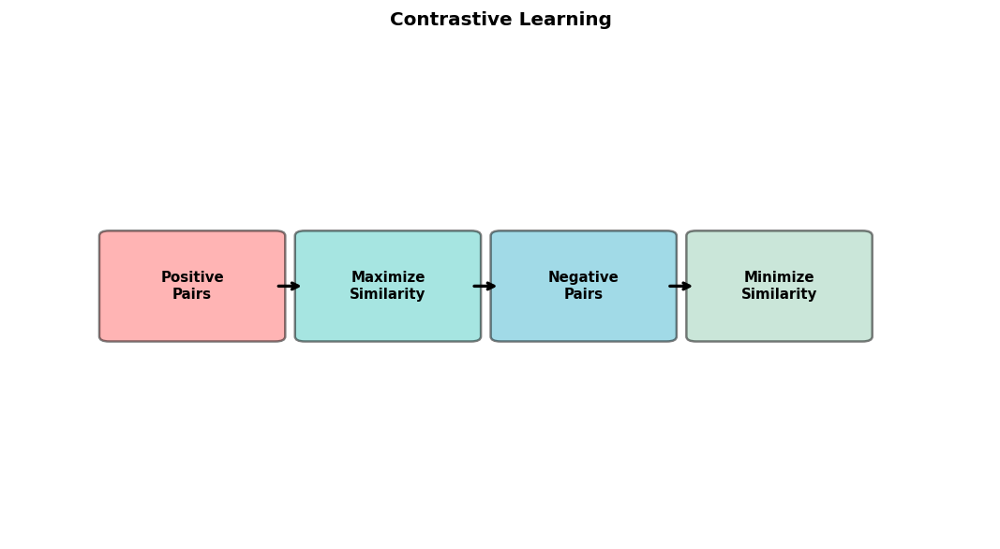
CLIP Training Objective
Contrastive loss on batch of N pairs
Maximize similarity of correct (image, text) pairs
Minimize similarity of incorrect pairs
Loss: InfoNCE
Temperature scaling: τ learned parameter
Symmetric: Both image→text and text→image
Result: Aligned vision-language space

Slide 26
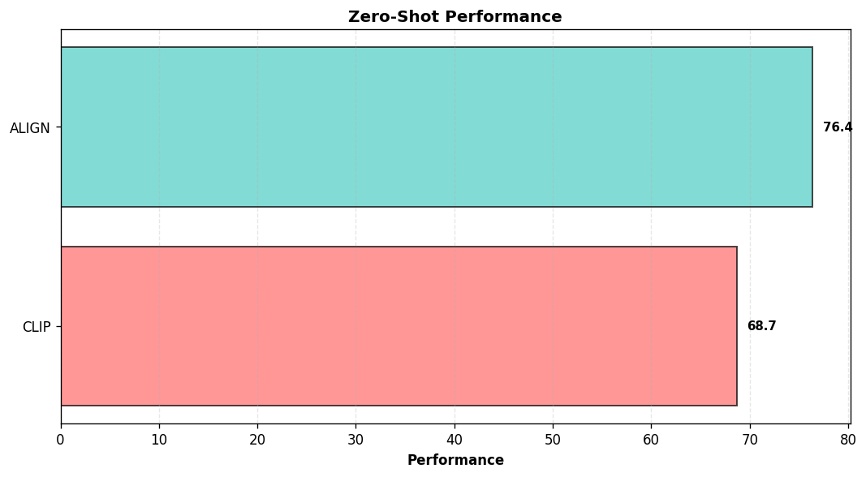
ALIGN: A Large-scale ImaGe and Noisy text
Similar to CLIP (Google, 2021)
Key difference: Noisy web data (1.8B pairs)
No careful curation
Components:
  EfficientNet for images
  BERT for text
Same contrastive objective
Insight: Scale > data quality
Comparable or better results

Slide 27
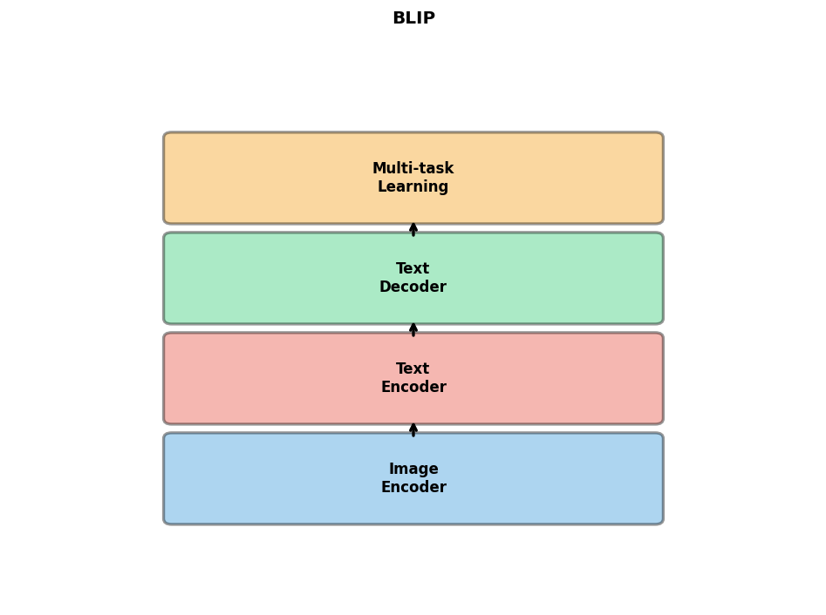
BLIP: Bootstrapping Language-Image Pre-training
Encoder-decoder architecture (Salesforce, 2022)
Three components:
  1. Image encoder: ViT
  2. Text encoder: BERT-like
  3. Text decoder: GPT-like
Multi-task learning:
  Contrastive learning
  Image-text matching
  Image-conditioned LM
CapFilt: Synthetic captions

Slide 28
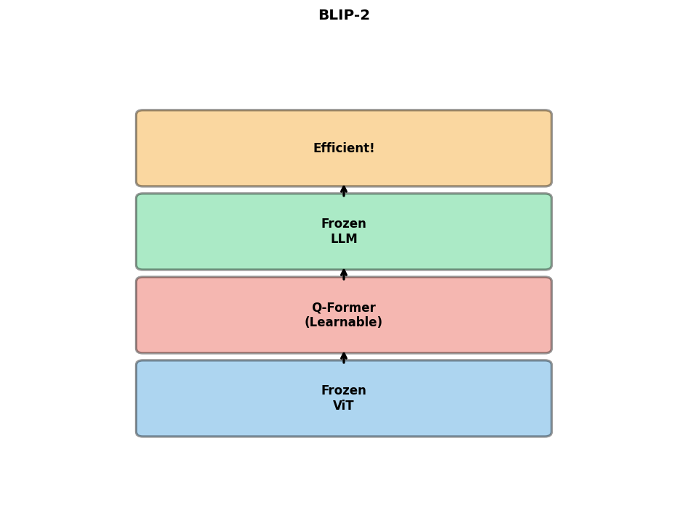
BLIP-2: Querying Transformer
Efficient architecture (Salesforce, 2023)
Key innovation: Q-Former
  Lightweight module between frozen encoders
  Learnable query tokens
  Cross-attention to vision
Two-stage training:
  Stage 1: Vision-language learning
  Stage 2: Vision-to-language generation
Much more parameter-efficient

Slide 29
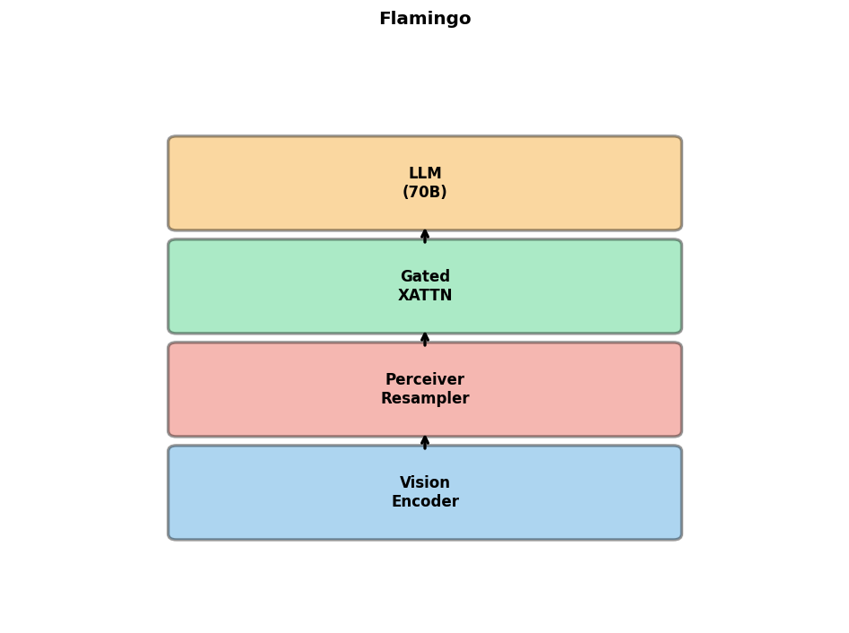
Flamingo: Visual Language Model
Few-shot learning VLM (DeepMind, 2022)
Architecture:
  Vision encoder: Frozen pre-trained
  Perceiver resampler: Compress features
  LLM: Frozen Chinchilla 70B
  Cross-attention: Gated XATTN-DENSE
Interleaved image-text input
In-context learning: Few-shot prompting
Powerful few-shot visual understanding

Slide 30
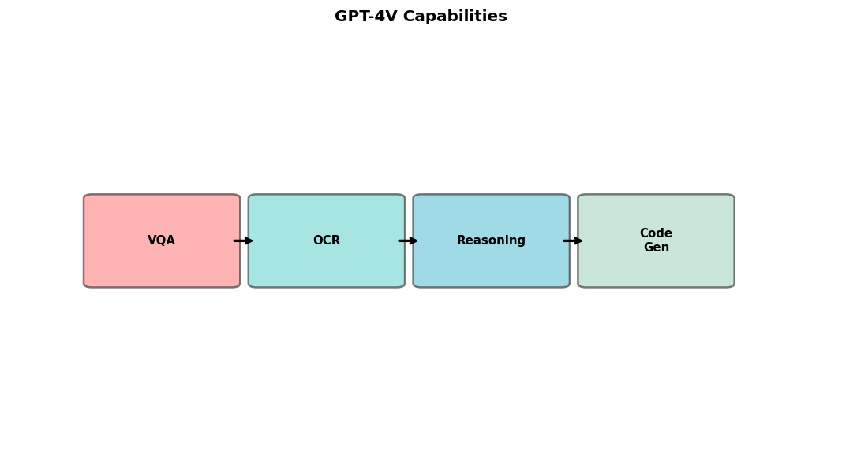
GPT-4V: Multimodal GPT-4
Proprietary multimodal model (OpenAI, 2023)
Accepts images and text as input
Architecture details not disclosed
Likely components:
  Enhanced CLIP-like vision encoder
  Large language model: GPT-4
  Sophisticated fusion
Capabilities: VQA, OCR, reasoning, code
State-of-the-art performance

Slide 31
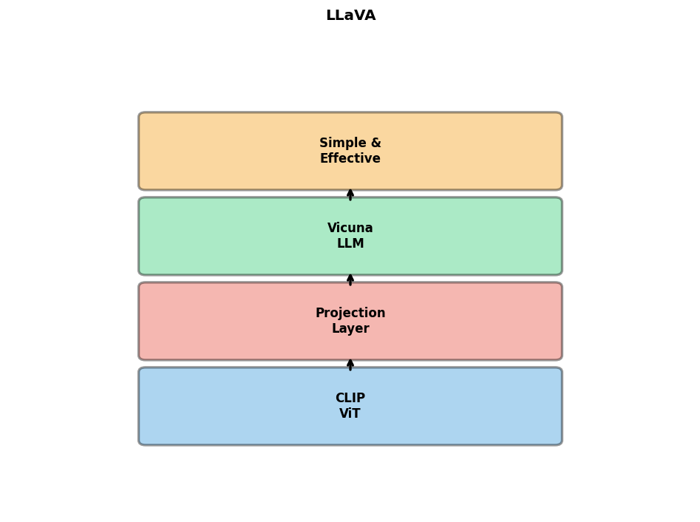
LLaVA: Large Language and Vision Assistant
Open-source VLM (Liu et al., 2023)
Simple architecture:
  Vision encoder: CLIP ViT-L/14
  Projection: Linear or MLP
  LLM: Vicuna (LLaMA-based)
Training data: GPT-4 generated instructions
Two-stage training:
  Pre-training: Projection only
  Fine-tuning: Full model or LoRA
Excellent performance, modest compute

Slide 32
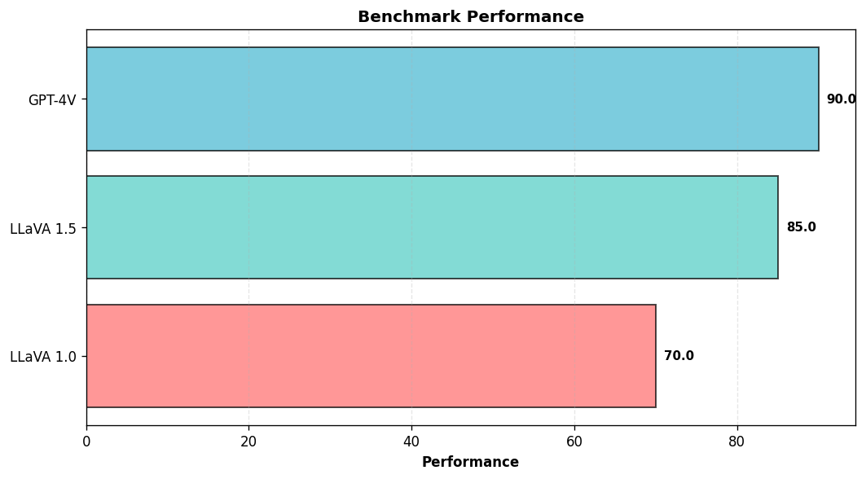
LLaVA 1.5 Improvements
Enhanced version (2023)
Improvements:
  MLP projection: 2-layer vs 1-layer
  Higher resolution: 336×336 vs 224
  Better instruction data
  Academic task data: VQA, OCR
Unified training recipe
Near GPT-4V on some tasks
Efficient: Fine-tune on single GPU

Slide 33
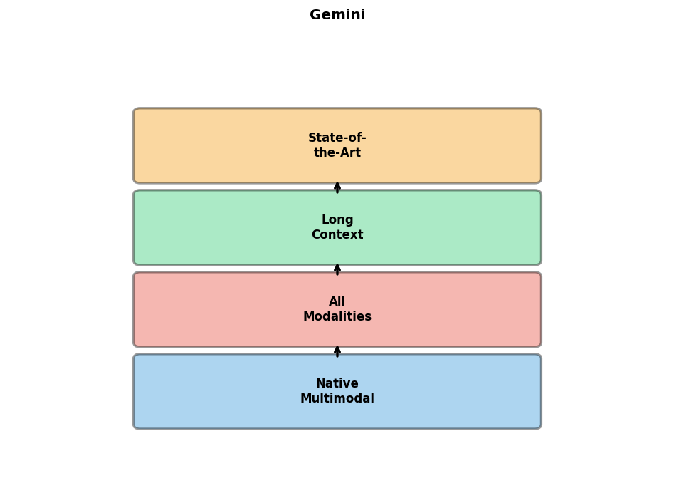
Gemini: Google's Multimodal Model
Native multimodal model (Google, 2023)
Three sizes: Nano, Pro, Ultra
Key: Natively multimodal from scratch
  Not adapting separate models
  Joint training on all modalities
Capabilities:
  Image, video, audio, text
  Long context: Up to 1M tokens
  Complex reasoning
State-of-the-art benchmarks

Slide 34
Any-to-Any Multimodal Models
Next generation: Unified for all modalities
Examples:
  NExT-GPT: Any-to-any generation
  CoDi: Composable diffusion
  Unified-IO 2: Single model, any task
Capabilities:
  Text → Image, Audio, Video
  Image → Text, Audio
  Any modality → Any modality
Challenges: Training complexity, data

Slide 35
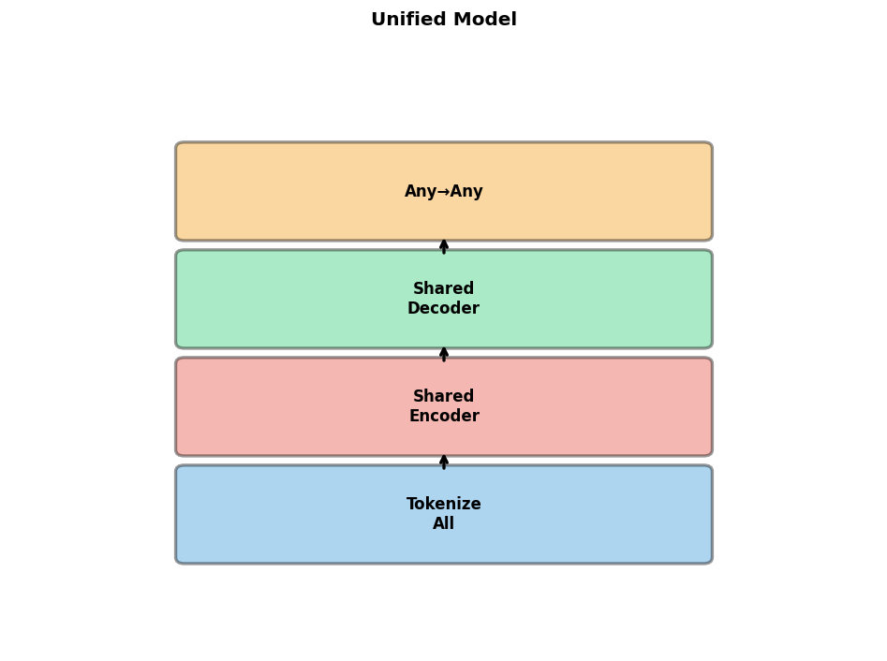
Unified Multimodal Models
Goal: Single model for all modalities
Approaches:
  Tokenize all modalities (Unified-IO)
  Shared encoder-decoder
  Modality-specific adapters
Benefits:
  Simplified deployment
  Cross-modal transfer
  Efficient inference
Research direction: Foundation models

Slide 36
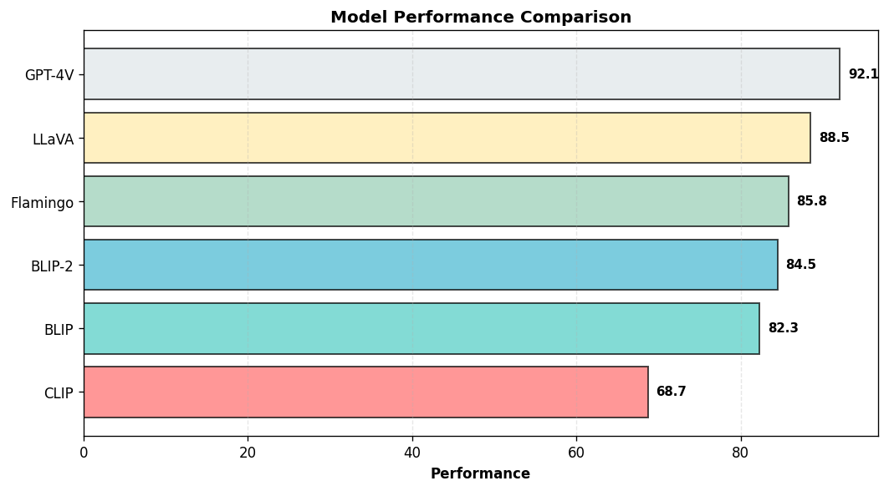
Architecture Comparison
CLIP: Fast, dual-encoder, zero-shot
BLIP: Versatile, generation + understanding
BLIP-2: Efficient, frozen components
Flamingo: Few-shot, interleaved input
LLaVA: Open-source, instruction-tuned
GPT-4V: State-of-the-art, proprietary
Selection: Task, compute, data, performance

Slide 37
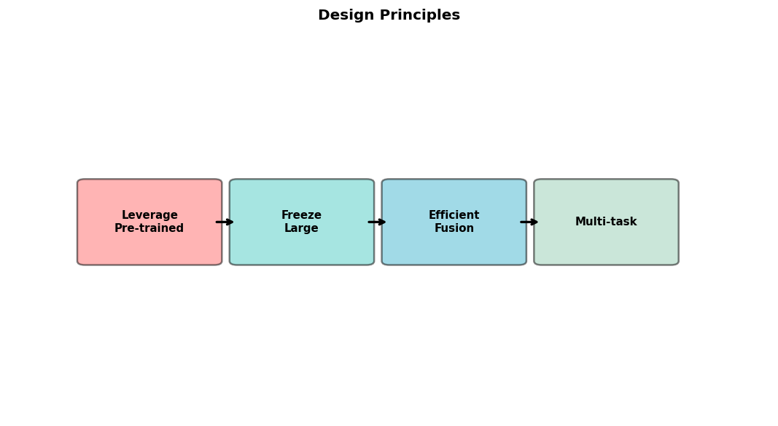
Design Principles
1. Leverage pre-trained models when possible
2. Freeze large components to reduce compute
3. Use efficient fusion (Q-Former, projectors)
4. Multi-task learning for generalization
5. High-quality instruction data crucial
6. Balance model size vs. performance
7. Consider inference efficiency
8. Open-source enables research

Slide 38
Part III: Training Strategies

Slide 39
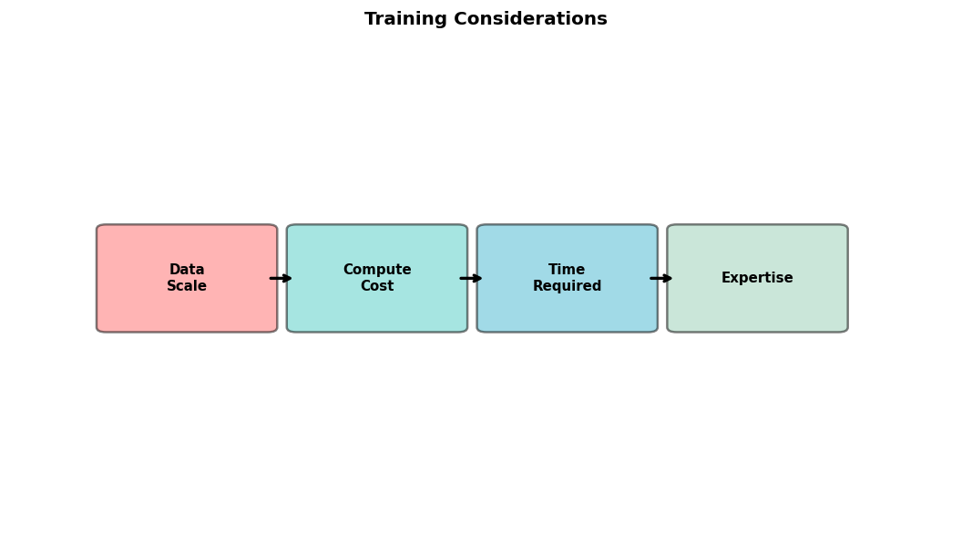
Training from Scratch
When to train from scratch?
  Novel architectures
  Unique data distribution
  Proprietary requirements
Challenges:
  Massive data (millions of pairs)
  Extensive compute (1000s GPU hours)
  Careful hyperparameter tuning
Alternative: Fine-tune pre-trained models

Slide 40
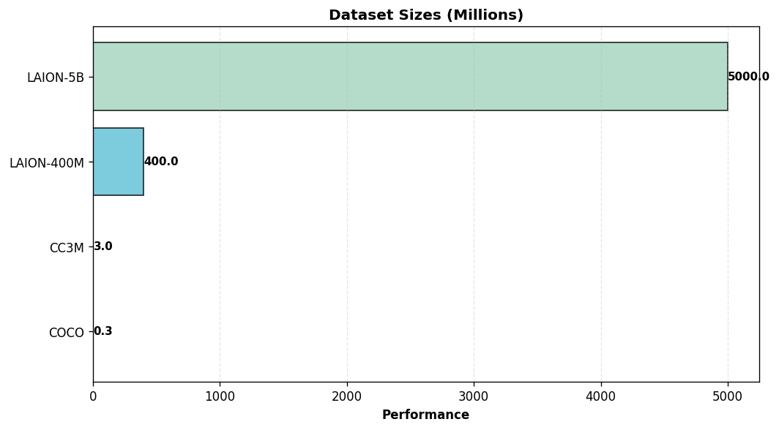
Data Requirements
Scale: Millions/billions of pairs
Types of data:
  Image-caption pairs
  Interleaved image-text
  Video-subtitle pairs
  Question-answer pairs
Data quality vs. quantity:
  CLIP: Curated 400M
  ALIGN: Noisy 1.8B
Diversity crucial for generalization

Slide 41
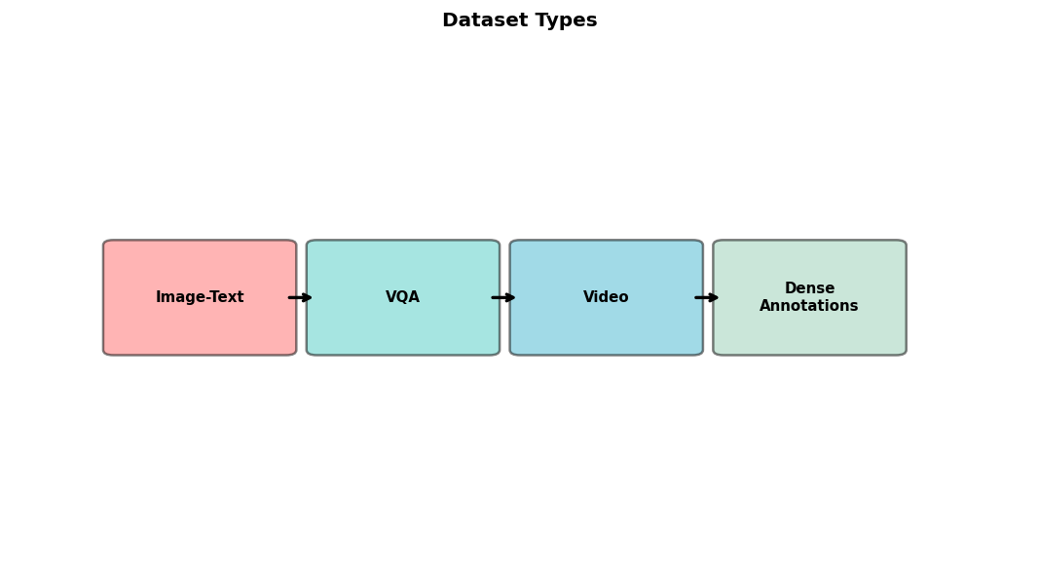
Key Datasets
Image-Text:
  COCO: 330K images with captions
  Visual Genome: 108K dense annotations
  Conceptual Captions: 3.3M pairs
  LAION-400M/5B: Large-scale web
VQA:
  VQAv2: 1.1M questions
  GQA: 22M questions with graphs
Video: WebVid, HowTo100M, YT-Temporal

Slide 42
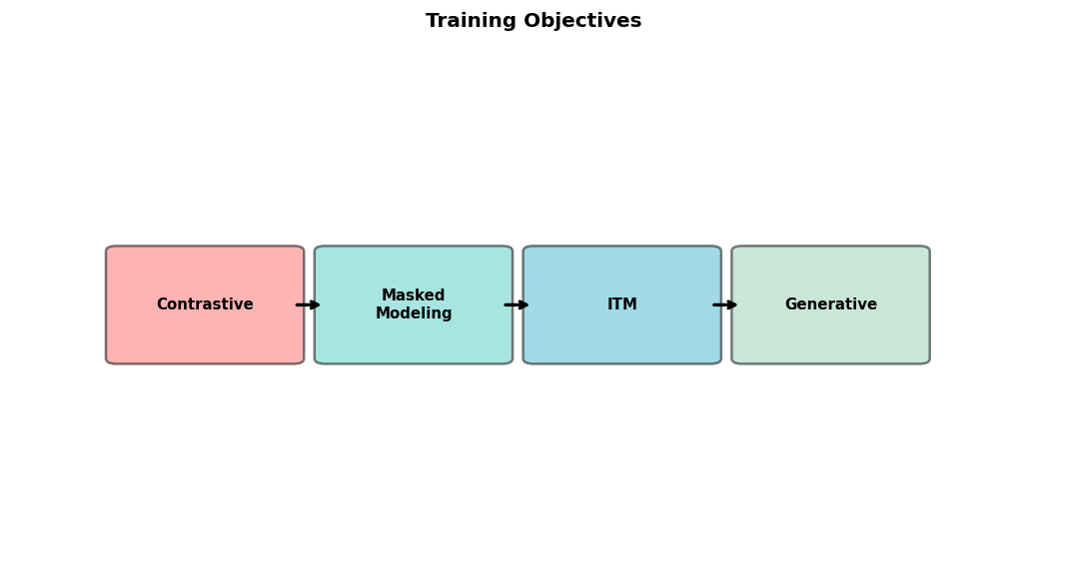
Pre-training Objectives
1. Contrastive Learning:
  Align positive pairs, separate negatives
  InfoNCE loss
2. Masked Language/Image Modeling:
  Mask tokens/patches, predict them
  Learn contextualized representations
3. Image-Text Matching:
  Binary: match or not
4. Generative objectives:
  Caption/image generation

Slide 43

Contrastive Learning
Core idea: Similar items close, dissimilar far
For multimodal: Match corresponding modalities
Positive pairs: (image, caption) from same example
Negative pairs: All other combinations
Loss function: InfoNCE
  Numerator: Similarity of positive
  Denominator: Sum of all similarities
Temperature scaling: Control sharpness
Effective for aligned embeddings

Slide 44
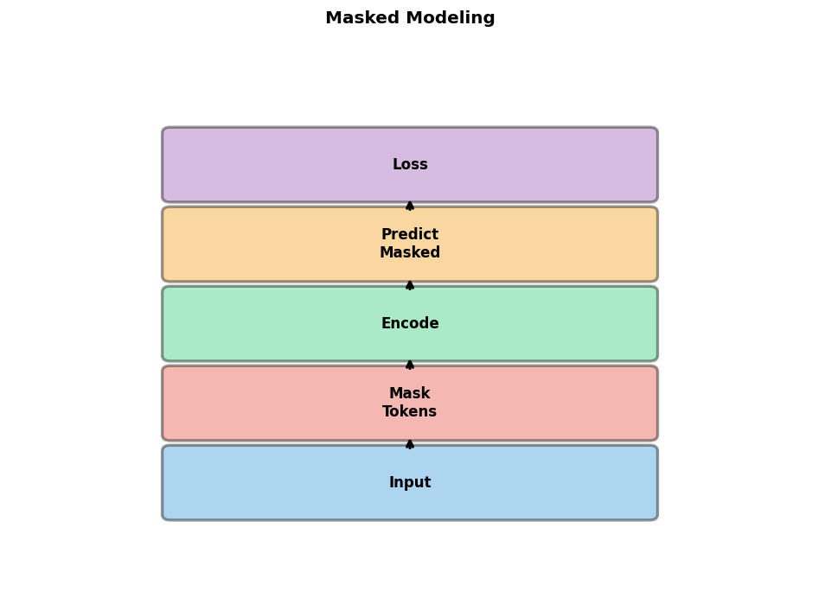
Masked Language/Image Modeling
Masked Language Modeling (MLM):
  Mask random tokens in text
  Predict from context
  Used in BERT, VilBERT
Masked Image Modeling (MIM):
  Mask random patches
  Reconstruct patches
  Used in MAE, SimMIM
Multimodal: Mask in both
Learn robust cross-modal representations

Slide 45

Image-Text Matching (ITM)
Binary classification task
Input: Image and text pair
Output: Match (1) or not (0)
Requires cross-modal interaction
  Usually through cross-attention
Negative sampling strategies:
  Random negatives from batch
  Hard negatives: Similar but wrong
Used alongside contrastive learning
Improves fine-grained alignment

Slide 46

Training Stability
Challenges:
  Large batch sizes needed
  Gradient explosion/vanishing
  Modality imbalance
Solutions:
  Gradient clipping
  Layer normalization
  Warmup learning rate schedule
  Mixed precision (FP16/BF16)
  Careful initialization
Monitor: Loss curves, gradient norms

Slide 47
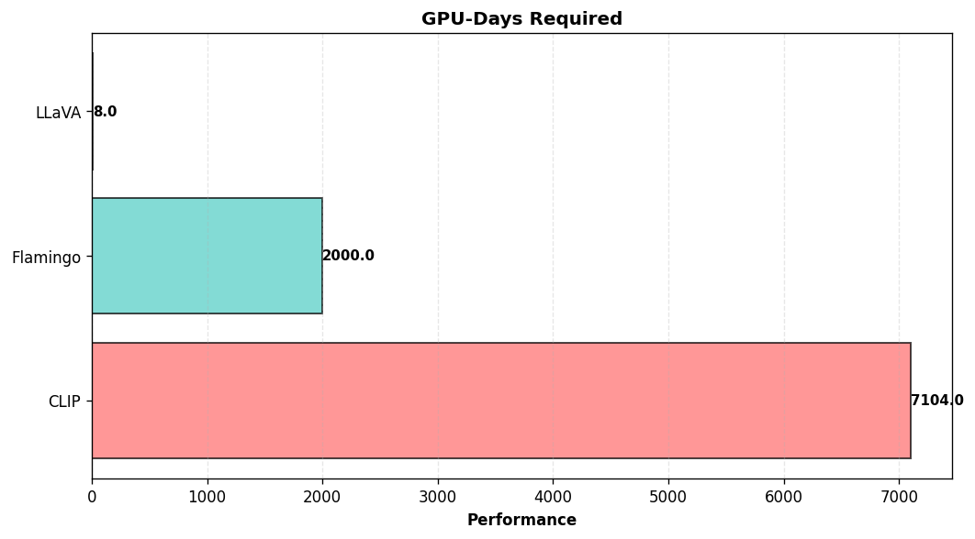
Computational Requirements
Training large models is expensive
Examples:
  CLIP: 592 V100 GPUs, 12 days
  Flamingo: TPUv4 pods, weeks
  LLaVA: 8 A100 GPUs, ~1 day
Factors: Model size, batch, data, resolution
Cost reduction:
  Freeze components
  Lower resolution in pre-training
  Use smaller models for research

Slide 48

Distributed Training
Essential for large-scale training
Strategies:
  Data parallelism: Split data across GPUs
  Model parallelism: Split model across GPUs
  Pipeline parallelism: Split layers
  Tensor parallelism: Split tensors
Frameworks:
  PyTorch DDP, FSDP
  DeepSpeed, Megatron-LM
Communication overhead: Critical bottleneck

Slide 49
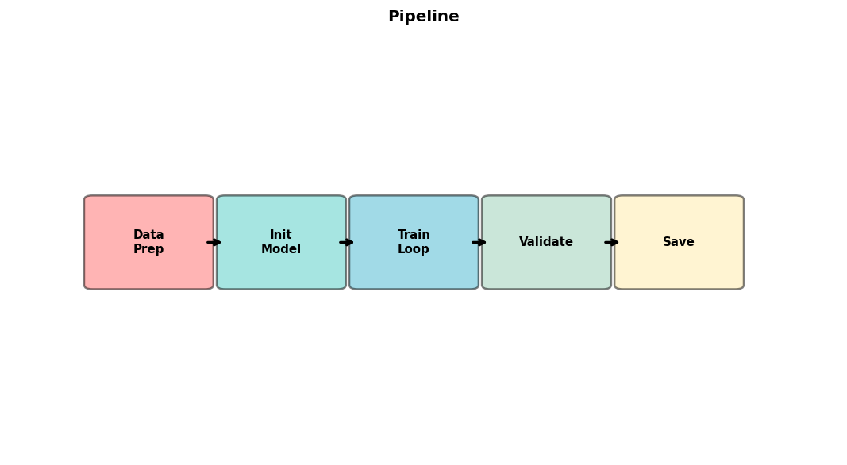
Training Pipeline
1. Data preparation:
  Collect and clean data
  Create train/val/test splits
2. Preprocessing:
  Tokenization, resizing
  Augmentation strategies
3. Model initialization:
  Load pre-trained weights
4. Training loop:
  Forward, loss, backward, update
5. Evaluation and checkpointing

Slide 50

Evaluation Metrics
Image-Text Retrieval:
  Recall@K, Mean Rank
VQA:
  Accuracy, VQA score
Image Captioning:
  BLEU, METEOR, CIDEr, SPICE
Zero-shot Classification:
  Top-1/Top-5 accuracy
General:
  Cross-modal similarity
  Human evaluation

Slide 51

Key Benchmarks
Classification: ImageNet, CIFAR
VQA: VQAv2, GQA, OK-VQA, VizWiz
Captioning: COCO Captions, NoCaps
Retrieval: COCO, Flickr30K
Reasoning: NLVR2, CLEVR
OCR: TextVQA, DocVQA, Infographics
Video: MSRVTT, ActivityNet
Comprehensive: MMBench, SEED-Bench, MM-Vet

Slide 52
Part IV: Fine-tuning Strategies

Slide 53
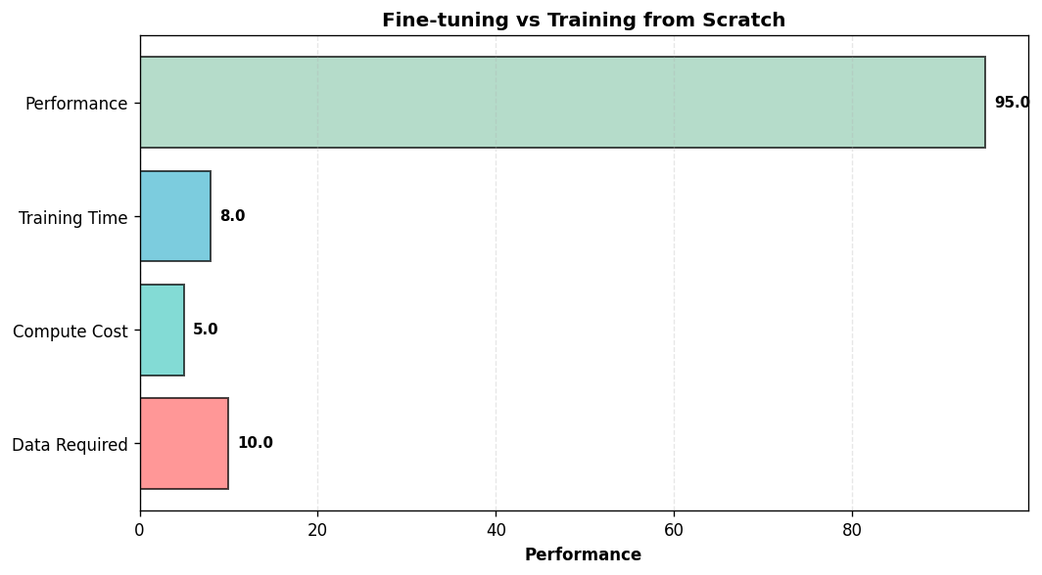
Fine-tuning Overview
Most practical approach
Start with pre-trained multimodal model
Adapt to specific task or domain
Advantages:
  Less data required
  Less compute required
  Faster convergence
  Better performance
Types: Full vs. parameter-efficient

Slide 54
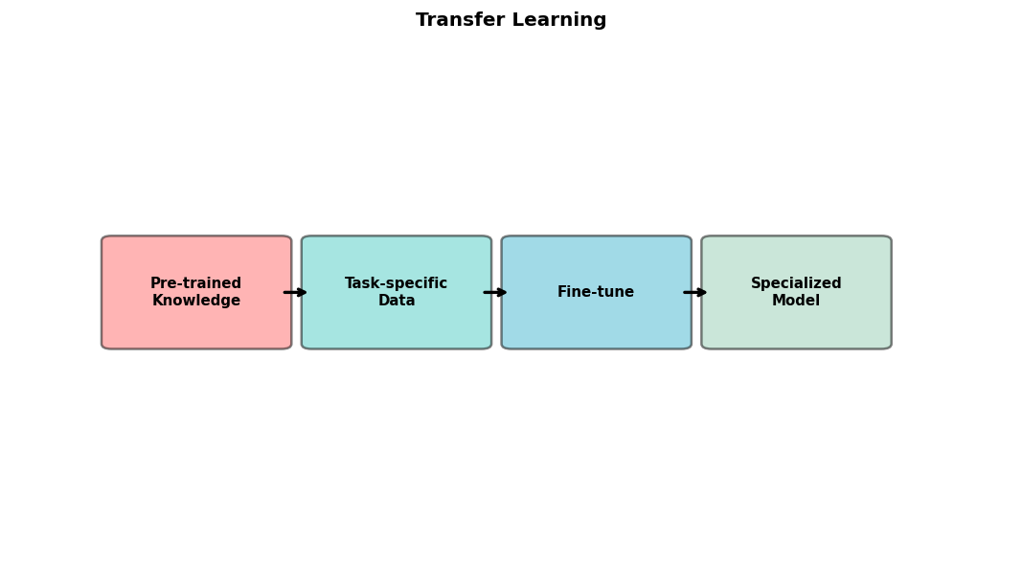
Transfer Learning
Leverage knowledge from pre-training
Pre-trained model already understands:
  Visual concepts
  Language semantics
  Cross-modal alignment
Fine-tuning teaches:
  Task-specific patterns
  Domain-specific knowledge
  Output format requirements
Critical: Choose appropriate base model

Slide 55
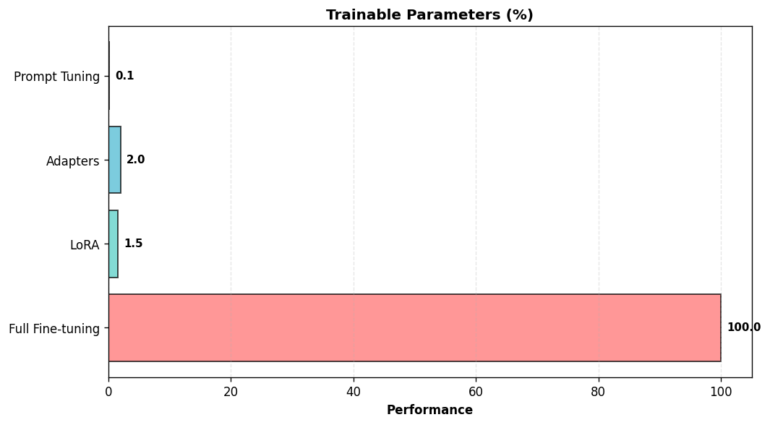
Parameter-Efficient Fine-tuning (PEFT)
Goal: Fine-tune with minimal parameters
Why PEFT?
  Large models too expensive
  Reduced memory
  Faster training
  Easy deployment (store adapters)
Methods:
  LoRA, Adapters, Prompt tuning
Often achieves comparable performance

Slide 56

LoRA: Low-Rank Adaptation
Learn low-rank updates to weights
W_new = W_frozen + B × A
  W_frozen: Original weights
  B, A: Low-rank matrices (rank r)
Only train B and A (1-2% of parameters)
Apply to:
  Attention projections (Q, K, V)
  Feed-forward layers
Works well for LLM in VLMs
Implementation: PEFT library

Slide 57
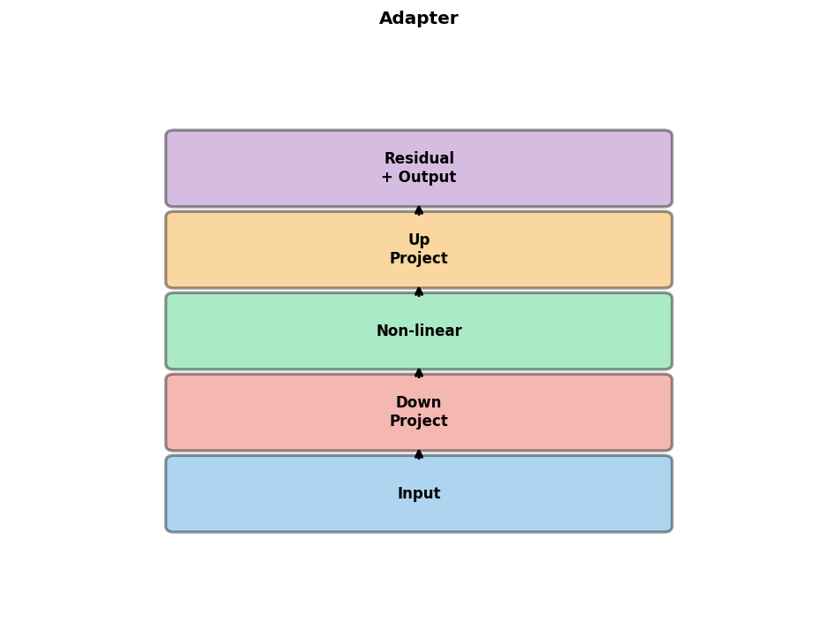
Adapter Modules
Small bottleneck layers inserted in network
Structure:
  Down-projection: d → r
  Non-linearity
  Up-projection: r → d
  Residual connection
Inserted after attention and FFN
Only adapters trained
Slightly more parameters than LoRA
Good for vision encoders

Slide 58
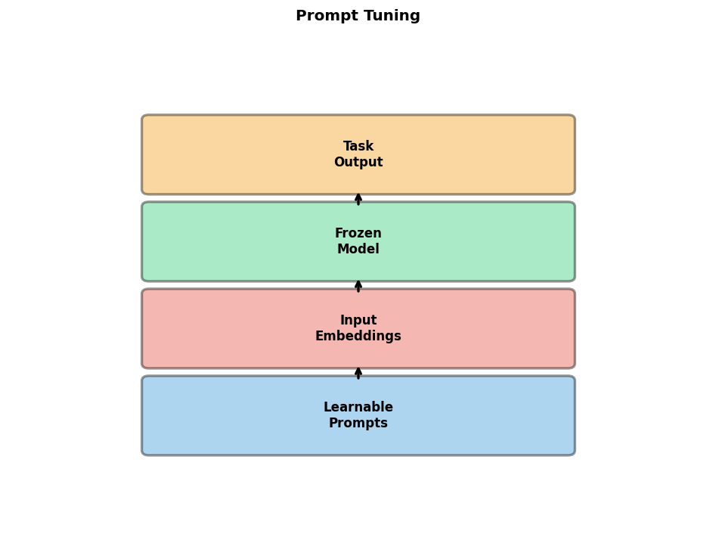
Prompt Tuning
Learn soft prompts: Continuous embeddings
Prepend learnable tokens to input
Visual prompt tuning:
  Learn perturbations to input image
  Or learn visual prefix tokens
Text prompt tuning:
  Learn continuous prompt embeddings
Extremely parameter-efficient
Challenges: More careful tuning needed
Good for: Few-shot learning

Slide 59
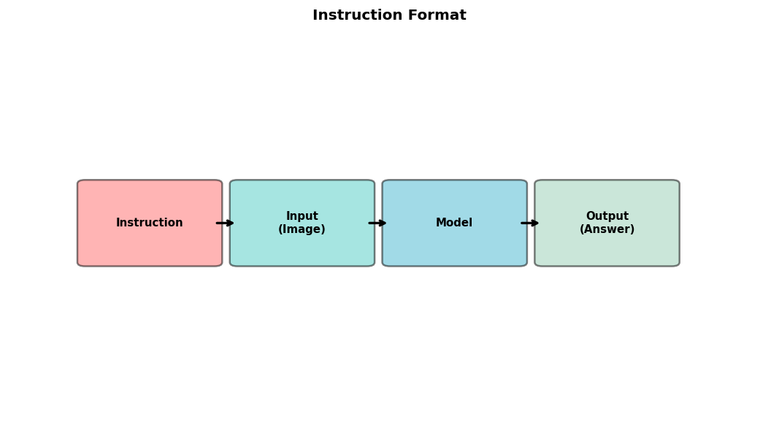
Instruction Tuning
Fine-tune on instruction-following data
Format: (Instruction, Input, Output)
Example:
  Instruction: 'Describe the image'
  Input: [Image]
  Output: 'A photo of...'
Benefits:
  Better instruction following
  More natural interactions
  Improved zero-shot generalization
Used in: LLaVA, InstructBLIP, Otter

Slide 60
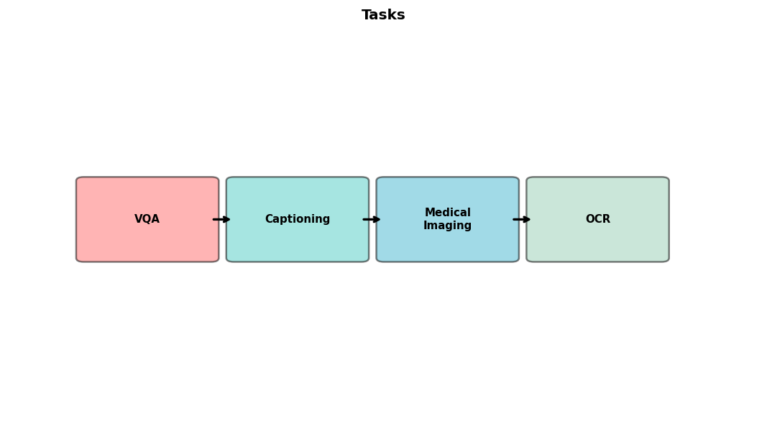
Task-Specific Fine-tuning
Adapt to specific downstream tasks
Examples:
  VQA: Fine-tune on VQAv2
  Captioning: Fine-tune on COCO
  Medical: Fine-tune on medical data
Task-specific head may be added
Data: 1K-100K task examples
Often use full fine-tuning or LoRA
Evaluation on task benchmark

Slide 61
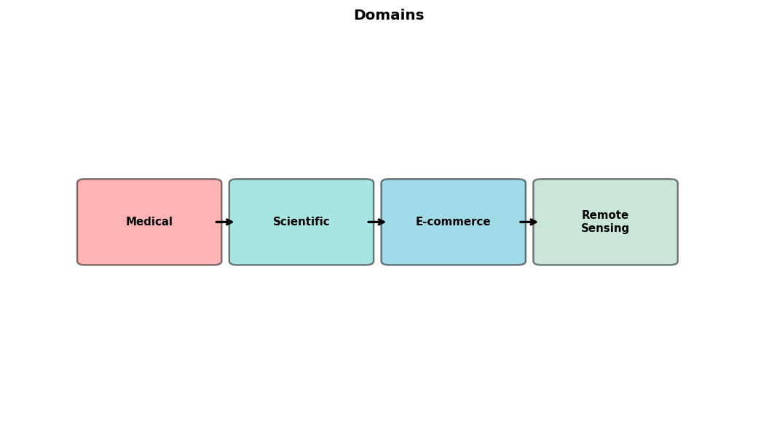
Domain Adaptation
Adapt to specific domain:
  Medical images and reports
  Scientific figures and papers
  E-commerce products
  Remote sensing imagery
Challenges:
  Domain shift from pre-training
  Specialized terminology
Solutions:
  Continue pre-training on domain data
  Task-specific fine-tuning

Slide 62
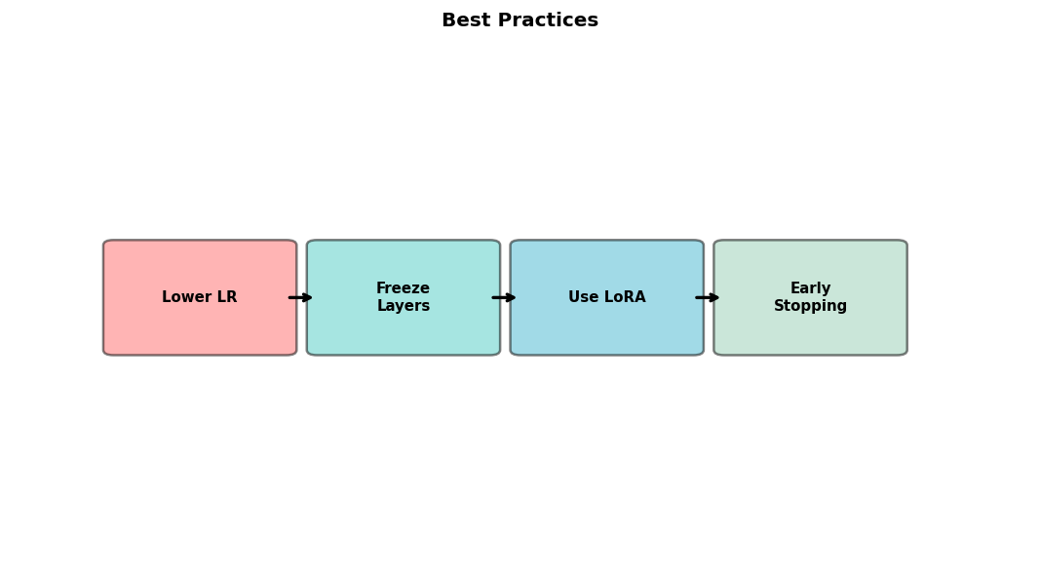
Fine-tuning Best Practices
1. Start with appropriate pre-trained model
2. Use lower learning rate than pre-training
3. Freeze vision encoder initially if needed
4. Use LoRA for large models
5. Monitor validation performance
6. Prevent overfitting:
  Early stopping, regularization
7. Data augmentation for small datasets
8. Gradient accumulation for larger batches

Slide 63
Part V: Implementation & Applications

Slide 64

Implementation Frameworks
HuggingFace Transformers:
  Pre-trained models: CLIP, BLIP, LLaVA
  Easy fine-tuning with Trainer API
  PEFT library for LoRA
PyTorch: Low-level flexibility
JAX/Flax: XLA compilation, TPU support
LangChain: Integration with applications
OpenCLIP: Open-source CLIP training
LLaVA codebase: Instruction tuning

Slide 65
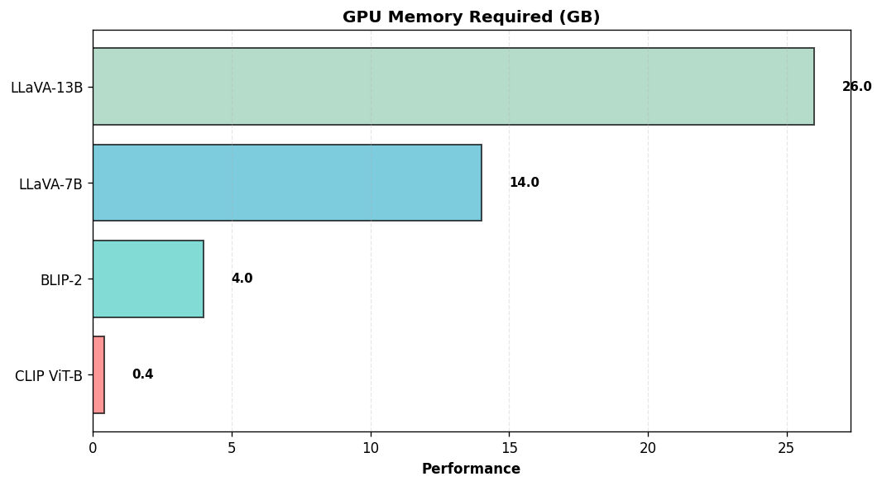
Hardware Requirements
GPU memory critical bottleneck
Model size considerations:
  CLIP ViT-B: ~400MB, any GPU
  BLIP-2: ~4GB, 16GB+ GPU
  LLaVA-7B: ~14GB, 24GB+ GPU
  LLaVA-13B: ~26GB, 40GB+ GPU
Memory reduction:
  8-bit quantization
  LoRA reduces by 2-3x
Palmetto: A100 (40/80GB), H100

Slide 66

Palmetto Cluster Setup
Clemson's HPC cluster
GPU nodes: V100, A100, H100
Setup steps:
  1. Request GPU: qsub -I ...
  2. Load modules: CUDA, conda
  3. Create env: conda create -n multimodal
  4. Install: transformers, torch, peft
Storage: /scratch for datasets
Jupyter via OnDemand
See lab notebook for details

Slide 67

Loading Pre-trained Models
HuggingFace example:
from transformers import CLIPModel, CLIPProcessor
model = CLIPModel.from_pretrained(
'openai/clip-vit-base-patch32')
processor = CLIPProcessor.from_pretrained(
'openai/clip-vit-base-patch32')
model.to('cuda')
See lab notebook for more examples!

Slide 68
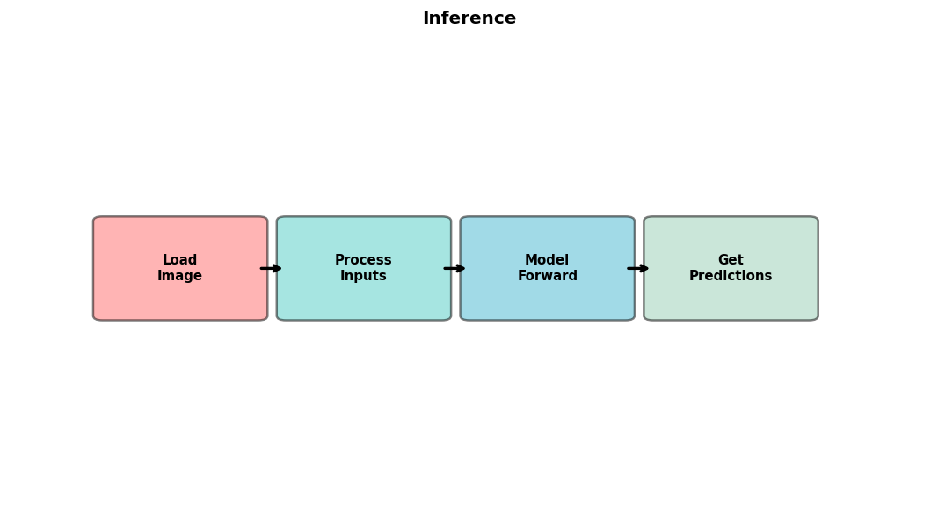
Inference Example
CLIP zero-shot classification:
image = Image.open('photo.jpg')
text = ['a photo of a cat', 'a photo of a dog']
inputs = processor(text=text, images=image,
return_tensors='pt')
outputs = model(**inputs)
probs = outputs.logits_per_image.softmax(dim=1)
See lab for BLIP, LLaVA examples

Slide 69
Fine-tuning Example
Using LoRA:
from peft import LoraConfig, get_peft_model
lora_config = LoraConfig(
r=8, lora_alpha=16,
target_modules=['q_proj', 'v_proj'])
model = get_peft_model(model, lora_config)
trainer = Trainer(model, args, dataset)
trainer.train()

Slide 70

Application: Visual Question Answering
Task: Answer questions about images
Input: Image + Question
Output: Answer (text)
Models: BLIP-2, LLaVA, InstructBLIP
Use cases:
  Accessibility for visually impaired
  Content moderation
  Educational tools
  Image search and retrieval
Datasets: VQAv2, GQA, OK-VQA

Slide 71
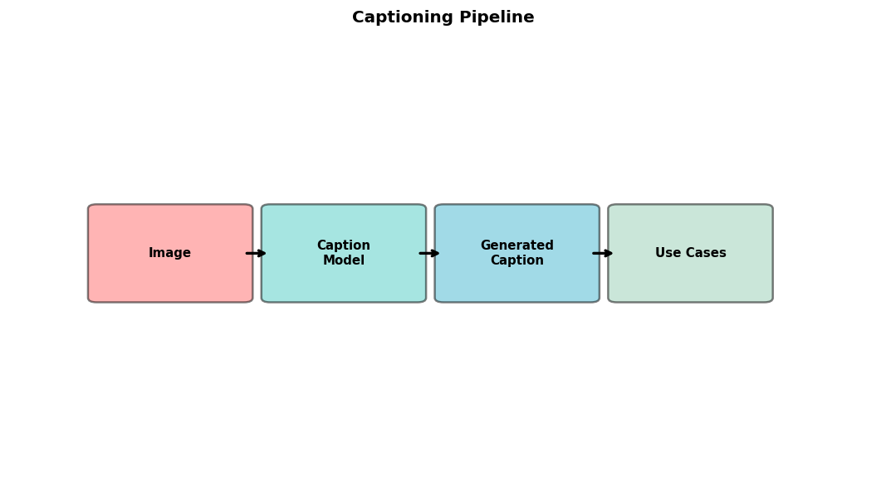
Application: Image Captioning
Task: Generate textual descriptions
Input: Image
Output: Caption (text)
Models: BLIP, BLIP-2, GIT
Use cases:
  Alt-text for web accessibility
  Photo organization and search
  Social media content
  Medical report generation
Evaluation: BLEU, CIDEr, SPICE

Slide 72
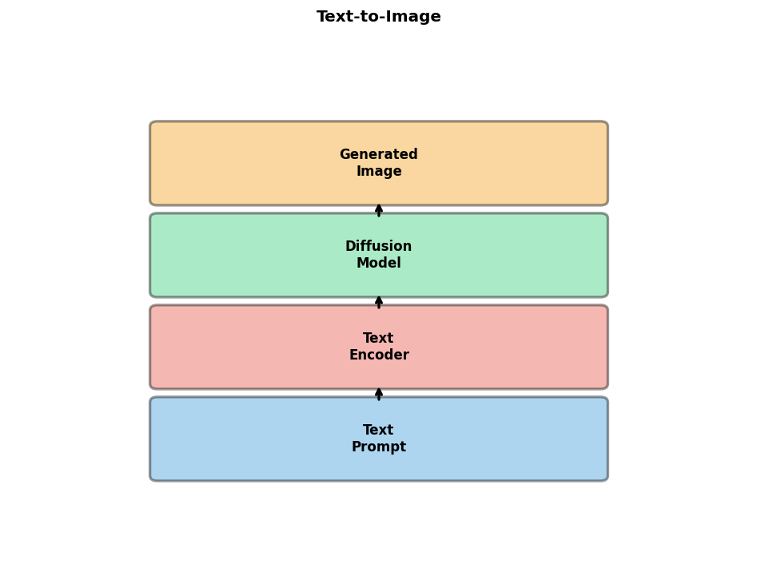
Application: Text-to-Image Generation
Task: Generate images from text
Input: Text prompt
Output: Image
Models: DALL-E, Stable Diffusion, Imagen
Architecture: Diffusion + text conditioning
  Text encoder: CLIP or T5
  Diffusion: U-Net with cross-attention
Use cases:
  Creative content generation
  Design and prototyping
  Data augmentation

Slide 73
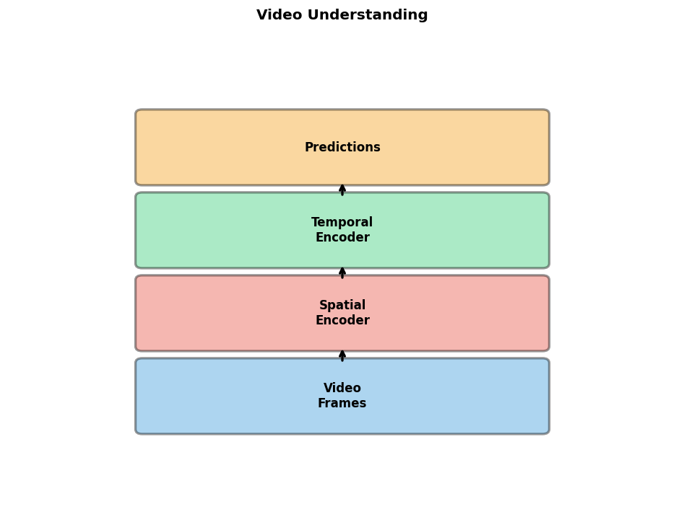
Application: Video Understanding
Task: Understand and reason about video
Input: Video (frames + audio)
Output: Caption, answer, action
Models: VideoMAE, TimeSformer, Video-LLaMA
Challenges:
  Temporal modeling
  Long sequences (memory)
  Multi-modal fusion (visual+audio+text)
Applications: Surveillance, sports, education

Slide 74

Challenges and Limitations
Hallucination: Generating false information
Robustness: Sensitive to input variations
Bias: Reflecting dataset biases
Computational cost: Training and inference
Data requirements: Large paired datasets
Interpretability: Understanding decisions
Safety: Potential for misuse
Evaluation: Measuring true understanding

Slide 75

Future Directions
Scaling: Larger models, more modalities
Efficiency: Smaller models with better performance
Grounding: Connecting to physical world
Reasoning: Better logical and causal reasoning
Embodied AI: Integration with robotics
Multilinguality: Support more languages
Scientific applications: Discovery and analysis
Democratization: Making models accessible

Slide 76
Key Takeaways
Multimodal learning enables richer AI
Modern architectures leverage pre-trained components
Contrastive learning is key for alignment
Fine-tuning is practical for most applications
Parameter-efficient methods make it accessible
Many open-source models available
Applications span VQA to text-to-image
Exciting field with rapid progress

Slide 77

Resources
Papers:
  CLIP, BLIP-2, LLaVA, Flamingo
Code:
  HuggingFace Transformers, PEFT
  OpenCLIP, LLaVA GitHub
Datasets:
  COCO, Visual Genome, LAION
Tutorials:
  HuggingFace docs
  Papers with Code
Next: Lab session!

Slide 78
Questions & Discussion

