Slide 1


CSCE 580: Introduction to AI CSCE 581: Trusted AI Lecture 17: Building Chatbots
Student Presenters: Kausik Lakkaraju, Bharath C Muppasani, Sara Rae Jones
PROF. BIPLAV SRIVASTAVA, AI INSTITUTE
24TH OCT 2023
Carolinian Creed: “I will practice personal and academic integrity.” Credits: Copyrights of all material reused acknowledged

Slide 2
Organization of Lecture 17
Introduction Segment
Recap of Lecture 16
Main Segment
Building Chatbots
RASA
SafeChat Framework
Concluding Segment
Course Project Discussion
About Next Lecture – Lecture 18
Ask me anything

Slide 3
Introduction Section

Slide 4
Recap of Lecture 16
Topic discussed
Trust Issues
Explainability
LIME tool

Slide 5

Intelligent Agent Model
(Static vs. Dynamic)
Environment
(Observable vs.
Partially Observable)
(perfect vs.
Imperfect)
Perception
Goals
(Full vs.
Partial satisfaction)
Action
(Deterministic vs.
Stochastic)
(Instantaneous vs.
Durative)

Slide 6
Relationship Between Main AI Topics
Human
Agent
Human
Interaction
Reasoning
Representation (Models)
Insights
Learning
Data

Slide 7
Where We Are in the Course
CSCE 580/ 581 – In This Course
• Week 1: Introduction, Aim: Chatbot / Intelligence Agent
• Weeks 2-3: Data: Formats, Representation and the Trust Problem
• Week 4-5: Search, Heuristics - Decision Making
• Week 6: Constraints, Optimization – Decision Making
• Week 7: Classical Machine Learning – Decision Making, Explanation
• Week 8: Machine Learning - Classification
• Week 9: Machine Learning - Classification – Trust Issues and Mitigation Methods
• Topic 10: Learning neural network, deep learning, Adversarial attacks
• Week 11: Large Language Models – Representation, Issues
• Topic 12: Markov Decision Processes, Hidden Markov models - Decision making
• Topic 13: Planning, Reinforcement Learning – Sequential decision making
• Week 14: AI for Real World: Tools, Emerging Standards and Laws; Safe AI/ Chatbots

Slide 8
Main Section
Credit: Retrieved from internet

Slide 9
Rasa
Rasa is an open source, scalable AI framework that can be used to build conversational agents.
Rasa is used by many companies like American Express, BlueCross BlueShield, Dell, …..
Chatbot terminology:
Intent: Intention of the user behind a message.
Entity: They are used to identify important parts of the message that affects the response chosen by the chatbot. Ex: Time, location.
Message | Intent | Entities
When will the flight to ORD arrive at CAE? | Arrivals | ORD, CAE
Can I book an appointment with the dentist for tomorrow? | Booking | dentist, tomorrow
Credit:
https://rasa.com/docs/rasa/

Slide 10
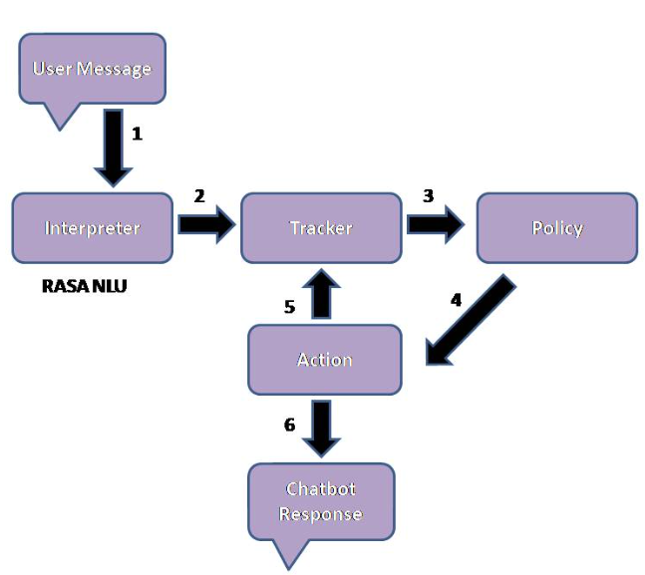
Rasa Workflow
Rasa consists of two major components: Rasa NLU and Rasa Core.
Rasa Natural Language Understanding (NLU) takes user message as input and recognizes entities and intent and passes it to RASA core.
Rasa Core selects the appropriate response based on the the input passed by Rasa NLU and sends it back to the user.
Rasa workflow:
User message is converted into a dictionary which consists of the message, intent, and entities extracted.
Tracker keeps a record of the conversation.
Current state of the tracker is sent to the policy which decides the next action that needs to be taken.
Chatbot’s response depends on the action chosen.
Credit:
https://rasa.com/docs/rasa/
https://www.analyticsvidhya.com/blog/2022/02/a-simple-guide-to-rasa-3-x/

Slide 11
Setting Up Virtual Environment (python env)
If you do not have ‘pip’ on your system, download the script from: https://bootstrap.pypa.io/get-pip.py
Run ‘python get-pip.py’ on your terminal to install pip.
Run ‘python3 -m pip install --user virtualenv’ to install virtual environment package.
Run ‘python3 -m venv env’ to create a virtual environment, ‘env’.
Run ‘source env/bin/activate’ to activate the virtual environment.
To leave the virtual environment, run ‘deactivate’.
Alternative: use conda

Slide 12
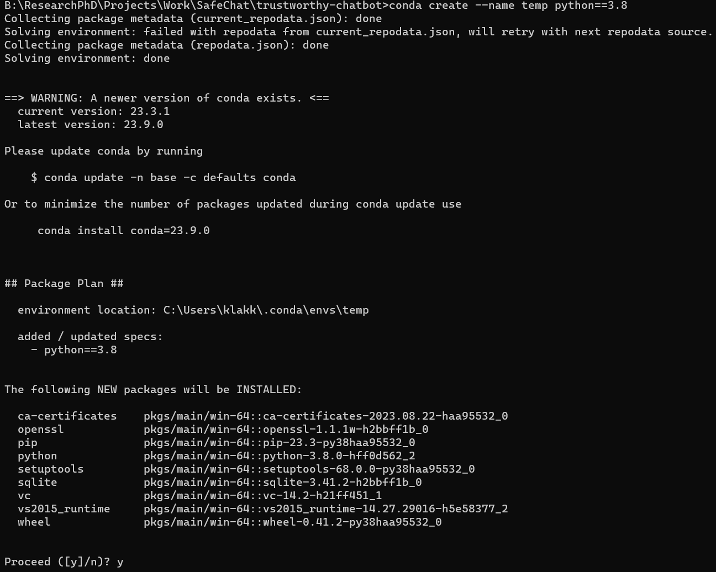
Setting Up Virtual Environment (conda env; recommended)
Install anaconda from https://www.anaconda.com/download.
To create a virtual environment, run the command ‘conda create –name <env_name> python==3.8’
To activate the environment, run ‘conda activate <env_name>’
To deactivate the environment, run ‘conda deactivate’.

Slide 13
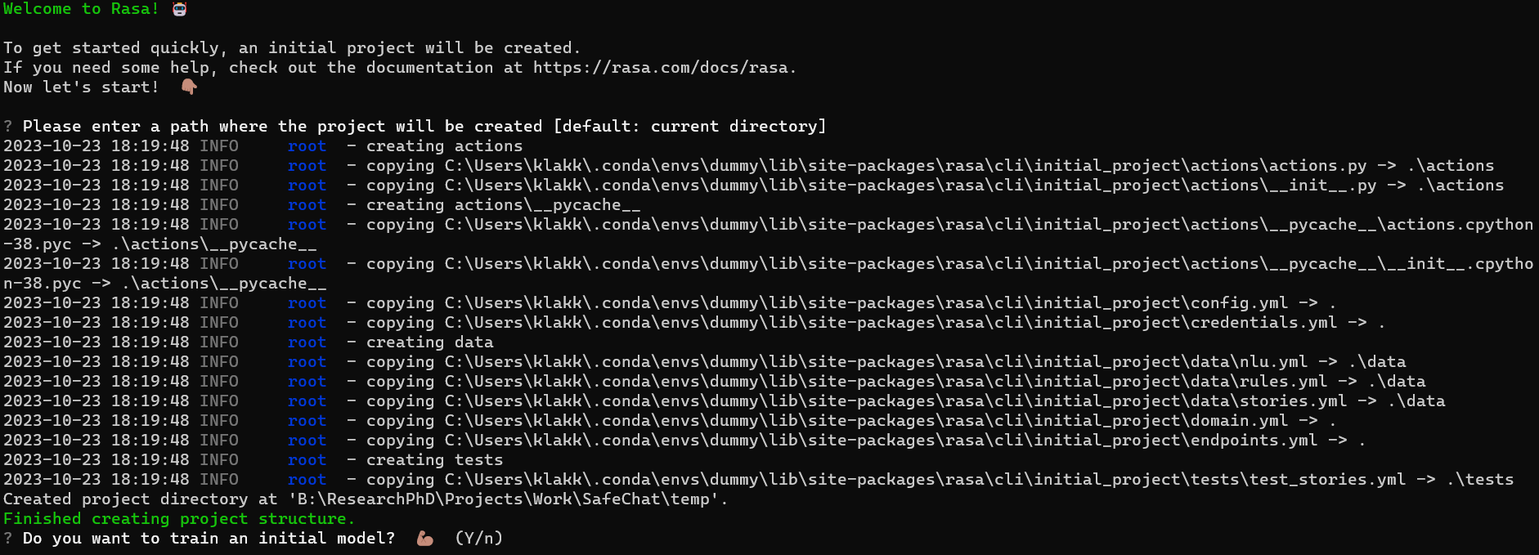
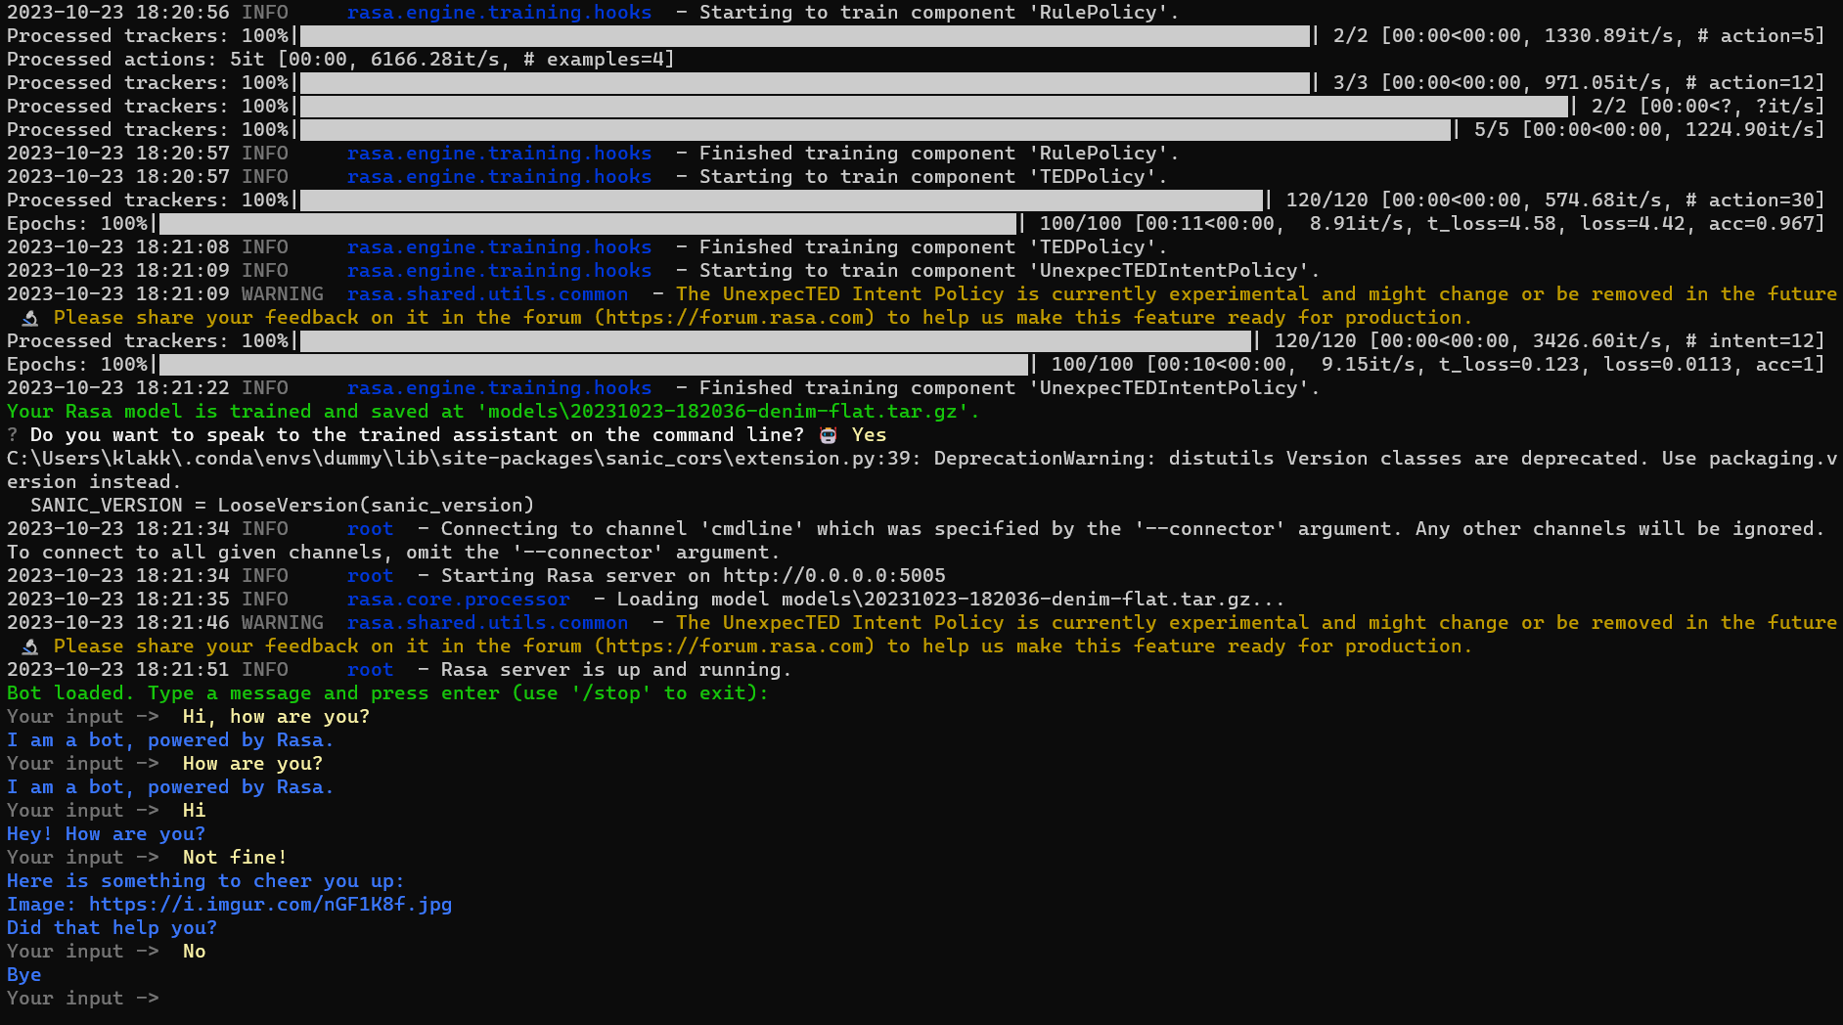
Build a Chatbot with Rasa
Install Rasa using the command, ‘pip install rasa==3.1’
Run ‘rasa init’ to build a basic Rasa chatbot.
Run ‘rasa shell’ to talk to your chatbot.

Slide 14
What is SafeChat?
SafeChat architecture was introduced in [1]. It is a Rasa-based framework that can be used to build safe and trustworthy chatbots.
The uniqueness of SafeChat is:
A safe design where the responses can be traced back to their original source (e.g., official FAQs).
A do-not-answer strategy that can deflect certain user questions that are not supposed to be answered.
A low-programming design pattern based on the open-source Rasa platform to generate chatbots quickly for any region.
A quick domain-independent chatbot framework with CSV-based Q/A support and automatic intent generator with support for backend integration and testing.
References:
Muppasani, B., Pallagani, V., Lakkaraju, K., Lei, S., Srivastava, B., Robertson, B., ... & Narayanan, V. (2022). On Safe and Usable Chatbots for Promoting Voter Participation. arXiv preprint arXiv:2212.11219.

Slide 15
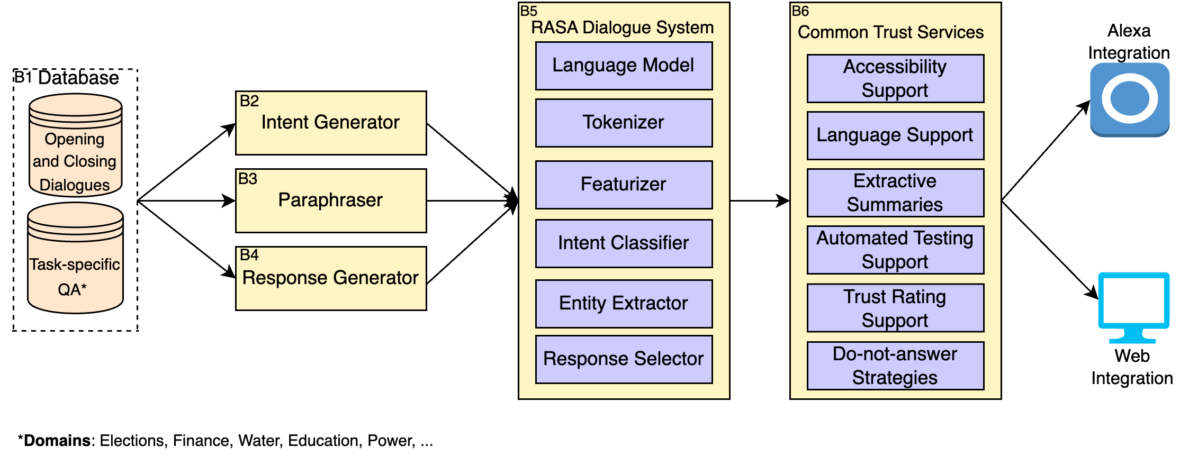
SafeChat Architecture (1/2)
Database (B1): The database is the source from which we extract the training data to train the chatbot. We ensure that the source is reliable and trustworthy. Task-specific QA refers to the data source pertaining to the chosen domain. The opening and closing dialogues are usually generic (like greeting and saying bye).
Intent Generator (B2): Intent Generator helps in tagging existing questions to an intent, which can later be utilized to map any new incoming user utterance to an available intent to provide desired answers.
Paraphraser (B3): A paraphraser can be used to augment the training data by paraphrasing the questions given in an official FAQ document.

Slide 16
SafeChat Architecture (2/2)
Response Generator (B4): A response is usually text but can also include multi-modal content like images and audio. The safe chatbot architecture reuses the response generation module available in the RASA Dialogue System.
RASA Dialogue System (B5): We use the RASA chatbot framework to build the chatbot. The dialogue system has an NLU pipeline with different components for understanding human conversation and responding appropriately.
Common Services (B6): The common services are optional, and the user has the flexibility of choosing the services they need. Some of the accessibility options are font settings and Text-to-Speech.
System Integration: Our framework allows easier web integration and integration with Alexa.

Slide 17
Building a Chatbot using SafeChat
Run ‘git clone https://github.com/ai4society/trustworthy-chatbot.git’ to clone our SafeChat repository.
Go to the project directory and run ‘pip install –r requirements.txt’ to install all the required packages.
Run ‘code/configure_rasa.py’, ’code/extract_intent.py’ and ‘code/paraphraser.py’ files in the same order to create your chatbot.

Slide 18
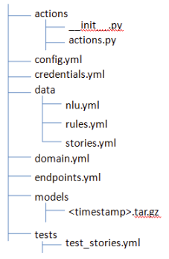
Chatbot File Structure
config.yml: It has pipeline, policies, and other NLU components.
‘/data’ consists of:
nlu.yml: It contains intents and examples for each intent with entities.
rules.yml: Defines a fixed conversation path that chatbot follows.
stories.yml: It contains conversations paths the chatbot needs to take in order to respond to the user messages appropriately.
domain.yml: This file acts as an index for the chatbot. It contains intents, entities, slots, responses, forms, and actions.
‘/models’ contain the trained chatbot model that can be used to talk to the chatbot.
Credit:
https://rasa.com/docs/rasa/
https://www.analyticsvidhya.com/blog/2022/02/a-simple-guide-to-rasa-3-x/

Slide 19
Running your chatbot
Go to the ‘Chatbot’ directory that is generated and to train the chatbot, run ‘rasa train’.
To talk to the trained chatbot, run ‘rasa shell’. Also, run ‘rasa run actions’ in another instance of the terminal.

Slide 20
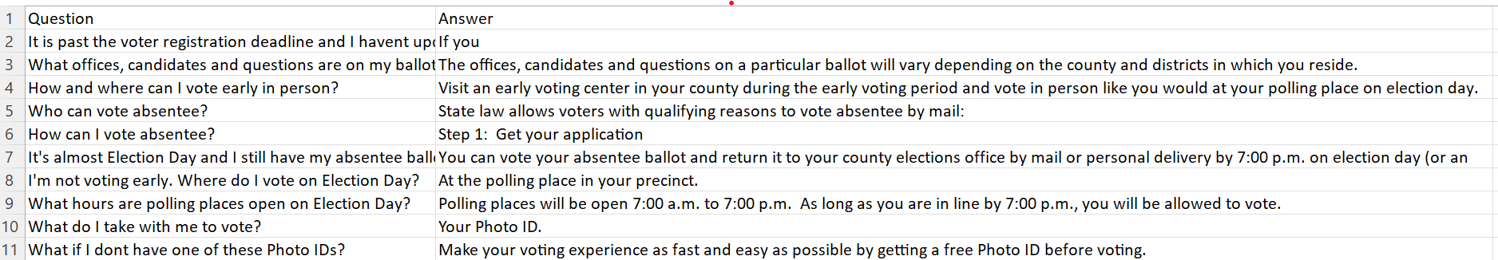
Build your own chatbot with SafeChat
Create a new ‘Chat.csv’ file in the ‘data/’ directory with your desired FAQs. The CSV should have a column called ‘Question’ with all the queries and another column called ‘Answer’ with the corresponding answers.
Run ‘code/configure_rasa.py’, ’code/extract_intent.py’ and ‘code/paraphraser.py’ files in the same order to create your chatbot.
Go to the generated ‘Chatbot/’ directory. Run ‘rasa train’ to train the chatbot and ‘rasa shell’ to interact with your chatbot. Also, run ‘rasa run actions’ in another instance of the terminal.

Slide 21
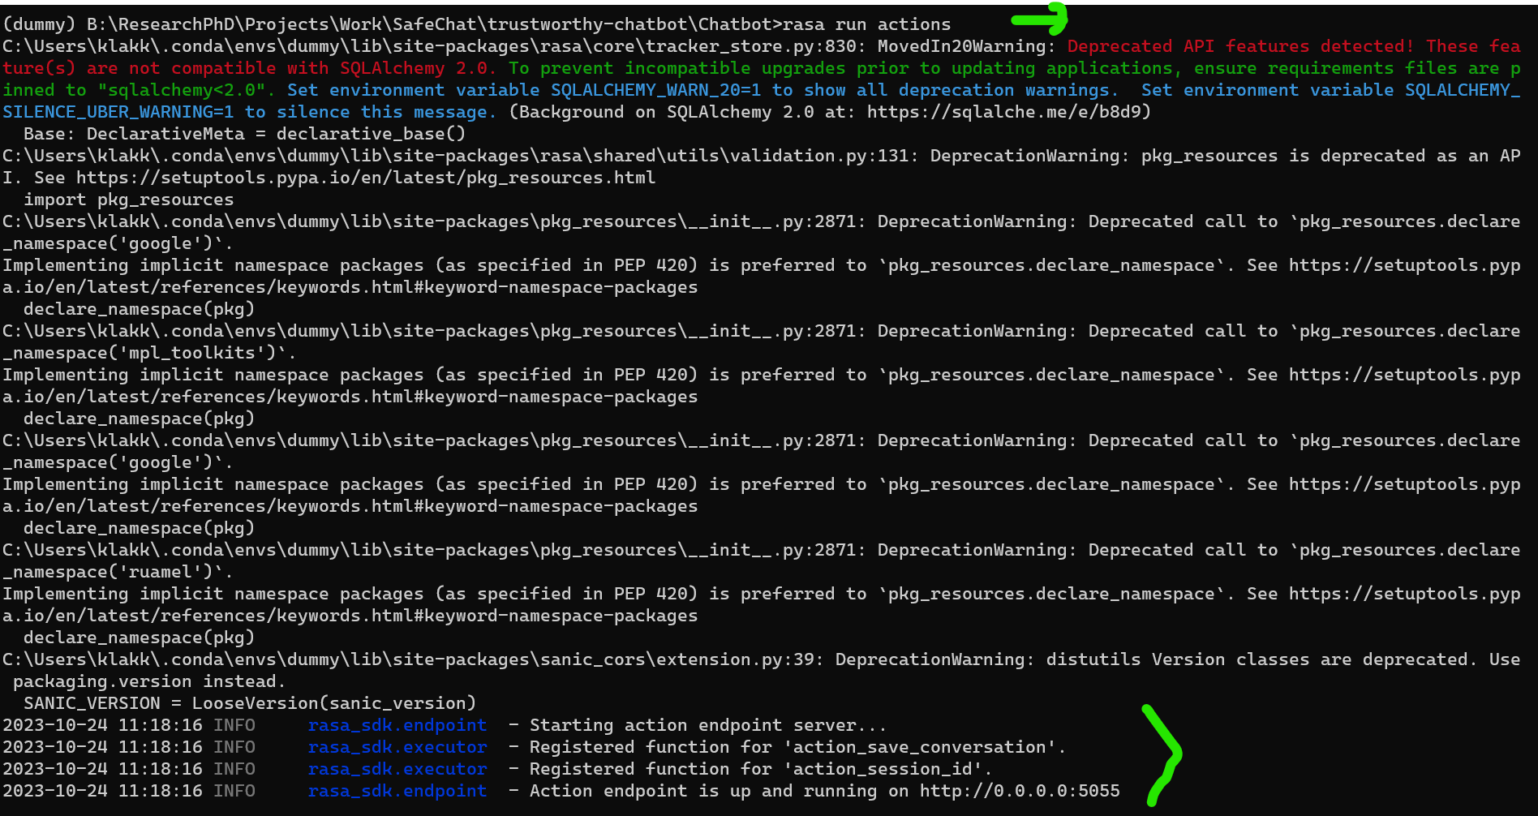
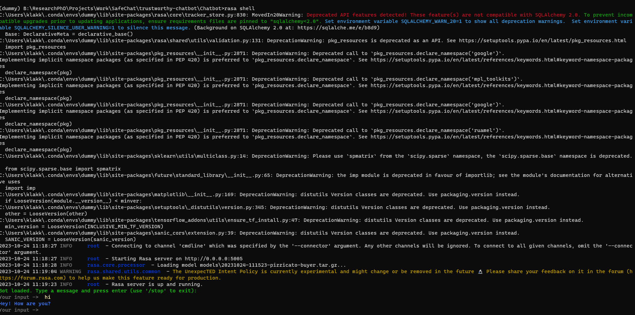
Working Screenshots: Running the Chatbot

Slide 22
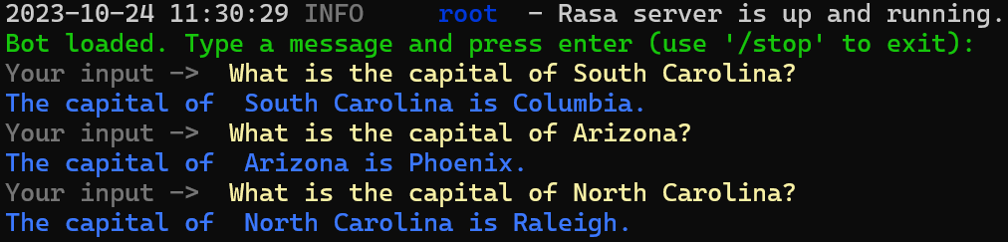
Working Screenshots: Talking to the Chatbot

Slide 23
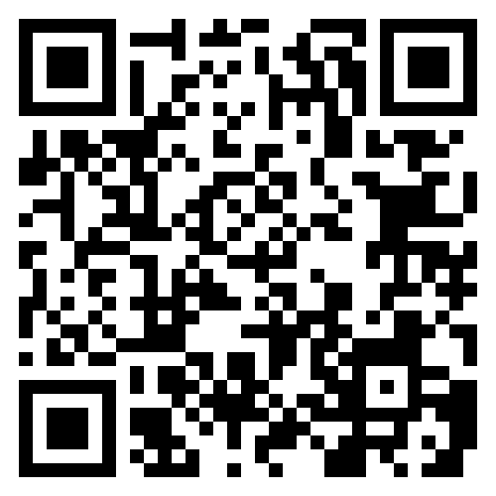
Survey Link
Please fill the survey using the following link to help us improve our SafeChat architecture.

Slide 24
Course Project

Slide 25
Project Discussion: What Problem Fascinates You ?
Data
Water
Finance
…
Analytics
Search, Optimization, Learning, Planning, …
Application
Building chatbot
Users
Diverse demographics
Diverse abilities
Multiple human languages
Project execution in sprints
Sprint 1: (Sep 12 – Oct 5)
Solving: Choose a decision problem, identify data, work on solution methods
Human interaction: Develop a basic chatbot (no AI), no problem focus
Sprint 2: (Oct 10 – Nov 9)
Solving: Evaluate your solution on problem
Human interaction: Integrated your choice of chatbot (rule-based or learning-based) and methods
Sprint 3: (Nov 14 – 30)
Evaluation: Comparison of your solver chatbot with an LLM-based alternative, like ChatGPT

Slide 26
Project Discussion: Dates and Deliverables
Project execution in sprints
Sprint 1: (Sep 12 – Oct 5)
Solving: Choose a decision problem, identify data, work on solution methods
Human interaction: Develop a basic chatbot (no AI), no problem focus
Sprint 2: (Oct 10 – Nov 9)
Solving: Evaluate your solution on problem
Human interaction: Integrated your choice of chatbot (rule-based or learning-based) and methods
Sprint 3: (Nov 14 – 30)
Evaluation: Comparison of your solver chatbot with an LLM-based alternative, like ChatGPT
Oct 12, 2023
Project checkpoint
In-class presentation
Nov 30, 2023
Project report due
Dec 5 / 7, 2023
In-class presentation

Slide 27
Skeleton: A Basic Chatbot
Illustrative Project
Title: Solve and explain solving of n-queens puzzle
Key idea: Show students how a course project will look like
Who will care when done: students of the course, prospective AI students and teachers
Data need: n: the size of game; interaction
Methods: search
Evaluation: correctness of solution, quality of explanation, appropriateness of chat
Users: with and without AI background; with and without chess background
Trust issue: user may not believe in the solution, may find interaction offensive (why queens, not kings? …)
Run in an infinite loop until the user wants to quit
Handle any user response
User can quit by typing “Quit” or “quit” or just “q”
User can enter any other text and the program has to handle it. The program should write back what the user entered and say – “I do not know this information”.
Handle known user query types // Depends on your project
“Tell me about N-queens”, “What is N ?”
“Solve for N=4?”
“Why is this a solution? ”
Handle chitchat // Support at least 5, extensible from a file
“Hi” => “Hello”
…
Store session details in a file

Slide 28
Project Discussion: Illustration
Title: Solve and explain solving of n-queens puzzle
Key idea: Show students how a course project will look like
Who will care when done: students of the course, prospective AI students and teachers
Data need: n: the size of game; interaction
Methods: search
Evaluation: correctness of solution, quality of explanation, appropriateness of chat
Users: with and without AI background; with and without chess background
Trust issue: user may not believe in the solution, may find interaction offensive (why queens, not kings? …)
Create a private Github repository called “CSCE58x-Fall2023-<studentname>-Repo”. Share with Instructor (biplav-s) and TA (kausik-l)
Create Google folder called “CSCE58x-Fall2023-<studentname>-SharedInfo”. Share with Instructor (prof.biplav@gmail.com) and TA (lakkarajukausik90@gmail.com)
Create a Google doc in your Google repo called “Project Plan” and have the following by next class (Sep 5, 2023)

Slide 29
Project Illustration: N-Queens
Sprint 1: (Sep 12 – Oct 5)
Solving: Choose a decision problem, identify data, work on solution methods
Method 1: Random solution
Method 2: Search – BFS
Method 3: Search - …
Human interaction: Develop a basic chatbot (no AI) as outlined
Deliverable
Code structure in Github
./data
./code
./docs
./test
Presentation: Make sprint presentation on Oct 12, 2023

Slide 30
Reference: Project Rubric
Project results – 60%
Working system ? – 30%
Evaluation with results superior to baseline? – 20%
Considered related work? – 10%
Project efforts – 40%
Project report – 20%
Project presentation (updates, final) – 20%
Bonus
Challenge level of problem – 10%
Instructor discretion – 10%
Penalty
Lack of timeliness as per announced policy (right) - up to 30%
Milestones and Penalties
Oct 12, 2023
Project checkpoint
In-class presentation
Penalty: presentation not ready by Oct 10, 2023 [-10%]
Nov 30, 2023
Project report due
Project report not ready by date [-10%]
Dec 5 / 7, 2023
In-class presentation
Project presentations not ready by Dec 4, 2023 [-10%]

Slide 31
Lecture 17: Summary
We talked about
Building Chatbots
Rasa
SafeChat Framework

Slide 32
Concluding Section

Slide 33
About Next Lecture – Lecture 18

Slide 34
Lecture 18: Explanation, Machine Learning – Unsupervised
Recap: Trusted AI/ Explanations
Unsupervised ML/ Clustering

