Slide 1

On KIO Interfaces
Andrei Aksjonov, PhD
Muhammed Enis Şen AI4SEC
17.02.2026

Slide 2
AGENDA
Design Principles
API Concept
Orchestrator
Notes:
Today we’re not reporting results—we’re ensuring we can deliver them. The asks are surgical:

Slide 3

Design Principles

Slide 4

Design Principles
The system emphasizes:
Agentic AI
DevOps lifecycle
Traceability
Modular containerization
The system must support:
Deterministic replay
Full artifact lineage
Distributed execution
Partial failure recovery
Dynamic scaling
Observability
Notes:
Today we’re not reporting results—we’re ensuring we can deliver them. The asks are surgical:

Slide 5
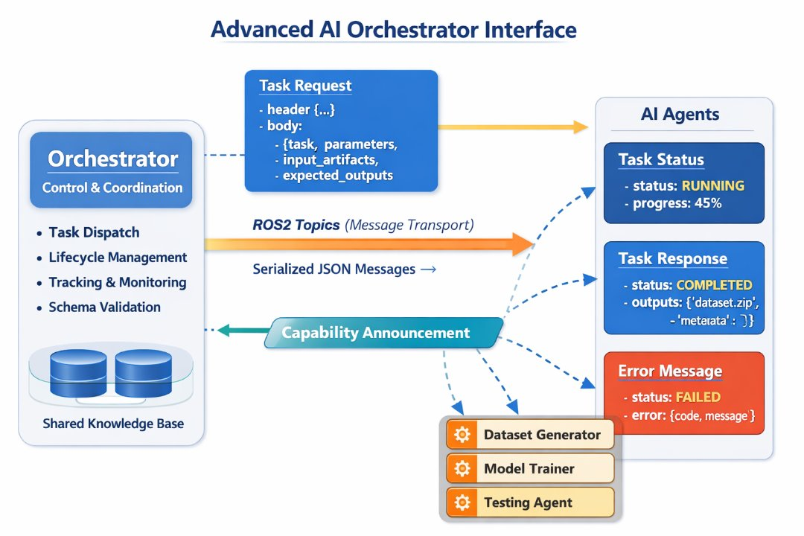
Interface
Clear decoupling
Container-friendly
Pub/sub scalability
Structured JSON communication
Allows routing
Enables:
Traceability
Versioning
Replay
auditing
Dynamic routing
Capability matching
Agent replacement
Notes:
Today we’re not reporting results—we’re ensuring we can deliver them. The asks are surgical:

Slide 6
API Concept

Slide 7
Unified Message Envelope
{
"header": {
"message_id": "uuid",
"correlation_id": "uuid",
"timestamp": "ISO8601",
"sender": "orchestrator",
"target_agent": "dataset_generator",
"message_type": "TASK_REQUEST",
"protocol_version": "1.0.0",
"project_id": "project_42",
"workflow_id": "wf_001",
"step_id": "step_003"
},
"body": {}
}
Notes:
Today we’re not reporting results—we’re ensuring we can deliver them. The asks are surgical:

Slide 8
Task Request Body
{
"task": {
"task_id": "task_789",
"task_type": "generate_dataset",
"priority": "NORMAL",
"retry_policy": {
"max_retries": 3,
"backoff_strategy": "exponential"
},
"timeout_seconds": 600
},
"parameters": {
"dataset_name": "vehicle_dataset_v1",
"amount": 50,
"datatype": "jpeg",
"image_size": {
"width": 1024,
"height": 768
},
"output_format": "COCO"
},
"input_artifacts": [],
"expected_outputs": [
{
"name": "dataset_archive",
"type": "zip",
"schema": "dataset_schema_v2"
}
]
}
Notes:
Today we’re not reporting results—we’re ensuring we can deliver them. The asks are surgical:

Slide 9
Task Status Message
{
"header": { ... },
"body": {
"task_id": "task_789",
"status": "RUNNING",
"progress": 45,
"estimated_completion": "ISO8601"
}
}
Notes:
Today we’re not reporting results—we’re ensuring we can deliver them. The asks are surgical:

Slide 10
Task Response (Success)
{
"header": { ... },
"body": {
"task_id": "task_789",
"status": "COMPLETED",
"execution_time_ms": 34212,
"output_artifacts": [
{
"artifact_id": "artifact_555",
"name": "vehicle_dataset_v1",
"location": "s3://datasets/vehicle_v1.zip",
"checksum": "sha256:xxxx",
"metadata": {
"samples": 50,
"format": "jpeg"
}
}
],
"logs_reference": "logstore://task_789"
}
}
Notes:
Today we’re not reporting results—we’re ensuring we can deliver them. The asks are surgical:

Slide 11
Task Response (Failure)
{
"header": { ... },
"body": {
"task_id": "task_789",
"status": "FAILED",
"error": {
"error_code": "DATA_GEN_TIMEOUT",
"error_message": "Image generation exceeded timeout",
"retryable": true
}
}
}
Notes:
Today we’re not reporting results—we’re ensuring we can deliver them. The asks are surgical:

Slide 12
Capability Registration Interface
{
"header": {
"message_type": "CAPABILITY_ANNOUNCEMENT"
},
"body": {
"agent_name": "dataset_generator",
"version": "2.1.0",
"supported_tasks": [
{
"task_type": "generate_dataset",
"input_schema": "dataset_gen_v2",
"output_schema": "dataset_artifact_v2"
}
],
"hardware_requirements": {
"gpu": true,
"memory_gb": 16
}
}
}
Notes:
Today we’re not reporting results—we’re ensuring we can deliver them. The asks are surgical:

Slide 13
Pseudo Interface Specification: Agent API Contract
interface Agent {
onTaskRequest(TaskRequest request) -> void
publishTaskStatus(TaskStatus status) -> void
publishTaskResponse(TaskResponse response) -> void
publishHeartbeat(Heartbeat msg) -> void
publishCapability(CapabilityAnnouncement msg) -> void
}
Notes:
Today we’re not reporting results—we’re ensuring we can deliver them. The asks are surgical:

Slide 14
Pseudo Interface Specification: Orchestrator API Contract
interface Orchestrator {
registerAgent(CapabilityAnnouncement capability)
dispatchTask(TaskRequest request)
updateTaskState(TaskStatus status)
finalizeTask(TaskResponse response)
handleFailure(ErrorMessage error)
}
Notes:
Today we’re not reporting results—we’re ensuring we can deliver them. The asks are surgical:

Slide 15
Orchestrator

Slide 16
States -> Transitions
From | Event | To
INITIALIZING | Agents registered | IDLE
IDLE | Workflow submitted | ACTIVE
ACTIVE | All workflows done | IDLE
ACTIVE | Agent failure detected | DEGRADED
DEGRADED | Recovery successful | ACTIVE
DEGRADED | Critical failure | RECOVERY
RECOVERY | System restored | IDLE
ANY | Shutdown signal | SHUTDOWN

Slide 17
Orchestrator Internal Modules (example)
+-------------------------------------------------+
| ORCHESTRATOR |
|--------------------------------------------------|
| 1. Workflow Manager |
| 2. Task Scheduler |
| 3. Agent Registry |
| 4. State Store |
| 5. Event Processor |
| 6. Provenance Manager |
| 7. Retry Manager |
| 8. Timeout Monitor |
| 9. Compensation Engine |
+-------------------------------------------------+

Slide 18
Task State Machine
CREATED # Task exists but not yet scheduled.
QUEUED # Ready for execution but waiting for agent availability.
DISPATCHED # Message sent to agent.
ACKNOWLEDGED # Agent confirmed receipt.
RUNNING # Agent actively executing.
PROGRESSING # Optional granular state for long-running tasks.
COMPLETED # Successful execution.
FAILED # Execution failed.
RETRYING # Retry policy activated.
TIMEOUT # Exceeded execution deadline.
CANCELLED # Manually cancelled.
COMPENSATING # Rollback logic executing.
COMPENSATED # Rollback completed.

Slide 19
Workflow Transition Diagram
CREATED
↓ validate
VALIDATING
↓ valid
READY
↓ dispatch first tasks
RUNNING
↓ tasks pending dependencies
BLOCKED
↓ dependency resolved
RUNNING
↓ all tasks completed
COMPLETED
↓ error
FAILED

Slide 20















THANKS!

