Slide 1

WP6 T6.1 - Observability
Hemanth Singh & Yasin Ünal | BitNet
01.09.2026

Slide 2
One observability plane for every KIO agent.

Slide 3


Contents
Why observability
End-to-end execution & telemetry flow
In-process SDK flow — two parallel streams
Grafana dashboard
Data contract & onboarding
Remote KIO connectivity
Key takeaways

Slide 4
Why Observability
KIO microservices are built by different consortium partners, orchestrated together at runtime.
OpenTelemetry + Langfuse give the platform one standardized view across all of them.
Orchestrator & worker health, request latency, execution paths, and LLM token usage — one shared contract, one dashboard.

Slide 5
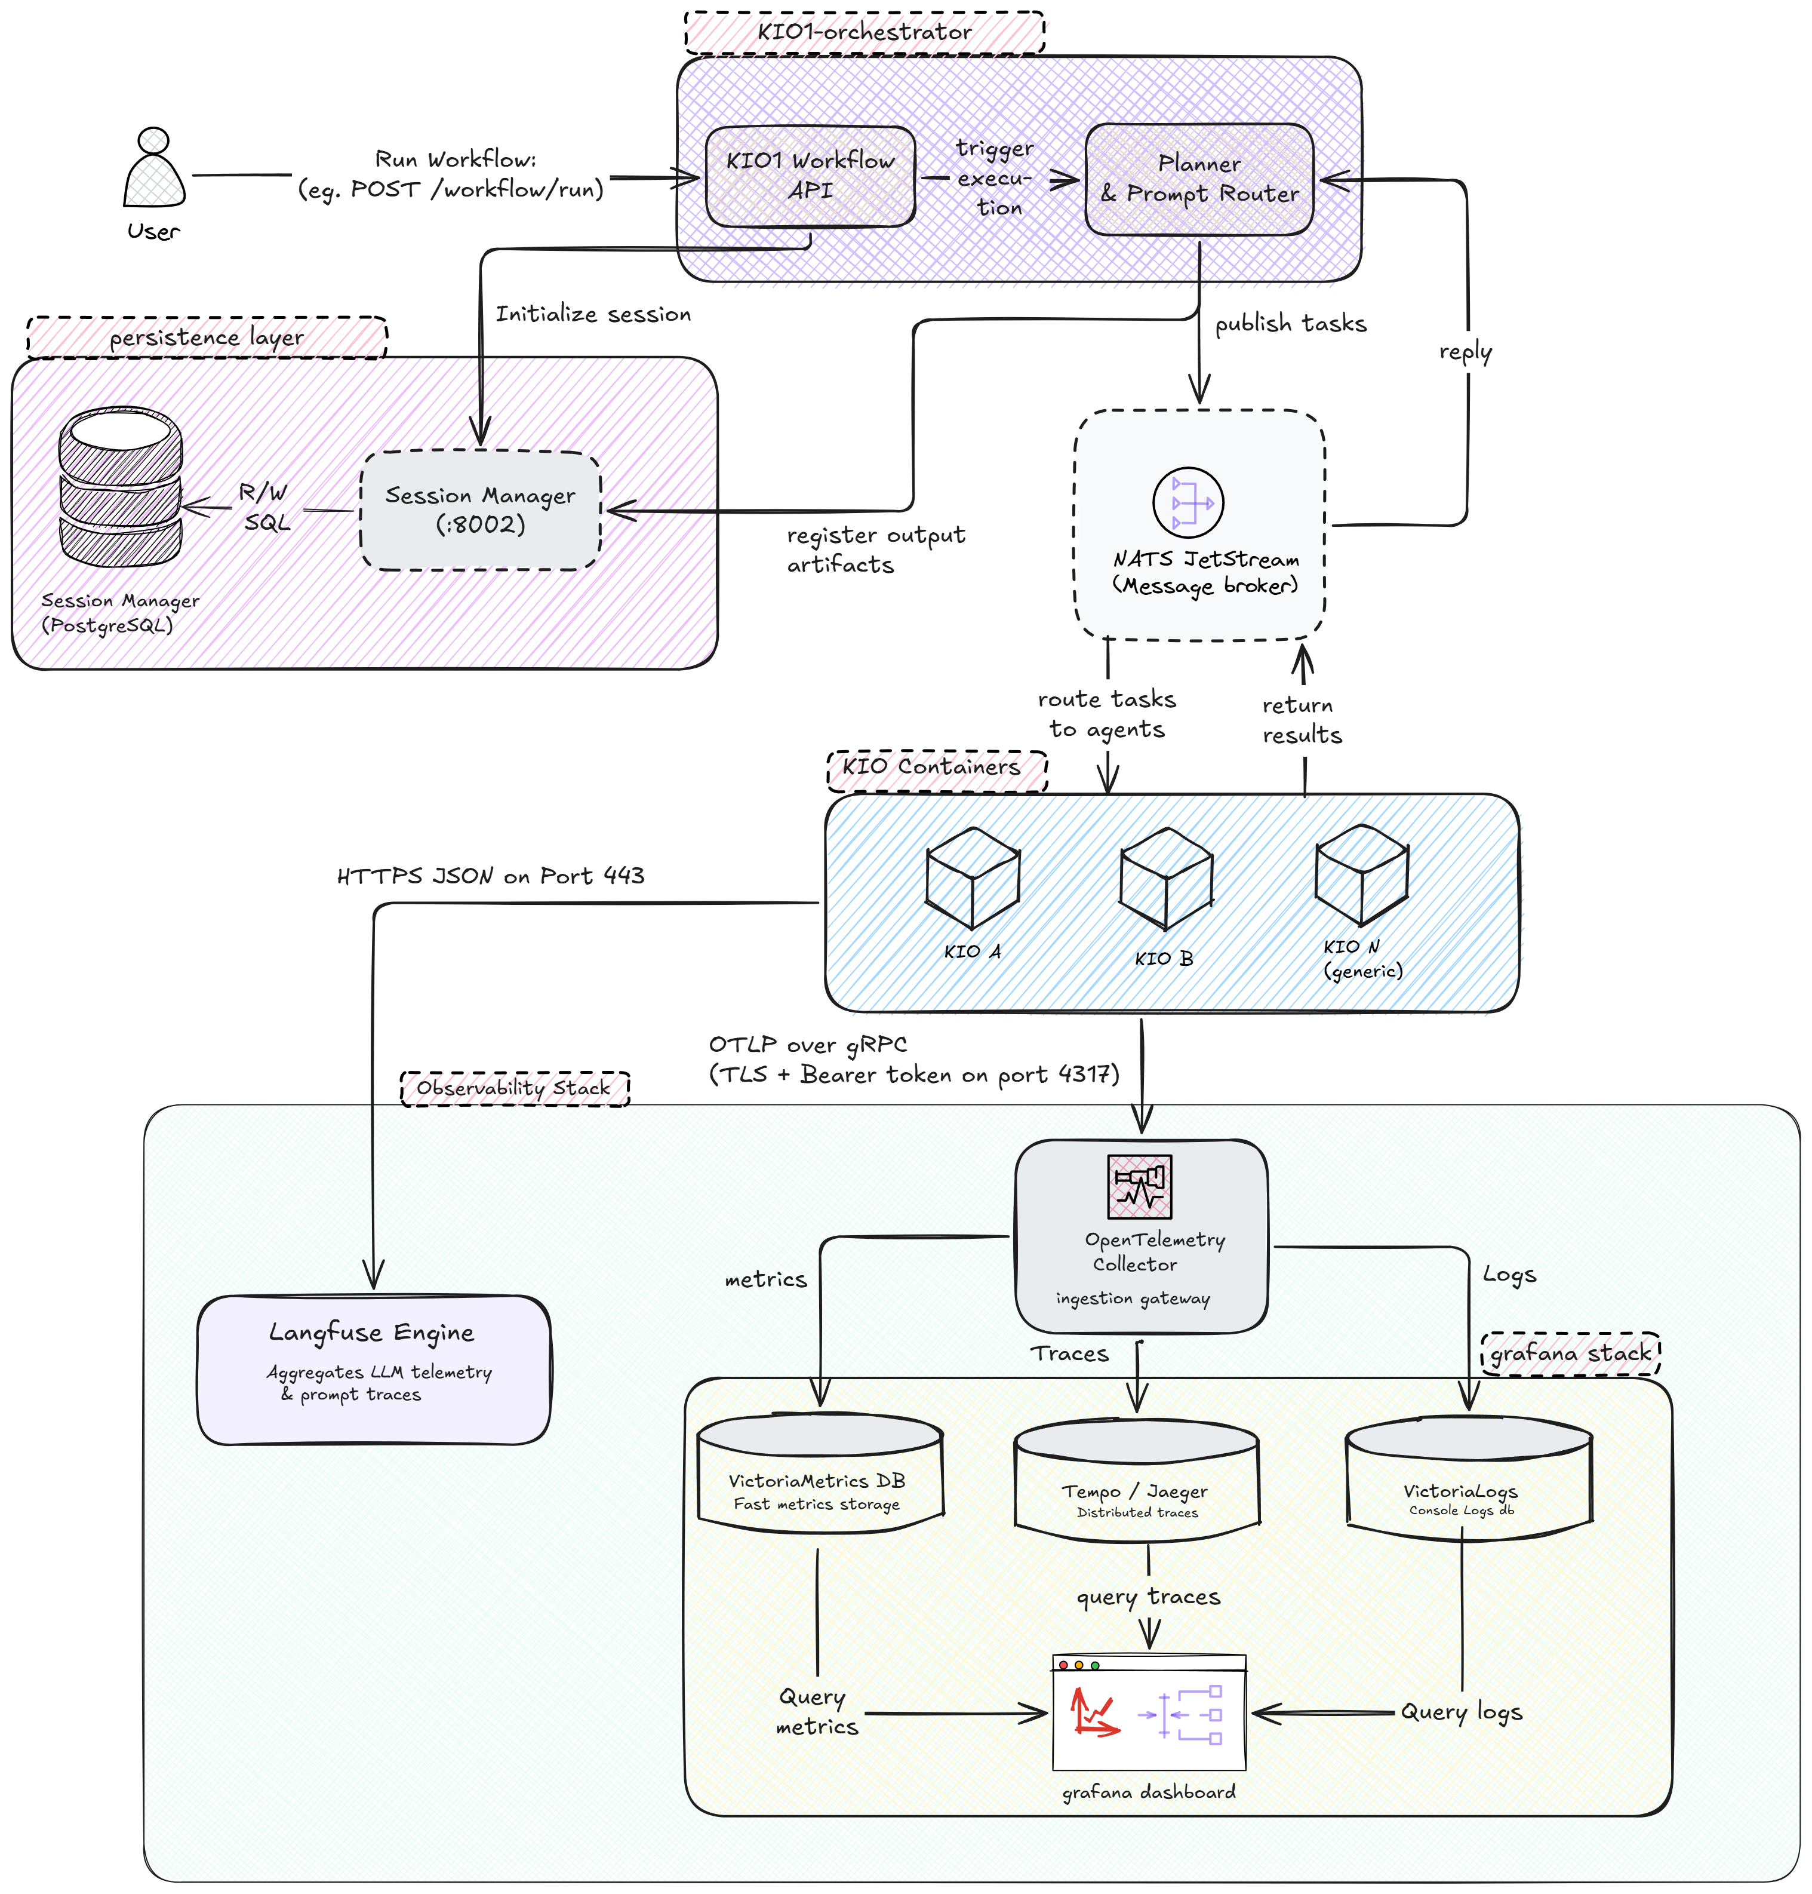
End-to-End Execution & Telemetry Flow

Slide 6
End-to-End Flow — Step by Step
Orchestration
  Workflow triggering — client POSTs to the KIO1 Workflow API
  Session initialisation — Session Manager records the session in PostgreSQL, returns a session id
  Task routing — Planner & Prompt Router builds the workflow graph, publishes via NATS (KIOEnvelope)
  Agent execution — NATS routes the envelope to the target KIO container
Telemetry & Completion
  Telemetry transmission — the KIO pushes OTLP (metrics/traces/logs) and Langfuse (prompts/cost) in parallel
  Telemetry routing — the Collector fans out to VictoriaMetrics, Tempo, VictoriaLogs
  Task completion & lineage — results return via NATS; the Planner logs output lineage in PostgreSQL

Slide 7
The Observability Stack
VictoriaMetrics
Tempo
Time-series metrics store — CPU, request counts, durations. Queried via PromQL.
Distributed tracing backend — exact execution timeline & code path across containers. Queried via TraceQL.
VictoriaLogs
Grafana
Log store for the KIOs' unstructured telemetry, indexed by session id & kio id. Queried via LogsQL.
Single web portal — dynamically filters and renders all three stores on one interactive screen.

Slide 8
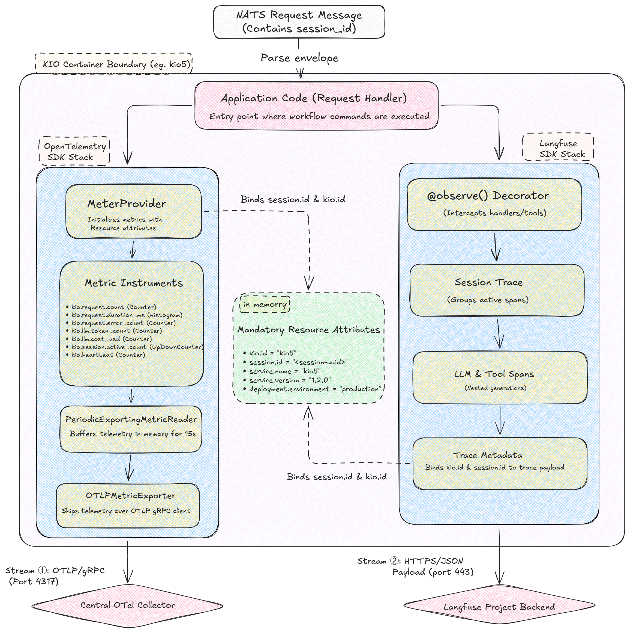
In-Process SDK Flow

Slide 9
Two Parallel Telemetry Streams
OpenTelemetry stream
  MeterProvider binds kio.id, service.name/version, deployment.environment
  Metric instruments record counts, durations, active sessions
  Buffered up to 15s, then pushed as OTLP over gRPC (4317) or HTTP (4318), bearer-token authenticated
Langfuse stream
  @observe() decorator intercepts the handler, opens a session trace
  Child spans capture prompt text, model, tokens, and duration per LLM/tool call
  Session id & kio id stamped as trace metadata, matching the OTel attributes; sent as JSON over HTTPS

Slide 10
Grafana Dashboard
System Liveness & Concurrency
Performance & Volumetrics
Heartbeat state timeline (green/red per KIO) and active-session count — VictoriaMetrics / PromQL.
Request rate (OK vs error) and P50 / P95 / P99 latency — VictoriaMetrics / PromQL.
Reliability & Tracing
AI Economics
Console logs via VictoriaLogs (LogsQL) and per-span trace waterfall via Tempo (TraceQL).
Cumulative LLM cost (USD) and input/output token throughput — VictoriaMetrics / PromQL.

Slide 11
Mandatory Metrics Contract
Metric | Type | Unit | Description
kio.request.count | Counter | 1 | Total requests (status = ok | error)
kio.request.duration_ms | Histogram | ms | End-to-end request latency
kio.request.error_count | Counter | 1 | Errors by category (error_type)
kio.llm.token_count | Counter | tokens | Input / output tokens (direction)
kio.llm.cost_usd | Counter | USD | Estimated LLM API cost
kio.session.active_count | UpDownCounter | 1 | Concurrent active requests
kio.heartbeat | Counter | 1 | Liveness tick, every 60 seconds
Every metric also carries the kio.id label. Names are permanent once released — dot notation kio.<domain>.<metric>.

Slide 12
Rules & Conventions
Naming — dot notation kio.<domain>.<metric>, never renamed once released
Low cardinality — no session ids, user names, or URLs as metric labels; session id lives in trace metadata only
No secrets or PII — never in metric labels or Langfuse payloads
Heartbeat — background counter every 60s; silence beyond 120s flags the KIO offline

Slide 13
120s
Maximum heartbeat silence before a KIO is flagged offline in the platform

Slide 14
Onboarding — Connecting a New KIO
1. Request credentials — OTLP bearer token + Langfuse public/secret keys from the platform team
2. Configure environment — OTEL_EXPORTER_OTLP_ENDPOINT, _HEADERS, _RESOURCE_ATTRIBUTES, LANGFUSE_* variables
3. Install packages — opentelemetry-api / -sdk + an OTLP exporter + langfuse
4. Initialise the SDKs — register the global MeterProvider at start-up
5. Verify — confirm kio.heartbeat in Grafana and a trace in Langfuse

Slide 15
Remote KIO Connectivity
Push-based by design — the platform never pulls; a KIO only needs outbound reach to the collector
Location-independent — same LAN, or across networks via a VPN such as Tailscale; only the endpoint host changes, no code change
Firewall — the platform host must allow inbound traffic on the OTLP port (4317/4318), or share a VPN
Same bearer token, sent via OTEL_EXPORTER_OTLP_HEADERS
Verify — a TCP check to the port, then confirm kio.heartbeat in Grafana (KIO Detail)

Slide 16
Key Takeaways
One shared contract — 7 mandatory metrics, dot-notation names, permanent once released
Two parallel streams — OpenTelemetry and Langfuse, bound to the same kio.id and session.id
One Grafana pane — VictoriaMetrics + Tempo + VictoriaLogs, filterable by container and session
Push-based & remote-friendly — any KIO connects the same way, with no code change
Secured — bearer-token authenticated OTLP; low-cardinality, secret-free telemetry by design

Slide 17

THANKS!
Do you have any questions?
hemant@bitnet.com.tr
yasin@bitnet.com.tr

