Slide 1

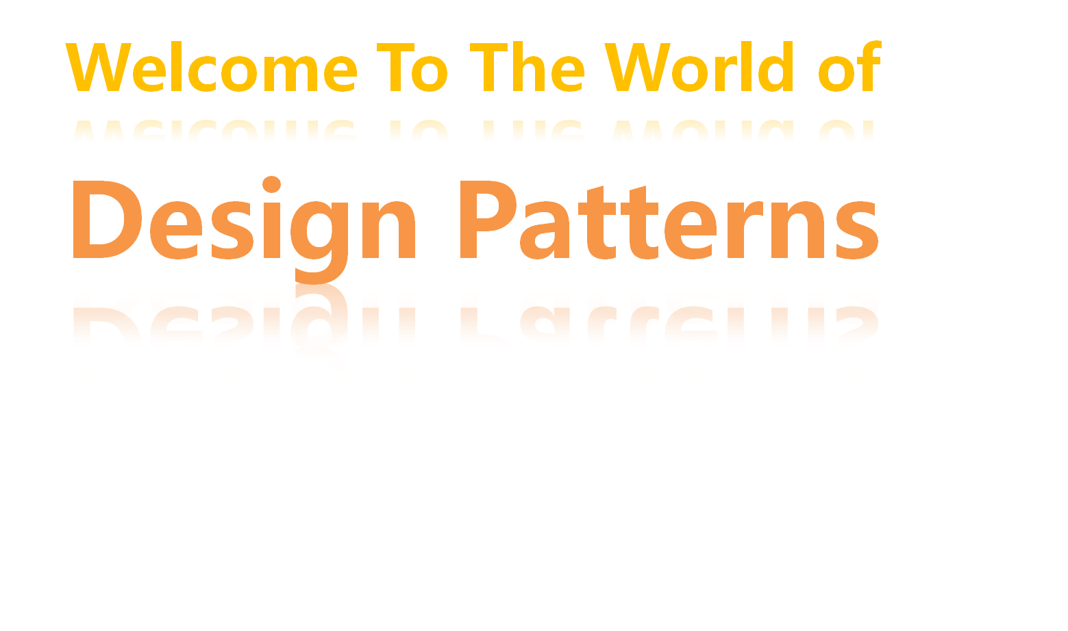


Slide 2
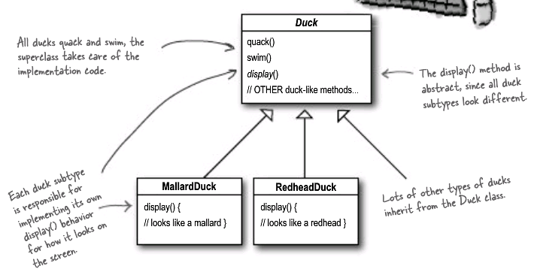
Think about this situation?
  Now we need the ducks to FLY
2 / 9

Slide 3
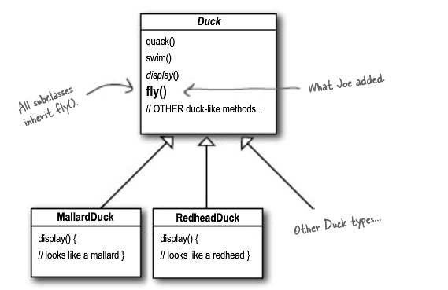
Solution 1
  But there is a problem that there were rubber ducks flying around the screen.
3 / 9

Slide 4
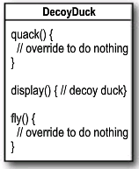
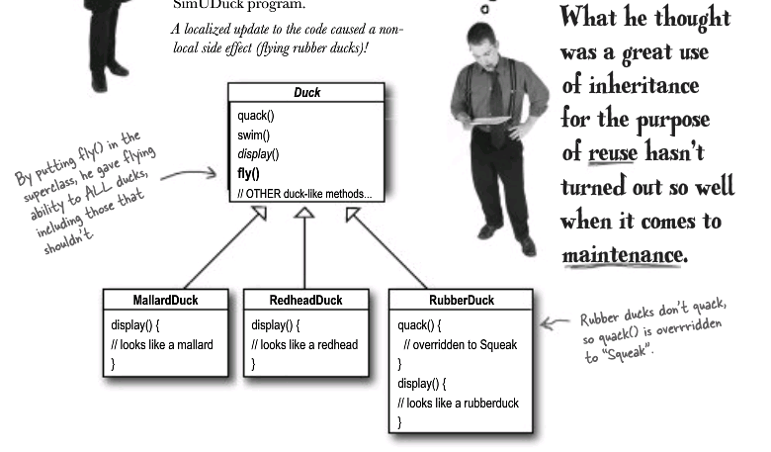
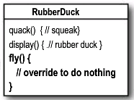
Fix —— using inheritance
  Which are disadvantages of using subclass to provide specific Duck behavior?
4 / 9

Slide 5
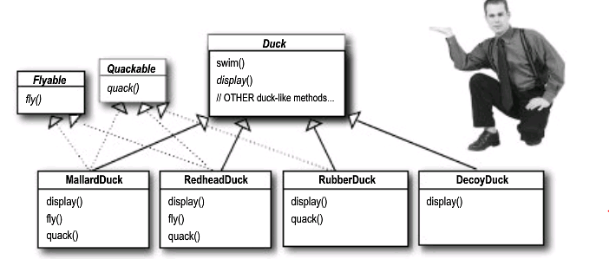
Solution 2 —— using interface
  What do you think about this design?
5/ 9

Slide 6
Solution 3 —— using strategy pattern
    The Strategy pattern defines a family of algorithms,
    Encapsulates each one, and makes them interchangeable. Strategy lets algorithm vary independently from clients that use it.
6/ 9

Slide 7
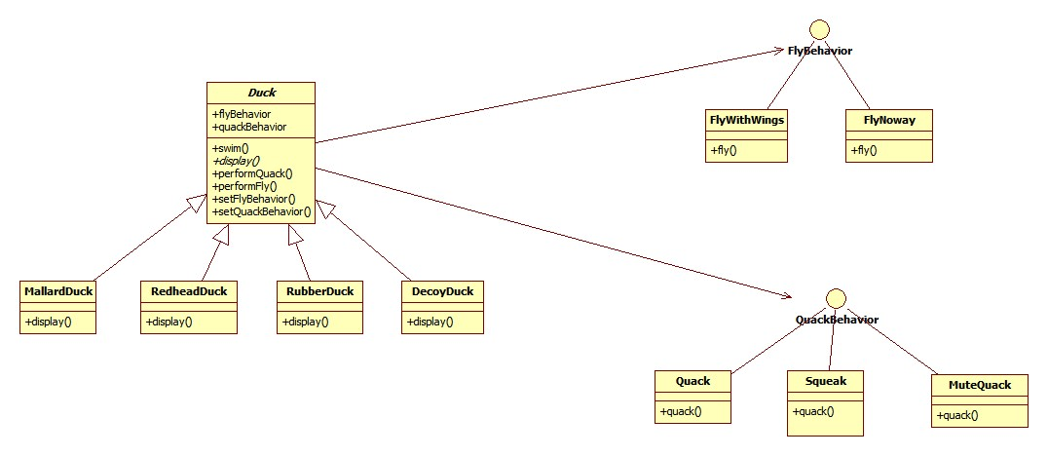
Solution 3
7/ 9

Slide 8
Solution 3
    Advantages: ?
    Disadvantages: ?
    Cases: ?
8/ 9

Slide 9

课件制作
Thank you！

