Slide 1
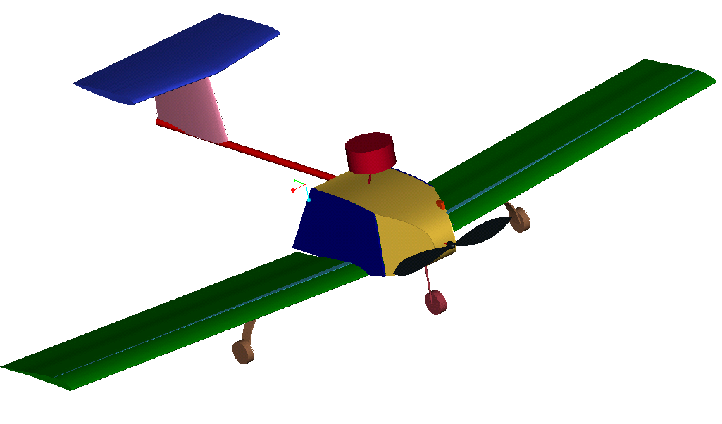
AERODRONE F8273
UCSD AIAA Design-Build-Fly 2003 Competition

Slide 2
What the 2003 DBF competition is all about…
General Requirements:
The unassembled aircraft must fit into a 1 x 2 x 4 foot box. Assembly of the aircraft will be timed and is considered in the overall score.
2. To commemorate the 1903 Wright Brothers flight distance, take-off must be within 120 feet.
3. The aircraft must complete two of the three missions:

Slide 3
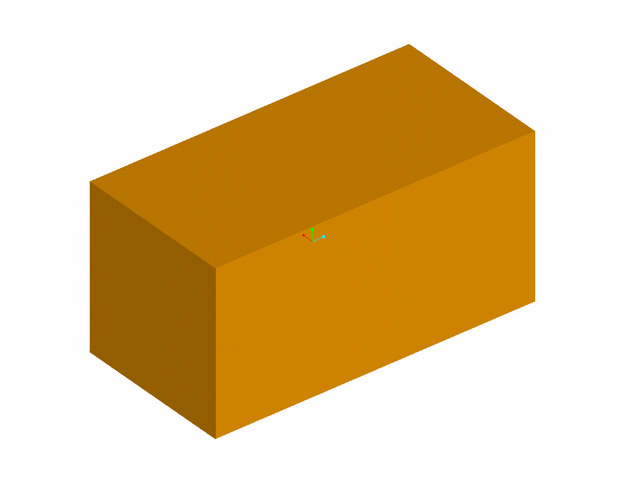
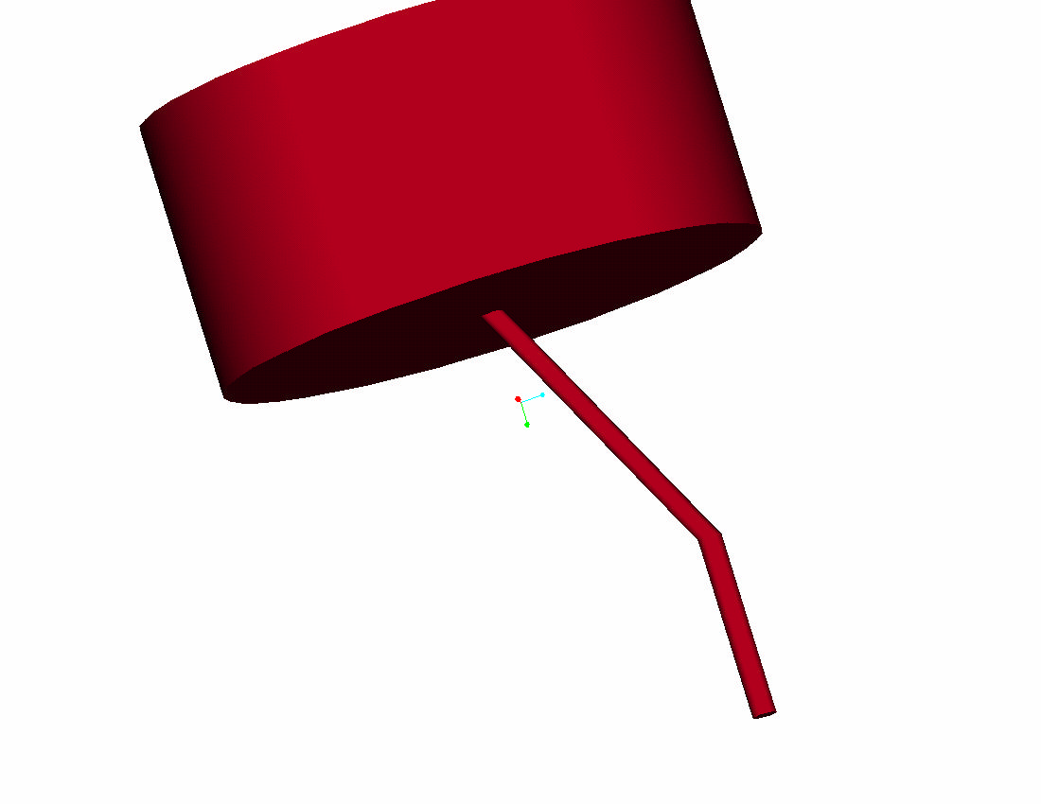
Cargo Box
Antenna

Slide 4
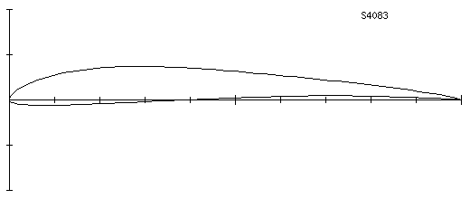
Aircraft Aerodynamics
Re: 300000 (take off) and 650000 (vmax)
Wing Airfoil: S4083
Airfoils Rejected: S1223, E423, E21x series
Wing Span: 8.75 ft with a 14 inch chord.

Slide 5
Why this airfoil
Low Drag at Cruise
High Cl (1.3)
High Lift to Drag Ratio (14.7)
Satisfactory Take off Distance for a 16.5 lbs aircraft (from pro-e weight estimation)

Slide 6
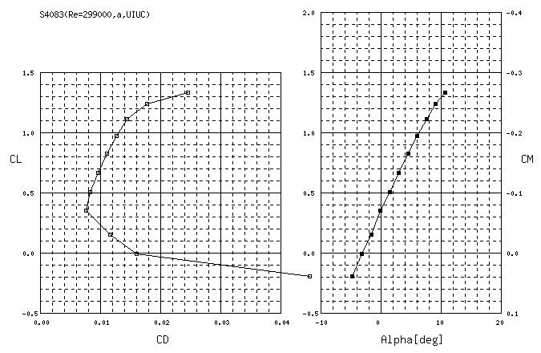
Airfoil Characteristics

Slide 7
Propulsion
Motor selection was limited by the rules of the contest to Graupner and Astro with a 40 amp fuse. Using MotorCalc required battery capacity, motor selection, and propeller properties were calculated for the required thrust and speed.
Motor: Graupner 3300-7 (single motor)
Battery: Sanyo-2400 (19 cell pack)
Propeller: 18in diameter with 15in pitch

Slide 8
Aircraft Performance
Turning Rate: 116 deg/sec Instantaneous (5.56 g)
75 deg/sec Sustained (4.85g)
Take-off Distance: 101 ft (out of 120 ft max)
Climb Rate: 14 ft/sec
Vstall: 36.6 ft/sec
Vto: 40.2 ft/sec
Vcruise: 54.1 ft/sec
Vmax: 86.4 ft/sec

Slide 9
Mission Times
We have calculated times for all three missions and have decided to do missions with difficulty factor of 2.0 and 1.5
Difficulty 2.0:
T(vcruise) = 3min 15 sec
T(vmax) = 2 min 25 sec
Difficulty 1.5:
T(vcruise) = 3min 20 sec
T(vmax) = 2 min 30 sec
Final scores:
Cruising: 10.27 with RAC (7.98)
Maxing: 10.81 with RAC (9.06)

Slide 10
Empennage
Vertical Tail Horizontal Tail
Span: 10 in; Span: 24 in;
Croot: 14 in; Croot: 14.3 in;
Ctip: 11.9 in; Ctip: 12.1 in;
Tail Airfoil: Thin symmetric airfoil
NACA 0009

Slide 11
Stability and Controls
Flaperons for control of the roll and to increase the coefficient of Lift at take-off
Flaperon Length = 70% of the span
Flaperon Chord = 18% of the wing chord
Rudder Chord = 25% of the chord vertical stabilizer
Elevator Chord =20% of the chord horizontal stabilizer
The Cg of the plane is ahead of the Center of Pressure, thus provides a static stability for the aircraft.
Xcg=21% MAC Xcp=45%MAC

Slide 12
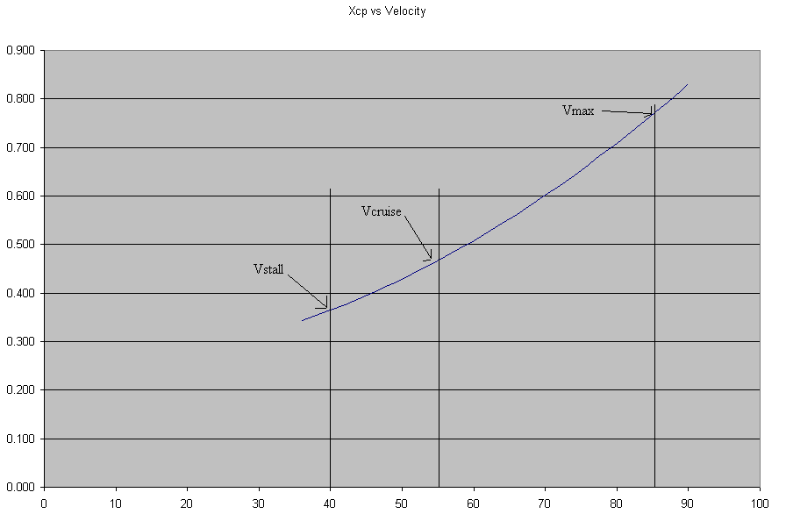

Slide 13
Aircraft Design
Structures
Design Method:
Designed a functional shape.
Assessed load paths.
Selected materials based on properties; bending,
shear, torsion, ect.
Derived thicknesses from solid mechanics, supplies available
and engineering intuition.
Verified Design with Finite Element Modeling.
F
E
E
D
B
A
C
K

Slide 14
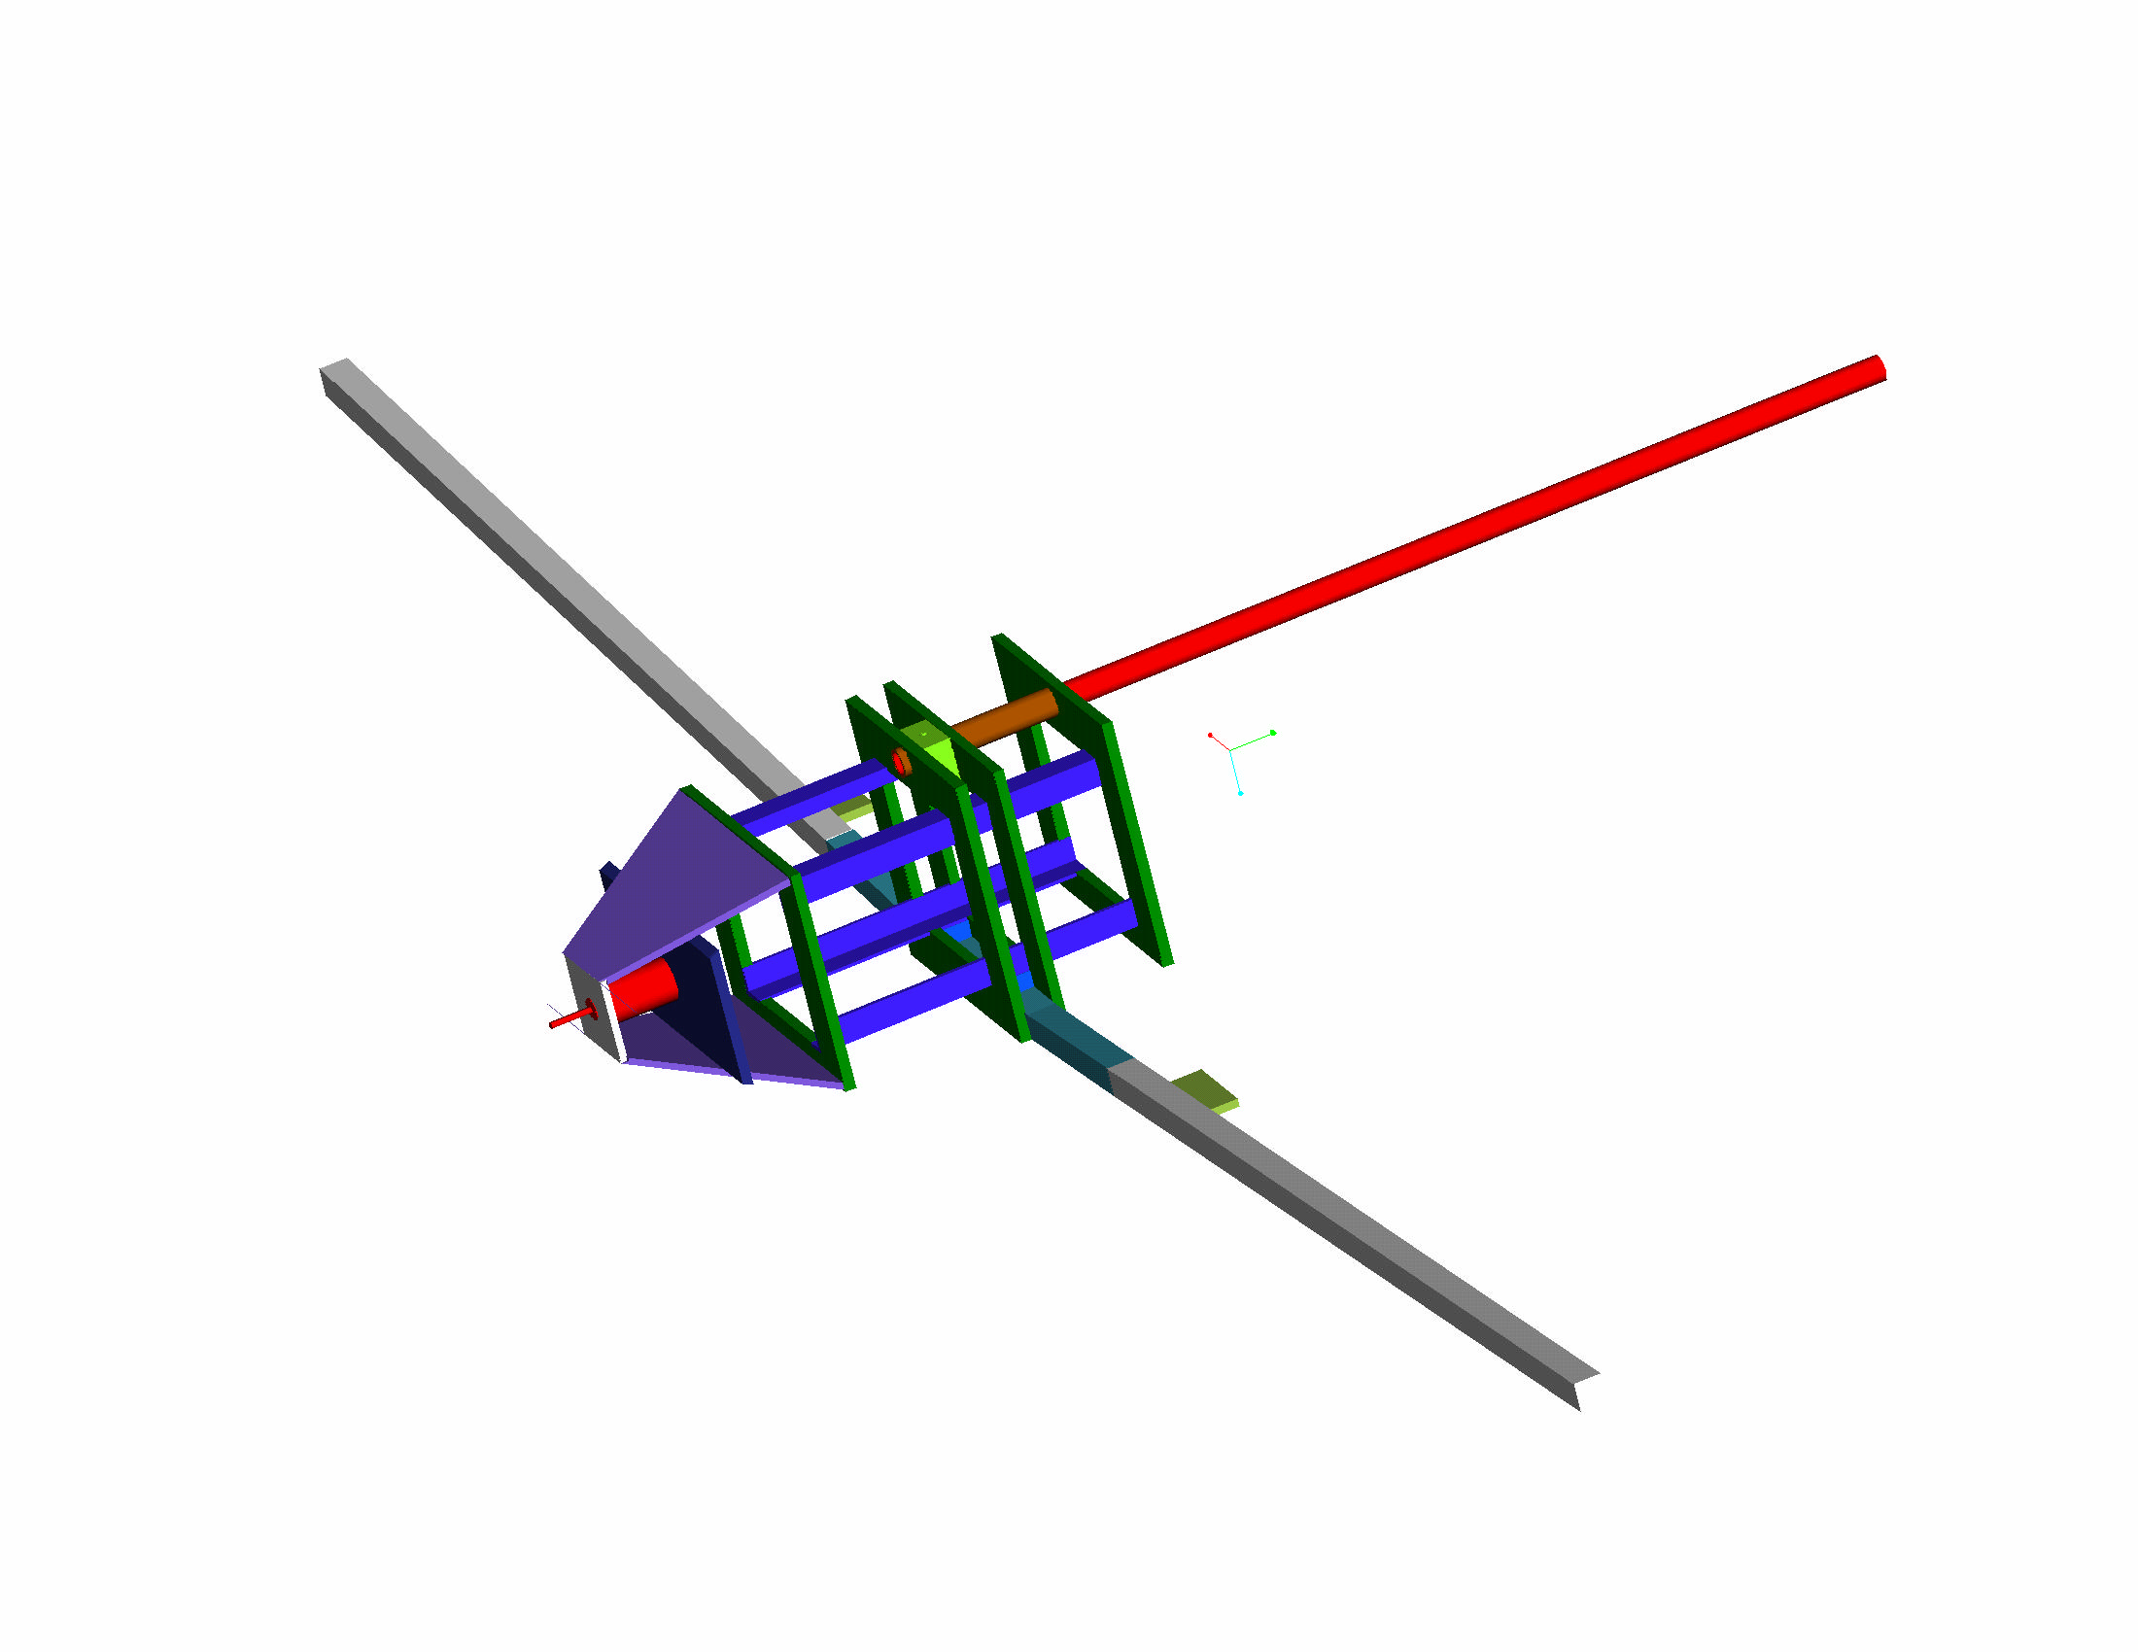
Aircraft Design
Structures
Weight Fully Loaded = 16 lb
Weight Unloaded = 11 lb
F.S. Yield = 1.5
F.S. Ultimate = 2.0
n = 5.6
CG without Batteries = 2.3 in. behind the Quarter Chord
CG desired = 0.5 in. front of the Quarter Chord
2.2lb Battery Placement = 7.6 in. front of the Quarter Chord

Slide 15
Aircraft Design
Structures
Wing Joiner:
  -One-piece foam core component (unidirectional carbon fiber top and bottom)
  -Entire part is wrapped with bi-directional carbon fiber
    (located below the payload and between two bulkheads to allow loads to transfer to the primary structure)
Wing Spar:
  -Made of the same composition as the joiner.
  -Loads from the spars are transferred to the joiner through a carbon fiber wrap sleeve.

Slide 16
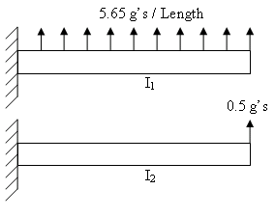
Aircraft Design
Structures
Requirements:
1) The spar must be able to withstand a distributed load of 5.65g’s with F.S. 2.0
2) The spar must be able to withstand a wing test at its tip of 0.5g’s with F.S. 2.0
3) Consider impact loads from hard landings
4) Torsion due to pitching moment.
Method:
h= (thickness of carbon fiber)
s(b)=M(l)*c/I=M(l)*c/(b*h^3/12)
M(l)=w*l^2/2

Slide 17
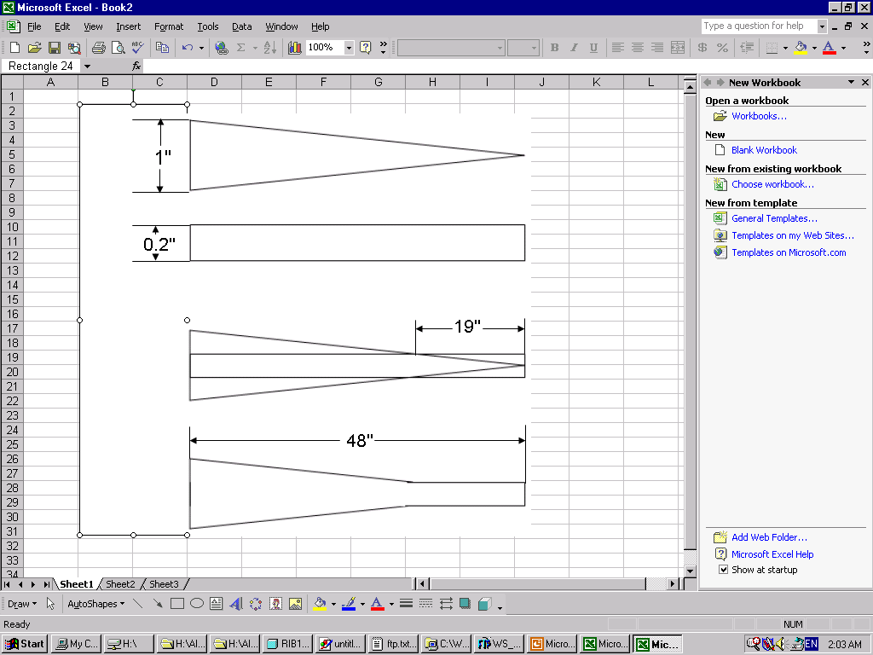
Aircraft Design
Structures
SPAR UNDER LOAD
FIGURE 1:
  5.6g distributed load
FIGURE 2:
  0.5g point load applied at wing tips
  (A safety test is preformed by lifting the plane by its wing tips, simulating a 0.5g load)
FIGURE3:
  5.6g distributed load and 0.5g point load applied at wing tips
FIGURE 1
FIGURE 2
FIGURE 3

Slide 18
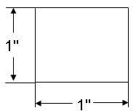
Aircraft Design
Structures
Pitching Moment= .095
Chord=14 in.
Dynamic Pressure=1.919x10^-3 psi
Torque at base=.224 ft. lbf.
tmax=12.923psi
Thickness required=.104in.
f=1.321x10-4 degrees
To reduce the amount of bi-directional carbon wrap laid at 45º around the spar and to assist in the stability of our wing, a torsion pin will be added
near the trailing edge.
t
b/h n1 n2
1.0 0.208 0.1406

Slide 19
Aircraft Design
Structures
Finite Element Analysis of the spar:
The spar structure was modeled using MSC Patran, with cantilever boundary conditions.
Distributed loads were used to model the loading during flight. 6 sections of constant loading were used to model the elliptical lift distribution of a finite wing.

Slide 20
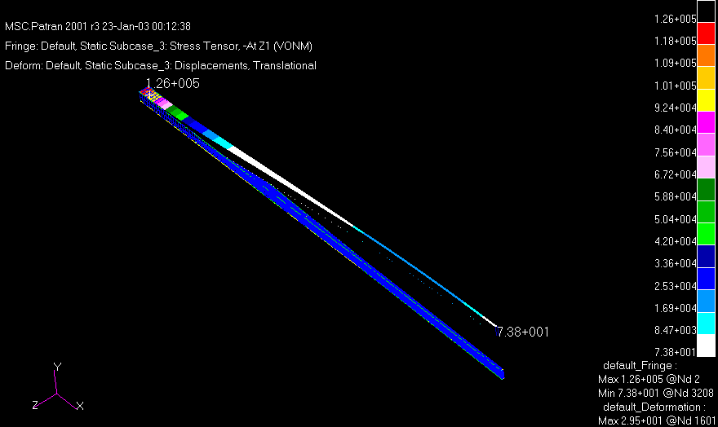
Aircraft Design
Structures

Slide 21
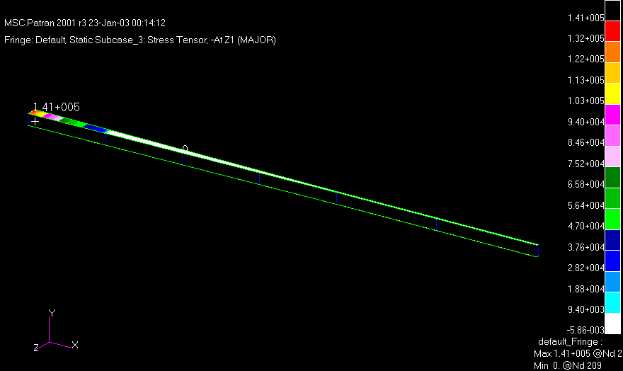
Aircraft Design
Structures

Slide 22
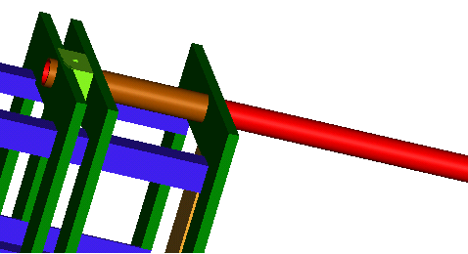
Aircraft Design
Structures
Boom:
        - 1” diameter carbon fiber tube inserted into a sleeve (mounted through 3 aft Bulkheads)
        - Sleeve provides a hard point to transfer loads to the primary structure

Slide 23
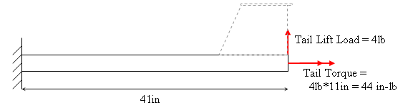
Aircraft Design
Structures
Boom: The boom is a 1” OD carbon fiber hollow tube with a wall thickness of .050”. Fiber ply orientation is [02/+-45]S.
J = .5*π(R_{O}⁴-R_{I}⁴) = .03376 in⁴
I = .25*π(R_{O}⁴-R_{I}⁴) = .01688 in4
Tip Deflection = .594 in
Tip Deflection = 1.188 in (with F.S. = 2)
Stress = 4857.82 lb/in^2
Stress = 9715.64 lb/in^2 (with F.S. = 2)
Shear Stress = 2428.91 lb/in^2
Shear Stress = 4857.82 lb/in^2 (with F.S. = 2)
OD = 1 in, Wall thickness = 0.05 in
E = 9.163E6 lb/in^2
G = 2.36E6 lb/in^2
Tensile Strength:
Longitudinal = 98,000 lb/in^2
Shear = 37,000 lb/in^2 (matrix)
  44,000 lb/in^2 (fiber)
Largest Allowable Torque = 2486.4in-lb

Slide 24
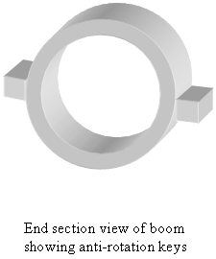
Aircraft Design
Structures
Boom Mount: The boom mount is designed to resist rotation and vertical/horizontal deflections.
Applied torque = 44in-lbs
= 88 in-lbs (with F.S.=2)
Applied shear stress = 2428.91 lb/in^2
= 4857.82 in-lbs (with F.S.=2)
Maximum shear stress of the matrix: 37,000 lb/in^2
Load (F.S. = 2): 8 lb
Required area of contact between the boom and the anti-rotation keys:
A= F/σ = 1.1E-4 in^2

Slide 25
Aircraft Design
Structures
Boom:
  -Carbon tow fiber anti-rotation keys are bonded to opposite sides of boom.
  -Contact area for each key is .125 in x 6 in = .75 in^2. (this far exceeds the minimum requirements outlined previously)
  -Keys also act as a guide in assembling.
  -Boom is kept from sliding by a screw-pin inserted from the top. (for mission with antennae, mounting stud serves as screw-pin)
  -Boom sleeve has cut-outs to receive anti-rotation keys and is kept as a torsion bearing member by a carbon-epoxy wrapped around outer circumference.
  -Between bulkheads 3 & 4, a wooden block houses the end of the boom and is equipped with a threaded insert to accept screw-pin.

Slide 26
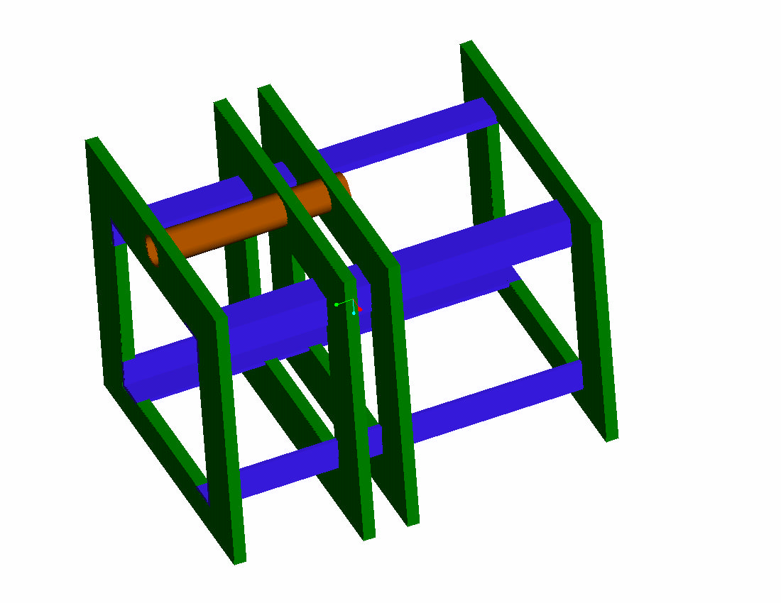
Aircraft Design
Structures
Primary Structure/Cargo Bay:
Fuselage:
  -Unidirectional carbon/foam core sandwich structure
Bulkheads:
  -5 bulkheads provide structural rigidity (aft 4 encase payload)
  -Sandwich structure made from unidirectional carbon and plywood.
Rails:
  -Payload held in place by 4 ‘L’ shaped rails running fore and aft through bulkheads.
  -Unidirectional carbon/foam sandwich structure (act to stiffen the fuselage)

Slide 27
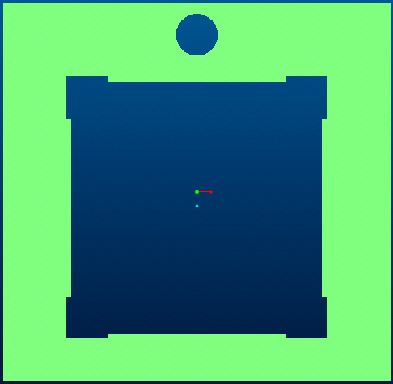
Aircraft Design
Structures
The Bulkheads
Material Selection
American Yellow Birch (betula alleghaniensis)
-hard, strong, and stiff
-high shock resistance, bending, and crushing strength
-glues well
-σ = 271518 lb/ft²
European Birch
(betula pendula)
-moderate strength, stiffness, stability, and shock resistance properties
-works easily
-glues well
-σ = 271518 lb/ft2

Slide 28
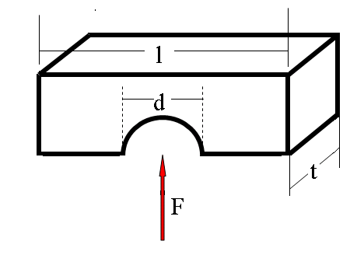
Aircraft Design
Structures
THICKNESS OF MATERIAL
Shear Stress
σ = F/dt ⇒ t = F/σd
Using σ_{YIELD}
for A.Y.B.W. t = 0.003 in
for E.B.W. t = 0.004 in
Factor of Safety = 1.5
Using σ_{ULT}
for A.Y.B.W. t = 0.004 in
for E.B.W. t = 0.005 in
Factor of Safety = 2

Slide 29
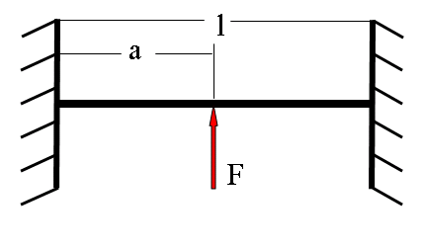
Aircraft Design
Structures
THICKNESS OF MATERIAL
Bending Stress
σ = -My/I ⇒ t = 12My/σh³
Using σ_{YIELD}
for A.Y.B.W. and E.B.W.
both thicknesses 0.03 in
Factor of Safety = 1.5
Using σ_{ULT}
for A.Y.B.W. and E.B.W.
both thicknesses 0.02 in t = 0.02 in
Factor of Safety = 2

Slide 30
Aircraft Design
Structures
Aft bulkhead was modeled in MSC Patran and loaded with the anticipated loading created by the empenage aerodynamic forces transferred through the boom.
Connections to rails were modeled by zero displacement boundary conditions.
  (This is not physically identical to the actual structure, but offers insight into the deformation behavior)

Slide 31
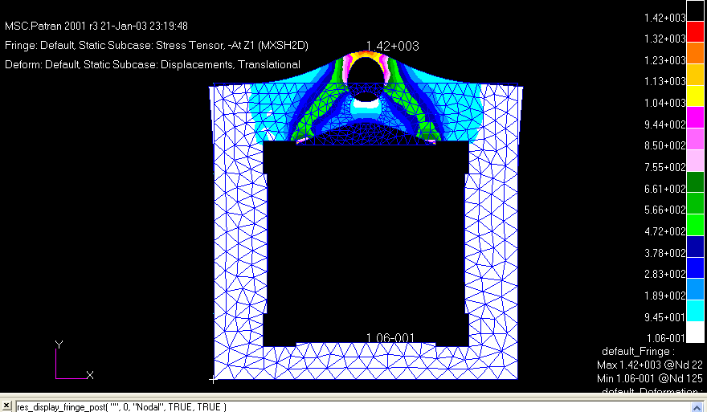
Aircraft Design
Structures

Slide 32
Aircraft Design
Structures
SECOND SET OF BOUNDARY CONDITIONS:
Able to visualize the effect of the unnatural boundary conditions used in the main modeling
Constraints on the top two corners were released
Shows a larger variation in stresses throughout the bulkhead indicating that the first set of BCs concentrated more of the deformation in the top of the bulkhead.
The real structure will exhibit a combination of these results.

Slide 33
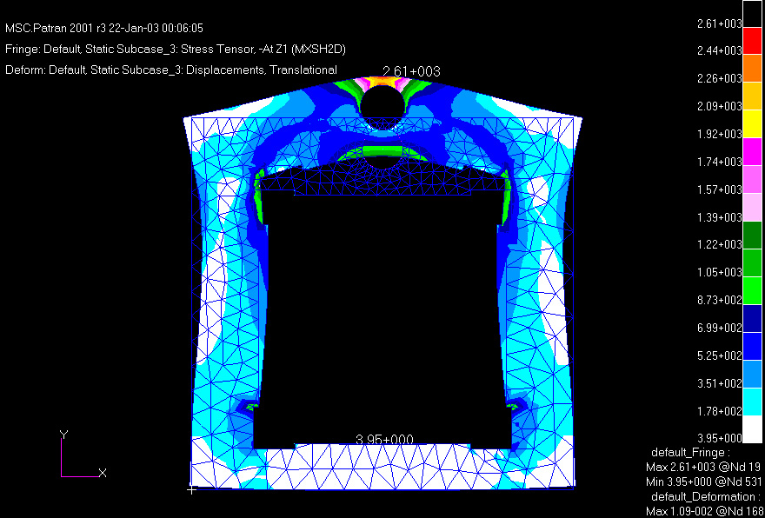
Aircraft Design
Structures

Slide 34
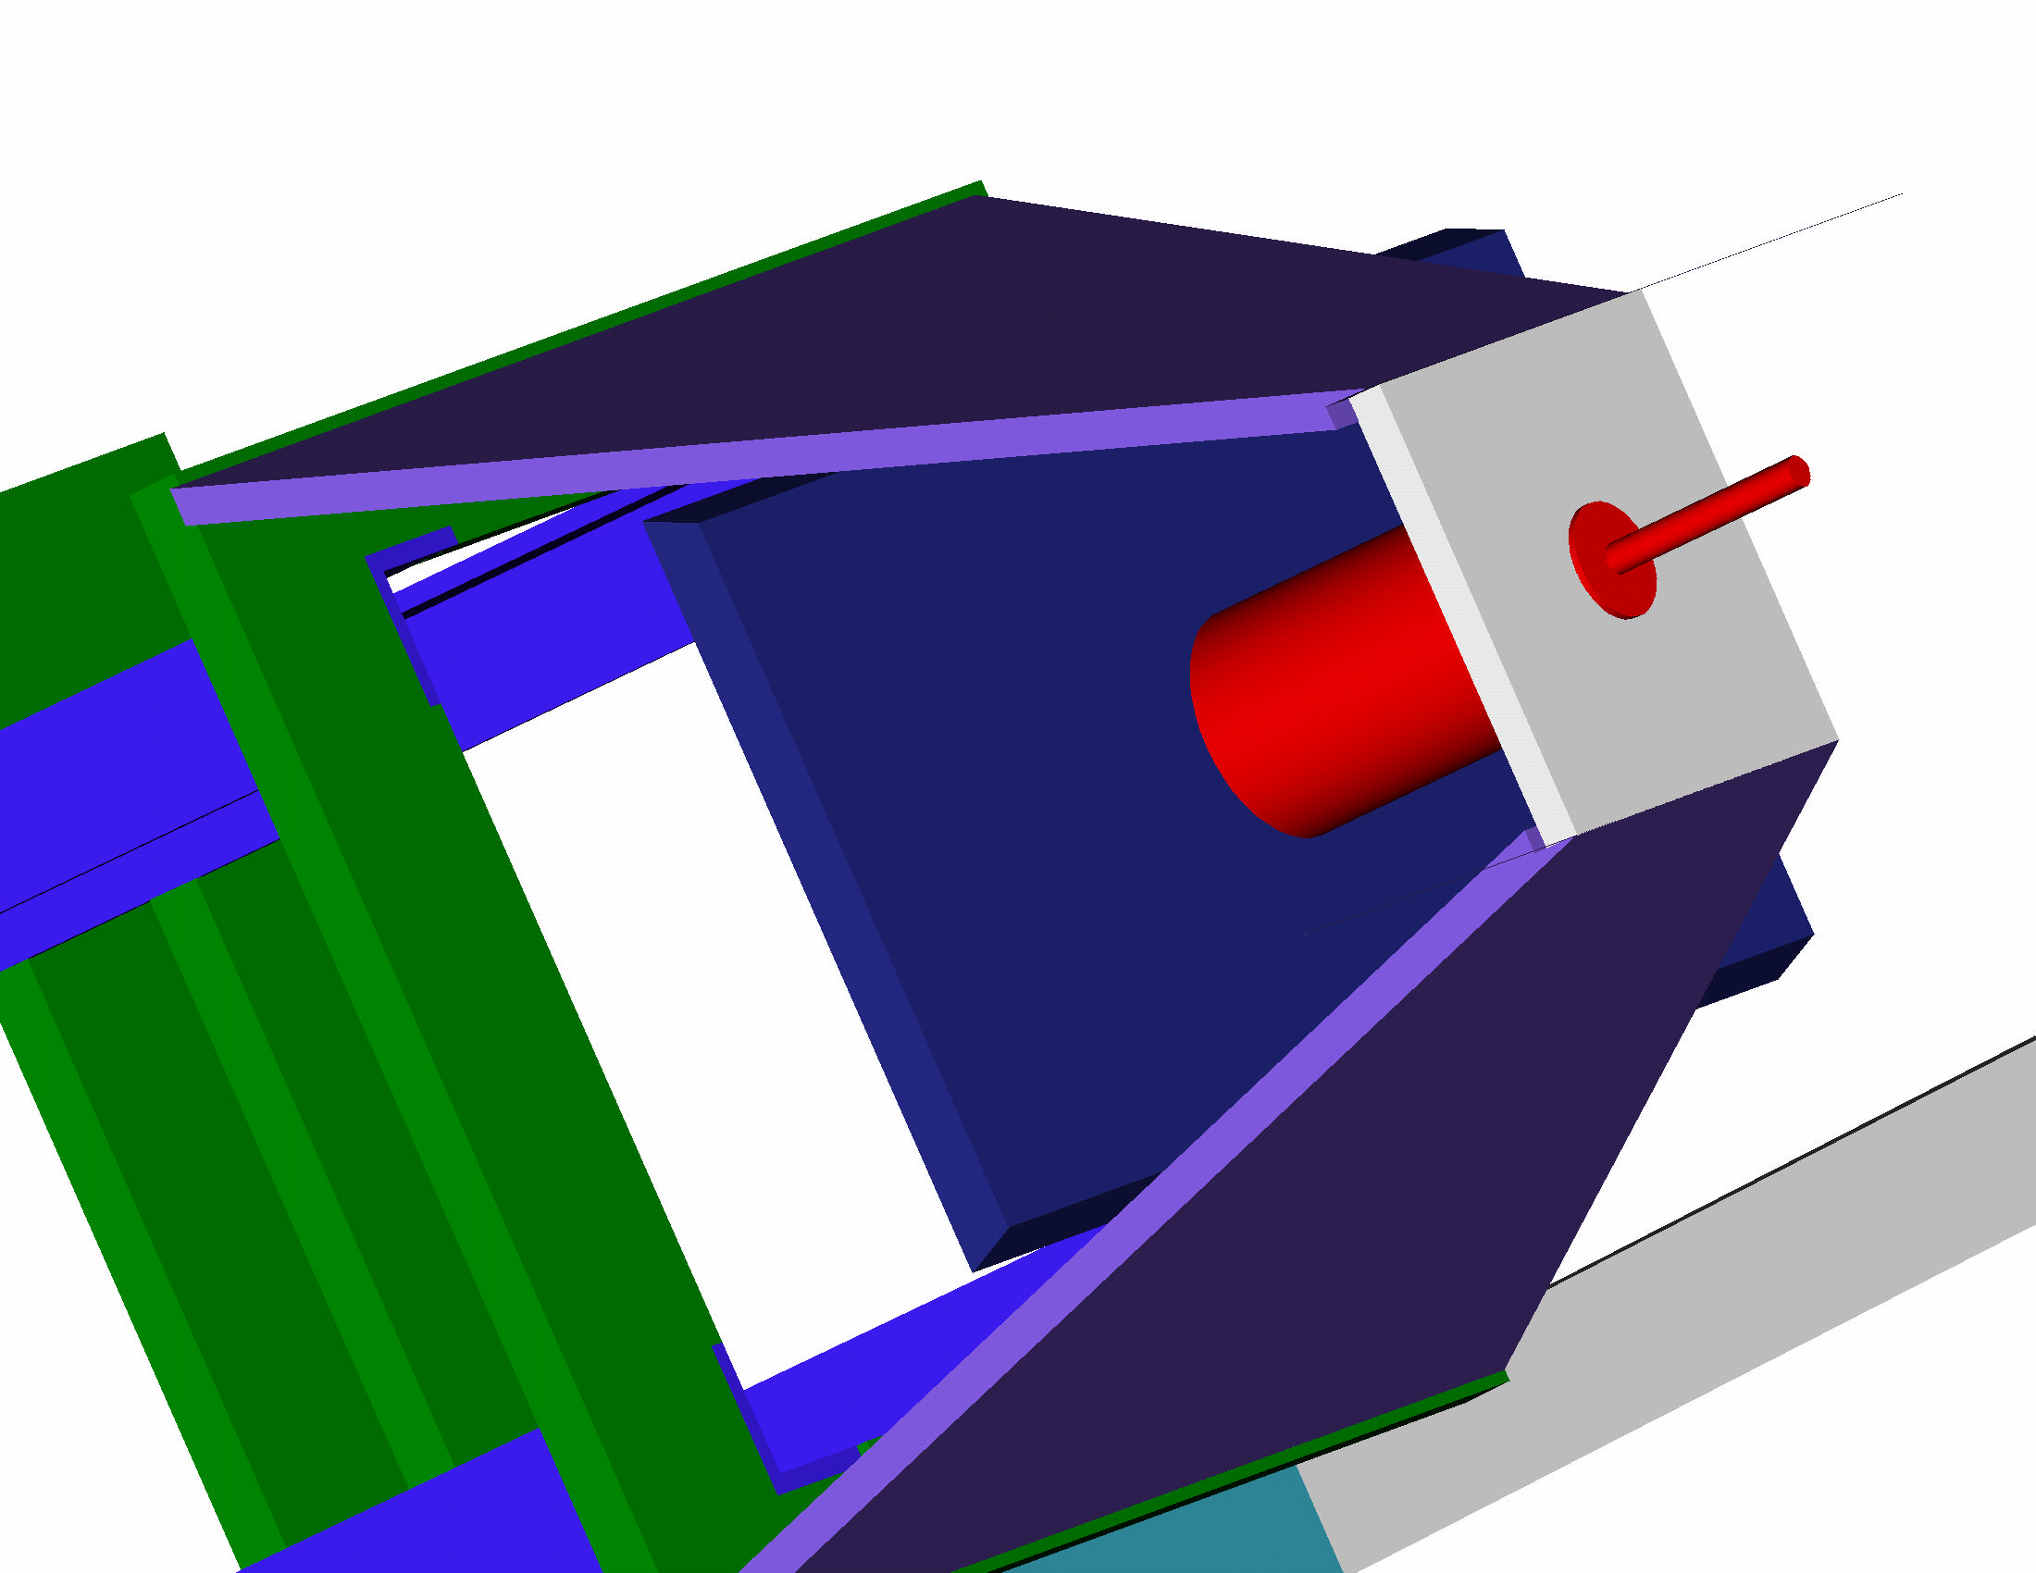
Aircraft Design
Structures
Motor Mount:
  -The motor mount is made from preimpregnated kevlar.
  -Thrust and landing loads are transferred to the primary structure through carbon/foam mounting plates.

Slide 35
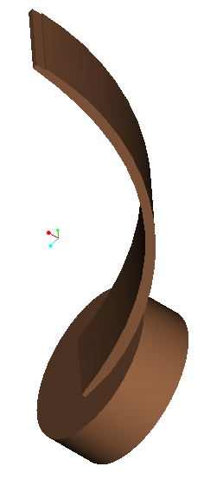
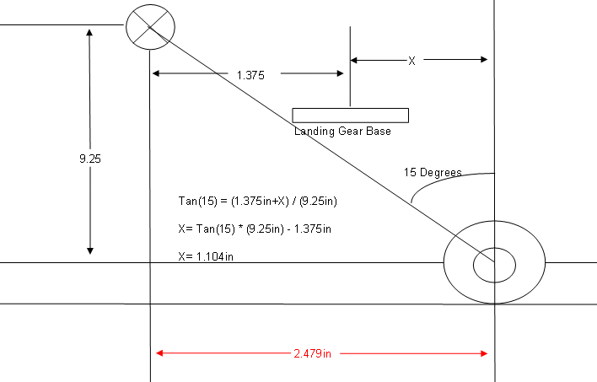
Aircraft Design
Structures
Landing Gear:
  -Main landing gear hub is positioned 15 degrees from the vertical CG axis. (15 degrees is the optimal angle for take off while providing a stable landing base)

Slide 36
Aircraft Design
Payload Delivery
Payload Delivery System:
Consists of a slingshot-type device which cradles the back of the cargo box and ejects the payload using rubber bands.
4 rubber bands will be used for a factor of safety of 2.
Rubber Bands:
#64 K=.24lb/in meu=.3
½ MV²=1/2*N*K*L₁² – F_{fr}* L₂=0 => N=(2*meu*W*L₂)/(K*L₁²)
2 Rubber Bands

Slide 37
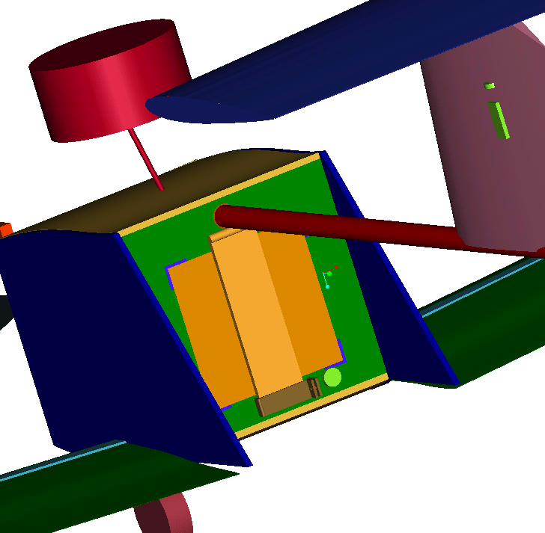
Aircraft Design
Payload Delivery
Door:
Our door was reduced in size because only a fraction of the door is needed to hold back the payload. Also the idea of a faring was thrown out because the benefits of the aerodynamics were not as significant as the weight added to the plane.

Slide 38
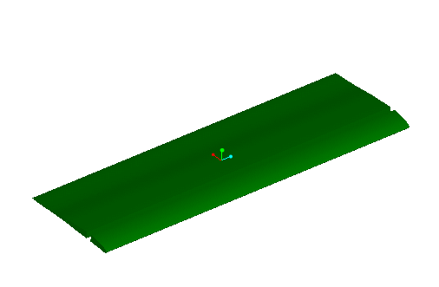
Aircraft Design
Fabrication
Wings:
  -The wings are made from white foam core wrapped with two layers of 1.5k bidirectional fiber glass set at 45 degrees.
  -Foam core is cut using hot wires and laser sculpted 1/16” plywood templates.
  -The composite is vacuum packed with painted mylar placed directly on the glass to remove voids and to provide a smooth painted finish

Slide 39
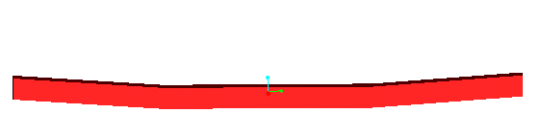
Aircraft Design
Fabrication
Wing Joiner:
  -White foam core is cut using a hot wire.
  -Unidirectional 3K carbon fiber is laid on the top and bottom of the foam.
  -The structure is then wrapped with 3K X 3K bidirectional carbon fiber set at 45 degrees.
  -The structure is put in a wood mold, which has been sprayed with mold release and allowed to cure.

Slide 40
Aircraft Design
Fabrication
Spars:
  -White foam core is cut using a hot wire.
  -Unidirectional 1K carbon fiber is laid on the top and bottom of the foam.
  -The structure is wrapped with 3K X 3K bidirectional carbon fiber set at 45 degrees.
  -The structure is put in a wood mold, which has been sprayed with mold release and allowed to cure.
The wing and wing joiner is lined up with the spar and sprayed with mold release. The structures is then wrapped with a layer of 3K X 3K bidirectional carbon-kevlar weave set at 45degrees and vacuum packed.

Slide 41

Aircraft Design
Fabrication
Ribs: A flat sheet of 1/16” airplane grade plywood will be cut using a laser tool. It will then be used to sandwich a ¼” piece of white foam.

Slide 42
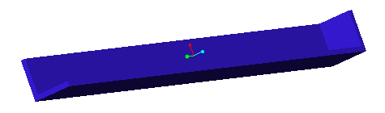
Aircraft Design
Fabrication
Payload Sliders:
  -Two thin pieces of foam are sandwiched by 3K unidirectional carbon fiber running the long way.
  -The sandwich structures are then sandwiched with 3K X 3K bidirectional carbon set at 45 degrees and vacuum-packed.
  -The new sandwich structures are epoxied to each other at right angles (A 2nd carbon piece is added to the end in order to act as a stopper for the payload)

Slide 43
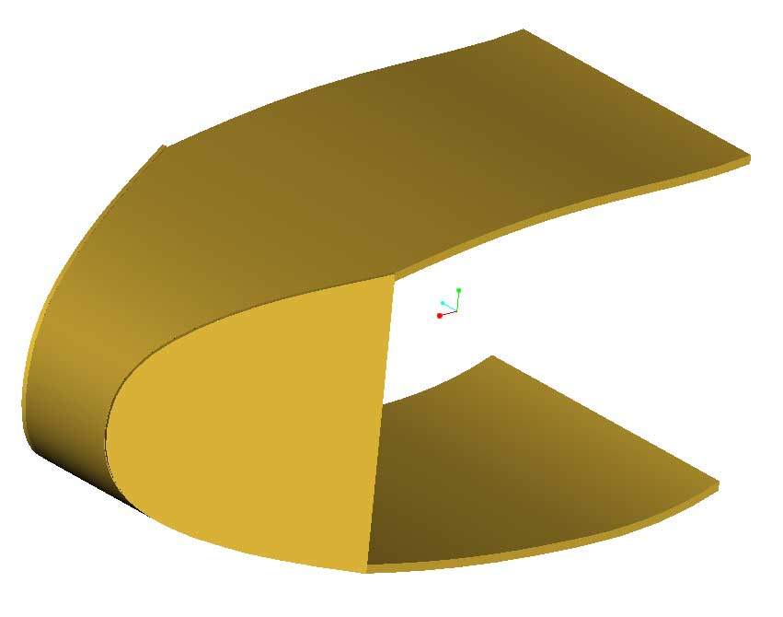
Aircraft Design
Fabrication
Skin:
-A female mold of the fuselage is made of white foam using 1/16” plywood templates and a hot wire.
-A single layer of 3K X 3K bidirectional carbon set at 45 degrees is placed in mold.
-Bleeder is put on top and the setup is vacuum packed.
-The top and the bottom will be done separately.

Slide 44
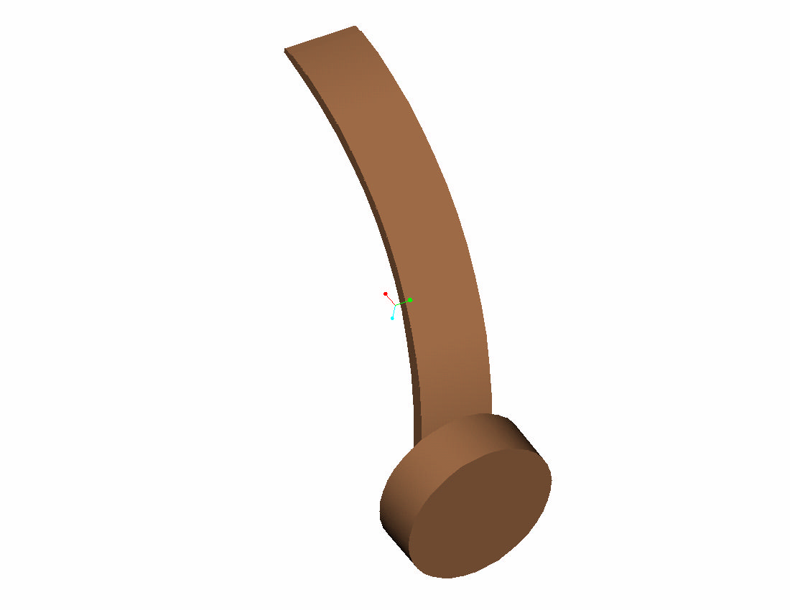
Aircraft Design
Fabrication
Rear Landing Gear:
  -Mold is made of aluminum using a CNC machine.
  -3K unidirectional prepreg is laid in the mold and autoclaved.

Slide 45
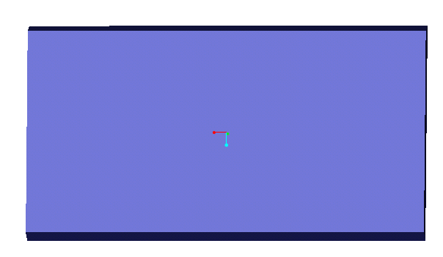
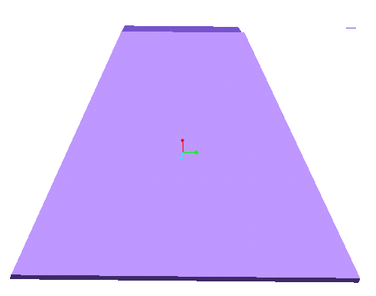
Aircraft Design
Fabrication
Firewall, and mounting plates:
  -Thin sheet of white foam is cut using a hot wire.
  -3K X 3K bidirectional carbon fiber set at 45 degrees sandwiches the foam.
  -Bleeder is put on top and the setup is vacuum packed.
  -The actual shape is then cut out.

Slide 46

Aircraft Design
Fabrication

Slide 47
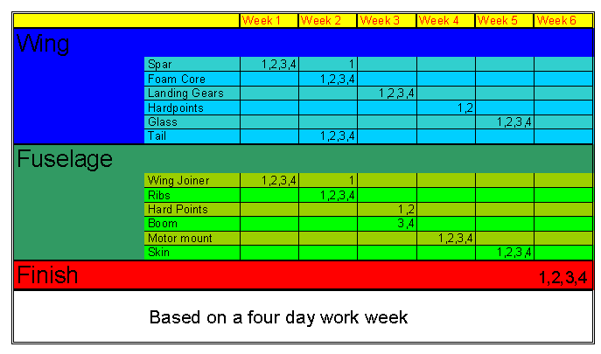
Aircraft Design
Fabrication Timeline

Slide 48
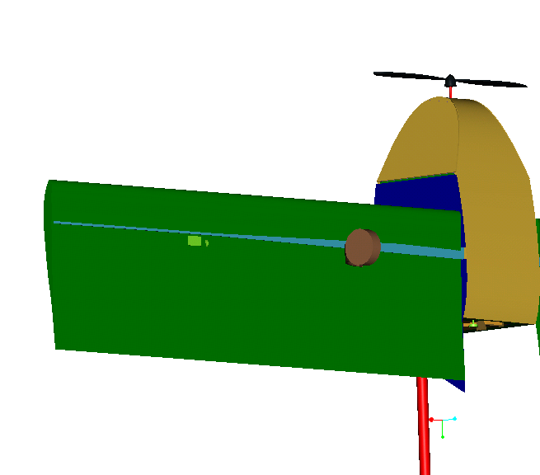
Finished Aircraft

Slide 49
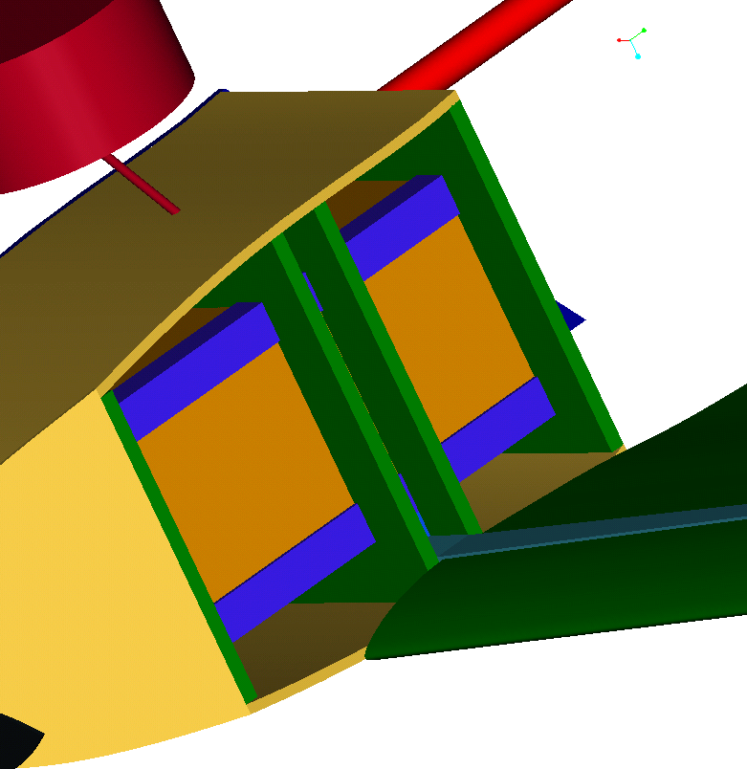
Finished Aircraft

Slide 50
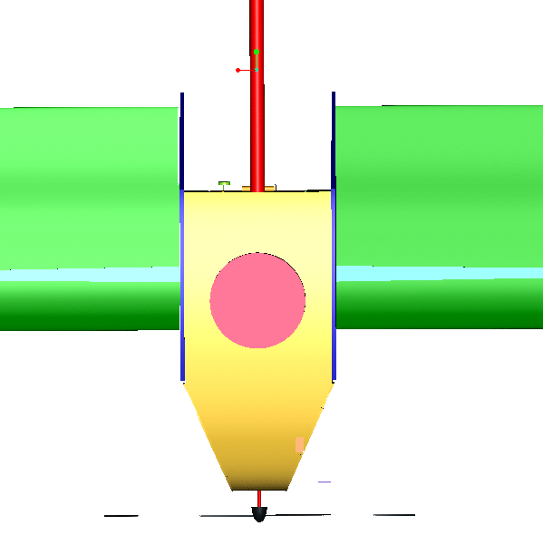
Finished Aircraft

Slide 51
Finished Aircraft

Slide 52
Questions??

