Slide 1
Team B
Furious Flier

Slide 2
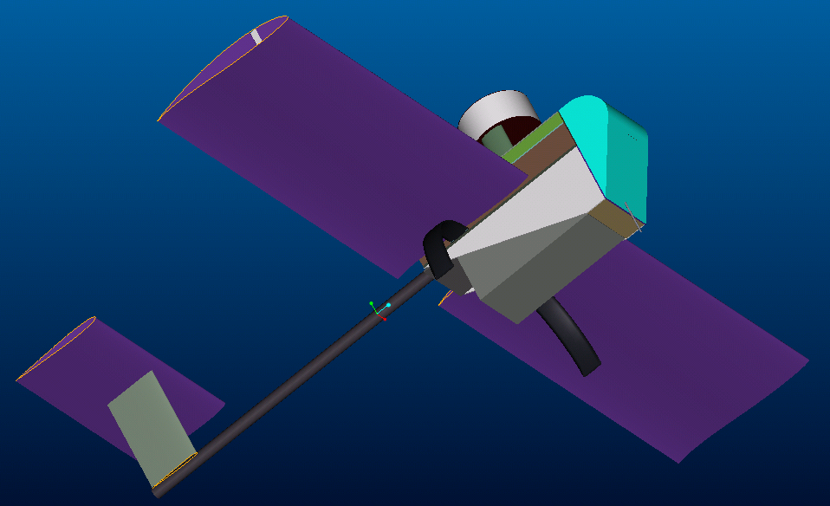
(Dramatic Shot)
(oooooh)
(aaaah)

Slide 3
Team Members
Structures: Dan Dalton
Aerodynamics: Dana Pugh
Propulsion: Mann Chau
Performance: Patty Martinez
Stability: Michael Basic
Construction: Chad Valenzuela
Competition: Chad Valenzuela

Slide 4
Primary Responsibilities
Structures:
  Design payload deployment device
  Design fuselage
  Analyze wings and spar
  Ensures structure is strong enough to withstand flight stress
  (The Inside)
Aerodynamics
  Quantitatively analyze the character of the airplane
    Determine the coefficients of lift coefficients of drag, etc.
  Determines main wing airfoil
  Determines Tail airfoil
  (The Outside)

Slide 5
Primary Responsibilities
Propulsion
  Picks a motor/battery combination to be used in flight
  Finds most efficient propeller for given application
  (The Forward)
Performance
  Quantitative characteristics of airplane
    Top Speed
    Stall Speed
    Takeoff/Landing Distance
    Flight Conditions
  Battery Life
  (The Fast)

Slide 6
Primary Responsibilities
Stability
  Calculates Center of Gravity
  Pitch and Torque
  Center of Lift
  Center of Pressure
  (No Crash)
Construction
  Organizes members into build details
  Procures proper materials
  Technical resource for other team members
  Ensures build efficiency
  Constructs = )
  (The Maker)

Slide 7
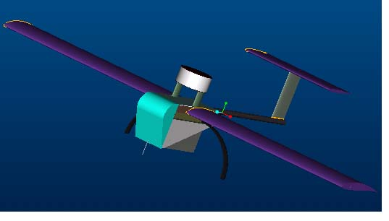
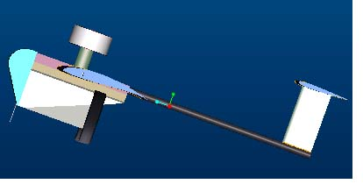
Structure
Name: Furious Flier
Estimated Weight: 15 lbs
“Backbone” is the main structural support while the rest is added for aerodynamics

Slide 8
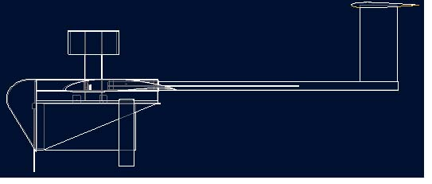
Layout
Layout indicates that the payload will have enough clearance
Angle at rest is approximately 3.5 degrees
When payload deploys, “trap door” closes the belly of the plane.

Slide 9
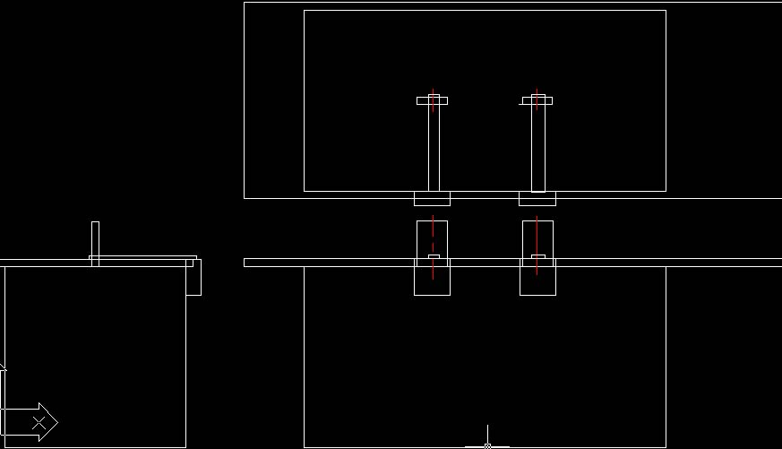
Payload Deployment
2 Hitec HS-85MG servos will pull out pins from the tab of the payload
Friction on the tabs 1 lbf
Small amounts of aluminum will be used to absorb shock on the backbone
Selenoids did not work
Having a trigger was too complicated

Slide 10
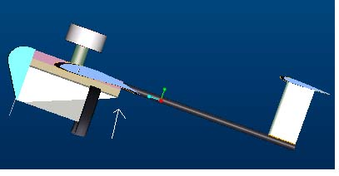
Features of Furious Flier
Rear landing gears are about 8 ¼” high with front landing gears also at 8 ¼” high
Landing gear connected to the “backbone” structure
“Backbone” made out of birch aircraft plywood
Spar is 0.5”x0.2” through the quarter chord
Wings, vertical and horizontal stabilizers detachable

Slide 11
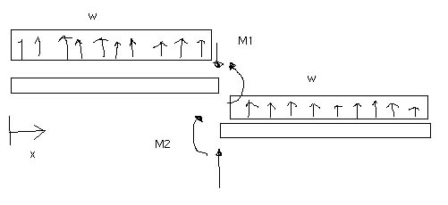
Spar/Wing Joiner Analysis
Make an imaginary cut at the center of the spar/wing joiner. The beam is under constant load. It is under constant load distribution.
Supposing that plane is undergoing 3 g’s of acceleration and carrying 17 lbf of load with 20% uncertainty
Total Length of the Spar: L = 7’ = 84” = 2.134 m
Estimated Weight: W = 17 lbf = 75.7 N
Constant Weight Distribution: w = 75.7 N / 2.134 m = 35.5 N/m
Bending Moment: M1 = M2 = 3 * w * L^2 / 4 = 3 * 35.5 N/m * (2.134 m)^2 / 4 = 121 N-m

Slide 12
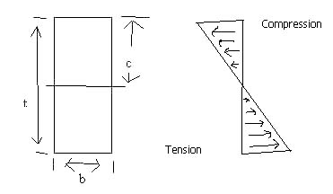
Bending Moment
Cross Section Analysis
Cross section of the spar/wing joiner.
c = t/2 = 1/4” = 6.4 mm
Moment of Inertia about axis: I = 1/12 * b * t^3
The ultimate tensile strength of carbon tow in 0, 45, and 90 degree orientations is approximately σy = 2900 MPa

Slide 13
Calculating b
FS = Ultimate Yield Stress / Allowable Yield Stress
I = 1/12 * b * t^3 = M * c * FS / σy
b = 12* M * c * FS / (σy * t^3)
b = 12 * 121 N-m * 6.4 mm * 1.5 / (2900 MPa * 12.7^3) ~ 2.4 mm
~15 mm x 5 mm or 0.5”x0.2” spar cross section chosen instead to make it easier to manufacture
~20 mm x 10 mm or 0.75”x0.4” wing joiner cross section

Slide 14
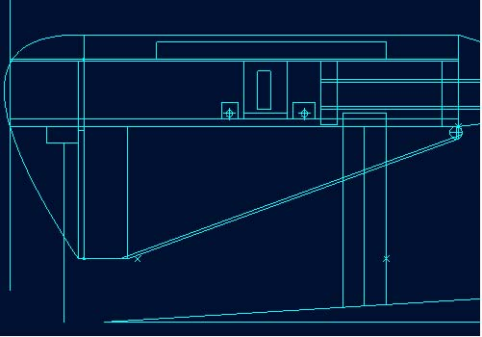
Landing Gear
If anything will fail, it would be the fuselage taking in the load of the shock of landing.
To reinforce the birch aircraft grade plywood, an extra layer of birch or small amounts of aluminum might be added to the landing gear.

Slide 15
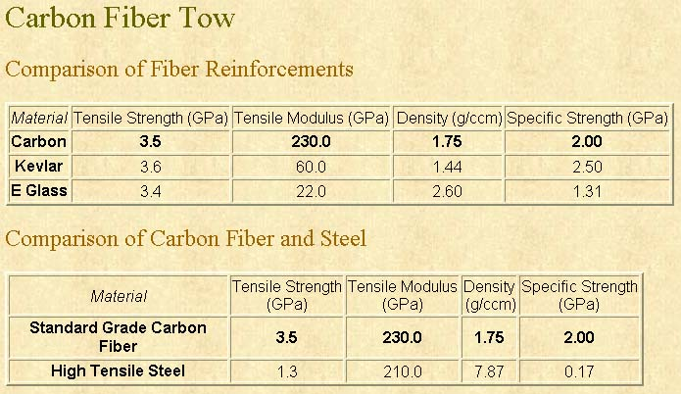
Materials Property

Slide 16
Propulsion System
Graupner 3300/7 with gear ratio of 2: 1
18 Ni-Cad C cells
18” span and 13” pitch propellers
Speed Control
4 servos for control surfaces, 1 servo for the payload, and 1 for the steer able nose landing gear

Slide 17
Batteries
18 Ni-Cad C cells
Estimated weight is 3.0 lbm or 2.67 oz./cell
1” diameter
1.8” length
2400 mAh
1.2 V
Energy density is 1.08 Wh/oz.

Slide 18
Propulsion Performance
Motor Amps = 37 A
In Flight Thrust = 78 oz.-in.
Static Thrust = 123.4 oz.-in.
Prop pitch speed at 50.2 mph
Flight Time Available = Pack Capacity (Ah) * 60 / Motor Current

Slide 19
Propellers
Carbon composite
To make the propeller 18” maximum span allowable, use the following:
  1” nose cone diameter
  Two 8 1/2” long blade with 13” pitch

Slide 20
AERODYNAMICS/
PERFORMANCE:
VISUALFOIL
airfoil
estimated flight conditions
geometry & weight estimations
tail: dimensions
C_{L} max
L/D max
max rate of climb
stall speed
take-off field length

Slide 21
Visual Foil
  GENERAL PURPOSE:
A simulation software that analyze and compare airfoils.
Generates REALISTIC aerodynamic data for general airfoil shapes in air and water .
All data & analysis in aerodynamic/performance section is based on VisFoil results and properties of the wing.

Slide 22
Airfoil
Airfoil: S4022
Reasons:
  Calculated Reynolds Number was high to reduce the drag coefficient
  Max Lift with Min Drag
  Stall characteristics were good
Picture on next slide
Air Properties
Density | 1.225 |  | kg/ m^3 |  | 0.002377 |  | slug/ ft^3
Temp |  |  |  |  | 518.69 |  | Rankin
Press | 1 |  | atm
Viscosity | 1.79E-05 |  | kg/ m s |  | 3.74E-07 |  | slug/ ft s
Flight Conditions
Velocity (50 mph) |  | 32.78 |  | m/s |  | 73.333 | ft/s
q Cruise |  |  |  |  |  | 6.4205 | slug/ ft s^2
Re= |  | 513098

Slide 23
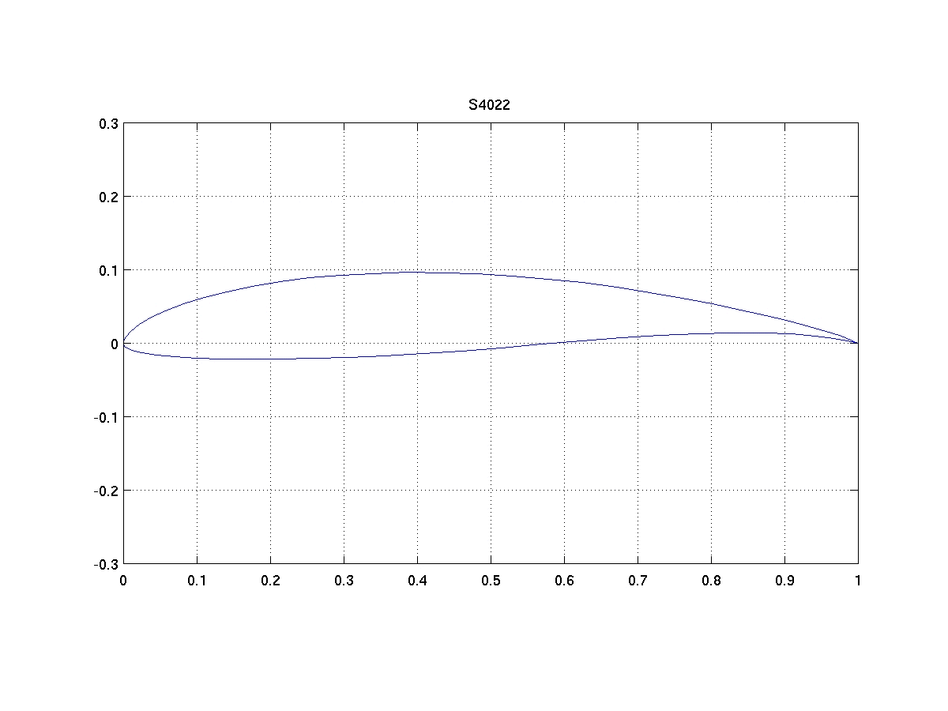

Slide 24
Geometry & Weight Estimations
Wing Dimensions
 | SI units |  | English
Chord | 0.33528 | m | 1.1 | ft
Span | 2.1336 | m | 7 | ft
Area | 0.7153534 | m^2 | 7.7 | ft^2
AR | 6.3636364
e | 0.7798147
CG
 | weight (oz) |  | weight (lbs) | CG (in)
empty | 192.65 |  | 12.04 | 12.12
w/payload | 272.65 |  | 17.04 | 12.09
w/payload & antenna | 288.65 |  | 18.04 | 12.08
Total Weight |  |  | 287.65 | oz
 |  |  | 17.9781 | lbs

Slide 25
Tail: Dimensions
Tail Dimensions
Tail Arm | 2.625 | ft | 31.500 | in
Taper Ratio | 1.000 | ft | 12.000 | in
Horizontal Area | 1.613 | ft | 19.360 | in
Vertical Area | 0.616 | ft | 7.392 | in
Vertical AR | 1.127
Vertical Tail Span | 0.833 | ft | 9.998 | in
Vertical Tail Chord | 0.739 | ft | 8.872 | in
Horizontal AR | 1.900
Horizontal Tail Span | 1.751 | ft | 21.010 | in
Horizontal Tail Chord | 0.921 | ft | 11.058 | in
The horizontal stabilizer was designed to be one-fourth the size of the wing span
The size of the vertical stabilizer was determined by the limits of the traveling box.

Slide 26
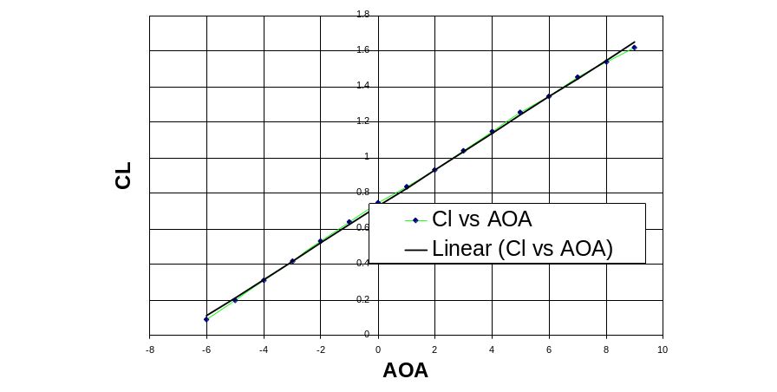
Maximum Coefficient of Lift
C_{L} max is the point right before the slope curves on a C_{L} Vs. Angle of Attack (AOA) plot (point prior to the stall)
From plot on right:
  C_{L} max ≈ 1.6 @ 9°

Slide 27
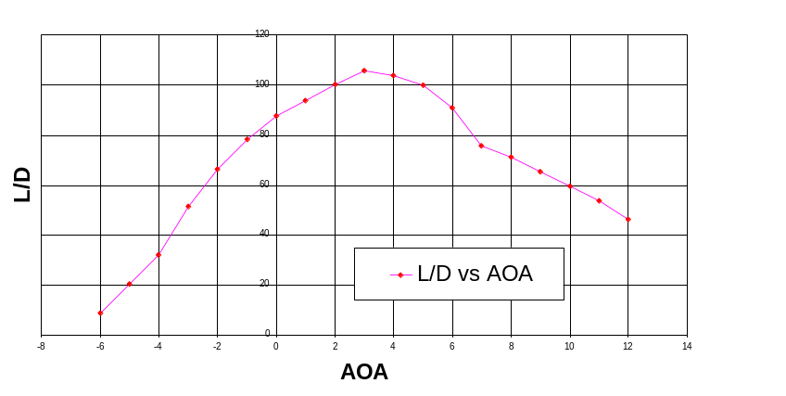
Maximum Lift/Drag Ratio
Angle obtained where the most lift occurs for the least amount of drag
The point where the ratio peaks on graph
Visfoil data:
  L/D ≈ 105 @ 3 °

Slide 28
Take-Off Field Length
Total take-off distance is the sum of the ground run (s₁) and airborne distance (s₂):
s1 =
(W/(2g))*((V₁²)
______________
(F_{o} – F₁)*ln(F_{o}/F₁)
s2 = H_{obsiticle}/(tanγ)
where
γ ≡ flight path angle
F_{o} = Thrust – (viscosity * Gross take-off weight)
F₁ = Thrust - Drag
Takeoff Calculations
 | Empty | w/Payload | w/Payload & Antenna
Take Off Dist. | 59.5 | 89.14 | 95.5 | ft

Slide 29
Estimated Flight Conditions
These estimations came from properties of air at sea level.
Estimated flight conditions came from experiences with previous DBF plane competitions.
Air Properties
Density | 1.225 | kg/m^3 | 0.002377 | slug/ft^3
Temperature |  |  | 518.69 | Rankin
Pressure | 1 | atm
K. Viscosity | 1.79E-05 | kg/m s | 3.74E-07 | slug/ ft s
Flight Conditions
Velocity (50 mph) | 32.78 | m/s | 73.333 | ft/s
q Cruise |  |  | 6.42057 | slug/ ft s^2
Re= | 513097.8

Slide 30
Maximum Rate of Climb
Rate of climb is a speed that reaches its maximum when it is the same speed at which the power required in level flight is minimum.
Assuming power available is independent of forward speed for propeller aircraft.
Equation of R/C =
((velocity @ level flight)*(thrust –drag))
_______________________________
(weight of plane)
Flight Performance
Rate of Climb | 8.39 | 5.93 | 5.6 | ft/s
Climbing Distance | 186.38 | 268.49 | 284.78 | ft
Climb Angle | 15.12 | 10.55 | 9.96 | deg
Climb Time | 2.54 | 3.66 | 3.88 | s
Turn Radius ® | 81.4 | 131.99 | 145.32 | ft

Slide 31
Stalling Speed
Stalling
Occurs as a consequence of separated flow caused by viscous effects at high AOA
A point when there is an abrupt decrease in lift and a large increase in drag.
The peak point on the previous C_{L} Vs. AOA plot.
V_{stall} =
((2*Weight of airplane)
________________________
(density*planform area*C_{L,max}))^{(1/2)}
Performance Summary
 | Empty | w/Payload | w/Payload & Antenna
Stall Speed | 22.05 | 26.23 | 26.99 | ft/s

Slide 32
Manufacturing
Manufacturing will begin as soon as funds are available to purchase needed materials and tools.
The Furious Flier will be constructed largely of composite materials. The fuselage will be made of birch aircraft grade plywood. The landing gear fuselage, boom, and propeller will all be at least partially made with carbon fiber. The wings will be wrapped in a lightweight fiberglass.

Slide 33
Strong and Light
Constructing with composite materials will help to keep the total weight of the airplane down while also making it very strong. The aircraft will also be esthetically pleasing with it’s sleek and clean look.
Manufacturing a strong and light plane will decrease our Rated Aircraft Cost (RAC) which is a vital key to our teams’ success.

Slide 34
Manufacturing Schedule
Once building begins, the team will meet Thursdays, Fridays and Saturdays in order to get 12 to 15 hours of work completed each week.
Goals for what needs to be completed by the end of the week will be drafted weekly by Mann and Chad in order to keep the team organized and motivated.
At least 2 team members will meet to do construction at any given time. 1 “veteran” team member must be present to ensure safety, productiveness and quality.

Slide 35
Flight Testing
The Furious Flier is planned to be fully completed by the last week of March 2003.
Completing the manufacturing early will enable the team to have 3 weeks in which to do flight testing and to make any last minute changes or amendments to the aircraft. This will also enable our pilot to become accustomed to the plane and its characteristics.

Slide 36
Competition
On the weekend of April 25-27, Team B hopes to send all of its working members to the competition in Patuxent, Maryland.
Members in attendance will be in charge of assembling the plane quickly to keep the total flight score as low as possible. Team B will conduct itself in professional and ethical manner, and plans to be given the duty of carrying back the first place plaque.

