Slide 1
Aircraft Design
Structures
Design Method:
Designed a functional shape.
Assessed load paths.
Selected materials based on properties; bending,
shear, torsion, ect.
Derived thicknesses from solid mechanics, supplies available
and engineering intuition.
Verified Design with Finite Element Modeling.
TLAR
F
E
E
D
B
A
C
K

Slide 2
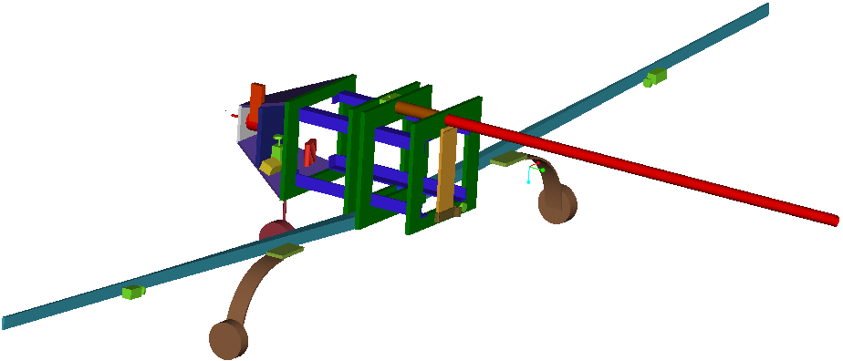
Aircraft Design
Structures
Weight Fully Loaded = 19.6 lb
Weight Unloaded = 14.6 lb
F.S. Yield = 1.5
F.S. Ultimate = 2.0
n = 5.6
CG without Batteries = 2.3 in. behind the Quarter Chord
CG desired = 0.5 in. front of the Quarter Chord
2.2lb Battery Placement = 7.6 in. front of the Quarter Chord

Slide 3
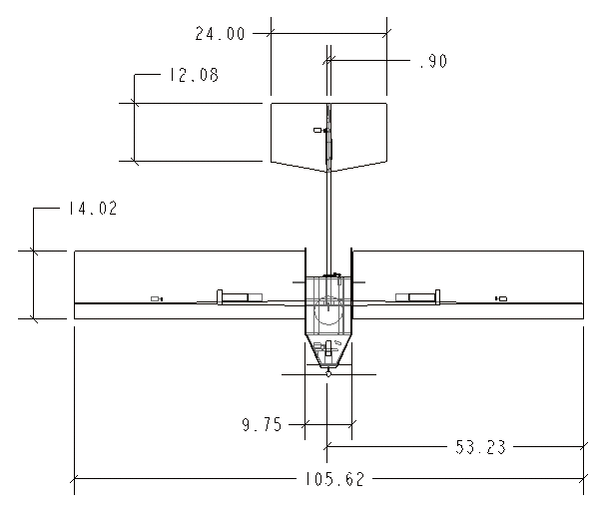
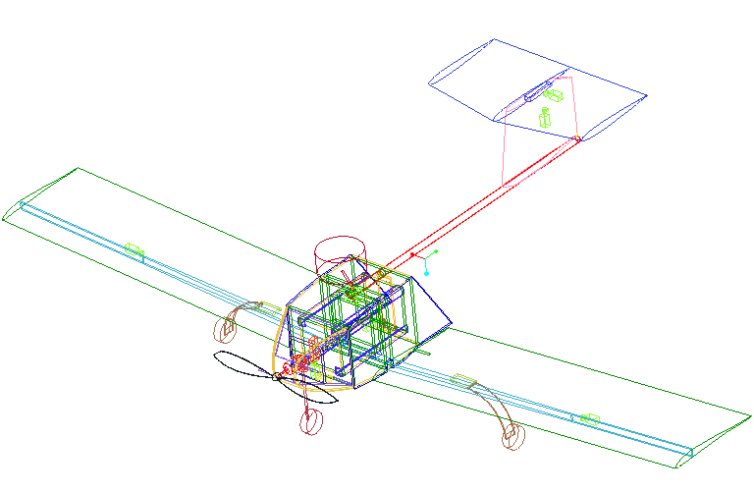
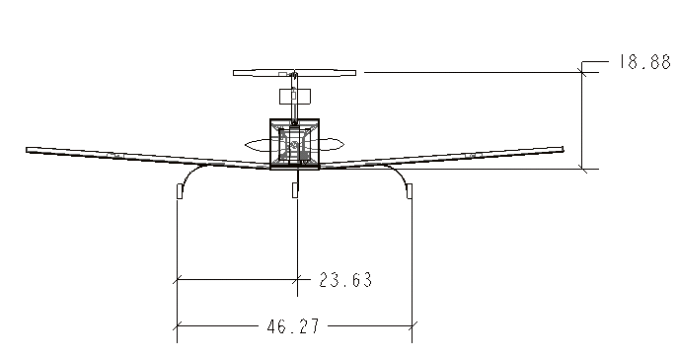
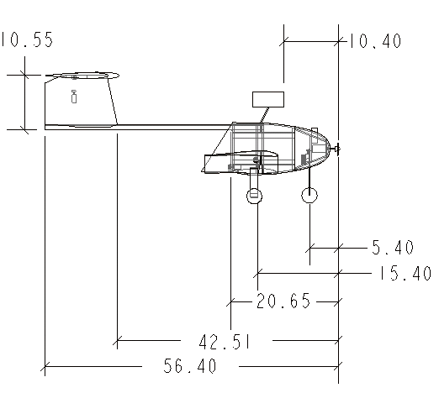
Aircraft Design
Structures

Slide 4
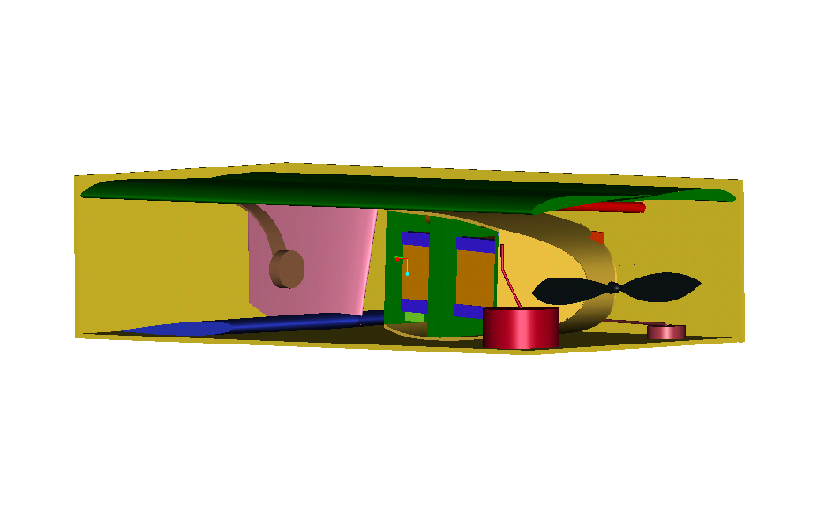
Aircraft Design
Structures
How she fits in the box.
Plywood shell with foam inserts to protect the aircraft.

Slide 5
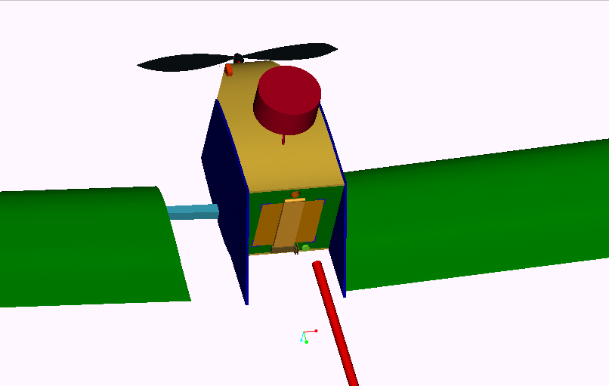
Aircraft Design
Structures
To keep the boom from sliding out, a screw-pin is inserted from the top of the fuselage. For the missions with the antennae, the mounting stud will serve as the screw-pin. The end of the boom (last 1 in.) is filled with a wooden dowel and has a hole to receive the screw-pin.
The end section of the boom is equipped with keys to resist rotation and assist alignment when installed into a sleeve hard mounted to the last 3 bulkheads.
The wing slides onto a 5 in. section of the wing joiner and a torsion pin with an interference fit.

Slide 6
Aircraft Design
Structures
Wing Joiner: The wing joiner is a one-piece balsa lateral grain core with unidirectional carbon fiber on top and bottom. The entire part is wrapped with +/- 45º carbon fiber. It is located below the payload and between the two center bulkheads to allow loads to transfer to the primary structure.
Spar: The wing spars are made of the same composition as the joiner. The loads from the spars are transferred to the joiner through a carbon fiber wrap sleeve.

Slide 7
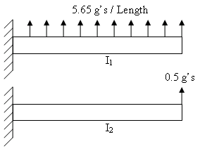
Aircraft Design
Structures
Requirements:
1) The spar must be able to withstand a distributed load of 5.65g’s with F.S. 2.0
2) The spar must be able to withstand a wing test at its tip of 0.5g’s with F.S. 2.0
3) Consider impact loads from hard landings
4) Torsion due to pitching moment.
Method:
h= (thickness of carbon fiber)
s(b)=M(l)*c/I=M(l)*c/(b*h^3/12)
M(l)=w*l^2/2

Slide 8
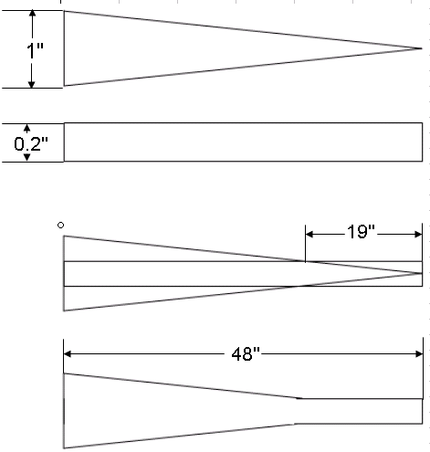
Aircraft Design
Structures
The first figure shows what the spar would look like considering a distributed load of 5.6g’s. During the competition a safety test will be done by lifting the plane by its wing tips, this is said to simulate a 0.5g load. The next figure would be the shape of the spar if only a wing test load of 0.5g’s was needed. However we needed the best of both situations. The last figure is the shape of the final spar.
I₁
I₂

Slide 9
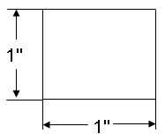
Aircraft Design
Structures
Pitching Moment= .095
Chord=14.000ft.
Dynamic Pressure=1.919x10^-3 psi
Surface Area=10.179in^2
Torque at base=.255 ft. lbf.
tmax=14.711psi
Thickness required=.104in.
f=1.321x10-4 degrees
To Reduce bi-directional carbon wrap around the spar and to assist in the
stability of our wing, a torsion pin was added.
b/h n1 n2
1.0 0.208 0.1406

Slide 10
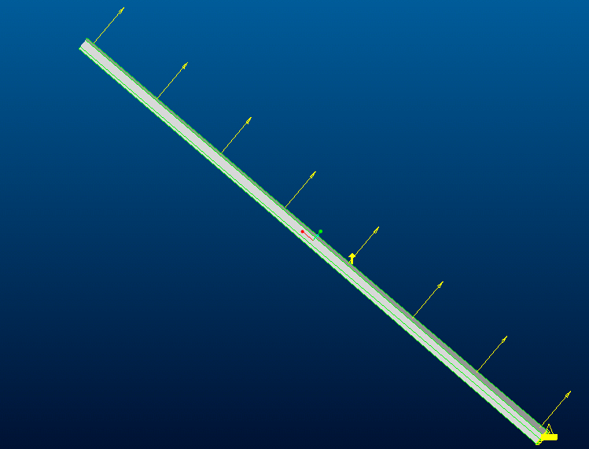
Aircraft Design
Structures
Finite Element Analysis of the spar:
The spar structure was modeled using MSC Patran and Pro-Mechanica as a cantilever beam.
A uniform distributed load was used to model the loading during flight.

Slide 11
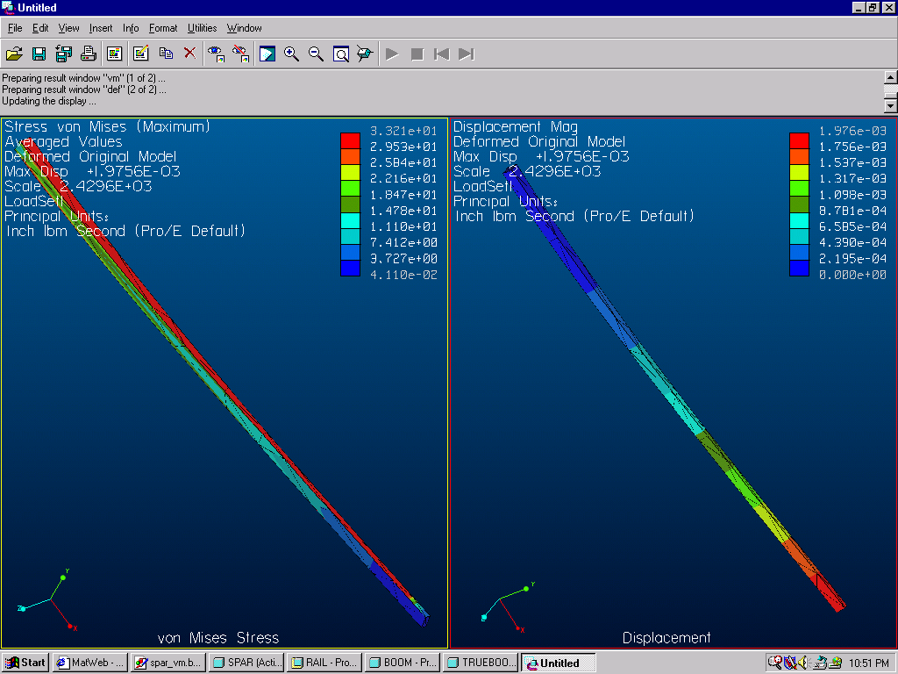
Aircraft Design
Structures

Slide 12
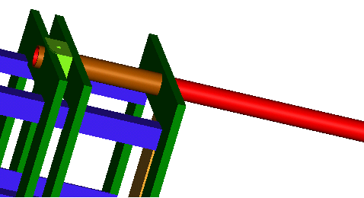
Aircraft Design
Structures
Boom: The boom is a 1” diameter carbon fiber tube inserted into a sleeve which is mounted through the three aft bulkheads. The sleeve provides a hard point to transfer loads to the primary structure.

Slide 13
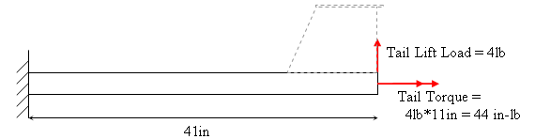
Aircraft Design
Structures
Boom: The boom is a 1” OD carbon fiber hollow tube with a wall thickness of .050”. Fiber ply orientation is [0₂/+-45]_{S}.
OD = 1 in, Wall thickness = 0.05 in
E = 9.163E6 lb/in^2
G = 2.36E6 lb/in^2
J = .5*π(R_{O}⁴-R_{I}⁴) = .03376 in⁴
I = .25*π(R_{O}⁴-R_{I}⁴) = .01688 in4
Tip Deflection = .594 in
Tip Deflection = 1.188 in (with F.S. = 2)
Stress = 4857.82 lb/in^2
Stress = 9715.64 lb/in^2 (with F.S. = 2)
Shear Stress = 2428.91 lb/in^2
Shear Stress = 4857.82 lb/in^2 (with F.S. = 2)
Tensile Strength:
Longitudinal = 98,000 lb/in^2
Shear = 37,000 lb/in^2 (matrix)
  44,000 lb/in^2 (fiber)
Largest Allowable Torque = 2486.4in-lb

Slide 14
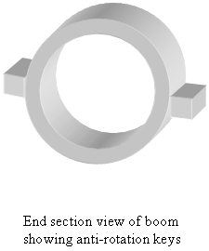
Aircraft Design
Structures
Boom Mount: The boom mount is designed to resist rotation and vertical/horizontal deflections.
Applied torque = 44in-lbs
= 88 in-lbs (with F.S.=2)
Applied shear stress = 2428.91 lb/in^2
= 4857.82 in-lbs (with F.S.=2)
Maximum shear stress of the matrix: 37,000 lb/in^2
Load (F.S. = 2): 8 lb
Required area of contact between the boom and the anti-rotation keys:
A= F/σ = 1.1E-4 in^2

Slide 15
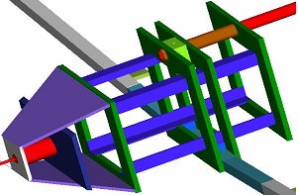
Aircraft Design
Structures
Primary Structure/Cargo Bay: The fuselage is composed of unidirectional carbon/foam core sandwich structure. Structural rigidity is provided by five bulkheads, the aft four will encase the payload. The bulkheads are sandwich structure made from unidirectional carbon and plywood. The payload is held in place by four ‘L’ shaped rails running fore and aft through four bulkheads. They are unidirectional carbon/foam sandwich structure. These will act to stiffen the fuselage.
4
5
3
2
1

Slide 16
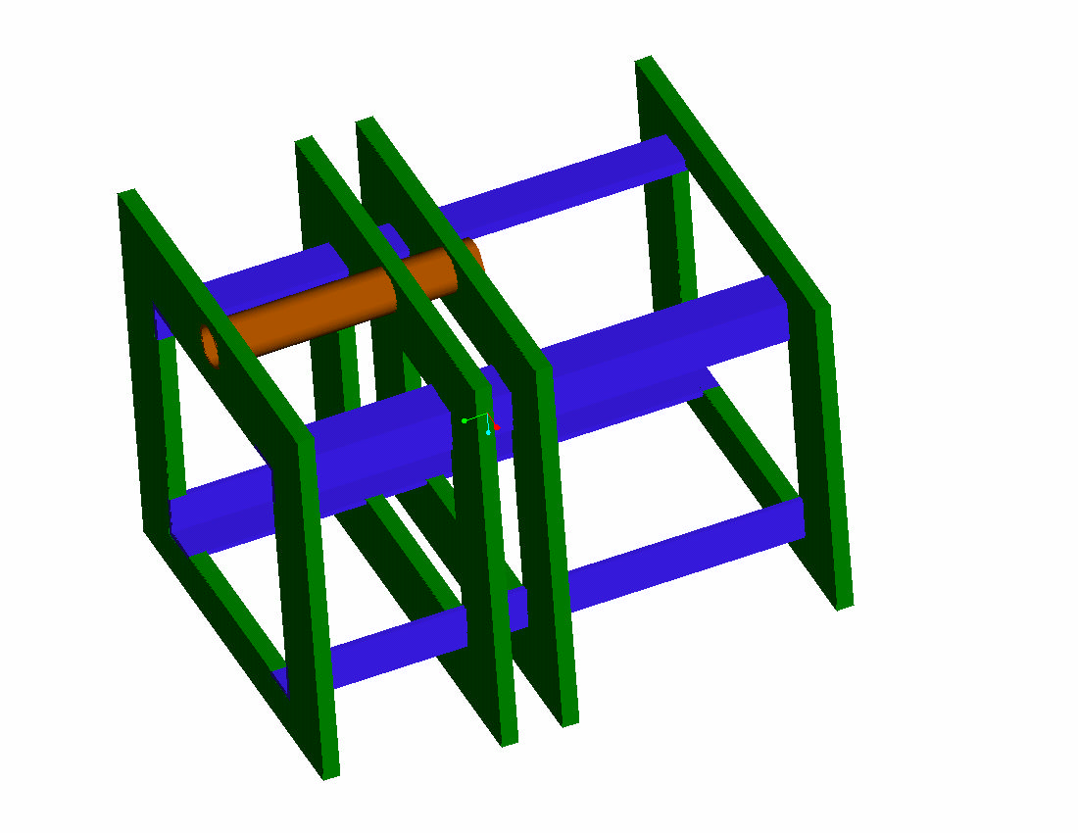
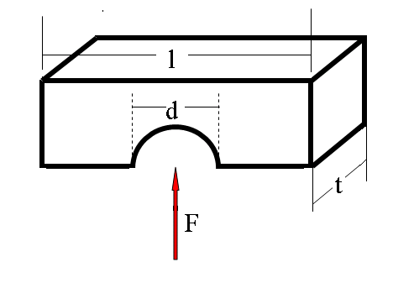
Aircraft Design
Structures
THICKNESS OF MATERIAL
Shear Stress
σ = F/dt ⇒ t = F/σd
Using σ_{YIELD}
for A.Y.B.W. t = 0.003 in
for E.B.W. t = 0.004 in
Factor of Safety = 1.5
Using σ_{ULT}
for A.Y.B.W. t = 0.004 in
for E.B.W. t = 0.005 in
Factor of Safety = 2

Slide 17
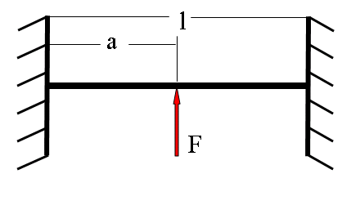
Aircraft Design
Structures
THICKNESS OF MATERIAL
Bending Stress
σ = -My/I ⇒ t = 12My/σh³
Using σ_{YIELD}
for A.Y.B.W. and E.B.W.
both thicknesses 0.03 in
Factor of Safety = 1.5
Using σ_{ULT}
for A.Y.B.W. and E.B.W.
both thicknesses 0.02 in t = 0.02 in
Factor of Safety = 2

Slide 18
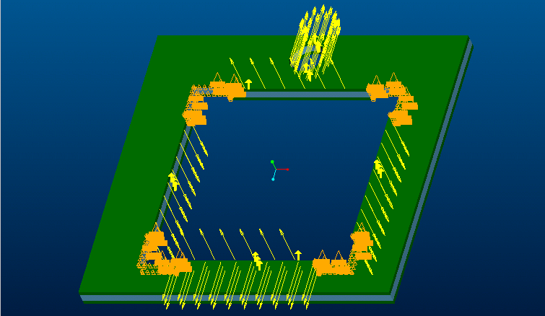
Aircraft Design
Structures
The aft bulkhead was also modeled in MSC Patran and Pro-Mechanica with the anticipated loading created by the empenage aerodynamic forces transferred through the boom and payload weight.
The connections to the rails were modeled by zero displacement boundary conditions. This is not physically identical to the actual structure, but offers insight into the deformation behavior.

Slide 19
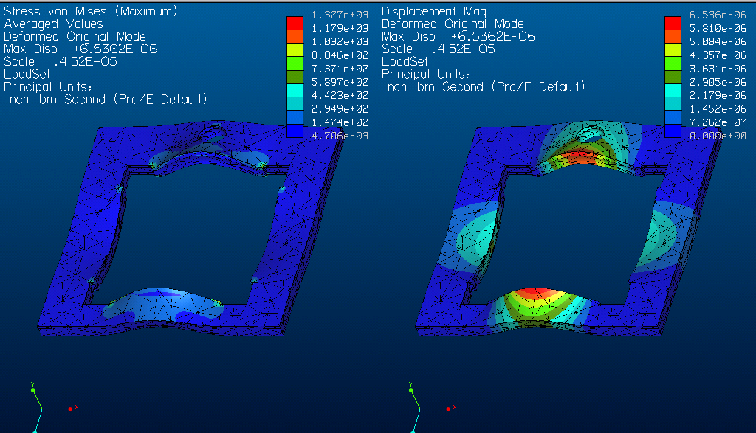
Aircraft Design
Structures

Slide 20
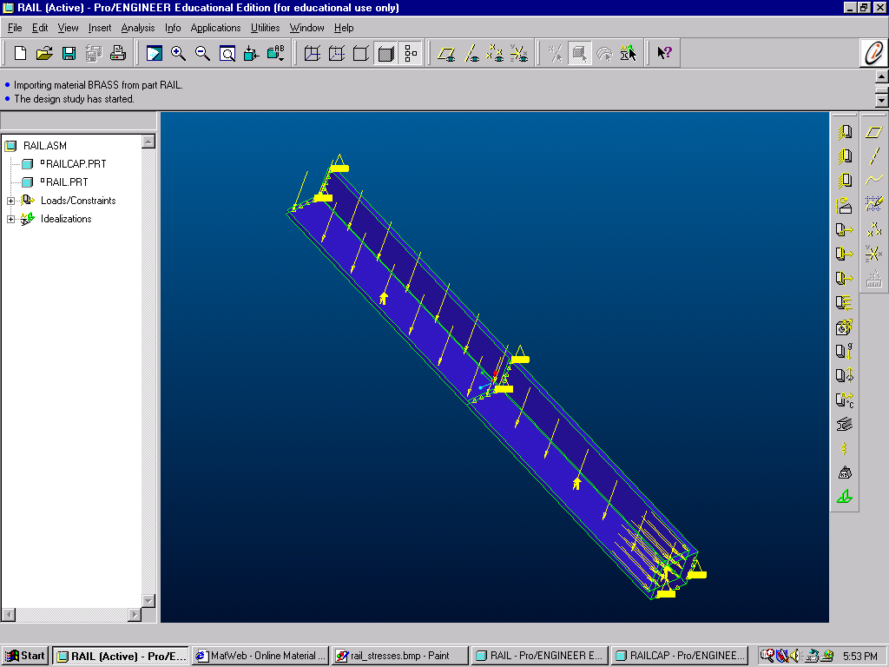
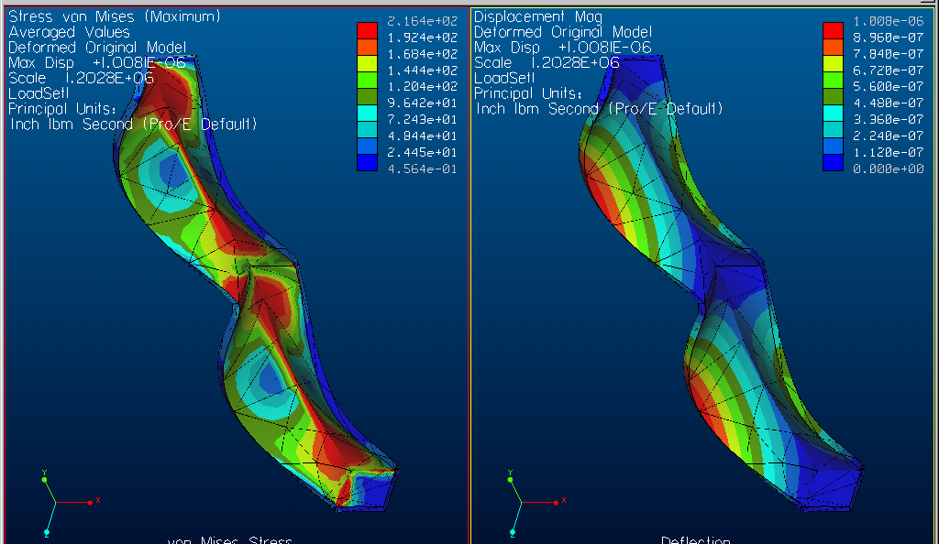
Aircraft Design
Structures
FEM of the lower left rail.

Slide 21
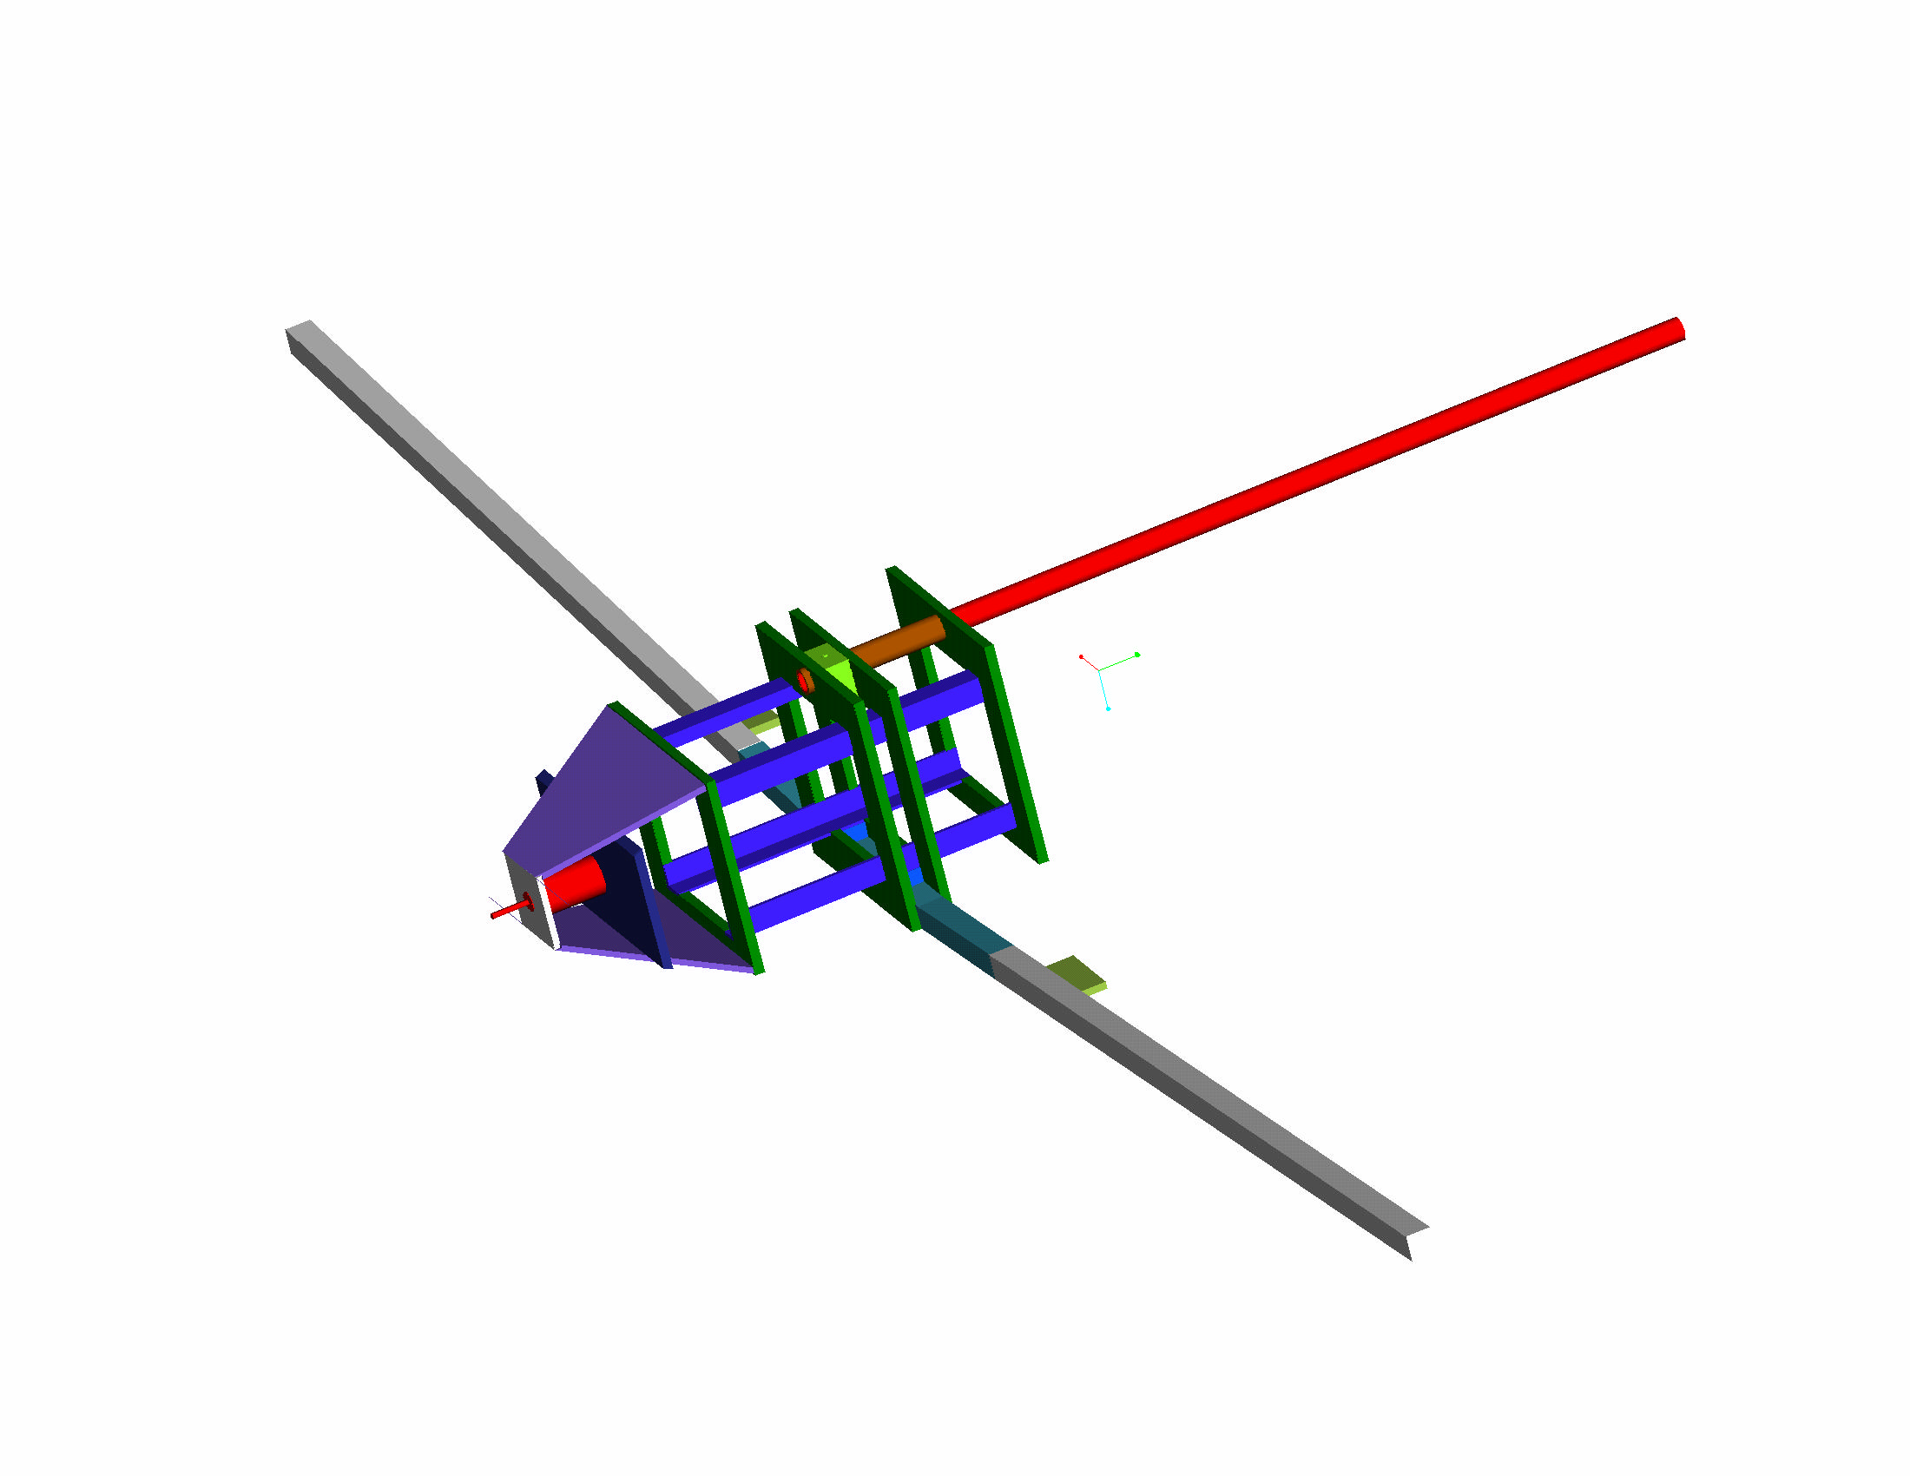
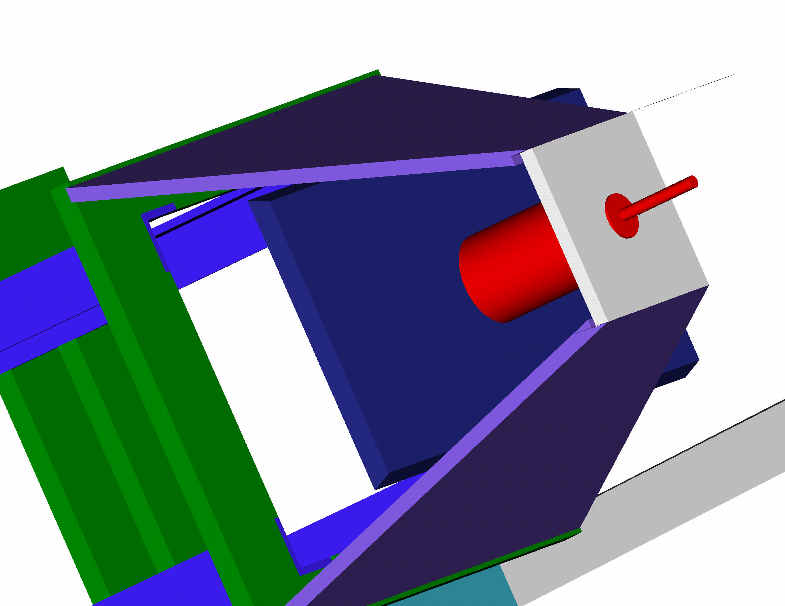
Aircraft Design
Structures
Motor Mount: The motor mount is made from preimpregnated kevlar. Thrust and landing loads are transferred to the primary structure through carbon/foam mounting plates.

Slide 22
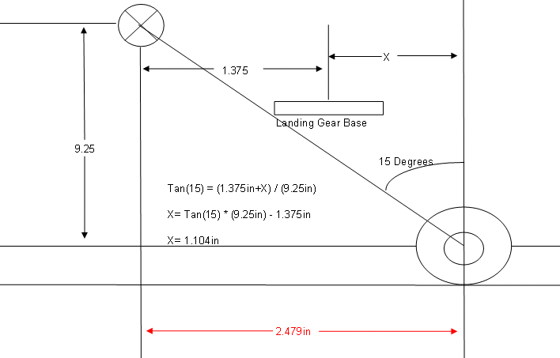
Aircraft Design
Structures
The main landing gear hub was positioned on a line 15 degrees
off the vertical axis off the CG. This 15 degree angle is optimal
For take off while providing a stable landing base.

Slide 23
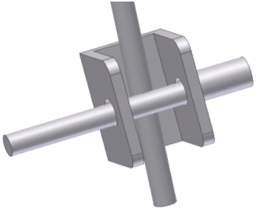
Aircraft Design
Payload Delivery
Payload Delivery System:
Consists of a slingshot-type device which cradles the back of the cargo box and ejects the payload using rubber bands.
4 rubber bands will be used doubling the required force.
Rubber Bands:
#64 K=.24lb/in meu=.3
½ MV²=1/2*N*K*L₁² – F_{fr}* L₂=0 => N=(2*meu*W*L₂)/(K*L₁²)
2 Rubber Bands

Slide 24
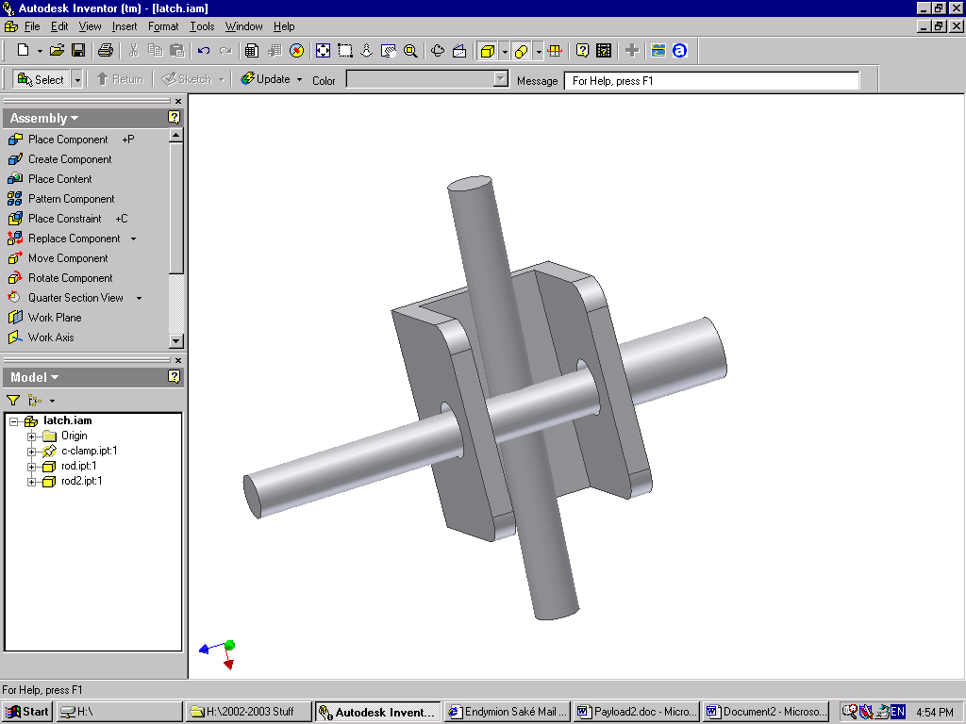
Aircraft Design
Payload Delivery
Latching Mechanism
Door Line
Servo pulls the pin out this direction
Then this door pin is free to open outward

Slide 25
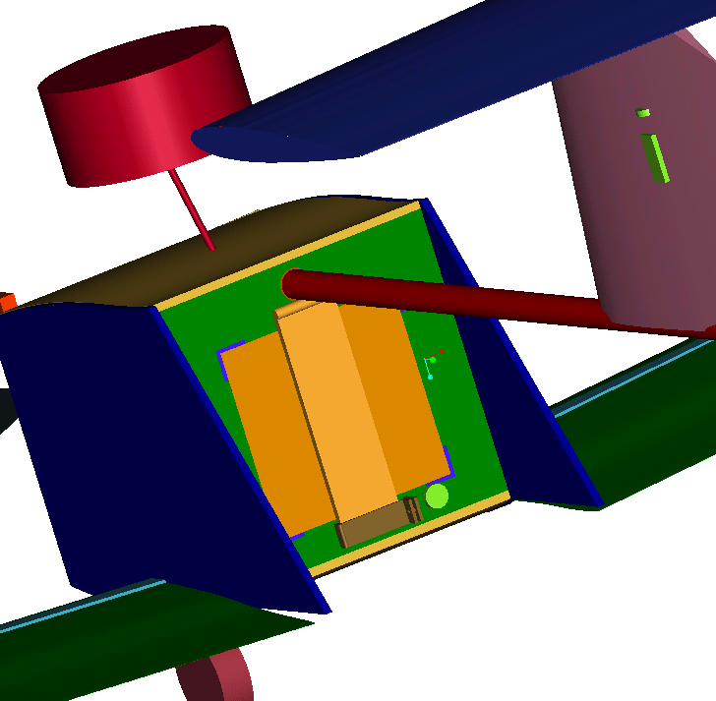
Aircraft Design
Payload Delivery
Door:
Our door was reduced in size because only a fraction of the door is needed to hold back the payload. Also the idea of a faring was thrown out because the benefits of the aerodynamics were not as significant as the weight added to the plane.

