Slide 1
Aerodynamic Reference Data
Seung (Paul) Yoo
4/30/2026

Slide 2
Goal
Create data to serve as a reference for workshop
Data Source
Surface pressure data from flight tests of an object that look similar to our SATCOM radome exists
Pressure Sensor Info
Measurement devices – total of 64 sensors
Static pressure taps – 56 sensors
5 rows: 1 centerline (16 sensors) , ±40% semi-span (12 sensors each), ± 80% semi-span (8 sensors each)
Sensors avoid 2% on the leading edge and 3% on the trailing edge to account for the lip shown on the radome picture
Kulite sensors to capture unsteadiness – 8 sensors
2 rows: at ±20% semi-span
4 sensors each row
Sensors located between 50% local chord to TE-5% local chord
1 ESP (64 channel) to monitor static pressure sensors and kulite sensors

Slide 3
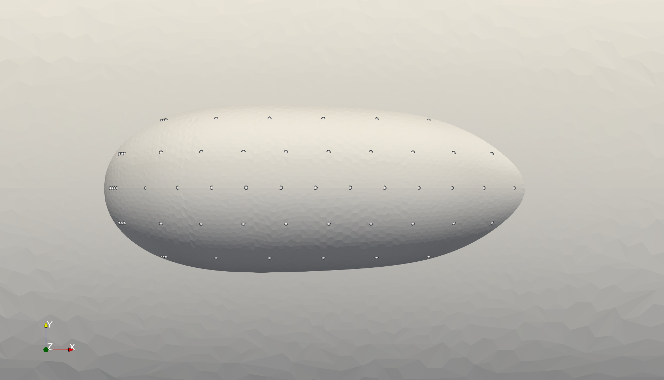
Sensor Locations

Slide 4
Geometry and Sensor Overlay
16 sensors
(y centerline)
4 sensors
(20% semispan)
12 sensors
(40% semispan)
8 sensors
(80% semispan)

Slide 5
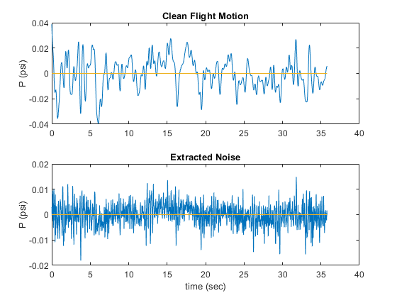
Flight-like Data
Noise
Flight path – turbulence, lack of precision autopilot
Sampling rate – ~100 Hz
Creating Data
Use actual flight data and extract noise and path information using low pass filter
Use average of 4 CFD solutions and add the noise and path data
Every sensor has different noise

Slide 6
Some things are not “realistic”
Time stamp starts from 0 sec
All data have same time duration
Didn’t take into account location of the sensor on error
No structural information – assumed flight test scenario of “rigid” structure

