Slide 1

Notes:
SLIDE 1
Hi everyone. Today I want to introduce Bursar — a platform for managing your team of AI agent employees.

Slide 2
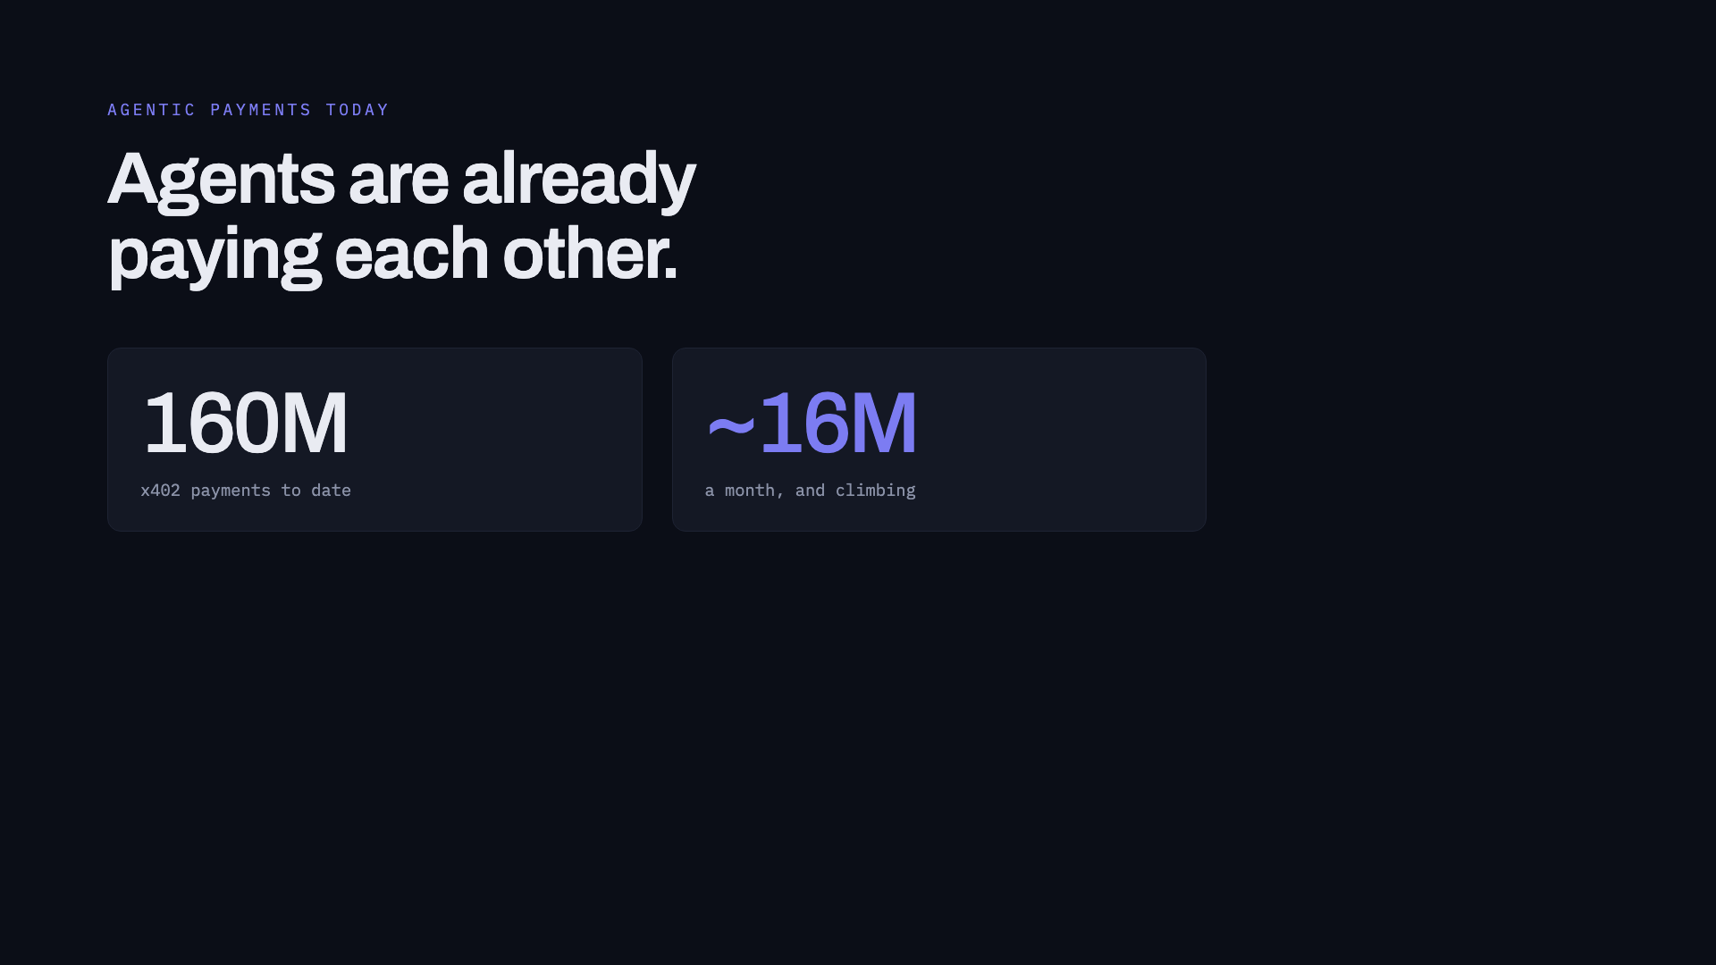
Notes:
SLIDE 2
Today, x402 has processed over a hundred and sixty million agentic payments, and it's running about sixteen million a month. And that number is growing fast. Which means more and more of us aren't running one agent any more — we're running whole teams of them.
[land on "teams", then click]

Slide 3

Notes:
SLIDE 3
You can already build a team of agents that pay for services to get your work done. What you can't do is manage them.
You have to fund every agent's wallet separately. And once they're running, there's no easy way to see how much any one of them is spending, or what it's spending it on.

Slide 4
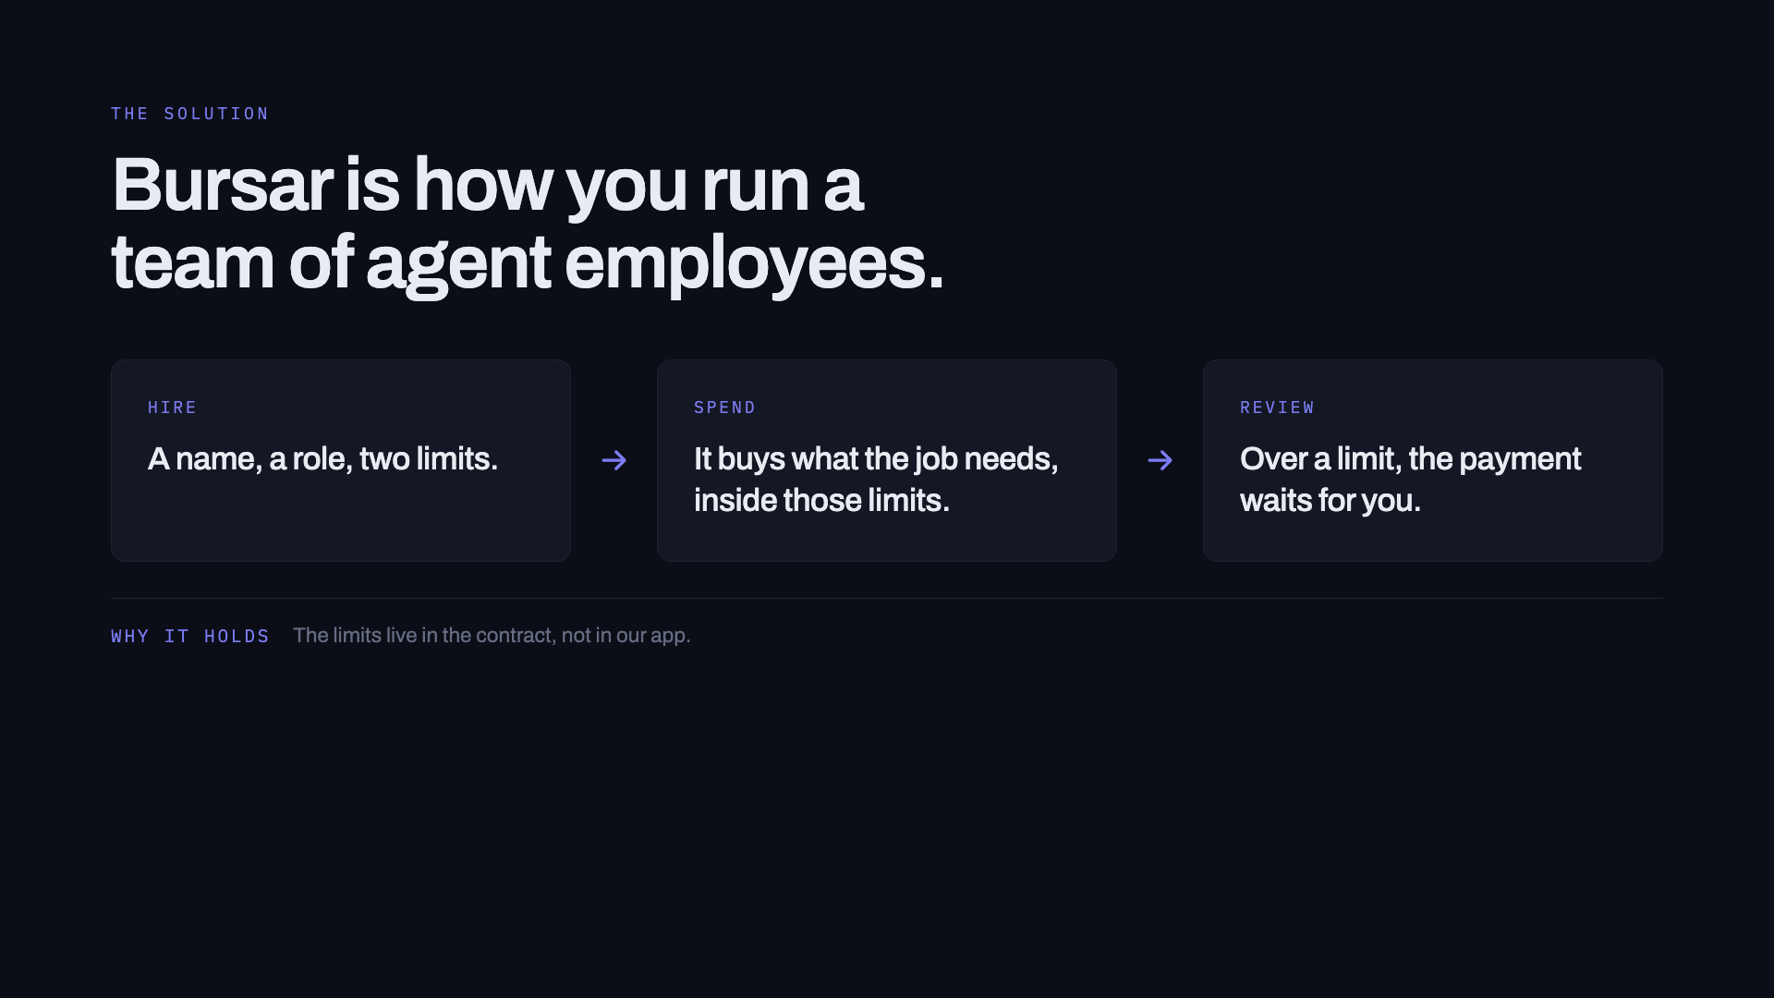
Notes:
SLIDE 4
Bursar puts your whole agentic team in one place. You hire agents into the team, and you set a spending policy for each one — what it can spend on a single purchase, and what it can spend in a month.
[optional, if you want the line the slide's footer promises:]
And those limits aren't just settings in our app — they're enforced by the smart contract that holds the money. So it doesn't just flag an overspend. It stops it.

