Slide 1
Deep Learning Basics
Slides to accompany the Pytorch exercises

Slide 2
Key
Slides with red headings (such as this one) carry notes or instructions for teachers
Slides with yellow headings (such as the next one) contain spoken content. They’re what the teacher might say.
Slides with blue headings are the actual visual accompaniment to use while talking.
The teacher can delete the red and yellow slides.
Notes:
I use the blue slides as visual aids while explaining concepts.
The yellow headed slides are what I talk.
The red slides are my lecture notes.

Slide 3
Motivation
Deep learning democratizes (I might even say deskills) AI:
Anyone can learn it (it’s only multiplications, matrices and partial differentiation which you won’t be using in your day-to-day work).
Anyone can teach it (it’s only multiplications and matrices and a little bit of partial differentiation).
Notes:
Explain that it is easy.

Slide 4
Motivation
It has a high benefits - costs ratio:
The same algorithms work on images, on text and on speech.
The same core math works for sequential models and non-sequential models.
You get three * two for the price of one!
Notes:
Explain the benefits.

Slide 5
What is deep learning?
Deep learning refers to the use of artificial neural networks with more than one layer of neurons (interconnections).
features
Notes:
Teacher: We hope to make clear in the very first content slide (page 2) that “deep” learning models are just neural networks, but with more than one layer of interconnections.
Deep learning as of today (2018) is based on the math of neural networks. And we say the neural networks are “deep” if they involve more than one layer of neurons. Deep learning models are just multilayered neural networks. We’ll see later on what changed between the 1980s when their performance was considered very poor and recent years when the self-same neural networks have yielded state-of-the-art performance on almost every task that machine learning has been applied to.
It might be useful to dispel students’ fear of math at this point by letting them know that if they don’t like math, they’re in the right class. Let them know that deep learning is different from other forms of machine learning in that it is very easy to learn. In order to develop an understanding of deep learning, the only math they will need to know is – hold your breath – multiplication and division. And maybe some differentiation. But the frameworks available today do the differentiation automatically for you, so you don’t even need to know that. Multiplication is enough.
Also, let the students know that what’s super-interesting about deep learning is that there is only one bit of math to learn (one learning algorithm) and it works for all problems. If we were teaching statistical machine learning, we’d be learning an algorithm for text, another for images, yet another for sequential classification (oh wait, you’d learn 3 algorithms just for HMMs – a sequential model). With neural networks, the underlying learning algorithm is the same for any kind of problem or model. So anyone who knows programming can learn this stuff in a few hours. In fact, by the end of this class, in four hours, you’ll all be building image classifiers, and a chatbot. Ready for this?

Slide 6
What is deep learning?
So now we know what deep learning is.
It’s a neural network.
And it has many layers.
Let’s see what a neural network is and does.
Notes:
Say this for the previous slide

Slide 7
Neural Networks
Neural networks represent functions.
A single layer has a set of input nodes and a set of output nodes. These are connected by weighted neurons.
The neurons multiply the input values by their own weights. Let’s say the input is f₁ and the weight on the neuron is W₁₁. The product is f₁ * W₁₁. This product goes to the output node c₁. c₁ adds up all the incoming products from all the neurons that terminate at c₁.
So, c₁ = f₁*W₁₁ + f₂*W₁₂ + f₃ * W₁₃ + 1 * b₁
Notes:
Say this for the next slide. Walk your students through the calculation of c1. And if you have time, let them lead you through the calculation of c2. Else they won’t have internalized it.

Slide 8
Neural Networks
Outputs = c ; Inputs = f ; Neurons = W
c₁
c₂
c₃
1
2
3
W₁₁
W₂₁
W₂₂
W₂₃
W₃₃
b₃
W₁₂
W₃₂
W₁₃
b₂
1
W₃₁
2
3
b₁
4
f₁
f₂
f₃
1
Operations:
1. each neuron (interconnection) has a weight = W
2. it contributes the weighted input value f to the output => f * W
3. each output is the sum of the contributions of all incoming neurons …
c = sum of neuron contributions = sum of f * W
Notes:
Let’s start. This is how a neural network with one layer of neurons looks. There is just a set of inputs and outputs. And they are connected by neurons (interconnections). The neurons all have weights. Each neuron multiplies the input at its lower end with its weight and contributes it to the output. Each output is the sum of all neuron contributions. That’s all a neural network is!
The bias is just a neuron whose input is always set to 1.
Teacher: Explain how a neural network works (without saying anything about training – so as to reduce student cognitive load). Goal: student knows what a neural network does.
Note: Give students enough time to read what’s on this slide.
Explain that the bias is an input which is always set to 1.
Ask them what the value of c1 is and c2 is and explain to them that c1 is f1 * W11 + f2 * W12 + f3 * W13 + b1 * 1. Make them say it out loud. That way, they’ll be sure to digest it.

Slide 9
Neural Networks Example
So, now that you’ve heard what neurons do, can you tell me what c1 and c2 are on this slide?
Notes:
Say this for the next slide. Walk your students through the calculation of c1. And if you have time, let them lead you through the calculation of c2. Else they won’t have internalized it.

Slide 10
Neural Networks Example
This is a problem based on the math of the previous blue slide. Ask the students to compute the outputs c1 and c2 given the inputs f1 and f2.
Goal: student develops an understanding of what a neural network does by doing what it does.
Note: Give ample time for digesting. Return to previous slides and explain if you see puzzled looks.
Walk through the solution => c1 is equal to W11 into f1 plus W12 into f2 plus 1 into b1, which is ...
Notes:
I use the blue slides as visual aids while explaining concepts.
The yellow headed slides are what I talk.
The red slides are my lecture notes.

Slide 11
Neural Networks Example
Outputs = c ; Inputs = f ; Neurons = W
c₁
c₂
1
2
W₁₁
W₂₁
W₂₂
W₁₂
b₂
1
2
b₁
4
f₁
f₂
1
f₁ = 1
f₂ = 2
W₁₁ = 3 W₁₂ = 4 b₁ = 0.5 What are c₁ and c₂?
W₂₁ = 7 W₂₂ = 1 b₂ = 0.3
Notes:
So, now that you’ve heard what neurons do, can you tell me what c1 and c2 are on this slide?
Teacher: This is a problem based on the math of the previous slide. Ask the students to compute the outputs c1 and c2 given the inputs f1 and f2. Goal: student develops an understanding of what a neural network does by doing what it does.
Note: Give ample time for digesting. Return to previous slides and explain if you see puzzled looks.
Walk through the solution => c1 is equal to W11 into f1 plus W12 into f2 plus 1 into b1, which is ...

Slide 12
Neural Networks Example
Outputs = c ; Inputs = f ; Neurons = W
c₁
c₂
1
2
W₁₁
W₂₁
W₂₂
W₁₂
b₂
1
2
b₁
4
f₁
f₂
1
f₁ = 1
f₂ = 2
W₁₁ = 3 W₁₂ = 4 b₁ = 0.5 What are c₁ and c₂?
W₂₁ = 7 W₂₂ = 1 b₂ = 0.3
c₁ = 1 * 3 + 2 * 4 + 0.5 = 11.5
c₂ = 1 * 7 + 2 * 1 + 0.3 = 9.3
Notes:
Here’s the solution.
Teacher: This slide is the answer to the problem set in the previous slide.
Note: Make them say it out loud.

Slide 13
Neural Networks
Now look at those equations you solved carefully.
Do you see a set of linear equations?

Slide 14
Neural Networks
Outputs = c ; Inputs = f ; Neurons = W
c₁ = f₁W₁₁ + f₂W₁₂ + f₃W₁₃ + b₁
c₂ = f₁W₂₁ + f₂W₂₂ + f₃W₂₃ + b₂
c₃ = f₁W₃₁ + f₂W₃₂ + f₃W₃₃ + b₃
Classes
1
2
3
W₁₁
W₂₃
W₃₃
b₃
W₂₁
W₂₂
W₁₂
W₃₂
W₁₃
b₂
1
W₃₁
2
3
b₁
4
Features
Notes:
Explain that the equations we just went over when written down look like this.
These are linear equations. What does that mean? They define lines in n-dimensional space where n is the number of inputs + 1. For example, y = mx + c is the equation of a line in 2 dimensions (here, there is only one input => x).
So, what such neural networks do, is learn a function which is a line in hyperspace.
Teacher: Show them the equations. Since they’ve already used the equation, it shouldn’t look too scary.
Note: Explain that each of these equations represents a line (or hyperplane) in n-dimensional space.
Hopefully they start seeing matrices in their heads & aren’t too scared to see matrices 2 slides later.

Slide 15
Neural Networks
Each of these equations is called a linear equation because it represents a line in n-dimensional space (hyperspace).
Can you see how that is so?
What form would those equations take if you had only one input?
y = mx + c
y = mx + c is the equation of a line in 2 dimensional space. Explain that c₁ = f₁W₁₁ + f₂W₁₂ + b₁ is analogous to that, but in 3 dimensional space.
Notes:
y = mx + c is the equation of a line in 2 dimensional space. Explain that c₁ = f₁W₁₁ + f₂W₁₂ + b₁ is analogous to that, but in 3 dimensional space.

Slide 16
Neural Networks
Outputs c are a linear combination of inputs f …
c₁ = f₁W₁₁ + f₂W₁₂ + b₁
c₂ = f₁W₂₁ + f₂W₂₂ + b₂
f₁ = 1
f₂ = 2
W₁₁ = 3 W₁₂ = 4 b₁ = 0.5
W₂₁ = 7 W₂₂ = 1 b₂ = 0.3
c₁ = 1 * 3 + 2 * 4 + 0.5 = 11.5
c₂ = 1 * 7 + 2 * 1 + 0.3 = 9.3
Notes:
Here is the algebraic form of the problem we just solved. The weights and biases represent lines in 3 dimensional space.

Slide 17
Neural Networks
This slide introduces the matrix form of the previous blue slide’s equations. Show that they are the same by walking them through matrix multiplication (which the students may have forgotten the procedure for).
Note: Use this slide to explain matrix multiplication. Explain the shorthand matrix notation below.
Notes:
I use the blue slides as visual aids while explaining concepts.
The yellow headed slides are what I talk.
The red slides are my lecture notes.

Slide 18
Neural Networks
This is how the same system of linear equations looks in matric form. Convince yourself that this is the same equation as on the previous page.
So, c1 is equal to f1 * W11 + f2 * W12
That’s the same equation as before, right?
Notes:
Go over the equations in matrix form. Show the students that nothing has changed. Point out how much simpler the shorthand matrix multiplication shown below looks (and you can use it to represent matrices of very large dimensions easily).

Slide 19
Neural Networks
We’ve been making the students do the forward pass of the backprop algorithm again and again without telling them about it.
They will get really familiar with computing the outputs of a neural network given the inputs.
Hopefully this will make it easier on them when they encounter the rest of backprop.

Slide 20
Neural Networks
Outputs c are a linear combination of inputs f …
W₁₁ W₂₁ = f₁ f₂ * W₁₂ W₂₂ + b₁ b₂
Classes c
W
c₁ c₂
Features f
Do the exercises on tensors in Pytorch – exercise 110.
Notes:
This is how the same system of linear equations looks in matric form. Convince yourself that this is the same equation as on the previous page.
Teacher: The matrix form of the previous slide’s equations. Show that they are the same by walking them through matrix multiplication (which the students may have forgotten the procedure for). Use the next slide if needed (the next slide works out the same neural network output computation in detail).
Note: Use this slide and the next one to explain matrix multiplication.

Slide 21
Neural Networks
Outputs c are a linear combination of inputs f …
W₁₁ W₂₁ = f₁ f₂ * W₁₂ W₂₂ + b₁ b₂
Classes c
W
c₁ c₂
Features f
W₁₁ = 3 W₂₁ = 7
W₁₂ = 4 W₂₂ = 1
f₁ = 1 f₂ = 2
b₁ = 0.5 b₂ = 0.3
c₁ = 1 * 3 + 2 * 4 + 0.5 = 11.5 c₂ = 1 * 7 + 2 * 1 + 0.3 = 9.3
Notes:
This is how the problem we solved would look if written in matrix form.
Teacher: The matrix form with explicit numbers assigned to make it clearer.
Show how the dimensions of the matrices used depend on the dimensionality of the inputs and outputs.
Exercises: Start with set 1 of the exercises … those whose names start with “exercise_1_”. These are exercises that allow students to familiarize themselves with the representation of matrices/vectors/tensors in Pytorch.
The exercise ‘exercise_1_tensor_representation_of_a_neural_network.py’ corresponds to this slide.

Slide 22
Neural Networks
Outputs c are a linear combination of inputs f …
W₁₁ W₂₁ = f₁ f₂ * W₁₂ W₂₂ + b₁ b₂
_{c = f W + b}
Classes c
W
c₁ c₂
Features f
See how simple this looks
Notes:
This is how the same system of linear equations looks in matrix form. Explain the shorthand matrix notation below.

Slide 23
Neural Networks
In the next slide, we ask the students to compute the outputs for a different number of inputs.
Hopefully, the students will realize that the matrix dimensions are tied to the input and output feature vector dimensions, and that the matrices act as transforms from a space with a certain number of dimensions to another.
Hopefully they also begin to notice that there’s one bias per output, so the dimensions of the bias vector are equal to the dimensions of the output vector.

Slide 24
Neural Networks
Outputs c are a linear combination of inputs f …
W₁₁ W₂₁ = f₁ f₂ f₂ * W₁₂ W₂₂ + b₁ b₂
W₁₃ W₂₃
_{c = fW + b}
Classes c
W
c₁ c₂
Features f
W₁₁ = 3 W₂₁ = 7
W₁₂ = 4 W₂₂ = 1
W₁₃ = 1 W₂₃ = 2
c₁ = ?
c₂ = ?
f₁ = 1 f₂ = 2 f₃ = 3
b₁ = 0.5 b₂ = 0.3
Try this out!
Also do this in Pytorch – exercise 210.
Notes:
Do exercise_210.
Can you solve this? What are c1 and c2? Note how the number of rows of the weight matrix corresponds to the number of inputs and the number of columns (of both the weight and the bias matrices) corresponds to the number of outputs. You can think of this neural network layer as a transform from a 3 dimensional space to a 2 dimensional space. It transforms 3 dimensional vectors into 2 dimensional vectors.
Teacher: Problem. Ask the students to compute the outputs c1 and c2 given the inputs f1, f2 and f3. Goal: student develops an understanding of matrix dimensioning and computing a forward pass as tensor multiplication by doing it.
Note: Next, we will use the concepts and math learnt so far to do classification.
Exercises: Ask students to modify the program ‘exercise_1_tensor_representation_of_a_neural_network.py’ to represent this model.

Slide 25
Neural Networks
Time for comic relief!
Take a little break from the computing, and talk a little theory?

Slide 26
Machine Learning
There are three broad categories of machine learning algorithms:
Supervised
Unsupervised
Reinforcement-Learning
Notes:
There is a really cool Yann LeCun talk (and slides to go with it) where he goes over these in detail.

Slide 27
Machine Learning
Supervised learning is where you’re given inputs and corresponding output labels picked from a finite set of labels (and these labels are not part of the inputs).
Unsupervised learning is where you have the inputs but have to predict some part of the inputs given the other parts, or some grouping of the inputs, etc. You just don’t have any labels or external output values in your training data.
Reinforcement learning is where the feedback is limited to a reward (or a whack in the rear). You’re not told what the right answer was.

Slide 28
Machine Learning
Categories of Machine Learning >>
Supervised
Unsupervised
Reinforcement
Notes:
We’re going to start with supervised learning algorithms.

Slide 29
Supervised Machine Learning
Categories of Supervised Machine Learning >>
Classification
Regression
We’re going to do this now!

Slide 30
Supervised Machine Learning
There are two kinds of supervised machine learning from the point of view of the output
Classification – where your input is some data and your output is one or more of a set of finite choices (also called labels, buckets, categories or classes)
Regression – where your input is some data and your output is a real number.
Notes:
There’s this really cool Yann LeCun talk/slides where he goes over these in detail. I just can’t seem to find the link. Help anyone!?

Slide 31
The Classifier
What is a Classifier?
Something that performs classification.
Classification = categorizing
Classification = deciding
Classification = labelling
Classification = Deciding = Labelling

Slide 32
Classification
Remember, this course is an experiment in “learning by doing”.
So, when you teach a concept, get the students to do it.
Hopefully, then they’ll get it.
Watch.

Slide 33
Classification
Which of the doors (whose heights are given in the next slide) would be considered ‘tall’ and which would be considered ‘short’.
Ok, what you’ve just done is classification.
Why is it classification?
You just categorized a door in one of two categories – tall and short
You just decided if a door is tall or short
You just labelled a door as tall or short
In this case, the input data was a number (structured data).
Let’s look at two examples of classification where the input is unstructured data.

Slide 34
Classification = Deciding = Labelling
5’ 8”
6’2”
5’11”
5’11”
5’8”
6’6”
5’ 2”
6’9”
6’8”
6’10”
Classify these door heights as: Short or Tall ?

Slide 35
Classification
In the case of doors, the input data was a number (the door height) which is structured data.
Let’s look at an example of classification where the input is unstructured data.
Here is an image of a landscape. What is the colour you see here?

Slide 36
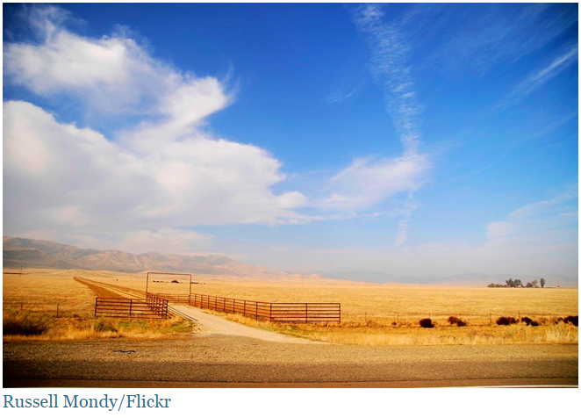
What is Classification?
What colour do you see here?

Slide 37
What is Classification?
Classification = Categorizing = Labelling = Deciding
Blue

Slide 38
Classification
You said that the colour here is blue.
What have you just done?
You’ve categorized this area of the image into one of a set of colours.
You’ve labelled this area as blue.
You’ve decided this is blue.
You’ve done classification.
Humans operate as classifiers more often than we realize.

Slide 39
Classification
Do one more exercise with the students.
Ask one of them to volunteer for an experiment.
Ask the volunteer what their name is.
Let’s say the volunteer’s name is Lisa.
Ask Lisa, “Is your name Lisa?”
Lisa says, “Yes”.
Ask the class what Lisa just did.
They usually won’t realise she just performed classification.
Ask the class what choices Lisa had to pick from.
Her choices for an answer were limited to “yes” and “no”.
So she chose from one of two (a finite set of) categories.
So she performed classification.
This is another example of classification where the input data is unstructured (speech or text).

Slide 40
Classifiers
Ok, now let’s see how we can build a classifier using the math that you have learnt so far.
What neural networks do is take an input which is a vector of real numbers and give you an output which is a set of real numbers.
Can you turn this machinery into a classifier?

Slide 41
Neural Networks as Classifiers
Since classification is deciding …
Could you use the outputs c to make a hard decision? How would you do it?
W₁₁ W₂₁ W₃₁ = f₁ f₂ f₃ * W₁₂ W₂₂ W₃₂ + b₁ b₂ b₃
W₁₃ W₂₃ W₃₃
Classes c
W
c₁ c₂ c₃
Features f
These are the equations you have already gone over.
You take some inputs f₁ f₂ f₃ …
and get some real numbers as outputs .. c₁ c₂ c₃.
Can you use the values of c₁ c₂ c₃ to make a decision?

Slide 42
Neural Networks as Classifiers
Could you use the outputs c to make a hard decision? How would you do it?
W₁₁ W₂₁ W₃₁ = f₁ f₂ f₃ * W₁₂ W₂₂ W₃₂ + b₁ b₂ b₃
W₁₃ W₂₃ W₃₃
Classes c
W
c₁ c₂ c₃
Features f
Can you use the values of c₁ c₂ c₃ to make a decision?
Hint: c₁ c₂ c₃ stand for category 1, category2, category 3.

Slide 43
Neural Network Classifiers
Yes, you can. If the outputs c are preferences for categories …
W₁₁ W₂₁ W₃₁ = f₁ f₂ f₃ * W₁₂ W₂₂ W₃₂ + b₁ b₂ b₃
W₁₃ W₂₃ W₃₃
Classes c
W
c₁ c₂ c₃
Features f
You can just say that the category (output) favoured by
the neural network is the one with the highest value.
So, the category output by the classifier is argmax_{n} (c_{n})

Slide 44
Classification
Now get the students to do the classification themselves using ye olde example.

Slide 45
Neural Network Classifiers
Outputs c are a linear combination of inputs f …
W₁₁ W₂₁ = f₁ f₂ f₂ * W₁₂ W₂₂ + b₁ b₂
W₁₃ W₂₃
Classes c
W
c₁ c₂
Features f
The category output by the classifiers is argmax_{n} (c_{n})
W₁₁ = 3 W₂₁ = 7
W₁₂ = 4 W₂₂ = 1
W₁₃ = 1 W₂₃ = 2
c₁ = ?
c₂ = ?
f₁ = 1 f₂ = 2 f₃ = 3
b₁ = 0.5 b₂ = 0.3
Which category did the classifier output?
Do this in Pytorch – exercise 310.
Notes:
Do exercise_310

Slide 46
Classification
Here’s the first fun problem!!!

Slide 47
Neural Network Classifiers Problem 1
W₁₁ W₂₁ = f₁ f₂ * W₁₂ W₂₂
Classes c
W
c₁ c₂
Features f
Come up with weights such that if f₁ > f₂ the classifier will
select c₁ else c₂ !

Slide 48
Neural Network Classifiers Problem 1
Example 1: since f1 < f2 below, c1 must be less than c2.
Classes c
W
f₁ = 1 f₂ = 2
c₁ < c₂
Features f
When f₁ < f₂ … c₁ < c₂ so argmax_{n} (c_{n}) = 2
(the categories being 1 & 2).

Slide 49
Neural Network Classifiers Problem 1
Example 2: if f1 > f2, then c1 must be more than c2.
Classes c
W
f₁ = 4 f₂ = 2
c₁ > c₂
Features f
When f₁ > f₂ … c₁ > c₂ so argmax_{n} (c_{n}) = 1
(the categories being 1 & 2).

Slide 50
Neural Network Classifiers Problem 1
Come up with weights such that if f₁ > f₂ the classifier will
select c₁ else c₂ !
Classes c
W
W₁₁ = ? W₂₁ = ?
W₁₂ = ? W₂₂ = ?
Features f
Find the weights so that f₁ < f₂ => c₁ < c₂
Try this in Pytorch – exercise 350.
Notes:
One answer to the first problem is [[1,0],[0,1]]. Another is [[2,1],[1,2]]. There are multiple answers. Anything with the top left and bottom right weights high and the weights in the other diagonal low should work.

Slide 51
Classification
Here’s the second fun problem!!!

Slide 52
Neural Network Classifiers Problem 2
W₁₁ W₂₁ = f₁ f₂ f₂ * W₁₂ W₂₂
W₁₃ W₂₃
Classes c
W
c₁ c₂
Features f
Come up with weights such that if f₁ > f₂ + f₃ the classifier will select c₁ else c₂ !

Slide 53
Neural Network Classifiers Problem 2
Example: since f1 < f2 + f3 below, c1 must be less than c2.
Classes c
W
f₁ = 4 f₂ = 2 f₃ = 3
c₁ < c₂
Features f
Since f₁ < f₂ + f₃, c₁ < c₂ so argmax_{n} (c_{n}) = 2 (the categories being 1 & 2)

Slide 54
Neural Network Classifiers Problem 2
Come up with weights such that if f₁ > f₂ + f₃ the classifier will select c₁ else c₂ !
Classes c
W
W₁₁ = ? W₂₁ = ?
W₁₂ = ? W₂₂ = ?
W₁₃ = ? W₂₃ = ?
Features f
Find the weights so that f₁ < f₂ + f₃ => c₁ < c₂
Try this in Pytorch – exercise 380.
Notes:
One answer to the second problem is [[1,0],[0,1],[0,1]]. Another is [[2,1],[1,2],[1,2]]. There are multiple answers. The right models would be like those for the first problem but with the second row repeated as the third row.

Slide 55
Classifiers
So now you know how a classifier works!
But the numbers you’re feeding in as input are not devoid of meaning.
Let’s take a look at the inputs in the last problem …
They could represent a text document!!!
Want to know how?
f₁ = 4 f₂ = 2 f₃ = 3

Slide 56
Neural Network Document Classifiers
Say a language has only the words “a”, “b” and “c”.
Now, in a document …
f₁ = count of “a” f₂ = count of “b” f₃ = count of “c”
category₁ = Sports category₂ = Politics
Question: What are f1, f2 and f3 for each of the following documents?
a b a c a b c a c
a b a a c
Notes:
As the students to do the this exercise. The answers are:
1. f1 = 4, f2 = 2 and f3 = 3
f1 = 3, f2 = 1 and f3 = 1

Slide 57
Neural Network Document Classifiers
Say a language has only the words “a”, “b” and “c”.
Now, in a document …
f₁ = count of “a” f₂ = count of “b” f₃ = count of “c”
category₁ = Sports category₂ = Politics
Answer:
a b a c a b c a c f₁ = 4, f₂ = 2, f₃ = 3
a b a a c f₁ = 3, f₂ = 1, f₃ = 1
Notes:
Here’s the answer.

Slide 58
Neural Network Document Classifiers
a b a c a b c a c f₁ = 4, f₂ = 2, f₃ = 3
a b a a c f₁ = 3, f₂ = 1, f₃ = 1
Now, if you apply the weights you came up with for Problem 2 to these inputs, what classes would you find these documents belonging to?
f₁ > f₂ + f₃ => c1
f₁ <= f₂ + f₃ => c2
Notes:
Now ask the students to do this problem. If they use the weights they got for problem 2, they will satisfy the classification rules shown here.

Slide 59
Neural Network Document Classifiers
f₁ > f₂ + f₃ => c1
f₁ <= f₂ + f₃ => c2
W₁₁ = 1 W₂₁ = 0
W₁₂ = 0 W₂₂ = 1
W₁₃ = 0 W₂₃ = 1
class of f₁ = 4, f₂ = 2, f₃ = 3 => ?
class of f₁ = 3, f₂ = 1, f₃ = 1 => ?
Compute c1 and c2 then do argmax(c1, c2)
Notes:
Here’s the answer.

Slide 60
Neural Network Document Classifiers
f₁ > f₂ + f₃ => c1
f₁ <= f₂ + f₃ => c2
f₁ = 4, f₂ = 2, f₃ = 3 => category₂
f₁ = 3, f₂ = 1, f₃ = 1 => category₁
Notes:
Here’s the answer.

Slide 61
Neural Network Document Classifiers
f₁ = count of “a” f₂ = count of “b” f₃ = count of “c”
c₁ = Sports c₂ = Politics
a b a c a b c a c => Politics
a b a a c => Sports

Slide 62
Text Classification
So you’ve learnt how text can be represented as a vector of numbers.
You’ve also learnt to do topic classification.
Provided someone gives you the weights!
But documents have a vocabulary of thousands of words, so the weight matrix can be very large. It would be very difficult to come up with a good one manually.
Is there a better way to come up with a weight matrix?
Can you show the neural network some examples and ask it to come up with a weight matrix?
Yes, you can. That’s called training a neural network.
f₁ = 4 f₂ = 2 f₃ = 3

Slide 63
Training a Neural Network
How do you learn the weights automatically?
Step 1: Get some training data
Step 2: Create a loss function reflecting the badness of the neural net
Step 3: Adjust the weights to minimize the loss (error) on the training data
Classes c
W
Features f
Let the machine learn weights such that if f₁ > f₂ + f₃ the classifier will select c₁ else c₂ !
Give it examples (training data) + tell it which is the right way up + let it climb up on its own.
W₁₁ = ? W₂₁ = ?
W₁₂ = ? W₂₂ = ?
W₁₃ = ? W₂₃ = ?
c₁ < c₂
f₁ = 4 f₂ = 2 f₃ = 3
So argmax_{n} (c_{n}) = 2

Slide 64
Step 1: Get some training data
That’s easy (for us).
We can generate it!
Classes c
W
c = 1 f₁ = 4 f₂ = 2 f₃ = 3
c = 0 f₁ = 2 f₂ = 1 f₃ = -3
c = 0 f₁ = -2 f₂ = -1 f₃ = -3
c = 1 f₁ = 3 f₂ = 1 f₃ = 7
c = 1 f₁ = -3 f₂ = 1 f₃ = 0
c = 0 f₁ = 3 f₂ = 1 f₃ = 1
Features f
Try this in Pytorch – exercise 410.

Slide 65
Step 2: Create a loss function
Classes c
A loss function is a function that reflects the degree of incorrectness of the machine learning algorithm.
To make Step 3 easy, this loss function thing has to be differentiable.
W
Features f

Slide 66
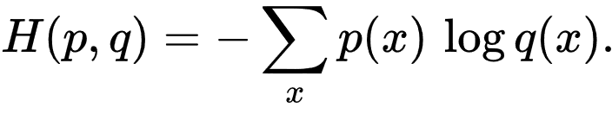
Step 2: Create a loss function
There’re many such functions and one that’s usually used with classifiers is “cross-entropy”.
p is the one-hot encoding of the correct class
q is the softmax of the classifier’s output
Classes c
W
Features f

Slide 67
Step 2: Create a loss function
Cross entropy:
For classifiers:
p is the one-hot encoding of the correct class
q is the softmax of the classifier’s output
Classes c
W
Features f

Slide 68
Step 2: Create a loss function
One-hot encoding of a number
It is just a vector with a 1 in the position of that number and 0 in the positions of all other numbers.
One-hot encoding of a category number
A vector with a 1 in the position of that category and 0s at the positions of all other categories.
Classes c
W
Features f

Slide 69
Step 2: Create a loss function
Say we are deciding between 3 classes.
The one hot encoding of category 0 is [1, 0, 0]
The one hot encoding of category 1 is [0, 1, 0]
What is the one-hot encoding of category 2?
Classes c
W
Features f

Slide 70
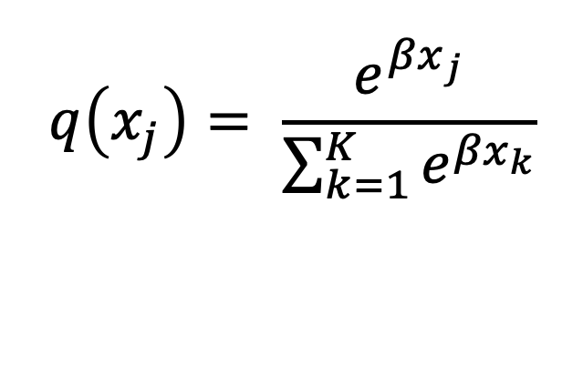
Step 2: Create a loss function
Cross entropy:
For classifiers, q is the softmax of the classifier’s output
Classes c
W
Features f
$$q\left(x_{j}\right)= \frac{e^{{βx}_{j}}}{\sum_{k=1}^{K}{e^{{βx}_{k}}}}$$
for j = 1..K classes
Notes:
What exactly does the softmax function do? Find out in the next slide.

Slide 71
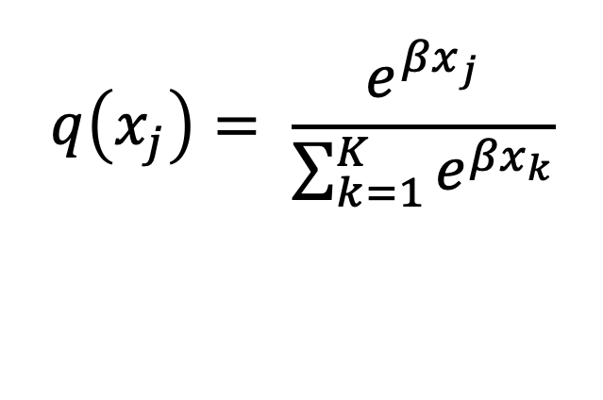
Softmax
Softmax
h = q(x) = softmax(x)
Approximates argmax(x) with real numbers in the range (0,1) that sum to 1 and therefore can be used with a probabilistic intepretation
Classes c
W’
Hidden h
$$q\left(x_{j}\right)= \frac{e^{{βx}_{j}}}{\sum_{k=1}^{K}{e^{{βx}_{k}}}}$$
W
for j = 1..K classes
Features f
Notes:
q is the softmax function.

Slide 72
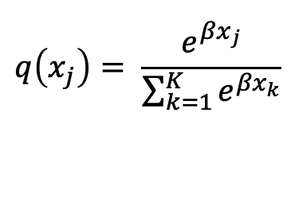
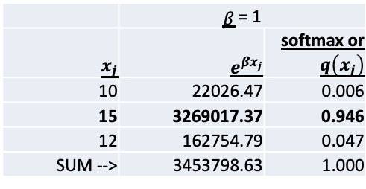
Softmax
Softmax is a “soft approximation” for argmax.
argmax(10,15,12) = (0,1,0)
Here, we have represented the output in one hot encoding, showing 15 is the highest number
Classes c
W’
Hidden h
W
 | 𝛽 = 1
$$x_{j}$$ | $$e^{{βx}_{j}}$$ | softmax or $q\left(x_{j}\right)$
10 | 22026.47 | 0.006
15 | 3269017.37 | 0.946
12 | 162754.79 | 0.047
SUM --> | 3453798.63 | 1.000
$$q\left(x_{j}\right)= \frac{e^{{βx}_{j}}}{\sum_{k=1}^{K}{e^{{βx}_{k}}}}$$
Features f
for j = 1..K
You can see that q(15) is approximately 1! In addition, softmax sums to 1, so you can interpret as a probability distribution provided you agree with how concentrated the probability is.
Notes:
q is the softmax function.

Slide 73
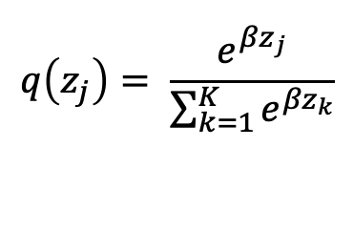
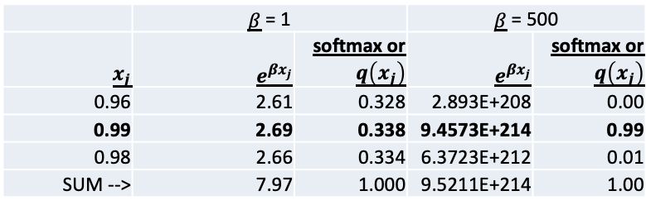
Softmax
Softmax is a “soft approximation” for argmax.
argmax(0.96, 0.99, 0.98) = (0,1,0)
Let’s see what happens to softmax when the inputs are close to each other
Classes c
W’
Hidden h
 | 𝛽 = 1 |  | 𝛽 = 500
$$x_{j}$$ | $$e^{{βx}_{j}}$$ | softmax or $q\left(x_{j}\right)$ | $$e^{{βx}_{j}}$$ | softmax or $q\left(x_{j}\right)$
0.96 | 2.61 | 0.328 | 2.893E+208 | 0.00
0.99 | 2.69 | 0.338 | 9.4573E+214 | 0.99
0.98 | 2.66 | 0.334 | 6.3723E+212 | 0.01
SUM --> | 7.97 | 1.000 | 9.5211E+214 | 1.00
$$q\left(z_{j}\right)= \frac{e^{{βz}_{j}}}{\sum_{k=1}^{K}{e^{{βz}_{k}}}}$$
W
for j = 1..K
Features f
You can see that q(0.99) is approximately 1 when 𝛽 is large (theoretically, when 𝛽 → infinity)! You can see clearly how different the softmax looks when 𝛽 changes. A probabilistic interpretation is valid only if the spread of q(Zi) matches your thoughts on how likely each class is.
Notes:
q is the softmax function.

Slide 74
Softmax
Cross-Entropy
loss =
loss = - log (softmax(z))
where z is the output of the correct output node.
Classes c
W’
If z is the correct category, p(x) = 0 for all x not equal to z
So the summation goes away and you get -p(z) log q(z)
But, p(z) is 1.
So loss = - log q(z). But q is the softmax function … so …
Hidden h
W
Features f
Notes:
The summation disappears because only one of the one hot vectors’ elements is 1 (where x is the correct category).

Slide 75
Step 2: Create a loss function
The cross entropy loss for different data points …
Classes c
These are more difficult to classify because f1 is only a little more than f2 + f3
W
c = 0 f₁ = 4 f₂ = 2 f₃ = 1.9 cross entropy = 0.6444
c = 0 f₁ = 5 f₂ = 2 f₃ = 1.9 cross entropy = 0.2873
c = 0 f₁ = 6 f₂ = 2 f₃ = 1.9 cross entropy = 0.1155
c = 0 f₁ = 10 f₂ = 2 f₃ = 1.9 cross entropy = 0.0022
Features f
These are easier to classify because f1 is a lot more than f2 + f3, so the classifier fares better, hence the cross-entropy is lower.
Notes:
Over to the python exercises 430 and 450 - where the students get to calculate the softmax and the cross entropy for the classifier’s outputs for various data points.

Slide 76
Step 2: Create a loss function
The students can work through the python exercises 430 and 450.
You could also explain that instead of using the softmax function, you could use the logistic function (normalized) for thresholding. This is covered in exercise 480.

Slide 77
Step 3: Minimize the loss
Now we have a loss function that reflects the degree of incorrectness of a classifier.
The best classifier is one whose weights and bias values minimize the loss.
Training is nothing but finding the weights and biases that minimize the loss.
Classes c
W
Features f
loss
W

Slide 78
Step 3: Minimize the loss
You can iteratively train a classifier (find the weights and biases that minimize the loss):
Start with random values for weights and biases
Adjust the weights so the loss (computed by the loss function) decreases.
Compute the loss for the current weights.
Nudge the weights up or down so we reduce the loss (go down the gradient)!
Classes c
W
Features f
loss
W
Notes:
Do the exercise on minimizing the parameters x for a toy loss function x^2 + 3

Slide 79
Step 3: Minimize the loss
Let’s say the classifier has a scalar weight x … and assume the loss function x^2+3
Train this classifier (find the x that minimizes the loss) iteratively.
Classes c
W
Features f
loss
W
Notes:
Do the exercise on minimizing the parameters x for a toy loss function x^2 + 3

Slide 80
Step 3: Minimize the loss
Start with a random value for x
Let’s just start with x = 2
Compute the loss x^2 +3 for x = 2. That is 2^2 +3 which is 7
Forward
Pass
Classes c
W
Features f
loss
W
Notes:
Forward pass part of minimizing the parameters x for a toy loss function x^2 + 3

Slide 81
Step 3: Minimize the loss
The partial derivative of the loss with respect to the weight is …
d loss / dx =
= d (x^2 + 3) / dx
= 2*x = 4
Backward
Pass
Classes c
W
The partial derivative of the loss with respect to x is positive. What this tells us is that if x is increased the loss will increase.
Features f
loss
W
Notes:
Do the exercise on minimizing the parameters x for a toy loss function x^2 + 3 – this is exercise 510

Slide 82
Step 3: Minimize the loss
Since the loss will increase if x increases, instead decrease the weight x so that the loss decreases … x = x – 0.01 * 4
= 2 – 0.01 * 4
The new value of x is 1.96
Classes c
W
Features f
0.01 is the learning rate
loss
W

Slide 83
Step 3: Minimize the loss
Calculate the loss to convince yourself that the loss has decreased.
We started with x = 2 which gave a loss of 7
After one iteration, x = 1.96
The loss is now 6.8416 which is less than 7
Repeat the forward and backward steps a few hundred times and x will reach (actually approach) 0.
Notes:
You don’t have to do this manually. There’s a pytorch exercise for this – exercise 510.

Slide 84
Step 3: Minimize the loss
We just trained a neural network using the backpropagation algorithm!
But, we did not use any training data.
How do we take training data into account during training?

Slide 85
Step 3: Minimize the loss
How do we take training data into account during training?
It’s all in the loss function.
To take training data into account, use a loss function that involves training data (the parameters to be learnt are the variables and the training data are the constants).

Slide 86
Step 3: Minimize the loss
If you have training data ->
Start with random values for the variables (weights and biases) to be minimized.
Randomly select a subset (or one) of the training data as input.
Compute the loss for that input.
Calculate the gradient of the loss for each parameter.
Nudge the parameter in a direction opposite to the gradient.
Repeat from step 2!
Classes c
Forward
Pass
W
Backward
Pass
Features f
loss
Back-Propagation = Forward Pass + Backward Pass
W
Notes:
We’ll see how to “nudge the parameter” in the next slide.

Slide 87
Nudging the parameters
Stochastic Gradient Descent (SGD)
Calculate the gradient
W₁₁ = W₁₁ – 0.01 * gradient
Classes c
W
Features f
0.01 is the learning rate
loss
W

Slide 88
Nudging the parameters
Adaptive Gradient (AdaGrad)
Calculate the gradient
W₁₁ = W₁₁ – 0.01 * k * gradient
(where k depends on the past gradient history of W₁₁)
Classes c
W
Features f
loss
W

Slide 89
Nudging the parameters
Adam
Calculate the gradient
Use it to calculate the first order moment m and the second order moment g
W₁₁ = W₁₁ – 0.01 * k
(where k depends on the moments m and g)
Classes c
W
Features f
loss
W

Slide 90
Classification using Neural Networks
Now, let’s train a classifier (find the weights that minimize the loss) for toy datasets based on Toy Problem 1 and Toy Problem 2.
Pytorch does backpropagation automatically for us, so you only have to construct your neural network, choose the loss function, and for batches of input data, compute the loss. The rest of it is handled automatically by Pytorch.
Notes:
Do exercises 530 and 550

Slide 91
Classification
Walk through the code for building neural network classifiers for the toy problems 1 and 2 with the students – exercises 530 and 550.
This will familiarize them with the building and operation of single-layer neural networks.
We now move on to multilayer neural networks.
The next toy problem is about problems that single layer neural networks can’t solve.

Slide 92
Classification
Here comes the third fun problem!!!

Slide 93
Neural Network Classifiers Problem 3
Classes c
Come up with weights such that if f₁ * f₂ > 0 the classifier will select c₁ else c₂ ! Examples >>
W
f₁ = 1 f₂ = -2 c = 2
f₁ = 1 f₂ = 2 c = 1
f₁ = -1 f₂ = -2 c = 1
f₁ = -1 f₂ = 2 c = 2
Features f
… learn the weights by machine learning.
Notes:
Train a classifier on the corresponding toy dataset (the third dataset in the data folder).

Slide 94
Neural Network Classifiers Problem 3
Take an example from the toy data.
When f1 = 1, f2 = -2 the product f1 * f2 is -2 (is negative), so the class is 2.
Can you come up with suitable weights to do this either manually or using machine learning?
Let’s try machine learning.
Notes:
There’s python code in the exercises for this.

Slide 95
Neural Network Classifiers Problem 3
Using the training data …
Classes c
f₁ = 1 f₂ = -2 c = 2
f₁ = 1 f₂ = 2 c = 1
f₁ = -1 f₂ = -2 c = 1
f₁ = -1 f₂ = 2 c = 2
W
Features f
… we want to learn the weights automatically.
W₁₁ = ? W₂₁ = ?
W₁₂ = ? W₂₂ = ?
This is a classification task. So, train a classifier!
Notes:
There’s python code in the exercise 610 and 630 for this.

Slide 96
Neural Network Classifiers Problem 3
Surprise!
You will find that try as you might, you cannot train a classifier (with the single layer of neurons) that classifies this dataset correctly.
The classifier’s loss will not go down
When tested on the test dataset, the classification accuracy will hover around 50%
Why was it not possible to train the classifier?
Notes:
There’s python code in the exercise 610 and 630 for this. Make sure that you look through the data and internalize it.

Slide 97
Classification
The idea is to introduce the students by doing to the awesome result that a single layer of neurons cannot compute the XOR function.
That data (for problem 3) is actually a variant of the XOR function.

Slide 98
Neural Network Classifiers Problem 3
W₁₁ W₂₁ W₃₁ = f₁ f₂ f₃ * W₁₂ W₂₂ W₃₂ + b₁ b₂ b₃
W₁₃ W₂₃ W₃₃
_{c = Wf + b}
The trouble is that we’re learning parameters W and b such that …
Classes c
W
c₁ c₂ c₃
Features f

Slide 99
Neural Network Classifiers Problem 3
What are these equations called?
Linear equations!
Why is that a problem?
The classifier draws a “decision boundary” – a divider between classes – that is a line.
So the classifier can only learn to separate classes using a straight line.
Something like this (show next slide).
The blue points represent one class and the green points another class.
This is how the data points for problems 1 and 2 look.
Can you draw a straight line through them?
Yes, the green and blue points can be separated by one straight line.
Notes:
There’s python code in the exercises for this.

Slide 100
Linear Decision Boundary
c = Wf + b
The line between the classes is often called the “decision boundary”
c
f

Slide 101
Neural Network Classifiers Problem 3
What about problem 3?
This is how the data we trained the classifier with for problem 3 looks if you plot it on a graph.
Notes:
(show next slide)

Slide 102
Classification
When you go to the next slide, you’ll see some students go “oh wow”.
You’ll literally see 0 shaped mouths.
Very satisfying.
If you don’t see the 0 mouths, don’t worry. It happens a lot of times. But I often wonder - perhaps I gave away too much? Perhaps they know about the XOR linear inseparability problem already. Perhaps I went too fast? Perhaps they’re just kids and they’re overwhelmed? Perhaps they switched off?

Slide 103
Decision Boundary for Problem 3
c <> Wf + b
This quadrant holds points where x is negative and y is positive
This quadrant holds points where x and y are both positive
c
This quadrant holds points where x is positive and y is positive
This quadrant holds points where x and y are both negative
f

Slide 104
Neural Network Classifiers Problem 3
Can you separate the blues from the greens with one straight line?
…
…
No way you can do that right?
Trying putting a straight line through that drawing so that the blue dots fall on one side and the green dots on the other side.
You can’t.
You’ll need multiple straight lines (or a weird crooked line).
In other words, you’ll need a non-linear decision boundary.
Notes:
There’s python code in the exercises for this.

Slide 105
Neural Network Classifiers Problem 3
A system of linear equations can’t give us a non-linear decision boundary.
So, one layer of neurons cannot by themselves never solve the XOR problem (you get around this problems using non-linear transformations called kernels, as you do in SVMs, but a layer of neurons alone can’t do the trick).
So how do you learn a non-linear decision boundary.
Will adding one more layer of neurons help?
Notes:
There’s python code in the exercises for this.

Slide 106
Deep Learning Algorithms
Can we learn a non-linear separator if we add one more layer of neurons W’ ???
c₁ = W’₁₁h₁ + W’₁₂h₂
c₂ = W’₂₁h₁ + W’₂₂h₂
h₁ = W₁₁f₁ + W₁₂f₂
h₂ = W₂₁f₁ + W₂₂f₂
Classes c
W’
Hidden h
W
Features f

Slide 107
Neural Network Classifiers Problem 3
Let’s see what sort of decision boundary that gives us!

Slide 108
Deep Learning Algorithms
Can we learn a non-linear separator if we add one more layer of neurons W’ ???
c₁ = W’₁₁(W₁₁f₁ + W₁₂f₂) + W’₁₂(W₂₁f₁ + W₂₂f₂)
c₂ = W’₂₁(W₁₁f₁ + W₁₂f₂) + W’₂₂(W₂₁f₁ + W₂₂f₂)
Classes c
W’
Hidden h
W
Features f

Slide 109
Deep Learning Algorithms
Can we learn a non-linear separator if we add one more layer of neurons W’ ???
c₁ = (W’₁₁W₁₁ + W’₁₂W₂₁) f₁ + (W’₁₁W₁₂ + W’₁₂W₂₂) f₂
c₂ = (W’₂₁W₁₁ + W’₂₂W₂₁) f₁ + (W’₂₁W₁₂ + W’₂₂W₂₂) f₂
_{A linear combination of the} _{features once} _{again!} c = f W W’
Classes c
W’
Hidden h
W
Features f

Slide 110
Neural Network Classifiers Problem 3
As you can see, the weights factor out!
So all you get is another linear decision boundary with a set of weights that is the product of the two weight matrices.
Is there any way you can get an arbitrary decision boundary like this .
Notes:
(show next slide)

Slide 111
So, how can we learn a non-linear separator like this?
c <> f W + b
The separator is non-linear!!
c
f

Slide 112
Neural Network Classifiers Problem 3
You have to introduce a non-linearity between the two layers of neurons.
You do that using a non-linear function called an activation function.
Notes:
(show next slide)

Slide 113
Introducing a non-linearity
We can learn a non-linear separator if we introduce a non-linear function g.
c₁ = W’₁₁h₁ + W’₁₂h₂
c₂ = W’₂₁h₁ + W’₂₂h₂
h₁ = g(a₁)
h₂ = g(a₂)
a₁ = W₁₁f₁ + W₁₂f₂
a₂ = W₂₁f₁ + W₂₂f₂
Classes c
W’
Hidden h
W
Features f

Slide 114
Neural Network Classifiers Problem 3
The output of each layer of neurons (after the linear transform) is called the pre-activation.
After the pre-activation passes through the non-linear activation function, the output is called the activation.
I’ve represented the pre-activation by the orange circle and the activation by the green circle in these diagrams.

Slide 115
Activation Function
c₁ = W’₁₁h₁ + W’₁₂h₂
c₂ = W’₂₁h₁ + W’₂₂h₂
h₁ = g(a₁)
h₂ = g(a₂)
a₁ = W₁₁f₁ + W₁₂f₂
a₂ = W₂₁f₁ + W₂₂f₂
‘g’ is called the “activation function”.
‘a’ is called the “pre-activation”.
‘g(a)’ is called the “activation”.
The activation becomes the input to the
_{next higher layer.}
Classes c
W’
Hidden h
W
Features f

Slide 116
Neural Network Classifiers Problem 3
There are a number of activation functions that are used.
You have already seen one – the softmax – that is used only on the output layer.
The oldest of the activation functions are the sigmoid and tanh.
One of the more recent ones (2000) is the ReLU.
Do exercise 650s

Slide 117
Classification
Do exercise 650 to see how the different activation functions work.

Slide 118

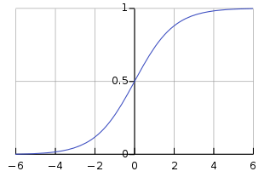
Activation Function 1
Sigmoid
h = g(a) = sigm(a)
Squishes a real number to (0,1)
Classes c
W’
Hidden h
W
h = sigm(a)
Features f
a

Slide 119
Activation Function 1
The next few slides show that the sigmoid function transforms real numbers from the space (-infinity, +infinity) to the space (0,1)

Slide 120
Converting From Real Numbers to 0 - 1
‘a’ is called the “pre-activation”.
a ranges from –inf to +inf
This is the input to the sigmoid function.

Slide 121
Converting From Real Numbers to 0 - 1
‘c’ is the “pre-activation” of the final layer.
c ranges from –inf to +inf
This last pre-activation is passed as input to the final non-linearity which is typically the softmax function.
I will refer to ‘c’ as the “final pre-activation”

Slide 122
Sigmoid / Logistic Function
In the following slides, we show how a sigmoid activation function transforms the input from the space of real numbers to that of 0 to 1.
Do exercise 650s

Slide 123
Converting From Real Numbers to 0 - 1
If a ranges from –inf to +inf.
ranges from 0 to +inf.
Notes:
This is also worked out in exercise 650

Slide 124
Converting From Real Numbers to 0 - 1
If
ranges from 0 to +inf.
1 + ranges from 1 to +inf.

Slide 125
Converting From Real Numbers to 0 - 1
If
1 + ranges from 1 to +inf.
ranges from 0 to 1.
Sigmoid function

Slide 126
Activation Function 1
Sigmoid
h = g(a) = sigm(a)
Squishes a real number to (0,1)
It has a derivative at every value of a.
d(sigm(a))/d(a) = sigm(a) * (1 – sigm(a))
Classes c
W’
Hidden h
W
Features f

Slide 127

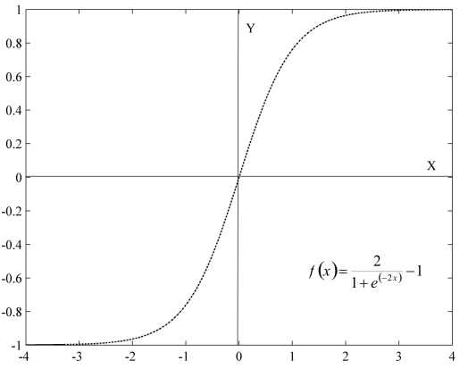
Activation Function 2
Hyperbolic Tangent
h = g(a) = tanh(a)
Squishes a real number to (-1,1)
Classes c
W’
Hidden h
W
h = tanh(a)
Features f
a

Slide 128
Activation Function 2
Hyperbolic Tangent
h = g(a) = tanh(a)
Squishes a real number to (-1,1)
It has a derivative at every value of a.
d(tanh(a))/d(a) = 1 – tanh(a)^2
Classes c
W’
Hidden h
W
Features f

Slide 129
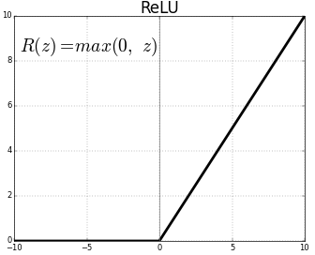
Activation Function 3
Rectified Linear Unit
h = g(a) = ReLU(a)
Squishes a real number to (0,inf)
Classes c
W’
Hidden h
W
h = ReLU(a)
Features f
a

Slide 130
Activation Function 3
Rectified Linear Unit
h = g(a) = ReLU(a)
Squishes a real number to (0,inf)
_{If a <= 0, ReLU(a) = 0}
_{If a > 0, ReLU(a) = a}
It has a derivative at every value of a.
d(ReLU(a))/d(a) = 1_{a>0}
1_{a>0} just means “1 if a > o else 0”
Classes c
W’
Hidden h
W
Features f

Slide 131
Activation Function 0
Softmax is also a non-linear activation function but it is never used between layers because it converts a dense representation of information into an approximation of the one-hot encoding which is very inefficient at carrying information through a system (so if you put the softmax between layers, you won’t get much value from layers above the softmax activation function).

Slide 132
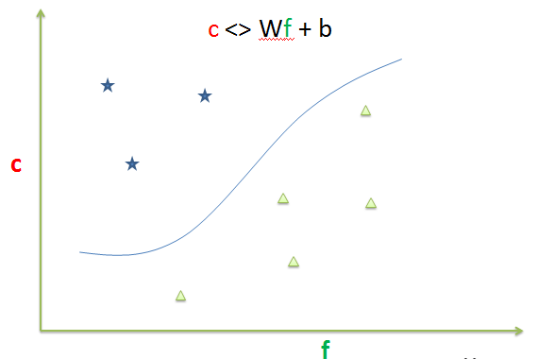
Deep Learning
c₁ = W’₁₁h₁ + W’₁₂h₂
c₂ = W’₂₁h₁ + W’₂₂h₂
h₁ = g(a₁)
h₂ = g(a₂)
a₁ = W₁₁f₁ + W₁₂f₂
a₂ = W₂₁f₁ + W₂₂f₂
So now if you choose the weights W and W’ suitably, you will get a non-linear separator between classes c₁ and c₂.
Classes c
W’
Hidden h
W
Features f

Slide 133
Deep Learning
This is the essence of deep learning – using a multi-layered network with non-linearities at each stage.
Classes c
W’
Hidden h
W
Features f

Slide 134
Deep Learning
How do you make a deep learning model learn the weights W and b?
Classes c
1
2
W’
W’₁₁
b'₂
W’₂₁
W’₂₂
1
W’₁₂
2
b'₁
3
Hidden h
W₁₁
b₂
W
W₂₁
W₂₂
1
W₁₂
2
b₁
3
Features f
Notes:
The answer is on the next page.

Slide 135
Training a Deep Neural Network
How do you learn the weights automatically?
Step 1: Get some training data
Step 2: Create a loss function reflecting the badness of the neural net
Step 3: Adjust the weights and biases to minimize the loss (error) on the training data
Classes c
W’,b’
Hidden h
W,b
Features f
Let the machine learn weights and biases for each layer such that if f₁ * f₂ > 0 the classifier will select c₁ else c₂ !
W = ? b = ? W’ = ? b’ = ?

Slide 136
Deep Learning
You can now train a classifier with more than one layer on the XOR dataset.
Convince yourself that this classifier’s loss decreases over multiple epochs.
Try different activation functions.
Notes:
Since we’re able to get high accuracies on the classification task, we have in essence learnt to model non-linear decision boundaries.

Slide 137
Classification
Do exercises 670, 680, 690 and 695 to see how the ReLU changed multilayer neural networks.
The exercises demonstrate that two-layer neural networks can sometimes learns better using ReLUs than with sigmoids.

Slide 138
Deep Learning Math
You’ve learnt how to train a deep learning model (make it learn the weights W and b). But do you know the math?
Classes c
1
2
W’
W’₁₁
b'₂
W’₂₁
W’₂₂
1
W’₁₂
2
b'₁
3
Hidden h
W₁₁
b₂
W
W₂₁
W₂₂
1
W₁₂
2
b₁
3
Features f

Slide 139
Backpropagation
We now teach the students the backpropagation algorithm for a multi-layer neural network.
Backprop has two parts – forward and backward
(we’ve already seen that).
The forward part: calculating the loss on a batch of training data, for the current set of weights.
We’ve done this quite a few times.
So, there is just the backward part.

Slide 140
Deep Learning Math
You’re already familiar with the forward pass.
You compute the loss for a batch of training data and for the current parameters.
What about the backward pass?
You compute the derivates of the loss with respect to each of the parameters and then nudge the parameters so that the loss decreases.
1
2
W’₁₁
b'₂
W’₂₁
W’₂₂
1
W’₁₂
2
b'₁
3
W₁₁
b₂
W₂₁
W₂₂
1
W₁₂
2
b₁
3

Slide 141
Deep Learning Math
What are the derivatives needed for the backward pass?
Derivatives needed:
d(loss)/d(W’)
d(loss)/d(b’)
d(loss)/d(W)
d(loss)/d(b)
1
2
W’₁₁
b'₂
W’₂₁
W’₂₂
1
W’₁₂
2
b'₁
3
W₁₁
b₂
W₂₁
W₂₂
1
W₁₂
2
b₁
3
Let’s start with
these two
Notes:
These are the only derivatives you really need because they tell you which way to nudge the parameters.

Slide 142
Backpropagation
d(loss)/d(W’)
d(loss)/d(b’)
d(loss)/d(W)
d(loss)/d(b)
These are the only derivatives you really need because they tell you which way to nudge the parameters.

Slide 143
Backpropagation
Notice that all the derivatives are of the loss.
So, to compute these derivatives, you have to walk back from the loss through the nodes nearest the loss.
What’s each node? It’s a function.
Layers of neurons are just nested functions
Chain rule: If f(x) = f(g(x))
then df/dx = df/dg*dg/dx
Let us try this with d(loss)/d(W’)

Slide 144
d(loss)/d(W’)
loss
loss = -log(softmax(c))
where c = W’h + b’
loss = -log(softmax(W’h + b’))
Chain:
Intermediate computations from W’ to the loss
loss <- log <- softmax <- c <- W’
c
1
2
W’₁₁
b'₂
W’₂₁
W’₂₂
1
W’₁₂
h
2
b'₁
3
W₁₁
b₂
W₂₁
W₂₂
1
W₁₂
f
2
b₁
3

Slide 145
Backpropagation
Chain for d(loss)/d(W’) :
Intermediate computations from W’ to the loss
loss <- log <- softmax <- c <- W’
In the forward pass, you walk from W’ to loss
In the backward pass, you come back from loss to W’
d(loss)/dW’ = { d(loss)/dlog * dlog/dsoftmax } *
dsoftmax/dc * dc/dW’
1
2
3

Slide 146
Backpropagation
Chain for d(loss)/d(W’) :
Intermediate computations from W’ to the loss
loss <- log <- softmax <- c <- W’
In the backward pass, you come back from loss to W’ chaining derivatives along the way
d(loss)/dW’ = [{ d(loss)/d(log) * d(log)/dsoftmax } *
dsoftmax/dc ] * dc/dW’
1
= dloss / dsoftmax(c)
2
= dloss / dc
3
= dloss/dW’
Notes:
What you’re doing along the way is computing the derivative using the chain rule.

Slide 147
d(loss)/d(log)
loss
loss = -1 * log(softmax(c))
So,
d(loss) / d(log(softmax(c)))
Using d(-1 * x)/dx = -1
d(loss) / d(log(softmax(c))) = -1
c
1
2
W’₁₁
b'₂
W’₂₁
W’₂₂
1
W’₁₂
h
2
b'₁
3
W₁₁
b₂
W₂₁
W₂₂
1
W₁₂
f
2
b₁
3

Slide 148
d(loss)/d(softmax)
loss
d(loss)/d(softmax(c))
= d(loss)/d(log(softmax(c))) * d(log(softmax(c)))/d(softmax(c))
… by the chain rule …
but we already have
d(loss)/d(log(softmax(c))) = -1
c
1
2
W’₁₁
b'₂
W’₂₁
W’₂₂
1
W’₁₂
h
2
b'₁
3
W₁₁
b₂
W₂₁
W₂₂
1
W₁₂
f
2
b₁
3

Slide 149
d(loss)/d(softmax)
loss
So, d(loss)/d(softmax(c))
= d(loss)/d(log(softmax(c))) * d(log(softmax(c)))/d(softmax(c))
… by the chain rule
= -1 * d(log(softmax(c)))/d(softmax(c))
(substituting -1 for d(loss)/d(log(softmax(c))))
Using d(log(x))/dx = 1/x in the above …
d(loss)/d(softmax(c)) = -1/softmax(c)
c
1
2
W’₁₁
b'₂
W’₂₁
W’₂₂
1
W’₁₂
h
2
b'₁
3
W₁₁
b₂
W₂₁
W₂₂
1
W₁₂
f
2
b₁
3
Notes:
Watch https://www.youtube.com/watch?v=1N837i4s1T8 for the math in detail.

Slide 150
d(loss)/d(softmax)
loss
d(loss)/d(softmax(c)) =
-1/softmax(c)
c
1
2
W’₁₁
b'₂
W’₂₁
W’₂₂
1
W’₁₂
h
2
b'₁
3
W₁₁
b₂
W₂₁
W₂₂
1
W₁₂
f
2
b₁
3
Notes:
Watch https://www.youtube.com/watch?v=1N837i4s1T8 for the math in detail.

Slide 151
Backpropagation
loss <- log <- softmax <- c <- W’
d(loss)/dW’ = [ { d(loss)/dlog * dlog/dsoftmax } *
dsoftmax/dc ] * dc/dW’
We have completed step 1 and computed dloss/dsoftmax(c). So we now proceed to Step 2.
1
= dloss / dsoftmax(c)
2
= dloss / dc
3
= dloss/dW’
Notes:
What you’re doing along the way is computing the derivative using the chain rule.

Slide 152
d(loss)/d(c)
loss
d(loss)/d(c) = {d(loss)/d(softmax(c)) *
d(softmax(c))/d(c)}
We’ve already computed d(loss)/d(softmax(c)
What is d(softmax(c))/d(c)?
c
1
2
W’₁₁
b'₂
W’₂₁
W’₂₂
1
W’₁₂
h
2
b'₁
3
W₁₁
b₂
W₂₁
W₂₂
1
W₁₂
f
2
b₁
3

Slide 153
d(softmax(c))/d(c)
loss
What is d(softmax(c))/d(c)?
I’m going to tell you that …
d(softmax(c))/d(c) =
softmax(c) ( t – softmax(c) )
For a derivation of the above, visit the Youtube link … https://www.youtube.com/watch?v=1N837i4s1T8
t is the one-hot vector* of the correct class.
*In a two-class classification problem, t is [1,0] if the correct class is 0 and [0,1] if not.
c
1
2
W’₁₁
b'₂
W’₂₁
W’₂₂
1
W’₁₂
h
2
b'₁
3
W₁₁
b₂
W₂₁
W₂₂
1
W₁₂
f
2
b₁
3
Notes:
I’ve not explained how we solved d(softmax(c))/d(c). The derivation is available at https://www.youtube.com/watch?v=1N837i4s1T8

Slide 154
d(loss)/d(c)
loss
d(loss)/d(c) =
{d(loss)/d(softmax(c)) *
d(softmax(c))/d(c)}
But, d(loss)/d(softmax(c))
= -1/softmax(c)
and d(softmax(c))/d(c)
= softmax(c) ( t – softmax(c) )
So, d(loss)/d(c) =
{ -1/softmax(c) *
softmax(c) ( t – softmax(c) )}
= -1 * ( t – softmax(c) )
d(loss)/d(c) = (softmax(c) – t)
c
1
2
W’₁₁
b'₂
W’₂₁
W’₂₂
1
W’₁₂
h
2
b'₁
3
W₁₁
b₂
W₂₁
W₂₂
1
W₁₂
f
2
b₁
3
Notes:
Derivation explained in https://www.youtube.com/watch?v=1N837i4s1T8

Slide 155
d(loss)/d(c)
Chain rule:
d(loss)/dc
=
{d(loss)/d(softmax(c)) *
d(softmax(c))/d(c)}
=
(softmax(c) – t)
c
1
2
W’₁₁
b'₂
W’₂₁
W’₂₂
1
W’₁₂
h
2
b'₁
3
W₁₁
b₂
W₂₁
W₂₂
1
W₁₂
f
2
b₁
3

Slide 156
Backpropagation
It looks simple because I’m working with tensors.
All these derivations are explained very rigorously without the use of tensors in this Youtube video by Hugo Larochelle
https://www.youtube.com/watch?v=1N837i4s1T8

Slide 157
Backpropagation
Chain for d(loss)/d(W’):
Intermediate computations from W’ to the loss
loss <- log <- softmax <- c <- W’
We’ve walked back from loss to c.
The difficult part is over!
From here, the math is easy (in tensor space).

Slide 158
d(loss)/d(W’)
Chain rule:
d(loss)/dW’
=
{d(loss)/d(c)} * d(c)/d(W’)
But c = hW’+b’
So, d(c)/dW’
= d(hW’+b’)/dW’ = h^{T}
= h^{T} * (softmax(c) – t)
c
1
2
W’₁₁
b'₂
W’₂₁
W’₂₂
1
W’₁₂
h
2
b'₁
3
W₁₁
b₂
W₂₁
W₂₂
1
W₁₂
f
2
b₁
3
Notes:
I’m assuming here that all input and output vectors are represented by horizontal matrices.

Slide 159
d(loss)/d(b’)
Chain rule:
d(loss)/d(b’)
=
{d(loss)/d(c)} * d(c)/d(b’)
But c = hW’+b’
So d(c)/db’
= d(hW’+b’)/db’ = 1
= (softmax(c) – t)
c
1
2
W’₁₁
b'₂
W’₂₁
W’₂₂
1
W’₁₂
h
2
b'₁
3
W₁₁
b₂
W₂₁
W₂₂
1
W₁₂
f
2
b₁
3

Slide 160
Backpropagation
We’ve just thrown a bunch of equations at the students.
They’re not going to have digested this yet.
So, let’s take a specific input and output and work through the backpropagation algorithm.
This way, they’ll see what those equations mean, and just how easy it all is!

Slide 161
Backpropagation
d(loss)/d(W’)
d(loss)/d(b’)
d(loss)/d(W)
d(loss)/d(b)
Yay! We got two of them!
Let’s do an exercise to compute d(loss)/d(W’) and d(loss)/d(b’) manually just so we really get it.

Slide 162
Exercise on d(loss)/d(W’) and d(loss)/d(b’)
Let’s say our training data is:
h1 = -10, h2 = 20 correct class=1
Let’s start with randomly picked weight and bias matrices.
c
1
2
W’₁₁
b'₂
W’₂₁
W’₂₂
1
W’₁₂
h
2
b'₁
3
2
1
W’ =
b’ =
0 0
Notes:
I’m assuming here that all input and output vectors are represented by horizontal matrices.

Slide 163
Exercise on d(loss)/d(W’) and d(loss)/d(b’)
Our training data is:
h1 = -10, h2 = 20 correct class=1
The input vector is therefore.
The correct class is 1, so the target one hot vector is
c
1
2
W’₁₁
b'₂
W’₂₁
W’₂₂
1
W’₁₂
h
2
b'₁
3
h =
-10 20
2
1
W’ =
t =
0 1
b’ =
0 0
Notes:
I’m assuming here that all input and output vectors are represented by horizontal matrices.

Slide 164
Exercise on d(loss)/d(W’) and d(loss)/d(b’)
Let’s start with the forward pass. We have assumed W’ and b’ and the input vector is h
So, we have everything we need to calculate the outputs c
c = hW’+b’
What is c?
c
1
2
W’₁₁
b'₂
W’₂₁
W’₂₂
1
W’₁₂
h
2
b'₁
3
-10 20
h =
2
1
W’ =
b’ =
0 0
Notes:
I’m assuming here that all input and output vectors are represented by horizontal matrices.

Slide 165
Exercise on d(loss)/d(W’) and d(loss)/d(b’)
h =
-10 20
c
1
2
2
1
W’ =
W’₁₁
b'₂
W’₂₁
W’₂₂
1
W’₁₂
h
2
b'₁
3
b’ =
0 0
c = hW’+b’
2
1
-10 20
*
+
0 0
=
30 0
So, c
30 0
=
Notes:
I’m assuming here that all input and output vectors are represented by horizontal matrices.

Slide 166
Exercise on d(loss)/d(W’) and d(loss)/d(b’)
Now that we have the final pre-activation c, we need to calculate the final activation, which is softmax(c).
The softmax essentially squishes the ouputs into extreme probabilities.
So what is softmax(c)?
c
1
2
W’₁₁
b'₂
W’₂₁
W’₂₂
1
W’₁₂
h
2
b'₁
3
30 0
c =
2
1
W’ =
b’ =
0 0
Notes:
I’m assuming here that all input and output vectors are represented by horizontal matrices.

Slide 167
Exercise on d(loss)/d(W’) and d(loss)/d(b’)
c =
30 0
The softmax essentially squishes the ouputs into extreme probabilities.
c
1
2
W’₁₁
b'₂
W’₂₁
W’₂₂
1
W’₁₂
h
2
b'₁
3
softmax(c) =
1 9.3*10⁻¹⁴
2
1
softmax(c) ~=
1 0
W’ =
log(softmax(c)) ~=
0 -30
-log(softmax(c)) ~=
0 30
b’ =
0 0
30 is the loss, since the right class is 1
Notes:
I’m assuming here that all input and output vectors are represented by horizontal matrices.

Slide 168
Exercise on d(loss)/d(W’) and d(loss)/d(b’)
The forward pass is completed.
We have loss = 30
Now to compute d(loss)/d(W’)
and d(loss)/d(b’).
This is the backward pass.
c
1
2
W’₁₁
b'₂
W’₂₁
W’₂₂
1
W’₁₂
h
2
b'₁
3
2
1
W’ =
b’ =
0 0
Notes:
I’m assuming here that all input and output vectors are represented by horizontal matrices.

Slide 169
Exercise on d(loss)/d(W’) and d(loss)/d(b’)
To get to either d(loss)/d(W’)
or d(loss)/d(b’) …
We need to first compute ...
d(loss)/d(c) =
c
1
2
W’₁₁
b'₂
W’₂₁
W’₂₂
1
W’₁₂
h
2
b'₁
3
2
1
W’ =
(softmax(c) – t)
b’ =
0 0
Notes:
I’m assuming here that all input and output vectors are represented by horizontal matrices.

Slide 170
Exercise on d(loss)/d(W’) and d(loss)/d(b’)
d(loss)/d(c) =
But from the forward pass,
The correct class is 1, so the target one hot vector is
So
(softmax(c) – t)
c
1
2
W’₁₁
b'₂
W’₂₁
W’₂₂
1
W’₁₂
h
2
b'₁
3
softmax(c) ~=
1 0
2
1
W’ =
t =
0 1
b’ =
0 0
(softmax(c) – t) =
1 -1
Notes:
I’m assuming here that all input and output vectors are represented by horizontal matrices.

Slide 171
Exercise on d(loss)/d(W’) and d(loss)/d(b’)
d(loss)/d(c) =
So, d(loss)/d(c)
So, d(loss)/d(c) =
softmax(c) – t
c
1
2
W’₁₁
b'₂
W’₂₁
W’₂₂
1
W’₁₂
h
2
b'₁
3
1 0
-
0 1
2
1
=
1 -1
W’ =
1 -1
b’ =
0 0
Notes:
I’m assuming here that all input and output vectors are represented by horizontal matrices.

Slide 172
Backpropagation
Once you have d(loss)/d(c), the rest is easy!
Chain rule:
d(loss)/dW’ = {d(loss)/d(c)} * d(c)/d(W’)
= h^{T} * (softmax(c) – t)
d(loss)/db’ = {d(loss)/d(c)} * d(c)/d(b’)
= 1 * (softmax(c) – t)

Slide 173
Exercise on d(loss)/d(W’) and d(loss)/d(b’)
h =
-10 20
d(loss)/dW’ =
{d(loss)/d(c)} * d(c)/d(W’)
= h^{T} * (softmax(c) – t)
= *
=
c
1
2
W’₁₁
b'₂
W’₂₁
W’₂₂
1
W’₁₂
h
2
b'₁
3
-10
20
1 -1
2
1
W’ =
-10 10
20 -20
b’ =
0 0
Notes:
I’m assuming here that all input and output vectors are represented by horizontal matrices.

Slide 174
Exercise on d(loss)/d(W’) and d(loss)/d(b’)
h =
-10 20
d(loss)/db’ =
{d(loss)/d(c)} * d(c)/d(b’)
= 1 * (softmax(c) – t)
= *
=
c
1
2
W’₁₁
b'₂
W’₂₁
W’₂₂
1
W’₁₂
h
2
b'₁
3
2
1
1
1 -1
W’ =
1 -1
b’ =
0 0
Notes:
I’m assuming here that all input and output vectors are represented by horizontal matrices.

Slide 175
Backpropagation
d(loss)/d(W’)
d(loss)/d(b’)
d(loss)/d(W)
d(loss)/d(b)
Yay! We got two of them! Two to go.

Slide 176
Deep Learning Math
Let’s get the remaining two
Derivatives needed:
d(loss)/d(W’)
d(loss)/d(b’)
d(loss)/d(W)
d(loss)/d(b)
1
2
W’₁₁
b'₂
W’₂₁
W’₂₂
1
W’₁₂
2
b'₁
3
W₁₁
Those were easy!
W₂₂
b₂
W₂₁
1
W₁₂
2
b₁
3
Now let’s try these two!
Notes:
Exercises 710 through 730 cover backprop over a single layer

Slide 177
Backpropagation
To compute the derivatives we need, we have to walk back from the loss through the nodes nearest the loss.
Chain for d(loss)/d(W)
= d(loss)/d(c) * d(c)/d(W)
Intermediate computations from W to the loss
loss <- log <- softmax <- c <- h <- a <- W
Notes:
The next slide explains how we got this chain

Slide 178
d(loss)/d(W)
loss
loss = -log(softmax(c))
where c = W’h + b’
But h = relu(a)
And a = Wx + b
So
loss = -log(
softmax(W’ * relu(Wx + b) + b’))
Chain:
Intermediate computations from W’ to the loss
loss <- softmax <- c <- h <- a <- W
c
1
2
W’₁₁
b'₂
W’₂₁
W’₂₂
1
W’₁₂
h
2
b'₁
3
W₁₁
b₂
W₂₁
W₂₂
1
W₁₂
f
2
b₁
3
Notes:
You can see that the chain comes from the nesting of the differentiable operations (functions) used in the computation of the loss from the parameter.

Slide 179
Backpropagation
loss <- log <- softmax <- c <- h <- a <- W
We’ve already computed the chain up to c
d(loss)/d(c) = (softmax(c) – t)
Let’s proceed from there by getting d(loss)/dh
Notes:
The next slide works out d(loss)/dh

Slide 180
d(loss)/d(h)
Chain rule:
d(loss)/d(h)
=
{d(loss)/d(softmax(c)) *
d(softmax(c))/d(c)} *
d(c)/d(h)
=
(softmax(c) – t) * W^{T}
c
1
2
W’₁₁
b'₂
W’₂₁
W’₂₂
1
W’₁₂
h
2
b'₁
3
W₁₁
b₂
W₂₁
W₂₂
1
W₁₂
f
2
b₁
3

Slide 181
d(loss)/d(a)
Chain rule:
d(loss)/da
= {d(loss)/d(softmax(c)) *
d(softmax(c))/d(c)} *
d(c)/d(h) * d(h)/d(a)
but h = relu(a), so dh/da = 1_{a>0}
= (softmax(c) – t) * W^{T} * (1_{a>0})
c
1
2
W’₁₁
b'₂
W’₂₁
W’₂₂
1
W’₁₂
h
2
b'₁
3
W₁₁
b₂
W₂₁
W₂₂
1
W₁₂
f
2
b₁
3

Slide 182
d(loss)/d(W)
Chain rule: d(loss)/dW
=
{d(loss)/d(softmax(c)) *
d(softmax(c))/d(c)} * d(c)/d(h) * d(h)/da * da/dW
=
(softmax(c) – t) * W^{T} * 1_{a>0} * x
c
1
2
W’₁₁
b'₂
W’₂₁
W’₂₂
1
W’₁₂
h
2
b'₁
3
W₁₁
b₂
W₂₁
W₂₂
1
W₁₂
f
2
b₁
3

Slide 183
d(loss)/d(b)
Chain rule: d(loss)/db
=
{d(loss)/d(softmax(c)) *
d(softmax(c))/d(c)} * d(c)/d(h) * d(h)/da * da/db
=
(softmax(c) – t) * W^{T} * 1_{a>0} * 1
c
1
2
W’₁₁
b'₂
W’₂₁
W’₂₂
1
W’₁₂
h
2
b'₁
3
W₁₁
b₂
W₂₁
W₂₂
1
W₁₂
f
2
b₁
3

Slide 184
Deep Learning Math
Now we have all the derivatives needed for the backward pass.
Derivatives needed:
d(loss)/d(W’)
d(loss)/d(b’)
d(loss)/d(W)
d(loss)/d(b)
1
2
W’₁₁
b'₂
W’₂₁
W’₂₂
1
W’₁₂
2
b'₁
3
W₁₁
b₂
W₂₁
W₂₂
1
W₁₂
2
b₁
3
Those were easy!
These were easy too!
Notes:
There are pytorch exercises for this part. Exercises 740 and 750 cover backprop over two layers.

Slide 185
Image Processing
We’ve seen how deep learning classifiers work.
Their inputs & outputs are real numbers.
We’ve encoded documents as real numbers.
Can we do something like this with images?
f₁ = count of “a” f₂ = count of “b” f₃ = count of “c”
c₁ = Sports c₂ = Politics
a b a c a b c a c => Politics
a b a a c => Sports

Slide 186
Image Processing
Let’s start with the MNIST dataset.
It contains 70,000 images of handwritten digits.
Each of these 70,000 images is a digit (0 to 9).
Each image is labelled as 0,1,2 …,9.
This is a classification problem (deciding between a finite set of choices, labelling with a finite set of labels, etc.)
What are the features?
Each image is a greyscale 28 x 28 image (8-bits per pixel).
So one could just read the pixels out into a vector of integers of length 784 and use them as the input.
Notes:
Exercise 810 downloads the MNIST dataset.

Slide 187

Applications to Image Processing
Use deep learning for image classification …
The MNIST dataset >>
Inputs:
Outputs: 5 0 4 1
28 x 28 images
greyscale
(8-bit)
The input to an image classification task is the image’s pixels
The output of the MNIST image classification task is the digit (there are 10 classes)

Slide 188
Applications to Image Processing
Each image is represented by a 2D grid of pixels (a matrix of integers) for greyscale images (and 3 or 4 matrices for colour).
0 3 2 3 1
0 2 0 0 0
0 0 1 2 0
0 0 3 0 0
3 2 0 0 0
0 0 2 1 0
0 2 0 0 2
3 0 0 0 3
2 0 0 2 0
0 2 3 0 0
0 0 0 3 0
3 0 0 2 0
3 2 3 3 0
0 0 0 3 0
0 0 0 3 0
0 0 0 0 0
0 0 0 2 0
0 0 3 0 0
0 2 0 0 0
0 0 0 0 0

Slide 189
Applications to Image Processing
Traditionally you would flatten these numbers out …
5 = 0 3 2 3 1 0 2 0 0 0 0 0 1 2 0 0 0 3 0 0 3 2 0 0 0
0 = 0 0 2 1 0 0 2 0 0 2 3 0 0 0 3 2 0 0 2 0 0 2 3 0 0
0 3 2 3 1
0 2 0 0 0
0 0 1 2 0
0 0 3 0 0
3 2 0 0 0
0 0 2 1 0
0 2 0 0 2
3 0 0 0 3
2 0 0 2 0
0 2 3 0 0
0 0 0 3 0
3 0 0 2 0
3 2 3 3 0
0 0 0 3 0
0 0 0 3 0
0 0 0 0 0
0 0 0 2 0
0 0 3 0 0
0 2 0 0 0
0 0 0 0 0
… and then pass the vector to a classifier.
Notes:
Do the exercises on MNIST image classification using single and multi layer neural networks.

Slide 190
Image Classification
Each image is a 28 x 28 (8-bit greyscale) image.
So one could just read the pixels out into a vector of integers of length 784 and use them as the input.
But there’s a better way - grouping together pixels that are close to each other (in 2D) in an image.
This is because each small area (in 2D) in an MNIST image contains local clues to the digit contained.
For example, a horizontal segment ending in the upper left area strongly suggests the number 7*.
* LeCun et al “Gradient-Based Learning Applied to Document Recognition”

Slide 191
LeNet5 Image Classification
In 1998* a paper described a deep neural network architecture called LeNet5 for image classification that used three types of layers:
Both C and S worked on local areas of the image.
Only F took as input a vectorized array.
F layers = Fully connected layers
C layers = Convolutional Layers
S layers = Subsampling Layers
* LeCun et al “Gradient-Based Learning Applied to Document Recognition”

Slide 192
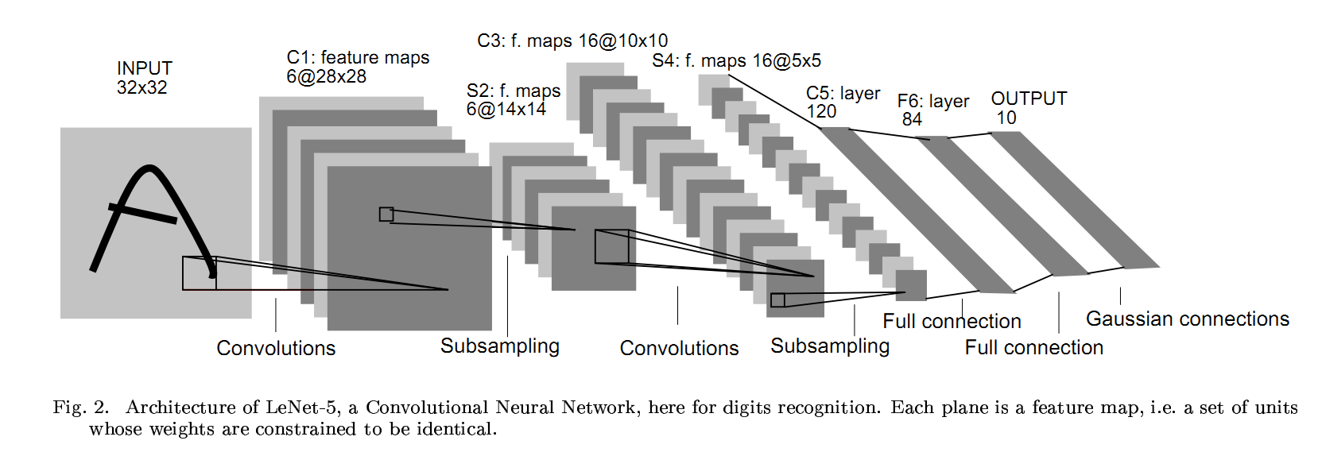
LeNet 5
Used 3 types of neural network layers on the MNIST task
F layers = Fully connected layers
C layers = Convolutional Layers
S layers = Subsampling (nowadays usually called “pooling”)
… and avoided flattening out pixels till the very last layer.
http://yann.lecun.com/exdb/publis/pdf/lecun-01a.pdf

Slide 193
LeNet5 Image Classification
Let’s look at the 3 types of layers:
F layers = Fully connected layers
C layers = Convolutional Layers
S layers = Subsampling Layers
* LeCun et al “Gradient-Based Learning Applied to Document Recognition”

Slide 194
Fully Connected Layer
We’ve seen this already …
c₁
c₂
c₃
1
2
3
W₁₁
W₁₀
W₂₁
W₂₃
W₃₃
b₃
W₂₀
W₂₂
W₁₂
W₃₂
W₁₃
b₂
0
1
W₃₁
2
3
b₁
4
W₃₀
f₁
f₂
f₃
1
f = inputs
c = outputs
Every input is connected to every output by an interconnection (neuron)

Slide 195
Convolutional Layer
Only some of the inputs are connected to some of the outputs, and the interconnections share weights.
The same weights W₁₀, W₁₁, W₁₂ are used in all the convolutions.
c₁
c₂
c₃
1
2
3
W₁₀
W₁₂
W₁₀
W₁₂
W₁₀
W₁₂
W₁₁
W₁₁
W₁₁
0
1
2
3
4
f₀
f₁
f₂
f₃
f₄
f = inputs
c = outputs
A finite (usually small) number of inputs is connected to one output.
Input region

Slide 196
Convolutional Layer Example
Supposing the weights were as follows ...
W₁₀ = -1
W₁₁ = +2
W₁₂ = -1
c₁
c₂
c₃
1
2
3
W₁₀
W₁₂
W₁₀
W₁₂
W₁₀
W₁₂
W₁₁
W₁₁
W₁₁
0
1
2
3
4
f₀ = 1
f₁ = 4
f₂ = 1
f₃ = 1
f₄ = 1
What are c₁ , c₂ and c₃?

Slide 197
Convolutional Layer Example
Supposing the weights were as follows ...
W₁₀ = -1
W₁₁ = +2
W₁₂ = -1
c₁= 6
c₂
c₃
1
2
3
W₁₀=-1
W₁₂=-1
W₁₁=2
0
1
2
3
4
f₀ = 1
f₁ = 4
f₂ = 1
f₃ = 1
f₄ = 1
c₁=6 (by applying the weights)
What are c₂ and c₃?

Slide 198
Convolutional Layer Example
Supposing the weights were as follows ...
W₁₀ = -1
W₁₁ = +2
W₁₂ = -1
c₁= 6
c₂=-3
c₃
1
2
3
W₁₀=-1
W₁₂=-1
W₁₁=2
0
1
2
3
4
f₀ = 1
f₁ = 4
f₂ = 1
f₃ = 1
f₄ = 1
c₂=-3 (by taking another step/stride)
What is c₃?

Slide 199
Convolutional Layer Example
Supposing the weights were as follows ...
W₁₀ = -1
W₁₁ = +2
W₁₂ = -1
c₁= 6
c₂=-3
c₃ = 0
1
2
3
W₁₀=-1
W₁₂=-1
W₁₁=2
0
1
2
3
4
f₀ = 1
f₁ = 4
f₂ = 1
f₃ = 1
f₄ = 1
c₃=0 (by taking another step/stride)
Easy!

Slide 200
Convolutional Layer Example
The outputs are calculated from local regions of the inputs.
Note that we used the same weights for every local region.
c₁ = 6
c₂ = -3
c₃ = 0
1
2
3
W₁₀ = -1
= 1
W₁₁ = +2
W₁₀
W₁₁
W₁₁
W₁₁
W₁₂
W₁₂ = -1
W₁₀
W₁₂
W₁₂
0
1
2
W₁₀
3
4
f₀ = 1
f₁ = 4
f₂ = 1
f₃ = 1
f₄ = 1

Slide 201
Convolutional Layer Example
Try it again for this set of weights!
c₁
c₂
c₃
1
2
3
W₁₀ = 1/3
W₁₁ = 1/3
W₁₀
W₁₁
W₁₁
W₁₁
W₁₂
W₁₂ = 1/3
W₁₀
W₁₂
W₁₂
0
1
2
W₁₀
3
4
f₀ = 1
f₁ = 4
f₂ = 1
f₃ = 1
f₄ = 1
What are c₁ , c₂ and c₃?

Slide 202
Convolutional Layer Example
c₁ = 2
c₂ = 2
c₃ = 1
1
2
3
W₁₀ = 1/3
= 1
W₁₁ = 1/3
W₁₀
W₁₁
W₁₁
W₁₁
W₁₂
W₁₂ = 1/3
W₁₀
W₁₂
W₁₂
0
1
2
W₁₀
3
4
f₀ = 1
f₁ = 4
f₂ = 1
f₃ = 1
f₄ = 1
The outputs are smoother … these weights act as low-pass filters and smooth the output (blur the image). (They average all the pixels in the local region).

Slide 203
2D Convolutional Layer
With images, your convolutions are in 2 dimensions …
1 | 1 | 1 | 0 | 0
0 | 1 | 1 | 1 | 0
0 | 0 | 1 | 1 | 1
0 | 0 | 1 | 1 | 0
0 | 1 | 1 | 0 | 0
Let’s say we have a 5x5 image with 1 bit pixels like this.
Animated image from: https://hackernoon.com/visualizing-parts-of-convolutional-neural-networks-using-keras-and-cats-5cc01b214e59

Slide 204
2D Convolutional Layer
Let’s say the convolutional layer covers a 3x3 region of the image …
1
It takes as input a 3x3 region of the image and produces one output … which is the sum of the weighted inputs.
1 | 1 | 1 | 0 | 0
0 | 1 | 1 | 1 | 0
0 | 0 | 1 | 1 | 1
0 | 0 | 1 | 1 | 0
0 | 1 | 1 | 0 | 0
Animated image from: https://hackernoon.com/visualizing-parts-of-convolutional-neural-networks-using-keras-and-cats-5cc01b214e59

Slide 205
2D Convolutional Layer
Let’s say the convolutional layer covers a 3x3 region of the image … its weights can be represented by a grid …
image
weights
1 | 1 | 1 | 0 | 0
0 | 1 | 1 | 1 | 0
0 | 0 | 1 | 1 | 1
0 | 0 | 1 | 1 | 0
0 | 1 | 1 | 0 | 0
1 | 0 | 1
0 | 1 | 0
1 | 0 | 1
Animated image from: https://hackernoon.com/visualizing-parts-of-convolutional-neural-networks-using-keras-and-cats-5cc01b214e59

Slide 206
2D Convolutional Layer
We can apply the convolution just like we did in 1D.
weights *
image
1 | 0 | 1
0 | 1 | 0
1 | 0 | 1
1 | 1 | 1 | 0 | 0
0 | 1 | 1 | 1 | 0
0 | 0 | 1 | 1 | 1
0 | 0 | 1 | 1 | 0
0 | 1 | 1 | 0 | 0
4
=
Animated image from: https://hackernoon.com/visualizing-parts-of-convolutional-neural-networks-using-keras-and-cats-5cc01b214e59

Slide 207
2D Convolutional Layer
Now we move around the image … stride by stride.
A stride can be one pixel or more, but there’s usually an overlap of local regions before and after a stride.
weights *
image
1 | 0 | 1
0 | 1 | 0
1 | 0 | 1
1 | 1 | 1 | 0 | 0
0 | 1 | 1 | 1 | 0
0 | 0 | 1 | 1 | 1
0 | 0 | 1 | 1 | 0
0 | 1 | 1 | 0 | 0
4 | 3
=
Animated image from: https://hackernoon.com/visualizing-parts-of-convolutional-neural-networks-using-keras-and-cats-5cc01b214e59

Slide 208
2D Convolutional Layer
Since we are moving 1 pixel in each step, the stride here is considered as 1.
weights *
image
1 | 0 | 1
0 | 1 | 0
1 | 0 | 1
1 | 1 | 1 | 0 | 0
0 | 1 | 1 | 1 | 0
0 | 0 | 1 | 1 | 1
0 | 0 | 1 | 1 | 0
0 | 1 | 1 | 0 | 0
4 | 3 | 4
=
Animated image from: https://hackernoon.com/visualizing-parts-of-convolutional-neural-networks-using-keras-and-cats-5cc01b214e59

Slide 209
2D Convolutional Layer
Since we are moving 1 pixel in each step, the stride here is considered as 1 in both x and y axes.
weights *
image
1 | 1 | 1 | 0 | 0
0 | 1 | 1 | 1 | 0
0 | 0 | 1 | 1 | 1
0 | 0 | 1 | 1 | 0
0 | 1 | 1 | 0 | 0
1 | 0 | 1
0 | 1 | 0
1 | 0 | 1
4 | 3 | 4
2
=
Animated image from: https://hackernoon.com/visualizing-parts-of-convolutional-neural-networks-using-keras-and-cats-5cc01b214e59

Slide 210
2D Convolutional Layer
Since we are moving 1 pixel in each step, the stride here is considered as 1 in both x and y axes.
weights *
image
1 | 1 | 1 | 0 | 0
0 | 1 | 1 | 1 | 0
0 | 0 | 1 | 1 | 1
0 | 0 | 1 | 1 | 0
0 | 1 | 1 | 0 | 0
1 | 0 | 1
0 | 1 | 0
1 | 0 | 1
4 | 3 | 4
2 | 4
=
Animated image from: https://hackernoon.com/visualizing-parts-of-convolutional-neural-networks-using-keras-and-cats-5cc01b214e59

Slide 211
2D Convolutional Layer
Now you do it! What’s the next one?
weights *
image
1 | 1 | 1 | 0 | 0
0 | 1 | 1 | 1 | 0
0 | 0 | 1 | 1 | 1
0 | 0 | 1 | 1 | 0
0 | 1 | 1 | 0 | 0
1 | 0 | 1
0 | 1 | 0
1 | 0 | 1
4 | 3 | 4
2 | 4 | ?
=
Animated image from: https://hackernoon.com/visualizing-parts-of-convolutional-neural-networks-using-keras-and-cats-5cc01b214e59

Slide 212
2D Convolutional Layer
What’s the next one?
weights *
image
1 | 1 | 1 | 0 | 0
0 | 1 | 1 | 1 | 0
0 | 0 | 1 | 1 | 1
0 | 0 | 1 | 1 | 0
0 | 1 | 1 | 0 | 0
4 | 3 | 4
2 | 4 | 3
?
1 | 0 | 1
0 | 1 | 0
1 | 0 | 1
=
Animated image from: https://hackernoon.com/visualizing-parts-of-convolutional-neural-networks-using-keras-and-cats-5cc01b214e59

Slide 213
2D Convolutional Layer
What’s the next one?
weights *
image
1 | 1 | 1 | 0 | 0
0 | 1 | 1 | 1 | 0
0 | 0 | 1 | 1 | 1
0 | 0 | 1 | 1 | 0
0 | 1 | 1 | 0 | 0
4 | 3 | 4
2 | 4 | 3
2 | ?
1 | 0 | 1
0 | 1 | 0
1 | 0 | 1
=
Animated image from: https://hackernoon.com/visualizing-parts-of-convolutional-neural-networks-using-keras-and-cats-5cc01b214e59

Slide 214
2D Convolutional Layer
What’s the next one?
weights *
image
1 | 1 | 1 | 0 | 0
0 | 1 | 1 | 1 | 0
0 | 0 | 1 | 1 | 1
0 | 0 | 1 | 1 | 0
0 | 1 | 1 | 0 | 0
4 | 3 | 4
2 | 4 | 3
2 | 3 | ?
1 | 0 | 1
0 | 1 | 0
1 | 0 | 1
=
Animated image from: https://hackernoon.com/visualizing-parts-of-convolutional-neural-networks-using-keras-and-cats-5cc01b214e59

Slide 215
2D Convolutional Layer
This is sometimes called a feature map.
There you have it!
weights *
image
1 | 1 | 1 | 0 | 0
0 | 1 | 1 | 1 | 0
0 | 0 | 1 | 1 | 1
0 | 0 | 1 | 1 | 0
0 | 1 | 1 | 0 | 0
1 | 0 | 1
0 | 1 | 0
1 | 0 | 1
4 | 3 | 4
2 | 4 | 3
2 | 3 | 4
*
=
Animated image from: https://hackernoon.com/visualizing-parts-of-convolutional-neural-networks-using-keras-and-cats-5cc01b214e59

Slide 216
2D Convolutional Layer
And the weights are called a kernel.
This is sometimes called a feature map.
weights *
image
1 | 1 | 1 | 0 | 0
0 | 1 | 1 | 1 | 0
0 | 0 | 1 | 1 | 1
0 | 0 | 1 | 1 | 0
0 | 1 | 1 | 0 | 0
1 | 0 | 1
0 | 1 | 0
1 | 0 | 1
4 | 3 | 4
2 | 4 | 3
2 | 3 | 4
*
=
Animated image from: https://hackernoon.com/visualizing-parts-of-convolutional-neural-networks-using-keras-and-cats-5cc01b214e59

Slide 217
2D Convolutional Layer
You can watch that as an animation here …
Animated image from: https://hackernoon.com/visualizing-parts-of-convolutional-neural-networks-using-keras-and-cats-5cc01b214e59

Slide 218
2D Convolutional Layer
In some convolutional layers you can use multiple kernels to produce multiple feature maps.
weights *
image
1 | 0 | 1
0 | 1 | 0
1 | 0 | 1
4 | 3 | 4
2 | 4 | 3
2 | 3 | 4
1 | 1 | 1 | 0 | 0
0 | 1 | 1 | 1 | 0
0 | 0 | 1 | 1 | 1
0 | 0 | 1 | 1 | 0
0 | 1 | 1 | 0 | 0
*
=
0 | 1 | 0
1 | -4 | 1
0 | 1 | 0
-2 | 0 | -2
2 | -1 | 0
2 | -1 | -2

Slide 219
2D Convolutional Layer
You can also use the feature maps as inputs to higher convolutional layers. The kernels can take inputs from multiple feature maps.
4 | 3 | 4
2 | 4 | 3
2 | 3 | 4
1 | 0
0 | 1
*
=
?
0 | 1
1 | 0
-2 | 0 | -2
2 | -1 | 0
2 | -1 | -2
weights *
image

Slide 220
2D Convolutional Layer
You can also use the feature maps as inputs to higher convolutional layers.
weights *
image
1 | 0
0 | 1
4 | 3 | 4
2 | 4 | 3
2 | 3 | 4
=
10
0 | 1
1 | 0
-2 | 0 | -2
2 | -1 | 0
2 | -1 | -2

Slide 221
2D Convolutional Layer
You can also use the feature maps as inputs to higher convolutional layers.
weights *
image
1 | 0
0 | 1
4 | 3 | 4
2 | 4 | 3
2 | 3 | 4
=
10 | 3
0 | 1
1 | 0
-2 | 0 | -2
2 | -1 | 0
2 | -1 | -2

Slide 222
2D Convolutional Layer
Your turn. What’s the next output?
weights *
image
4 | 3 | 4
2 | 4 | 3
2 | 3 | 4
1 | 0
0 | 1
=
10 | 3
?
-2 | 0 | -2
2 | -1 | 0
2 | -1 | -2
0 | 1
1 | 0

Slide 223
2D Convolutional Layer
Your turn. What’s the next output?
weights *
image
4 | 3 | 4
2 | 4 | 3
2 | 3 | 4
1 | 0
0 | 1
=
10 | 3
6 | ?
-2 | 0 | -2
2 | -1 | 0
2 | -1 | -2
0 | 1
1 | 0

Slide 224
2D Convolutional Layer
The number of output feature maps depends on the number of kernels.
4 | 3 | 4
2 | 4 | 3
2 | 3 | 4
1 | 0
0 | 1
=
10 | 3
6 | 7
0 | 1
1 | 0
-2 | 0 | -2
2 | -1 | 0
2 | -1 | -2
weights *
image

Slide 225
2D Convolutional Layer
You can flatten a 2D image by using kernels of the same size as the image (the number of kernels equals the output vector).
1 | 0
0 | 1
0 | 1
1 | 0
17
9
13
13
*
10 | 3
6 | 7
=
1 | 1
0 | 0
0 | 0
1 | 1
weights *
image

Slide 226
LeNet5 Image Classification
We’re now familiar with 2 of the 3 types of layers:
Let’s now see how subsampling layers work.
Their purpose, according to LeCun et al, is to reduce the sensitivity of the output to shifts and distortions by reducing the resolution of the feature map.
F layers = Fully connected layers
C layers = Convolutional Layers
S layers = Subsampling Layers
* LeCun et al “Gradient-Based Learning Applied to Document Recognition”

Slide 227
Pooling (Subsampling) Layer
No overlap in connections to inputs, and resolution is reduced (in order to increase translational invariance).
There are no weights involved.
There are two common types: max and average.
c₁
c₂
c₃
1
2
3
0
1
2
3
4
5
f₀
f₁
f₂
f₃
f₄
f₅
Max pooling: c_{i/2} = max(f_{i}, f_{i+1})
Average pooling: c_{i/2} =(f_{i} + f_{i+1})/2

Slide 228
Pooling Example
Try it for these inputs. Let’s try max pooling.
c₁ = 2
c₂ = ?
c₃ = ?
1
2
3
0
1
2
3
4
5
f₀ = 1
f₁ = 2
f₂ = 4
f₃ = 2
f₄ = 1
f₅ = 1
Max pooling: c_{i/2} = max(f_{i}, f_{i+1})
Notes:
c₂ = 4 and c₃ = 1

Slide 229
Pooling Example
Try it for these inputs. Let’s try average pooling.
c₁ = 1.5
c₂ = ?
c₃ = ?
1
2
3
0
1
2
3
4
5
f₀ = 1
f₁ = 2
f₂ = 4
f₃ = 2
f₄ = 1
f₅ = 1
Average pooling: c_{i/2} =(f_{i} + f_{i+1})/2
Notes:
c₂ = 3 and c₂ = 1

Slide 230
Subsampling Layers
Let’s max pooling in 2 dimensions.

Slide 231
Subsampling Layer
It works similarly in 2 dimensions.
Max pooling
4 | 3 | 1 | 3
2 | 4 | 3 | 2
2 | 3 | 2 | 1
2 | 1 | 0 | 1
=
4

Slide 232
Subsampling Layer
It works similarly in 2 dimensions.
Max pooling
4 | 3 | 1 | 3
2 | 4 | 3 | 2
2 | 3 | 2 | 1
2 | 1 | 0 | 1
=
4 | 3

Slide 233
Subsampling Layer
It works similarly in 2 dimensions.
Max pooling
4 | 3 | 1 | 3
2 | 4 | 3 | 2
2 | 3 | 2 | 1
2 | 1 | 0 | 1
=
4 | 3
3

Slide 234
Subsampling Layer
It works similarly in 2 dimensions.
Max pooling
4 | 3 | 1 | 3
2 | 4 | 3 | 2
2 | 3 | 2 | 1
2 | 1 | 0 | 1
=
4 | 3
3 | 2

Slide 235
Subsampling Layers
Let’s try average pooling in 2 dimensions.

Slide 236
Subsampling Layer
It works similarly in 2 dimensions.
Average pooling
4 | 3 | 1 | 3
2 | 4 | 3 | 2
2 | 3 | 2 | 1
2 | 1 | 0 | 1
=
3.25

Slide 237
Subsampling Layer
It works similarly in 2 dimensions.
Average pooling
4 | 3 | 1 | 3
2 | 4 | 3 | 2
2 | 3 | 2 | 1
2 | 1 | 0 | 1
=
3.25 | 2.25

Slide 238
Subsampling Layer
It works similarly in 2 dimensions.
Average pooling
4 | 3 | 1 | 3
2 | 4 | 3 | 2
2 | 3 | 2 | 1
2 | 1 | 0 | 1
=
3.25 | 2.25
2

Slide 239
Subsampling Layer
It works similarly in 2 dimensions.
Average pooling
4 | 3 | 1 | 3
2 | 4 | 3 | 2
2 | 3 | 2 | 1
2 | 1 | 0 | 1
=
3.25 | 2.25
2 | 1

Slide 240
2D Subsampling Layer
In 2 dimensions …
You’re basically shrinking the image.
Animated image from: https://hackernoon.com/visualizing-parts-of-convolutional-neural-networks-using-keras-and-cats-5cc01b214e59

Slide 241
LeNet 5
C1 layer = Convolutional layer mapping 1 channel to 6
S2 layer = Subsampling layer mapping 6 channels to 6
C3 layer = Convolutional layer mapping 6 channels to 16
S4 layer = Subsampling layer mapping 16 channels to 16
C5 layer = Convolutional layer mapping 16 channels to 120
F6 layer = Maps input vector of length 120 to an output vector of length 84
F7 layer = Maps input vector of length 84 to an output vector of length 10

Slide 242
2D Convolutional Layer
This convolutional layer has 4 kernels (each taking inputs from 1 feature map). It can be thought of as a mapping from 1 channel (feature map) to 4 channels.
1 | 0
0 | 1
0 | 1
1 | 0
17
9
13
13
*
10 | 3
6 | 7
=
1 | 1
0 | 0
0 | 0
1 | 1
weights *
image

Slide 243
2D Convolutional Layer
This convolutional layer has 1 kernel (taking inputs from 2 feature maps). It can be thought of as a mapping from 2 channels (feature maps) to 1 channel.
4 | 3 | 4
2 | 4 | 3
2 | 3 | 4
1 | 0
0 | 1
=
10 | 3
6 | 7
0 | 1
1 | 0
-2 | 0 | -2
2 | -1 | 0
2 | -1 | -2
weights *
image

Slide 244
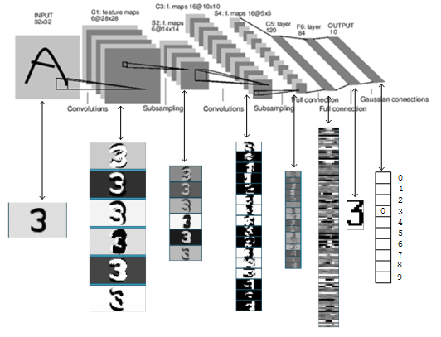
LeNet 5
LeNet 5 - what each layer does
input image
applies 6 filters
applies 16 filters
decreases resolution
Notes:
There are exercises on image classification. They are exercises 810 through 890.

Slide 245
More Powerful Models
More powerful classification models have been developed in the years since and have achieved superhuman performance on the ILSVRC (ImageNet Large-Scale Visual Recognition Challenge) using 1.4 million images categorized into 1000 categories.
These include:
AlexNet (ILSVRC 2012 winner), Clarifai (ILSVRC 2013 winner), VGGNet (ILSVRC 2014 2nd Place), GoogLeNet (ILSVRC 2014 winner), ResNet (ILSVRC 2015 winner).
ResNet had 152 layers. It beat humans (5.1% error rates) on ILSVRC. It had an error rate of just 3.57%.
Notes:
Read about some of them here: http://slazebni.cs.illinois.edu/spring17/lec01_cnn_architectures.pdf

Slide 246
You’re on your own from here
I’ve not prepared detailed notes below this point.
You’re on your own from here on (for now).

Slide 247
Deep Learning Models
The deep learning models we have seen are limited to:
a fixed number of features (f₁ & f₂)
all features being read at one shot
Classes c
1
2
W’
W’₁₁
b'₂
W’₂₁
W’₂₂
1
W’₁₂
2
b'₁
3
Hidden h
W₁₁
b₂
W
W₂₁
W₂₂
1
W₁₂
2
b₁
3
Features f

Slide 248
Sequential Deep Learning Models
But there are lots of real world problems where the features form long sequences (that is, they have an ordering):
Speech recognition
Machine translation
Handwriting recognition
DNA sequencing
Self-driving car sensor inputs
Sensor inputs for robot localization

Slide 249
Sequential Deep Learning Models
Classes c
Is there a deep learning model that can be presented with features sequentially?
1
2
W’
W’₁₁
b'₂
W’₂₁
W’₂₂
1
W’₁₂
2
b'₁
3
Hidden h
W₁₁
b₂
W
W₂₁
W₂₂
1
W₁₂
2
b₁
3
Features f

Slide 250
Sequential Deep Learning Models
Classes c
Yes.
They’re called …
Recurrent Neural Networks (RNNs):
V
Hidden h
W’
W
Features f

Slide 251
Sequential Deep Learning Models
Classes c
Recurrent Neural Networks (RNNs):
At time t = 0
V
Hidden h
W’
1
2
W
V₁₁
V₂₁
V₂₂
b'₂
Features f
V₁₂
1
2
b'₁
3
At any point in time, an RNN looks almost like a
regular multilayer neural network …
Almost!
W₁₁
b₂
W₂₁
W₂₂
1
W₁₂
2
b₁
3

Slide 252
Sequential Deep Learning Models
Classes c
Recurrent Neural Networks (RNNs):
At time t = 0
V
Hidden h
W’
1
2
W
1
2
V₁₁
V₂₁
V₂₂
b'₂
Features f
V₁₂
1
2
b'₁
3
There is a difference:
In addition to its inputs, it also reads its own hidden “state” … from the previous time step.
W₁₁
b₂
W₂₁
W₂₂
1
W₁₂
2
b₁
3

Slide 253
Sequential Deep Learning Models
Recurrent Neural Networks (RNNs):
At time t = 1
1
2
V₁₁
V₂₁
V₂₂
b'₂
1
2
V₁₂
1
2
b'₁
3
V₁₁
V₂₁
V₂₂
b'₂
V₁₂
Now when it reads the
previous
hidden “state” …
the vector of previous
hidden state values contains
the values from t = 0
W₁₁
b₂
1
2
b'₁
3
W₂₁
W₂₂
1
W₁₂
2
b₁
3
W₁₁
W₂₂
b₂
W₂₁
1
W₁₂
2
b₁
3
t = 0
t = 1

Slide 254
Sequential Deep Learning Models
Recurrent Neural Networks (RNNs):
At time t = 2
1
2
V₁₁
V₂₁
V₂₂
b'₂
1
2
V₁₂
1
2
b'₁
3
V₁₁
V₂₁
V₂₂
b'₂
V₁₂
Now when it reads the
previous
hidden “state” …
the vector of previous
hidden state values contains
the values from t = 1
W₁₁
b₂
1
2
b'₁
3
W₂₁
W₂₂
1
W₁₂
2
b₁
3
W₁₁
W₂₂
b₂
W₂₁
1
W₁₂
2
b₁
3
t = 1
t = 2

Slide 255
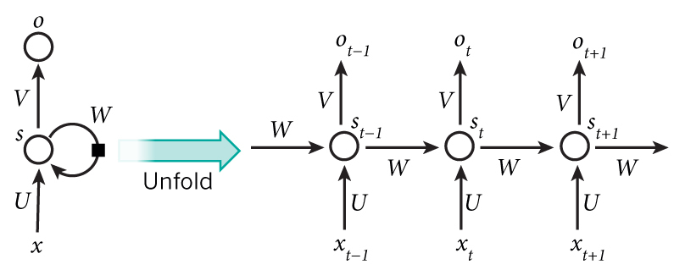
Sequential Deep Learning Models
Illustration of RNNs from the WildML blog.
http://www.wildml.com/2015/09/recurrent-neural-networks-tutorial-part-1-introduction-to-rnns/

Slide 256
Sequential Deep Learning Models
Classes c
We’re going to explore RNNs using a toy problem - adding up the bits in a binary sequence.
Generated data:
2 0 1 0 0 1
3 1 0 0 1 1
5 1 1 1 1 1
0 0 0 0 0 0
http://monik.in/a-noobs-guide-to-implementing-rnn-lstm-using-tensorflow/
V
Hidden h
W’
W
Features f
Notes:
Do exercise 910 and 920.

Slide 257
Sequential Deep Learning Models
Recurrent Neural Networks (RNNs):
At time t = 1
Let’s say the state is managed by some machinery in a box.
The box is something that takes …
an input
the previous state
… and returns …
an output
the new state
… at each time-step.
1
2
V₁₁
V₂₁
V₂₂
b'₂
1
2
V₁₂
RNN
1
2
b'₁
3
V₁₁
V₂₁
V₂₂
b'₂
V₁₂
RNN
W₁₁
b₂
1
2
b'₁
3
W₂₁
W₂₂
1
W₁₂
2
b₁
3
W₁₁
W₂₂
b₂
W₂₁
1
W₁₂
2
b₁
3
t = 0
t = 1

Slide 258
Sequential Deep Learning Models
Long Short-Term Memory (LSTMs):
At time t = 1
In LSTMs, the box is more complex.
But it still takes …
an input
the previous state
… and returns …
an output
the new state
… at each time-step.
1
2
1
2
LSTM
LSTM
1
2
1
2
t = 0
t = 1

Slide 259
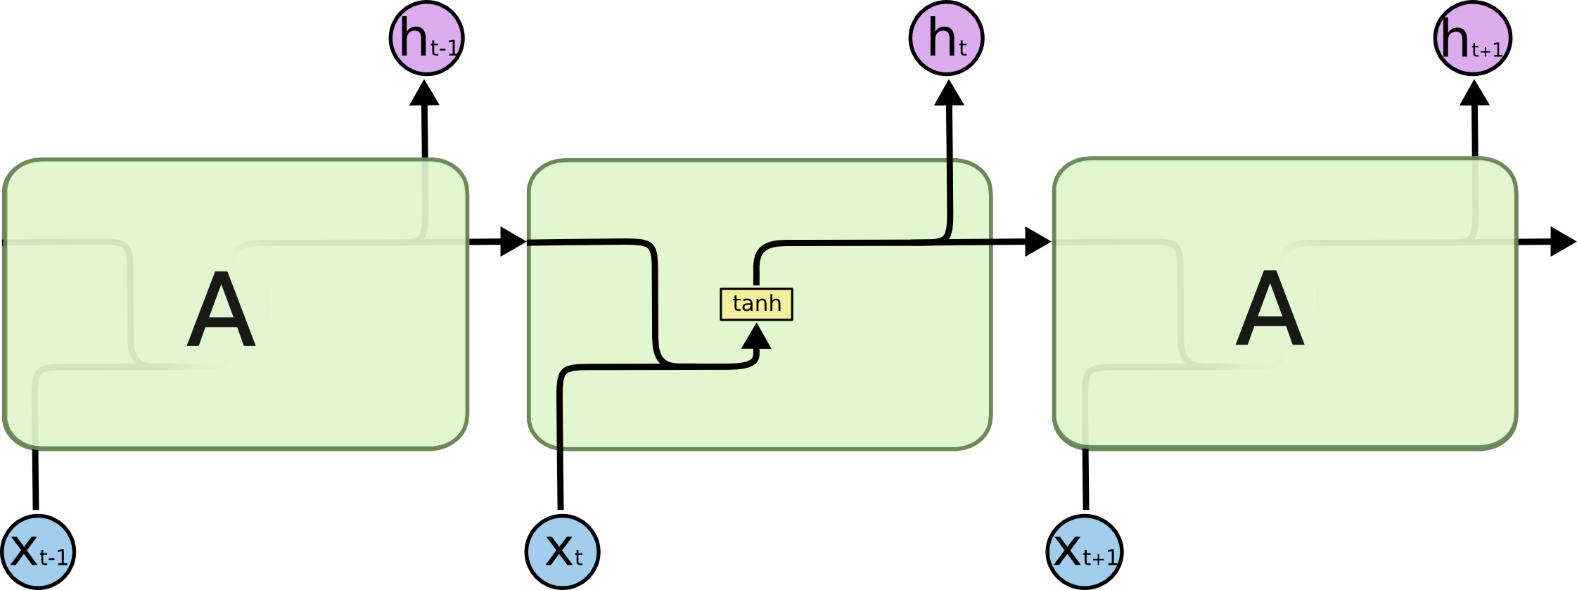
Sequential Deep Learning Models
The RNN box
output at time t - 1
output at time t
state at time t-1
state at time t
This is an RNN box
input at time t
Source: http://colah.github.io/posts/2015-08-Understanding-LSTMs/

Slide 260
Sequential Deep Learning Models
The RNN box
This is an RNN box
The code for this in pytorch is:
x = torch.cat((state, features_at_current_step), 1)
state = output = F.tanh(x.mm(W) + b)

Slide 261

Sequential Deep Learning Models
The LSTM box
output at time t - 1
output at time t
state at time t-1
state at time t
This is an RNN box
input at time t
Source: http://colah.github.io/posts/2015-08-Understanding-LSTMs/

Slide 262
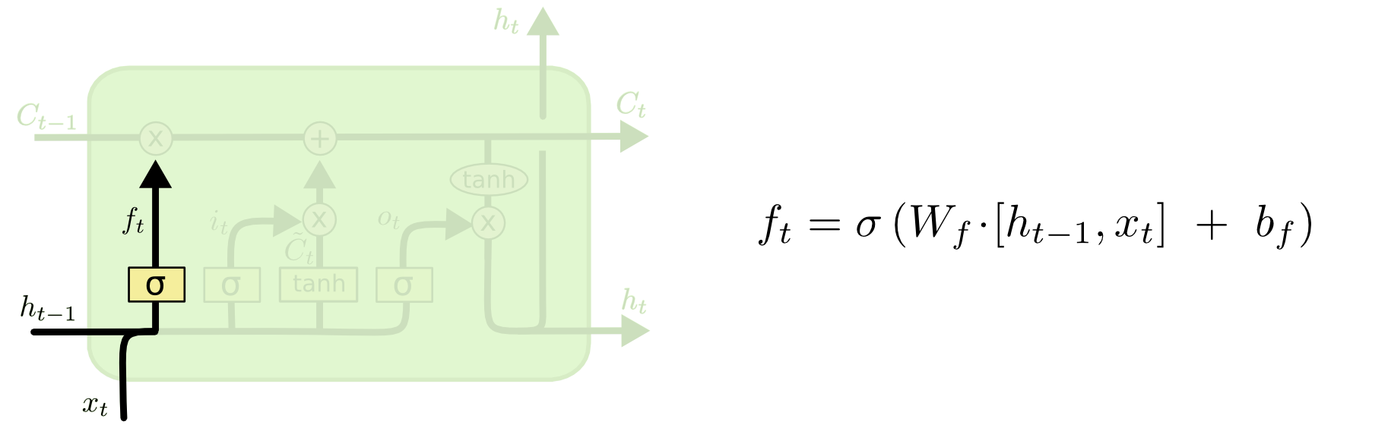
Sequential Deep Learning Models
How the LSTM works (step-by-step walk-through)
Just copied and pasted from: http://colah.github.io/posts/2015-08-Understanding-LSTMs/

Slide 263
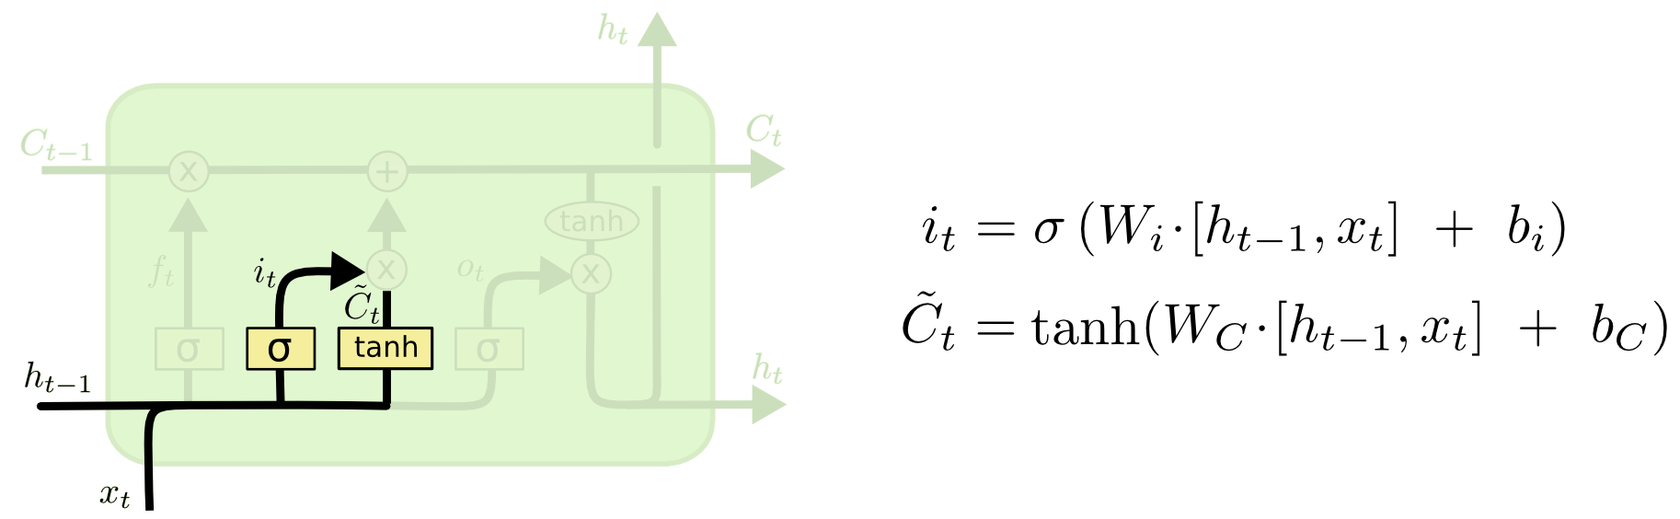
Sequential Deep Learning Models
How the LSTM works (step-by-step walk-through)
Just copied and pasted from: http://colah.github.io/posts/2015-08-Understanding-LSTMs/

Slide 264
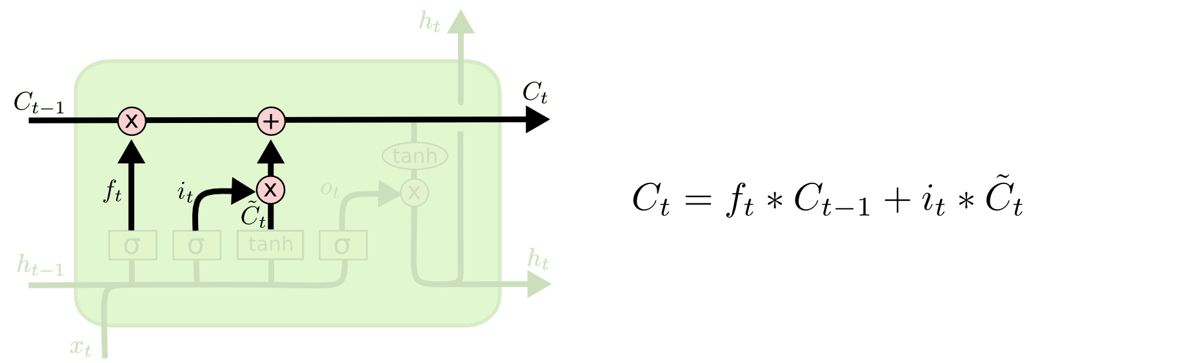
Sequential Deep Learning Models
How the LSTM works (step-by-step walk-through)
Just copied and pasted from: http://colah.github.io/posts/2015-08-Understanding-LSTMs/

Slide 265
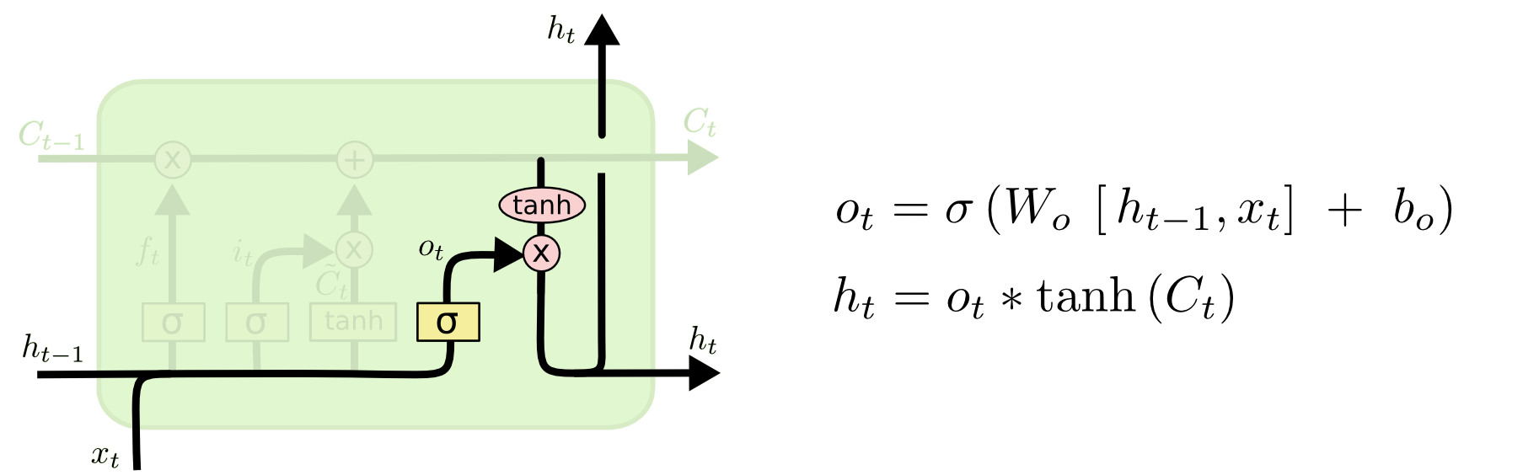
Sequential Deep Learning Models
How the LSTM works (step-by-step walk-through)
Just copied and pasted from: http://colah.github.io/posts/2015-08-Understanding-LSTMs/

Slide 266
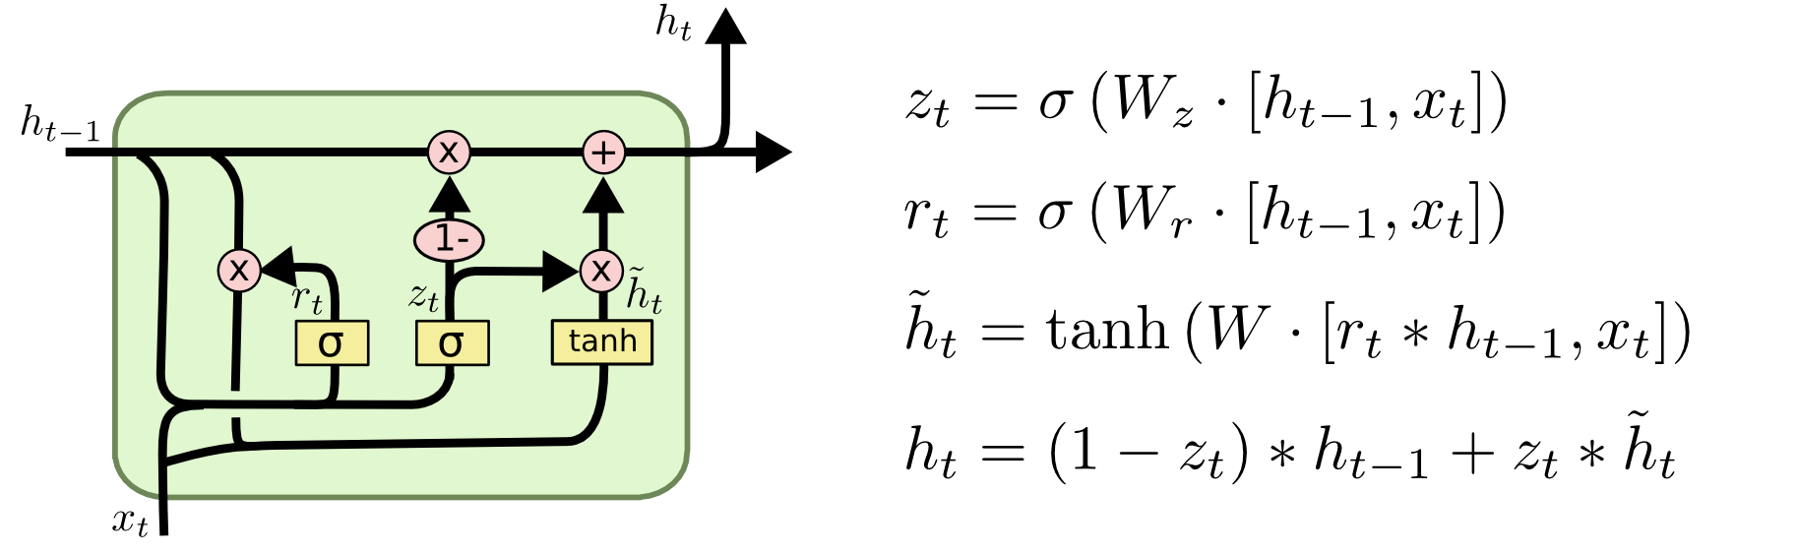
Sequential Deep Learning Models
GRUs
Just copied and pasted from: http://colah.github.io/posts/2015-08-Understanding-LSTMs/

Slide 267
Sequential to Sequence Models
Sequence to Sequence Models:
These can understand and generate sequences.
Parts:
Encoder - the part that encodes sequences
Decoder - the part that generates sequences
Notes:
Do exercise 980

Slide 268
Sequential to Sequence Models
The Encoder:
Just an RNN (maybe LSTM) without the output.
The encoding is just the last hidden state of the RNN/LSTM
LSTM
LSTM
Encoding
1
2
Hey
1
2
t = 0
there
t = 1

Slide 269
Sequential Deep Learning Models
The Decoder:
Just another RNN (maybe LSTM) with output.
Hello
1
2
STOP Symbol
1
2
Encoding
LSTM
The first hidden state of the RNN/LSTM is the encoding
LSTM
1
2
1
2
START Symbol
t = 0
The first input to the decoder is a special symbol to indicate start of decoding
t = 1

Slide 270
Concepts for Further Reading
General:
LSTMs and GRUs (related to RNNs)
Dropout
Vanishing Gradient Problem
Deep Neural Networks as Universal Approximators
Important for NLP:
Sequence to Sequence Models
Attention Models
Embeddings (Word2Vec, CBOW, Glove)
Important for CV:
Convolutional Neural Networks (CNNs)
Pooling Layers
Attention Models
Multidimensional RNNs

Slide 271
Links for Further Learning
Hugo Larochelle’s course:
https://www.youtube.com/watch?v=SGZ6BttHMPw&list=PL6Xpj9I5qXYEcOhn7TqghAJ6NAPrNmUBH
Tutorials:
https://jasdeep06.github.io/posts/towards-backpropagation/
http://monik.in/a-noobs-guide-to-implementing-rnn-lstm-using-tensorflow/
https://github.com/jcjohnson/pytorch-examples
http://colah.github.io/posts/2014-07-NLP-RNNs-Representations/
http://colah.github.io/posts/2015-08-Understanding-LSTMs/
https://iamtrask.github.io/2015/11/15/anyone-can-code-lstm/
https://distill.pub/2016/augmented-rnns/
http://www.wildml.com/2015/11/understanding-convolutional-neural-networks-for-nlp/
http://www.wildml.com/2015/10/recurrent-neural-network-tutorial-part-4-implementing-a-grulstm-rnn-with-python-and-theano/
https://theneuralperspective.com/2016/11/20/recurrent-neural-networks-rnn-part-3-encoder-decoder/
https://theneuralperspective.com/2016/11/20/recurrent-neural-network-rnn-part-4-attentional-interfaces/
Siraj Rawal’s videos:
https://www.youtube.com/watch?v=h3l4qz76JhQ&list=PL2-dafEMk2A5BoX3KyKu6ti5_Pytp91sk
https://www.youtube.com/watch?v=cdLUzrjnlr4

Slide 272
Advanced Concepts for Further Reading
Zero-Shot, One-Shot and Few-Shot Learning
Meta Learning in Neural Networks
Transfer learning
Neural Turning Machines
Key-Value Memory
Pointer Networks
Highway Networks
Memory Networks
Attention Models
Generative Adversarial Networks
Relation Networks (for reasoning) and FiLM
BIDAF model for question answering

Slide 273
Links for Further Learning
Papers
Awesome Deep Learning Papers – someone’s made a iist! - https://github.com/terryum/awesome-deep-learning-papers
Backpropagation: http://www.nature.com/nature/journal/v323/n6088/abs/323533a0.html
LeCun on backpropagation: http://yann.lecun.com/exdb/publis/index.html#lecun-88
Efficient Backprop: http://yann.lecun.com/exdb/publis/pdf/lecun-98b.pdf
ReLU: http://www.nature.com/nature/journal/v405/n6789/full/405947a0.html
LSTM: ftp://ftp.idsia.ch/pub/juergen/lstm.pdf
GRU: https://arxiv.org/abs/1412.3555
LSTM a search space odyssey: https://arxiv.org/pdf/1503.04069.pdf
Schmidhuber Deep Learning Overview: http://www.idsia.ch/~juergen/deep-learning-overview.html
Handwriting recognition: https://www.researchgate.net/publication/24213728_A_Novel_Connectionist_System_for_Unconstrained_Handwriting_Recognition
Generating sequences with RNNs: https://arxiv.org/pdf/1308.0850v5.pdf
Speech Recognition with RNNs: https://arxiv.org/pdf/1303.5778.pdf
LeCun’s papers: http://yann.lecun.com/exdb/publis/index.html#selected
Natural Language Processing
Sequence to Sequence: http://papers.nips.cc/paper/5346-sequence-to-sequence-learning-with-neural-networks.pdf
Neural Machine Translation: https://arxiv.org/pdf/1409.0473.pdf
BIDAF: https://arxiv.org/abs/1611.01603
Pointer Networks: https://arxiv.org/abs/1506.03134
Neural Turing Machine: https://arxiv.org/abs/1410.5401
Dynamic Coattention Networks for Question Answering: https://arxiv.org/pdf/1611.01604.pdf
Machine Comprehension: https://arxiv.org/abs/1608.07905v2
GNMT: https://research.googleblog.com/2016/09/a-neural-network-for-machine.html
Stanford Glove: https://nlp.stanford.edu/pubs/glove.pdf
Computer Vision
Digit Recognition: https://arxiv.org/pdf/1003.0358.pdf
OverFeat: https://arxiv.org/abs/1312.6229
Feature hierarchies: https://arxiv.org/abs/1311.2524
Spatial Pyramid Pooling: https://arxiv.org/abs/1406.4729
Performance on ImageNet 2012: http://papers.nips.cc/paper/4824-imagenet-classification-with-deep-convolutional-neural-networks
Surpassing Human-Level Performance on ImageNet: https://arxiv.org/abs/1502.01852
Surpassing Human-Level Face Recognition Performance: https://arxiv.org/abs/1404.3840
Reinforcement Learning
Deep Q-Networks: https://deepmind.com/research/dqn/
Hybrid Reward Architecture https://blogs.microsoft.com/ai/2017/06/14/divide-conquer-microsoft-researchers-used-ai-master-ms-pac-man/
AlphaGo Paper: https://storage.googleapis.com/deepmind-media/alphago/AlphaGoNaturePaper.pdf
AlphaGo Zero Paper: https://deepmind.com/research/alphago/
Speech:
https://www.techrepublic.com/article/why-ibms-speech-recognition-breakthrough-matters-for-ai-and-iot/
https://www.technologyreview.com/s/602714/first-computer-to-match-humans-in-conversational-speech-recognition/

Slide 274
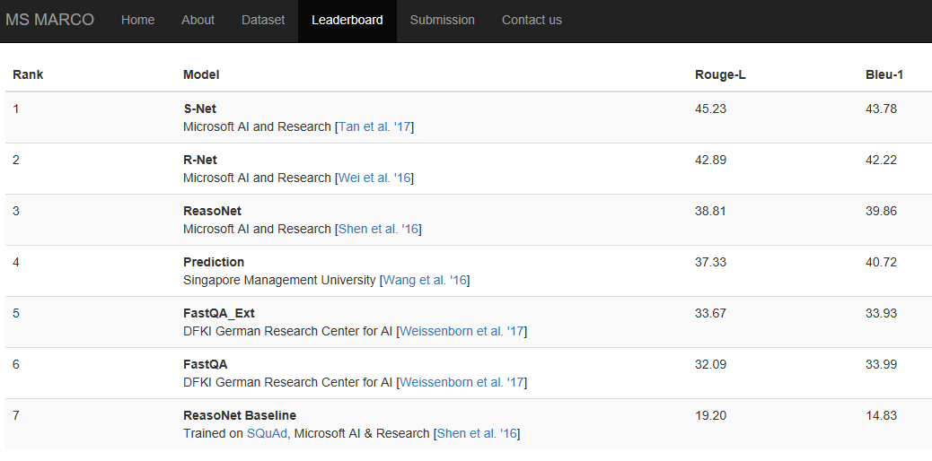
Links to competitions you can participate in
Squad
https://rajpurkar.github.io/SQuAD-explorer/
MSMarco
http://www.msmarco.org/leaders.aspx
ConvAI
http://convai.io/1_round/

Slide 275
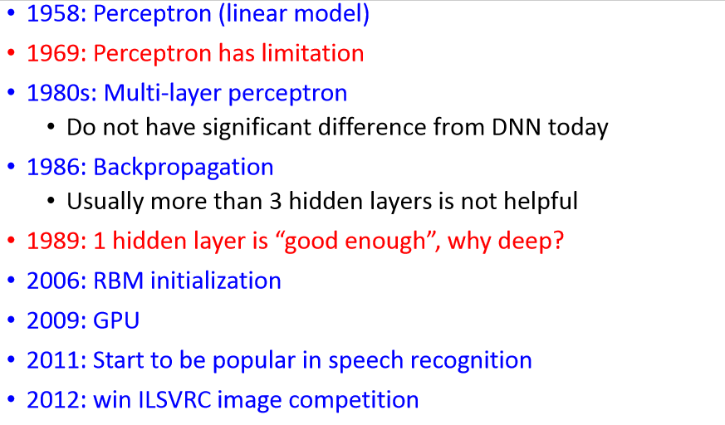
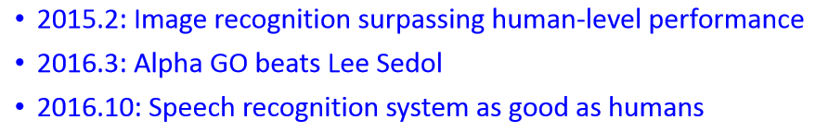
History of Deep Learning
Source: http://speech.ee.ntu.edu.tw/~tlkagk/courses/ML_2017/Lecture/DL.pdf

Slide 276
Recent History of Deep Learning
2017.07: Relation Networks beats humans at relational reasoning on a toy dataset.
2017.10: AlphaGo Zero teaches itself Go and beats AlphaGo (which beat Lee Sidol).
2017.12: AlphaZero teaches itself chess and Go and beats Stockfish 8 and AlphaGo Zero.
2017.12: Text to speech system that sounds convincingly human (Tacotron 2).
Source: http://speech.ee.ntu.edu.tw/~tlkagk/courses/ML_2017/Lecture/DL.pdf

Slide 277
THE END
Deep Learning Basics
Cohan Sujay Carlos
Aiaioo Labs
Benson Town
Bangalore
India
Notes:
Suggestions / Questions / Comments can be sent to cohan@aiaioo.com

