Slide 1
Entwicklung einer Digital Twin-Applikation für einen Industrieroboter mit ROS und OPC-UA
Ahmed Ibrahim Almohamed
ibraah0@thu.de

Slide 2
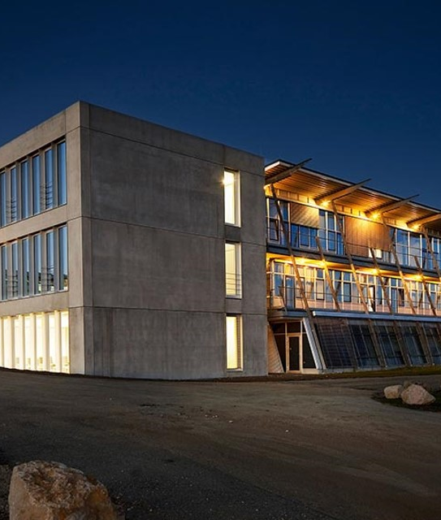
Agenda
Updates
Technical Foundations
State of Art
OPCUA Ros2 Server - Architecture
OPCUA Ros2 Server - Sequences
Demo

Slide 3
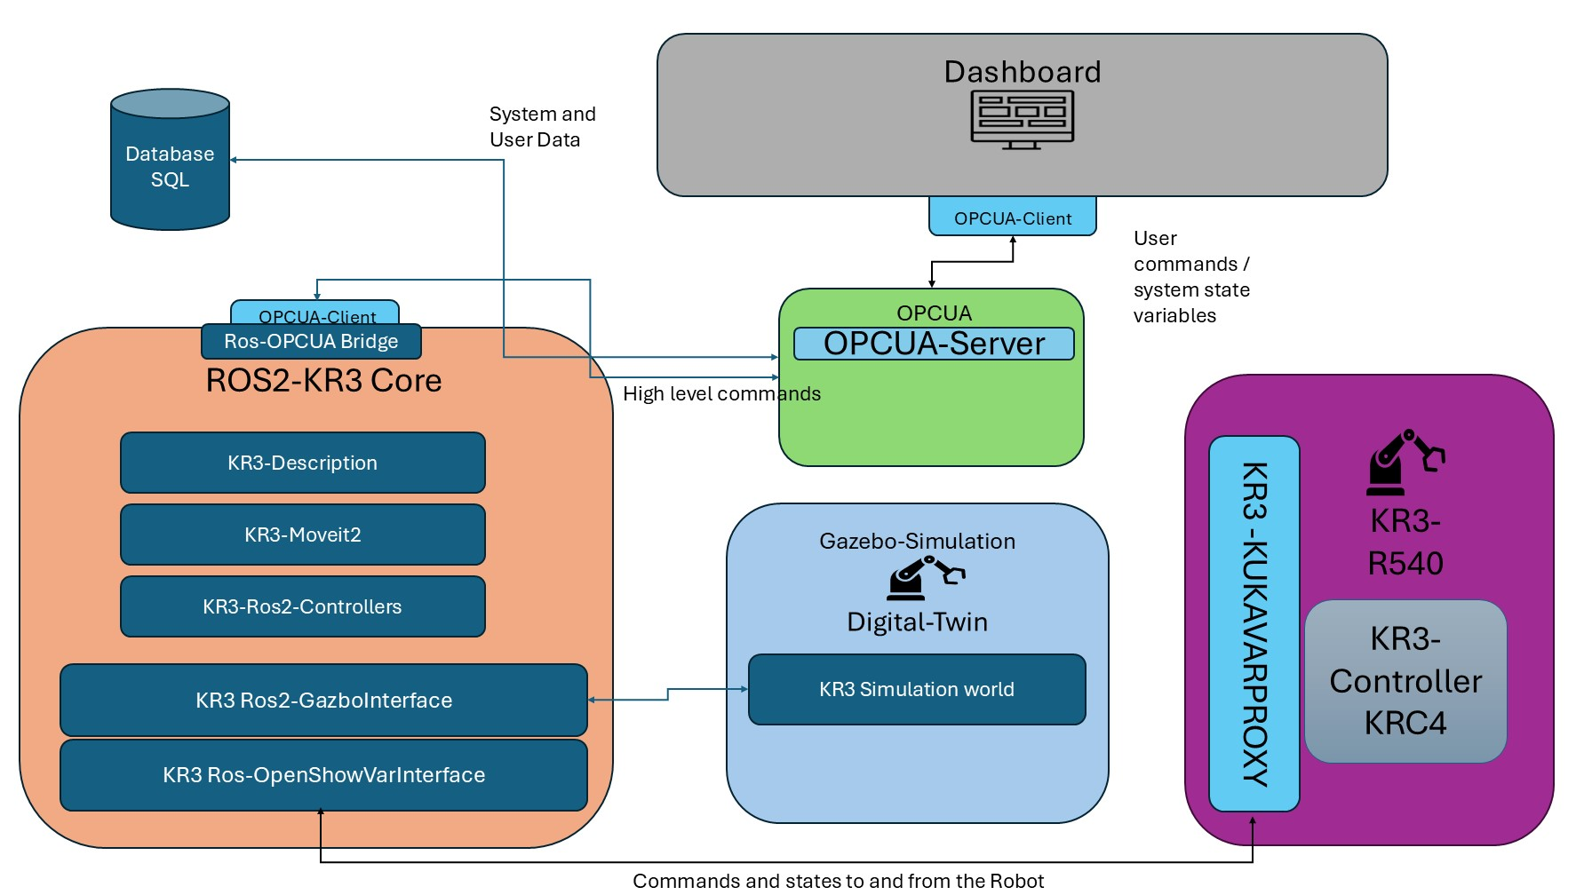
Update
Notes:
System overview :

Slide 4
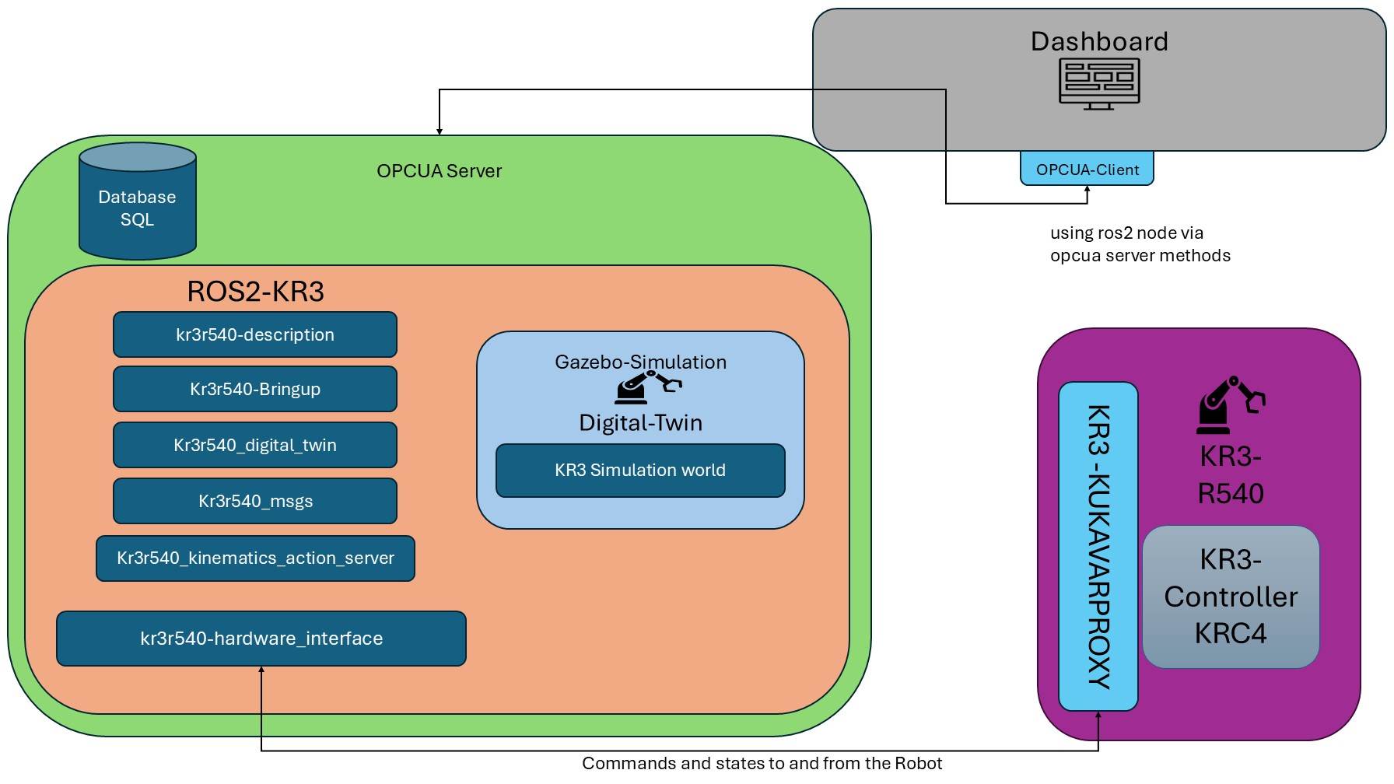
Update
Notes:
System overview :

Slide 5
Update
Notes:
System overview :

Slide 6
Update
Notes:
System overview :

Slide 7
Update
Notes:
System overview :

Slide 8
Update
Notes:
System overview :

Slide 9
Technical Foundations
Problem
HMI 1
HMI 2
HMI 1
HMI 2
Company A communication
Company A communication
OPC
OPC
Company B communication
Company B communication
Windows PC
Company A communication
Company B communication
Company A
Company B
Company A
Company B
Notes:
Language is the protocol used to express human thoughts among each-other, but it may be like French which is a regional language and can be understood by the people of that region, or it may be like Hindi which is central communication medium that can be interpreted by different regional people over the country. Today we discuss Basics of OPC & OPC UA vs OPC DA
Thus OPC can be considered as language for the communication between machines in industries, in which one of the latest version of OPC that is OPC UA (Unified Architecture) is a cross-platform protocol for machine to machine communication like English and on the other hand the older version of OPC is OPC DA (Data Access) not compatible with multi-platform.

Slide 10



Technical Foundations
Problem
Device 1
HMI 1
Device 2
HMI 2
Notes:
Problem : say we have 2 devices , that each connect to 2 HMIs , now on each device we need to implement the connect , CRUD , and more for each HMI !! So for bigger system , this is quite hard to do and takes a lot of time !

Slide 11
Technical Foundations
Solution
OPC Server
OPC Client
OPC Data
Device 1
Standard Interface
HMI 1
DCOM/COM
OPC Data
Device 2
HMI 2
Notes:
So a Solution was to create a middle layer ( standard interface ) and let the HMI all connect to that interface via a Client -> OPC server is the standard interface and the OPC Client is the the Client of the HMI The devices sends standard data (OPC Data ) to the server where the server then connects via (DCOM) (distributed COM) or (COM ) (component Object Model ) (Only works on Windows)
Thus the problem with complicated communication was reduced via OPC standard (better known as OPC Classic)

Slide 12
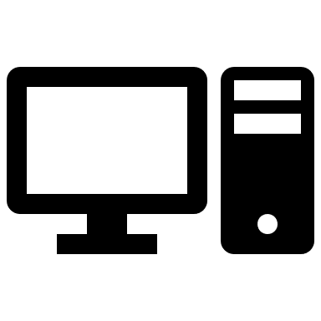
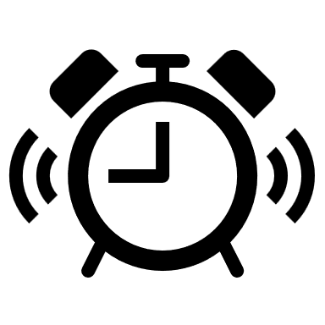
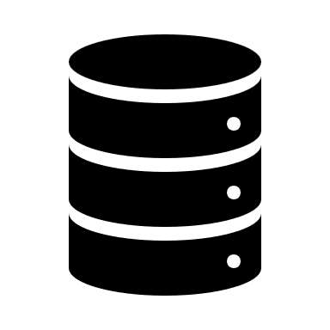
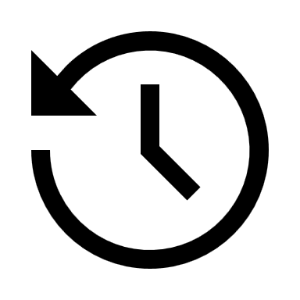
Technical Foundations
OPC - Open Platform Communications / Data Interface Types
OPC DA Server
OPC A&E Server
OPC HDA Server
OPC DA Server defines the exchange of data including values, time and quality information
OPC A&E Server – defines the exchange of alarm and event type message information , as well as variables states and state management
OPC HDA Server – defines query methods and analytics that may be applied to historical , time stamped data

Slide 13
Technical Foundations
OPC - Open Platform Communications
“The OPC standard is a series of specifications developed by industry vendors, end-users and software developers. These specifications define the interface between Clients and Servers, as well as Servers and Servers, including access to real-time data, monitoring of alarms and events, access to historical data and other applications.”

Slide 14

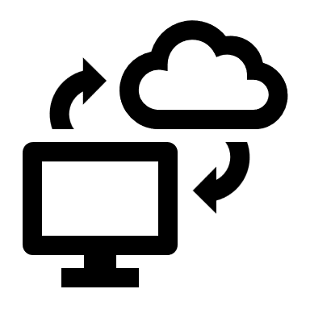

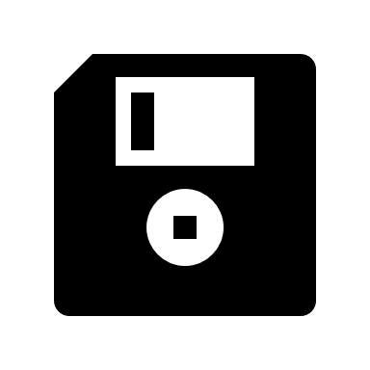
Technical Foundations
Depend on Windows OS
Problem
OPC Server
OPC Client
OPC Data
Cannot connect to the Internet
Device 1
Standard Interface
HMI 1
DCOM/COM
OPC Data
Not Secure
Device 2
HMI 2
Simple Data
Notes:
So the a new problem arised : the COM and DCOM depend on Windows , cannot connect to the internt and they are not secured (easily hackable)

Slide 15
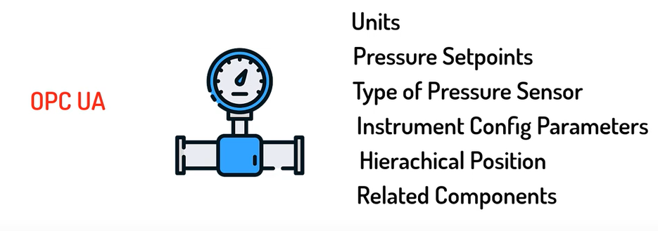
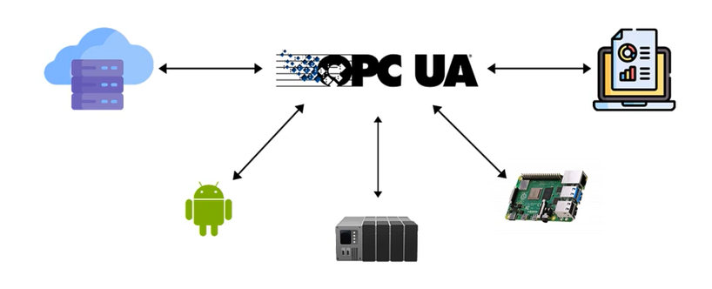
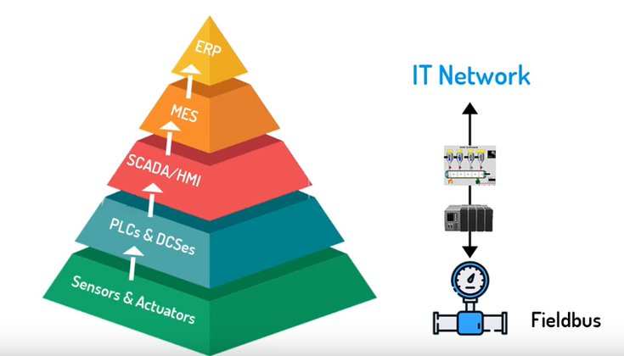
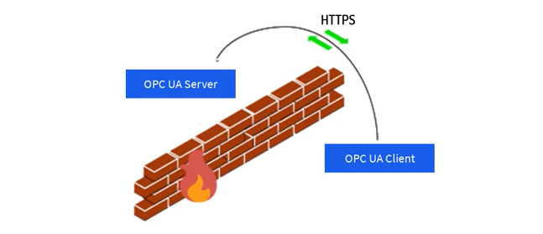
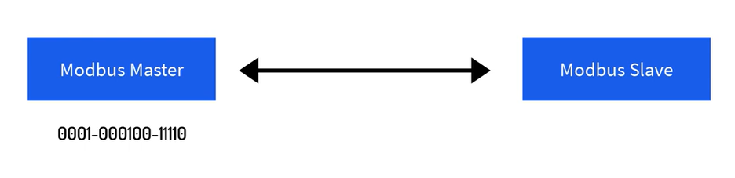
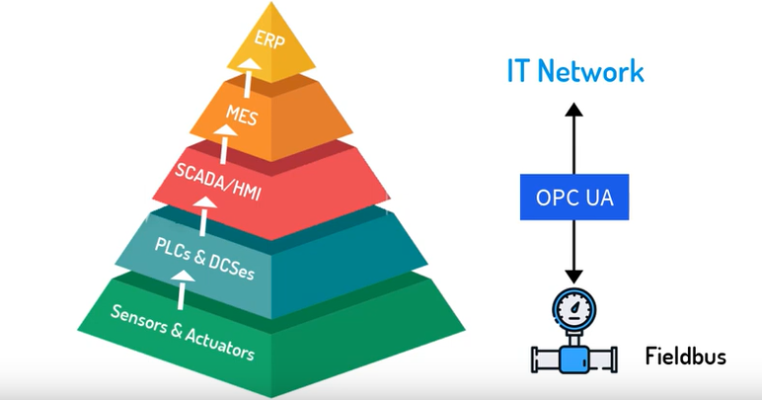
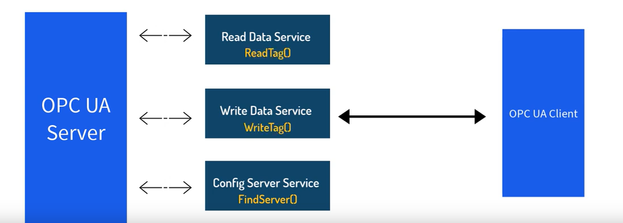
Technical Foundations
Solution
“A Solution was developed by going back to drawing board and developing new set of requirements or OPCUA “
Cross Platform & Internet Read
Complex Information Model
Service Oriented Architecture
Simplified IT Integration

Slide 16
Technical Foundations
OPCUA - Open Platform Communications Unified Architecture
“The OPC Unified Architecture (UA), released in 2008, is a platform independent service-oriented architecture that integrates all the functionality of the individual OPC Classic specifications into one extensible framework.

Slide 17

ROS2 and OPCUA
Problem
Sensors
Actuators
OPCUA Server
protocol-specific implementations
MODBUS
IO-Link
PROFINET

Slide 18
ROS2 and OPCUA
Proposal
Out of scope for this MPA
In scope for this MPA
ROS2 Core
Ros and Micro Ros
Sensors
OPCUA Server
Actuators
Via mapping
Over DDS
MODBUS
IO-Link
Connect to Server by mapping ros2 nodes into ocpua data structure
PROFINET
Unify the connection protocols by using ROS and micro ROS
Notes:
Advantages of This Setup
Unified Communication Layer:
ROS 2 acts as the middleware to unify devices with various protocols, abstracting their differences.
Scalability:
Adding new devices requires creating only a new ROS 2 node or micro-ROS agent for the device/protocol.
Extensibility:
The OPC UA server can easily integrate with HMIs or SCADA systems, providing a standard interface.
Real-Time Capability:
ROS 2's QoS (Quality of Service) settings ensure that data from real-time protocols like PROFINET is handled appropriately.
Separation of Concerns:
Device communication is handled by ROS 2/micro-ROS, while the OPC UA server focuses on exposing data to industrial systems.

Slide 19
State of Art
Environment Setup
Ros2 package tree and implementation
Integrating OPCUA and ROS2
KukaVarProxy Experimental Hardware communication
Dashboard
New system Roadmap

Slide 20
State of Art
Environment Setup
Ros2 package tree and implementation
Integrating OPCUA and ROS2
Dashboard
KukaVarProxy Experimental Hardware communication
New system Roadmap
Ubuntu Dual Boot
Created a Shell script to Automate the ROS2 build
Enabled HMI mirroring with the lab’s PC (both OS)
Enabled a shared driver between the Robot and the lab’s PC
Installed the KukaVarProxyServer on the robot

Slide 21
State of Art
Environment Setup
Ros2 package tree and implementation
Integrating OPCUA and ROS2
KukaVarProxy Experimental Hardware communication
Dashboard
New system Roadmap
Added a KRL script to move the robot with help of a custom global variable.
Created a KukaClient library in C++ to act as a client of the KukaVarProxy
Tested the KukaClient library

Slide 22
State of Art
Environment Setup
Ros2 package tree and implementation
Integrating OPCUA and ROS2
KukaVarProxy Experimental Hardware communication
Dashboard
New system Roadmap
Create a ros2 project with the new system packages (Done)
Implement the new system packages (Done)
Using Gazebo Ignition (Done)
Integrate the Tcp Client into the ROS2 (Done)
Create Digital Shadow (Done)
Create Digital Twin (Done)

Slide 23
State of Art
Environment Setup
Ros2 package tree and implementation
Integrating OPCUA and ROS2
KukaVarProxy Experimental Hardware communication
Dashboard
New system Roadmap
Design and implementation of OPCUA Server
Integrating ROS2 nodes into the OPCUA Server
Setting and terminating ROS2 functionalities by mapping ROS2 nodes to OPCUA methods
Dockerizing The System and exposing the GUI of Gazebo and Port of the OPCUA Server
Creating a Visual Commission Use case

Slide 24
State of Art
Environment Setup
Ros2 package tree and implementation
Integrating OPCUA and ROS2
KukaVarProxy Experimental Hardware communication
Dashboard
New system Roadmap
Design a Dashboard application
Implement the Dashboard application
Embed an OPCUA Client on the application
Test the application

Slide 25
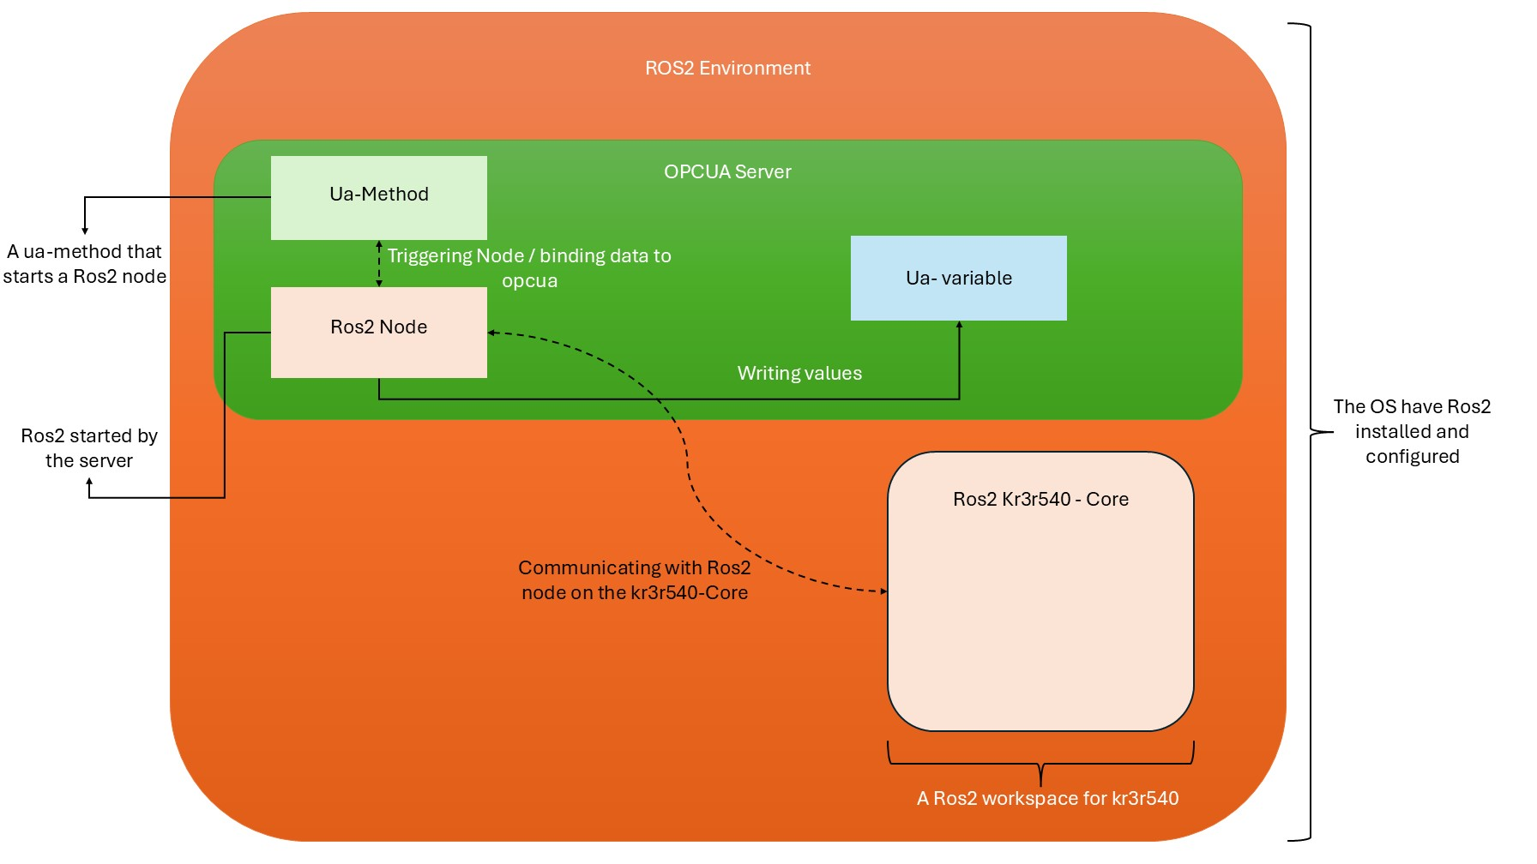
OPCUA Ros2 Server - Architecture
Overview

Slide 26
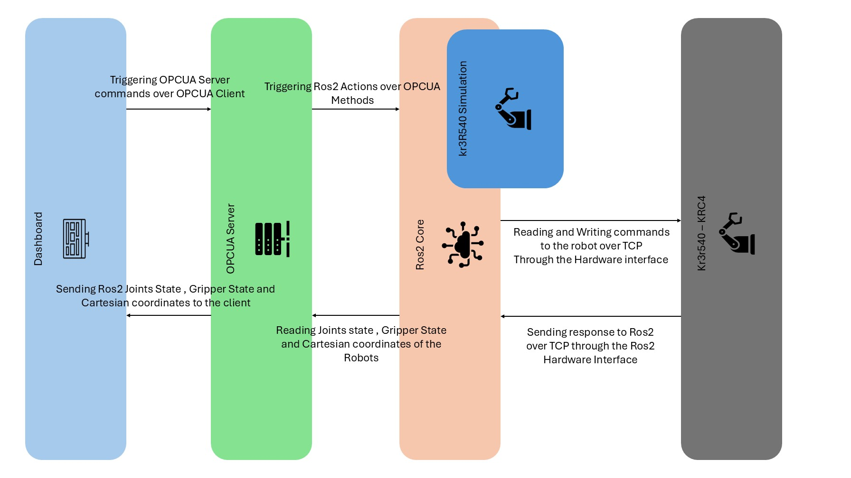
OPCUA Ros2 Server - Sequences
Overview

Slide 27
DEMO

Slide 28
Vielen Dank für Ihre Aufmerksamkeit.
www.thu.de

