Slide 1
Entwicklung einer Digital Twin-Applikation für einen Industrieroboter mit ROS und OPC-UA
Ahmed Ibrahim Almohamed
ibraah0@thu.de

Slide 2
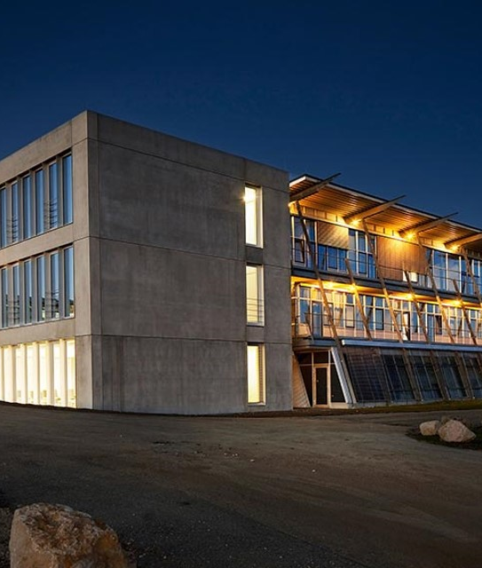
Agenda
Introduction
Use case Application
Current state of the system
System overview
Timeline
Conclusion

Slide 3
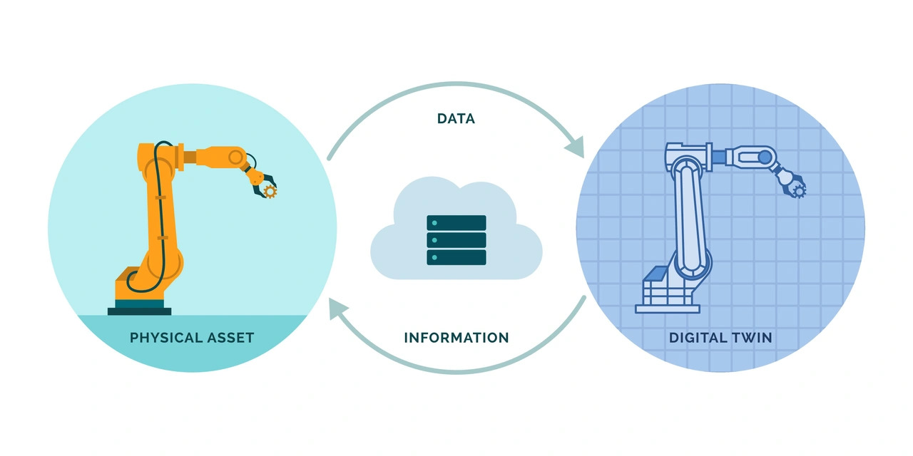
Introduction
Digital Twin
Notes:
What is a DT ?
represents the creation of a virtual replica of a physical object or system that is used to simulate, monitor, and optimize its real-world counterpart.

Slide 4
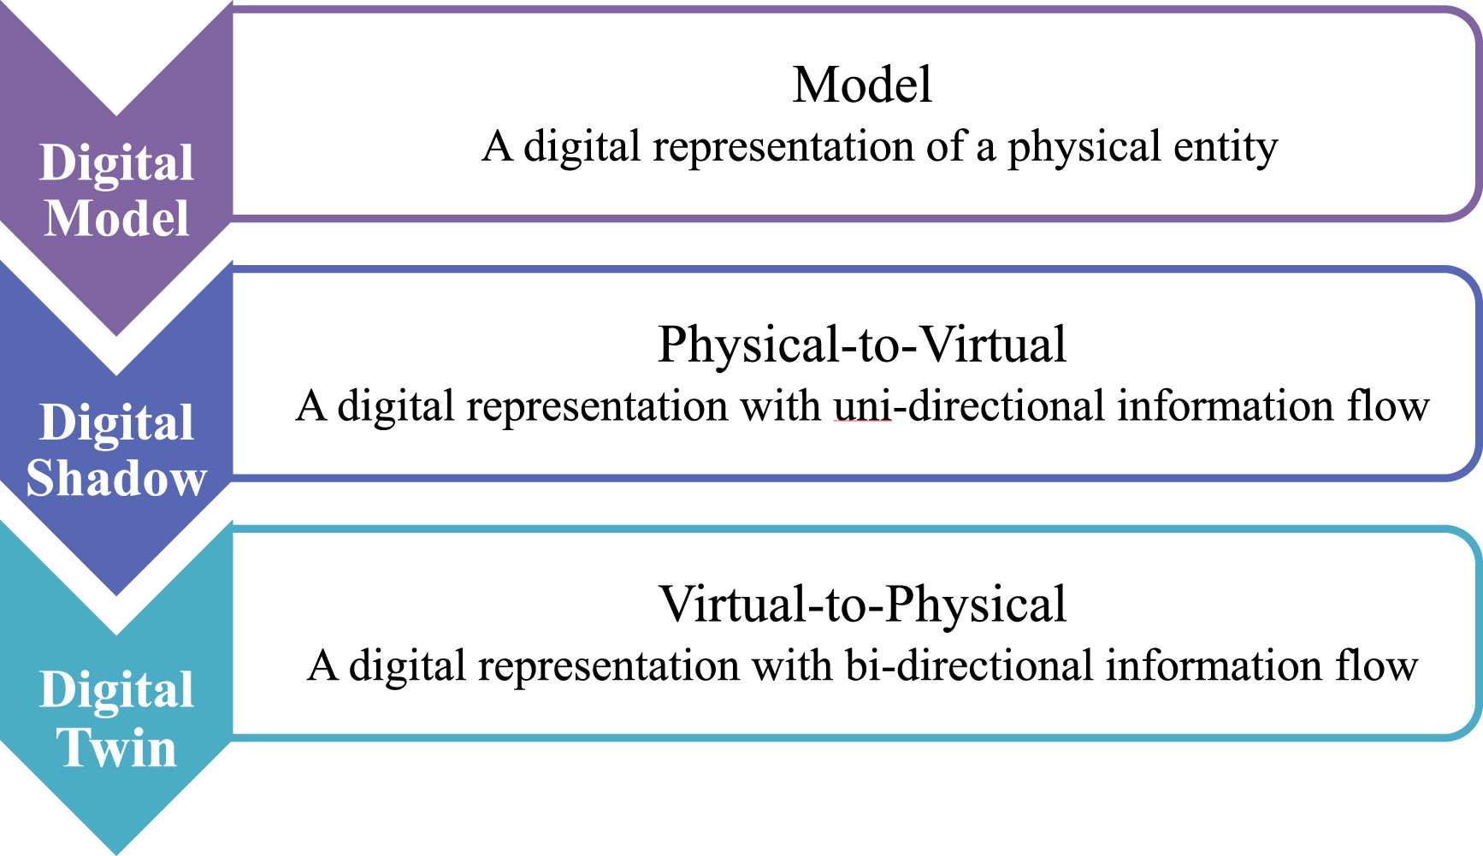
Introduction
Level of Integration
Notes:
Layers of integration :
Mirroring or Digital Model involves the creation of an exact virtual replica of a physical object or system in real-time
Shadowing focuses on continuously updating the digital twin with real-time data from its physical counterpart

Slide 5
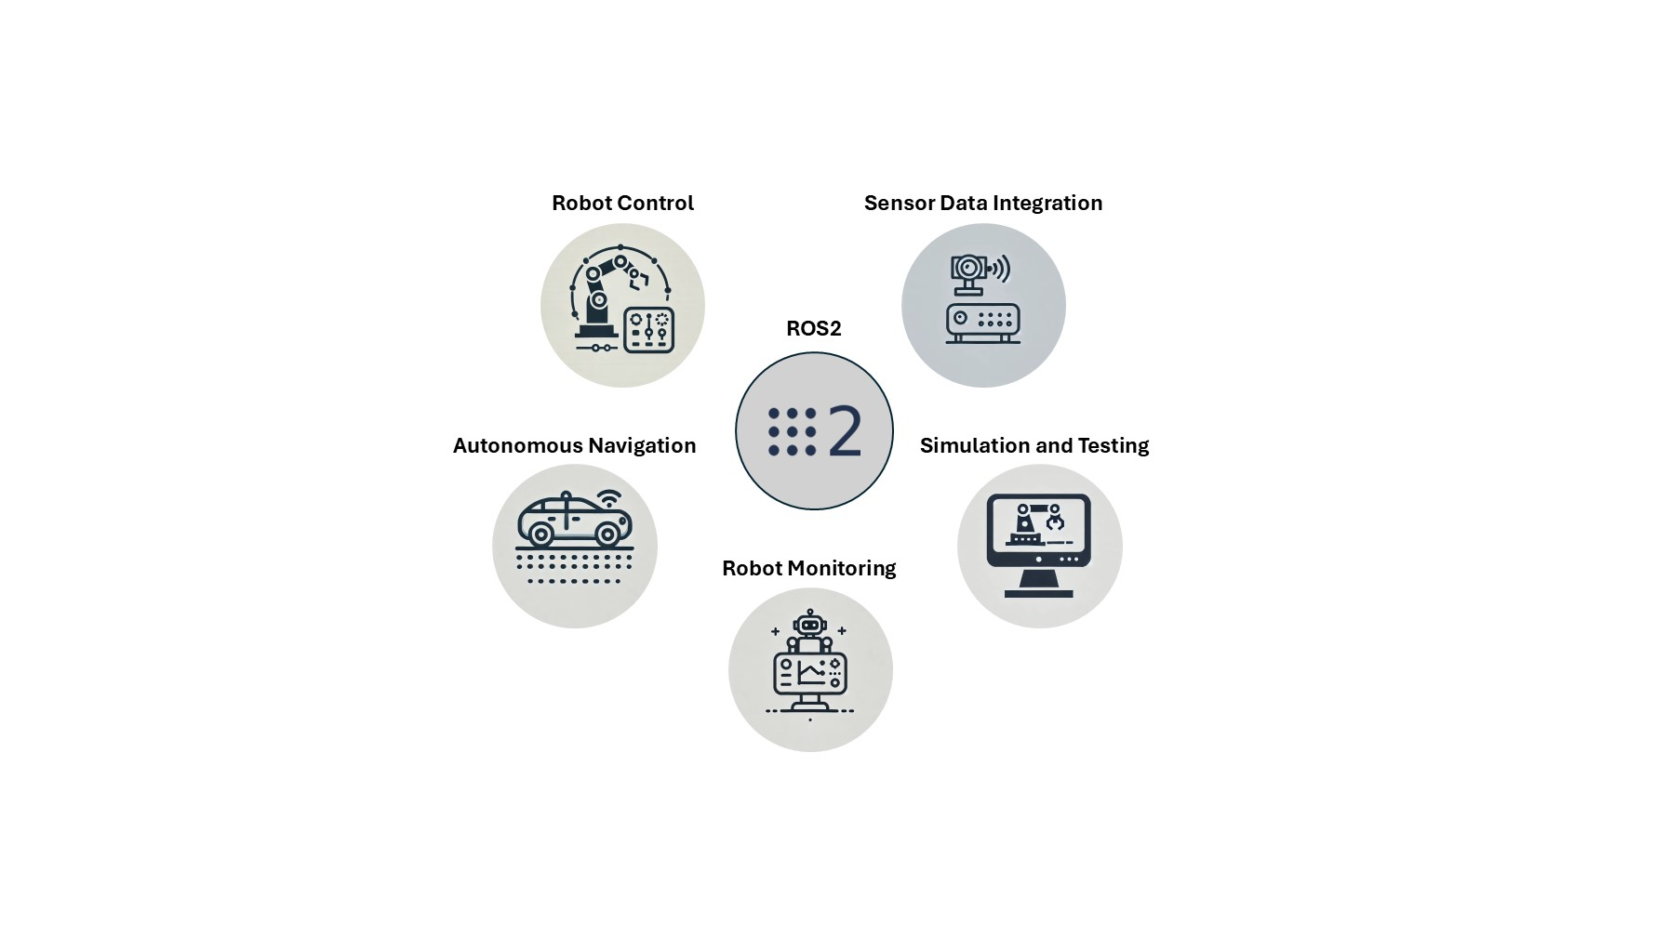
Introduction
ROS2
Notes:
What is ROS2 :
is an open source software development kit for robotics applications
The purpose of ROS 2 is to offer a standard software platform to developers across industries that will carry them from research and prototyping through to deployment and production

Slide 6
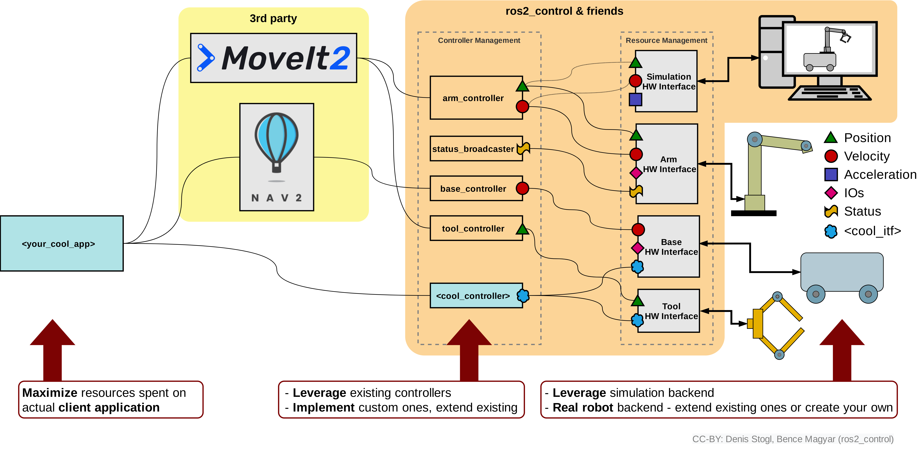
Introduction
ROS2 architecture overview
Notes:
ROS2 Layers :
App Layer : where the high level commands come ( RVIZ or some ros2 node )
3rd party software : like Movit2 for motion planning, manipulation, 3D perception, kinematics, control, and navigation.
Controllers

Slide 7
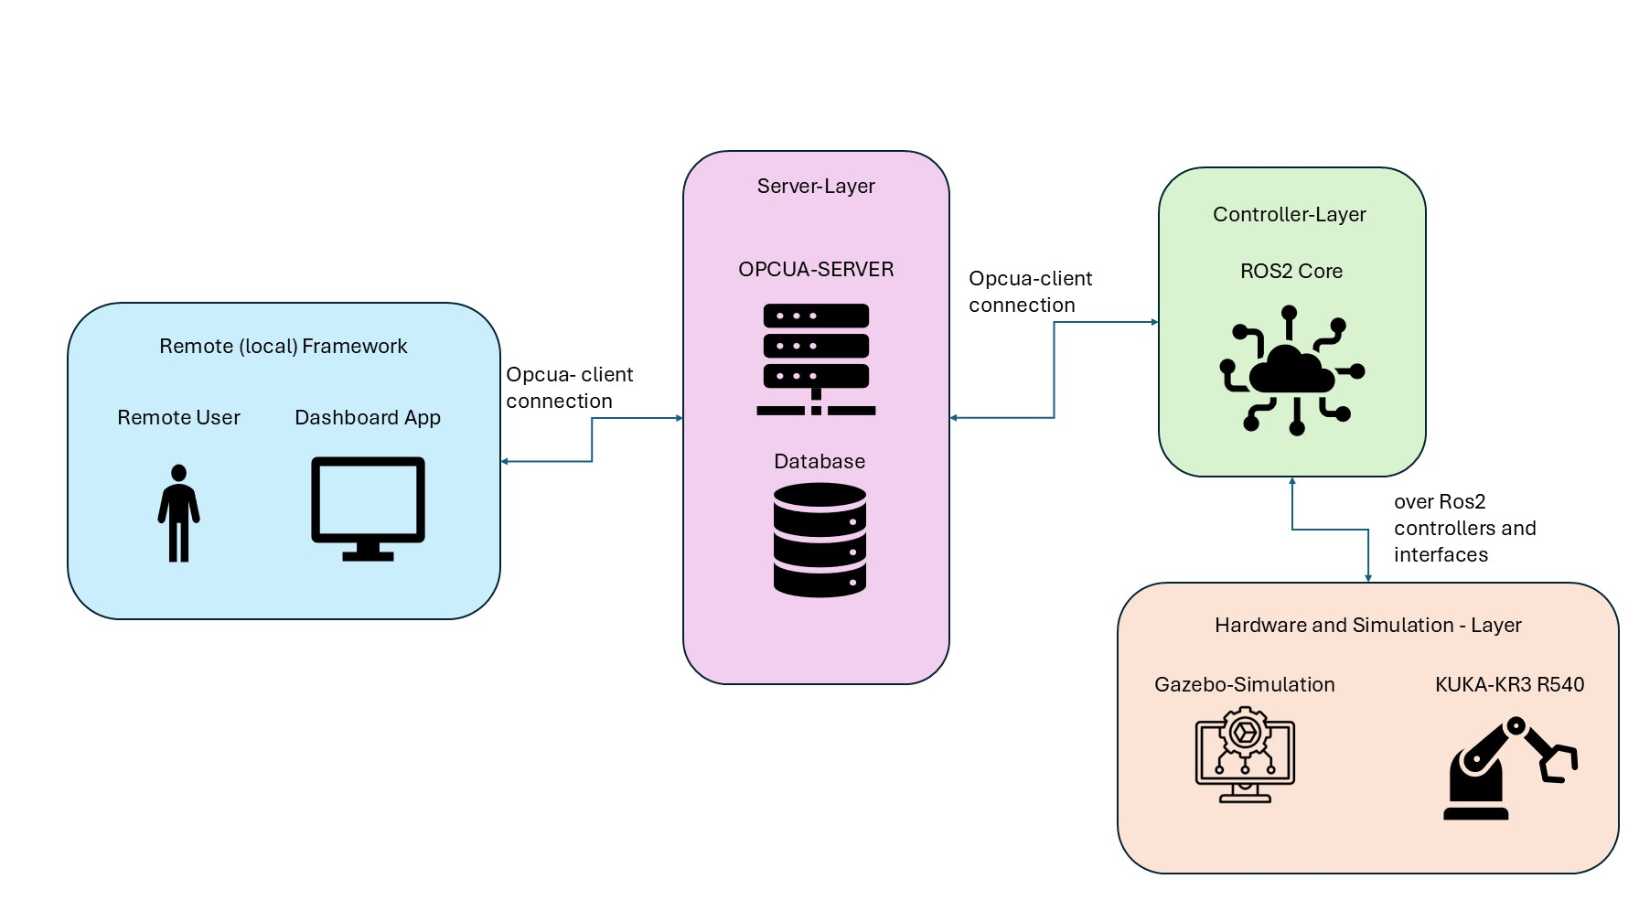
Use case Application
Remote (and local) Monitoring and Control of KUKA robots in the THU robotics lab
Notes:
Usecase overview :
Main components :
Remote frame work : is a dashboard with functionalities to chose the point to move both of the twins (and monitor the simulation)
Server Layer : connect the remote frame work with the controller layer of the system and authenticate the user (and store the user data and system data )
Controller layer : cotnroll the hardware layer accordingly to the user interactions and sends back states from the hardware to the user layer
Hardware and Simulation layer : contains the connectios to the hardware and the simulation and their own system

Slide 8
Vielen Dank für Ihre Aufmerksamkeit.
www.thu.de

