Slide 1
Entwicklung einer Digital Twin-Applikation für einen Industrieroboter mit ROS und OPC-UA
Ahmed Ibrahim Almohamed
ibraah0@thu.de

Slide 2
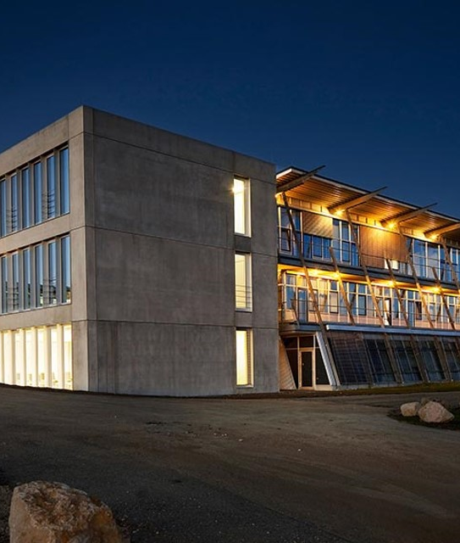
Agenda
Introduction
Use case Application
State of the art
Roadmap

Slide 3

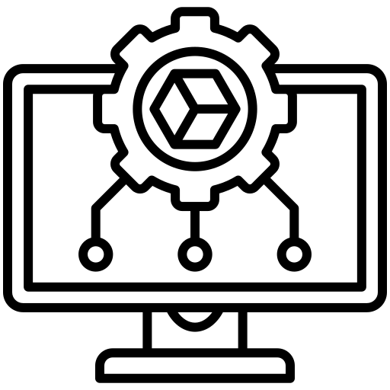
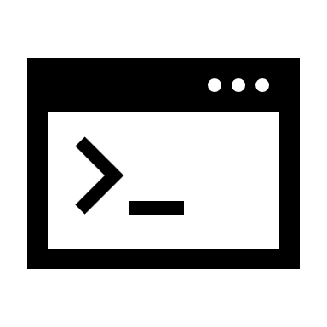

Introduction
Problem
Manual coding to the robot
No simulation environment
Limited Software Skills
Shrink the focus on the robotics concept
Notes:
Many students have limited software development skills, making it difficult to navigate the complexities of coding and robot interaction.
Students manually write code on their PCs and transfer it to the robot using a USB drive, which is time-consuming.
The manual process increases the likelihood of errors and requires significant technical effort, distracting students from focusing on core robotics concepts.
There is currently no simulation environment where students can test their code before deploying it on the real robot, limiting opportunities for trial and error

Slide 4


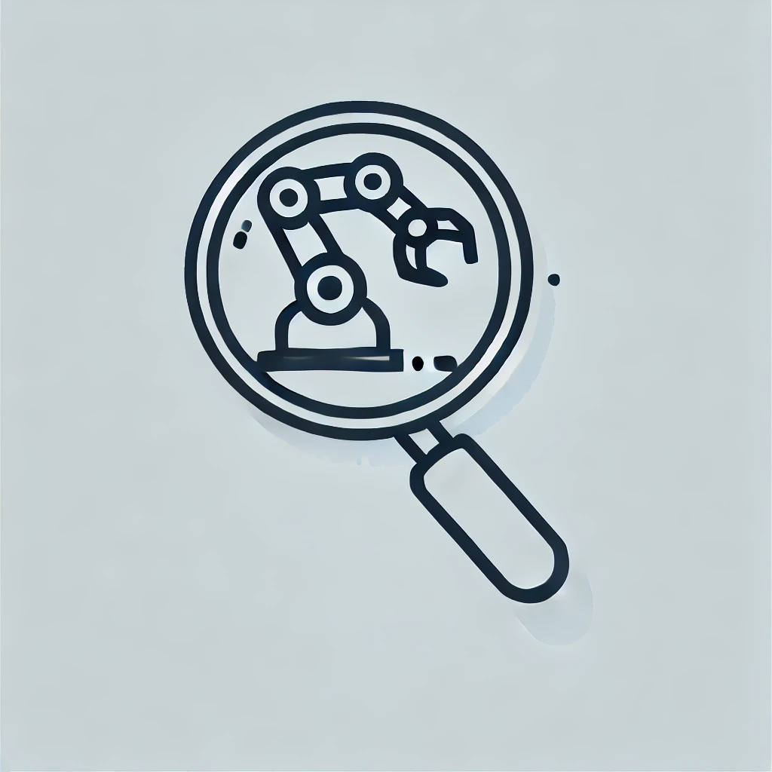
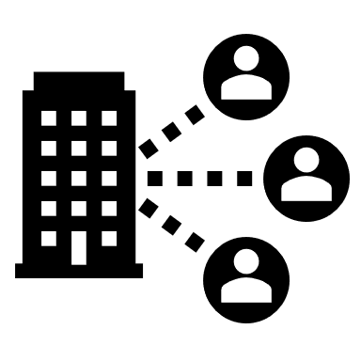
Introduction
Goals
Simulation and real time integration
Automation
Focus on Robotics concepts
Remote access
Notes:
Automation: Automate the process of transferring code to the robot and controlling it to reduce technical overhead.
Focus on Robotics Concepts: Enable students to concentrate on understanding robotics concepts rather than dealing with complex software development tasks.
Simulation and Real-time Integration: Provide a simulation environment where students can test their code before using the physical robot, or even run simulations and real robots in parallel, enhancing the learning experience.

Slide 5
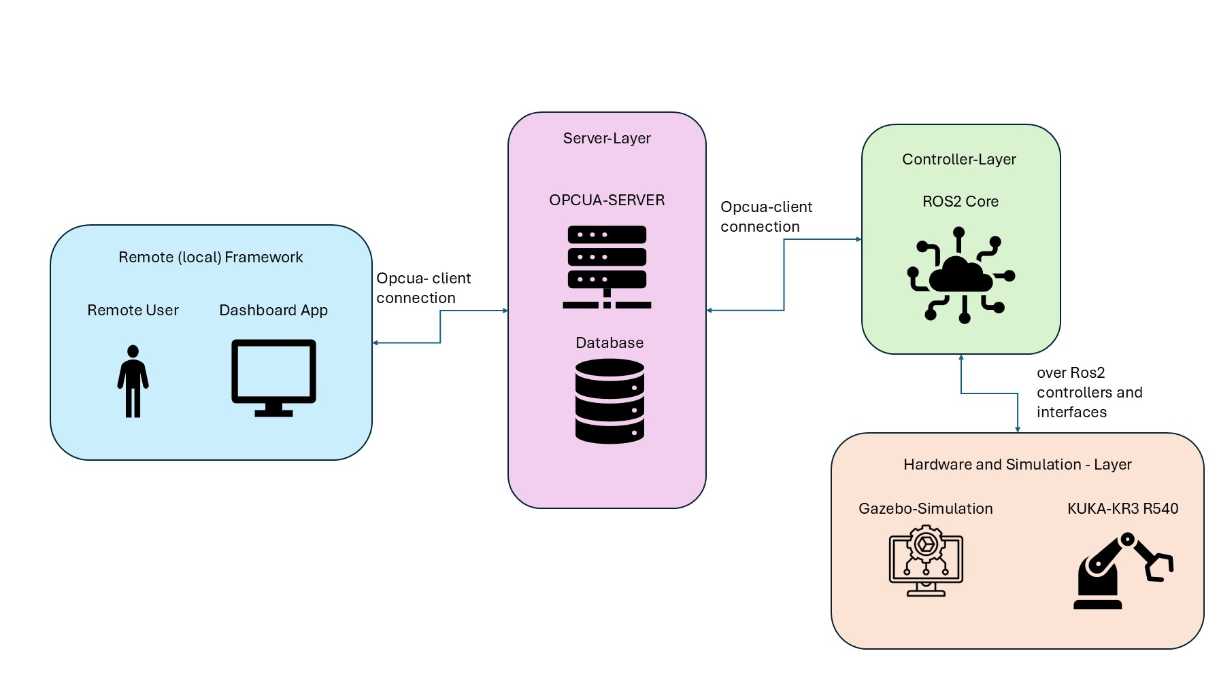
Use case Application
Remote (and local) Monitoring and Control of KUKA robots in the THU robotics lab
Notes:
Usecases overview :
Main components :
Remote frame work : is a dashboard with functionalities to chose the point to move both of the twins (and monitor the simulation)
Server Layer : connect the remote frame work with the controller layer of the system and authenticate the user (and store the user data and system data )
Controller layer : control the hardware layer accordingly to the user interactions and sends back states from the hardware to the user layer
Hardware and Simulation layer : contains the connections to the hardware and the simulation and their own system

Slide 6
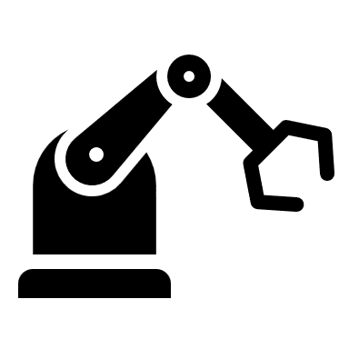

State of Art
Current system overview
ROS2-KR3 Core
Gazebo-Simulation
Digital-Twin
User
KR3-Description
Kr3_scripts
KR3 Simulation world
KR3-Moveit2

Slide 7
State of Art
Current packages
We shall use
Urdf and xacro files
Kr3r540_description
Only moveit files
Kr3r540_moveit
Kr3r540_scripts

Slide 8
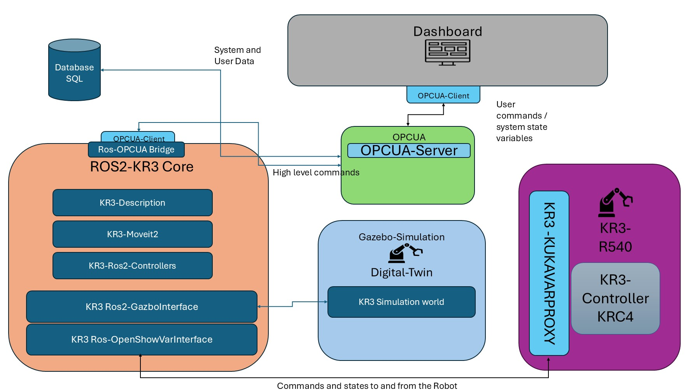
Use case Application
New system overview
Notes:
System overview :

Slide 9
State of Art
New system packages
Old Urdf and xacro files
Kr3r540_discription
For Robot model and Gazebo files
Old moveit files
Kr3r540_bringup
For robot controller and hardware plugins
Kr3r540_Moveit
For motion planning
Kr3r540_hardware_interface
For Hardware interface library
Kr3r540_Gazebo_Interface
For Gazebo interface library
Kr3r540_Opcua_Brigde
For OPCUA connection

Slide 10
Roadmap
Environment Setup
Ros2 package tree and implementation
Ros2 OPCUA Bridge
OPCUA Server and Database
KukaVarProxy Experimental Hardware communication
Dashboard
New system Roadmap
Notes:
System overview :

Slide 11
Roadmap
Ubuntu Dual Boot
Created a Shell script to Automate the ROS2 build
Enabled HMI mirroring with the lab’s PC (both OS)
Enabled a shared driver between the Robot and the lab’s PC
Installed the KukaVarProxyServer on the robot
Environment Setup
Ros2 package tree and implementation
Ros2 OPCUA Bridge
OPCUA Server and Database
KukaVarProxy Experimental Hardware communication
Dashboard
Notes:
System overview :

Slide 12
Roadmap
Environment Setup
Ros2 package tree and implementation
Ros2 OPCUA Bridge
OPCUA Server and Database
KukaVarProxy Experimental Hardware communication
Dashboard
Added a KRL script to move the robot with help of a custom global variable.
Created a KukaClient library in C++ to act as a client of the KukaVarProxy
Tested the KukaClient library
Notes:
System overview :

Slide 13
Roadmap
Environment Setup
Ros2 package tree and implementation
Ros2 OPCUA Bridge
OPCUA Server and Database
KukaVarProxy Experimental Hardware communication
Dashboard
Create a ros2 project with the new system packages
Implement the new system packages
Notes:
System overview :

Slide 14
Roadmap
Environment Setup
Ros2 package tree and implementation
Ros2 OPCUA Bridge
OPCUA Server and Database
KukaVarProxy Experimental Hardware communication
Dashboard
Design , implement and test a bridge between ROS2 and OPCUA Client
Connect an OPCUA Client to the bridge
Notes:
System overview :

Slide 15
Roadmap
Environment Setup
Ros2 package tree and implementation
Ros2 OPCUA Bridge
OPCUA Server and Database
KukaVarProxy Experimental Hardware communication
Dashboard
Create an OPCUA server
Create a SQL Database
Notes:
System overview :

Slide 16
Roadmap
Environment Setup
Ros2 package tree and implementation
Ros2 OPCUA Bridge
OPCUA Server and Database
KukaVarProxy Experimental Hardware communication
Dashboard
Design a Dashboard application
Implement the Dashboard application
Embed an OPCUA Client on the application
Test the application
Notes:
System overview :

Slide 17
DEMO

Slide 18
Vielen Dank für Ihre Aufmerksamkeit.
www.thu.de

Slide 19
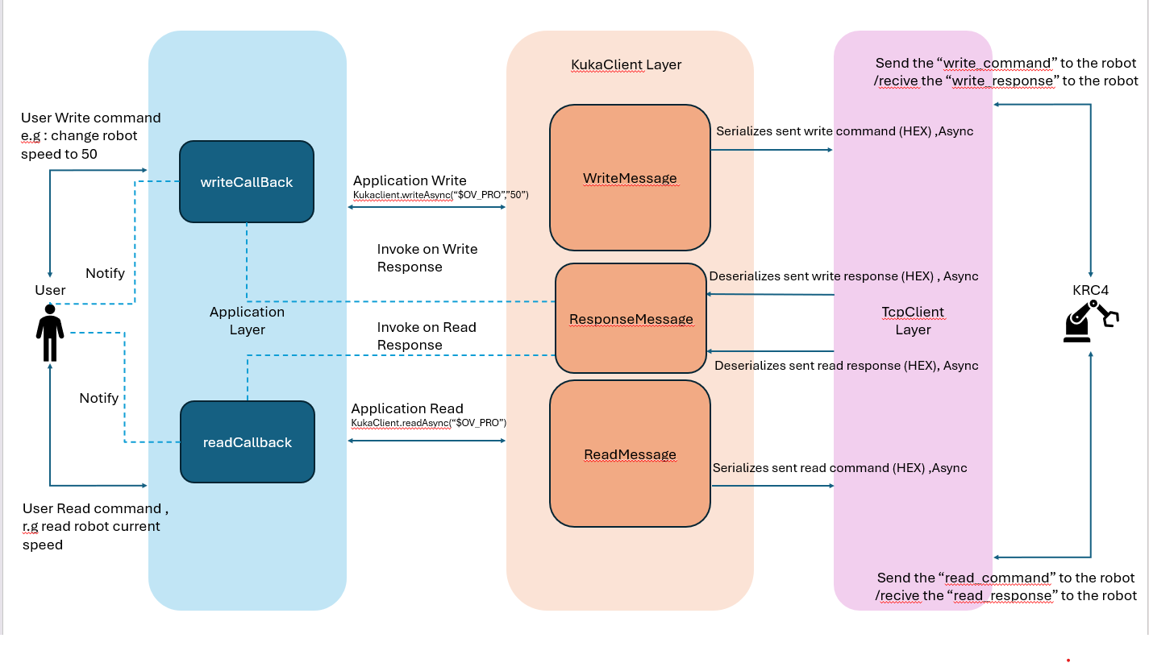
KukaVarProxy Clinet
Overview

Slide 20
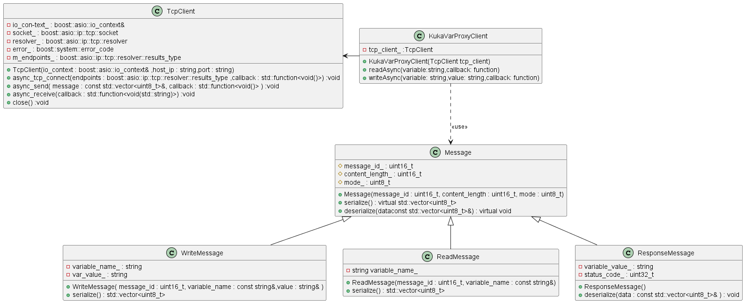
KukaVarProxy Clinet
Classes

