Slide 1
Climate Resilience & Agricultural Recovery in Syria
Proposal by:
Ahmed Ibrahim Almohamed
Email:
Ahmaedibrahim311@gmail.com
A Multi-Regional Collaborative Research Initiative

Slide 2





Problem Overview
Climate change and recurring droughts
Shortage of farmers due to conflict
Lack of updated data and research losses after the war
Destroyed and outdated irrigation systems across the country
Impact of low rainfall on rainfed crops

Slide 3
Solution Framework
Pillar 1
Pillar 2
Pillar 3
Research and Innovation
Field implementation
Collaboration & Scaling
Create research hubs to collect and analyze data from different sources (e.g Remote sensing , field surveys, smart sensing)
On-the-ground pilots of climate smart farming solutions (e.g drought-tolerant seeds , smart drip irrigation systems ,soil conservation)
Formal partnerships with Syrian universities, ministries and NGOs to co-design activities, share data, and scale successful practices

Slide 4

Framework in Action
Inputs
Framework
Outputs
Adoption of resilient farming practices
Fundings
Increased crop yields
Activities
Technical expertise
Strengthened farmer networks and local research capacity
Field surveys
Satellite analysis
Data modeling
Resources
Pilot trials of climate-smart farming
Improved water-use efficiency
Farmer training
Community workshops
.
.
.
National-wide database for farming and climate data
Repair of irrigation systems

Slide 5





Expected results
Improved Crop Yields
Trained Local Experts
Reliable Data Systems
Better Water Use
Informed Policy & Planning
Farmers achieve higher and more stable productivity, especially in drought-prone areas
Farmers, engineers, and students gain hands-on experience with climate-smart tools
A national database links climate conditions with crop outcomes for future planning
Smart irrigation and moisture monitoring reduce water waste and increase efficiency
Results feed into long-term strategies for resilience and recovery in agriculture

Slide 6
Damage and Losses
FAO 2017

Slide 7
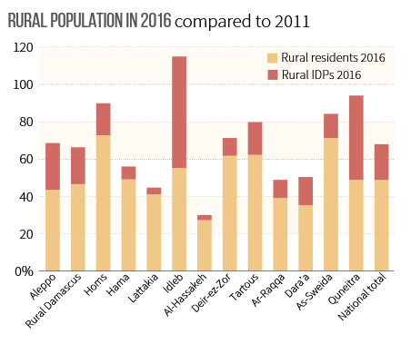
Framer shortage
FAO 2017

Slide 8
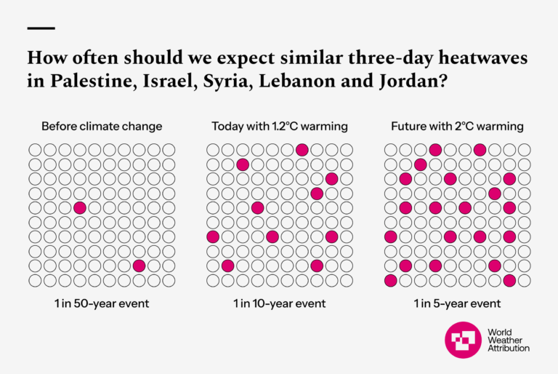
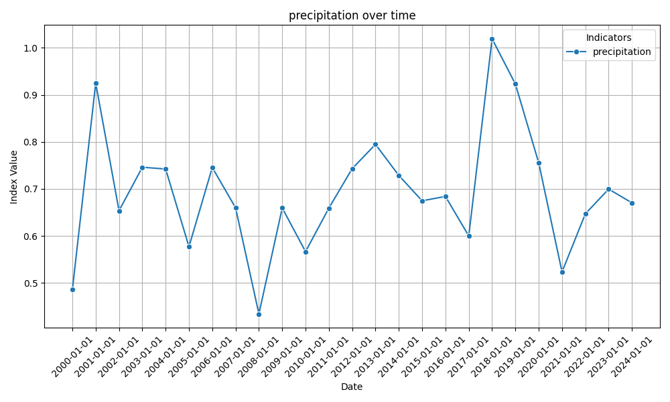
Drought and climate change

Slide 9
Inputs
Framework
Outputs
Adoption of resilient farming practices
Fundings
Increased crop yields
Activities
Technical expertise
Strengthened farmer networks and local research capacity
Field surveys
Satellite analysis
Data modeling
Resources
Pilot trials of climate-smart farming
Improved water-use efficiency
Farmer training
Community workshops
.
.
.
National-wide database for farming and climate data
Repair of irrigation systems

