Slide 1
Data Visualization Project
Subject: 47451 Data Visualization
Name: Anisjon Berdiev
Student ID: 09893014
Date: 1/7/2024

Slide 2
Data Visualization Problem 1:
What is the problem you want to solve in data analysis?
Visualize CO2 emissions data to find core issues and contributors.
What is the dataset for data analysis?
Our World in Data Carbon Emissions
What is the download link URL? (Please clearly marked the download URL link of your dataset)
https://github.com/owid/co2-data/blob/master/owid-co2-data.csv

Slide 3
Data Visualization Problem 1:
Which tool do you use to visualize the results of your data analysis?
Plotly and Pandas (in requirements.txt)
Plotly is an interactive lib so please run it on vscode, images are just screenshots.
Streamlit for deployment
What is the file name?
09893014_DataVisualization_Project.py

Slide 4
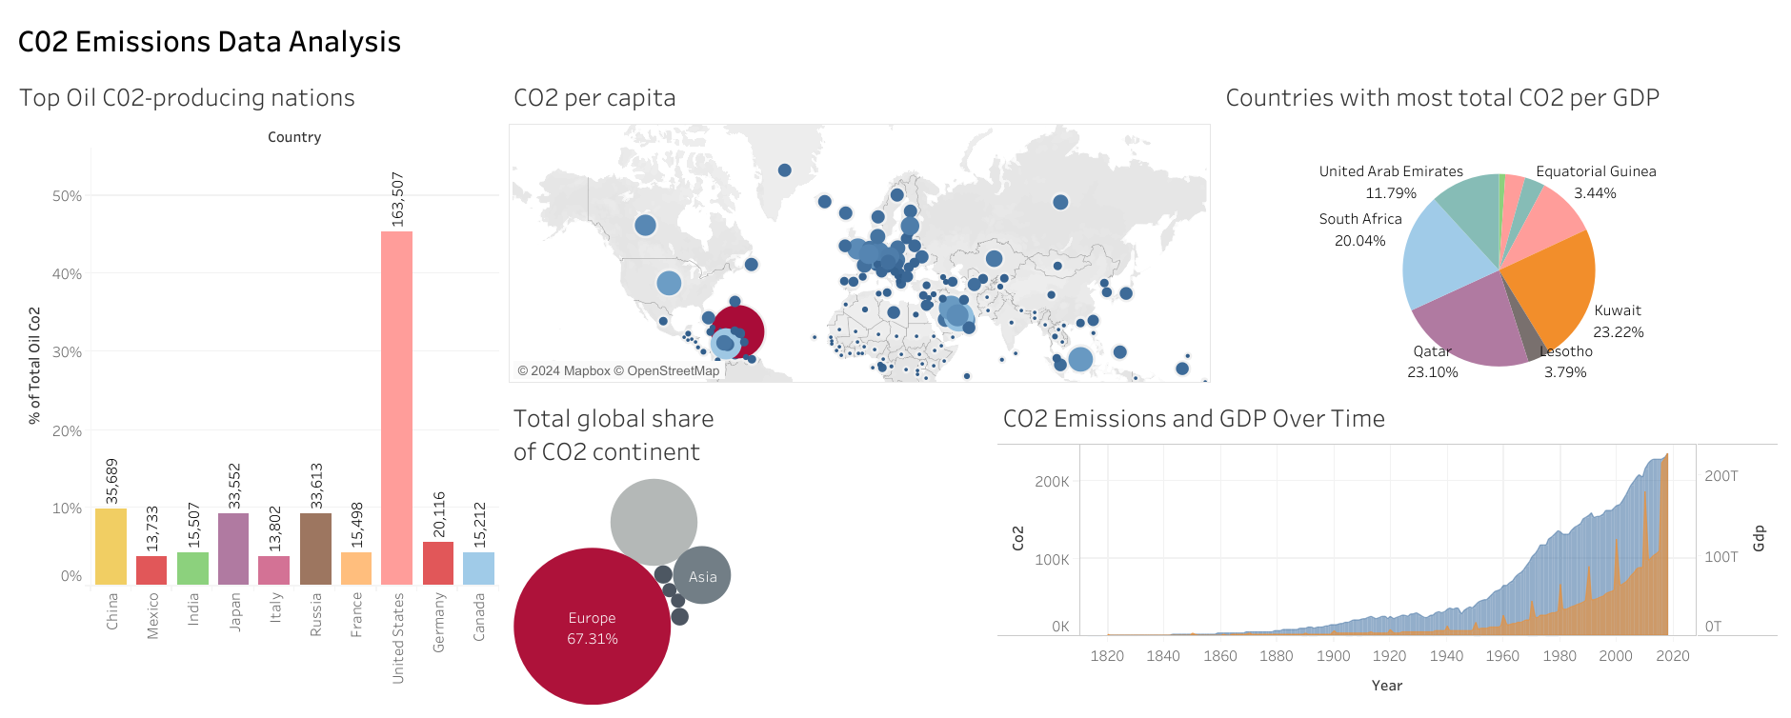
Tablue: Visual analysis result

Slide 5
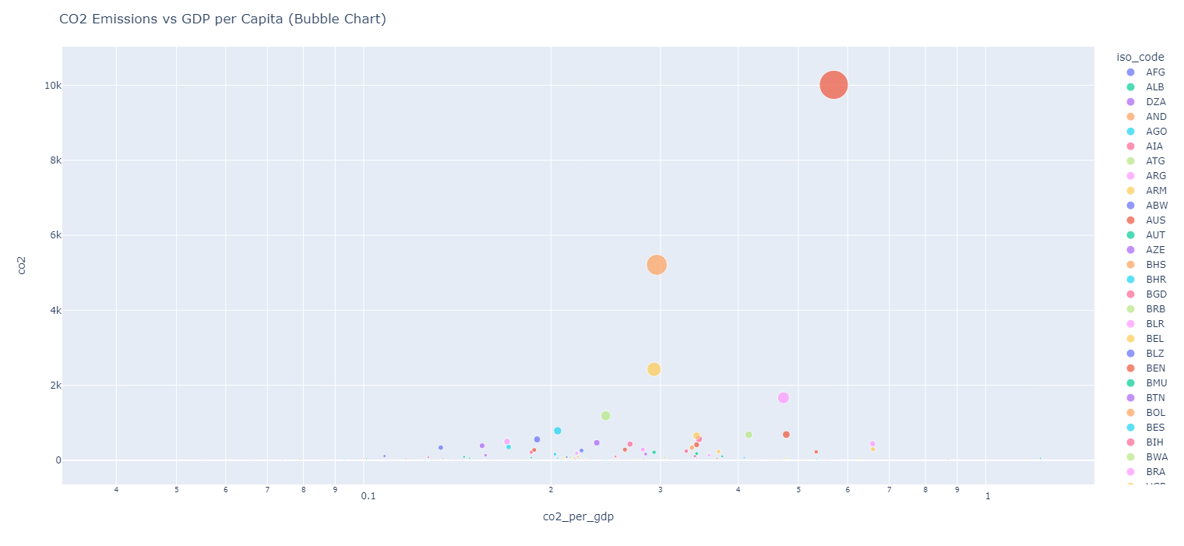
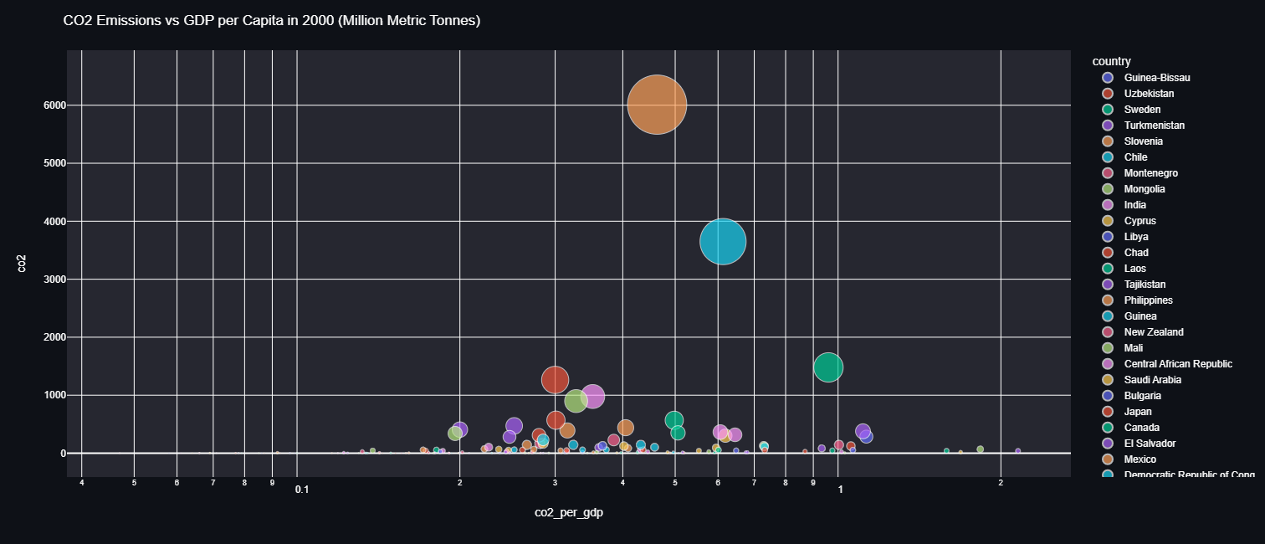
The visual analysis result of problem 1

Slide 6
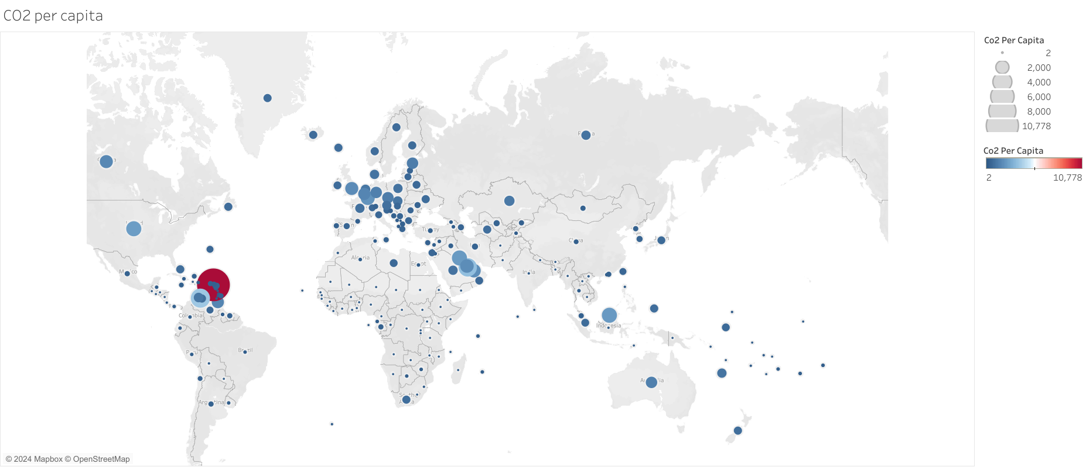
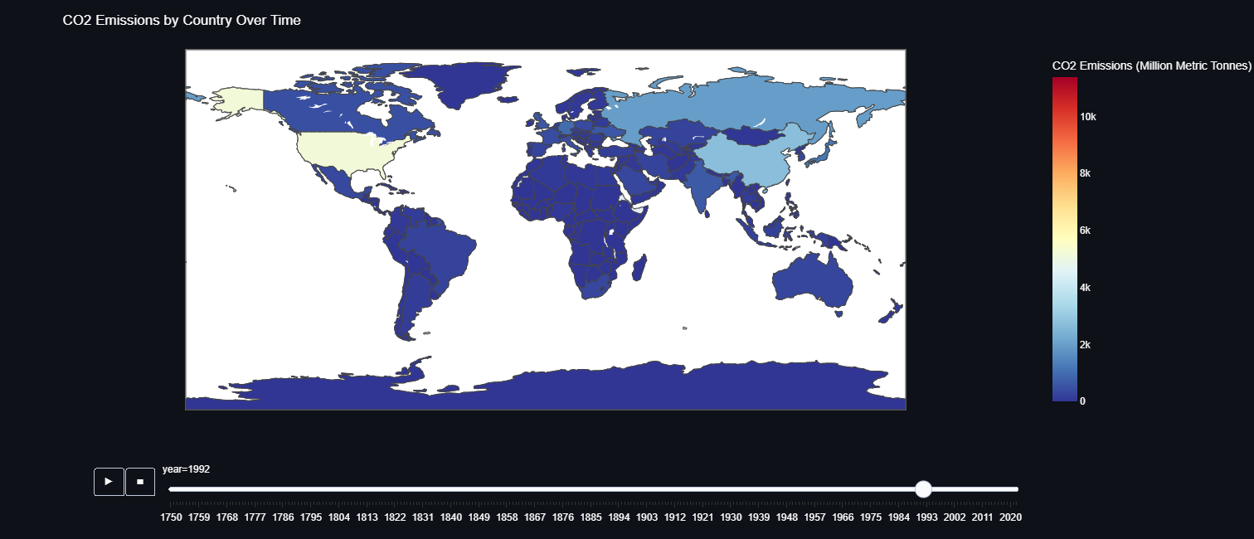
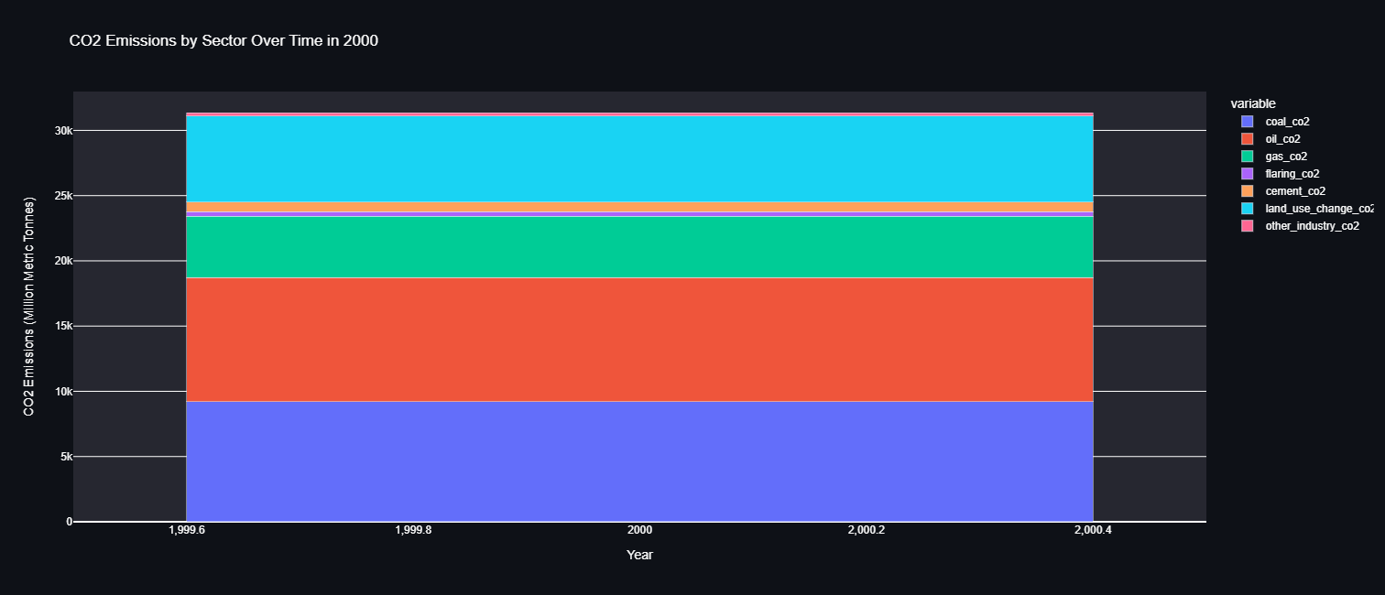

Slide 7
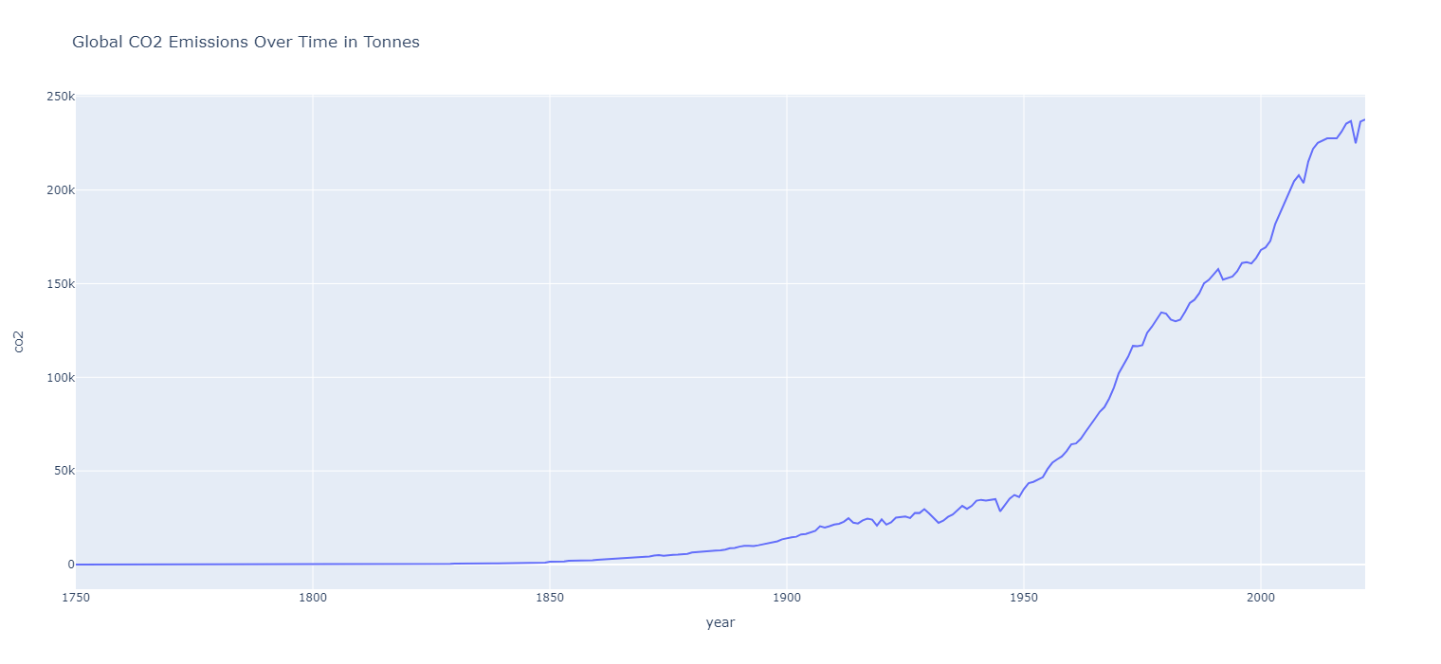
The visual analysis result of problem 1

Slide 8
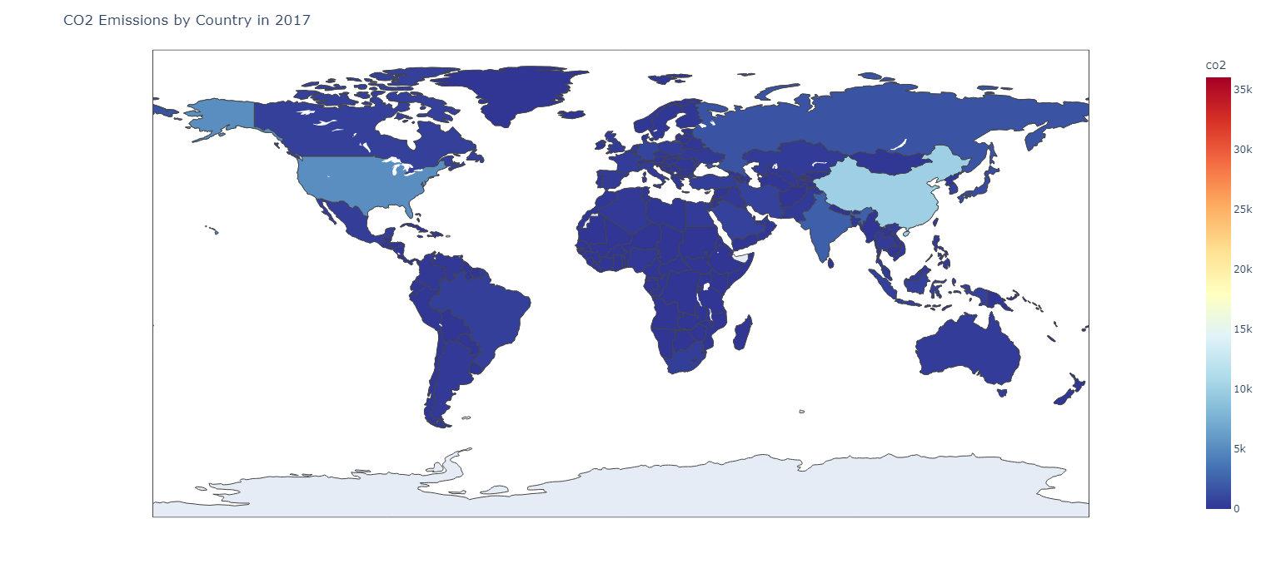
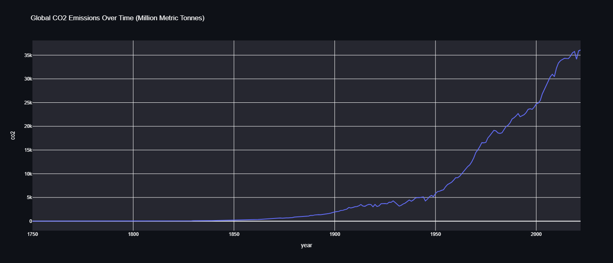
The visual analysis result of problem 1

Slide 9
The visual analysis result of problem 1
What is the conclusion of data analysis insights obtained through visual charts?
Countries with the largest economies account for the most CO2 emissions
Largest industrial sectors emitting carbon are Coal, Oil, and Others
Carbon emissions and global temperature correlate

