Slide 1
Distributed Computing
Mahesh C

Slide 2
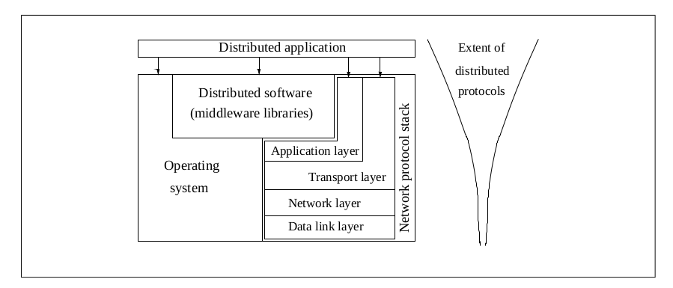
Relation to Computer System Components

Slide 3
Motivation
Inherently distributed computations ( bank)
Resource sharing
Access to geographically remote data and resources.
Enhanced reliability
Increased Performance/Cost ratio
Scalability
Modularity and incremental expandability

Slide 4
Design Issues and Challenges - System Perspective
Communication
Processes
Naming.
Synchronization.
Applications Programming Interface (API) and transparency
Data storage and access
Consistency and replication
Fault tolerance
Security

Slide 5
Design Issues and Challenges - Algorithmic Perspective
Designing useful execution models and frameworks
Dynamic distributed graph algorithms and distributed routing algorithms
Time and global state in a distributed system.
Synchronization.
Synchronization/ coordination mechanisms.
Reliable and fault-tolerant distributed systems
Real-time scheduling.
Performance
Group communication, multicast, and ordered message delivery.
Monitoring distributed events and predicates.
Distributed program design and verification tools.
Data replication, consistency models, and caching.
World Wide Web design – caching, searching, scheduling.
Distributed shared memory abstraction.
Load balancing.

Slide 6
Applications of Distributed Computing
Mobile systems
Ubiquitous or pervasive computing
Publish-subscribe, content distribution, and multimedia.
Security in distributed systems.
Sensor networks
Peer-to-peer computing
Distributed agents
Distributed data mining
Grid computing

