Slide 1
Distributed Computing
Mahesh C

Slide 2
A Model of Distributed Executions
The execution of a process consists of a sequential execution of its actions.
The actions are atomic and the actions of a process are modeled as three types of events, namely, internal events, messagesend events, and message receive events.

Slide 3
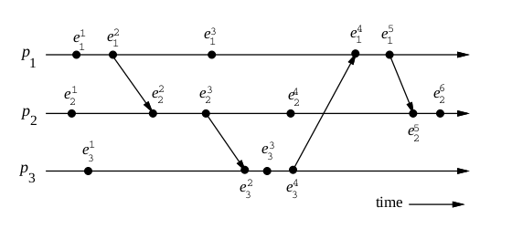
A Model of Distributed Executions

Slide 4
Casual Precedance
In an asynchronous distributed system , there is no global clock.
There is no real ordering of events.
There is casula event ordering if one event affect the outcome of another event.
Example : send(m) and recv(m) are in casual order

Slide 5
Casual Precedance
In an asynchronous distributed system , there is no global clock.
There is no real ordering of events.
There is casula event ordering if one event affect the outcome of another event.
Example : send(m) and recv(m) are in casual order

Slide 6
Logical vs. Physical Concurrency
In a distributed computation, two events are logically concurrent if and only if they do not causally affect each other.
Physical concurrency, on the other hand, has a connotation that the events occur at the same instant in physical time.
Two or more events may be logically concurrent even though they do not occur at the same instant in physical time.

Slide 7
Logical vs. Physical Concurrency
However, if processor speed and message delays would have been different, the execution of these events could have very well coincided in physical time.
Whether a set of logically concurrent events coincide in the physical time or not, does not change the outcome of the computation.
Therefore, even though a set of logically concurrent events may not haveoccurred at the same instant in physical time, we can assume that these events occured at the same instant in physical time.

Slide 8
Models of Communication Networks
There are several models of the service provided by communication networks, namely, FIFO, Non-FIFO, and causal ordering.
In the FIFO model, each channel acts as a first-in first-out message queue and thus, message ordering is preserved by a channel.
In the non-FIFO model, a channel acts like a set in which the sender process adds messages and the receiver process removes messages from it in a random order

