Slide 1
Distributed Computing
Mahesh C

Slide 2
Design Issues and Challenges - Algorithmic Perspective
Designing useful execution models and frameworks
Dynamic distributed graph algorithms and distributed routing algorithms
Time and global state in a distributed system.
Synchronization.
Synchronization/ coordination mechanisms.
Reliable and fault-tolerant distributed systems
Real-time scheduling.
Performance
Group communication, multicast, and ordered message delivery.
Monitoring distributed events and predicates.
Distributed program design and verification tools.
Data replication, consistency models, and caching.
World Wide Web design – caching, searching, scheduling.
Distributed shared memory abstraction.
Load balancing.

Slide 3
Applications of Distributed Computing
Mobile systems
Ubiquitous or pervasive computing
Publish-subscribe, content distribution, and multimedia.
Security in distributed systems.
Sensor networks
Peer-to-peer computing
Distributed agents
Distributed data mining
Grid computing

Slide 4
A Model of Distributed Computations
The processors do not share a common global memory and communicate solely by passing messages over the communication network.
A distributed system consists of a set of processors that are connected by a communication network. The communication delay is finite but unpredictable.
There is no physical global clock in the system to which processes have instantaneous access.
Thecommunication medium may deliver messages out of order, messages may be lost, garbled, or duplicated due to timeout and retransmission, processors may fail, and communication links may go down.

Slide 5
A Model of Distributed Computations
The system can be modeled as a directed graph in which vertices represent the processes and edges represent unidirectional communication channels.

Slide 6
A Distributed Program
A distributed program is composed of a set of n asynchronous processes p ₁ , p ₂ , ..., p _{i} , ..., p _{n} that
communicate by message passing over the communication network. Without loss of generality, assume that each process is running on a different processor.

Slide 7
A Distributed Program
Let C ij denote the channel from process p _{i} to process p _{j} and let M _{ij} denote a message sent by p _{i} to p _{j} . The communication delay is finite and unpredictable.
Process execution and message transfer are asynchronous – a process may execute an action spontaneously and a process sending a message does not wait for the delivery of the message to be complete.

Slide 8
A Distributed Program
The global state of a distributed computation is composed of the states of the processes and the communication channels.
The state of a process is characterized by the state of its local memory and depends upon the context.
The state of a channel is characterized by the set of messages in transit in the channel.

Slide 9
A Model of Distributed Executions
The execution of a process consists of a sequential execution of its actions.
The actions are atomic and the actions of a process are modeled as three types of events, namely, internal events, messagesend events, and message receive events.

Slide 10
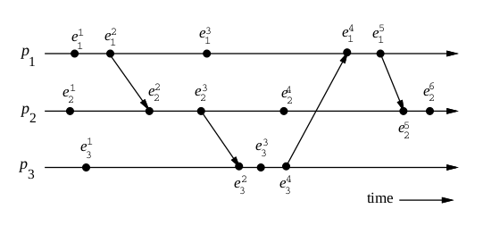
A Model of Distributed Executions

