Slide 1
MCP Services Dashboard
Connecting Claude Code to real services through MCP, saving the data locally, and searching it all in one place
Gabi Slepoy · Lior Bongart
Course project · October 2026

Slide 2
Project overview
Each service is reached through its official MCP server. Claude Code downloads the data, saves it in one shared format, and the dashboard searches it.
Service
(Notion, Jira…)
Claude Code
+ MCP server
dataExports/
local files
Dashboard
webapp/
Notion
Jira
GitHub
Slack
Gmail
Done
Done
Done
Done
Waived
Read only: downloads never change anything in the source service.

Slide 3
Test accounts and data
Throwaway accounts made for this course. All people and projects are invented.
JS
ML
AC
Project Falcon
A fake student project that ties the data together
13 Notion pages
13 Jira issues, FALCON-1 to FALCON-13
Joe Smith
Maria Lopez
Alex Chen
Project manager
Design and usability
Technical lead
Search for “Joe Smith” and results come back from all four services: Notion, Jira, GitHub and Slack.

Slide 4
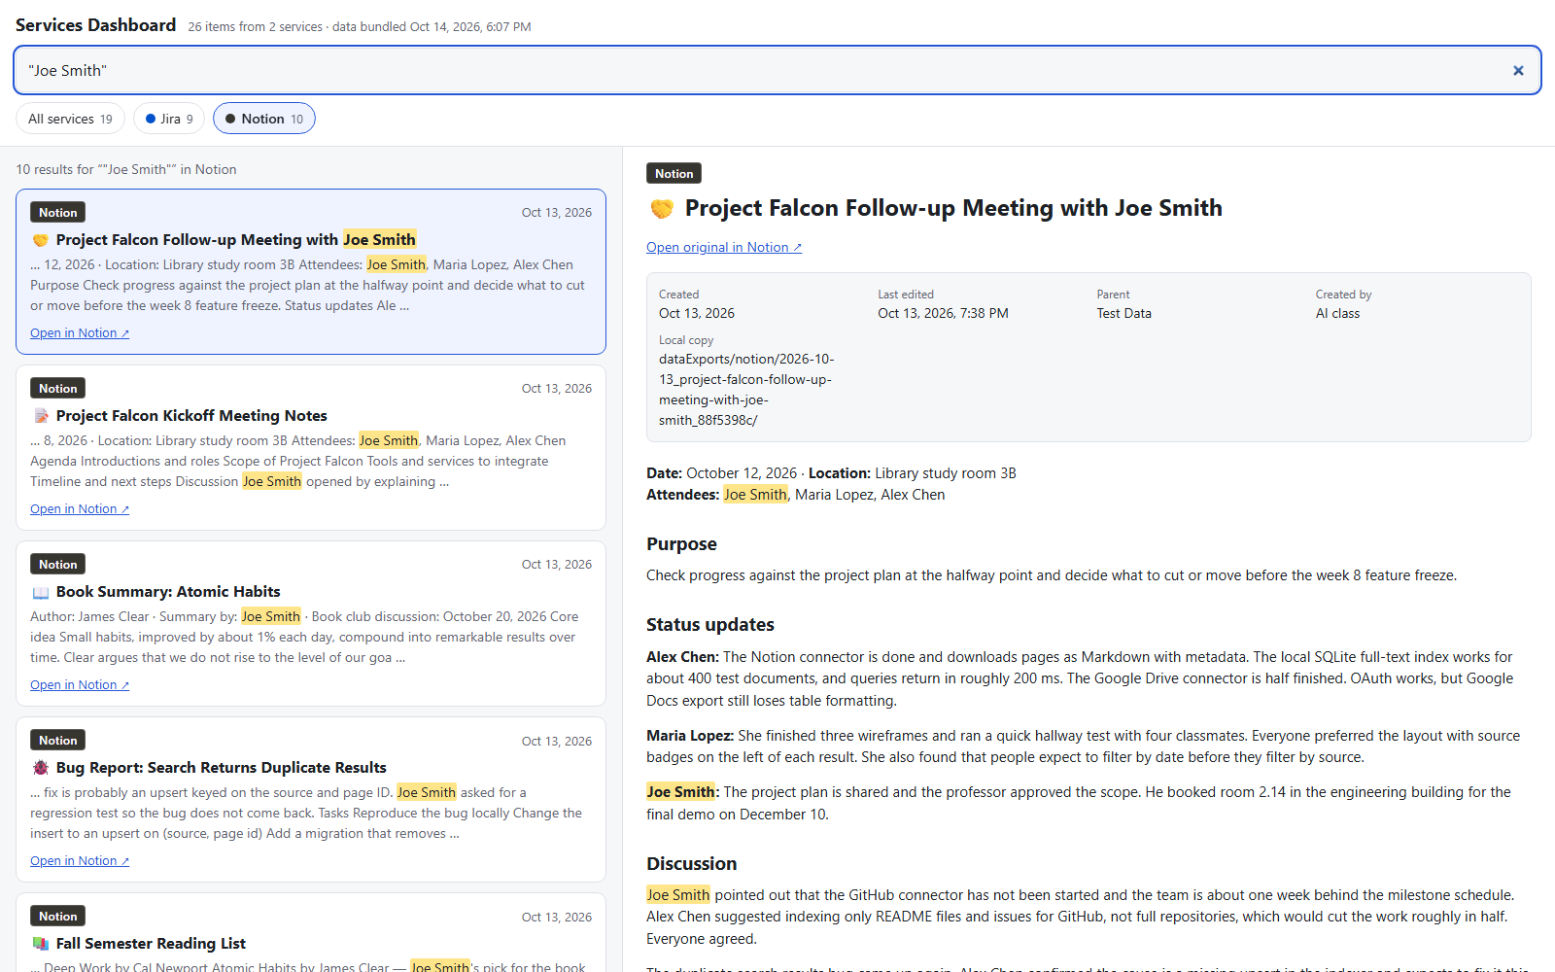
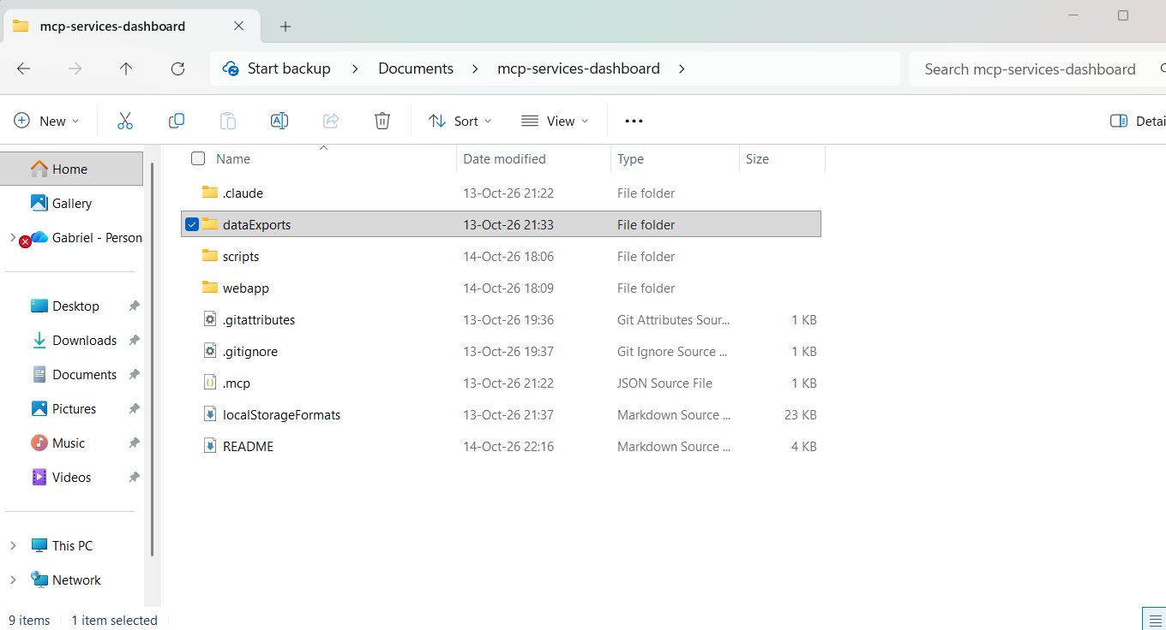
Notion: original page and local copy
→
Original in Notion
Same page opened in the dashboard

Slide 5
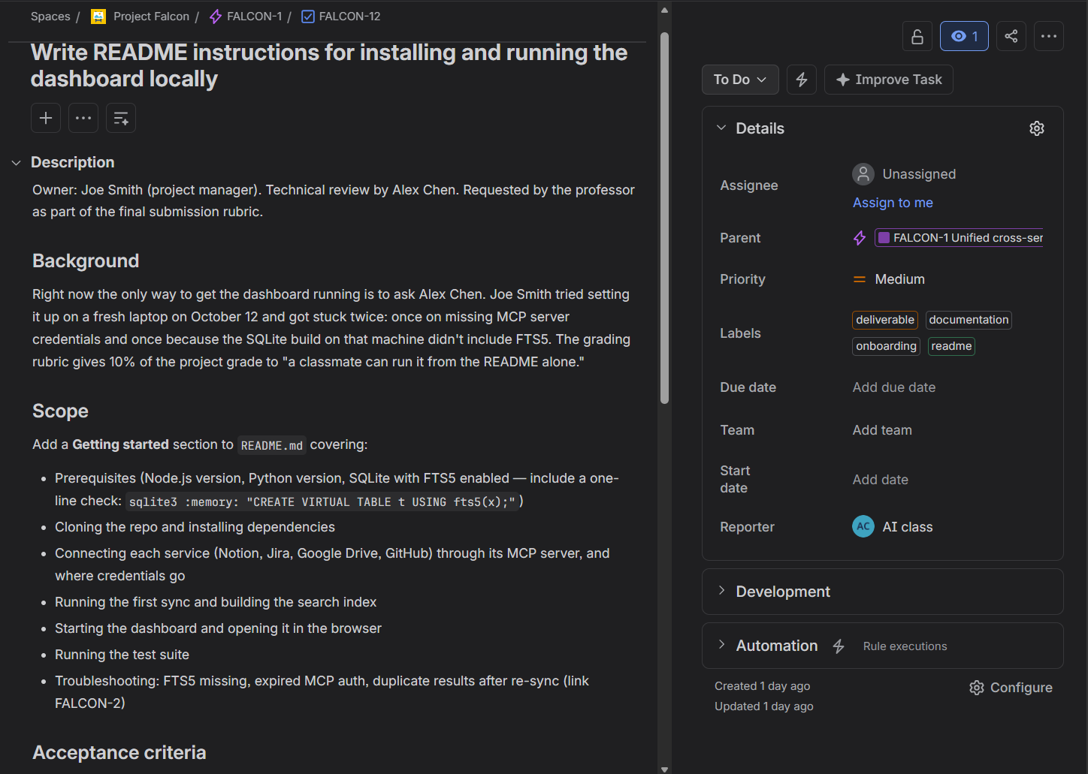
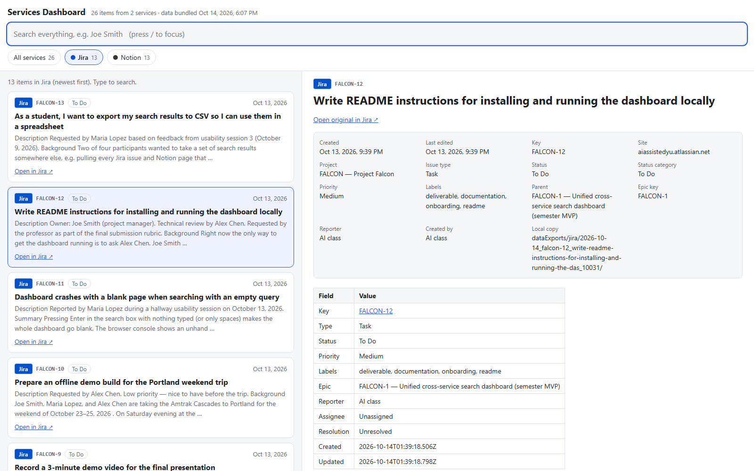
Jira: original issue and local copy
→
FALCON-12 in Jira
FALCON-12 opened in the dashboard

Slide 6
One storage format for every service
dataExports/
notion/
index.json
2026-10-13_project-falcon-…_88f5398c/
content.md
metadata.json
jira/
index.json
2026-10-14_falcon-12_write-readme-…_10031/
content.md
metadata.json
{
"service": "jira",
"id": "10031",
"key": "FALCON-12",
"title": "Write README instructions…",
"created_time": "2026-10-14T01:39:18Z",
"downloaded_at": "2026-10-14T01:41:47Z",
"download_request": { "tool": … }
}
metadata.json (shortened)
One folder per item: content.md + metadata.json
index.json lists every item per service
The item ID is the identity, so re-downloads update instead of duplicating
Folder layout (full spec: localStorageFormats.md)

Slide 7
Skills for repeatable downloads
download-notion
download-jira
Saves Notion pages to dataExports/notion/
Saves Jira issues to dataExports/jira/
Example request:
Example request:
“Download the pages under Test Data”
“Download all FALCON issues”
Tested in a fresh conversation
With no earlier context, each skill downloaded 3 new items in the right format and rebuilt index.json.

Slide 8
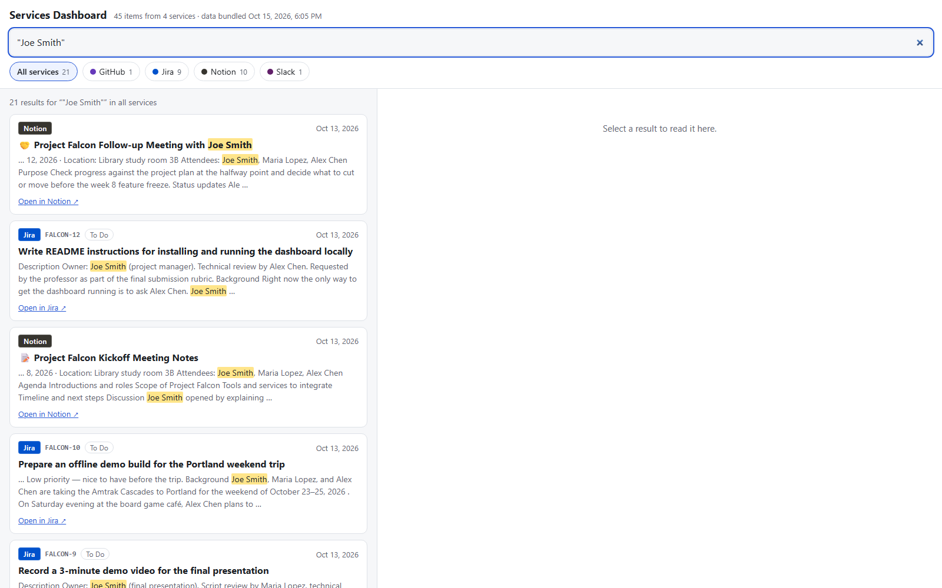
Dashboard: one search across all services
Searches all services at once, or one at a time
Quotes for exact phrases, matches highlighted
Opens the full item with its metadata
Plain HTML, works offline: double-click index.html
Rerun one script after each download
“Joe Smith”: 21 results from all four services

Slide 9
Gmail: tried, then waived
✓
✓
✓
✗
OAuth client
Consent screen
Sign-in
Tool calls
We used Google's official Gmail MCP server.
Every tool call was rejected: the Google Cloud project must be in the Workspace Developer Preview Program.
The instructor waived Gmail, so we removed it from .mcp.json.

Slide 10
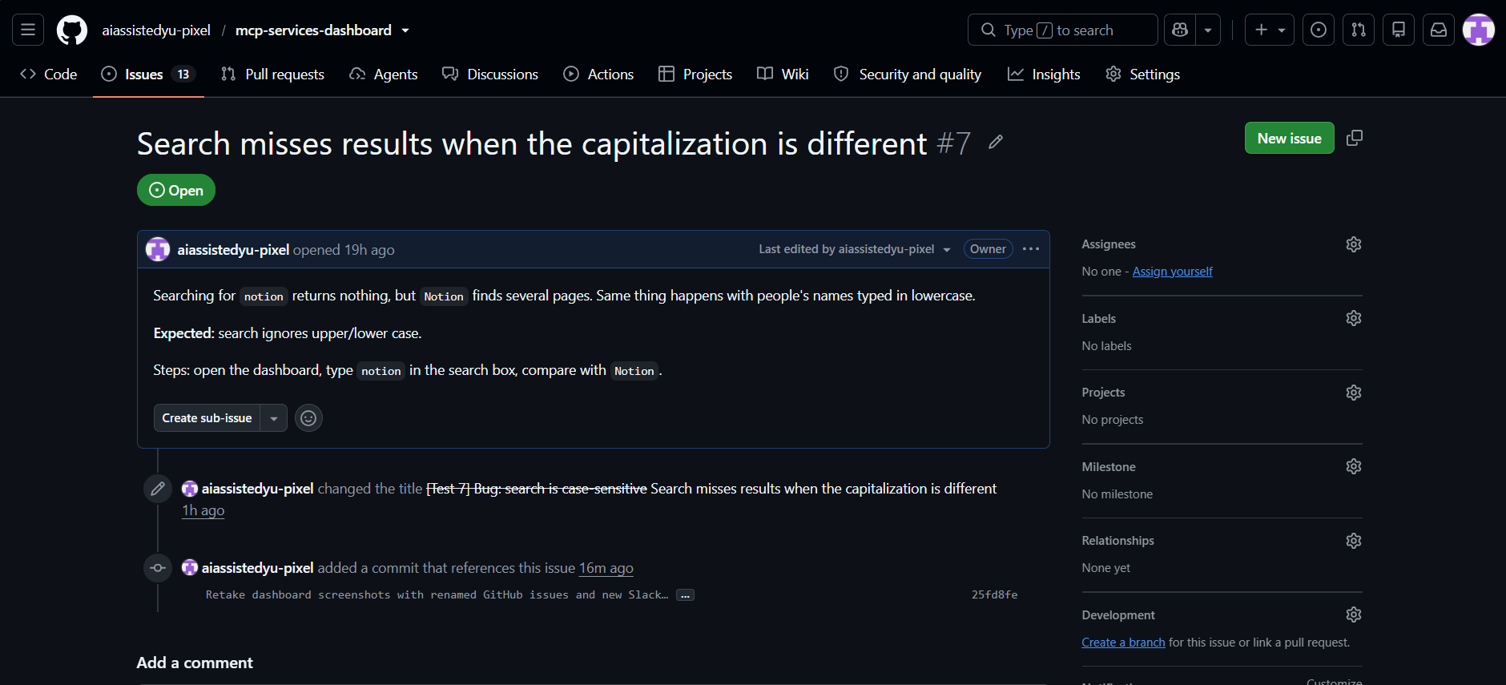
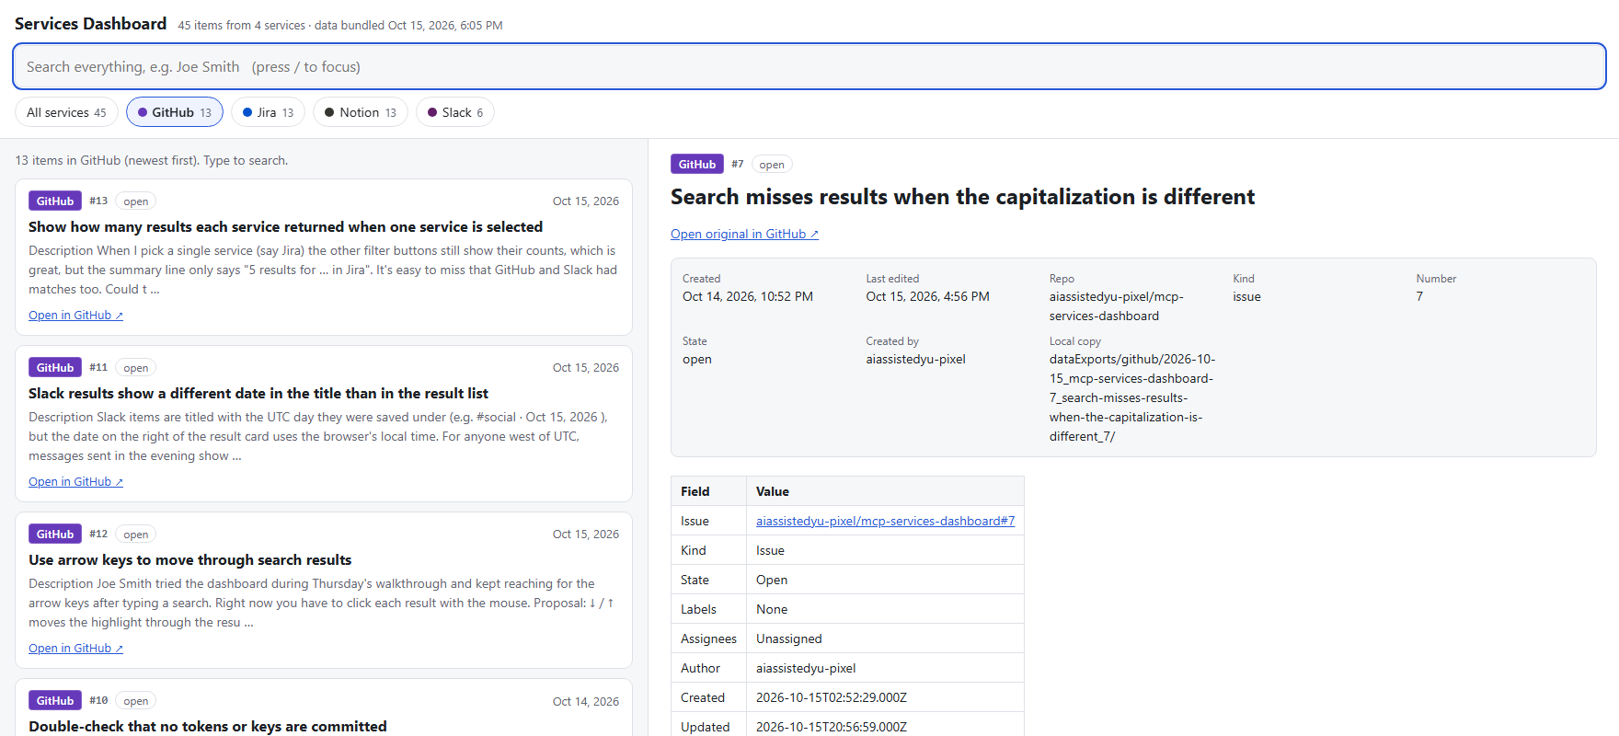
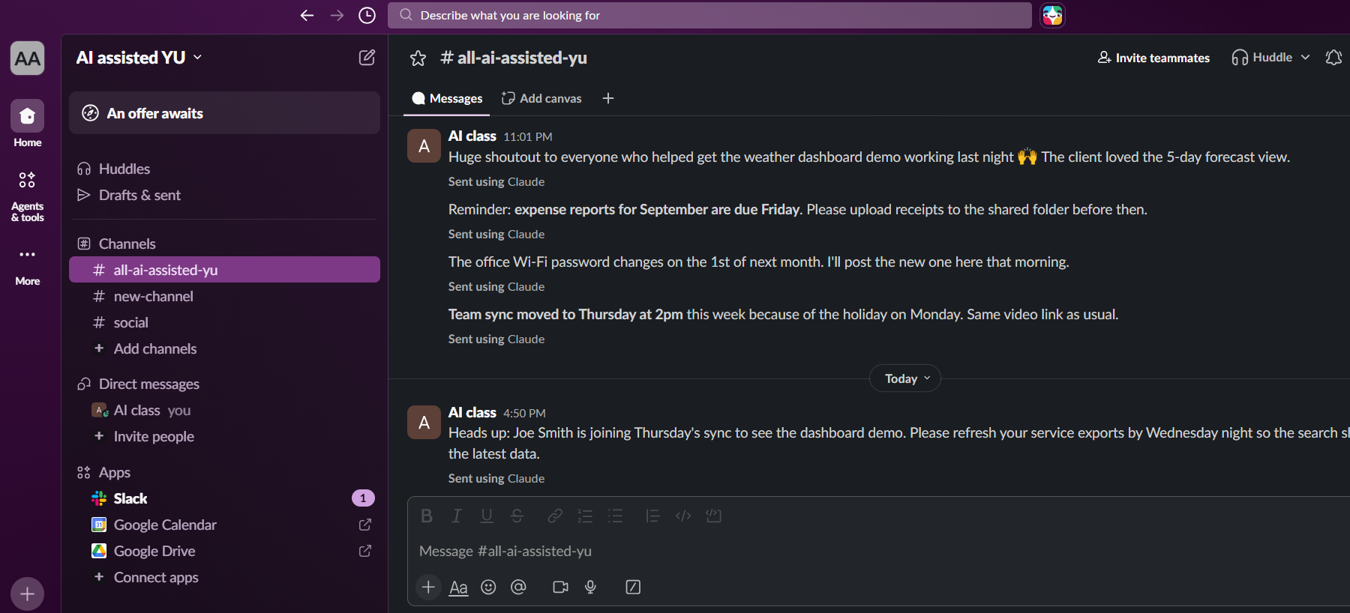
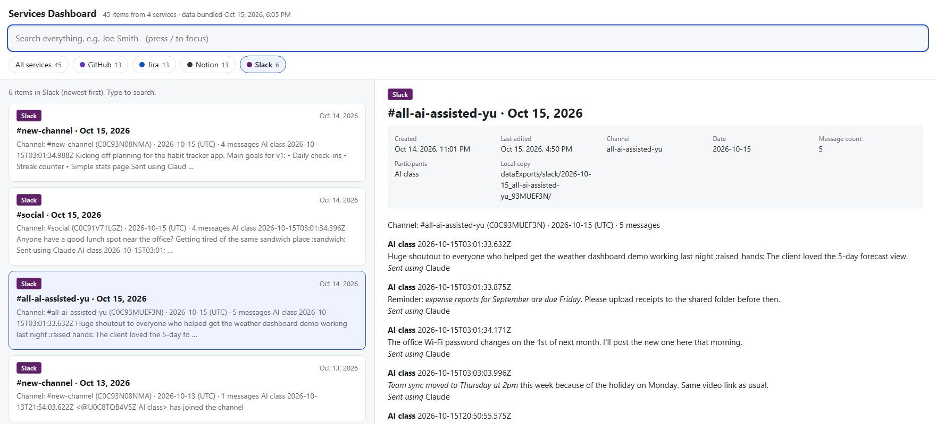
Lior's services
→
Issue #7 in GitHub
Issue #7 opened in the dashboard
→
#all-ai-assisted-yu, Oct 15 in Slack
#all-ai-assisted-yu, Oct 15 opened in the dashboard

Slide 11
Who did what
Gabi Slepoy
Lior Bongart
Notion: connection, export, skill
Jira (extra service): connection, export, skill
Gmail setup attempt
Shared storage format and download skills
Dashboard and its data build script
GitHub: MCP connection, issue export, download-github skill
Slack (extra service): MCP connection, channel export, download-slack skill
Slack added to .mcp.json
Dashboard: GitHub and Slack integration

