Slide 1
Smart Parking
Alexander Baev

Slide 2
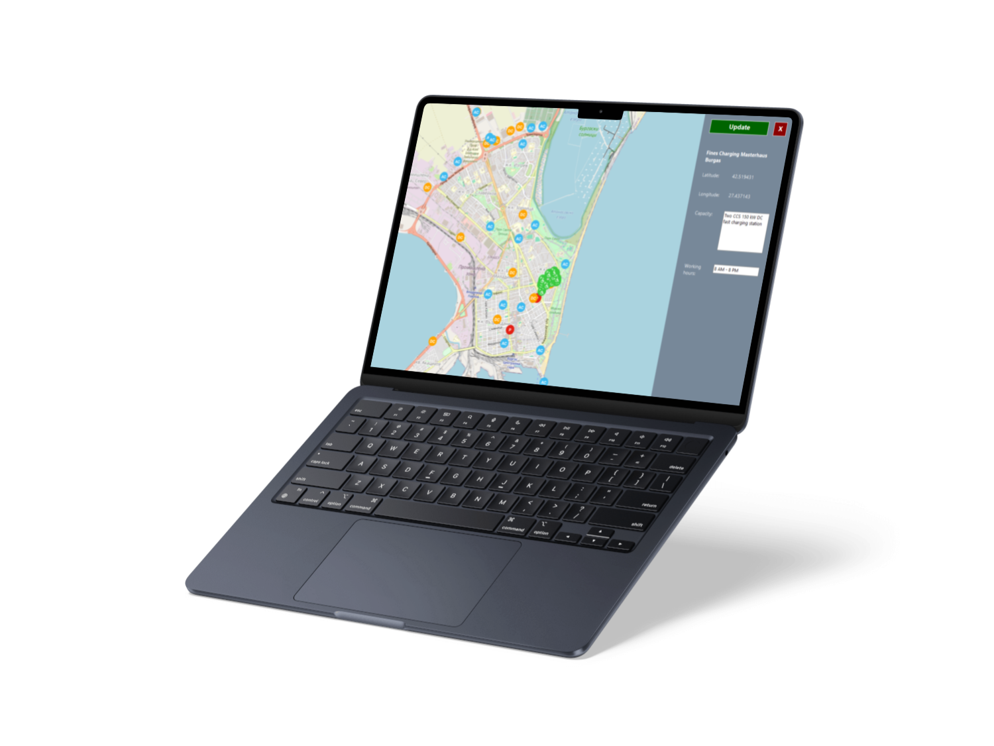
Idea

Slide 3






Used technologies

Slide 4

Demonstration

Slide 5
Thank you for
the attention

