Slide 1
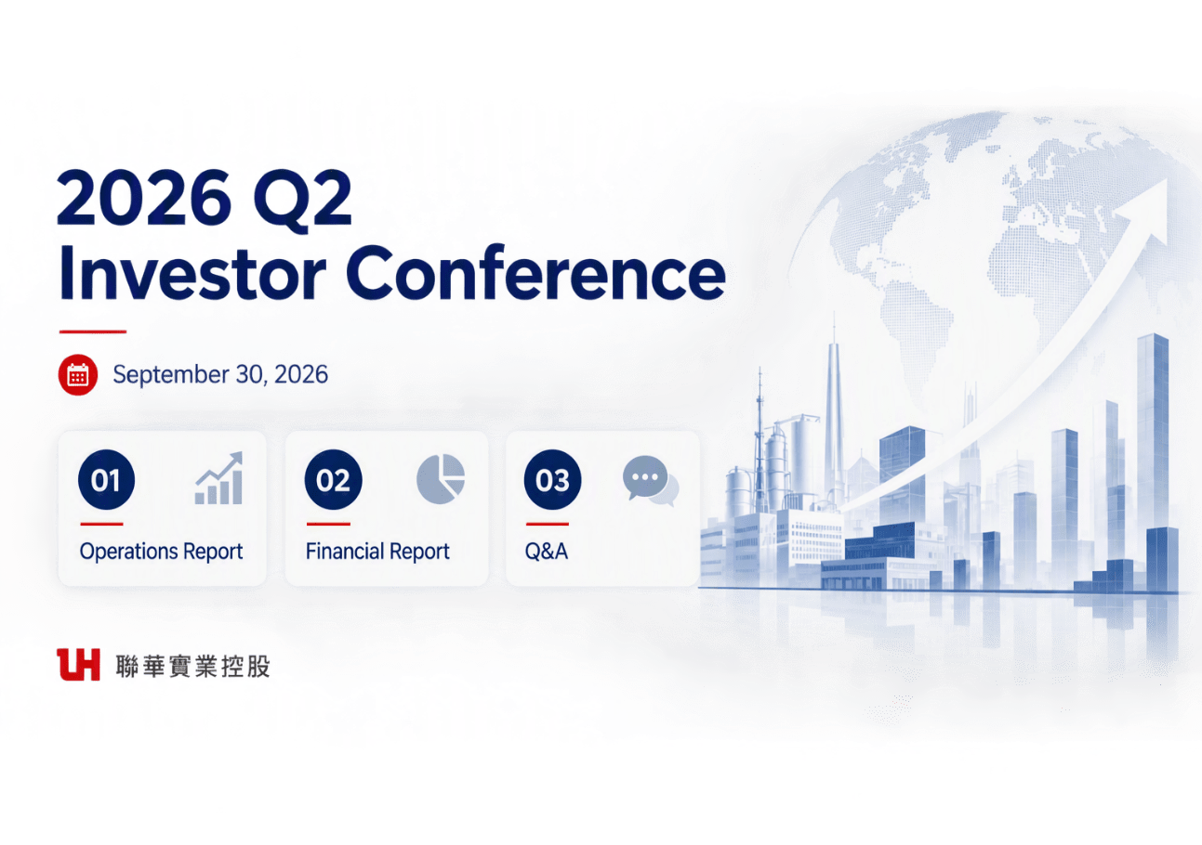


Lien Hwa Industrial Holdings Corporation
Notes:
Lien Hwa Industrial Holdings Corporation

Slide 2
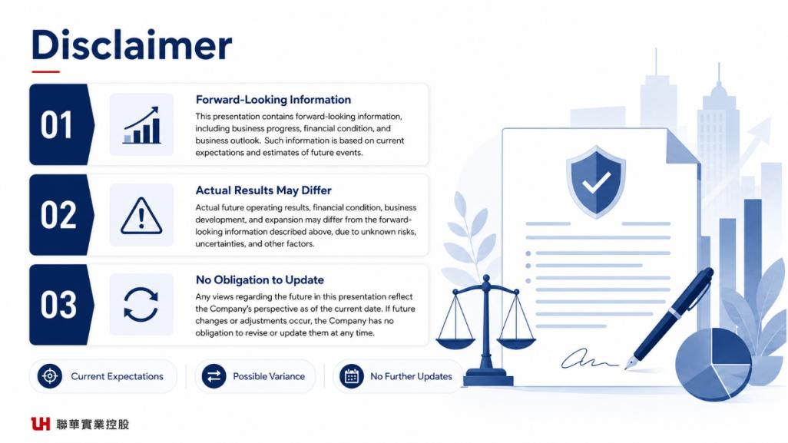

Slide 3
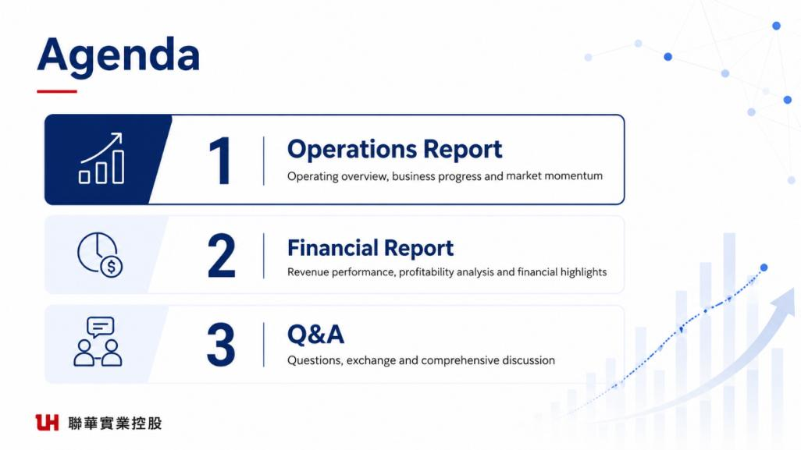

Slide 4
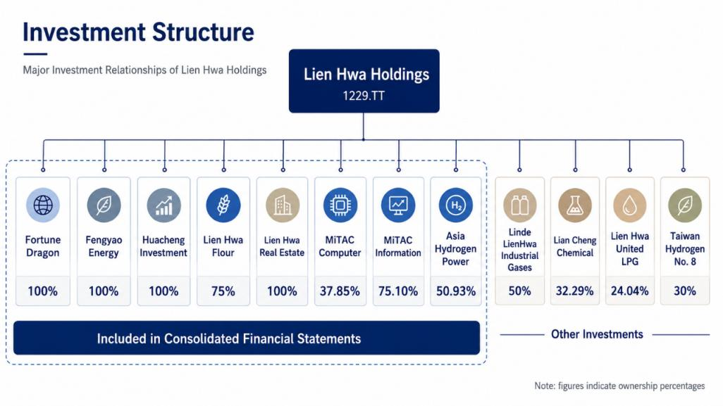

LHIHC
Feng Yao Energy Co., Ltd.
Hua Cheng Investment
Lien Hwa Milling Corp.
Lien Hwa Property Development Corp.
MI
MiTC
AHE
LLH
UPC
Lien Hwa United LPG
TXI BA WENG INC.
32.30%
Notes:
簡稱為LHIH / 神資MiTC
將右下角改為other equity investments

Slide 5
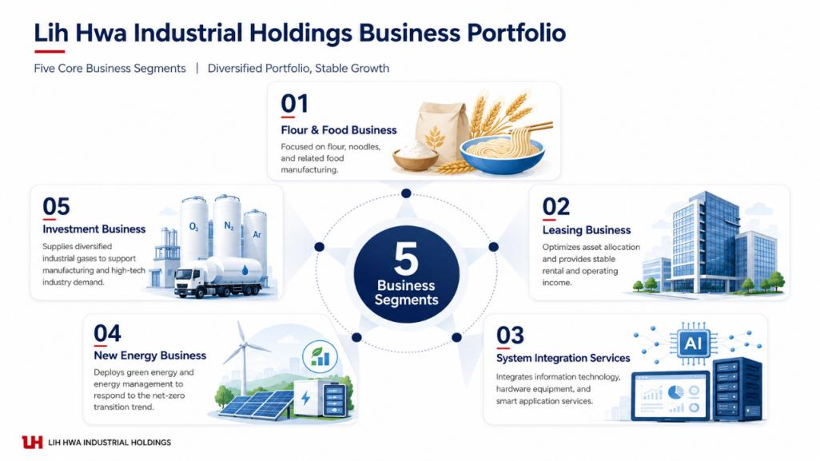
LHIHC Business Group
Focused on flour manufacturing and sales
Rental Business
Notes:
0. Lih 應改正為Lien 或直接簡寫LHIHC
1. 改正01 將 & food 刪除，應為Flour Business，另股東會年報是寫麵食事業，建議將麵粉改回麵食，英文皆為Flour Business
2. 改正02 將 Leasing 改正為 Rental

Slide 6
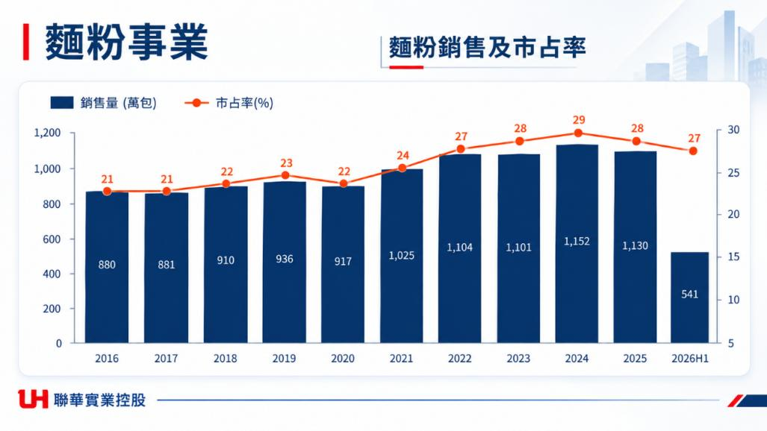
Flour Business
Flour Sales and Market Share
Sales (10,000 bags)
Market Share (%)
Notes:
+2026上半年大約市占率/維持10年趨勢圖就好。
*2026/9/16 因中東情勢升溫導致國際油價上漲，關鍵原物料稅負減徵措施延長至2027年3月底：免徵進口黃豆、小麥、玉米營業稅。
*產業主要以內銷為主,市場有限,營收要大幅成長不易,如小麥成本穩定,每年賺2~3億
Data from：\\tp_files\財會主管作業資料庫\各項會議報告\2026會議
*市場需求持續下降, 傳統麵粉產業已由成長市場轉向
*預估2026年聯華仍維持市場第一，但市場規模持續縮小。
2026Q2麵粉銷售541萬包麵粉較去年同期558萬包減少3%
2026Q2義麵銷售2,467公噸較去年同期2,500公噸減少1%
2026 H1 營收2,427M 較去年同期 2,536M -3% >> 售價及銷量皆減少所致
2026 H1 稅後淨利151M較去年同期 115M +32% >>銷量減少/成本減少、小麥耗用價少USD 9元/噸，及受惠於小麥匯率 31.6較去年減少，業外利息支出減少及兌換利益增加
小麥價格2025 年的低價環境已不復見，預判Q2 季末前漲勢仍有支撐
2025市占率下降因進口麵粉影響
2025年(實際)1130萬(包) 市占28%
(以113糧食年報估算<114/09/30出版>)114年糧食年報需待115/9出版
*2021僑泰興入股*

Slide 7
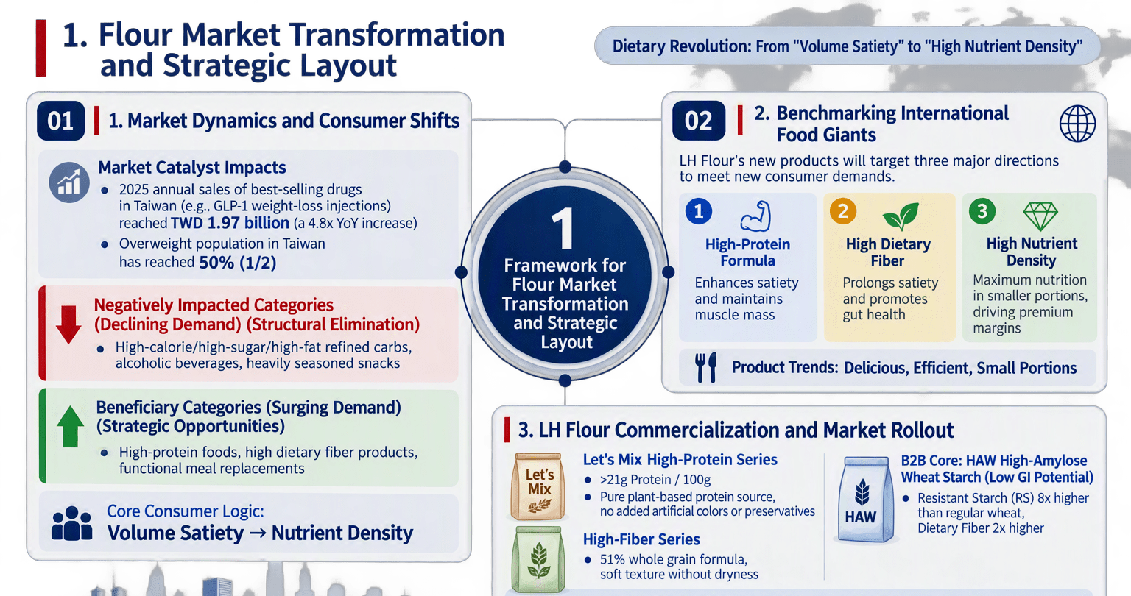

Conclusion & Opportunities：In response to the dietary revolution, LH Flour leverages "High Protein, High Fiber, and HAW High-Amylose Wheat Starch" to build high-functional competitive differentiation.
Notes:
瘦瘦針浪潮下的面對市場轉型與佈局
傳統麵粉需求放緩，高蛋白、高纖維與機能性產品看好
114 年度營業結果報告(From股東會年報)
營運成果：聯華製粉食品(股)公司114 年度稅後淨利較上一年度成長33%。
研究發展：持續深化數位化與智慧化應用，透過AI與數據分析技術，優化原料運用與製程管理，提升產品品質與研發效率。
115年度營業計畫及發展策略(From股東會年報)
麵食事業：持續強化食品研發能量，透過專業實驗與製程技術，提供客戶多元且具差異化的產品解決方案。
(一)市場分析
1.主要產品銷售地區及市埸佔有率
(1)麵食產品：本公司麵粉產品銷售涵蓋國內與海外市場，整體仍以國內市場為主要銷售重心。佔國內市場約30% 之市場佔有率
海外市場方面，主要銷售地區包括香港、澳門、新加坡及馬來西亞等地。
(2)二次加工產品：義大利麵產品以內銷為主、外銷為輔。內銷市場主要服務品牌代工客戶、食品加工業者及餐飲通路。外銷市場則以港澳地區為主要銷售地區，維持穩定出貨。

Slide 8
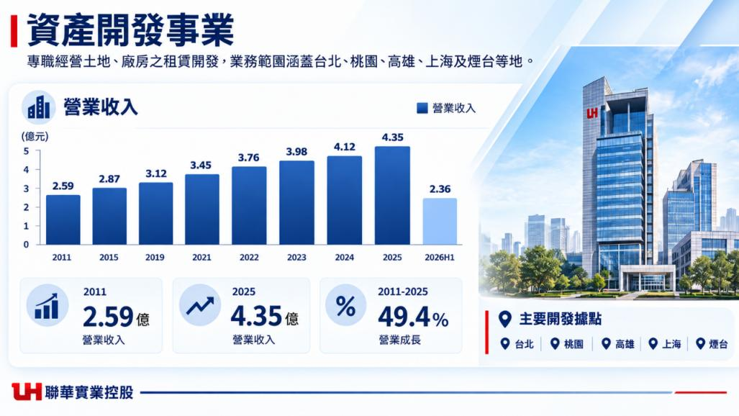

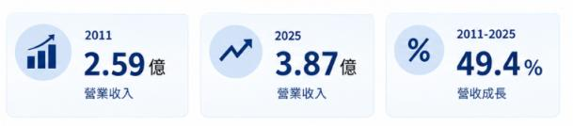




Asset Development Business
Specializing in the leasing and development of land and factories, with a business footprint spanning
Taipei, Taoyuan, Kaohsiung, Shanghai, and Yantai.
Continued expansion of the asset base
Revenue
(NT$ 100 million)
3.87
2.59
2.36
Primary Development Sites
Taipei
Taoyuan
Kaohsiung
Shanghai
Yantai
Notes:
2026Q2：2.36億，全年營收大約較去年成長三成
４月起將增加富岡物流中心之租金收入，1~5年租金：13,435,535 第６、11、16租賃年度起調漲4.5%
下半年亦有七堵新廠挹注(神通資科9/1起租並開始算租金)
*2026預估全年(未沖銷)$5.17億：置產5.2e (租賃收入5.18e + 停車場收入118m) 台華 RMB 253m 雙華 RMB 662m
*上海(25K㎡) 煙台(52K㎡)亦有廠房出租 1平方公尺 = 0.3025 坪
114 年度營業結果報告(From股東會年報)：聯華置產租賃收入連續八年穩健成長，並有效利用資產投入太陽能發售電。
*2025年租賃收入(未沖銷)$4.41億：台灣4.04億+雙華2,900m(0.29億)+台華800m(0.08億)
115年度營業計畫及發展策略
置產事業
完善物流與產業設施布局，推動智慧化管理，並結合再生能源應用，提升資產長期營運效益。
*產業之現況與發展
台灣商用不動產產業因科技業和製造業發展，持續帶動辦公室和生產設施需求增加，尤其是半導體產業持續擴張，帶來研發和生產空間強烈需求。商業設施和購物中心建設陸續興建，滿足消費者的需求。面對營建成本居高不下挑戰，商用不動產市場仍應謹慎應對。未來商用不動產行業有望持續成長，但需有效應對供需平衡、持續發展和市場競爭等挑戰，確保穩定發展成長策略。
＊短期發展:
不動產租賃：規劃整合閒置土地、關係企業辦公空間，活化升級老舊廠區。除與永聯物流開發公司合作的桃園楊梅現代化大型智慧物流園區持續興建中，針對基隆七堵廠區同步整體性規劃，擴展既有不動產業務發展空間。

Slide 9
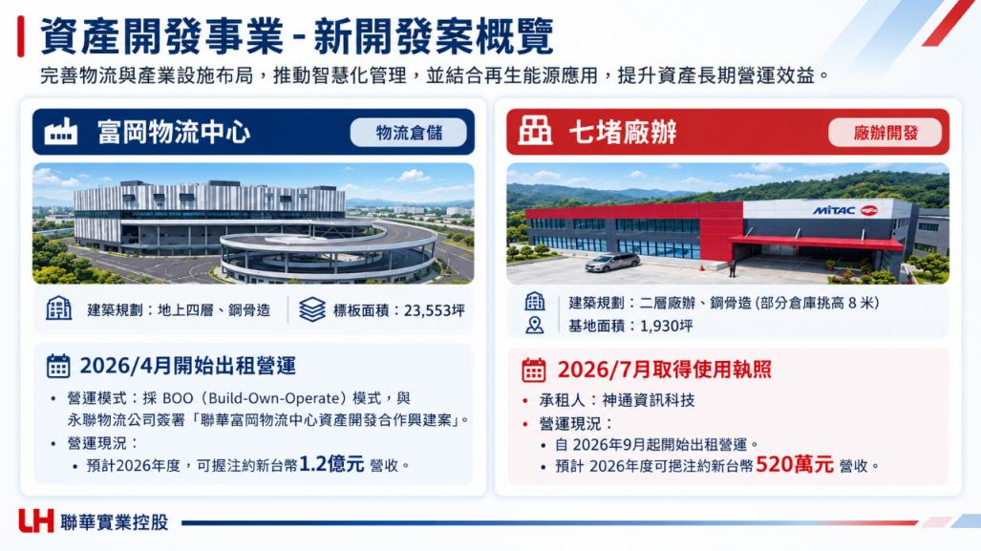

Asset Development: New Project Overview
Optimized logistics and industrial facilities, smart management, and renewable energy improve long-term asset operations.
Fukang Logistics Center
Logistics &
Warehousing
Qidu Factory & Office
Factory & Office
Development
Building plan: Four above-ground floors; steel-frame structure
Gross floor area:
23,553 ping
Building plan: Two-story steel-frame factory and office
Warehouse clear height: 8 m (partial); site area: 1,930 ping
Leasing Began in April 2026
Occupancy Permit Obtained in July 2026
Operating Model: Adopted BOO model, signing the "Lien Hwa Fukang Logistics Center Asset Development Joint Construction Agreement" with Ally Logistics Property (ALP).
Expected revenue contribution: NT$120 million in 2026.
• Tenant: MiTAC Information Technology Corp.
Operating Status:
• Leasing began in September 2026.
• Expected FY2026 revenue: NT$5.2 million.
Notes:
**富岡物流：2026/2月取得使用執照。契約日:2023/6/1
112年3月獲經濟部核可，依《促進民間參與公共建設法》第 8 條第 1 項第 6 款，民間機構自備私有土地投資興建、取得所有權，並自營或委託第三人營運，即屬 BOO 模式。
**目前租賃現況：目前永聯已正式對外使用: A棟租客台積電，B棟3、4樓租客神雲
富岡物流中心已達可供使用狀態，相關支出已由在建工程轉列為房屋及建築，並開始認列相關租賃收入及提列折舊
2021/10與永聯物流(設計規劃及興建)簽署合作「聯華富岡物流中心資產開發合作興建案」
**七堵廠辦：2026/7/15取得使用執照
配合神通資科遷廠需求，規劃包含常溫倉庫、生產廠房及辦公室，完工後租予神通資科。
租賃現況：神通資科9/1起租並開始算租金，每月約130萬元，本年度預計520萬
114 年度營業結果報告(From股東會年報)：聯華置產租賃收入連續八年穩健成長，並有效利用資產投入太陽能發售電。

Slide 10
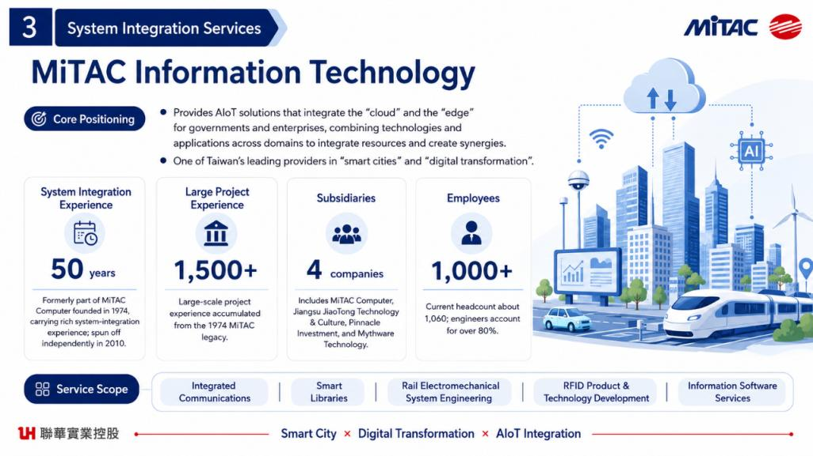


System Integration Business
MiTAC Information Technology Corp.
Notes:
System Integration Business
MiTAC Information Technology Corp.

Slide 11
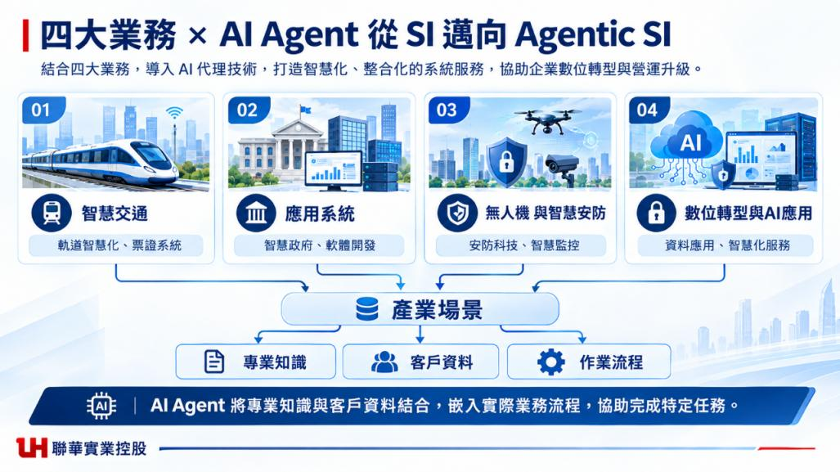
Four Businesses × AI Agents: From SI to Agentic SI
Integrating AI agents across four businesses to build smarter, integrated system services for enterprise transformation.
Smart Transportation
Application Systems
Drones and Smart Security
Digital Transformation & AI Applications
Smart rail and ticketing systems
Smart government and
software development
Security technology and smart surveillance
Data applications and intelligent services
Industry Use Cases
Domain Knowledge
Customer Data
Workflows
AI agents integrate domain knowledge with customer data into operational workflows, driving execution of specific tasks and business upgrades.

Slide 12
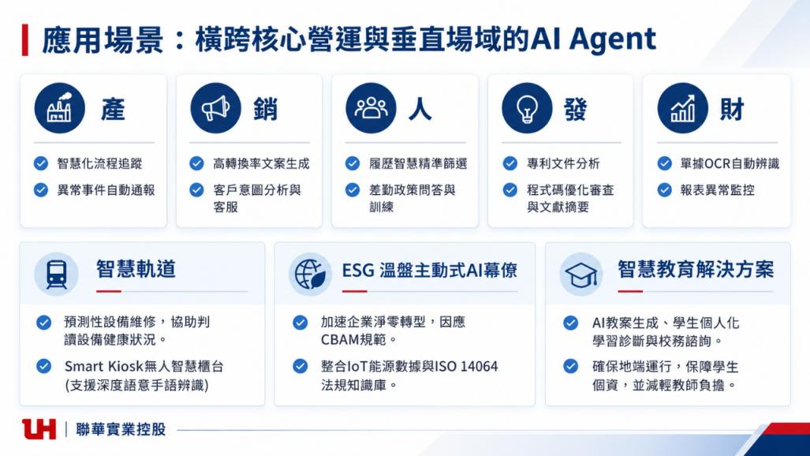

AI Agent Use Cases Across Core Operations and Industry Verticals
Operations
Sales
HR
R&D
Finance
Intelligent workflow tracking
Automatic anomaly alerts
High-conversion copy generation
Customer intent analysis and support
Smart résumé screening
Attendance policy Q&A and training
Patent document analysis
Code review, optimization, and literature summarization
Automated document OCR
Financial report anomaly monitoring
Smart Rail
Proactive AI Advisor for ESG GHG Inventory
Smart Education Solutions
Predictive maintenance helps identify equipment status.
Smart Kiosk unmanned platform supports deep semantic sign language recognition.
Accelerates corporate net-zero transition and supports CBAM compliance.
Combines IoT energy data with an ISO 14064 regulatory knowledge base.
AI creates personalized learning diagnostics and academic guidance.
Ensures on-premises execution to protect student data privacy while reducing teachers' workload.

Slide 13
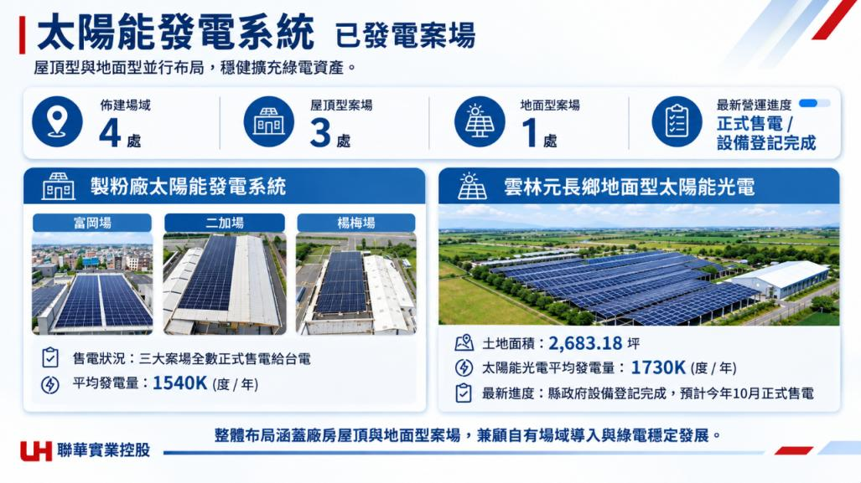

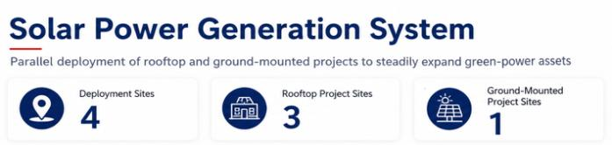
－Solar Power Generation System
Operating
Solar Power Projects
Operational
Highlight：
Commercial Operation /
Equipment Registration
Complete
Land Area: 2,683.18 Ping
Power Sales Status：All three sites have commenced commercial power sales to TPC
Average Solar Power Generation: 1,730K kWh / year
Average Solar Power Generation: 1,540K kWh / year
Latest Status: County government equipment registration completed;
commercial power sales expected to commence in October this year
Notes:
目前進度:
製粉三個案場富岡,二加,楊梅都已經正式售電給台電
雲林元長目前縣政府設備登記完成,預計最晚今年十月可以正式售電。

Slide 14
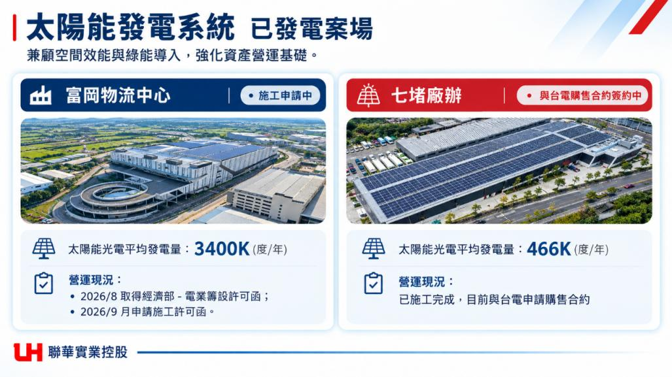

－Solar Power Generation System
Projects Under Construction &
Scheduled for Operation
Balancing space efficiency with green energy integration to strengthen the foundation of asset operations.
Fukang Logistics Center
Construction Permit
Application Pending
Qidu Factory & Office
PPA with Taipower
Signing in Progress
Average solar generation: 3,400K kWh/year
Average solar generation: 466K kWh/year
Operating status
Operating status
• Aug 2026: MOEA power business establishment permit received.
• Sep 2026: Construction permit application filed.
Construction completed; signing a power purchase agreement with Taipower is in progress.
Notes:
富岡物流屋頂太陽能光電工程：
答:MOU內容主要是未來興建完成後，綠電銷售對象是聯華氣體，目前申請施工許可,許可通過之後才可以進場施工,所以現場尚未開工,目前進度看來 最快可能也要11月才能進場施工，整個流程完成可能會落在明年第二季。建議有進度再說明。
*裝置容量3,339KW，平均發電量 : 3400K (度/年) *
本案由聯華實業向置產租用屋頂，投資興建。
電以市場價格出售給聯華氣體。
綠電以市場價格出售給聯華氣體
2024年8月與神通資科簽訂工程合約。
基隆七堵廠辦屋頂太陽能光電工程：太陽能目前已施工完成，目前與台電申請購售合約。
答:七堵目前一樣賣電給台電,現場進度95%,還要等台電來接外線掛表,掛表後還要運轉測試,測試完成後到市政府登記,預估完成整個流程會在今年12月
＊配合神通資科遷廠需求，規劃包含常溫倉庫、生產廠房及辦公室，完工後租予神通資科。
█ 計畫於七堵廠辦完工後於屋頂裝置太陽能光電設備，提升廠房利用價值。
█ 裝置容量：500Kwp (第三型)
█ 綠電透過售電業者出售或躉售台電。

Slide 15
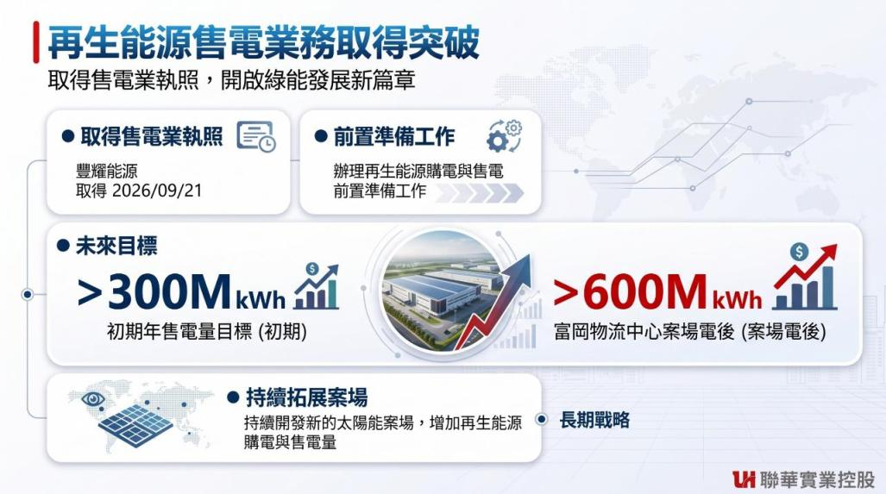
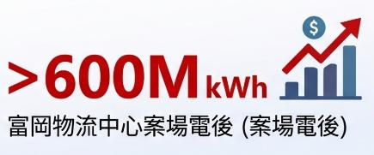
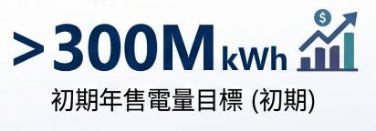

－Breakthrough in Renewable Energy Power Retailing Business
Obtained Power Retailing License
Obtained Power
Retailing License
Preparatory Work
Feng Yao Energy Co., Ltd.
Conducting preparatory work for renewable energy PPAs and electricity sales
Obtained on Sep 21, 2026
2027 Electricity Sales Volume
2028 Electricity Sales Volume
Post-power generation of the Fukang Logistics Center solar site
Continuing Project Expansion
Continuously developing new solar sites to increase renewable energy procurement and sales volumes.
Long-Term Strategy

Slide 16
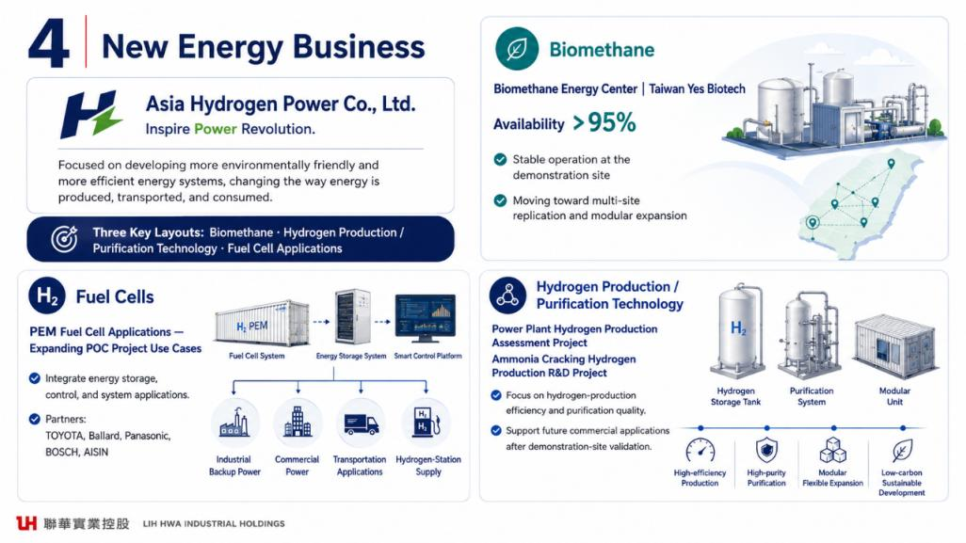


Biogas Biomass Energy Centers / TXI BAWENG INC.
Phase 1: 334 kW (Utilization Rate >95%)
Phase 2: 1 MW
(Scheduled for Completion in Q4 2026)
Notes:
Asia Hydrogen Energy Corporation
TXI BAWENG INC.

Slide 17
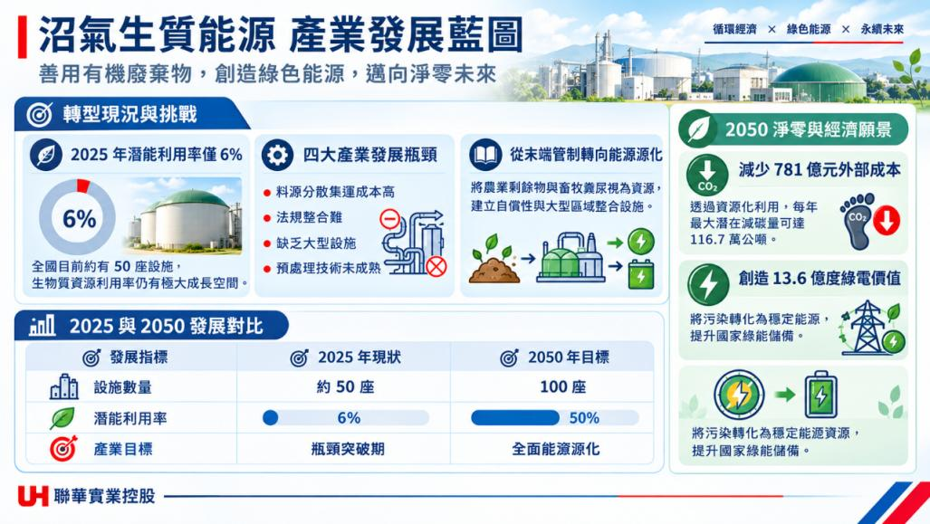
Biogas and Biomass Energy Industry Blueprint
Circular Economy × Green Energy × Sustainable Future
Using organic waste to create green energy and advance a net-zero future
Transition and Challenges
Source: Ministry of Environment News
2050 Net-Zero and Economic Vision
2025 potential utilization rate: 6%
Four industry bottlenecks
From end-of-pipe treatment to energy recovery
Cut external costs by NT$78.1bn
• Costly feedstock logistics
Treat agricultural residues and livestock manure as resources, establish self-sustaining ecological and large-scale regional integrated facilities.
Resource recovery could reduce up to 1.167 million tonnes of emissions a year.
• Complex regulation
• Few large facilities
About 50 facilities nationwide. Biowaste utilization still has substantial room to grow.
• Immature pretreatment
Generate NT$ 1.36 billion in green electricity value.
2025 vs. 2050 Outlook
Turn waste into a stable energy source and strengthen Taiwan’s green power supply.
Indicator
2025 Status
2050 Target
Facilities
About 50
100
Utilization rate
Turn waste into a stable energy source and strengthen Taiwan’s green power supply.
Industry milestone
Break bottlenecks
Full energy recovery

Slide 18
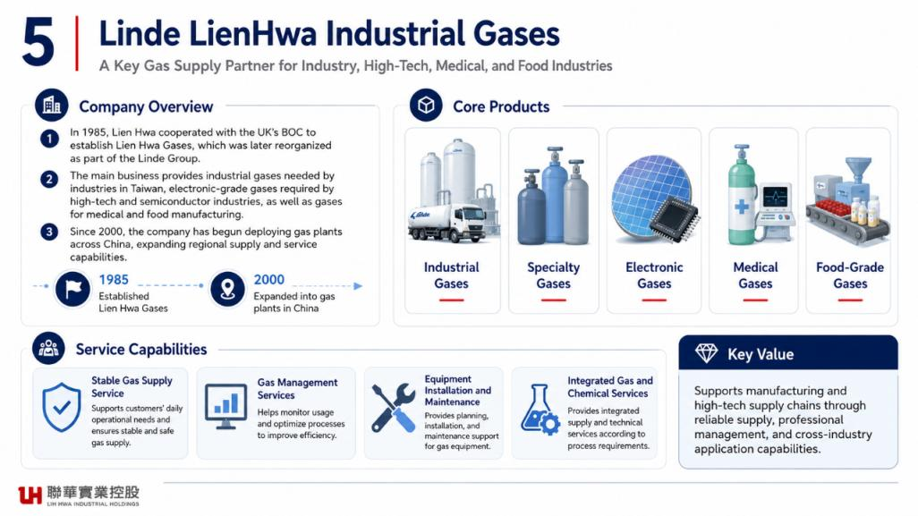
Linde LienHwa Industrial Gases Co., Ltd.
Notes:
Linde LienHwa Industrial Gases Co., Ltd.

Slide 19
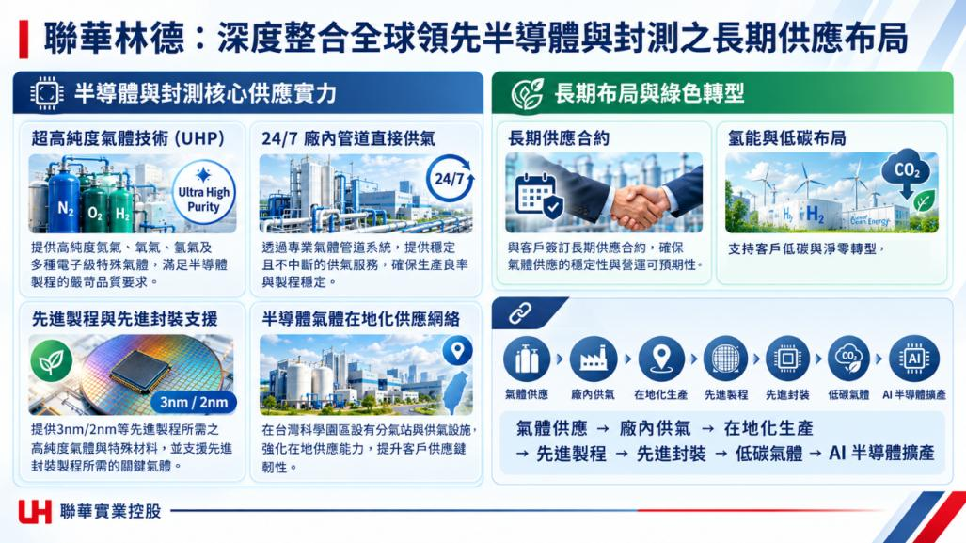
Linde LienHwa: Deeply Integrated Long-Term Supply for Semiconductor and Packaging Leaders
Core Semiconductor and Packaging Supply
Long-Term Investment and Green Transition
Ultra-High-Purity Gas Technology (UHP)
24/7 On-Site Pipeline Supply
Long-Term Supply Contracts
Hydrogen and Low-Carbon Solutions
High-purity nitrogen, oxygen, hydrogen and electronic specialty gases meet stringent semiconductor quality needs.
Dedicated pipelines deliver continuous gas supply for yield and process stability.
Long-term contracts secure supply stability and predictable operations.
Support customers’ low-carbon transition and sustainability goals.
Advanced Nodes and Packaging
Local Semiconductor Gas Network
Gas Supply
On-Site Supply
Local Production
Advanced Nodes
Packaging
Low Carbon
AI
Semiconductor Expansion
High-purity gases and specialty materials support 3 nm / 2 nm nodes, as well as critical gases for advanced packaging.
Local distribution stations in Taiwan’s science parks improve supply capacity and resilience.
Gas Supply → On-Site Supply → Local Production →
Advanced Nodes → Advanced Packaging → Low-Carbon Gases →
AI Semiconductor Expansion
3 nm / 2 nm

Slide 20
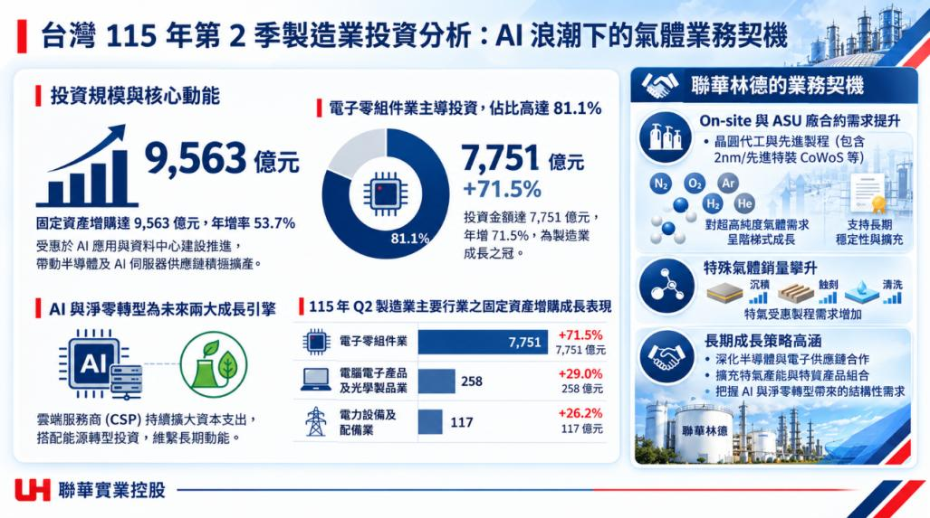
Taiwan Manufacturing Investment, Q2 2026: AI and Gas Opportunities
Source: Ministry of Economic Affairs, Statistics Department (Sept. 10, 2026)
Linde LienHwa Business Opportunities
Investment Scale and Key Drivers
Electronic Components Lead: 81.1%
Rising Demand for On-Site and ASU Supply
NT$956.3bn
NT$775.1bn
+71.5%
Wafer foundries and advanced packaging, including 2 nm and CoWoS.
Capital Expenditures grew 53.7% to NT$956.3bn.
Investment reached NT$775.1bn, up 71.5%, driving manufacturing growth.
Stepped growth in demand for ultra-high-purity gases.
Support long-term operational stability and capacity expansion
Driven by AI applications and data center expansion, semiconductor and AI server supply chains are actively boosting capacity.
Higher Specialty Gas Sales
Q2 2026 CapEx Growth by Industry (NT$100m)
Demand rises across deposition, etch and cleaning.
AI and Net Zero: Two Growth Engines
Deposition
Etching
Cleaning
Electronic components
7,751
+71.5%
NT$775.1bn
Long-Term Growth Strategy
+29.0%
NT$25.8bn
Deepen collaboration within semiconductor and electronics supply chains
Expand specialty gas capacity and product portfolio
Capture structural demand driven by AI and net-zero transformation
Computers and optical products
Power equipment and distribution
+26.2%
NT$11.7bn
Cloud service providers continue heavy capital spending and energy-transition investment.

Slide 21
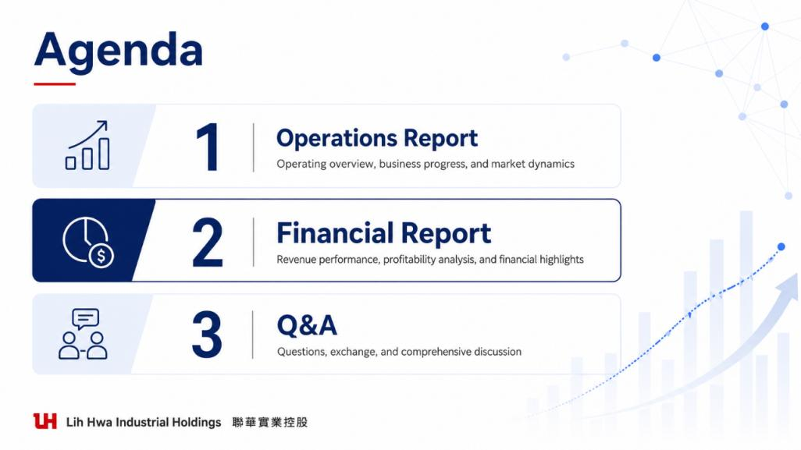

Slide 22
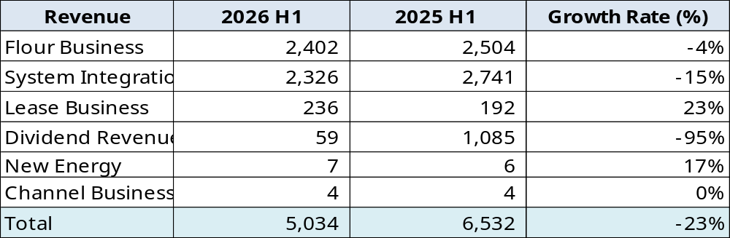


Revenue Distribution
Unit：NT$ Million
Notes:
1.麵粉事業：製粉兩期差異減少1.02億，因降低售價以反映較低小麥成本，對獲利低的客戶不供貨
2.資訊整合(神資)：兩期差異減少4.14億，因嚴審毛利過低之專案甚至不接。依據IFRS15之規定，維護專案延後認列。
3.租賃事業：兩期差異增加4,400萬，物流中心開始收租。
4.股利收入(神通)：兩期差異減少10.26億，主係聯強股利尚未認列

Slide 23
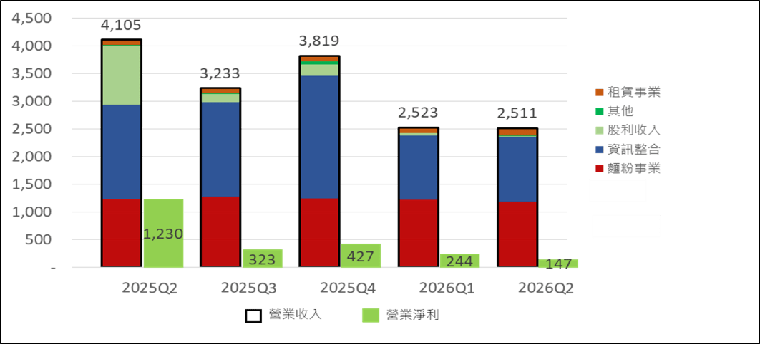
Quarterly Operating Revenue &
Operating Profit
Unit：NT$ Million
Lease Business
Other
Dividend Revenue
System Integration Business
Flour Business
Revenue
Operating Profit

Slide 24
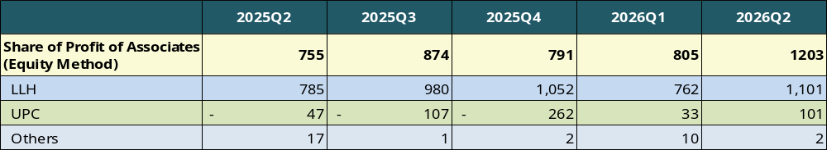

Investment Income
NT$ Millions

Slide 25
Quarterly Net Profit after tax & EPS
Net Profit/NT$ million
EPS/ NT$
Net Profit after tax
EPS
Notes:
Q2&Q3係各公司股利收入高峰期
同年度比較 2025 vs 2024
EPS+0.23 : $2.57 vs $2.34
毛利率 上升4%
毛額 +715m +27%
營業淨利 +716m +54%
稅後淨利 +711m +15%
同期比較 2025Q4 vs 2024Q4
稅後淨利：+16% (+166m)
原因 毛利率 上升4%
毛額 +52% (+275m)
營業淨利 +117% (+230m)

Slide 26
Net Asset Value per Share Trend
NAV（NTD）
Share Capital (NT$100m)
NAV
Share Capital

Slide 27
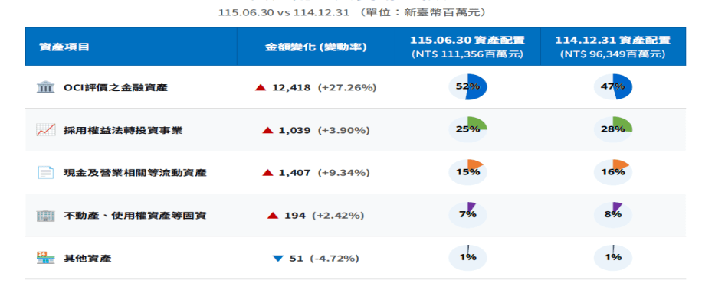
Asset Allocation
Total Assets： 2026.06.30 NT$ 111,356M vs 2025.12.31 increase NT$ 15,007M (+15.58%)
2026.06.30 VS 2025.12.31 （Unit：$ million）
Assets Items
Amount Change (Change %)
2026.06.30 Asset Allocation
(NTD 111,356M)
2025.12.31 Asset Allocation
(NTD 111,356M)
Financial Assets at OCI
Equity-Method
Investees
Cash and Operating-related
current assets
Fixed Assets (including
PP&E and ROU Assets)
Other Assets

Slide 28
Asset Allocation - FVOCI
2026.06.30 vs 2025.12.31
Investment Targets
兩期變動數(%)
Amount Increase (Change %) ）
2026.06.30
2025.12.31
MiTAC Holdings Corporation
238
(+1.21%)
01
▲
Shareholding percentage: 17%
TSR 7.6%
Share price CAGR of 21.4%
Synnex Technology International Corporation
10,641
(+57.34%)
02
▲
Kelington Group Berhad
998
(+55.35%)
03
▲
4.83%
3.96%
Shareholding percentage: 19%
TSR 5.7%
Share price CAGR of 7.8%
Other
541
(+9.87%)
04
▲
Total : 57,967M
Total : 45,549M

Slide 29


Slide 30
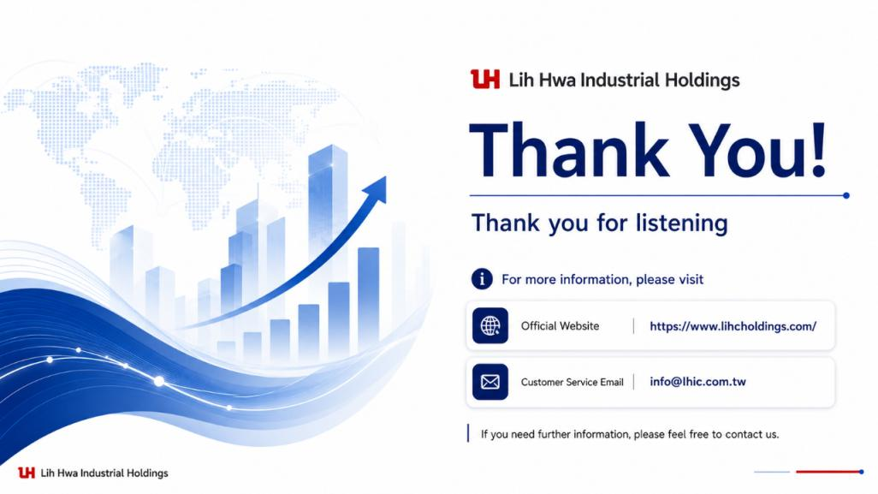


https://www.lhicholdings.com/

Slide 31
合併營收趨勢
Notes:
*2025年資訊整合事業營收衝上 66億新台幣（年增 17%）占2025集團總營收比例49%，超越傳統麵食，奠定集團轉型科技控股核心。
*2026Q2: revenue YoY -1,498M (-23%)
1.麵粉事業：製粉兩期差異減少1.02億，因降低售價以反映較低小麥成本，對獲利低的客戶不供貨
2.資訊整合(神資)：兩期差異減少4.14億，因嚴審毛利過低之專案甚至不接。依據IFRS15之規定，維護專案延後認列。
3.租賃事業：兩期差異增加4,400萬，物流中心開始收租。
4.股利收入(神通)：兩期差異減少10.26億，主係聯強股利尚未認列(時間差)
營業收入 2026H1 2025H1 成長率 金額差異
資訊整合 2,326 2,740 -15% (414)
麵粉事業 2,402 2,504 -4% (102)
股利收入 59 1,085 -95% (1,026)
租賃事業) 236 192 23% 44
新能源 7 7
合計 5,034 6,532 (1,497)
------
2025 vs 2024 +5%(+637m)
2025Q4 vs 2024Q4 +20% (648m)
營業收入 2025Q4合併營收 2024Q4合併營收 成長率 差異 2025佔比% 2024佔比%
資訊整合 6,657 5,712 17% 945 49% 44%
麵粉事業 (台灣大陸) 5,021 5,549 -10% (528) 37% 43%
股利收入(神通) 1,444 1,074 34% 370 11% 8%
租賃事業 (台灣大陸) 387 377 3% 10 3% 3%
新能源 66 49 35% 17 0% 0%
食品通路 9 187 -95% (178) 0% 1%
合計 13,584 12,947 637 100% 100%

Slide 32
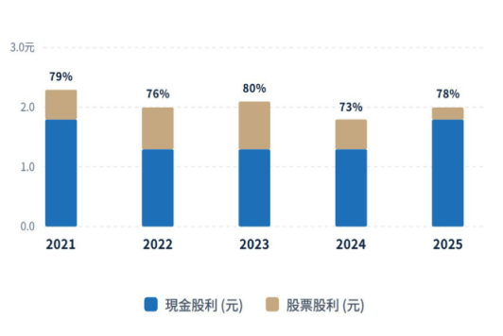

Dividend Policy
連續43年穩定配發股利
年度 | 2021 | 2022 | 2023 | 2024 | 2025
現金股利 (元) | 1.8 | 1.3 | 1.3 | 1.3 | 1.8
股票股利 (元) | 0.5 | 0.7 | 0.8 | 0.5 | 0.2
盈餘分配率 | 79% | 76% | 80% | 73% | 78%
盈餘分配率計算公式說明：
Notes:
111年以前EPS未依113年股數diluted

