Slide 1
Tensor Flow Keras Demonstration
In this presentation, we will demonstrate how to use the Keras package which is a part of the popular machine learning software, TensorFlow.
We will be labeling pictures of random clothing items according to their respective names.
Various Neural Network configurations will be discussed.
Finally, we will discuss how the implementation of specific optimization functions can have a effect on the accuracy of the classification.

Slide 2
TensorFlow Demonstration
Specifically, we’ll be discussing the difference between standard gradient descent and stochastic gradient descent and see how each method effects accuracy for the given data.

Slide 3
Neural Network Definition
Neural networks are a set of algorithms, modeled loosely after the human brain, that are designed to recognize patterns. They interpret sensory data through a kind of machine perception, labeling or clustering raw input. The patterns they recognize are numerical, contained in vectors, into which all real-world data, be it images, sound, text or time series, must be translated.
Neural networks help us cluster and classify. You can think of them as a clustering and classification layer on top of the data you store and manage. They help to group unlabeled data according to similarities among the example inputs, and they classify data when they have a labeled dataset to train on.

Slide 4
Deep Learning Example
Deep learning maps inputs to outputs. It finds correlations. It is known as a “universal approximator”, because it can learn to approximate an unknown function f(x) = y between any input x and any output y, assuming they are related at all (by correlation or causation, for example). In the process of learning, a neural network finds the right f, or the correct manner of transforming x into y, whether that be f(x) = 3x + 12 or f(x) = 9x - 0.1. Here are a few examples of what deep learning can do.

Slide 5
Classification
All classification tasks depend upon labeled datasets; that is, humans must transfer their knowledge to the dataset in order for a neural network to learn the correlation between labels and data. This is known as supervised learning.
Detect faces, identify people in images, recognize facial expressions (angry, joyful)
Identify objects in images (stop signs, pedestrians, lane markers…)
Recognize gestures in video
Detect voices, identify speakers, transcribe speech to text, recognize sentiment in voices
Classify text as spam (in emails), or fraudulent (in insurance claims); recognize sentiment in text (customer feedback)
Any labels that humans can generate, any outcomes that you care about and which correlate to data, can be used to train a neural network.

Slide 6
Clustering
Clustering or grouping is the detection of similarities. Deep learning does not require labels to detect similarities. Learning without labels is called unsupervised learning. Unlabeled data is the majority of data in the world. One law of machine learning is: the more data an algorithm can train on, the more accurate it will be. Therefore, unsupervised learning has the potential to produce highly accurate models.
Search: Comparing documents, images or sounds to surface similar items.
Anomaly detection: The flipside of detecting similarities is detecting anomalies, or unusual behavior. In many cases, unusual behavior correlates highly with things you want to detect and prevent, such as fraud.

Slide 7
Neural Network Elements
Deep learning is the name we use for “stacked neural networks”; that is, networks composed of several layers.
The layers are made of nodes. A node is just a place where computation happens, loosely patterned on a neuron in the human brain, which fires when it encounters sufficient stimuli. A node combines input from the data with a set of coefficients, or weights, that either amplify or dampen that input, thereby assigning significance to inputs with regard to the task the algorithm is trying to learn; e.g. which input is most helpful is classifying data without error? These input-weight products are summed and then the sum is passed through a node’s so-called activation function, to determine whether and to what extent that signal should progress further through the network to affect the ultimate outcome, say, an act of classification. If the signals passes through, the neuron has been “activated.”

Slide 8
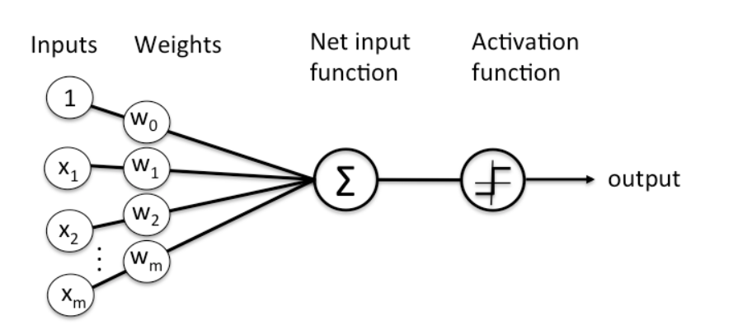
Here’s a diagram of what one node might look like.

Slide 9
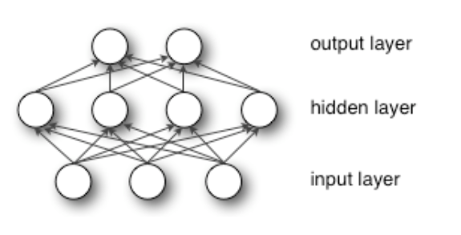
A node layer is a row of those neuron-like switches that turn on or off as the input is fed through the net. Each layer’s output is simultaneously the subsequent layer’s input, starting from an initial input layer receiving your data. Pairing the model’s adjustable weights with input features is how we assign significance to those features with regard to how the neural network classifies and clusters input.

Slide 10
Activation Functions
The activation function determines the output a node will generate, based upon its input. The activation function is set at the layer level and applies to all neurons in that layer.
Some examples include:
CUBE
ELU
HARDSIGMOID
HARDTANH
IDENTITY
LEAKYRELU
RATIONALTANH
RELU
RRELU
SIGMOID
SOFTMAX
SOFTPLUS
SOFTSIGN
TANH

Slide 11
Dense layer
A linear operation in which every input is connected to every output by a weight (so there are n_inputs * n_outputs weights - which can be a lot!). Generally followed by a non-linear activation function

Slide 12
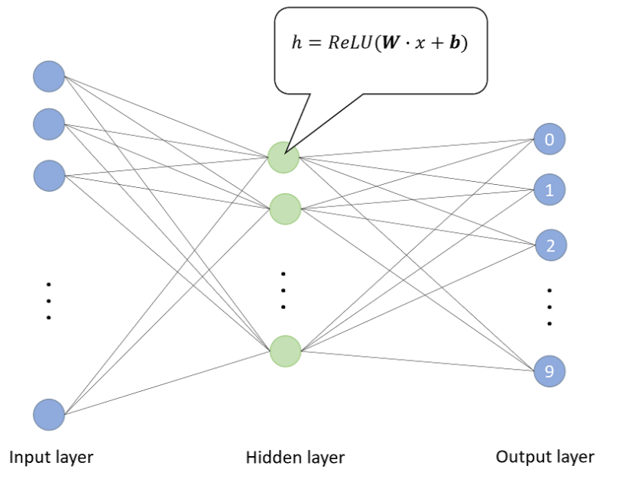
Dense layer

Slide 13
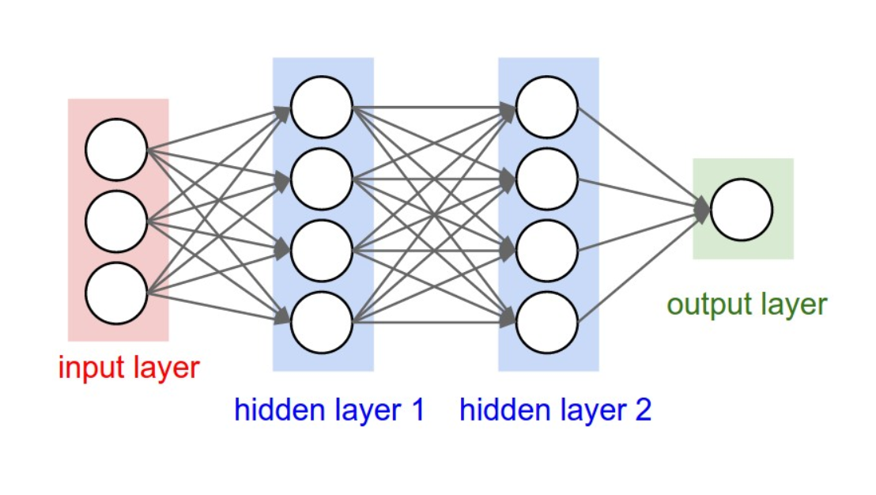
Dense Layer

Slide 14
Convolutional layer
A layer that consists of a set of “filters”. The filters take a subset of the input data at a time. In this model nearby inputs are connected to nearby outputs, and the weights for the convolutions at each location are shared. Due to the weight sharing, and the use of a subset of the weights of a dense layer, there’s far less weights than in a dense layer.
The operations performed by this layer are still linear/matrix multiplications, but they go through an activation function at the output, which is usually a non-linear operation.

Slide 15
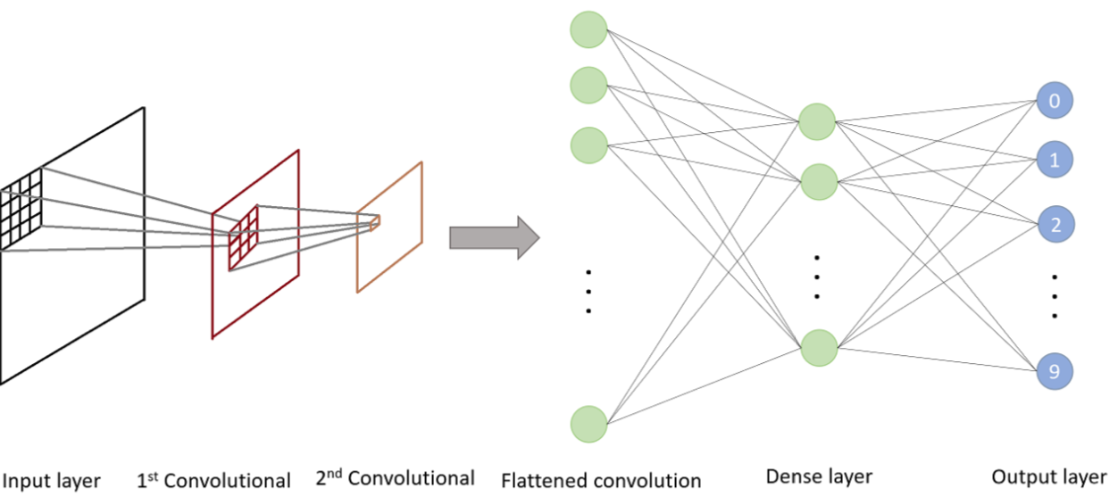
Convolutional layer

Slide 16
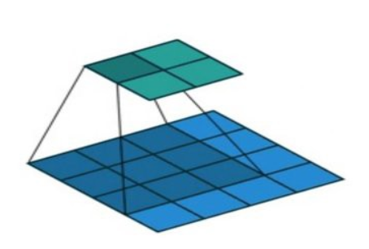
Convolutional layer
A convolution multiplies a matrix of pixels with a filter matrix or ‘kernel’ and sums up the multiplication values. Then the convolution slides over to the next pixel and repeats the same process until all the image pixels have been covered. This process is visualized below.

Slide 17
What is TensorFlow?
TensorFlow is an open source system developed by Google Brain Team.
It was designed for numerical computation and large scale machine learning.
Various machine learning (aka neural network models) are bundled together and made easily accessible in a user friendly front-end API (Application Programming interface).
TensorFlow was designed in C++ and is accessible by the user through Python.

Slide 18
What is Keras?
Keras is one of many packages in TensorFlow. According to it’s creater (Francois Chollet), this is what makes it unique from other packages:
“The most important decision was that Keras was going to be a self-contained framework for deep learning. That is to say, you can use Keras to solve problems end-to-end without ever having to interact with the underlying backend engine, Theano or TensorFlow.”
– Francois Chollet

Slide 19
More about Keras
To summarize this, Keras has it’s own graph data structure.
This means that all graphical operations are contained within Keras.
This means that graph structures are implement independently of TensorFlow.
This makes it easier to extend Keras to support new computation graphing engines as they come along.

Slide 20
3 fundamental tensor attributes
Rank
Axes
Shape

Slide 21
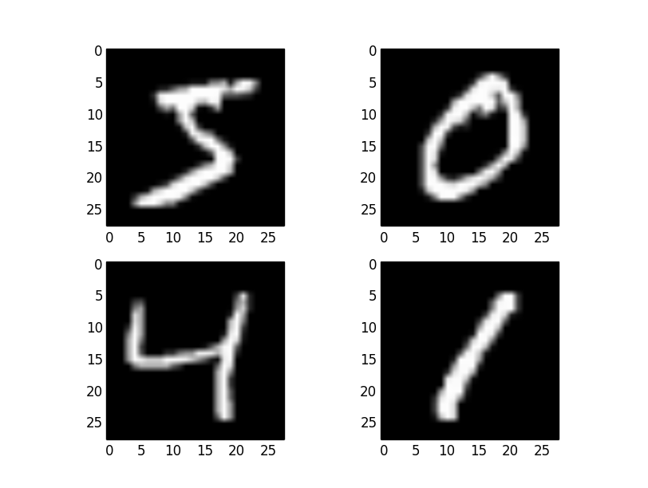
Rank of a tensor
Number of dimensions present in a tensor.
This refers to how many indices are required to access an element of the tensor.

Slide 22
Axes
The axes are the actual components of each dimension.
So the rank of a tensor refers to how many axes a tensor has to reference. This is similar to the rank of a matrix.

Slide 23
Shape of a Tensor
The same as the size of a Tensor.
Example: The same tensors from before have a 28 X 28 shape.

Slide 24
Python Code Analysis

Slide 25
Sequential Model
Assembles layers to build a model.
A model is usually a graph of layers, the most common being a stack of layers.
invoked by: tf.keras.models.sequential
“Linear Stack of Layers.”
this is a fully connected network (i.e. Multi-layer perceptron)

Slide 26
Sequential Model (continued)
The model needs to know what kind of input shape to expect.
Only the First layer needs information about it’s shape since following layers can do automatic shape inference.

Slide 27
Epoch’s
An Epoch represents one process of having all test data run through the neural network, and returned via backpropagation.
Depending on the type of data, the number of epochs can either increase or decrease the accuracy of the Neural Network.

Slide 28
Types of Loss Functions
Regression Loss Function
Mean Squared Error
Mean Squared Logarithmic Error Loss
Mean Absolute Loss Functions
Binary Classification Loss Functions
Binary Cross-Entropy
Hinge Loss
Squared Hinge Loss
Multi-Class Classification Loss Functions
Multi-Class Cross Entropy Loss
Sparse multiclass Cross-Entropy Loss
Kullback Leibler Divergence Loss

Slide 29
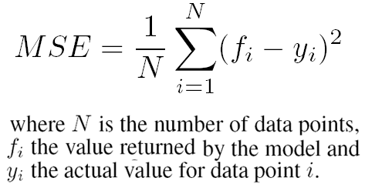
Mean Squared Error Loss
It is the preferred distribution if the distribution of the target variable is Gaussian.
MSE is calculated as the average of the squared differences between the predicted and actual results.

Slide 30

Categorical Cross Entropy
Prefered loss function when dealing with multi-class classification.
Sparese Categorical Cross Entropy Deals with true labels. This means that each data entry can only belong to one entry. (i.e. an image of the shoe can only be properly given the label of “a shoe”)
From previous data, the formula generates a probability of the most likely label (a predicted label) and compares this with the true label of the test data.

Slide 31
Optimizing
This is the process of finding the minimum cost (or Loss) function to optimize the weights of the neural network.
This includes 3 main arguments:
Optimizer – Specifies training procedure (adam optimizer, RMS prop optimizer, Gradient Descent Optimizer, Stochastic Gradient Descent).
Loss – Function to minimize during optimization (mean square error, categorical crossentropy, binary crossentropy).
Metrics – Used to monitor training

Slide 32
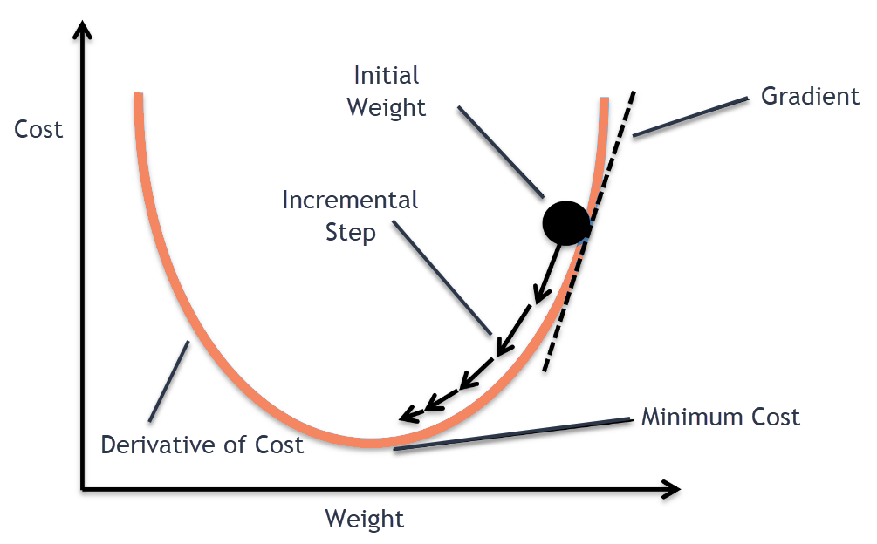
Gradient Descent
Process of adjust weights of a neural network by finding the lowest cost function.
During back propagation, DW is used to find new weights:
W = W – learning rate * dW

Slide 33
Adam Optimizer
“Adaptive Moment” estimation.
Accomplished through via RMSprop + Momentum.
Momentum uses previous gradients to smooth out the steps of the gradient descent.
In RMSprop, instead of using dW and db independently for each epoch, we take the exponentially weighted averages of the square of dW.
S_{dW} = β * S_{dW} + (1 – β) * dW²
After exponentially weighted averages are calculated, we plug them back in:
W = W – learning rate *dW / sqrt(S_{dW})

Slide 34
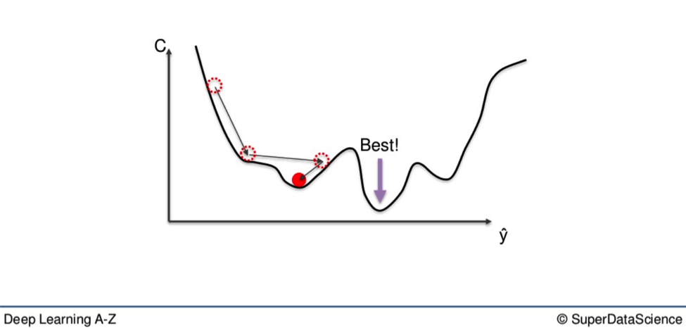
Stochastic Gradient Descent
If our cost function isn’t perfectly convex, stochastic gradient descent updates the weights of the neural network after each piece of data is run.

Slide 35
Advantages of Stochastic Gradient Descent
Although SGD is computationally more expensive. It has the advantage of escaping shallow local minima more easily.
Standard gradient descent works when the graph of the loss function is convex. However, this doesn’t always happen, and SGD works in data sets weather or not the data is convex.

