Slide 1
Design of a 16 bit SINGLE CYCLE MIPS CPU
COMPUTER ENGINEERING Pied Pipers
COE 381: MICROPROCESSORS DESIGN PROJECT
october 2019

Slide 2
Presentation Outline
General Introduction to processor Design
Overview of MIPS ISA
Register File Design
ALU Design
Datapath Design
Control Unit Design
Final CPU
Running test programs on the CPU

Slide 3
The steps in processor design
Step 1: Analyze instruction set to determine datapath requirements.
Step 2: Select set of datapath components & establish clock methodology
Step 3: Assemble datapath components that meet the requirements
Step 4: Analyze implementation of each instruction to determine setting of control points that realizes the register transfer.
Step 5: Assemble the control logic

Slide 4
THE MIPS ISA
Classical reduced instruction set architecture.
MIPS: Microprocessor without interlocked pipeline stages.
We mean Classical load/store architecture.
Very few instructions in total compared to IA-32

Slide 5
THE MIPS ISA
3 Instruction formats R (register),I (immediate), J (jump)
Every instruction can be represented in MIPS assembly language.
The assembly language representation has an equivalent machine level encoding.
MIPS-32 is a 32 bit ISA.

Slide 6
R-Type Instructions
MIPS assembly language representation
Register transfer language notation
Machine language encoding
op rd,rs,rt
R[rd] R[rs] op R[rt]
31 26
25 21
20 16
15 11
10 6
5 0
op
rs
rt
rd
shamt
funct
6 bits
5 bits
5 bits
5 bits
5 bits
6 bits

Slide 7
R-Type Instructions
All R-Type instructions have 000000 as opcode.
Which operation is performed depends on the value of the funct field.
shamt is the number of shifts and is used by shift operations.
A simple R-Type instruction is:
add $s1, $s2, $s3

Slide 8
I-Type Instructions
MIPS assembly language representation
Register transfer language notation
Machine language encoding
op rt, rs, imm
R[rt] R[rs] op imm
31 26
25 21
20 16
15 0
op
rs
rt
imm
6 bits
5 bits
5 bits
16 bits

Slide 9
I-Type Instructions
There are several ‘groups’ of immediate instructions.
The arithmetic and logical immediate:
addi, ori, xori
Memory operations: lw , sw
Conditional branch instructions: bne, beq
More on these instructions during their datapath design.

Slide 10
J – Type instructions
All J-Type instructions are jump instructions
There are a variety of j-type instructions.
MIPS assembly language representation:
Machine Language encoding
j target
31 26
25 0
op
imm
6 bits
26 bits

Slide 11
Our ISA (A MIPS Subset )
In total our processor can execute 13 MIPS ISAs
8 R-Type, 4 I-Type , 1 is J-Type

Slide 12
Datapath Design
The datapath determines how data and addresses flow around for processing.
For each instruction we convert to RTL and then consider the machine encoding to design it’s datapath.
The PC always points to the next instruction.
PC is incremented by 4 after ever instruction. Why?

Slide 13
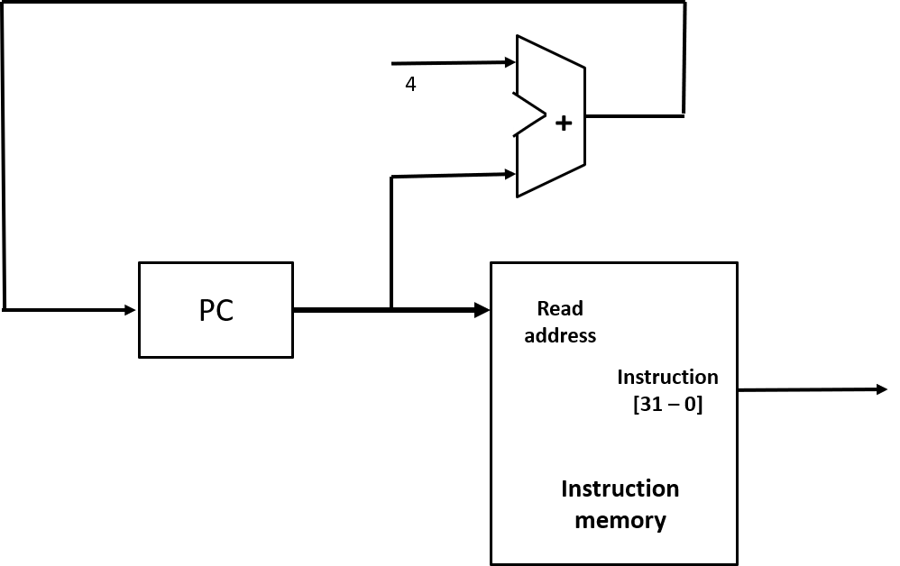
INSTRUCTION FETCH UNIT

Slide 14
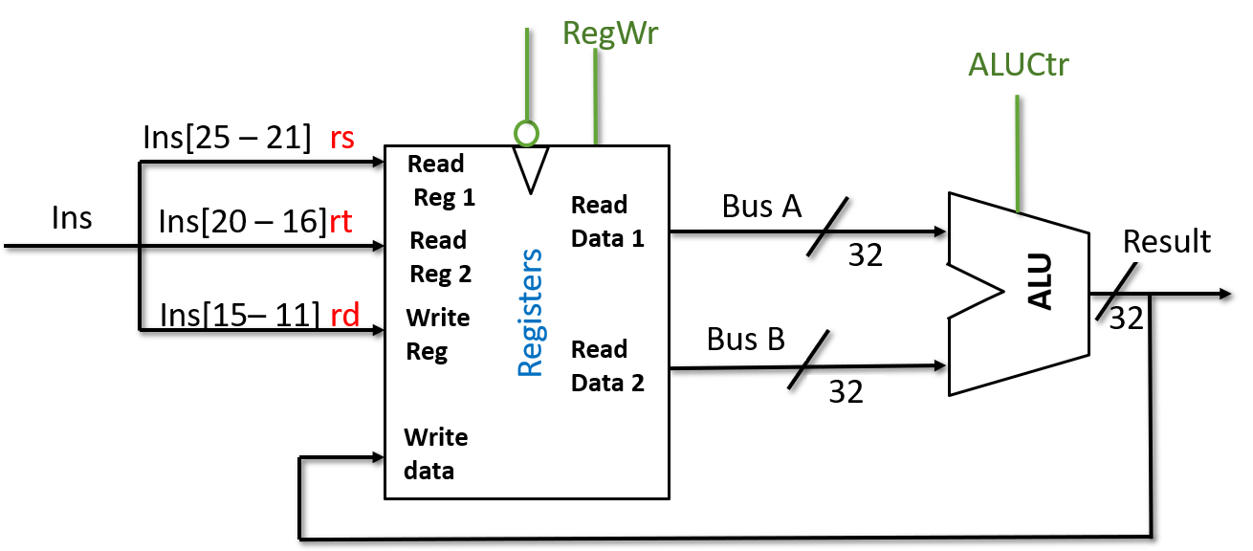
DATA PATH FOR R TYPE INSTRUCTION

Slide 15
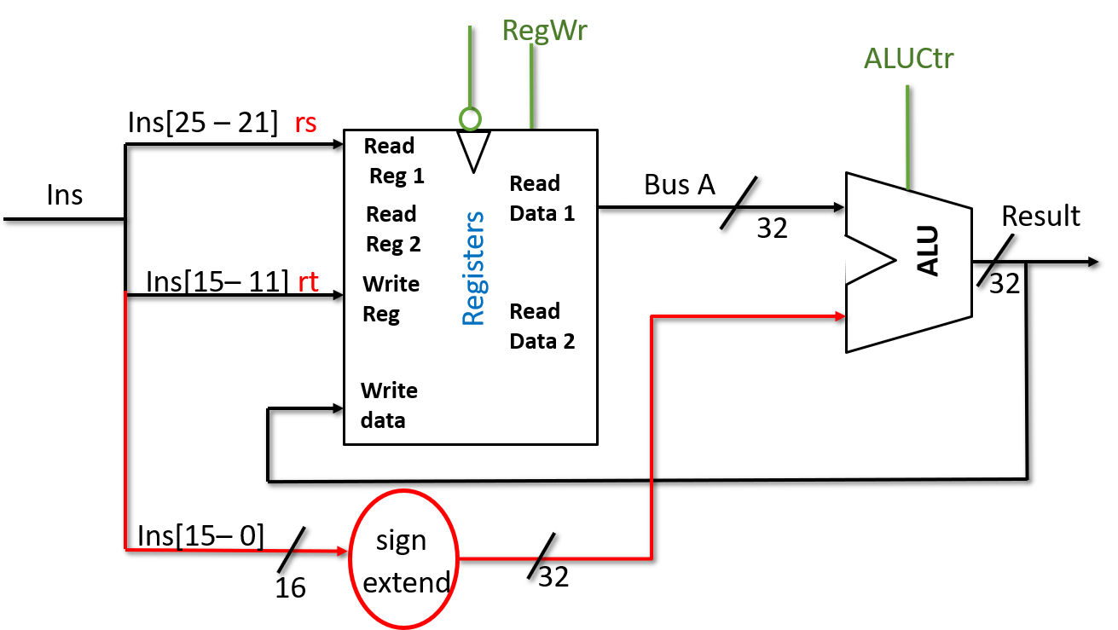
DATAPATH FOR SIMPLE J TYPE INSTRUCTION

Slide 16
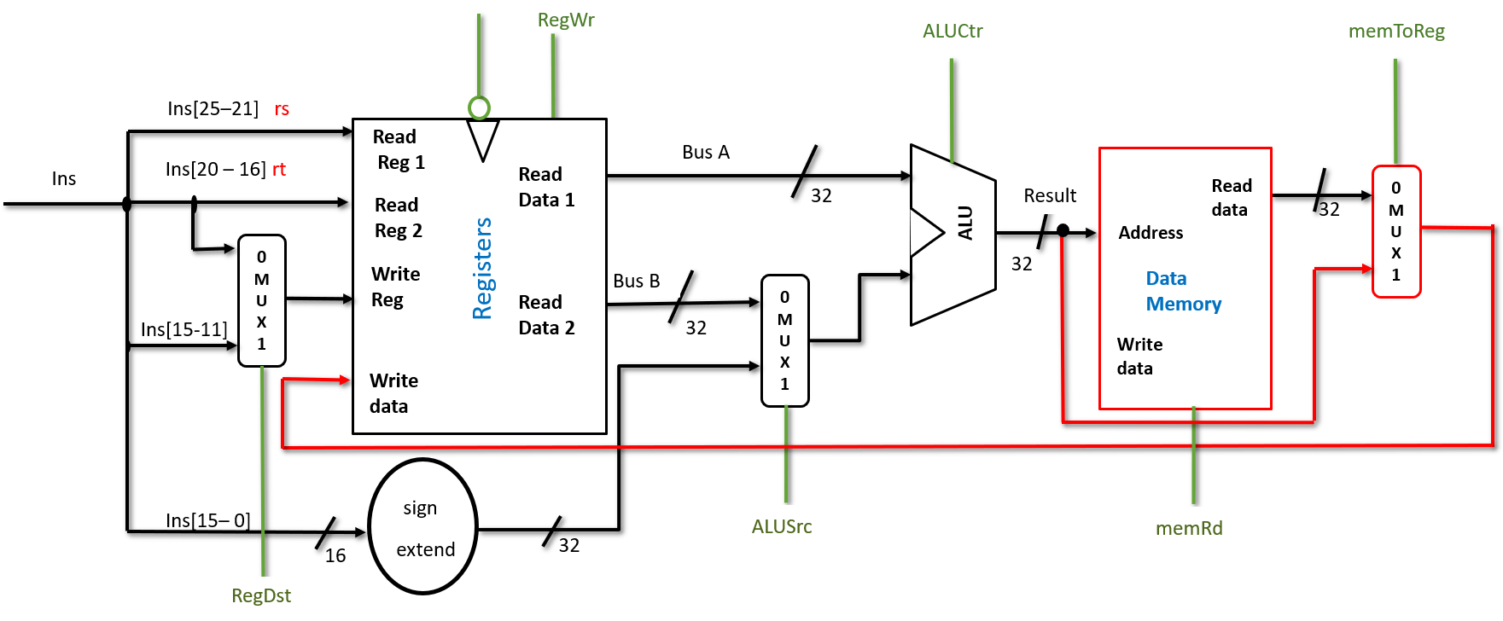
DATAPATH FOR LOAD INSTRUCTION

Slide 17
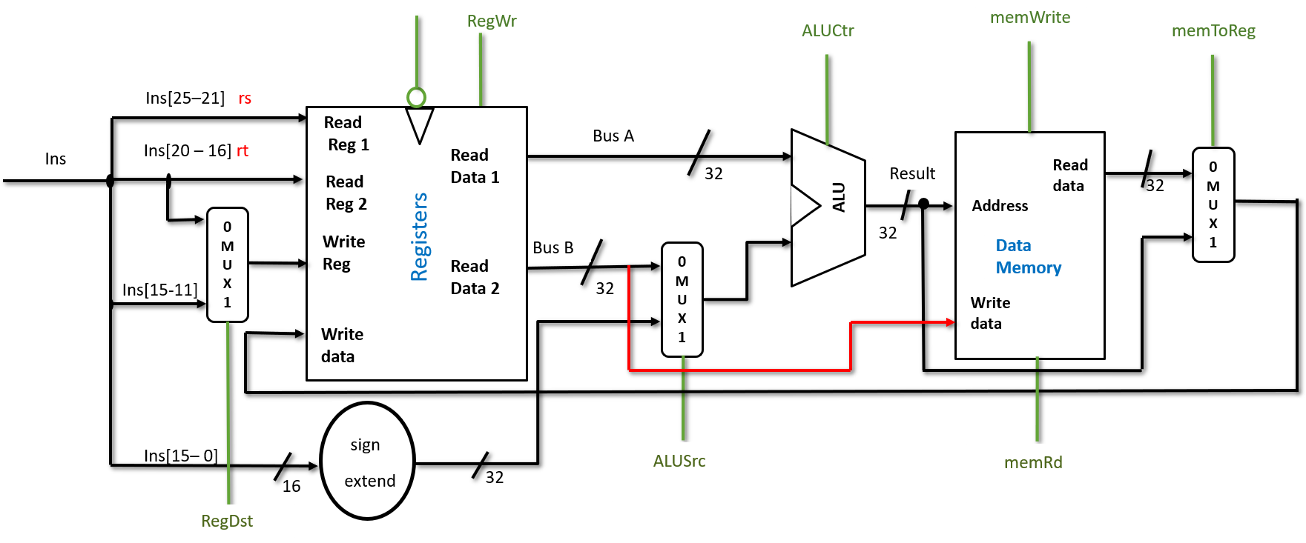
DATAPATH FOR STORE INSTRUCTION

Slide 18
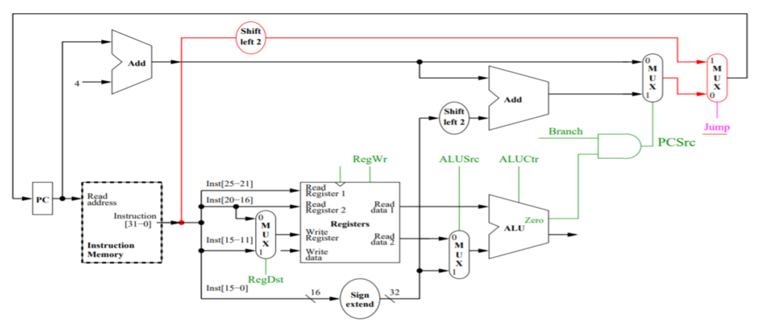
DATAPATH FOR branch AND JUMP INSTRUCTION

Slide 19
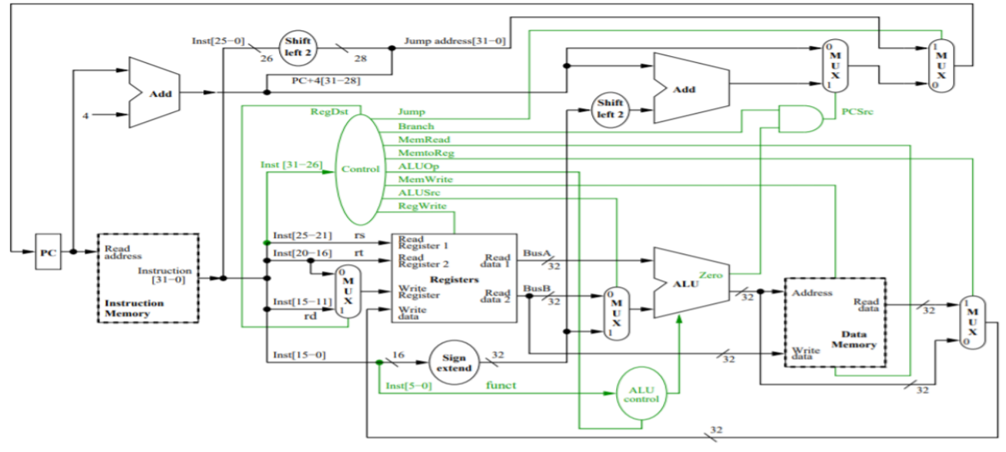
FINAL datapath

Slide 20
Logisim Demonstration

Slide 21
8th FIBONACCI NUMBER IN C
int main()
{
int n = 8; /* compute nth Fibonacci number */
int f1 = 1, f2 = -1; /* last two Fibonacci numbers */
while (n != 0) { /* count down to n = 0 */
f1 = f1 + f2;
f2 = f1 - f2;
n = n - 1;
}
printf("%d", f1); /* output the 8th fibonacci number */
return 0;
}

Slide 22
ASSEMBLY LANGUAGE CODE FOR FIBONACCI PROGRAM
# fib.asm
# Register usage: $3: n $4: f1 $5: f2
# return value written to address 0x1
fib: addi $3, $0, 8 # initialize n=8
addi $4, $0, 1 # initialize f1 = 1
addi $5, $0, -1 # initialize f2 = -1
loop: beq $3, $0, end # Done with loop if n = 0
add $4, $4, $5 # f1 = f1 + f2
sub $5, $4, $5 # f2 = f1 - f2
addi $3, $3, -1 # n = n - 1
j loop # repeat until done
end: sw $4, 1($0) # store result in address 1

Slide 23
MACHINE LANGUAGE CODE FOR FIBONACCI PROGRAM
Instruction Binary Encoding Hexadecimal Encoding
addi $3, $0, 8 001000 00000 00011 0000000000001000 20030008
addi $4, $0, 1 001000 00000 00100 0000000000000001 20040001
addi $5, $0, -1 001000 00000 00101 1111111111111111 2005ffff
beq $3, $0, end 000100 00011 00000 0000000000000100 10600004
add $4, $4, $5 000000 00100 00101 00100 00000 100000 00852020
sub $5, $4, $5 000000 00100 00101 00101 00000 100010 00852822
addi $3, $3, -1 001000 00011 00011 1111111111111111 2063ffff
j loop 000010 0000000000000000000000000011 08000003
sw $4, 1($0) 101011 00000 00100 0000000000000001 ac040001

