Slide 1
AI-Powered Online Examination and Learning Management Systems
First interim Project Presentation
Aibin Sabu NIE22CS006
Albert Joji NIE22CS008
Midhul M M NIE22CS032
Project Guide: Ms. Linny Sunny, AP, CSE

Slide 2
agenda
Introduction to AI in Educational Technology
Paper 1: AI-based Automated Question Paper Generation Using NLP
Paper 2: Secure Online Examination Systems - Cheating Prevention
Paper 3: Automated Grading and Evaluation Using Deep Learning
Paper 4: AI-driven Role-based Authentication in Academic Systems
Paper 5: AI-powered Doubt Resolution Systems
Comparative Analysis and Key Findings
Conclusion and Recommendations

Slide 3
INTRODUCTION
Paradigm Shift: Traditional education methods evolving to AI-powered systems
Driving Forces: Increased student populations, administrative burdens, need for scalability
Key Challenges: Maintaining quality while improving efficiency and accessibility
Natural Language Processing (NLP) for content understanding
Machine Learning for pattern recognition and personalization
Computer Vision for monitoring and authentication
Deep Learning for complex cognitive tasks
5 Research Papers reviewed (2024 publications)
Focus Areas: Question generation, security, authentication, student support Technology
Stack: Transformer models, CNN, LSTM, Biometric systems

Slide 4
Paper 1: AI-based Automated Question Paper Generation Using NLP Techniques
Problem: Manual question paper creation is time-consuming, inconsistent, and error-prone.
Method: NLP-based system (Gemini-1.5 Pro model) with content analysis, question generation, and quality assurance.
Results:
  80% faster question creation
  95% syllabus coverage, 85% instructor approval
Strengths: Scalable, bias reduction, real-time quality checks.
Limitations: Needs quality input material, high computational cost.

Slide 5
Paper 2: Secure Online Examination Systems - Cheating Prevention
Problem: Online exams face cheating risks like impersonation, collusion, and screen switching.
Method: Multi-modal approach (computer vision, ML anomaly detection, biometrics, behavioral analytics).
Results:
65% reduction in cheating cases
90%+ detection accuracy
Strengths: Real-time detection, scalable, adaptive learning.
Limitations: Privacy concerns, high cost, false positives.

Slide 6
Paper 3: Automated Grading and Evaluation Using Deep Learning
Problem: Manual grading is slow, inconsistent, and subjective.
Method: Deep learning models (BERT, CNN, BiLSTM, RoBERTa) with transfer learning and reinforcement learning.
Results:
80% accuracy, strong correlation with human graders
Partial credit & detailed feedback possible
Strengths: Scalable, unbiased, continuous improvement.
Limitations: Black-box issue, high training data needs, weak with creative/open-ended answers.

Slide 7
Paper 4: AI-driven Role-based Authentication in Academic Systems
Problem: Managing access in academic systems with many users and roles is complex.
Method: AI-enhanced RBAC (Role-Based Access Control) with biometrics, behavioral analytics, anomaly detection.
Results:
65% fewer unauthorized accesses
92% accuracy in role assignment
Strengths: Adaptive, continuous authentication, scalable.
Limitations: Setup complexity, privacy concerns, resource-heavy.

Slide 8
Paper 5: AI-powered Doubt Resolution Systems
Problem: Students lack real-time support in online learning, leading to reduced engagement.
Method: LLMs + knowledge graphs + semantic search for personalized, 24/7 doubt resolution.
Results:
40% higher course completion rates
85%+ correct responses
Strengths: Instant support, personalized answers, scalable across domains.
Limitations: Struggles with subjective/creative queries, risk of over-dependence, context limitations.

Slide 9
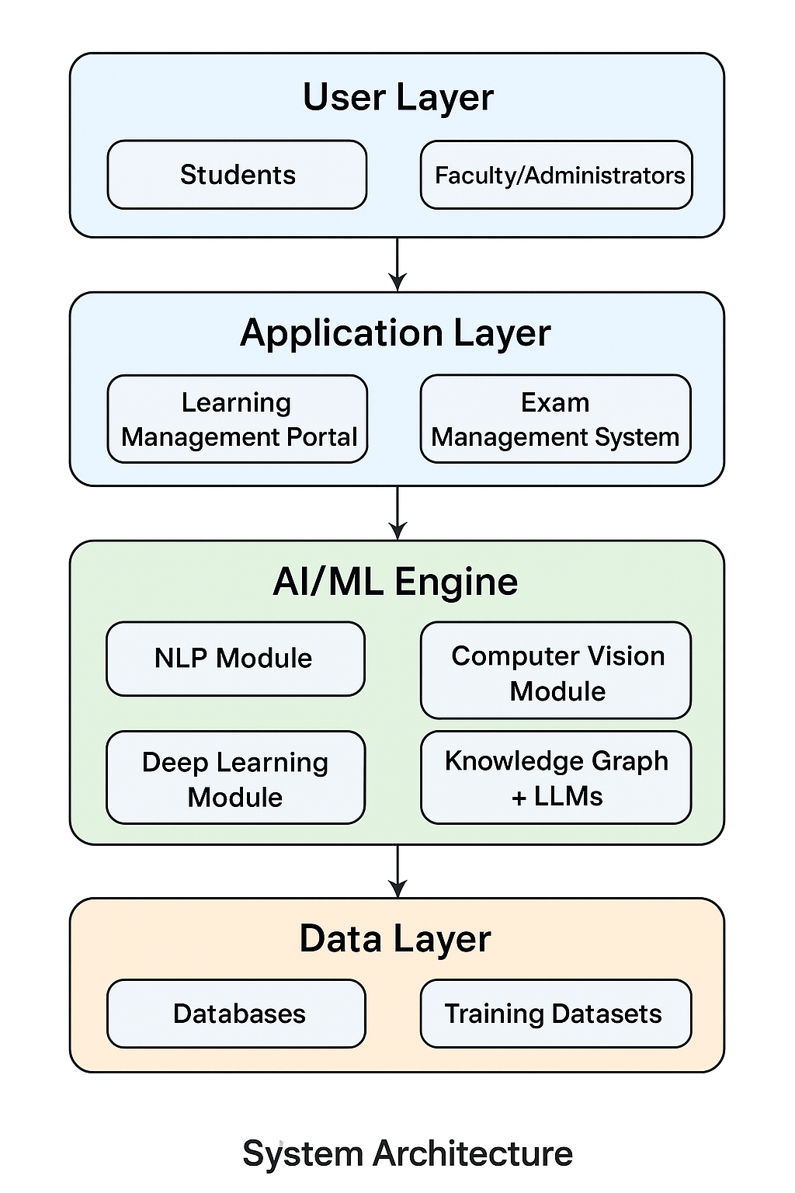
Technology
Architecture

Slide 10
Conclusion and Key Takeaways
Human-AI Collaboration: Augmentation rather than replacement
Privacy-First Design: Balancing functionality with user rights
Improvement: Systems that learn and adapt Accessibility Focus: Inclusive design for diverse populations
Personalized Learning: Individual-optimized educational experiences Intelligent
Assessment: Context-aware, fair evaluation systems Proactive
Support: Predictive assistance for learning challenges Global
Accessibility: Breaking down geographical and economic barriers

Slide 11
THANK YOU

