Slide 1
Grails: One hour to Deploy
Aleks Tamarkin Bloomberg

Slide 2
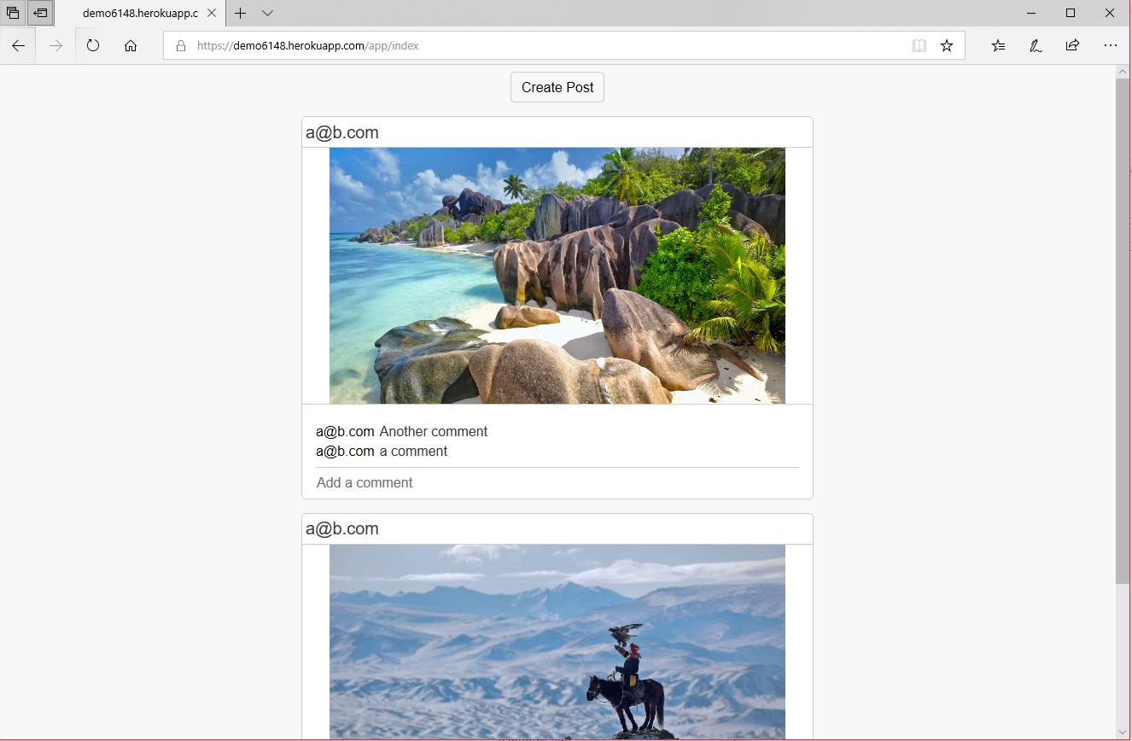
We are building
demo6148.herokuapp.com

Slide 3
Grails is a backend framework
Access your datastore
Get me all my blog posts
Checks access
Can this user get those blog posts?
Serves up my html/css/js
Compiles an efficient version of css/js
Reduces to few files as possible
Provides a development environment
No need to setup datastore
Recompiles files live

Slide 4
Why Grails
Opinionated
Light setup
Few requirements
Java Based
Err.. Groovy
If all else fails: Libraries

Slide 5
A Groovy Break

Slide 6
The Agenda: Get a presentable website up
Setup hello world
Add controllers (routes)
Classes & Datastores
Login/GSP/Forms
The Frontend (React.js)
Deploying to Heroku

Slide 7
Setup Hello World
Or at least the Grails Welcome Screen

Slide 8
Getting started
You will need
Java8
Create a project
http://start.grails.org
Run it
./grailsw run

Slide 9
Adding Controllers
Where the requests go to get answered

Slide 10
Contollers & Actions
New route /app/index
./grailsw create-controller app
Render things
render "hello world"
import grails.converters.JSON render([a: 1,b: [2, 3, "c"]] as JSON)
render file: "sample/a.png", contentType: "image/png"
Leave blank, create an index.gsp

Slide 11
Classes & Datastores
Let save some things

Slide 12
Entities
We should probably represent the following as classes
Okay, how do we save these things?
ImageFile
User
Post
Comment
User
User

Slide 13
How do we work classes
Lets say we have a class Post{…}
def p = new Post()
p.save()
p.delete()
Post.list(sort: ‘timestamp’, order: ‘descending’)
Post.findById(123)
Post.findAllByTimestampGreaterThan(12345)
Notes:
class User {
String email
static mapping = {
id name: 'email', generator: 'assigned'
}
}
class ImageFile {
byte[] imageData
String name
String contentType
static mapping = {
imageData sqlType: 'longblob'
}
static belongsTo = Post
}
class Comment {
User creator
String content
long timestamp = System.currentTimeMillis()
static belongsTo = Post
}
class Post {
User creator
ImageFile image
List<Comment> comments
long timestamp = System.currentTimeMillis()
static belongsTo = User
}

Slide 14
Lets code this up
bootstrap.groovy – save data on startup
Check out http://localhost:8080/dbconsole
AppController – lets create getters for our data
View the image
Get a JSON representation of our state
Notes:
import grails.util.Environment
if (Environment.getCurrent() != Environment.DEVELOPMENT) return
def user = new User(email: 'test@test.test')
user.save(flush: true)
def post = new Post(
creator: user,
image: new ImageFile(name: 'c.jpeg', contentType:"image/jpeg", imageData: new File("sample/c.jpeg").bytes),
comments: [
new Comment(creator: user, content: 'very cool!'),
new Comment(creator: user, content: 'agreed')
])
post.save(flush: true)
def getPostImage() {
def img = ImageFile.findById(params.id)
header 'Cache-Control', "max-age=44640"
render file: img.imageData, contentType: img.contentType
}
def getPosts() {
render([posts: Post.list(sort: 'timestamp', order: 'desc').collect {
[id: it.id, creator: it.creator.email, image: it.image.id, comments: it.comments.collect {
[content: it.content, creator: it.creator.email, id: it.id]
}]
}] as JSON)
}

Slide 15
Login/GSP/Forms
Guarding those Controllers

Slide 16
The login page & GSP
New controller
Showing the login page
Check if user exists
Create a new user if not
Redirect to the app controller
Use the built-in session Map
Build a login UI with GSP
Hit a controller + action not a URL
Conditionally display an error message
Notes:
<!Doctype html>
<html>
<head>
<asset:stylesheet src="login/index.css" />
</head>
<body>
<g:form action="login" class="login-form">
<g:if test="${flash.message}"><label>${flash.message}</label></g:if>
<input type="email" name="email" />
<g:submitButton name="submit" value="Login" />
</g:form>
</body>
</html>
class LoginController {
def index() { }
def login() {
if (params.email) {
def user = User.findByEmail(params.email)
if (!user) {
new User(email: params.email).save(flush: true)
}
session.email = params.email
redirect controller: 'app'
} else {
flash.message= "Email Cannot Be Blank"
redirect action: 'index'
}
}
}

Slide 17
Restrict the login page
Create an interceptor
Lets you wrap controllers + actions with before and after
Match on the app controller
Check the session
Redirect and return false if needed
Notes:
class LoginInterceptor {
LoginInterceptor () {
match controller: "app"
}
boolean before() {
if (!session.email) {
redirect controller: 'login'
return false
}
true
}
boolean after() { true }
void afterView() {
// no-op
}
}

Slide 18
Another Form to Upload Images
This time we have a file entry
<g:uploadForm /> to handle the file upload
Use request.getFile on the controller to get the file data we need
Bonus: Some javascript to display the selected image
Notes:
<!Doctype html>
<html>
<head>
<asset:javascript src="app/createPost.js" />
<asset:stylesheet src="app/index.css" />
</head>
<body>
<g:uploadForm action="savePost" class="post-create-form">
<div class="post-preview" name="preview"></div>
<label class="error-message" name="errmsg"></label>
<g:if test="${flash.message}"><label class='flash-message'>${flash.message}</label></g:if>
<input type="file" name="image" class='file-entry'/>
<g:submitButton name='upload' value="Create"/>
</g:uploadForm>
</body>
</html>
def savePost() {
def file = request.getFile('image')
new Post(creator: User.findByEmail(session.email), image:
new ImageFile(name: file.originalFilename, contentType: file.contentType, imageData: file.bytes)
).save(flush: true)
redirect action: 'index'
}
def addComment() {
Post post = Post.findById(params.id)
Comment comment = new Comment(creator: session.email, content: params.content)
post.comments << comment
if (post.save(flush: true)) {
render ([created:true, id: comment.id, user: session.email] as JSON)
} else {
println post.errors
render ([created:false] as JSON)
}
}
document.addEventListener('DOMContentLoaded', () => {
document.querySelector('.file-entry').onchange = function (evt) {
document.querySelector('.error-message').textContent = null;
var entry = evt.target;
console.log(evt);
var file = entry.files[0];
var reader = new FileReader();
reader.addEventListener("load", function () {
var result = reader.result;
var mime = result.substring(result.indexOf(':') + 1, result.indexOf(';'));
if (mime.substring(0, 'image'.length) !== 'image') {
entry.value = "";
document.querySelector('.error-message').textContent = "Error: bad file type: " + mime
return;
}
console.log(mime);
document.querySelector('.post-preview').style['background-image'] = "url(\"" + reader.result + "\")";
}, false);
if (file) {
reader.readAsDataURL(file);
}
};
});

Slide 19
The Frontend: React.js
Users need to see this website too…

Slide 20
Finally Some Config! (Libraries)
asset-pipeline – Compiles your js & css
Upgrade to 3.0.7
Add jsx & sass
clientDependencies
Downloads libs from npm/yarn/bower
Setup to download React.Js
Don’t forget to git ignore the vendor folder
Copy in your react frontend files
Notes:
assets "com.bertramlabs.plugins:jsx-asset-pipeline:3.0.7"
assets "com.bertramlabs.plugins:sass-asset-pipeline:3.0.7"
includes = ['*', 'app/**/*', 'login/**/*']
excludes = ['**/*']
classpath 'com.craigburke.gradle:client-dependencies:1.4.1‘
apply plugin: 'com.craigburke.client-dependencies‘
clientDependencies {
npm {
react('16.7.0') {}
'react-dom'('16.7.0') {}
}
}
grails-app/assets/vendor
<!Doctype html>
<html>
<head>
<asset:javascript src="app/index.js"/>
<asset:stylesheet src="app/index.css"/>
</head>
<body>
<div id="root" />
</body>
</html>
var React = require('react')
var ReactDOM = require('react-dom')
document.addEventListener('DOMContentLoaded', () => {
fetch('getPosts', {credentials: 'include'}).then(r => r.json()).then(data => {
console.log(data);
//ReactDOM.render(<Posts {...data} />, document.getElementById('root'));
});
});
var Post = require('post.js')
class Posts extends React.Component {
constructor(props) {
super(props);
this.state = {posts: props.posts}
}
render() {
return <div className='posts-root'>
<div className='posts-create' onClick={() => {window.location = 'createPost'}}></div>
{
this.state.posts.map(x =>
<Post key={x.id} postId={x.id} image={x.image} comments={x.comments} creator={x.creator} />
)
}
</div>
}
}

Slide 21
Deploying to Heroku
Up up and and deployed

Slide 22
More Config
We are going to need a database
Add a ClearDB MYSQL instance
We need to hookup the database.
The database library is constant, but the username & password is not
Heroku needs a procfile to know what to run
Also lets setup some of the variables
Finally lets set some config variables
GRADLE_TASK assemble
JAVA_OPTS -Dgrails.env=production
Notes:
Procfile:
web: cd build; java $JAVA_TOOL_OPTIONS -Dserver.port=$PORT -Dgrails.env=$GRAILS_ENV $JAVA_OPTS -jar libs/*.war
application.groovy
environments {
production {
dataSource {
url = System.env.JDBC_DATABASE_URL
username = System.env.JDBC_DATABASE_USERNAME
password = System.env.JDBC_DATABASE_PASSWORD
}
}
}

Slide 23
That’s all folks… Heres some TODOs
Persist the session across machines (using the cookie-session plugin)
Use something better than email to login
Features
Delete Posts
Likes
View permssions
What does the css (scss) look like?
P.S. Everything youv’e seen today is here
https://github.com/aibolit/sixonefoureight

