Slide 1

Intermediate Presentation
SVBRDF Estimation using a Physically-based Differentiable Renderer Markus Andreas Worchel

Slide 2
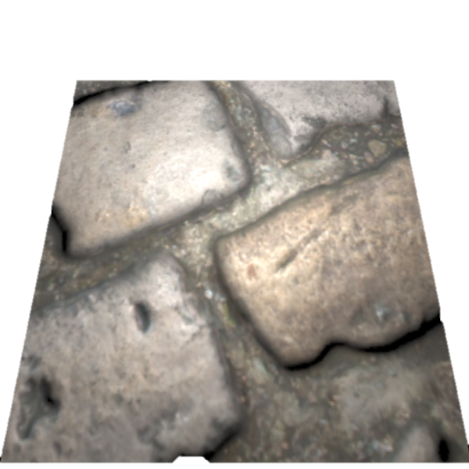
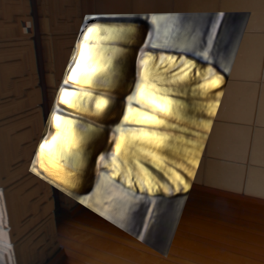
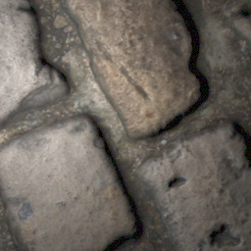
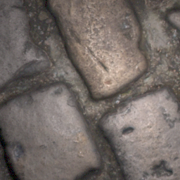
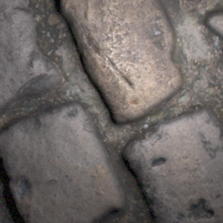
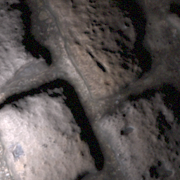
Recap
Physically-based
Differentiable Renderer
…
CNN
…
…
…
…

Slide 3
Schedule
Download database
Acquire testing and training code for the network
Get familiar with papers, source code and data
Acquire code for Mitsuba 2
Replace rendering layers of the network with Mitsuba 2
Evaluation (compare with unmodified method)

Slide 4
Models
Single-view Model (Deschaintre et al., 2018) ✓
Multi-view Model (Deschaintre et al., 2019) (✓)

Slide 5
Rendering
L1 loss between SVBRDF maps was implemented last time
Now: Rendering loss -> Requires local renderer
Implemented local renderer using Lambertian Diffuse Term and Cook-Torrance specular model

Slide 6
Integration of Path Tracer
Mitsuba 2 still not released → Fall back to Redner ✓
Redner is not compatible with Windows (requires GCC intrinsics) → Patch Redner code ✓ → Send PR to upstream repository ✓
Uses OpenEXR python bindings (no Windows compatibility) → Patch OpenEXRPython code ✓ → Send PR to upstream repository ✓

Slide 7

Integration of Path Tracer
Current rendering loss uses a trick to use as many information as possible
Given camera and light position looks like this
But renderer renders it like this (homography to orthogonal view)
📷
💡
💡
📷
📷
💡

Slide 8
Schedule
Download database
Acquire testing and training code for the network
Contact authors for training code
Fallback: Re-implementation
Acquire code for Mitsuba 2
Not yet officially released
Fallback: Use other renderer like render (Li et al., 2018)
Get familiar with papers, source code and data
Replace rendering layers of the network with Mitsuba 2
Evaluation (compare with unmodified method)

