Slide 1

Topic Presentation
SVBRDF Estimation using a Physically-based Differentiable Renderer Markus Andreas Worchel

Slide 2
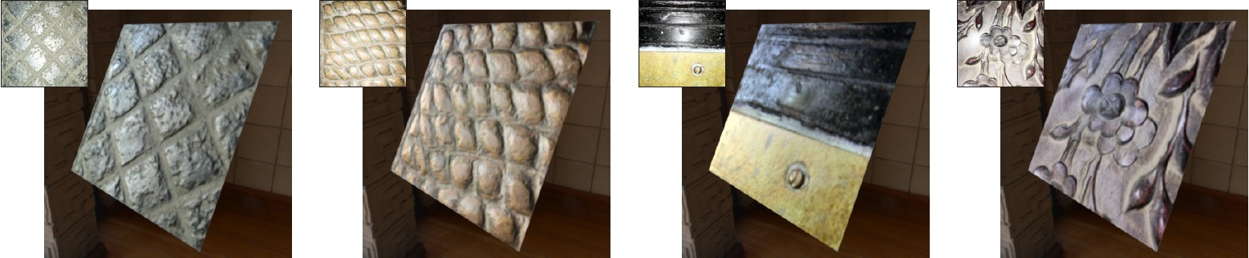
What?
Estimate surface material properties from images
Constraint: Use a physically-based differentiable renderer
Notes:
Want to estimate material properties from images of real world surfaces
Material properties here specifically reflection properties (not transmission)
I have one constraint for this task: I want to do this using a differentiable renderer at some point
--> is a renderer which allows differentiation of the output image with respect to the rendering parameters like e.g. camera position
- SVBRDF = spatially varying reflectance distribution function

Slide 3
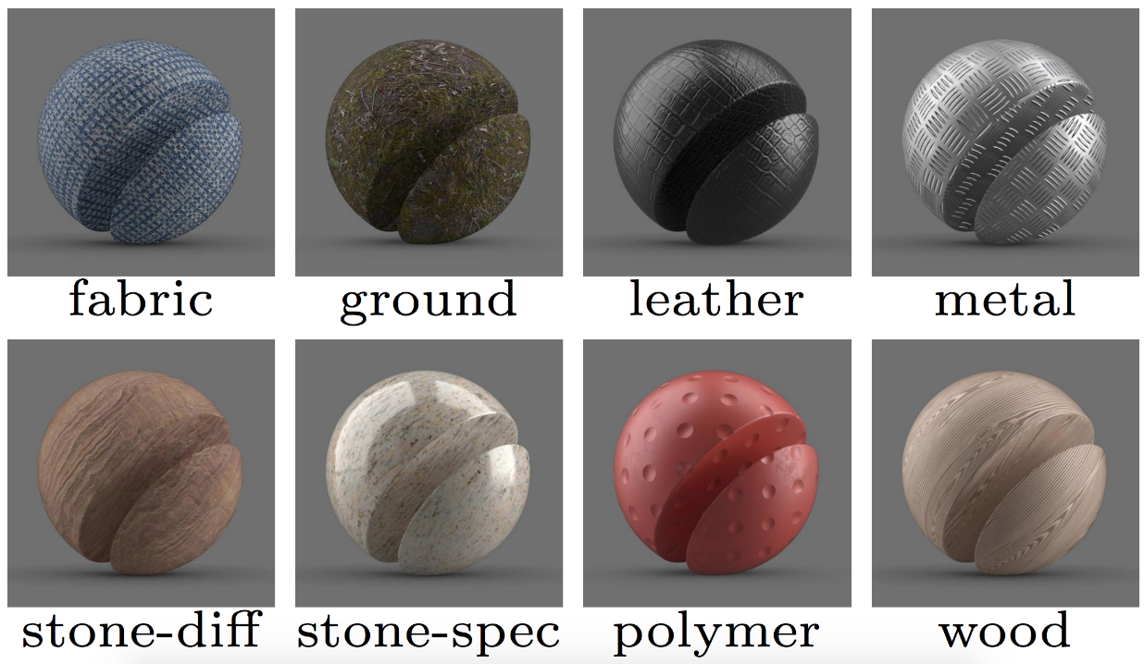
Why?
Gear towards holistic 3D reconstruction (geometry + material)
Photorealistic assets for
Games
Movies
Cultural heritage
…
Multi material 3D printing
Notes:
- (Want to touch on why even care about surface appearance of objects (why differentiable renderer is more clear after the “how”))
- Image-based material estimation is important if we want to have 3d reconstruction methods which not only recover the geometry but also the appearance of real world objects
--- reconstructing geometry from images is already very advanced, material not so much
Biggest use-case of such methods is probably the creation photorealistic assets
-- for example for integration in virtual environments like games, movies
-- cultural heritage (imagine ancient artifacts being scanned and preserved)
Others
- Another use-case could be re-crafting of real world objects with the corresponding materials (e.g. multi material 3d printers) --- Not 100% sure how advanced this field is

Slide 4
How?
Single-Image SVBRDF Capture with a Rendering-Aware Deep Network (Deschaintre et al., 2018)
Method based on machine learning and differentiable rendering
Dataset of 200000 (artificial) material samples
Integration of Mitsuba 2 (Nimier-David et al., 2019)
“Real” renderer enables simulation of
Global illumination
Transmittance effects
Notes:
Obviously I’m not going to building my own pipeline from scratch but use an existing one
Specifically I will use the paper … as base
From a single flash image of a flat surface they output material reflection properties of this surface
How exactly these properties are modeled will follow in the technical presentation
They use a convolutional network that is trained with the help of a very basic differentiable renderer (they use some kind of rendering loss as training objective)
Current plan is integrating the Mitsuba 2 renderer into their pipeline, so use a “real” renderer not just some tensorflow layers
“Real” renderer would lay the basis for extending the idea from flat surface and reflectance properties to arbitrarily shaped scenes (where global illumination is important to consider) and also transmittance properties needed for e. g. translucent materials

Slide 5
Schedule
Download database
Acquire testing and training code for the network
Contact authors for training code
Fallback: Re-implementation
Acquire code for Mitsuba 2
Not yet officially released
Fallback: Use other renderer like render (Li et al., 2018)
Get familiar with papers, source code and data
Replace rendering layers of the network with Mitsuba 2
Evaluation (compare with unmodified method)

