Slide 1

Final Presentation
SVBRDF Estimation using a Physically-based Differentiable Renderer Markus Andreas Worchel

Slide 2
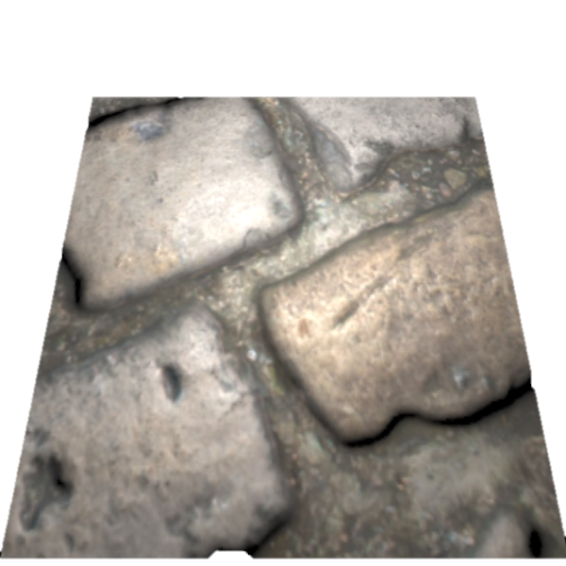
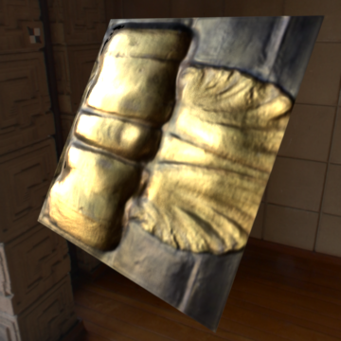
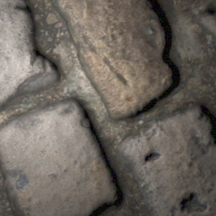
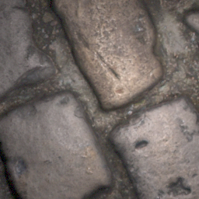
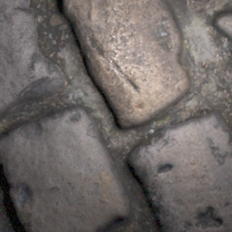
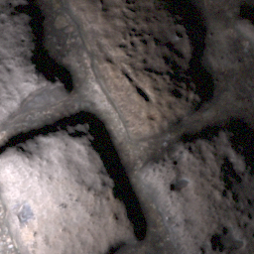
Recap – Topic
…
…
…
…
…

Slide 3
Recap – Approach
…
CNN
…
…
…
[1, 2]
…
[1] Deschaintre et al., 2018, Single-Image SVBRDF Capture with a Rendering-Aware Deep Network [2] Deschaintre et al., 2019, Flexible SVBRDF Capture with a Multi-Image Deep Network

Slide 4
Recap – Project Scope
Differentiable Pathtracer
[3]
…
CNN
…
…
…
[1, 2]
…
[1] Deschaintre et al., 2018, Single-Image SVBRDF Capture with a Rendering-Aware Deep Network [2] Deschaintre et al., 2019, Flexible SVBRDF Capture with a Multi-Image Deep Network
[3] Li et al., 2018, Differentiable Monte Carlo Ray Tracing through Edge Sampling

Slide 5
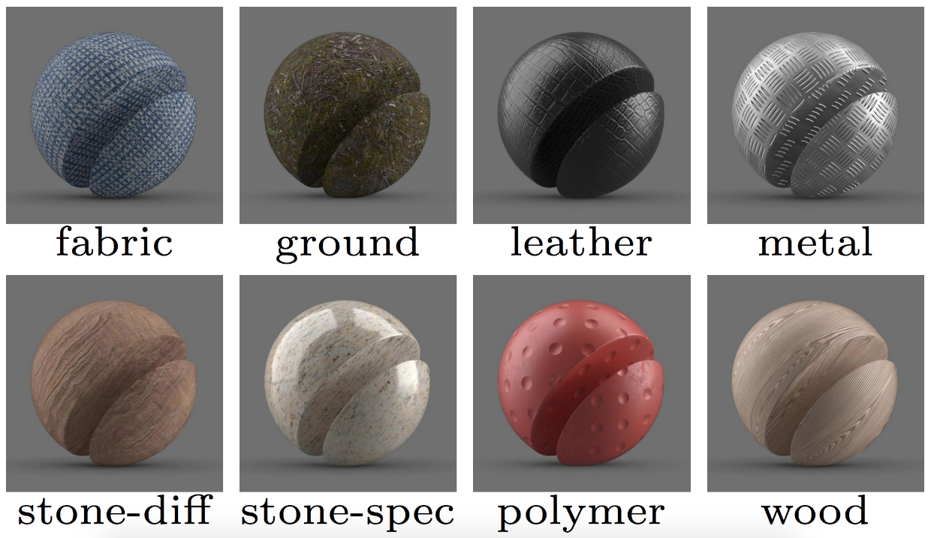
Recap – Motivation
Why material estimation?
Holistic 3D reconstruction (geometry + material)
Photorealistic assets for
Games
Movies
Cultural heritage
…
Multi material 3D printing
Why using a differentiable pathtracer?
General approach (independent of use case)
Flexible light transport simulations

Slide 6
Algorithm – Data
Data representation (images (maybe) + SVBRDFs)
Image generation
Material mixing

Slide 7
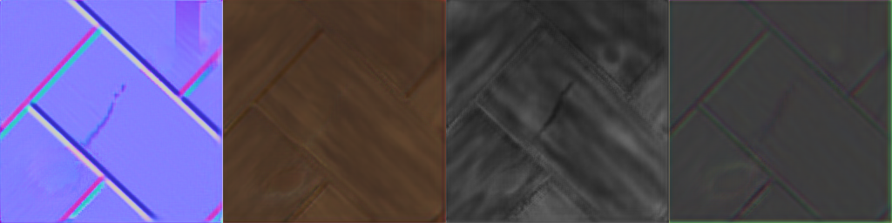

Algorithm – Overview
Data Reader
Encoder
Decoder
Loss
…
…
Global Track

Slide 8
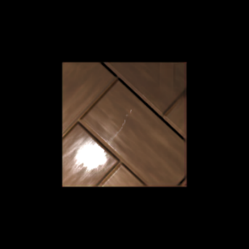

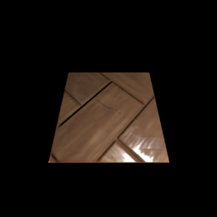
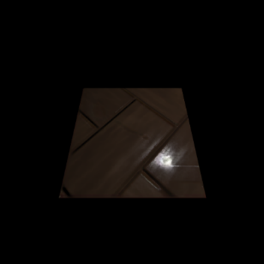
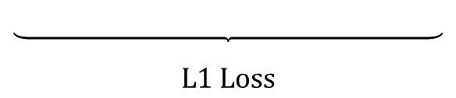
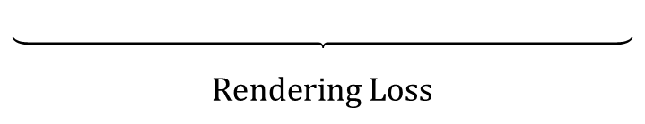
Algorithm – Loss
-
+
-
$$\text{L}\text{1 }\text{Loss}$$
$$\text{Rendering} \text{Loss}$$

Slide 9
Algorithm – Differentiable Renderers
Local Renderer implemented using
PyTorch Operations
Redner (pathtracer) implemented in C++
with PyTorch bindings

Slide 10
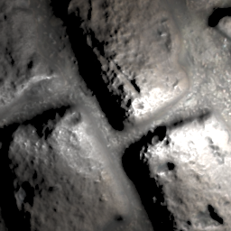
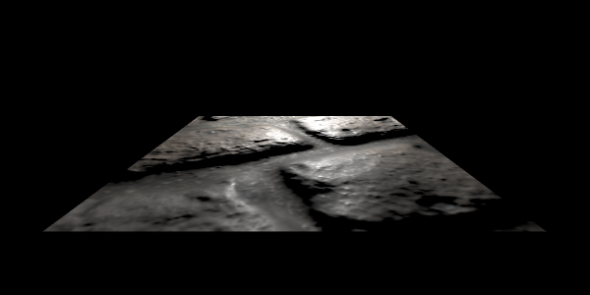
Renderer Output
Solution: patch rendering
No data for weight optimization

Slide 11
Patch Sampling in Redner
TODO: Explanation of manual derivates in C++ and video showing that the derivatives work (material optimization by comparing renderings)

Slide 12
Algorithm - Inference
TODO: Flowchart of the algorithm separated into Training and Inference (images, SVBRDF, image generation, data preparation, u-net encoder decoder, loss function (with renderers [direct illumination/pathtracing]))

Slide 13
Results
Qualitative comparison of reference results and re-implementation
Qualitative comparison of re-implementation direct illumination vs pathtracing
Quantitative comparison (training time, loss graphs)
Real world samples estimated by all methods
Videos / (interactive application?)

Slide 14
Limitations
Training time
Correlated feature maps
Metal

Slide 15
Future Work
BSDF estimation
Generic geometry
Optimized C++ implementation

