Slide 1

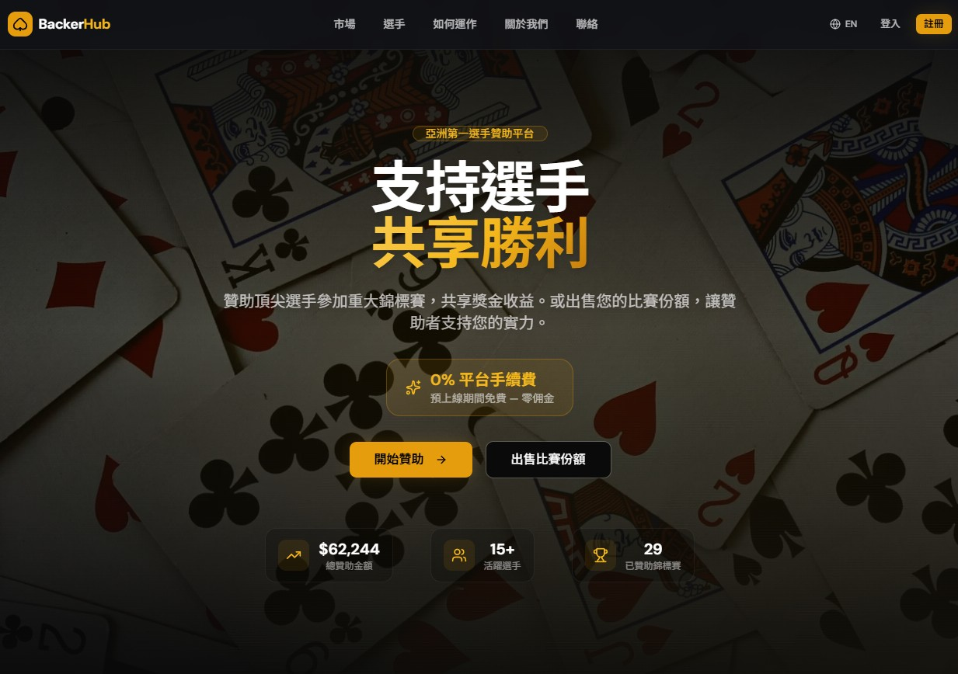

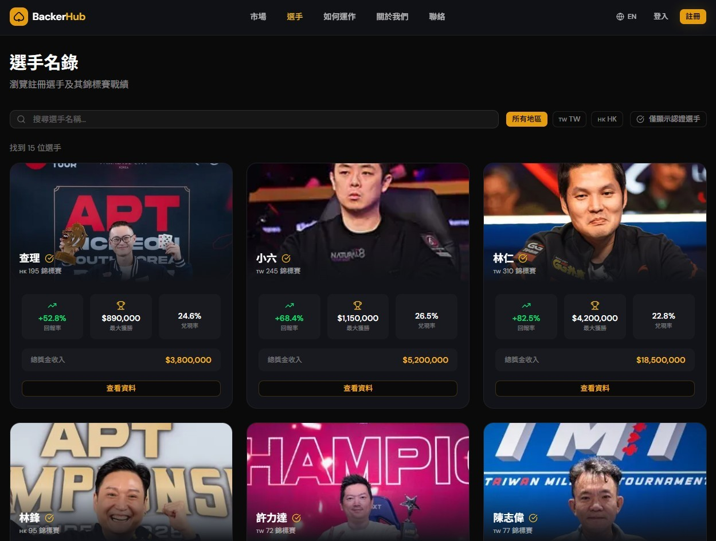

BackerHub
Back Players.
Share Victories.
Asia’s First Poker Backing Platform
Investor Presentation
Investor Presentation
March 2026

Slide 2





BackerHub Investor Presentation 2026
The Problem
Poker Staking is Broken
Fragmented & Informal
Western-Centric Platforms
Most staking deals happen on forums, WhatsApp groups, and handshake agreements. No escrow, no verification, no recourse when things go wrong.
Incumbents like StakeKings and PokerStake serve US/EU markets. They lack local Asian payment methods, Chinese language support, and regional focus.
Zero Trust Infrastructure
Opaque Fee Structures
No identity verification, no official result validation, and no reliability scoring. Players can disappear with backers' money without consequence.
Hidden commissions ranging from 1-10%. No transparent cost breakdowns means backers often don't know the true price they are paying for action.
2

Slide 3










The Solution
BackerHub Investor Presentation 2026
BackerHub: Trust-First Player Backing
Escrow-Protected Funds
Identity Verified Players
Backer money is never sent directly to players. Funds are held in secure escrow until specific, admin-verified milestones are met.
All players must pass KYC checks. Performance is tracked with transparency, including reliability scores and settlement history.
Multi-Step Verification
Built for Asia
A rigorous 3-step process: Registration proof, official result validation, and prize deposit confirmation — all admin-verified.
Full support for English & Traditional Chinese. Tailored for local tournaments with regional payment integration.
Integrated Local Payment Rails
ECPay
LINE Pay
JKoPay
AlipayHK
FPS
3

Slide 4









Market Opportunity
BackerHub Investor Presentation 2026
$11.4B Market with No Asia Leader
TAM Total Addressable Market
Key Market Indicators
$11.4B
Global Online Poker Market by 2030
13.7%
$481M
SAM Serviceable Addressable Market
Online Poker CAGR
to 2030
WSOP 2025
Prize Money
$2.3B
Asia-Pacific Poker Tournament Economy
$34M+
28,000+
SOM Serviceable Obtainable Market
$115M
APT Taipei Nov 2025
Total Prizes
APT Championship
Player Entries
Addressable Staking Market (Asia, Year 5)
4

Slide 5



BackerHub Investor Presentation 2026
Why Now
Three Tailwinds Converge
Legal Clarity
Tournament Boom
Payment Explosion
Key Milestone
Taipei 2025 Prizes
Fintech Market 2025
Supreme Court (Feb 2025)
$54M+ Total Prizes
$112.5B Market
Taiwan confirmed poker tournaments as a "mind sport" — definitively distinguishing it from gambling, paving the way for regulated growth.
Asian poker is exploding with 40%+ YoY growth in entries and prize pools, attracting global attention.
Massive adoption of digital wallets with 80%+ mobile penetration across the region simplifies cross-border staking.
CTP Club is now the #1 venue globally with 302,505 registered players.
APT Taipei: 22,909 entries, $20M prizes
LINE Pay: 13.1M users, $25B volume
APT Champ: 28,000+ entries, $34M+ prizes
Gov target: 8B non-cash tx by 2026
5

Slide 6







BackerHub Investor Presentation 2026
How It Works
Three Steps to Start Backing
01
Browse Players
Verified Stats & ROI
Explore verified poker players with detailed performance stats, ROI history, and reliability scores.
Filter by Buy-in
02
Back a Player
Transparent Fees
Purchase a percentage of a player's tournament action. Transparent cost breakdowns with funds held in escrow.
Escrow Protection
03
Win Together
Verified Winnings
When the player cashes, winnings are verified against official records and distributed proportionally automatically.
Auto-Distribution
6

Slide 7





User Flow
BackerHub Investor Presentation 2026
Complete BackerHub Experience
1
2
3
4
5
6
Onboarding
Browse
Transaction
Tournament
Settlement
Payout
Sign Up
Discovery
Buy Action
Notification
Receive ROI
Backer
Connect wallet or email registration
Filter by ROI & Rating
Purchase % + Fees
Result alert received
Auto-deposit to wallet
KYC Check
Escrow Lock
Live Tracking
Admin Verify
Distribute
System
Identity Verification
Funds held securely
API Integration
Confirm official results
Smart Contract Exec
Register
Create Listing
Confirm Reg
Compete
Report Result
Get Rated
Player
Profile & ID Upload
Set markup & % sold
Upload ticket proof
Play in tournament
Upload win proof
Reliability score up
7

Slide 8






BackerHub Investor Presentation 2026
Product
Institutional-Grade Risk Management
Escrow Protection
KYC Verified Players
Admin Verification
Funds never go directly to players. All money is held in secure escrow until specific milestones are admin-verified, ensuring 100% safety of backer capital.
Identity strictly verified. Detailed tracking of player stats, ROI history, and past cash rates ensures transparency before any deal is made.
Nothing is automated without oversight. Registration proof, tournament results, and deposits are all verified against official records by our team.
Enforced Deadlines
Reliability Scoring
Withdrawal Lock
Strict timelines: 48h for registration, 3 days for results, 14 days for deposit. Missed deadlines trigger immediate admin review and potential penalties.
Dynamic player scores based on on-time settlements versus defaults. Scores are public, creating accountability and helping backers choose wisely.
Smart contract logic prevents players from withdrawing funds while prize deposits are pending, preventing post-win escape and ensuring timely payouts.
8

Slide 9






Business Model
BackerHub Investor Presentation 2026
Simple, Scalable Revenue
Unit Economics
2% Platform Fee
Example: $10,000 Buy-in Tournament
Primary
Applied on every backer transaction post-launch. (0% during pre-launch campaign).
Action Sold
50%
Percentage of buy-in listed
1-3% Processing
Pass-through
Base Action Cost
$5,000
50% of $10,000 buy-in
Standard fees from ECPay, LINE Pay, and other gateways passed directly to users.
Player Markup
+$750
1.15x Multiplier
Premium Listings
Future (TBD)
Platform Fee
+$115
2% of total transaction
Featured placement & priority visibility in marketplace for pro players.
Total Cost to Backer
$5,865
Data & Analytics
Pro Tier (TBD)
$115.00
BackerHub Net Revenue
Advanced player insights and deep dive stats for serious institutional backers.
9

Slide 10









Business Model
BackerHub Investor Presentation 2026
Revenue Model Deep Dive
Fee Comparison
Where Backer Money Goes
BackerHub
2% Flat
Transparent
StakeKings
1-10%
Total Backed
Variable/Hidden
$5,965
PokerStake
Undisclosed
Opaque Model
Operator
N/A
Player Action
Platform Fee
Processing
Staking Only
96.3%
2.0%
1.7%
$5,750 (Base + Markup)
$115 Revenue
~$100 Pass-through
10

Slide 11





BackerHub Investor Presentation 2026
Competitive Landscape
No Asia-Focused Competitor Exists
Key Features
BackerHub
StakeKings
PokerStake
GGPoker
Asia Focus & Language
Market Leader
US/EU Only
Global/EU
Partial
Local Payments (TW/HK)
Native Integration
Credit Card/Crypto
Limited
Agent Based
Escrow Protection
Admin Verified
Partial
Direct P2P
Automated
Identity Verification
Strict KYC
Basic Email
None
Account Only
Platform Fee
2% Flat
1-10%
Hidden
0%
Transparent
Hidden Fees
Undisclosed
Rake Model
Crypto Support
USDT / BTC
Supported
Supported
Agent Only
11

Slide 12






Traction & Milestones
BackerHub Investor Presentation 2026
Building Momentum
Pre-Launch Status
2026 Roadmap
Full Platform Built
Next.js + Supabase architecture ready
Q1
Q2
Q3
Q4
Launch & Seed
Events & Growth
Expansion
Scale Up
Staking Lifecycle Live
Listing to payout automation
Platform Launch
HK Expansion
2,000+ Users
CTP Partnership
First APT Event
Crypto Live
Premium Features
Seed Users Onboarding
500 Active Users
Cross-border Staking
Series A Prep
Bilingual Interface
Marketing Push
English + Traditional Chinese
Key Targets (Year 1)
7 Payment Integrations
2,000+
$2M+
200+
85%
Configured & tested (ECPay, LINE, etc)
Registered Users
Gross Transaction
Listings Created
Settlement Rate
Verified Player Directory
13+ seeded initial pros
12

Slide 13








Go-To-Market Strategy
Land, Expand, Dominate
BackerHub Investor Presentation 2026
Phase 1: Taiwan
Phase 2: Hong Kong
Phase 3: APAC
Q1 2026
Q2 2026
Q3 2026
Q4 2026
2027+
Phase 1
Phase 2
Phase 3
Taiwan Launch
Hong Kong Expansion
APAC Scale
Q1 – Q2 2026
Q3 – Q4 2026
2027+
CTP Partnership
Local Payment Rail
Regional Entry
Direct access to 302K registered players at #1 global venue.
AlipayHK
PayMe
FPS
Japan, South Korea, Philippines expansion with localized support.
APT Sponsorship
Macau Coverage
Major Series
Major physical event presence in Taipei during tournament series.
Targeting high-roller cash games and cross-border staking.
Crypto Integration
Native Mobile Apps
0% Fee Campaign
Support for BTC, ETH, and USDT for frictionless large transfers.
Official partnerships with WPT & WSOP Asia events.
Aggressive user acquisition strategy for early adopters.
Local Payments
Dedicated iOS/Android apps + Organizer API integration.
ECPay
LINE Pay
JKoPay
500
$500K
2,000
$2.0M
10,000
$20M+
Target Users
Target GTV
Target Users
Target GTV
Target Users
Target GTV
13

Slide 14











The Team
BackerHub Investor Presentation 2026
Finance Meets Technology
Co-Founder
Co-Founder
Investment Banking
& Audit
AI Engineering
& Quant Systems
Former Big Four Auditor
+
Former Hedge Fund AI Engineer
Financial Audit & Compliance
ML & AI Systems Architecture
Risk Management & Controls
Quantitative Analysis & Modeling
Escrow Fund Architecture
Algorithm Design & Analytics
Regulatory Frameworks
Full-Stack Platform Engineering
14

Slide 15

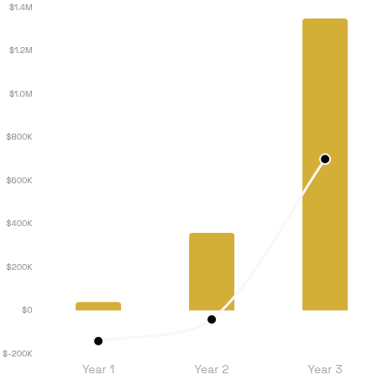



Financial Projections
Path to Profitability
BackerHub Investor Presentation 2026
METRIC | YEAR 1 | YEAR 2 | YEAR 3
GTV (Gross Transaction) | $2.0M | $12.0M | $45.0M
Active Users | 2,000 | 8,000 | 25,000
Listings Created | 200 | 1,200 | 4,500
Net Revenue | $40K | $360K | $1.35M
Operating Costs | $180K | $400K | $650K
Net Income | -$140K | -$40K | +$700K
Revenue vs. Net Income
Net Revenue
Net Income
Break-even mid-Year 2
Key Assumptions
2% Platform Fee (post-launch)
Avg Listing: $10K Buy-in
50% Action Sold
15

Slide 16





BackerHub Investor Presentation 2026
BackerHub
Back Players. Share Victories.
Seeking
40% Engineering
$500K
25% Business Dev
Use of
Funds
20% Marketing
Seed Round
15% Ops & Legal
support@backerhub.com
Taipei, Taiwan
www.backerhubasia.vercel.app
Confidential

