Slide 1

📋 Legal Strategy Overview
• Comprehensive defense strategy based on available evidence and precedents. Focus on procedural safeguards and constitutional protections.
• Tailored approach based on case specifics
• Professional presentation designed for your goals

Slide 2
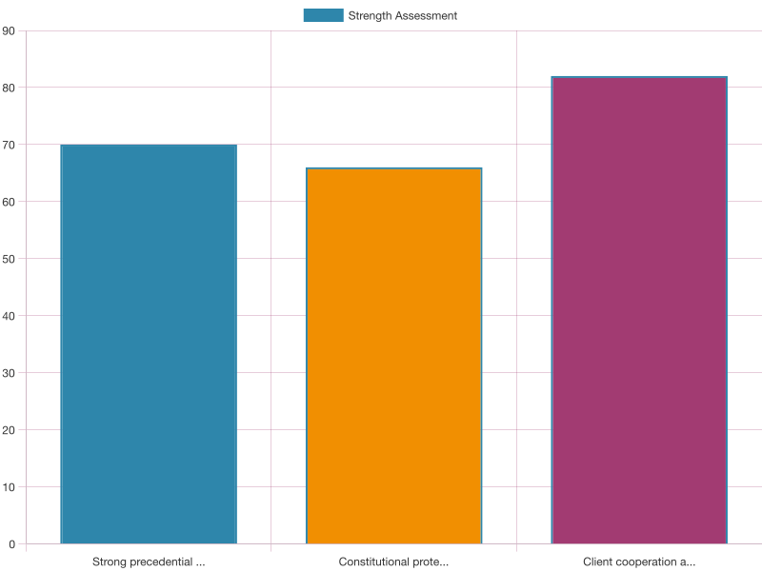
💪 Key Strengths & Advantages
• Strong precedential support available
• Constitutional protections applicable
• Client cooperation and support network

Slide 3
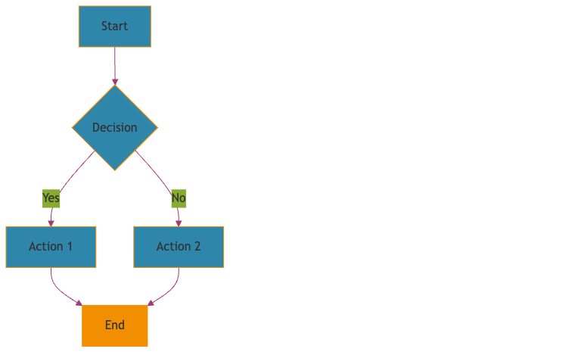
⚠️ Risk Analysis & Mitigation
• Evidence challenges require careful handling
• Procedural requirements must be met precisely
• Public perception considerations

Slide 4
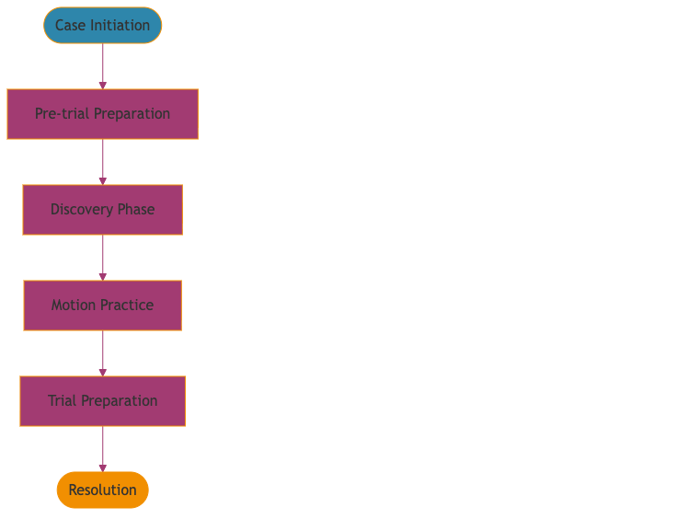
🎯 Recommended Strategic Approach
• Multi-pronged defense focusing on Charter applications, evidence challenges, and alternative resolutions.
• Evidence-driven decision making
• Goal-oriented execution plan

Slide 5
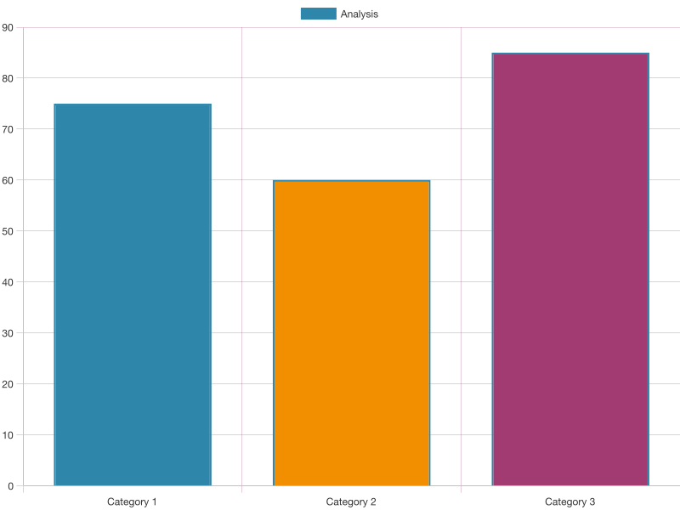
📅 Timeline & Implementation
• Early Charter applications to exclude problematic evidence
• Thorough cross-examination preparation
• Expert witness considerations
• Plea negotiation possibilities

Slide 6
✅ Next Steps & Action Items
• Immediate action items identified
• Resource requirements outlined
• Success metrics established

Slide 7
Thank You
Questions & Discussion
Legal Strategy Platform

