Slide 1
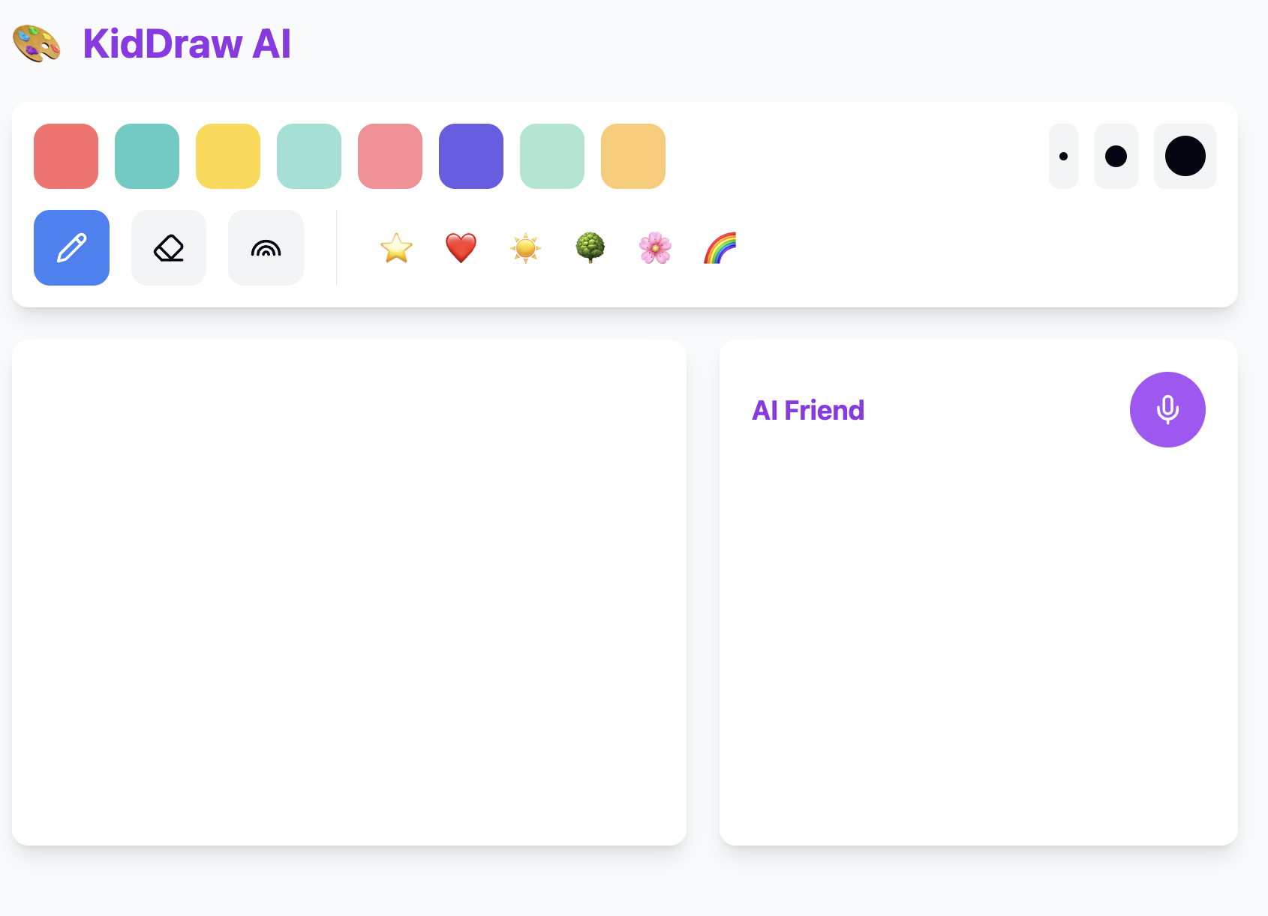
KidDrawAI
Powered by AIbyML.co.uk

Slide 2
Deep Structure for KidDrawAI:
AI Stack & API:
Llama-3.2-vision for image/text analysis (self-hosted)
Whisper for voice processing
TensorFlow behavior pattern analysis
WebSocket (real-time)
REST + GraphQL
Security:
E2E encryption
COPPA compliance
Parental dashboard
Firebase auth

Slide 3
Architecture for KidDrawAI:
Frontend:
React Native
TensorFlow.js for image preprocessing
Tailwind CSS UI
Drawing canvas + voice input
Backend:
Node.js/Express
PostgreSQL (user data)
MongoDB (drawings/interactions)
MinIO for media storage (self-hosted alternative to S3)

Slide 4
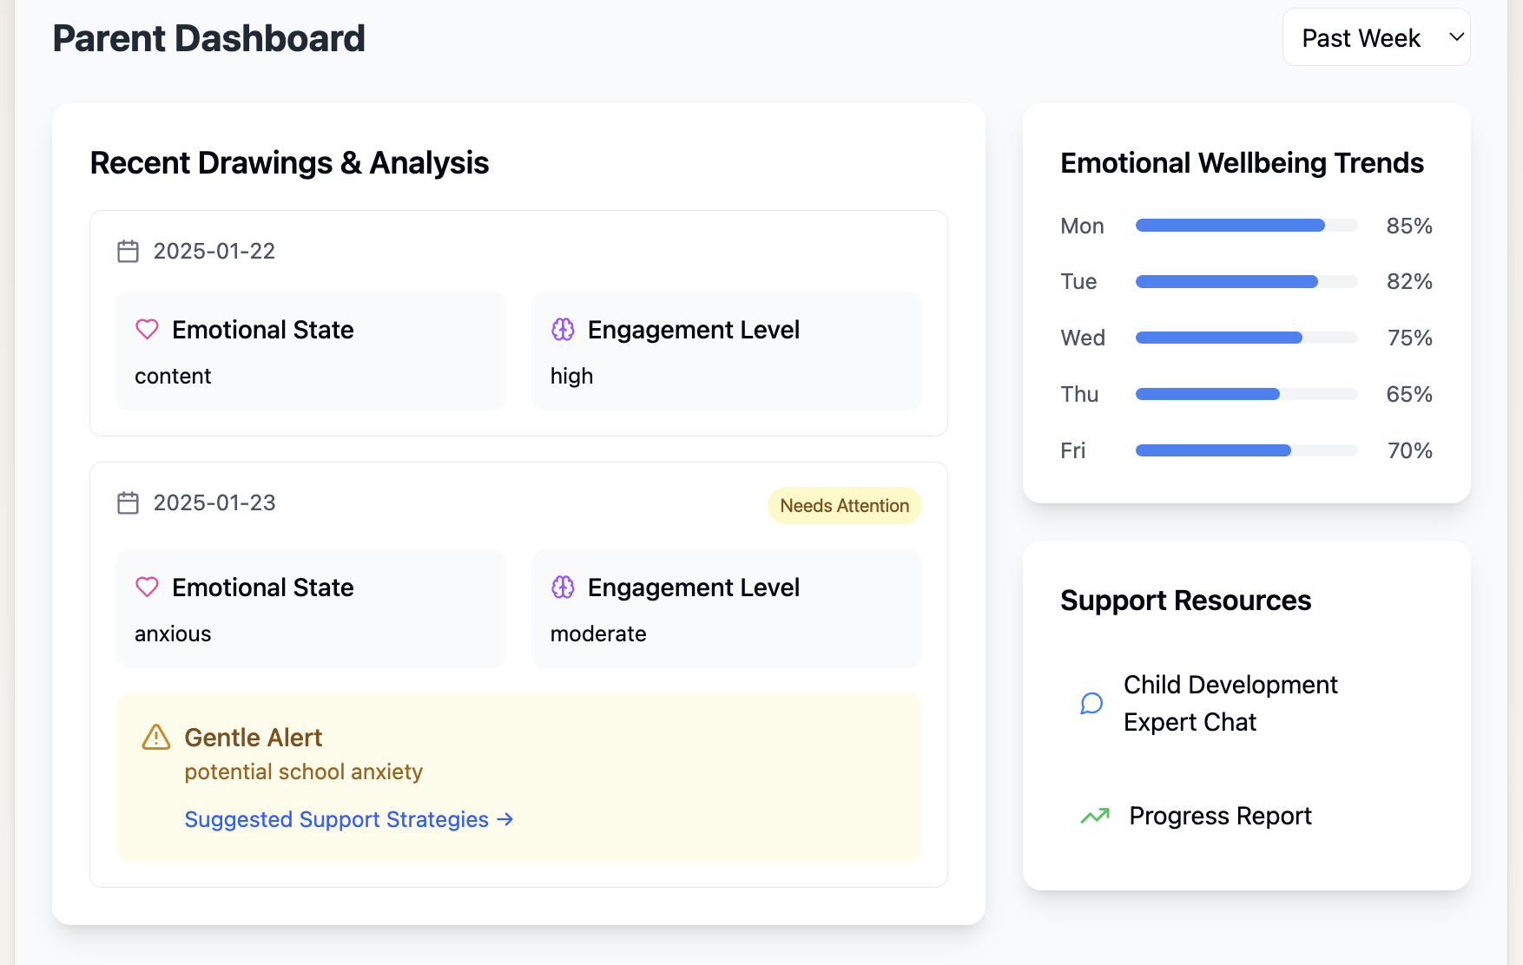
Parent Dashboard
Key features:
Privacy warning banner
Emotional state tracking
Gentle alerts for concerning patterns
Support resources
Professional consultation links
Encrypted local analysis reminder
Weekly/monthly trends

Slide 5
Proposed Directory Map
```
kiddraw-ai/
├── src/
│ …
services/
│ │ ├── llamaAPI.js
│ │ ├── voiceRecognition.js
│ │ ├── encryption.js
│ │ └── storage.js
│ ├── utils/
│ │ ├── drawingUtils.js
│ │ └── analysisUtils.js
│ ├── styles/
│ │ └── tailwind.css
│ ├── pages/
│ │ ├── DrawingApp.js
│ │ └── ParentPortal.js
│ └── App.js
├── public/
│ ├── assets/
│ │ └── stickers/
└── config/
├── llamaConfig.js
└── securityConfig.js
```
```
kiddraw-ai/
├── src/
│ ├── components/
│ │ ├── drawing/
│ │ │ ├── DrawingTools.js
│ │ │ ├── Canvas.js
│ │ │ ├── ColorPalette.ojs
│ │ │ ├── BrushSizes.js
│ │ │ ├── Stickers.js
│ │ │ └── AIAnalysisPanel.js
│ │ ├── parent/
│ │ │ ├── Dashboard.js
│ │ │ ├── DrawingAnalysis.js
│ │ │ ├── EmotionalTrends.js
│ │ │ ├── AlertSystem.js
│ │ │ └── SupportResources.js
│ │ └── shared/
│ │ ├── PrivacyBanner.js
│ │ └── VoiceInput.js
│ …

Slide 6

Development Timeline – 1st Phase
Month 1-2:
Frontend MVP (React Native setup, basic drawing interface)
Initial UI/UX design
Basic authentication flow
Local data storage setup
Month 2-3:
Backend infrastructure (Node.js, PostgreSQL, MongoDB)
MinIO integration
Basic API endpoints
Deploy Llama-3.2-vision model
Initial security protocols

Slide 7
Development Timeline – 2nd & 3rd Phase
Month 3-4:
AI integration (Llama-3.2 API connections completed and tested)
Drawing analysis pipeline
Voice processing with Whisper
Behavioral pattern recognition
COPPA compliance implementation
Month 4-5:
Parent dashboard
Real-time updates (WebSocket)
E2E encryption
Data anonymization
Custom fine-tuned Stable Diffusion for responses
Advanced security measures

Slide 8
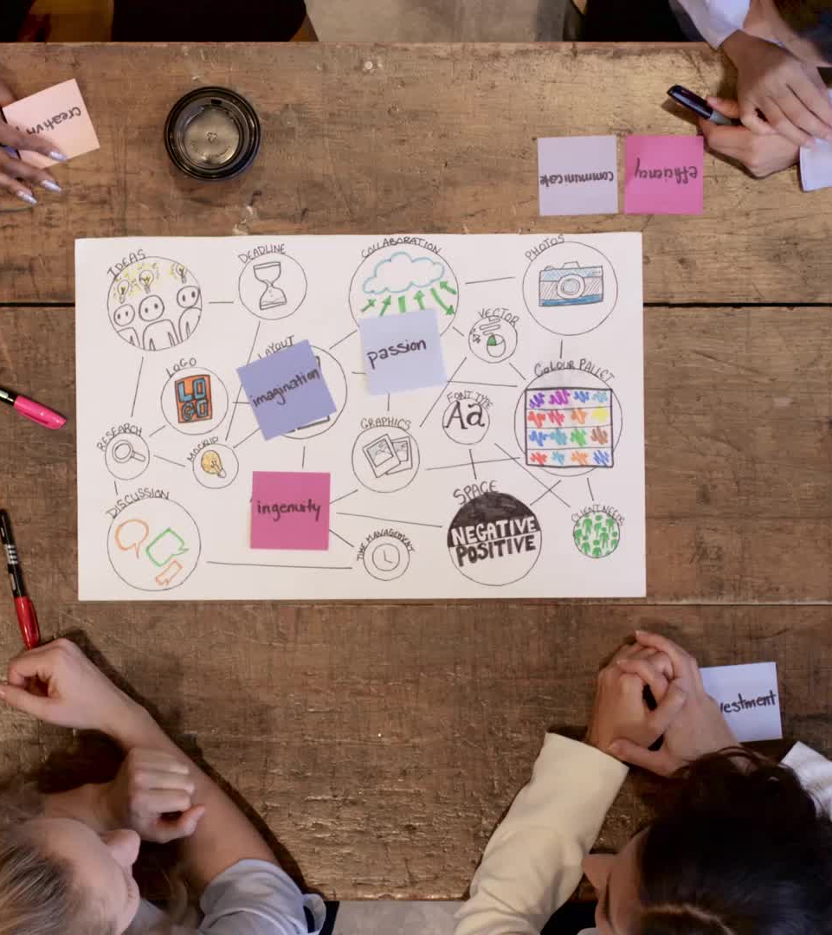
Development Milestones
Week 8: Working drawing interface (1st Phase)
Week 16: AI analysis fully functional (2nd Phase)
Week 20: Security compliance complete (3rd Phase)
Week 24: Production-ready (Launch)

