Slide 1
Clustering Knowledge Articles for AI-Readiness Assessment
An AI-Readiness Evaluation Framework for
Knowledge Articles Using Unsupervised Learning
Aligned with Retrieval-Augmented Generation Requirements
Capstone Project – AI & Machine Learning Author: Aicel Mae Alvarez Program:
Post Graduate Diploma in AI and Machine Learning

Slide 2
Dataset Overview
Source: Stack Exchange public data dump
Rationale: Stack Exchange Q&A posts closely resemble enterprise knowledge articles:
How-to guides
FAQs
Troubleshooting instructions
Code-heavy reference answers
Working Sample:
~10,000 question + accepted answer pairs
XML parsed and converted to structured tabular format
Sampling performed to fit Colab constraints
Key Limitation: Dataset represents community-driven content, not enterprise-authored KBs.

Slide 3
Feature Engineering
Clustering focused on structural and instructional signals, not topic semantics.
Engineered features include:
Answer length and question length
Number of links
Number of bullet points / list items
Number of code blocks
Title length
Presence of tags
Rationale: Moveworks-style AI readiness depends on structure, clarity, and instructional quality rather than popularity or topic.
These features operationalize structural clarity, instructional depth, and scannability, which are critical for retrieval-augmented AI assistants.

Slide 4
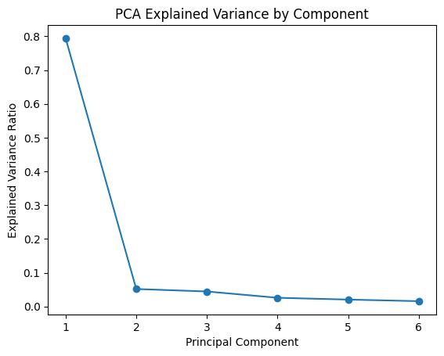
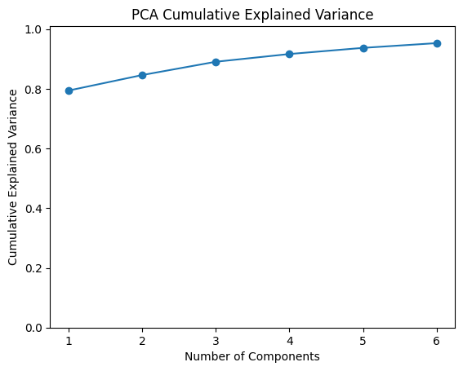
Data Preprocessing & Dimensionality Reduction
Preprocessing steps:
Null handling and duplicate removal
Feature scaling (StandardScaler)
Low-variance feature removal
PCA for dimensionality reduction
PCA Outcomes:
Reduced multicollinearity
Noise reduction
Improved cluster stability
Majority of variance retained in reduced dimensions
PCA-reduced structured features were selected as the primary clustering space.
PCA analysis shows that the first two components capture approximately 85% of the total variance, and the full retained components explain over 95%, confirming that the engineered structural features are highly correlated and suitable for dimensionality reduction without significant information loss.
Number of PCA components: 6
Cumulative explained variance (first 2): 0.8462
Cumulative explained variance (first 5): 0.9374
Cumulative explained variance (all): 0.9533

Slide 5
Clustering Models Evaluated
Multiple unsupervised models were evaluated to ensure robustness:
K-Means
Centroid-based clustering
Interpretable and scalable
Agglomerative Clustering
Hierarchical baseline
Explores non-spherical clusters
DBSCAN
Density-based clustering
Detects noise and outliers
All models were evaluated using internal validation metrics.

Slide 6
Model Selection & Metrics
Primary evaluation metric:
Silhouette Score (higher is better)
Secondary metrics:
Davies–Bouldin Index (lower is better)
Calinski–Harabasz Score (higher is better)
Key Result (K-Means):
k = 3 → Silhouette ≈ 0.71
Higher k values led to rapid performance degradation
Decision: k = 2 was excluded despite high silhouette due to trivial binary segmentation. k = 3 provided the best balance of performance and interpretability.
Although k=2 yielded a higher silhouette score, it resulted in a trivial binary split and was excluded in favor of k=3, which provided more meaningful and actionable structural archetypes.

Slide 7
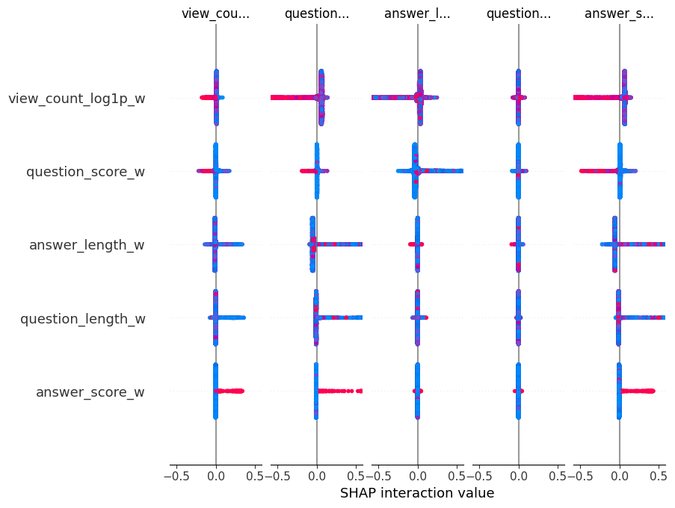
Explainability of Cluster Decisions
K-Means does not provide intrinsic feature importance.
Approach used:
Train a Random Forest surrogate model to predict cluster labels
Apply SHAP to explain surrogate predictions
Key Drivers of Cluster Separation:
Answer length
Number of links
Bullet/step structure
Code block density
SHAP confirms clusters are driven by meaningful structural signals, not noise.
Refer to SHAP summary plot for feature contribution distribution across clusters.

Slide 8
Final Cluster Assignment
Using K-Means (k = 3), articles were assigned to clusters:
Cluster 0: 9,315 articles
Cluster 1: 504 articles
Cluster 2: 181 articles
Observation:
Cluster imbalance is expected in real-world knowledge bases and reflects the rarity of highly structured, AI-ready content.
Cluster labels are nominal and do not imply ordinal ranking.
Clusters represent structural archetypes rather than quality rankings.

Slide 9
Ethical AI & Bias Analysis
No demographic attributes were available in the dataset.
Bias audits were performed using proxy-sensitive groups:
Content age (cohort)
Engagement level (view count quartiles)
Code-heaviness
Topic proxies (primary tags)
Findings:
No temporal bias detected
Structural bias observed across engagement and code-heavy content
Risk lies in misuse of clusters as absolute quality labels

Slide 10
Limitations
No ground-truth labels for AI readiness
Fairness analysis relies on proxy attributes
Stack Exchange content differs from enterprise-authored knowledge
Clustering captures structure, not semantic correctness
These limitations are explicitly documented and mitigated through careful interpretation.

Slide 11
Conclusion
This project demonstrates an end-to-end unsupervised ML pipeline for:
Structurally clustering knowledge articles
Explaining cluster behavior using SHAP
Auditing ethical risks and bias
The approach is robust, interpretable, and directly applicable to AI-readiness assessment in enterprise knowledge management systems.

