Slide 1
Model Advisor
Cross-vendor model selection and PTU/PAYG decision platform

Slide 2
The business question
Which model best fits this workload—not merely which benchmark is highest?
Will reserved PTU capacity be cheaper and sufficiently utilized, or is PAYG better?
How do quality, economics, latency and compliance priorities change the answer?

Slide 3
Solution at a glance
Natural language: documents/pages, users × generations, or explicit K/M/B token volume.
31 LLMs, 6 dedicated image models and 37 pre-scored insurance use cases.
Synchronized Top-N ranking, explanations, verified PAYG flags and image costs.
Immediate monthly/annual PAYG versus PTU verdict with full derivation and capacity validation.

Slide 4
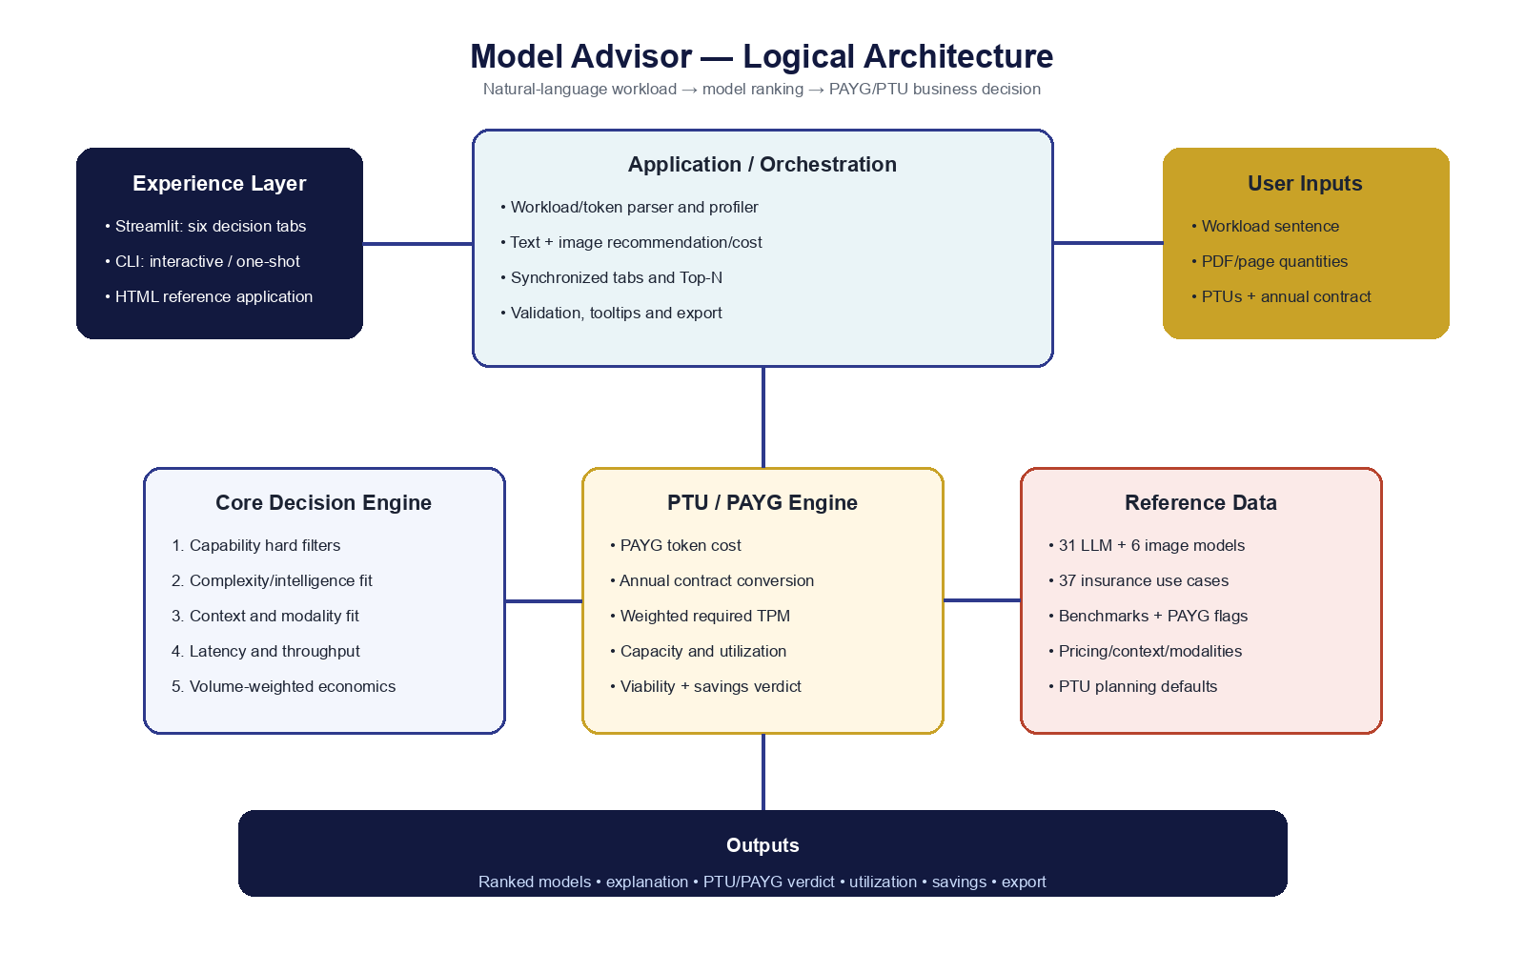
Logical architecture and decision flow

Slide 5
Recommendation flow
Parse documents/pages, users/generations, explicit tokens, frequency and image intent.
Create a profile: complexity, latency, volume, context, governance and modalities.
Apply hard requirements for vision/audio/video/image generation/open weights/context.
Rank Top-N LLMs and, when required, rank dedicated image models separately.

Slide 6
PTU versus PAYG
Shared UI inputs: PTU quantity and total annual contract cost.
PAYG uses synchronized monthly tokens and only marks availability verified when confirmed.
Derives hourly rate, weighted TPM, minimum PTUs, utilization, headroom and break-even.
Recommend PTU only when capacity is sufficient and fixed cost is lower.

Slide 7
Example: 8,000 PDFs × 5 pages
Estimated input: 34M tokens per monthly pass at 850 tokens/page.
Output estimate depends on OCR, classification, Q&A or summarization.
The engine ranks vision/document-capable models and shows alternatives.
A $162K/year, 50-PTU contract is compared with model-specific PAYG spend.

Slide 8
Decision cockpit
Automatically compares the same Top-N models selected in Recommendation.
Adjust quality, economics, latency and risk/compliance weights.
See every model’s live score bar and component scores as sliders change.
Review cost, throughput, utilization, PAYG verification and export CSV.

Slide 9
Controls and governance
Benchmark, release, SLM and PAYG verification are visible with tooltips.
Regulated workflows require logging, model versioning and human review.
Shared PTU assumptions and planning defaults are explicit and editable.
Azure/provider capacity, region, quota and contract figures require validation.

Slide 10
Deployment and operation
Python 3.10 + Streamlit in a project virtual environment.
Enterprise deployment: TLS reverse proxy, SSO/RBAC, audit logs and monitoring.
Automated tests cover six UI tabs, parsing, scoring and cost/capacity edge cases.
Quarterly or release-triggered refresh of model pricing and benchmarks.

Slide 11
Recommended next steps
Validate token-per-page and output ratios with a representative PDF sample.
Load 30–90 days of real traffic to establish peak TPM and seasonality.
Obtain region/model-specific Azure capacity and annual pricing quotes.
Run task-specific quality evaluation before final model and billing commitment.

