Slide 1
Outline
Java Message Services
Glassfish Server
Developing a simple chatting application
Conclusion

Slide 2
Java Message Services (JMS)
JMS (Java Message Service) is an API that provides the facility to create, send and read messages. It provides loosely coupled, reliable and asynchronous communication. JMS is also known as a messaging service.

Slide 3
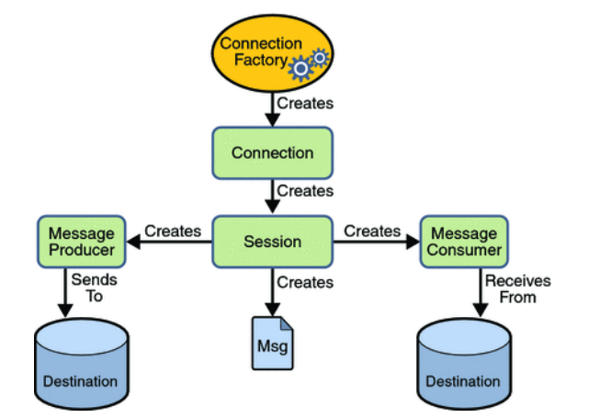
JMS Programming Model

Slide 4
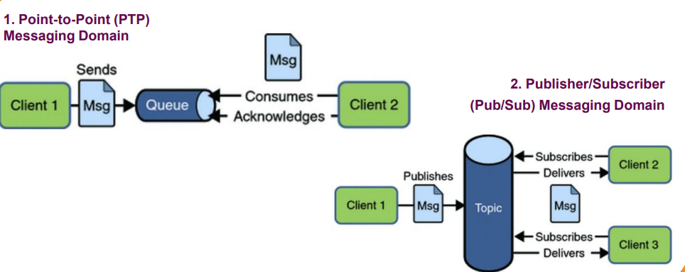
JMS messaging domains

Slide 5

Glassfish Server
GlassFish is the reference implementation of Java EE and as such supports Enterprise JavaBeans, JPA, JavaServer Faces, JMS, RMI, JavaServer Pages, servlets, etc.
GlassFish Server uses the Message Queue software as its native JMS provider, providing transparent JMS messaging support. This support is known within GlassFish Server as the JMS Service.
JMS requires only minimal administration. When a JMS client accesses a JMS administered object for the first time, the client JVM retrieves the JMS configuration from GlassFish Server.

Slide 6
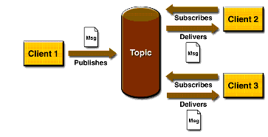
Developing a simple chatting application
Publish/Subscribe Messaging Domain
In Pub/Sub model, one message is delivered to all the subscribers. It is like broadcasting. Here, Topic is used as a message oriented middleware that is responsible to hold and deliver messages.

Slide 7
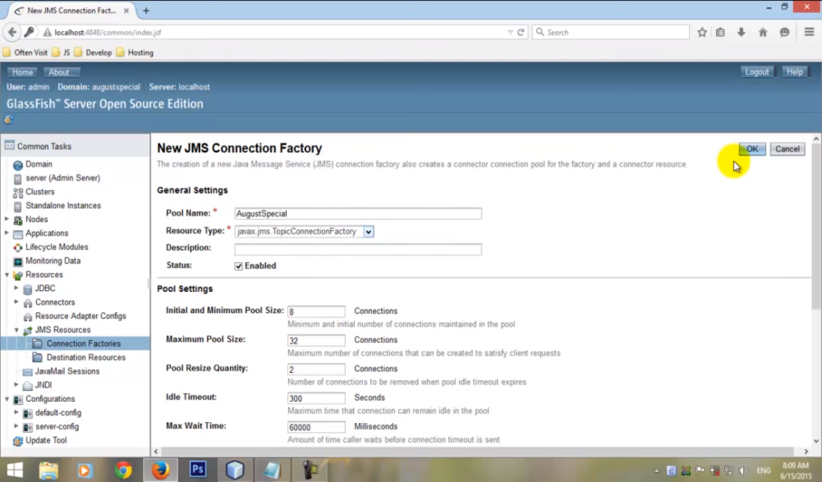
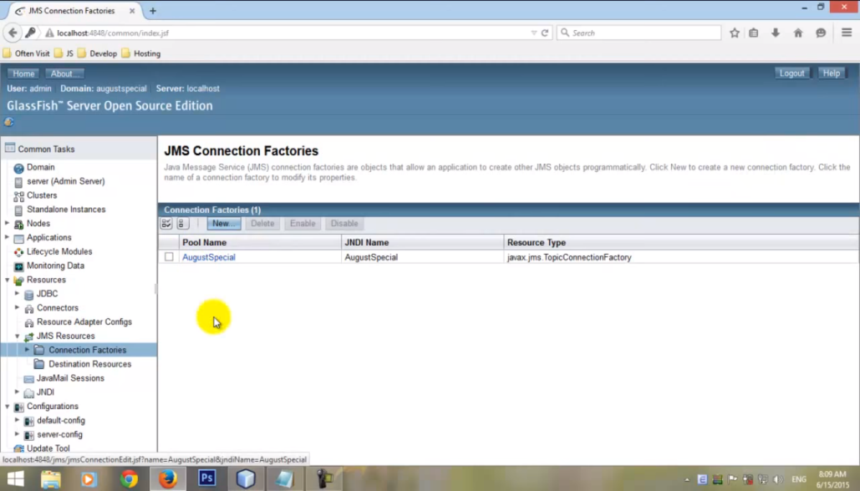
Creating connection factory
A connection factory is the object a client uses to create a connection to a provider. A connection factory encapsulates a set of connection configuration parameters that has been defined by an administrator. Each connection factory is an instance of the ConnectionFactory, QueueConnectionFactory, or TopicConnectionFactory interface.

Slide 8
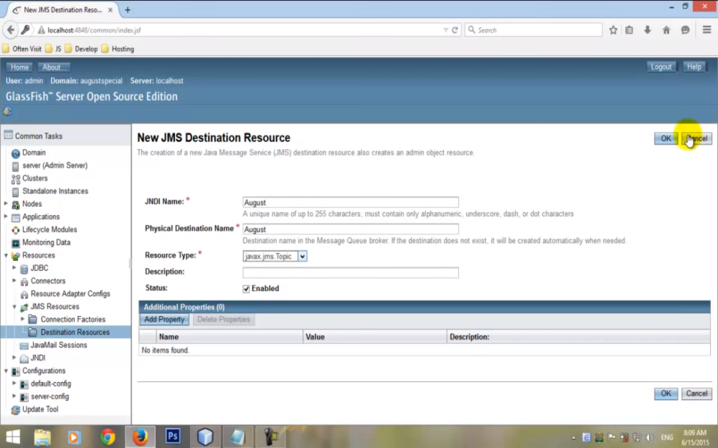
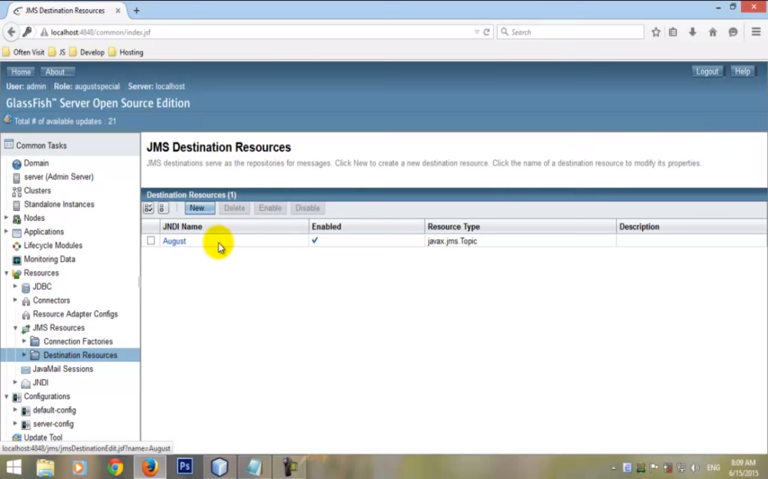
Creating destination resources
JMS destinations serve as the repositories for messages

Slide 9
Conclusion
JMS provides messaging service that is loosely coupled, reliable and can be synchronous or asynchronous communication

