Slide 1
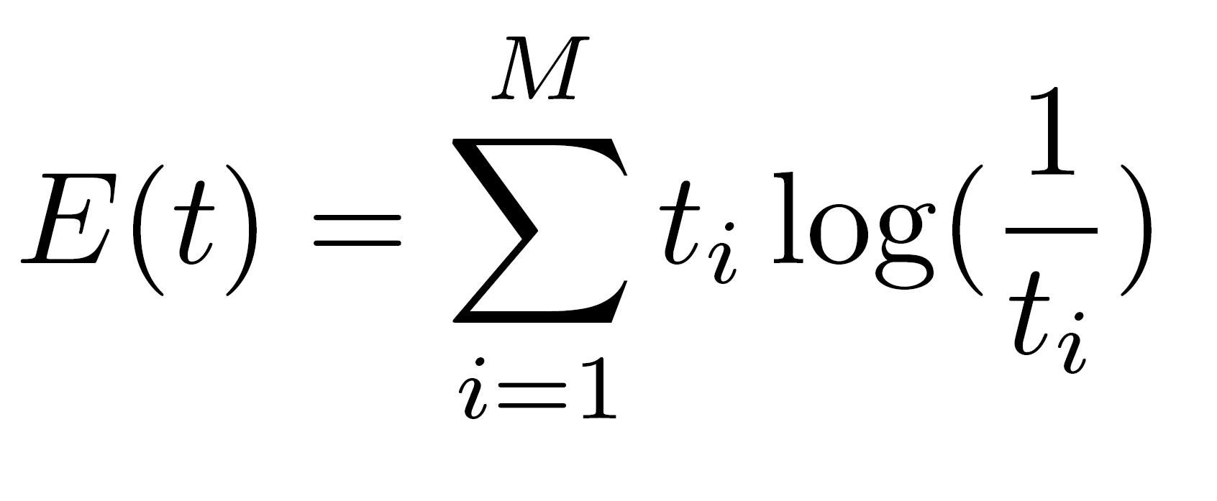
all about Entropy in ML.
Entropy Definition
Entropy of an event $t$ with $M$ different outcomes.
A.I. Cheatsheets

Slide 2
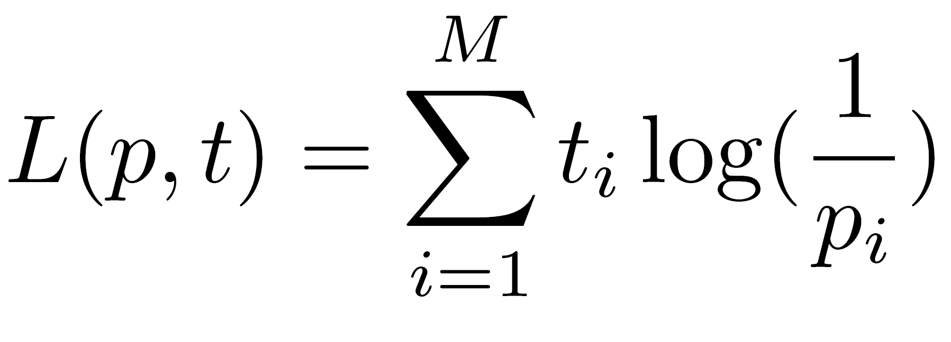
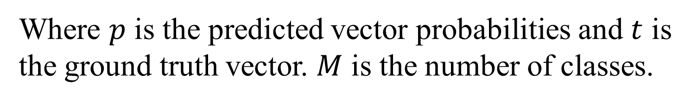
all about Entropy in ML.
Cross Entropy Definition
Where $p$ is the predicted vector probabilities and $t$ is the ground truth vector. $M$ is the number of classes.
A.I. Cheatsheets

Slide 3
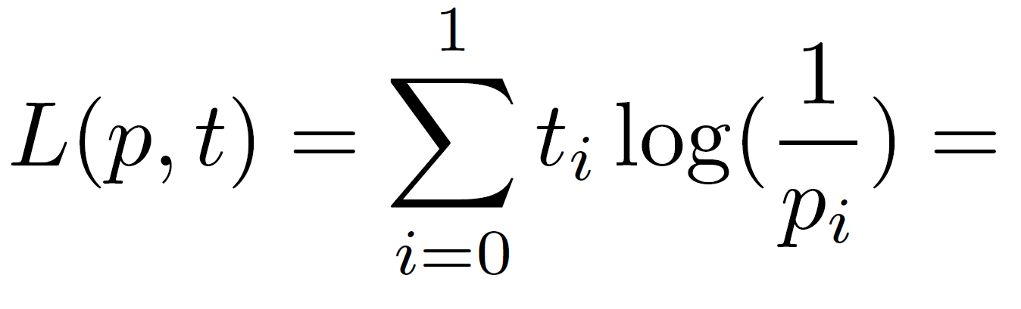
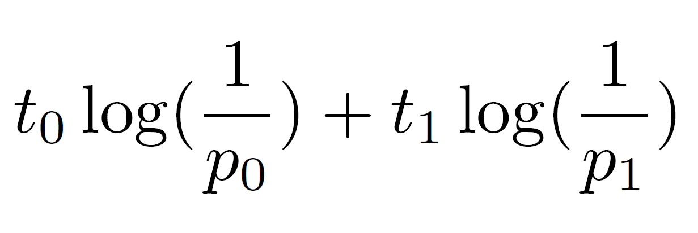
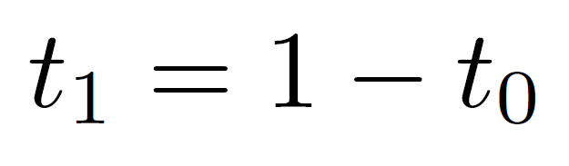
all about Entropy in ML.
Binary Cross Entropy Definition
Same as Cross Entropy, but used when classification problem is considered to have 2 classes (0 and 1). This can be used for multi-class problems with a little tweak.
A.I. Cheatsheets

