Slide 1
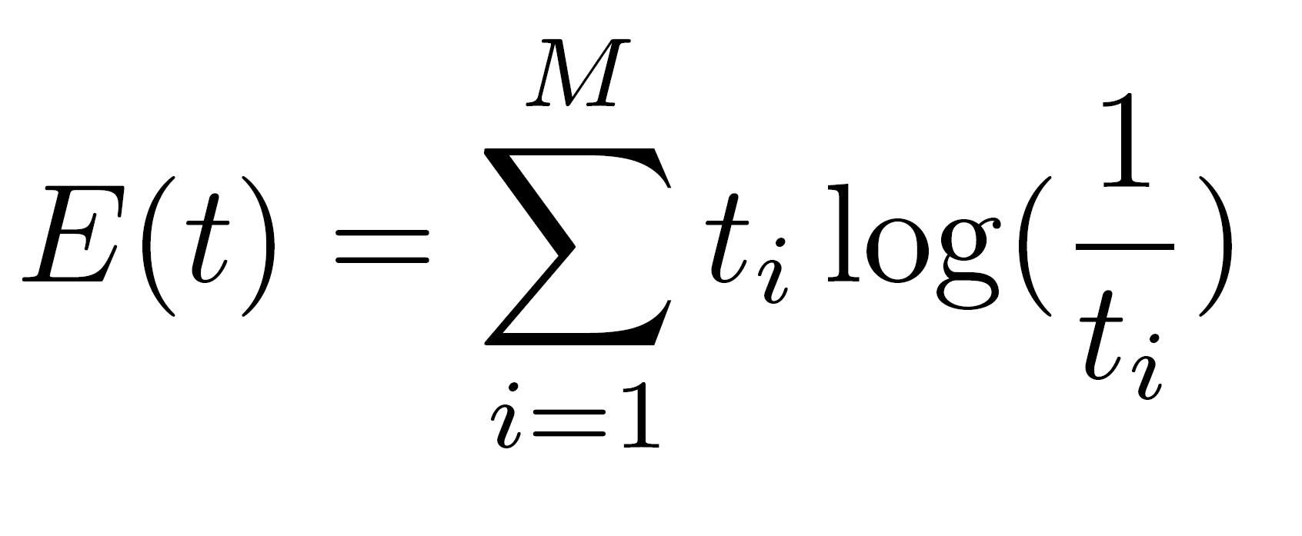
all about Entropy in ML.
Entropy Definition
Entropy of an event $t$ with $M$ different outcomes.
A.I. Cheatsheets

