Slide 1

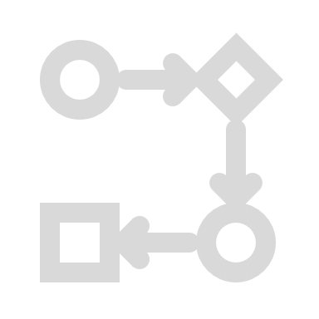




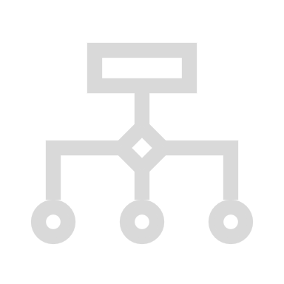
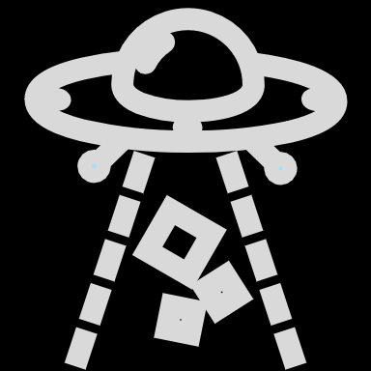

Product Success!
Validate Flows
Analyze Flows
Understand Maker Intent
Manual Testing
Dev Activity
Derive Customer Flows
Collect Events
Live User Activity

Slide 2

Product Success!
Validate Flows
Analyze Flows
Understand Maker Intent
Manual Testing
Dev Activity
Derive Customer Flows
Collect Events
Live User Activity

Slide 3

Product Success!
Validate Flows
Analyze Flows
Understand Maker Intent
Manual Testing
Dev Activity
Derive Customer Flows
Collect Events
Live User Activity

Slide 4

Product Success!
Validate Flows
Analyze Flows
Understand Maker Intent
Manual Testing
Dev Activity
Derive Customer Flows
Collect Events
Live User Activity

Slide 5
Product Success!
Validate Flows
Analyze Flows
Understand Maker Intent
Manual Testing
Dev Activity
Derive Customer Flows
Collect Events
Live User Activity

Slide 6

Product Success!
Validate Flows
Analyze Flows
Understand Maker Intent
Manual Testing
Dev Activity
Derive Customer Flows
Collect Events
Live User Activity

Slide 7

Product Success!
Validate Flows
Analyze Flows
Understand Maker Intent
Manual Testing
Dev Activity
Derive Customer Flows
Collect Events
Live User Activity

Slide 8
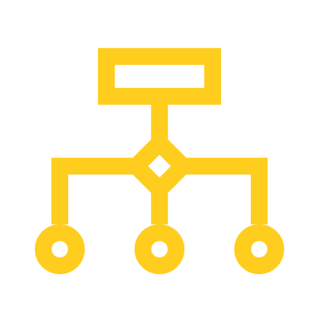
Product Success!
Validate Flows
Analyze Flows
Understand Maker Intent
Manual Testing
Dev Activity
Derive Customer Flows
Collect Events
Live User Activity

Slide 9

Product Success!
Validate Flows
Analyze Flows
Understand Maker Intent
Manual Testing
Dev Activity
Derive Customer Flows
Collect Events
Live User Activity

Slide 10
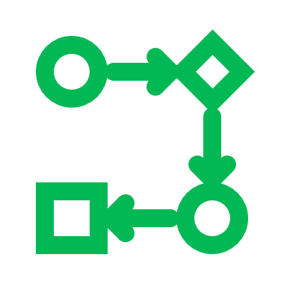
Product Success!
Validate Flows
Analyze Flows
Understand Maker Intent
Manual Testing
Dev Activity
Derive Customer Flows
Collect Events
Live User Activity

Slide 11



Product Success!
Validate Flows
Analyze Flows
Understand Maker Intent
Manual Testing
Dev Activity
Derive Customer Flows
Collect Events
Live User Activity

