Slide 1
Authentication & Authorization
(Active Directory, etc.)
Authentication & Authorization
(Active Directory, etc.)
User Interface
(Web site/Windows Application)
User Interface
(Web site/Windows Application)
Business Logics
(Class Libraries)
Business Logics
(Class Libraries)
Data Access Layer
(CRUD Operations)
Data Access Layer
(CRUD Operations)
aarbac
RDBMS
(Data Storage)
RDBMS
(Data Storage)
aarbac automatically handles permissions & entitlements
Data filter, permissions, entitlement related code
Application code
Application code

Slide 2

aarbac
An Automated Role Based
.NET framework
With built-in
T SQL Parser
https://github.com/eyedia/aarbac
https://www.nuget.org/packages/aarbac.NET/

Slide 3
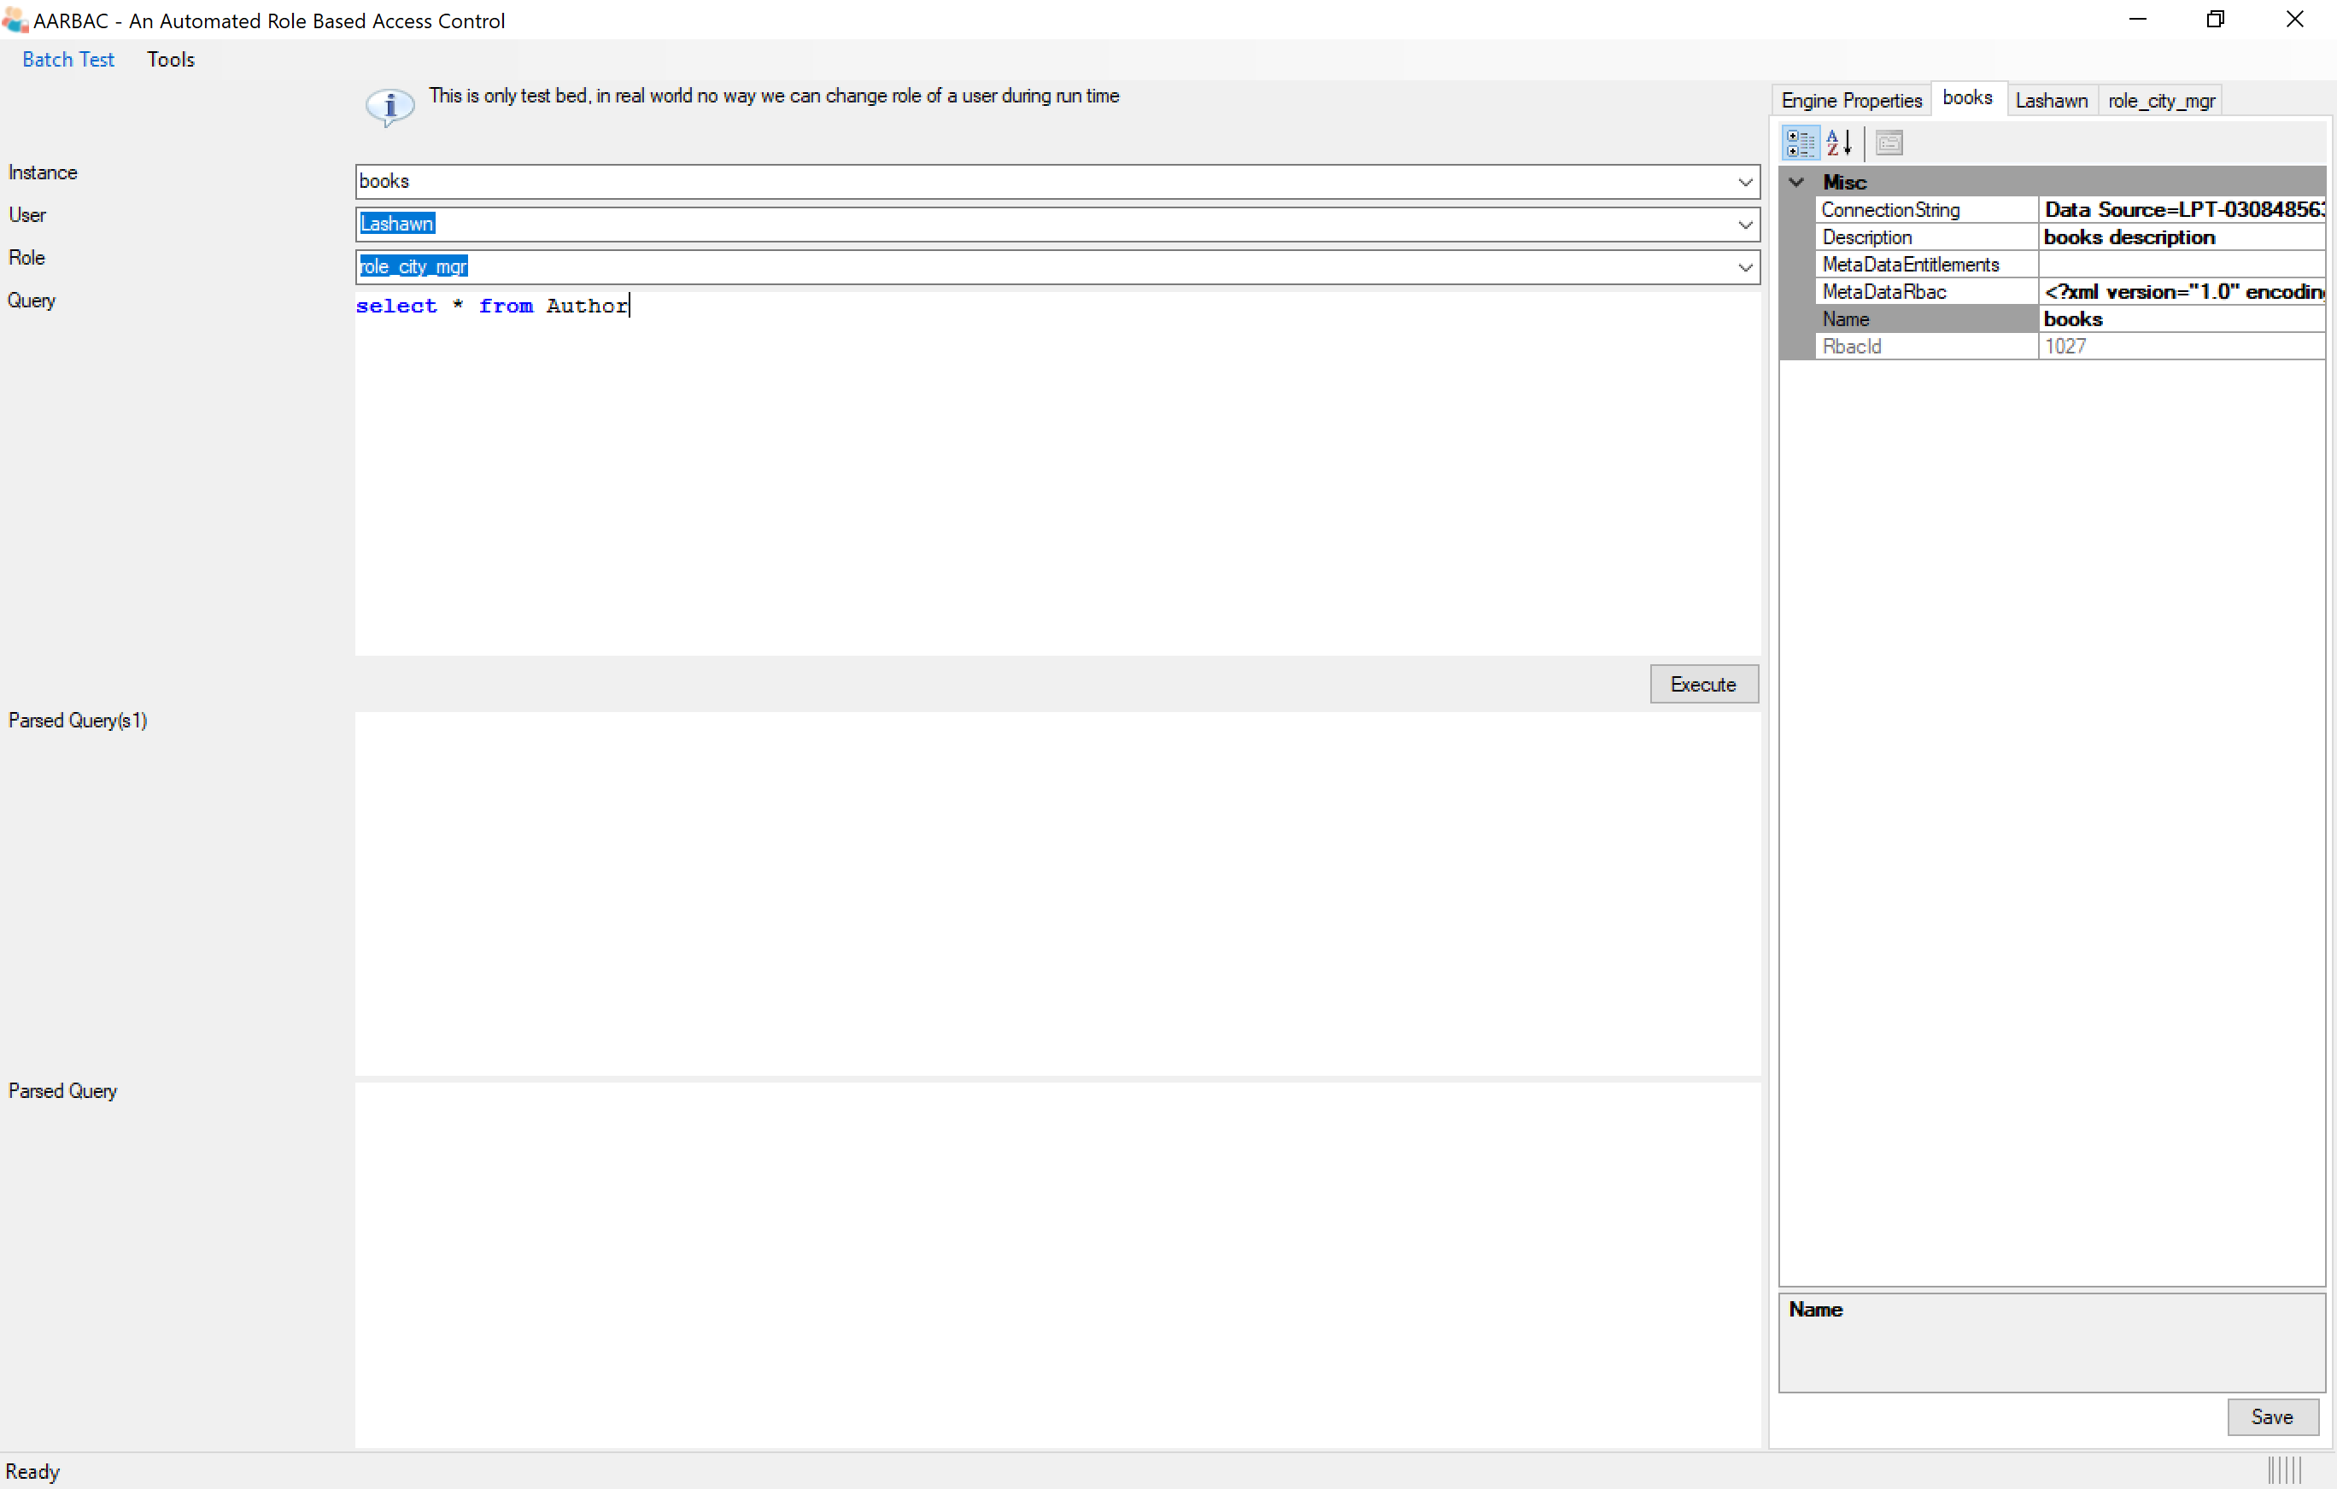

Selected aarbac instance details
Selected aarbac instance
You can view and modify the properties of an instance.
RBAC Meta Data will be generated by the framework. Every role’s base will be this meta data, and then set permission by modifying table and column level CRUDs and adding conditions to required tables according to the role.
Entitlement Meta Data will be entered by the admin as per the application. Every role’s entitlement will be this meta data and then set permissions of each node by setting visible and enable to true/false according to the role.
You can configure multiple applications (or aarbac instances) in a single aarbac repository.
You need to provide connection string, name and description of the application and aarbac will read the meta data and store into aarbac table.
In this case I configured ‘books’ application (or aarbac instance for ‘books’)
Please use aarbac.exe utility to create instances or you can create your own website and call aarbac REST API

Slide 4
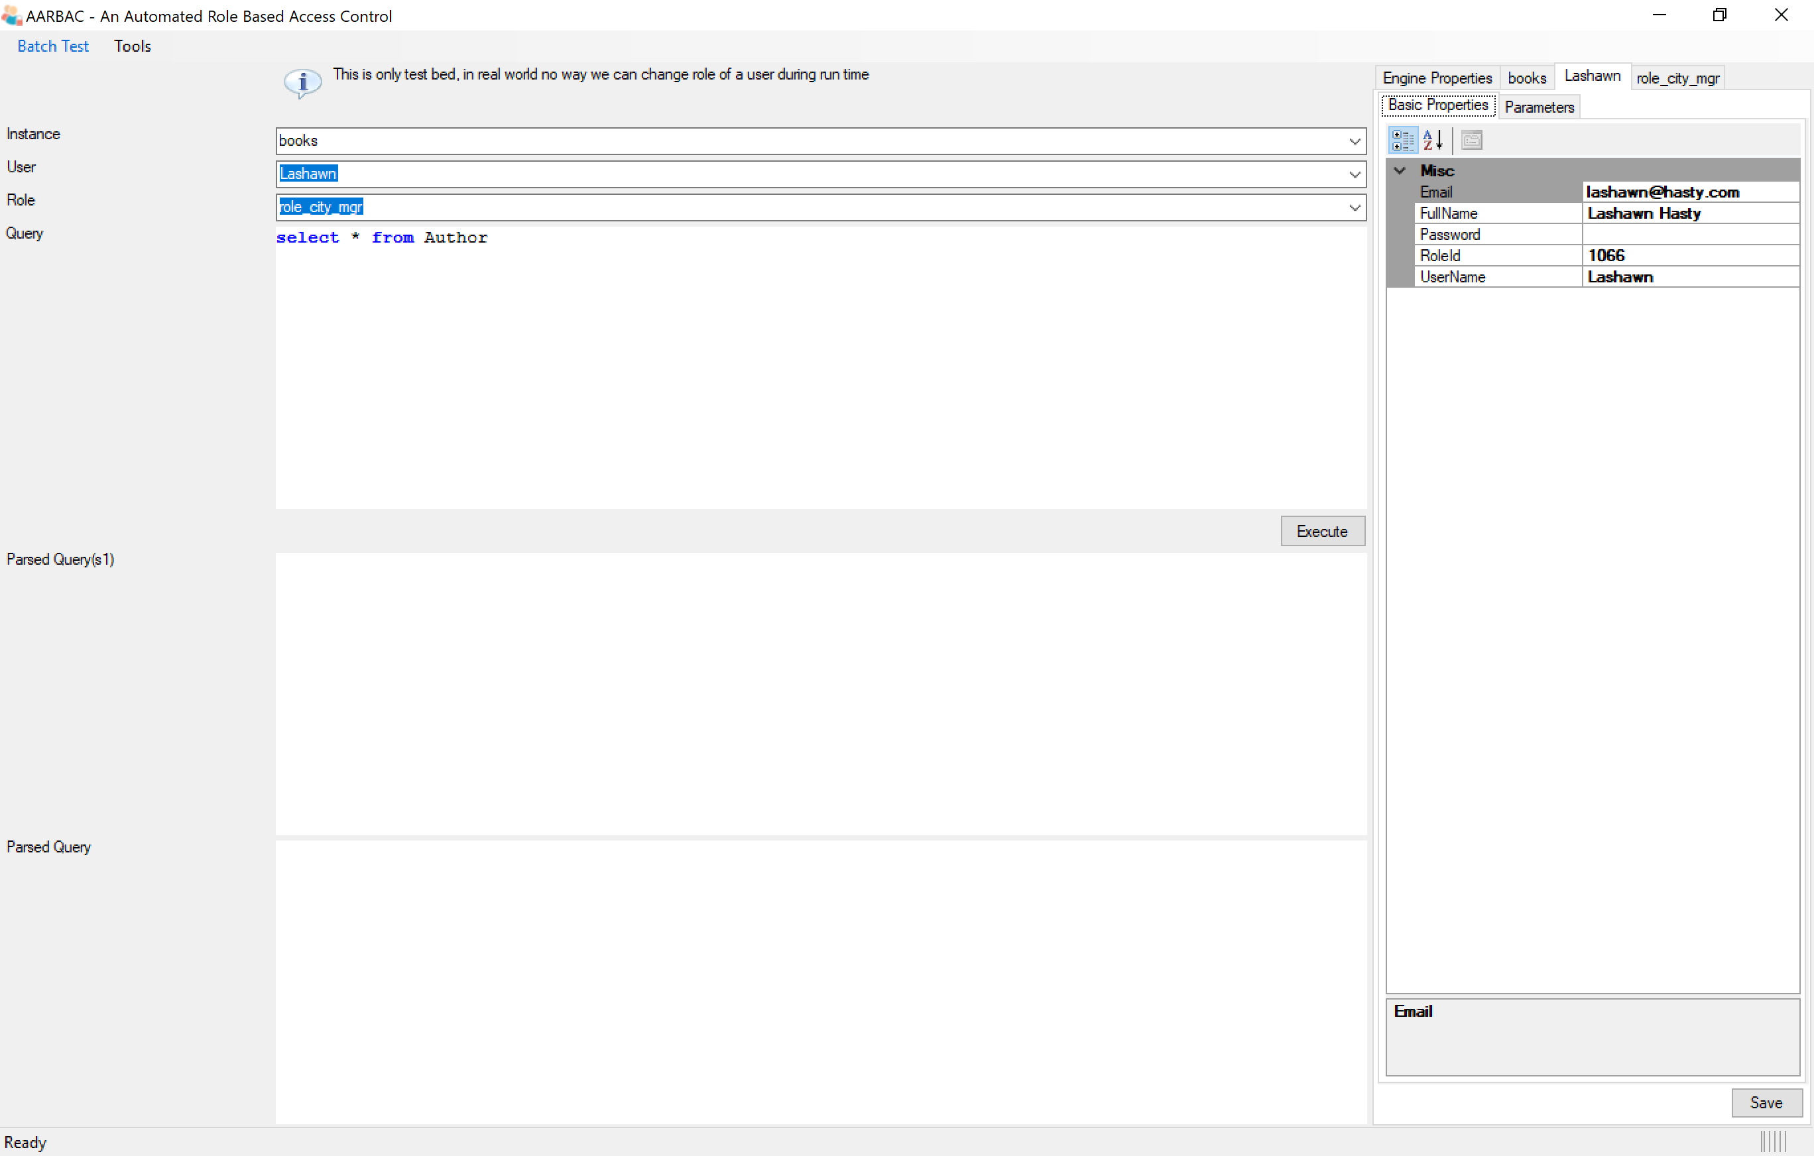
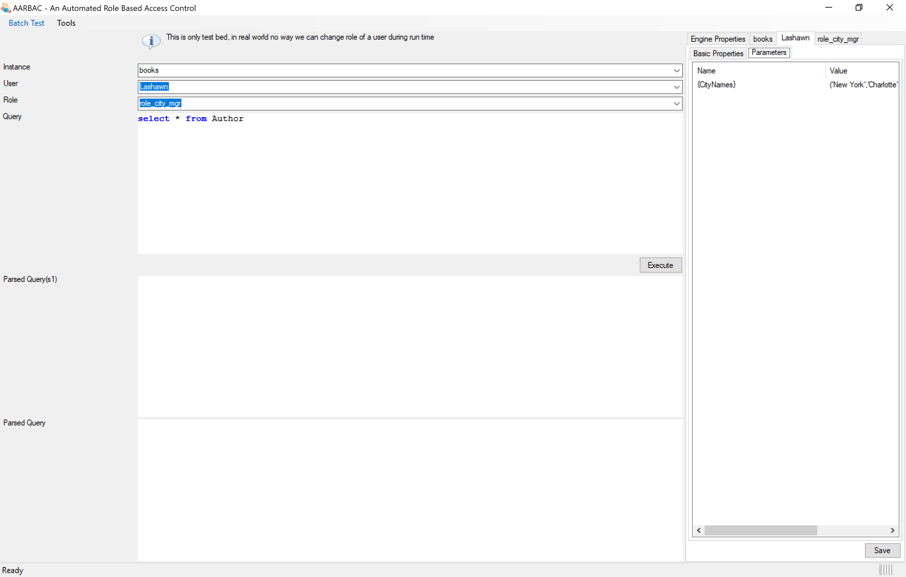
Selected user details
Selected user
You can view and modify the properties & parameters of the selected user.
Note that role can have parameters. For example in this case ‘role_city_mgr’ uses a parameter named ‘{CityNames}’ and we user ‘Lashawn’ parameter set to (‘Charlotte’, ‘New York’) assuming ‘Lashawn’ is a city manager. Similarly another city manager will use the same role, but will have different parameters set according to his permission.
Every user has 1 role.
In case of this testbed we will override the role of user to test various scenarios. This is not permitted in real world.

Slide 5
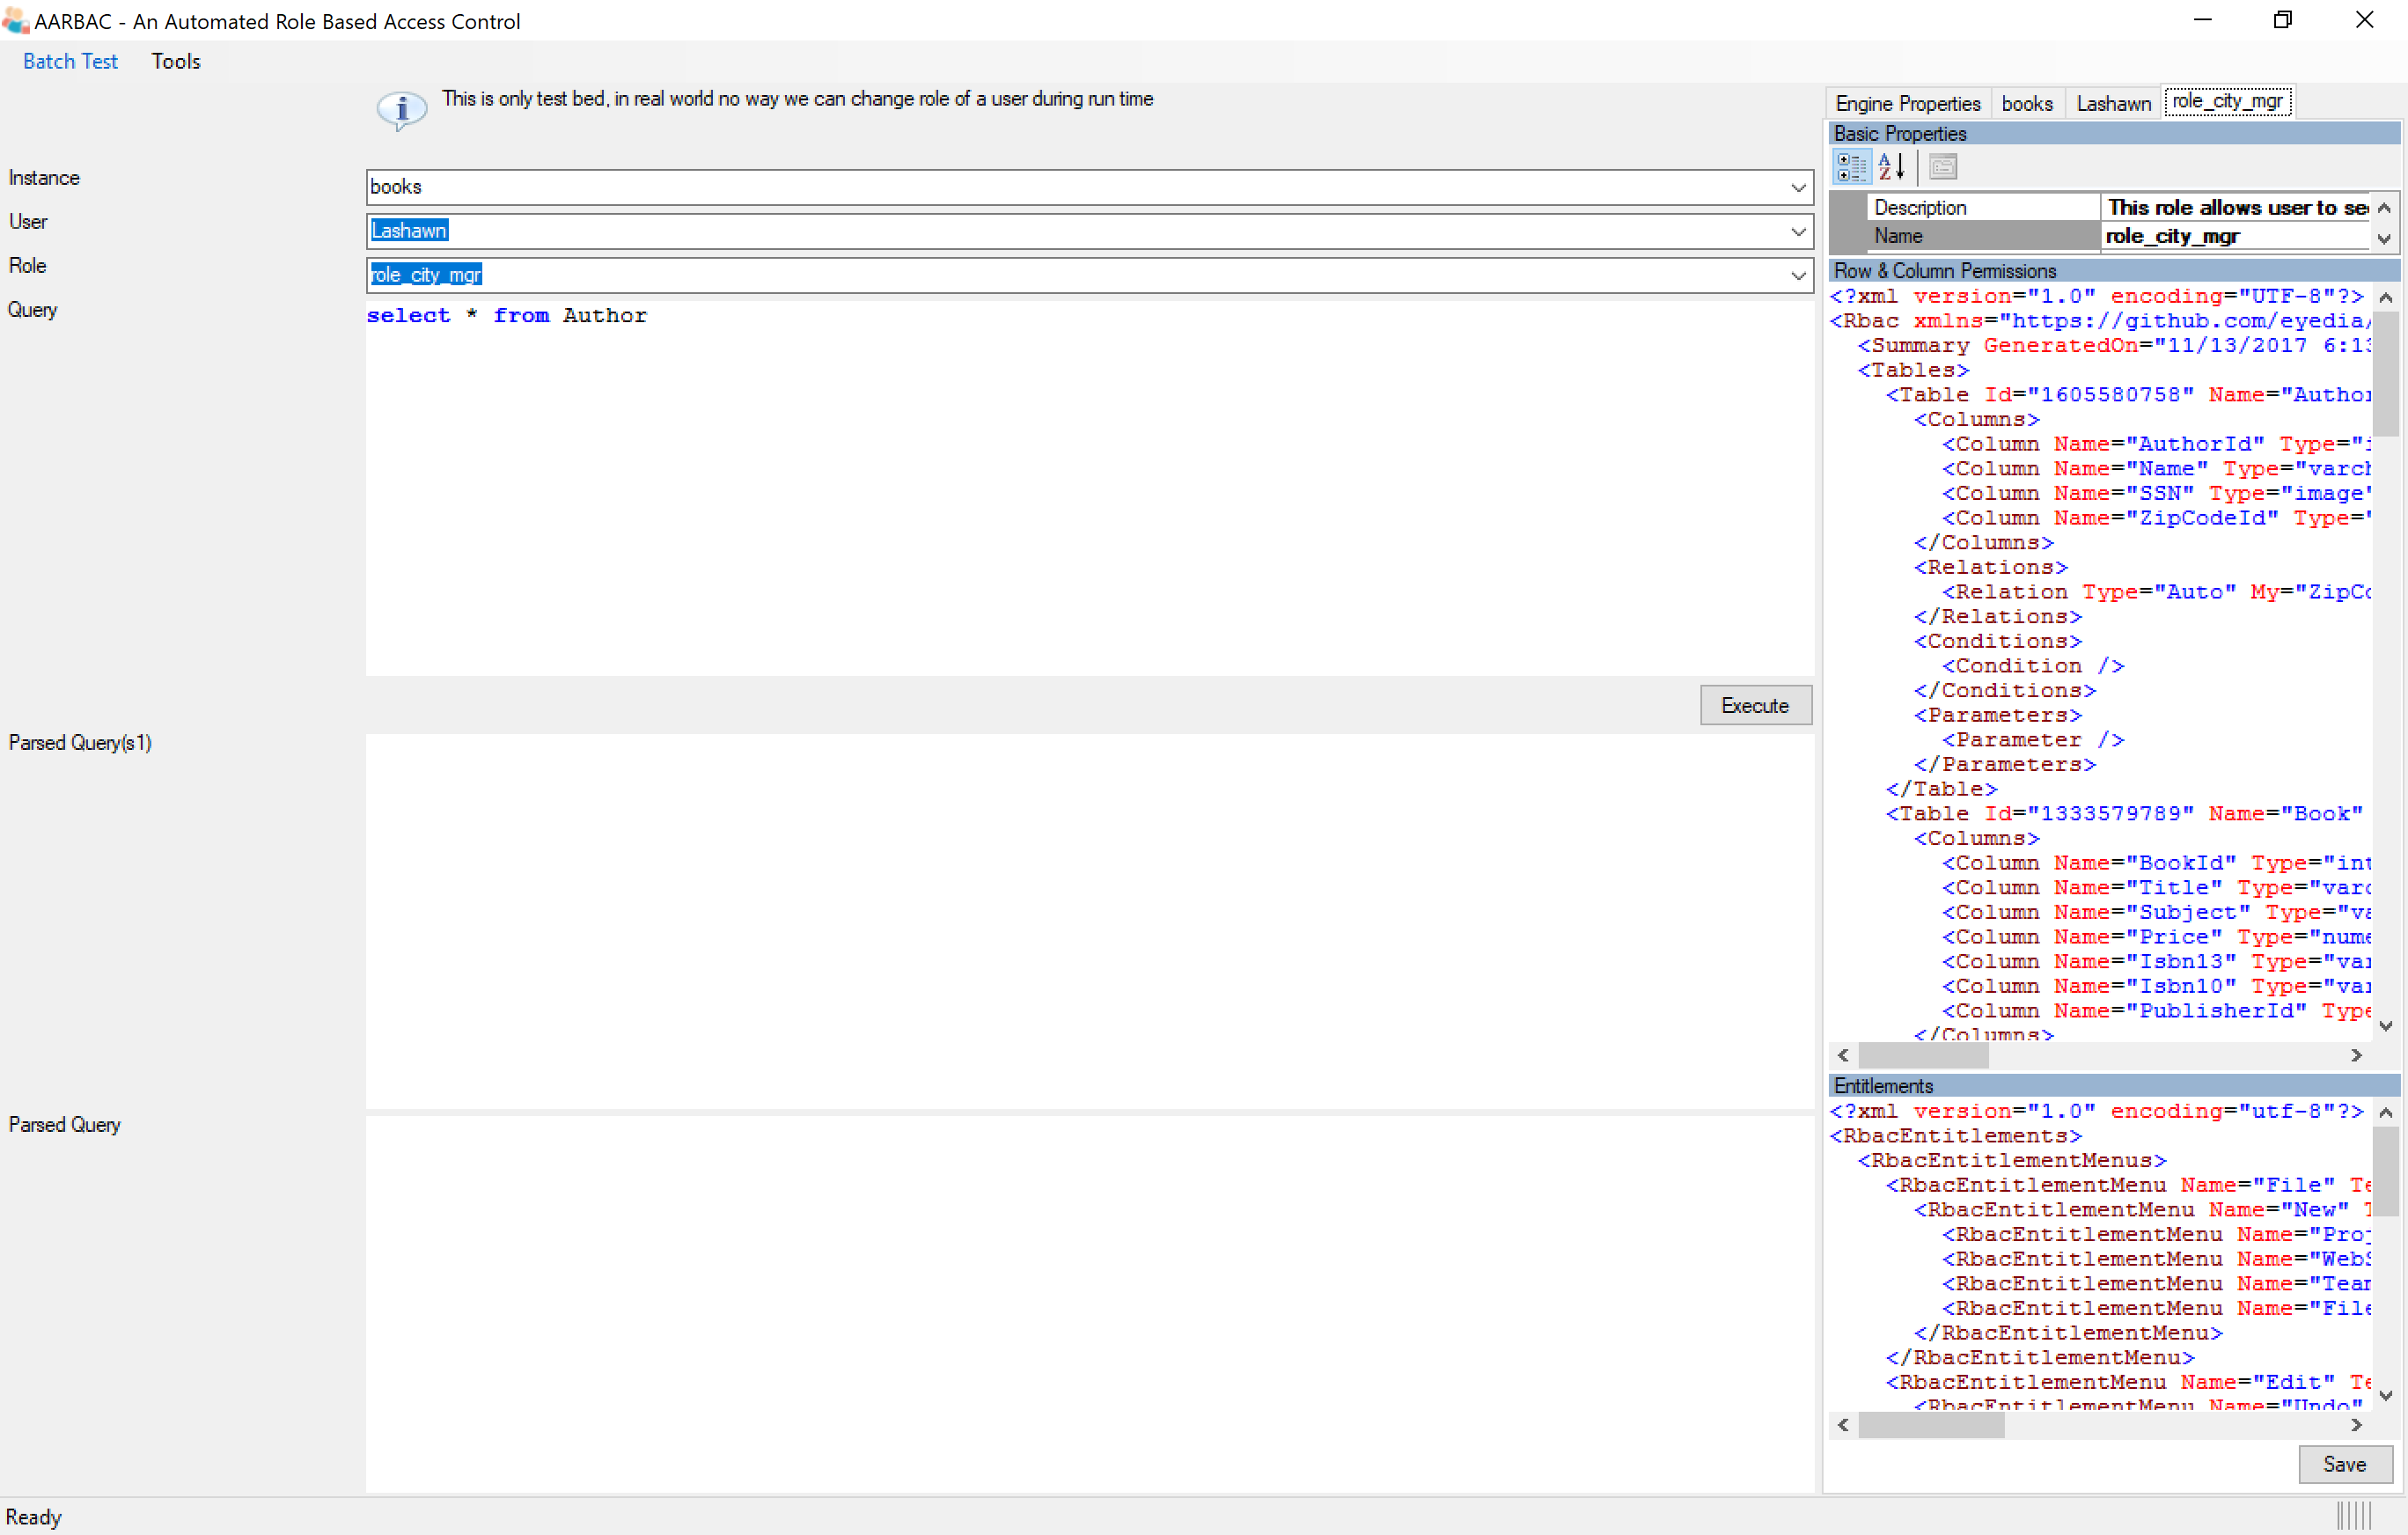
Selected role details
Selected role
You can view and modify the properties of an role.
Row and column permission
This is where you set the condition, notice these:
City – Condition added.
Author – cannot see SSN, cannot update SSN, can see name, and can update name.
Country – cannot see the complete table.
<few more>
Entitlements
Set ‘Enable’ & ‘Visible’ properties according to the role.
Every user has 1 role.
In case of this testbed we will override the role of user to test various scenarios. This is not permitted in real world.
Most of the sample test cases are based out of user ‘Lashawn’ and role ‘role_city_mgr’

Slide 6
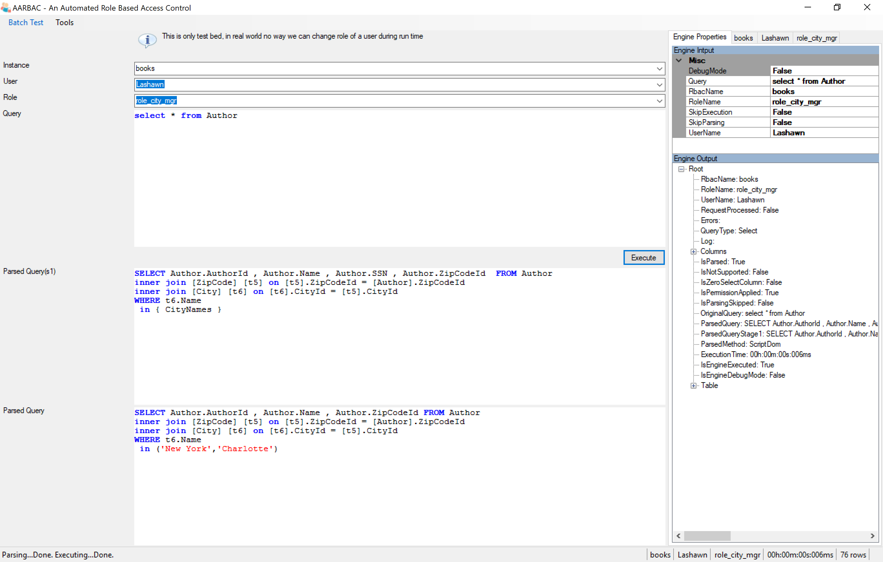
Engine Input Properties
When you click on ‘Execute’, the engine property is set accordingly.
Optionally you can override these parameters and click ‘Execute’ again.
Input Query
Once instance, user and role are selected, type/paste the input query.
To enable inline parsing while you type, select Menu→Tools→Inline Parsing
Engine Output Properties
Engine’s response
2 main objects: SQLQueryParser and SQLQueryEngine. Parser does the main job here. Engine just executes the query in case it is select query and populates the table object.

Slide 7

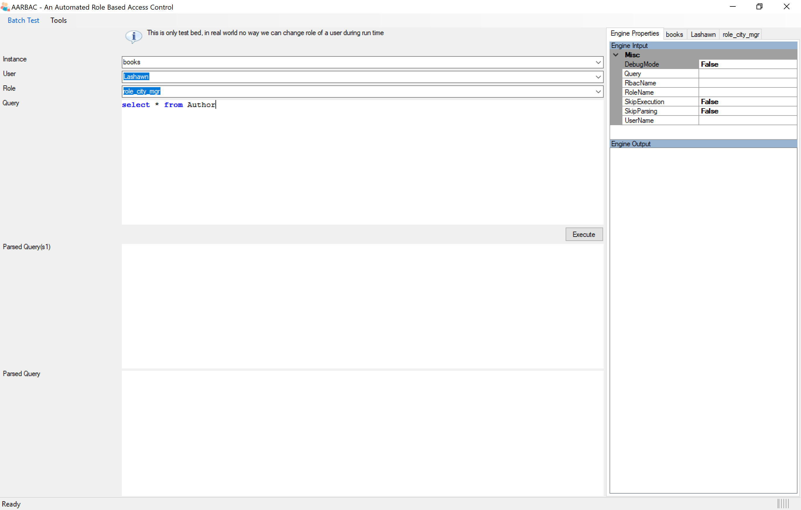
Engine Input
Populated when ‘Execute’ is clicked.
Modify the properties and click ‘Execute again.
Test
Type/Paste qyery
Click Execute
Parsed Query Stage 1
Parsed query stage 1
Parsed Query
Engine output
Final parsed query
Column level permission and user parameters
Note Author.SSN column
Showing only important properties.
If it is select query, table will be populated.

Slide 8

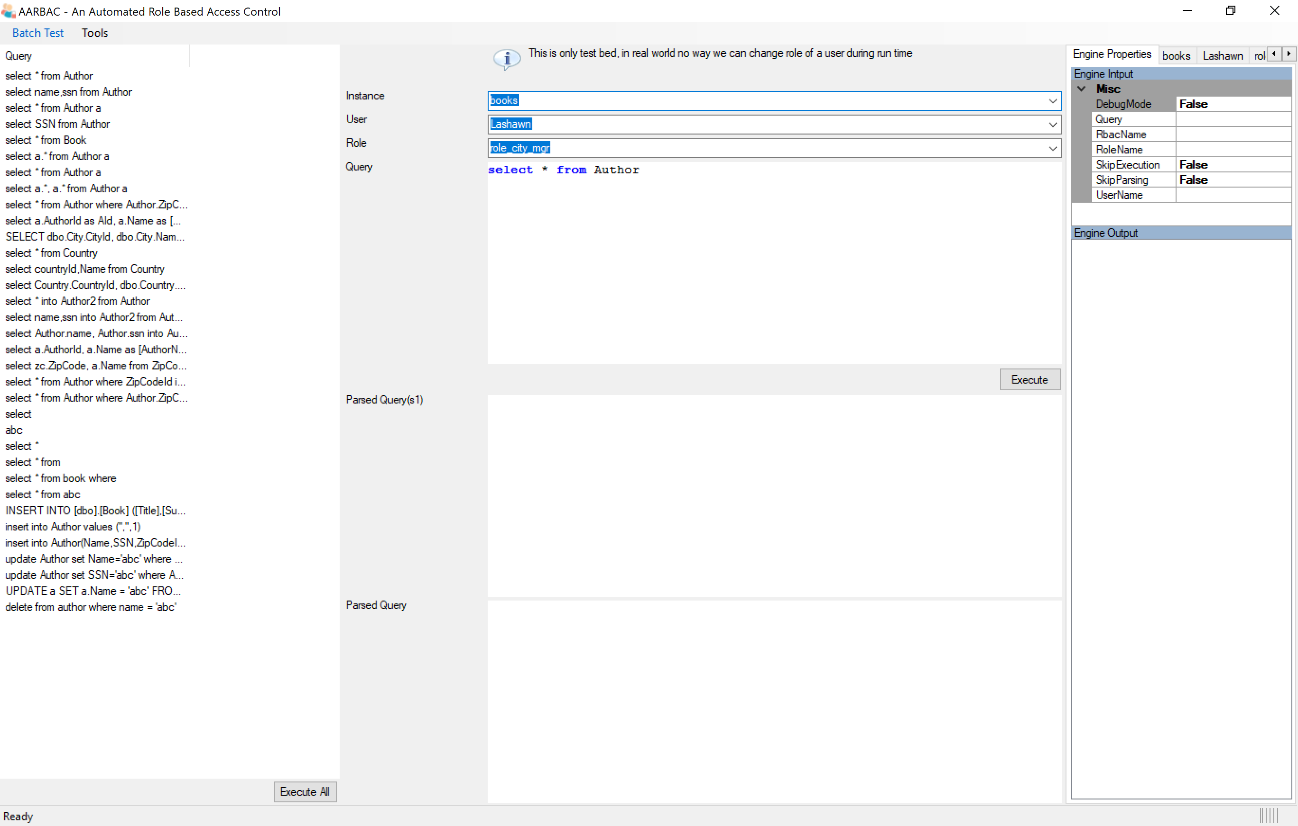
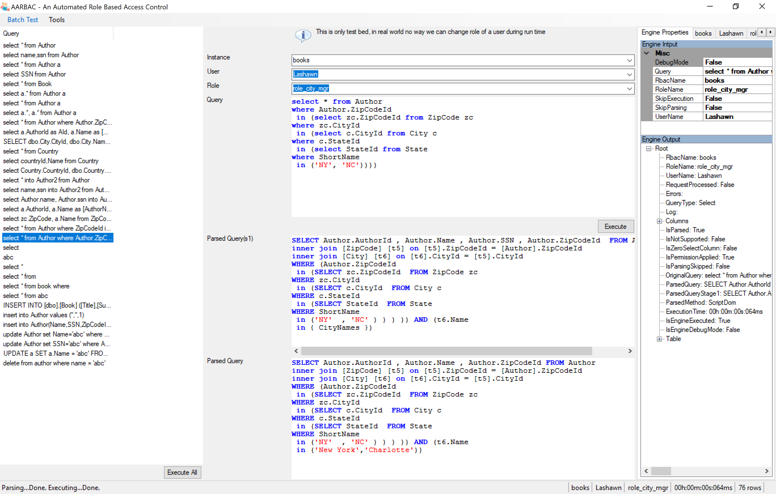
Batch Test
Click Batch Test→Load Queries
Select test.csv (included in the sample folder
Test One
Click on query to execute.
Use Up, Down arrows to execute others
Test All
Click ‘Execute All’
This will write test result into test_out.csv

Slide 9
aarbac
An Automated Role Based
.NET framework
With built-in
T SQL Parser
https://github.com/eyedia/aarbac
https://www.nuget.org/packages/aarbac.NET/

