Slide 1
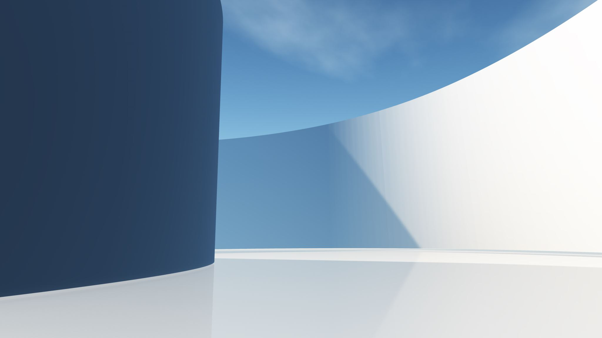
Processing LI-Chess Files

Slide 2

Step 1: Download and Unzip
https://database.lichess.org/
Local Download Folder (ZST-Files)
Local Unzip Folder (PGN-Files)
pzstd –d <filename>
unzstd lichess_db_standard_rated_2024-08.pgn.zst
del zst file
Register File
Status Updates
Django-DB

Slide 3
Step 2: Split and Reduce
Local Unzip Folder (PGN-Files)
Split Folder
Split Reduced Folder
Split in Files with 100k Games, Delete big PGN
Reduce Rules: - Min ELO: 2000 - Event: No Bullet
Stats: - Number Games - Blitz, Rapid, Bullet - ECO: Number of Games, Success, Gain/Loss - Ratings, AVG, Max, Min, 90%, 10%, 2000, 2500
Rules:
Game has evaluations
Max number of moves (ECO specific)
Django-DB
Evaluated Games Folder

Slide 4
Step 3: Workflows
Split Reduced Folder
Workflow Output Folder
Workflow:
Name (will be used for output folder)
List of
ECOs
Min ELO
Move Pattern

Slide 5
Folder
Cleanup Process for all Folder but:
Workflow Output
Archive
Local
Download
Unzip (???)
Big
Download (???)
Unzip (???)
Split
Split Reduced
Split Commented
Archive (Split or Split reduced), ZIP Folder
Target
Workflow Output
Status:
Downloaded
Unzipped
Splited
Splited processed
Workflow executed

Slide 6
Step 1: Download and Unzip

Slide 7
Step n: Cleanup
ZST Files: Delete after unzip
Big PGN Files (>100 GB): Delete after split
???

