Slide 1
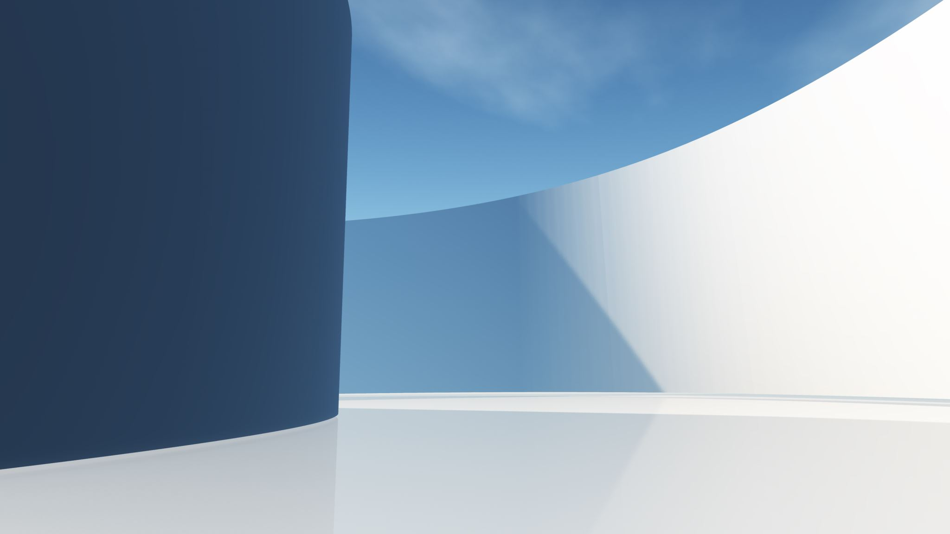
Processing LI-Chess Files

Slide 2

Step 1: Download and Unzip
https://database.lichess.org/
Local Download Folder (ZST-Files)
Local Unzip Folder (PGN-Files)
pzstd –d <filename>
unzstd lichess_db_standard_rated_2024-08.pgn.zst
del zst file
Register File
Status Updates
Django-DB

Slide 3
Step 2: Split
…/playground/pgn_eco_split.py
Split Folder (/Volumes/BIGWD8/Datalake/chess/lichess_downloads/eco_split)
Local Unzip Folder (PGN-Files)
https://github.com/cyanfish/pgnsplit
Split according to ECO, Delete big PGN
Stats: - Number Games - Blitz, Rapid, Bullet - ECO: Number of Games, Success, Gain/Loss - Ratings, AVG, Max, Min, 90%, 10%, 2000, 2500
Django-DB

Slide 4
Step 3: Reduce
…/playground/pgn_split.py
Split Folder (/Volumes/BIGWD8/Datalake/chess/lichess_downloads/pgn_split)
Split Reduced Folder (/Volumes/BIGWD8/Datalake/chess/lichess_downloads/eco ) (One File per Code and Month)
Reduce Rules: - Min ELO: 2000 - Event: No Bullet
volumes/BIGWD8/Datalake/chess/lichess_downloads/concat/eco
Stats: - Number Games - Blitz, Rapid, Bullet - ECO: Number of Games, Success, Gain/Loss - Ratings, AVG, Max, Min, 90%, 10%, 2000, 2500
Rules:
Game has evaluations
Max number of moves (ECO specific) (currently 40 Half Moves)
/Users/littlecapa/GIT/django/dj_big_data_chess/big_data_chess/tests/playground/concat_pgn.sh
Concat
Django-DB
Eval Folder (/Volumes/BIGWD8/Datalake/chess/lichess_downloads/eco_commented) (One File per Code and Month)
Evaluated Games Folder (/Users/littlecapa/Desktop/commented) have to rename it

Slide 5
Step 3: Reduce
…/playground/pgn_split.py
Split Folder (/Volumes/BIGWD8/Datalake/chess/lichess_downloads/pgn_split)
Split Reduced Folder (/Volumes/BIGWD8/Datalake/chess/lichess_downloads/eco ) (One File per Code and Month)
Reduce Rules: - Min ELO: 2000 - Event: No Bullet
volumes/BIGWD8/Datalake/chess/lichess_downloads/concat/eco
Stats: - Number Games - Blitz, Rapid, Bullet - ECO: Number of Games, Success, Gain/Loss - Ratings, AVG, Max, Min, 90%, 10%, 2000, 2500
Rules:
Game has evaluations
Max number of moves (ECO specific) (currently 40 Half Moves)
/Users/littlecapa/GIT/django/dj_big_data_chess/big_data_chess/tests/playground/concat_pgn.sh
Concat
Django-DB
Eval Folder (/Volumes/BIGWD8/Datalake/chess/lichess_downloads/eco_commented) (One File per Code and Month)
Evaluated Games Folder (/Users/littlecapa/Desktop/commented) have to rename it

Slide 6
Step 3: Workflows
Split Reduced Folder
Workflow Output Folder
Workflow:
Name (will be used for output folder)
List of
ECOs
Min ELO
Move Pattern

Slide 7
Folder
Cleanup Process for all Folder but:
Workflow Output
Archive
Local
Download
Unzip (???)
Big
Download (???)
Unzip (???)
Split
Split Reduced
Split Commented
Archive (Split or Split reduced), ZIP Folder
Target
Workflow Output
Status:
Downloaded
Unzipped
Splited
Splited processed
Workflow executed

Slide 8
Step 1: Download and Unzip

Slide 9
Step n: Cleanup
ZST Files: Delete after unzip
Big PGN Files (>100 GB): Delete after split
???

