Slide 1
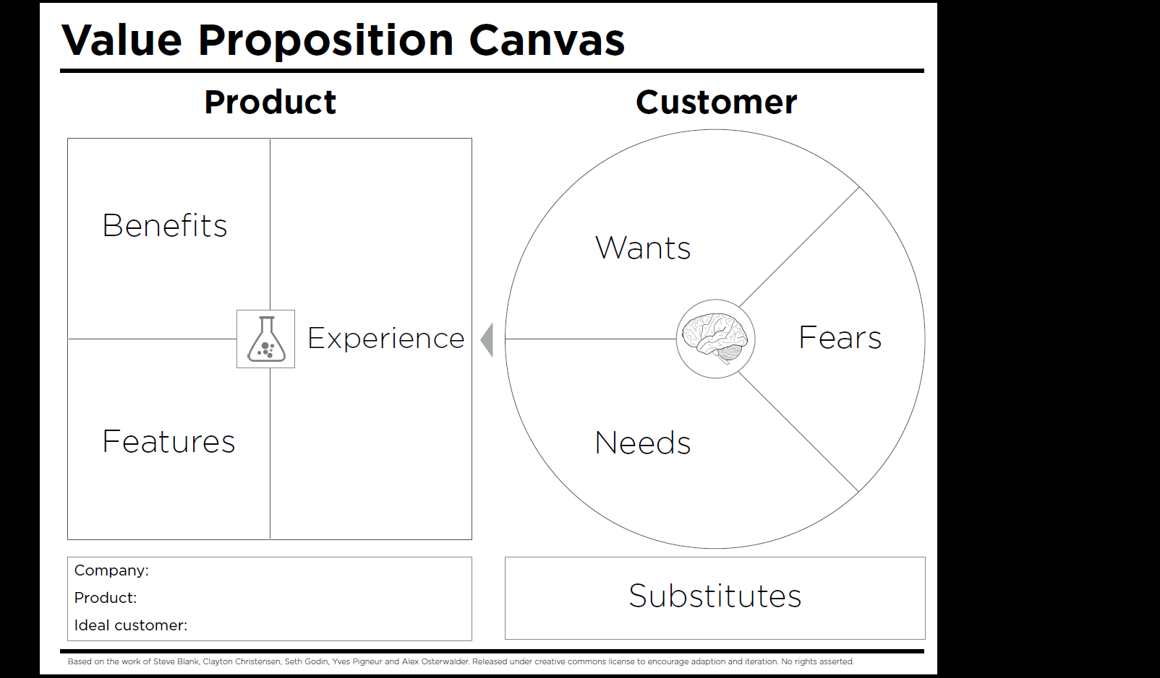
Simple, easy to use
Web application
Minimal stress in planning a suitable itinerary
Find new places to accomplish tasks
Quickly and easily plans a possible itinerary
User need not figure out precisely where to accomplish tasks
Plans efficient, optimised routes
Inefficient routes recommended
Understands what users need to do
Accomplish tasks as efficiently as possible
User only needs to indicate tasks, not locations
Can map errands to possible locations
Accomplish tasks within time limits (e.g. lunch breaks)
Inconvenient to use
Intelligent in matching tasks to locations
Plan itinerary to visit relevant places
Unsupported errands
Clean, fluid UI
Poor awareness of locations
Knows and plans better than users themselves
Get errands at various places done
User can indicate specific locations if desired
Optimal / near- optimal route calculation
Find places to accomplish errands (e.g. post letters)
Mental heuristics
Group Project Team 2
Existing knowledge of city/locations
busyroute (Routing Application)
Mapping applications (Google Maps, Citymapper etc.)
Busy professionals

