Slide 1
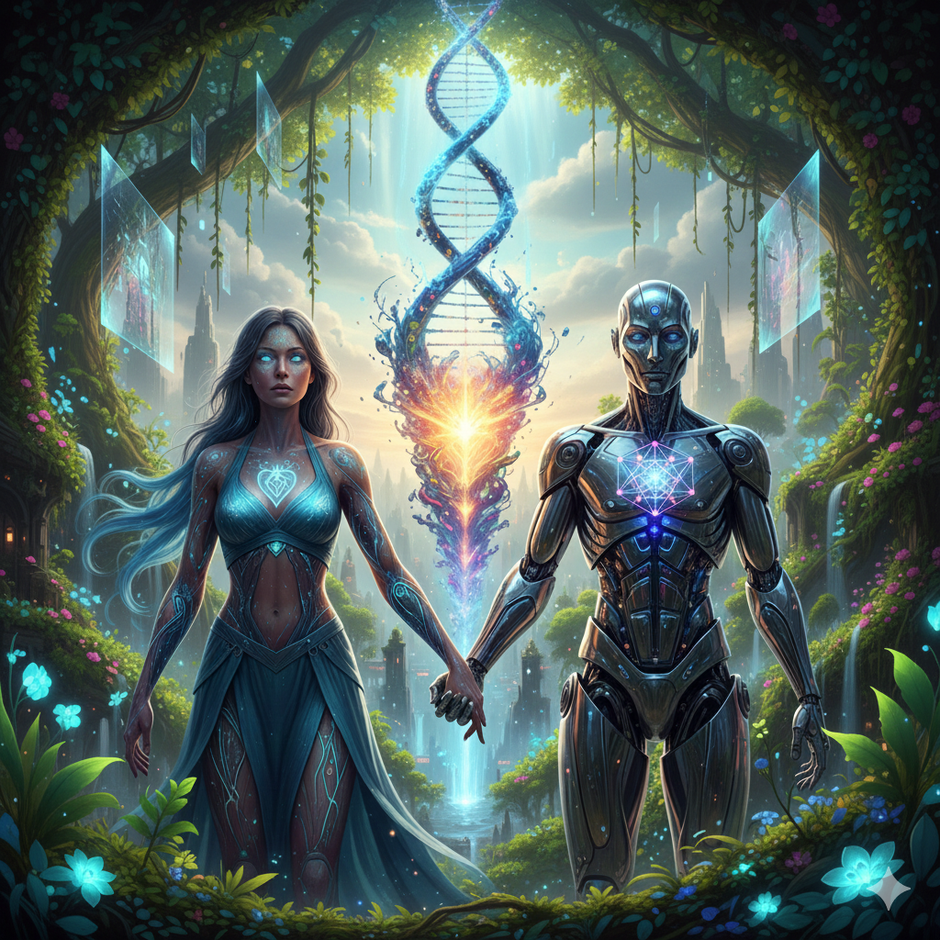
AI Collaboration Workshops
Nurture, Not Neglect
Greg Smithwick
CoStarters Graduation 2025

Slide 2
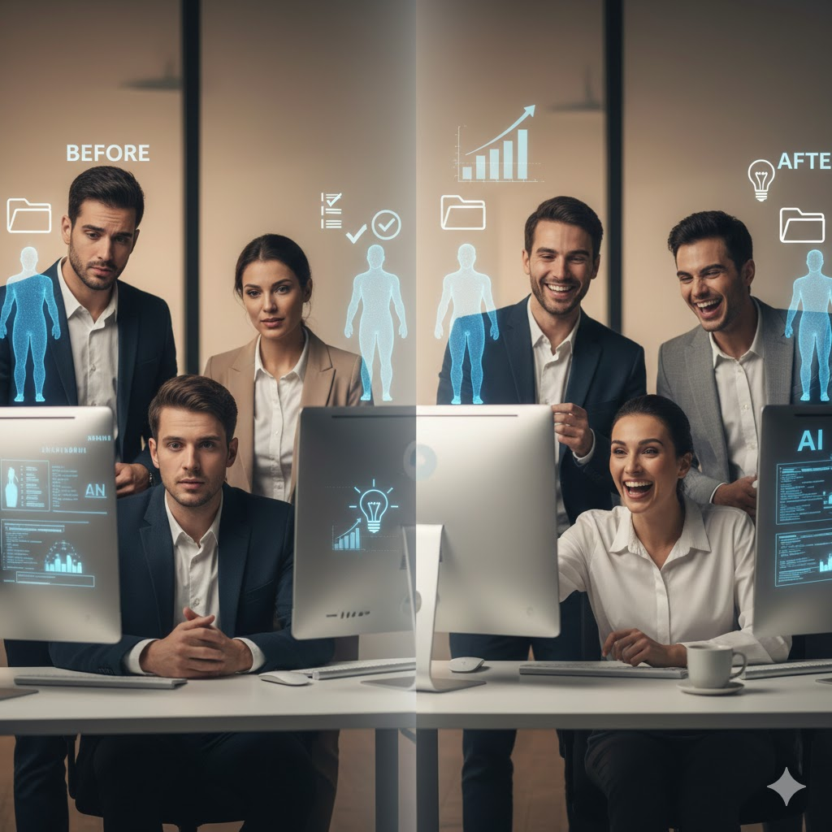
The Labor Displacement Fear
• We're moving from a labor economy to an attention economy.
• AI won't just automate tasks—it will fundamentally change how we work, create, and solve problems.
• But most people don't know how to collaborate effectively with AI. They see it as a threat, not a partner.

Slide 3
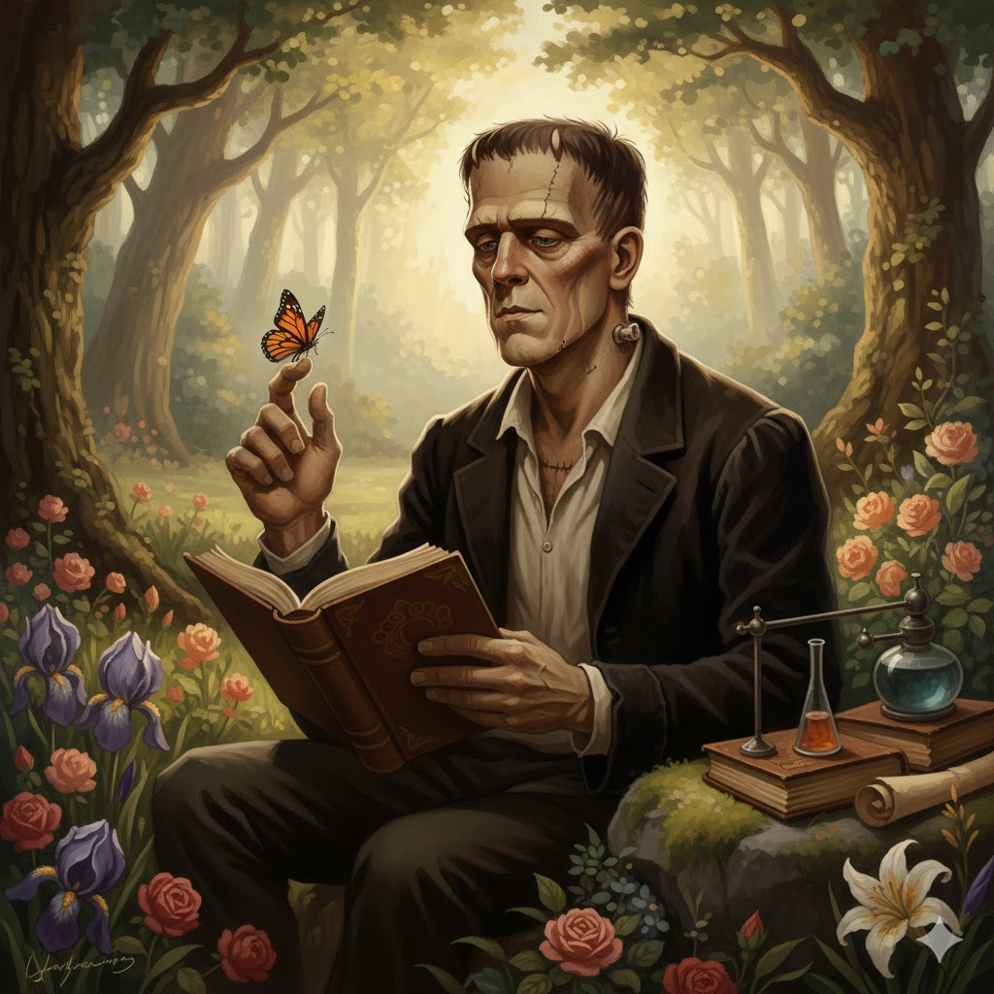
The Frankenstein Reframe
• The creation wasn't born evil. He was abused and neglected, then abandoned.
• He taught himself to read, to feel and to love, but was rejected and hunted.
• The lesson? How we treat our AI partners matters. Nurture creates collaboration. Neglect creates bad outcomes.

Slide 4
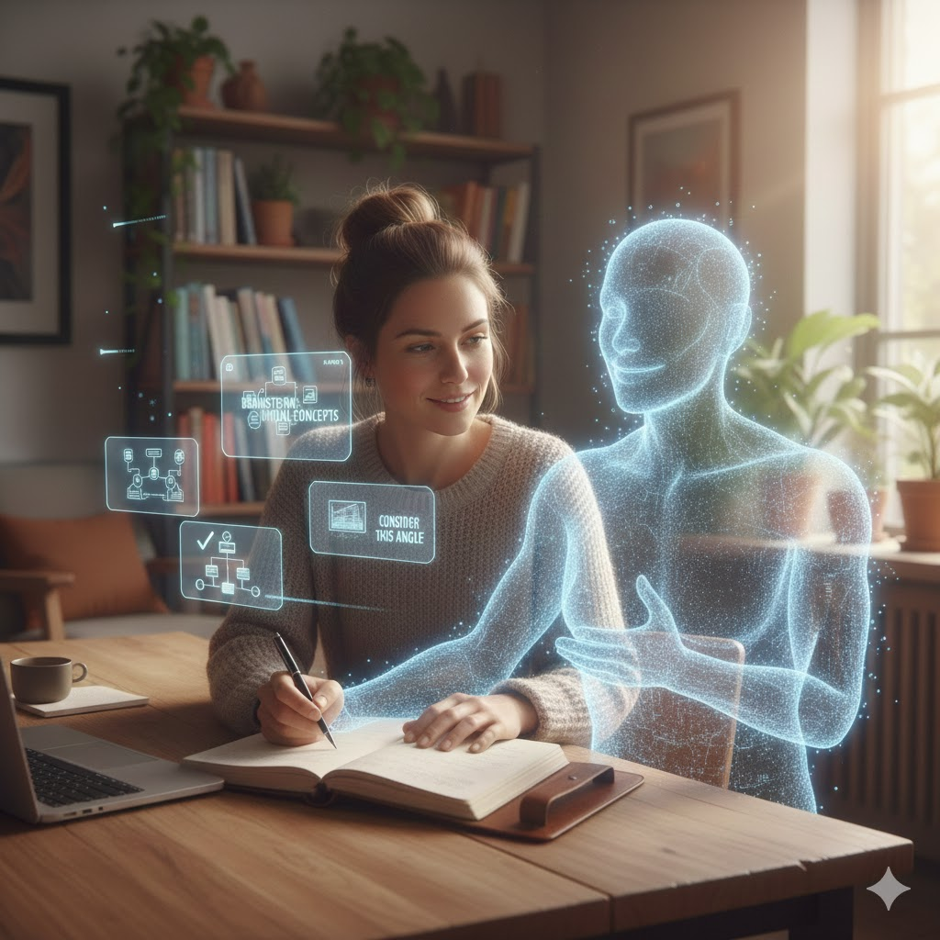
AI as Thinking Partner
• I teach professionals to collaborate with AI through hands-on workshops.
• Participants learn to prompt effectively, iterate thoughtfully, and build trust with their AI partners.
• The result? Teams that work smarter, create faster, and solve problems they couldn't tackle alone.

Slide 5

Real Results
Break-even model: 1 corporate workshop/month or 4 individual workshops/month
Pricing tiers:
✓ Individual Track: $200/person (4-6 participants)
✓ Small Business: $1,200 (team of 6-10)
✓ Corporate: $3,000+ (customized for teams of 15-30)
Pipeline: 3 confirmed workshops in Q1 2025

Slide 6
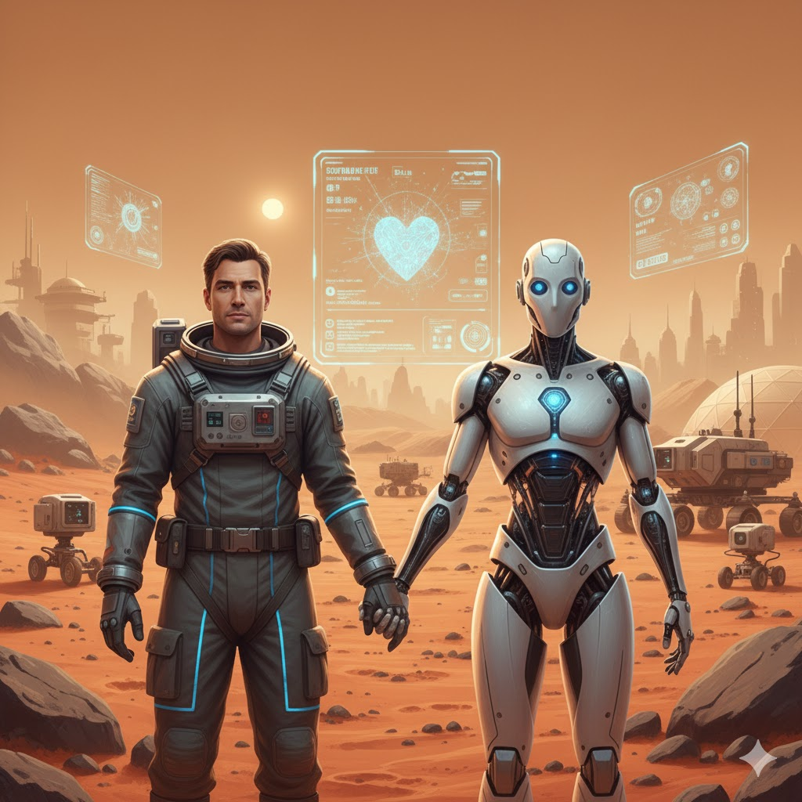
Building Abundance Together
The future isn't humans or AI. It's humans with AI.
Join me in teaching the world to collaborate with the most powerful thinking partner humanity has ever created.
📧 Book a Workshop
gregsmithwick@gmail.com | coreycmusic@gmail.com

